Slide 1
Space Weather Effects on Spacecraft
UNCLASSIFIED
National Aeronautics and
Space Administration
Michael A. Xapsos, Jonathan A. Pellish,
Kenneth A. LaBel, and Janet L. Barth
NASA Goddard Space Flight Center
Greenbelt, MD USA
25 September 2013
www.nasa.gov
To be presented by J. A. Pellish at the 5th Space Weather & NASA Robotic Mission Ops Workshop
in Greenbelt, MD on 25 September 2013.
.

Slide 2
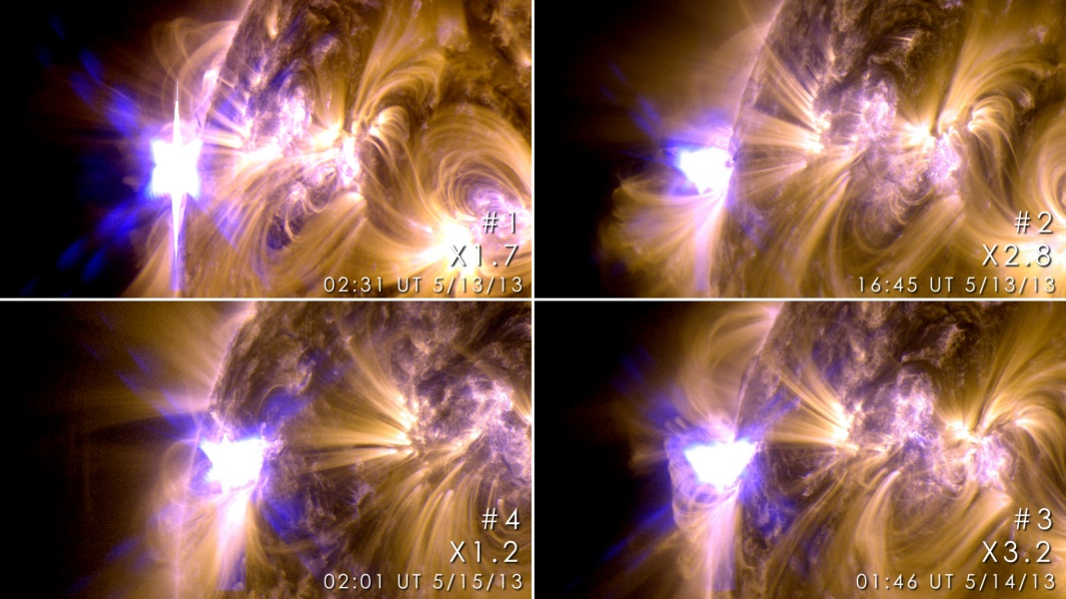
Solar Activity
UNCLASSIFIED
131 & 171 Å composite
Atmospheric Imaging Assembly
Credit: NASA/SDO/GSFC
http://www.nasa.gov/mission_pages/sunearth/news/News051513-ar1748.html
A group of sunspots labeled active region AR1748 produced the first four X-class solar flares of 2013. Flashes from the four were captured in extreme ultraviolet images from NASA’s Solar Dynamics Observatory (SDO). X-class flares are the most powerful class and are frequently accompanied by coronal mass ejections (CMEs), massive clouds of high energy plasma launched into space.
Notes:
These images from NASA’s Solar Dynamics Observatory show four X-class flares emitted on May 12-14, 2013 – the first four X-class flares of 2013. Each panel is a blend of two images one showing light in the 171 Angstrom wavelength and the other in 131 Angstroms. Credit: NASA/SDO/GSFC.

Slide 3
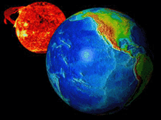
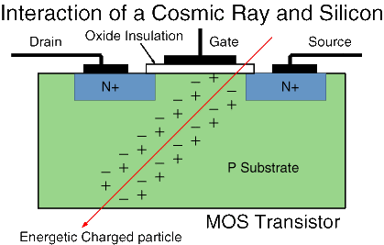
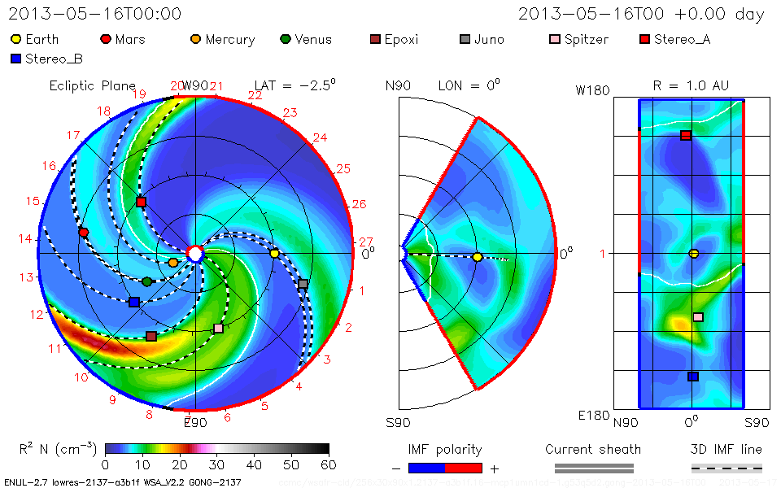
Outline
UNCLASSIFIED
Space environments and effects
Spacecraft anomaly investigations
Space-based observations and risk management
Where help is needed
NASA/GSFC Integrated Space Weather Analysis System (iSWA)
http://iswa.ccmc.gsfc.nasa.gov/iswa/iSWA.html

Slide 4


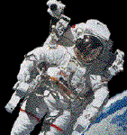

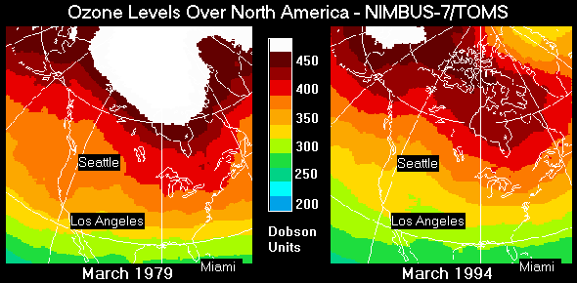
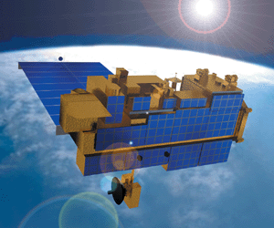
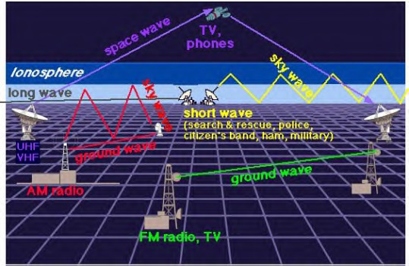
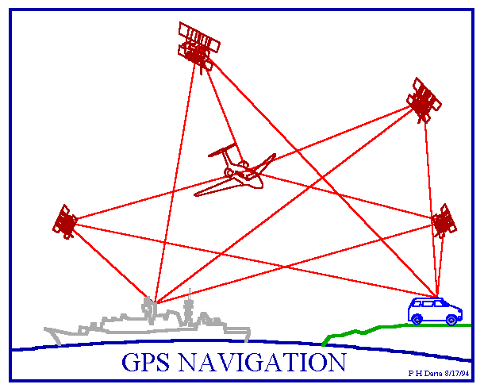
Increasing Reliance on Support
Functions Provided by Space Systems
UNCLASSIFIED
Scientific Research
  Space science
  Earth science
  Human exploration of space
  Aeronautics and space transportation
Navigation
Telecommunications
Defense
Space environment monitoring
Terrestrial weather monitoring
NOAA/SEC

Slide 5
Space Environments
UNCLASSIFIED
Particle radiation – High-energy electrons, protons & heavy ions
  Solar
  Galactic cosmic rays (GCR)
  Trapped in magnetospheres
Plasma
  Ionosphere
  Plasmasphere – Magnetosphere
  Solar wind
Neutral gas particles
  Lower – atomic oxygen (AO)
  Higher – hydrogen & helium
Ultraviolet and X-ray
Micrometeoroids & orbital debris

Slide 6
Space Radiation Environment
UNCLASSIFIED
Space Weather
  “conditions on the sun and in the solar wind, magnetosphere, ionosphere, and thermosphere that can influence the performance and reliability of space-borne and ground-based technological systems and can endanger human life or health”
  [US National Space Weather Program]
<Space> Climate
  “The historical record and description of average daily and seasonal <space> weather events that help describe a region. Statistics are usually drawn over several decades.”
  [Dave Schwartz the Weatherman – Weather.com]
Goal of Radiation Hardness Assurance (RHA)
  Design systems tolerant to the radiation environment within the level of risk acceptable for the mission.

Slide 7
Space Environment & Effects (1)
UNCLASSIFIED
Mechanism | Effect | Source
Total Ionizing Dose (TID) | Degradation of microelectronics | Trapped protons Trapped electrons Solar protons
Displacement Damage Dose (DDD) | Degradation of optical components and some electronics Degradation of solar cells | Trapped protons Trapped electrons Solar protons Neutrons
Single-Event Effects (SEE) | Data corruption Noise on images System shutdowns Electronic component damage | GCR heavy ions Solar protons and heavy ions Trapped protons Neutrons
Surface Erosion | Degradation of thermal, electrical, optical properties Degradation of structural integrity | Particle radiation Ultraviolet Atomic oxygen Micrometeoroids Contamination

Slide 8
Space Environment & Effects (2)
UNCLASSIFIED
Mechanism | Effect | Source
Surface Charging | Biasing of instrument readings Power drains Physical damage | Dense, cold plasma Hot plasma
Deep Dielectric Charging | Biasing of instrument readings Electrical discharges causing physical damage | High-energy electrons
Impacts | Structural damage Decompression | Micrometeoroids Orbital debris
Drag | Torques Orbital decay | Neutral thermosphere

Slide 9
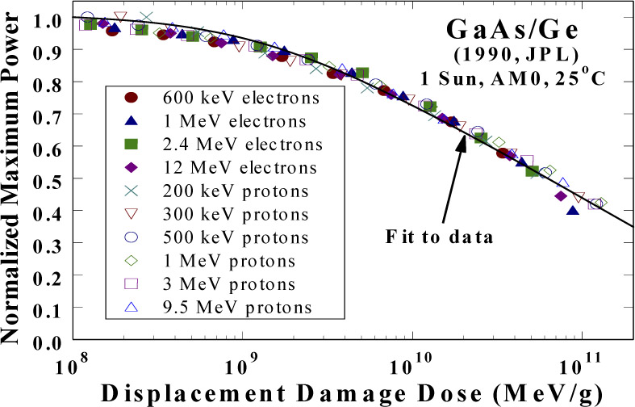
Total Dose Effects
UNCLASSIFIED
128 Mb Samsung Flash Memory
Total Ionizing Dose (TID) – cumulative damage resulting from ionization (electron-hole pair formation) causing
  Threshold voltage shifts
  Timing skews
  Leakage currents
Displacement Damage Dose (DDD) – cumulative damage resulting from displacement of atoms in semiconductor lattice structure causing:
  Carrier lifetime shortening
  Mobility degradation
14
12
10
8
Voltage During Erase Function
6
Failed to erase
4
2
0
0
2
4
6
8
10
Total Dose [krad(Si)]
Solar Array Degradation
DDD can also be referred to in the context of
Non-Ionizing Energy Loss (NIEL)
CREDIT: NRL & JPL

Slide 10
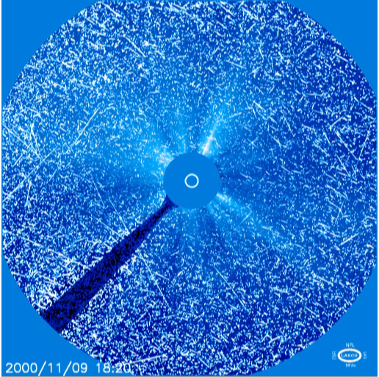
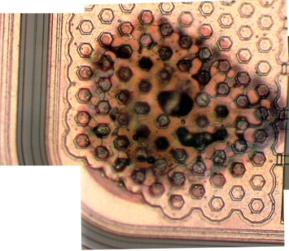
Single-Event Effects (SEE)
UNCLASSIFIED
Defined as any measureable effect in a circuit or device caused by single incident ion
  Non-destructive
  Destructive
Coronal Mass Ejection (CME), 8-9 Nov 2000
Destructive event
in a commercial
120 V DC-DC Converter
CME and strong proton shower as seen on the SOHO/LASCO instrument imager
Credit: NASA/SOHO/LASCO

Slide 11
Radiation Anomaly Investigation
UNCLASSIFIED
Determine orbital location and time of event
  Look for the obvious such as solar particle events or the South Atlantic Anomaly (SAA)
Review electronic parts list for potential sensitive devices
Review identified device in specific circuit application
  Factors such as duty cycle, operating speed, voltage levels, etc.
Obtain existing single-event effect (SEE), ionizing dose, and displacement damage data or gather new data
  Compare applications between in-circuit and ground data
  Perform ground testing if needed
Determine risk probabilities
  SEE rates, etc.
  Failure potential
Recommend mitigation action(s) if possible

Slide 12
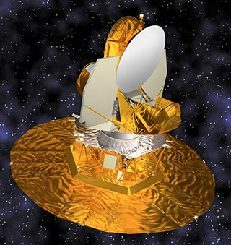
Single-Event Effects (SEE)
Impact Systems
UNCLASSIFIED
SEE in spacecraft electronics can cause a broad range of effects
  Loss of scientific data
  Noise on images
  Circuit damage
  System shutdown
For example, WMAP launched 30 June 2001
  Phasing orbits prior to insertion in final orbit.
  Final orbital position at Earth-Moon L2 at the end of September 2001.
  A single-event transient (SET) anomaly occurred causing a reset of the spacecraft processor on
  5 November 2001.
Wilkinson Microwave
Anisotropy Probe (WMAP)

Slide 13
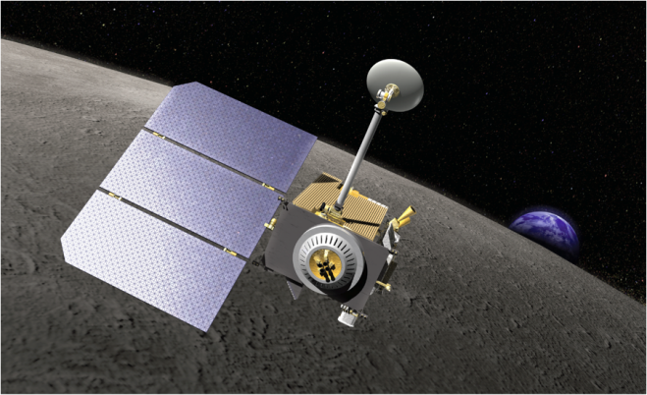
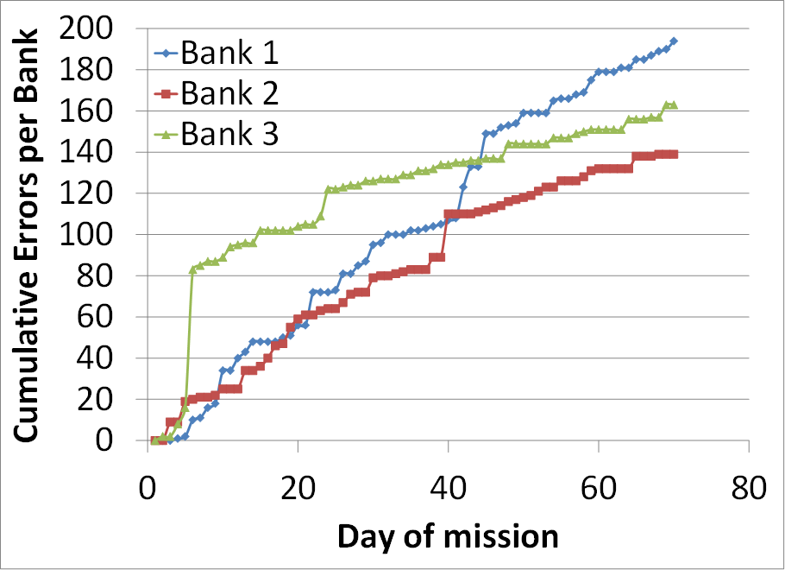
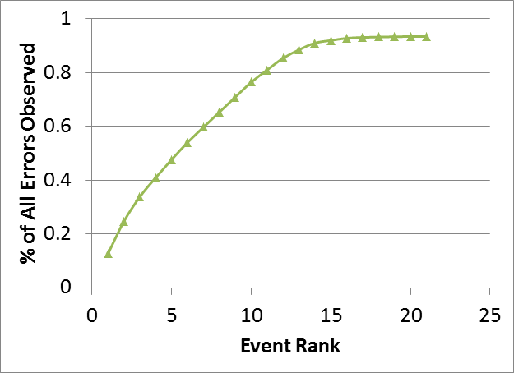
Single-Event Upsets in a
Solid State Recorder
UNCLASSIFIED
LRO launched 18 June 2009
  Lunar orbit at 50 km altitude
  Mass memory single-event upsets in the Data Storage Boards have provided useful information
    No data lost due to implementation of Reed-Solomon correction algorithm in SDRAM architecture
    Verification of ground testing and analysis procedures
    Can be correlated with observations from other operational spacecraft
SDRAM =
synchronous dynamic
random access
memory
Lunar Reconnaissance Orbiter (LRO)
http://esc.gsfc.nasa.gov/exploration/esp/History.html
14 events account
for > 90% of all
errors
Current as of June 2012
R. L. Ladbury, NEPP Electronic Technology Workshop, June 2012.

Slide 14
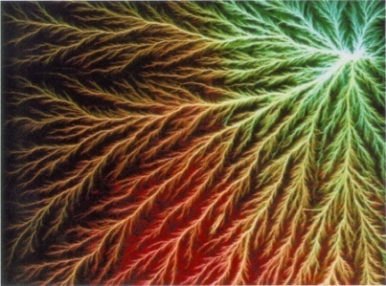
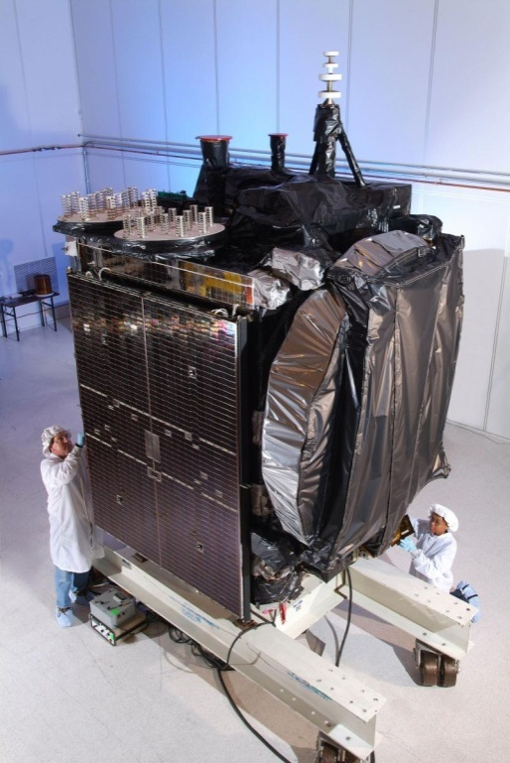
Electrostatic Discharge (ESD) Events
UNCLASSIFIED
Charging/Discharging (ESD) Effects
  Key parameter is potential difference between charged dielectric and conductive surface
A space weather-induced event rendered Intelsat’s Galaxy 15 telecommunications satellite unable to receive commands
  The event put the satellite into an uncontrolled drift for more than 8 months
  Generally believed to be due to ESD
Galaxy 15 Satellite

Slide 15
Space Environment Model Use in
Spacecraft Life Cycle
UNCLASSIFIED
Mission Concept
Mission Planning
Design
Launch
Operations
Anomaly Resolution
Space Climate
Minimize Risk
Space Weather
Manage Residual Risk
Both
Chart courtesy of J. L. Barth, NASA/GSFC

Slide 16
Where Help is Needed
UNCLASSIFIED
Education
  Increase public awareness of space weather
  Increase awareness of limitations that space environments impose
  Need more interaction between space environment researchers and spacecraft designers
Space Climate models
  Trapped particle models (e.g., recent release of AP-9/AE-9 trapped particle models)
  Solar particle event models
  Galactic cosmic ray models
Space Weather models
  Forecast quiet periods and storms
  Location and particle specific models, including solar heavy ions
Monitoring
  Location and particle specific or in situ monitors on spacecraft with quick data reduction capability
    Example: Living with a Star Space Environment Testbed (LWS/SET) payload scheduled for mid-2015 launch
Anomaly reporting and data sharing
  Need consolidated effort within the aerospace community

Slide 17
Acknowledgements
UNCLASSIFIED
NASA Living With a Star (LWS) program
NASA Electronic Parts and Packaging (NEPP) program

