Slide 1
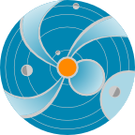
Space Weather Tools Demonstration
R. Mullinix and M. L. Mays
NASA GSFC Heliophysics Science Division, Space Weather Laboratory
25 September 2013
http://kauai.ccmc.gsfc.nasa.gov/
Feedback and suggestions are welcome!
and the CCMC/SWRC team
SPACE
WEATHER
RESEARCH
CENTER
Email: m.leila.mays@nasa.gov

Slide 2
Outline:
Ensemble modeling
DONKI
Scoreboard
Magnetic Connectivity and Ovation Prime
StereoCAT
One Click (Rick demo)

Slide 3
Ensemble Modeling

Slide 4
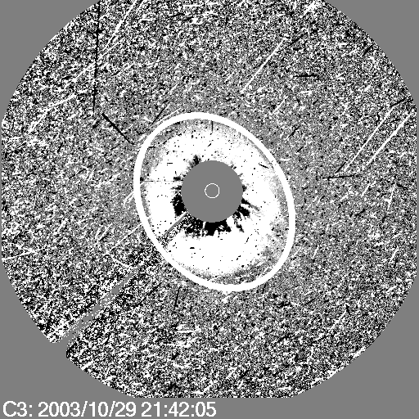
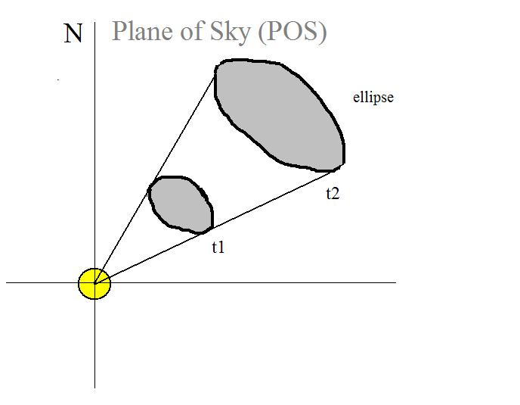
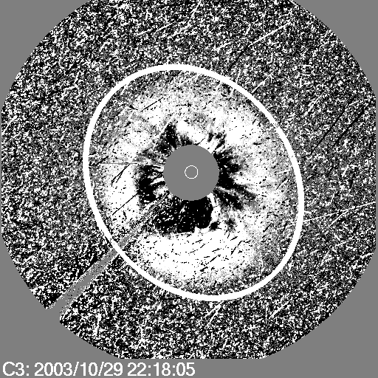
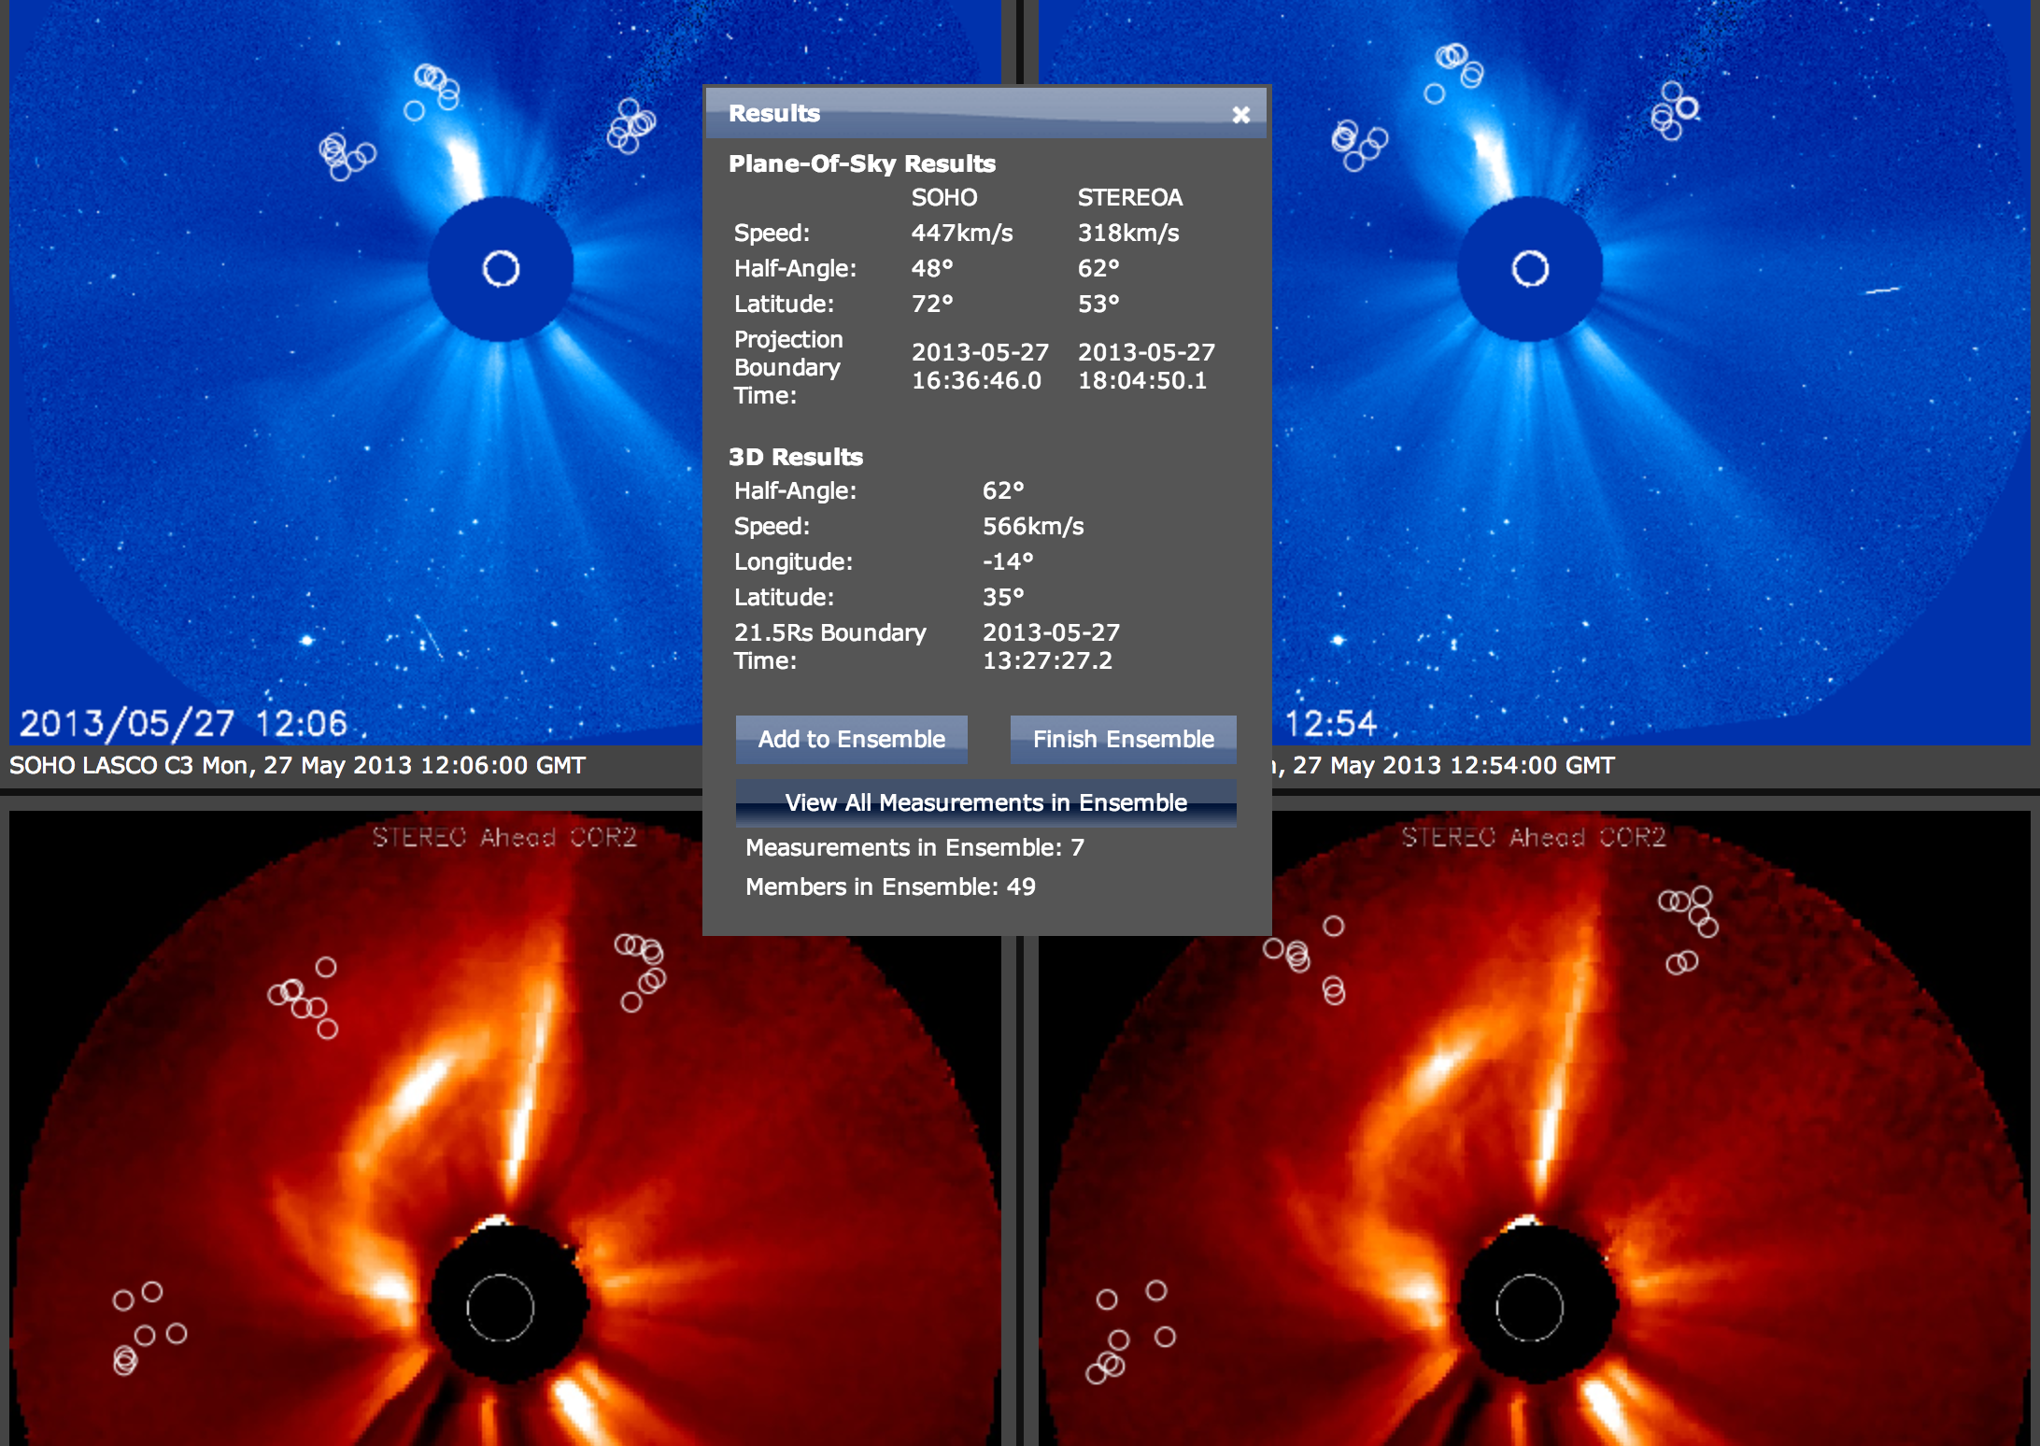
Cone Model Concept
Zhao et al, 2002, Cone Model:
CME propagates with nearly constant angular width in a radial direction
CME bulk velocity is radial and the expansion is isotropic
Parameters Defined with
StereoCAT (CCMC CME Triangulation Tool)
CME Parameters: Input To
WSA-ENLIL+Cone Model

Slide 5
Ensemble of Input Parameters
Ensemble modeling estimates the spread/uncertainty in CME arrival time predictions due to uncertainties in CME input parameters:
Produce a set of N CME input parameters with the CME triangulation analysis tool. Routine cases have been run with N=48. This number can be increased.
Run an ensemble of N runs of WSA-ENLIL cone model.
This gives an ensemble of N CME arrival times and impact estimates.
For N=48, a average run takes ~130 min on 24 nodes (4 processors/node) on our development system. We estimate that the same run will take ~80 minutes on the production system (16 processors/node).

Slide 6
WSA-ENLIL+Cone model: Automated Ensemble Pipeline
The automated ensemble modeling pipeline foundation is complete!
Improvements:
CME input parameters measured with the triangulation tool are automatically fed to the WSA-ENLIL model to digest.
Multiple CME capability added: up to five CMEs in a single simulation.
The total number of N simulations is now variable.
Capability of real-time or historical CME run option introduced.
New detailed results text shows a table of model results (arrival times, Kp estimates, etc) alongside each CME input parameter to allow for easy comparison.
Results are ingested into the integrated Space Weather Analysis system (iSWA)
Next steps:
Graphical improvements to allow comprehension of many (N) results at a glance
Perform more real-time runs to collect more performance statistics

Slide 7
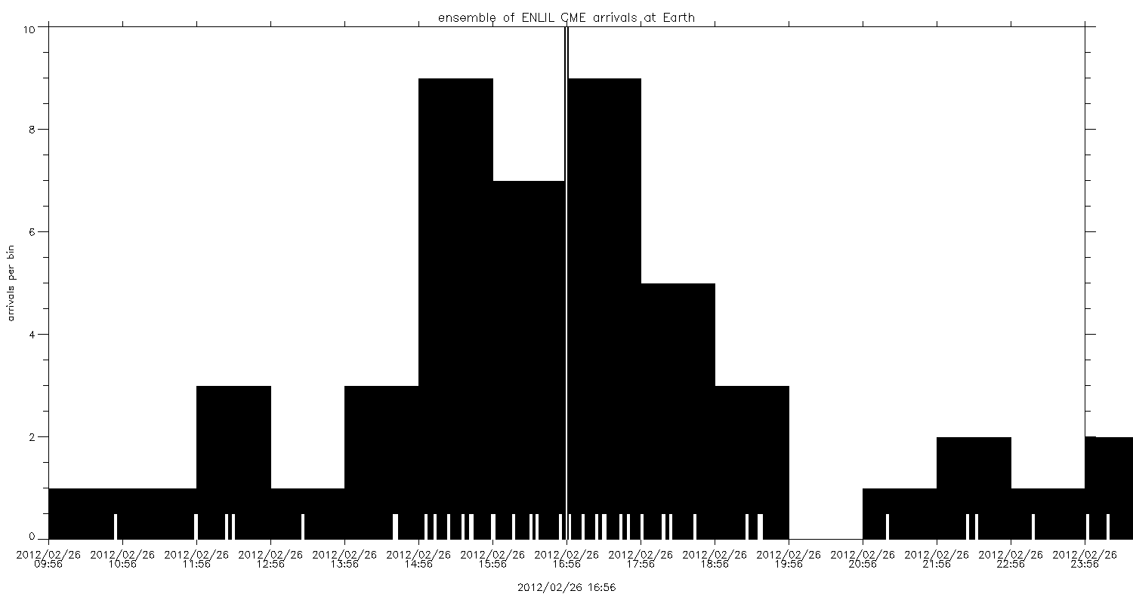
Example: 2012-02-24 CME
Histogram of CME Arrival Times for an Ensemble of Input Parameters
Predicted magnetopause
standoff distance range:
Minimum 5.1 R_{E}
Average 5.6 R_{E}
Maximum 6.7 R_{E}
Predicted arrival time range:
Earliest 2012-02-26T09:56 UT
Median 2012-02-26T16:56 UT
Latest 2012-02-26T23:56 UT
Predicted Kp range:
90˚ clock angle: 3-5
135˚ clock angle: 4-8
180˚ clock angle: 5-9
Predicted:
100% Hit
Hits 48
Misses 0
Observed arrival
2012-02-26 20:58 UT
Observed Kp=5
This is a prototype graph; we are working on graphical improvements to allow comprehension of many (N) results at a glance

Slide 8
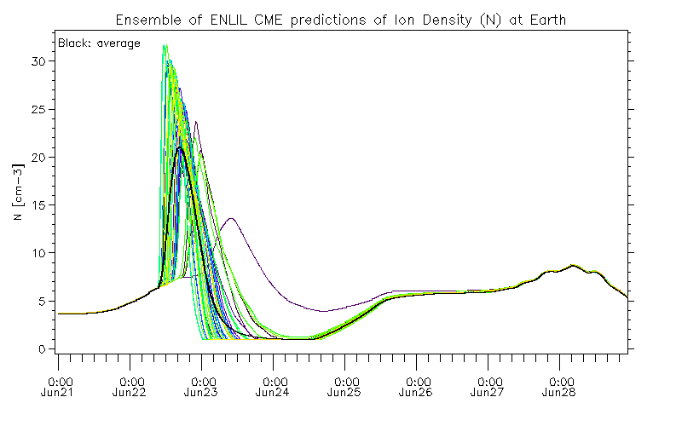
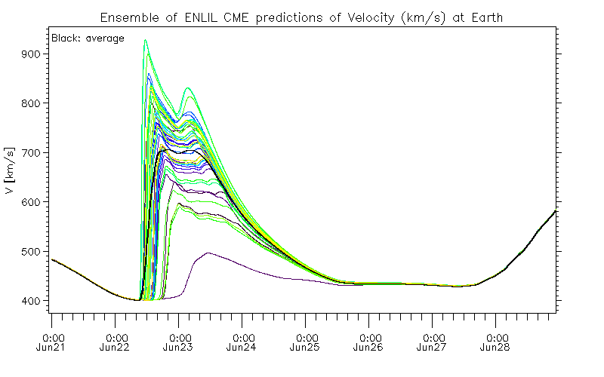
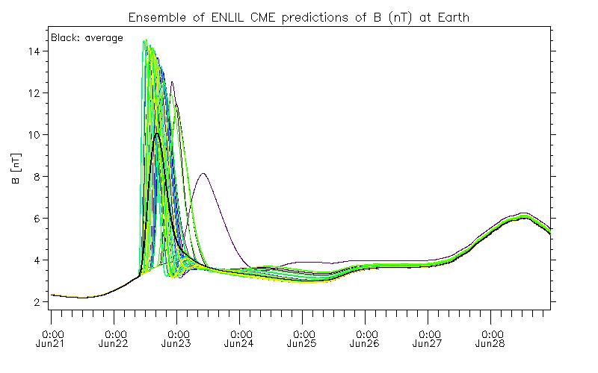
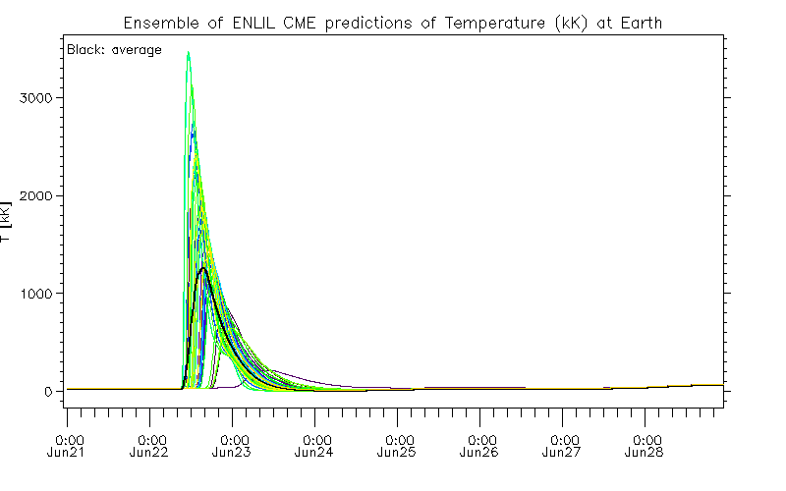
Plots in time of the solar wind density, velocity, magnetic field, and temperature at Earth, as predicted by the WSA-ENLIL+Cone model for the entire ensemble of CME input parameters.

Slide 9
General Ensemble Modeling Statistics
A total of 33 ensemble runs, 1,332 simulations, were performed
We have performed 23 ensemble runs (962 total simulations).
17 of these runs were performed in real time (before observed CME arrival).
6 runs were performed after the CME arrival.
Additionally, a model performance parametric study was carried out:
We performed 10 ensemble runs for one CME (370 total simulations)
The sensitivity of the CME arrival time prediction to free parameters for ambient solar wind model and CME was studied
This study carried out in close collaboration with the ENLIL model developer D. Odstrcil.

Slide 10
Ensemble Modeling Performance
For 6 out of 14 ensemble runs (containing hits) the observed CME arrival was within the range of ensemble arrival time predictions.
The ensemble arrival time predictions are helpful even if the observed arrival is not within the predicted range. This allows us to rule out prediction errors caused by tested CME input parameters. Prediction errors can also come from model limitations.
The average arrival time prediction was computed for each of the twelve ensembles. Using the actual arrival time this gives an average absolute error of 8.75 hours for all twelve ensembles, which is comparable to current forecasting errors. (RMSE=9.91, average error=-3.87).
We have learned that the initial distribution of CME input parameters is very important for the accuracy of ensemble CME arrival time predictions.
Particularly, the median and spread of the input distribution are important.

Slide 11
Demo:
Ensemble Modeling Products Available on iSWA
Demo links: 2013-06-21 CME| 2013-06-30 CME
2013-07-16 CME| 2013-09-19 CME

Slide 12
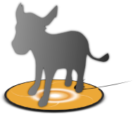
DONKI
Database of Notifications, Knowledge, and Information
http://kauai.ccmc.gsfc.nasa.gov/DONKI/
Project Lead: Chiu Wiegand

Slide 13
Before DONKI
Blogs for Daily and Weekly space weather activity
Difficult to Search
Difficult to describe a chain of events
Difficult to disseminate
Static email lists for notifications

Slide 14
DONKI Database of Notifications, Knowledge, and Information
Chronicles the daily interpretations of space weather observations, analysis, models, forecasts, and notifications including those provided by the Space Weather Research Center.
Comprehensive knowledge-base search functionality to support anomaly resolution and space science research.
Intelligent linkages, relationships, cause-and-effects between space weather activities
Automatic dissemination of forecasts and notifications
Enables remote participation by students, world-wide partners, model and forecasting technique developers
Demo: http://kauai.ccmc.gsfc.nasa.gov/DONKI

Slide 15
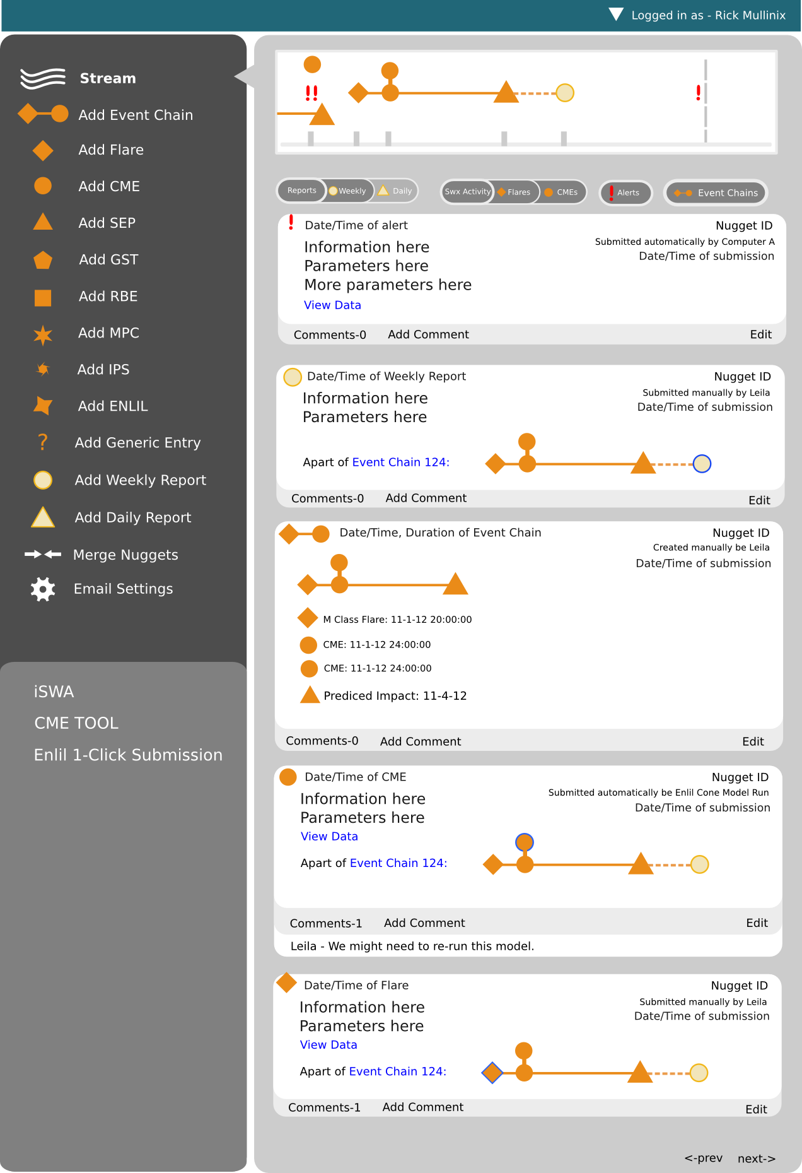
DONKI
Future Directions

Slide 16
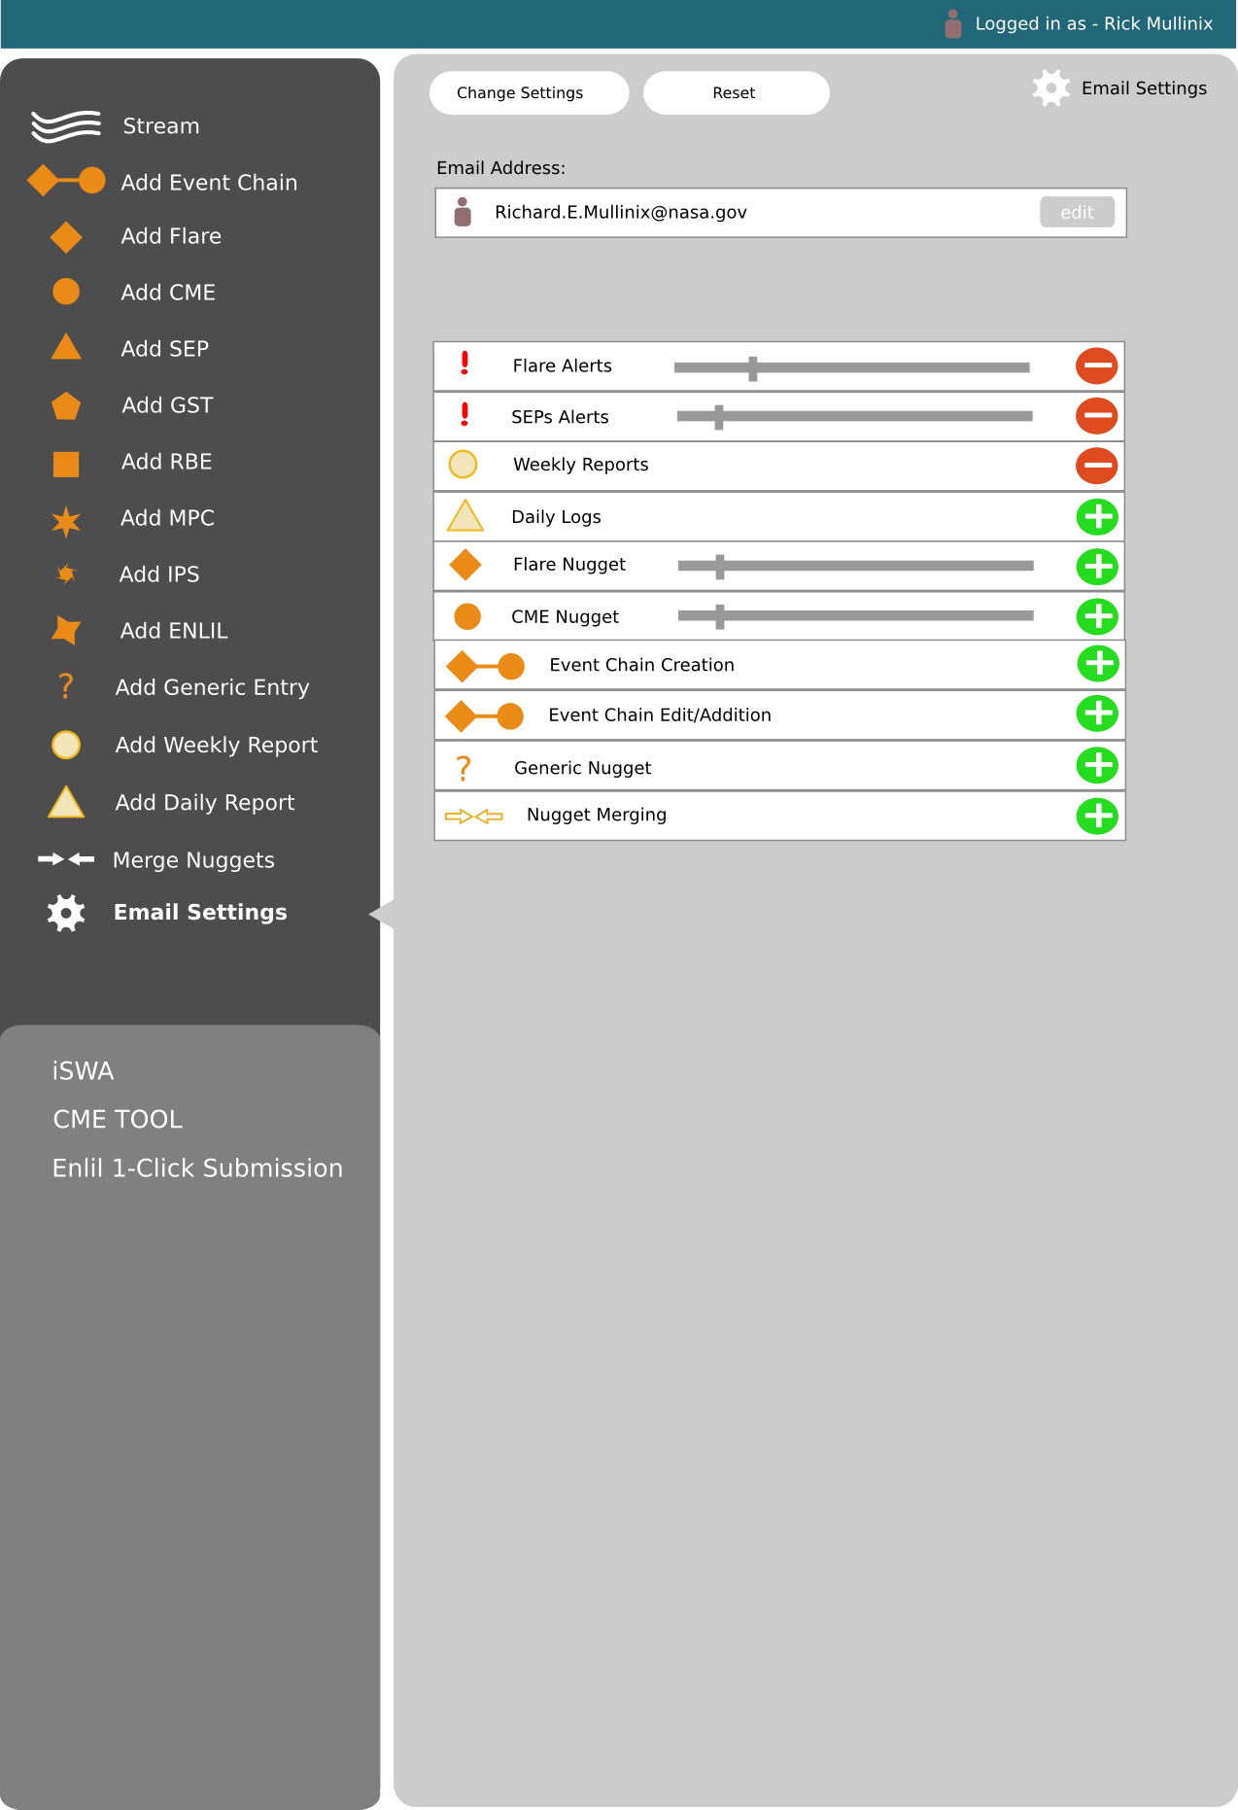

Slide 17
Demo:
DONKI
Database of Notifications, Knowledge, and Information
http://kauai.ccmc.gsfc.nasa.gov/DONKI/
Example: 2013-05-22 M7.3 flare and related activity,
2012-03-07 X5.4 flare.

Slide 18
Space Weather Scoreboard

Slide 19
Space Weather Scoreboard
The CME arrival time scoreboard is a research-based forecasting methods validation activity which provides a central location for the scientific community to:
submit their forecast in real-time
quickly view all forecasts at once in real-time
compare forecasting methods when the event has arrived
All prediction methods are welcome and all are encouraged to participate. Currently registered models include:
Anemomilos, ESA Model, H3DMHD (HAFv.3 +3DMHD), HAFv.3, STOA, WSA-Enlil + Cone Model, BHV Model, DBM, ECA Model, HelTomo, HI J-map technique, TH Model
The scoreboard also includes predictions from the SWRC (Space Weather Research Center).
http://swrc.gsfc.nasa.gov/main/cmemodels
http://kauai.ccmc.gsfc.nasa.gov/SWScoreBoard

Slide 20
http://kauai.ccmc.gsfc.nasa.gov/SWScoreBoard
Anyone can view predictions, please register to submit predictions.
Columns are sortable

Slide 21
Demo:
Space Weather Scoreboard
http://kauai.ccmc.gsfc.nasa.gov/SWScoreBoard

Slide 22
Demo of new iSWA cygnets:
Solarscape & Ovation Prime
iSWA wiki with Cygnet Descriptions: http://iswa.ccmc.gsfc.nasa.gov/wiki
Demo links: http://iswa.gsfc.nasa.gov/IswaSystemWebApp/isep.jsp
http://go.nasa.gov/15n0roG

Slide 23
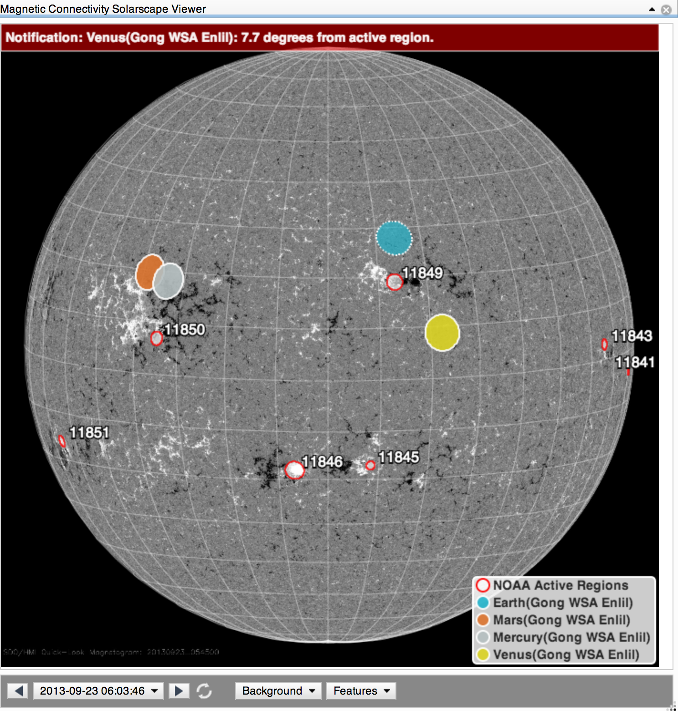
Demo: Magnetic Connectivity Solarscape Viewer
Demo link: http://iswa.gsfc.nasa.gov/IswaSystemWebApp/isep.jsp

Slide 24
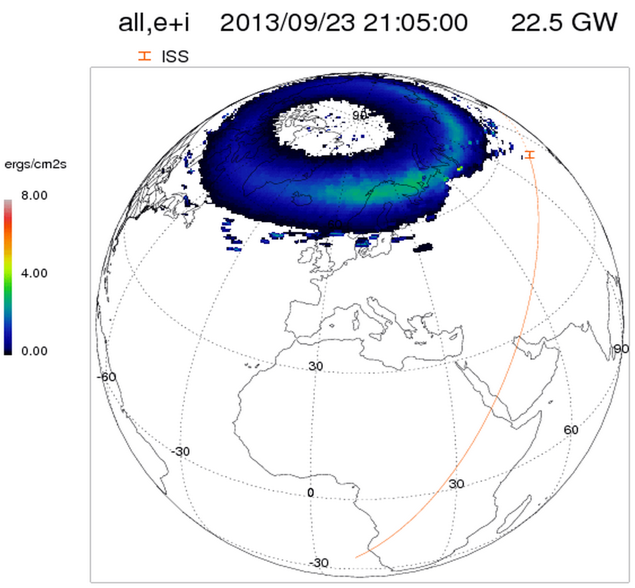
Ovation Prime
Ovation Prime is an empirical model extracted from many years of aurora data from DMSP2, and is driven by solar wind parameters measured at ACE
Provides three types (diffuse, discrete and wave aurora) of auroral precipitation patterns and can be displayed in different coordinate systems
Demo link
Newell, P. T., T. Sotirelis, and S. Wing (2009), Diffuse, monoenergetic, and broadband aurora: The global precipitation budget, J. Geophys. Res., 114, A09207, doi:10.1029/2009JA014326.

Slide 25
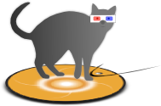
StereoCAT
Stereo CME Analysis Tool
http://ccmc.gsfc.nasa.gov/analysis/stereo/
Demo links: http://go.nasa.gov/1a4WYhN and http://go.nasa.gov/1eFYegi
Tutorials and Resources link

Slide 26
Demo:
WSA-ENLIL+Cone
1-Click
http://kauai.ccmc.gsfc.nasa.gov/EnlilOneClick

Slide 27
Resources and Tutorials
Space Weather Tools page: http://kauai.ccmc.gsfc.nasa.gov/
Scoreboard: http://kauai.ccmc.gsfc.nasa.gov/SWScoreBoard/
DONKI: http://kauai.ccmc.gsfc.nasa.gov/DONKI/
StereoCAT: http://ccmc.gsfc.nasa.gov/analysis/stereo/
Space Weather tutorials including StereoCAT:
http://ccmc.gsfc.nasa.gov/support/SWREDI/tutorials.php
iSWA wiki with Cygnet Descriptions: http://iswa.ccmc.gsfc.nasa.gov/wiki
Glossary of Space Weather Terms: http://iswa.ccmc.gsfc.nasa.gov/wiki/index.php/Glossary

Slide 28
Questions?
Feedback?
Suggestions?

