Slide 1
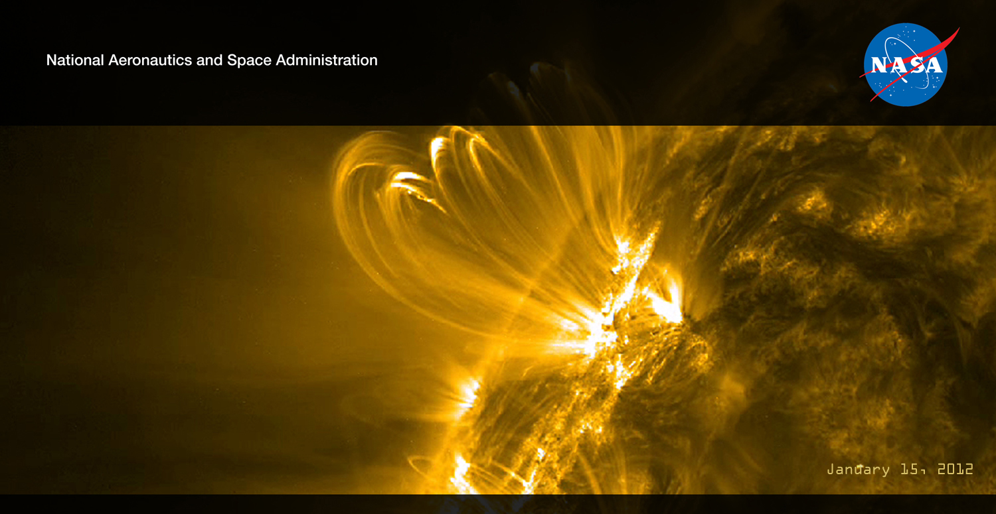
NASA Heliophysics:
The Science of Space Weather
Elsayed Talaat
Discipline Scientist, Heliophysics
NASA Headquarters

Slide 2
SMD Motivation
Fundamental Understanding
  Heliophysics provides the underlying science required to enable space weather forecasting
Heliophysics role in Space Weather
  Roughly one third of Heliophysics addresses Space Weather science
    Living With a Star Program (SDO, Van Allen (RBSP) and TR&T)
    STEREO (STP Program), SOHO, ACE
    CCMC
  Heliophysics formulates and implements a national research program for understanding the Sun and its interactions with the Earth and the Solar System.
  Currently, data from Heliophysics science missions are vital to the nation’s Space Weather infrastructure

Slide 3
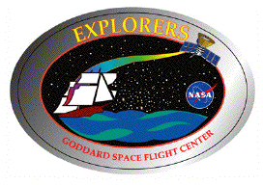
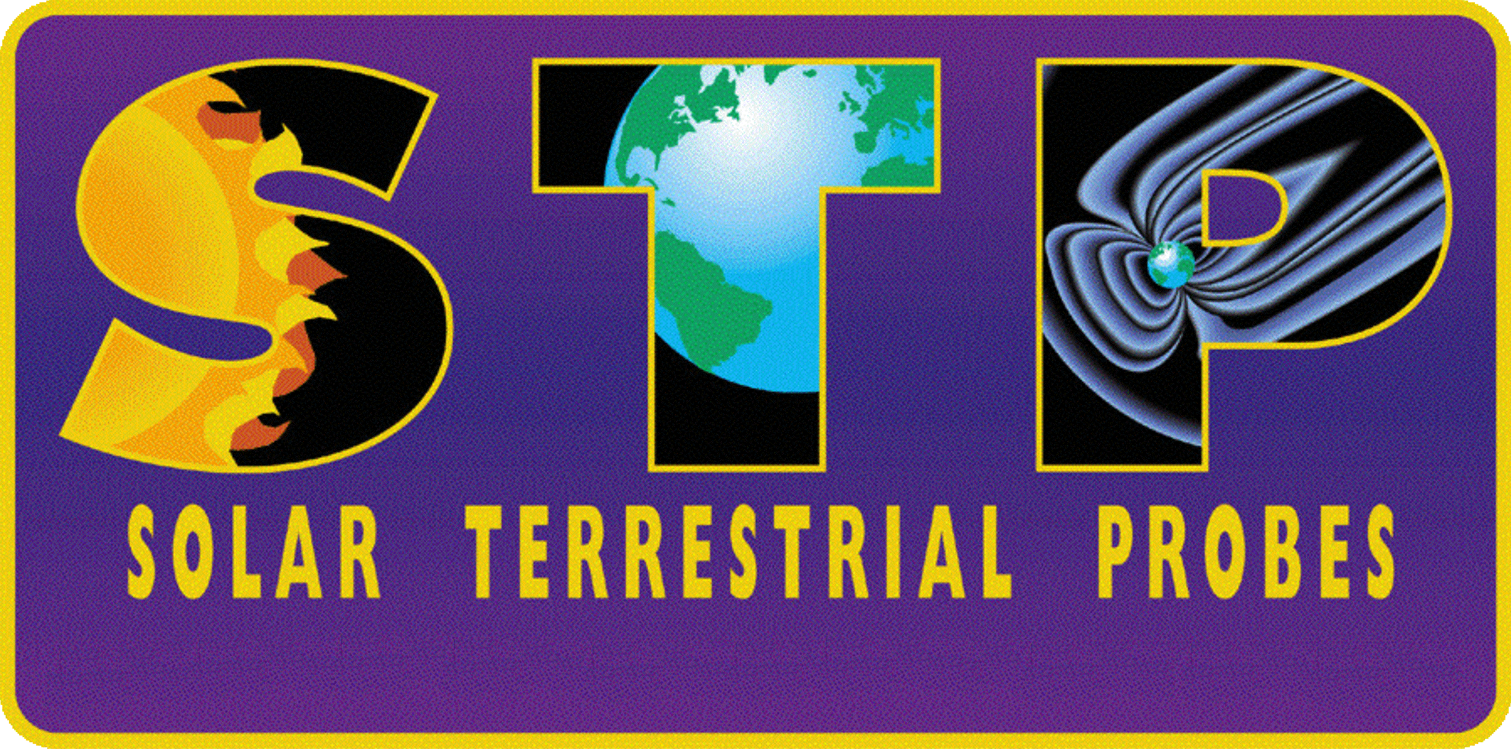
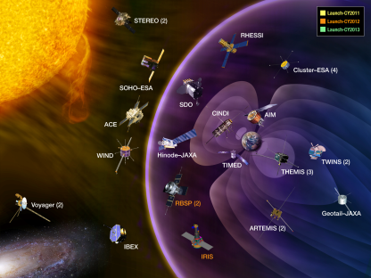

NASA Heliophysics
Strategic Objective: Understand the sun and its interactions with Earth and the solar system
Explorers
Solar Terrestrial Probes
Explore the physical processes in the space environment from the sun to the Earth and throughout the solar system
Advance our understanding of the connections that link the sun, the Earth and planetary space environments, and the outer reaches of our solar system.
Smaller, Competed Flight Program
Strategic Mission Flight Program
Research
Living With a Star
Develop the knowledge and capability to detect and predict extreme conditions in space to protect life and society and to safeguard human and robotic explorers beyond Earth.
Research tasks utilizing suborbital and existing assets
Strategic Mission Flight Program

Slide 4
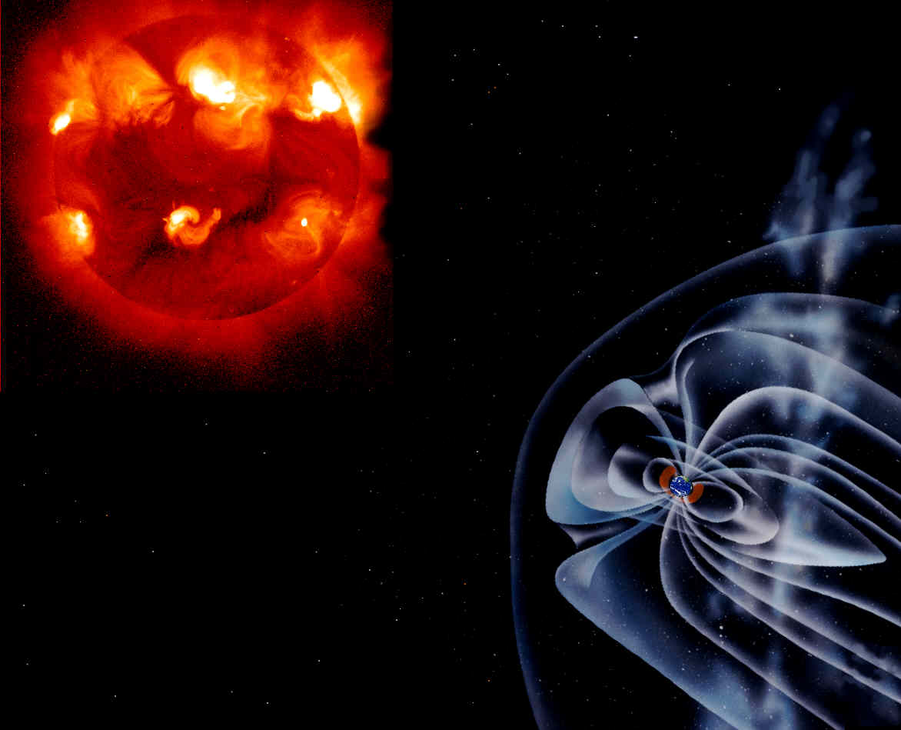
Primary Space Weather Satellites
NASA STEREO
(Ahead)
NASA Van Allen Probes
  Radiation belt conditions
NASA SDO, ESA/NASA SOHO
  Solar EUV Images
  Solar Corona (CMEs)
NOAA GOES
  Energetic Particles
  Magnetic Field
  Solar X-ray Flux
  Solar X-Ray Images
ESA/NASA SOHO
NASA ACE
  Solar wind composition, speed, and direction
  Magnetic field strength and direction
L1
NASA ACE
NOAA GOES
NOAA POES
NASA STEREO
  CME Direction and Shape
  Solar wind composition, speed, and direction
  Magnetic field strength and direction
NASA SDO
NASA Van Allen Probes
NOAA POES
  High Energy Particles
  Total Energy Deposition
  Solar UV Flux
NASA STEREO
(Behind)

Slide 5
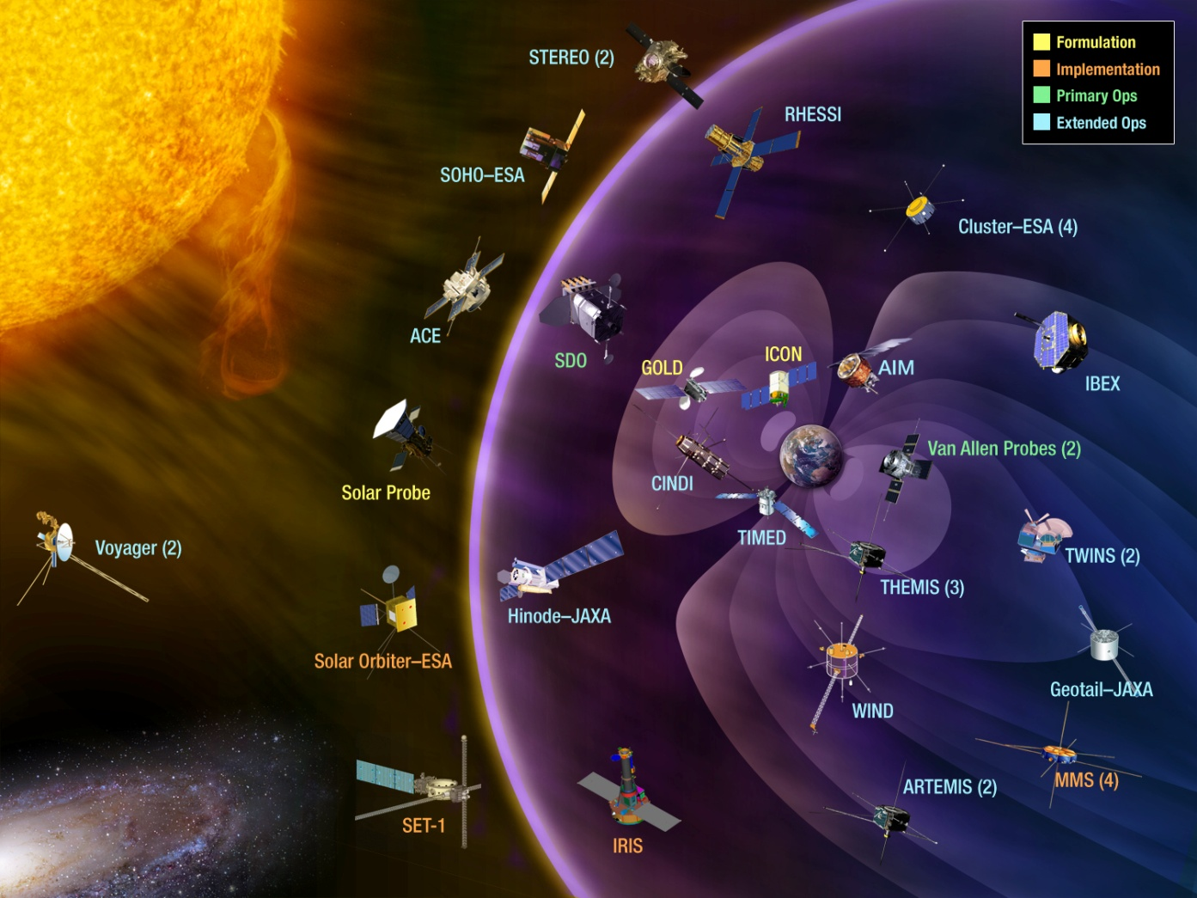
NASA’s Heliophysics Research Missions
A FLEET OF SPACECRAFT DESIGNED TO UNDERSTAND THE SUN AND
IT’S INTERACTIONS WITH EARTH AND THE SOLAR SYSTEM
The
Heliophysics has 18 operating missions: Voyager, Geotail, Wind, SOHO, ACE, Cluster, TIMED, RHESSI, TWINS, Hinode, STEREO, THEMIS, AIM, CINDI, IBEX, SDO, ARTEMIS,
Van Allen Probes, IRIS
6 missions are in development:
SET, MMS, SOC, SPP, ICON and GOLD.
Missions in red have
space weather utility.
5

Slide 6
Current Suite of Space Weather Observing Systems
From: Report on Space Weather Observing Systems: Current Capabilities and Requirements for the Next Decade
OFCM – NSWPC JAG for SEGA

Slide 7
NASA Roles & Responsibilities
Unified National Space Weather Capability (UNSWC)
The NASA mission is to drive advances in science, technology, and exploration to enhance knowledge, education, innovation, economic vitality, and stewardship of the Earth
Specific to space weather, NASA formulates and implements a national research program for understanding the Sun and its interactions with the Earth and the Solar System.
NASA develops on a reimbursable basis operational space weather satellites on behalf of NASA’s interagency partners; and provides leadership and management of space weather operations related to human space exploration; and is responsible for providing information for the safe and efficient operation of NASA’s robotic and human missions.
Heliophysics Research
Heliophysics research provides Theory, Data, and Modeling development services to national space weather efforts including the Community Coordinated Modeling Center (CCMC), a multi-agency partnership to enable, support and perform the research and development for next-generation space science and space weather models.
Smaller, Competed Flight Program
Strategic Mission Flight Program

Slide 8
Space Weather:
NASA / NOAA Roles & Responsibilities
NASA and NOAA work together (and with other agencies) on the satellite development, operations, data processing, and modeling that inform and improve space weather predictions.
Smaller, Competed Flight Program
Strategic Mission Flight Program

Slide 9
Space Weather:
NASA's Role
Specific to space weather, NASA formulates and implements a national research program for understanding the Sun and its interactions with the Earth and the Solar System and how these phenomena impact life and society
Smaller, Competed Flight Program
Strategic Mission Flight Program

Slide 10
Overarching LWS Science Goals
Energetic particles from giant solar storms and galactic cosmic rays pose major radiation hazards for astronauts. Passengers and crew on polar flights are also endangered by penetrating particle radiation. In support of NASA’s Exploration objectives, the TR&T delivers the understanding and modeling required for useful prediction of SEP variability and GCR modulation at the Earth, Moon, Mars and throughout the solar system.
Communication, navigation and other national infrastructures are increasingly dependent on satellites orbiting Earth. With increasing miniaturization these systems are ever more sensitive to the near-Earth space environment. To protect these assets, the TR&T delivers the understanding and modeling required for effective forecasting/specification of inner magnetospheric radiation and plasma.
The upper atmosphere and ionosphere is central to a host of space weather effects, ranging from anomalous satellite drag, GPS position error, radio blackouts, radar clutter and geomagnetically induced currents (GIC). In order to mitigate space weather’s impact on life and society the TR&T delivers understanding and predictive models of upper atmospheric and ionospheric coupling above and below.
One of the major challenges facing humanity is global climate change. In order to determine effective mitigation policies, natural and anthropogenic causes must be distinguished; the TR&T delivers the understanding of how variations in solar radiation, particles and magnetic fields contribute to global and regional climate change.

Slide 11
Space Weather:
NASA's Role
NASA researches and prototypes new mission and instrument capabilities in this area, providing new physics-based algorithms to advance the state of solar, space physics, and space weather modeling.
Smaller, Competed Flight Program
Strategic Mission Flight Program

Slide 12
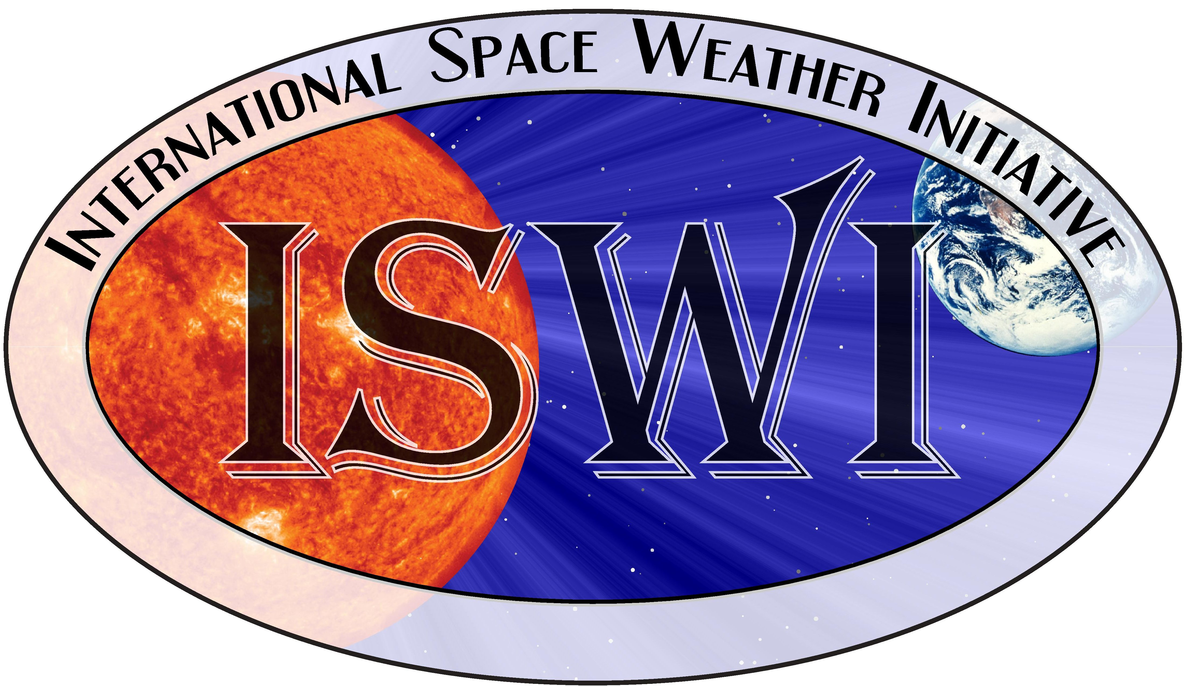
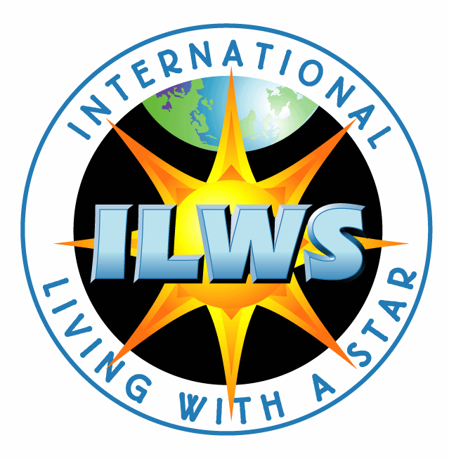


International Space Weather Activities
International Space Weather Initiative (ISWI)
  program of international cooperation to advance the space weather science by a combination of instrument deployment, analysis and interpretation of space weather data from the deployed instruments in conjunction with space data, and communicate the results to the public and students.
International Living With a Star (ILWS)
  Stimulate, strengthen, and coordinate space research to understand the governing processes of the connected Sun-Earth System as an integrated entity.
United Nations Committee on the Peaceful Uses of Outer Space (UNCOPUOS)
  review the scope of international cooperation in peaceful uses of outer space, to devise programmes in this field to be undertaken under United Nations auspices, to encourage continued research and the dissemination of information on outer space matters, and to study legal problems arising from the exploration of outer space.
Coordination Group for Meteorological Satellites (CGMS)
  International forum for the exchange of technical information on geostationary and polar orbiting meteorological satellite systems.
5
13

Slide 13
Recent Government Activity of Note
April 2013 OSTP Space Weather Report
  Finds that Federal agencies have deployed an effective mix of space-based and ground-based systems that are needed to support both operational space-weather services and scientific research.
  Highlights the role of space weather models in complementing current space- and ground-based observing systems
June 2013 SHIELD Act re-introduced in House
  To amend the Federal Power Act to protect the bulk-power system and electric infrastructure critical to the defense and well-being of the United States against natural and manmade electromagnetic pulse ("EMP") threats and vulnerabilities.
July 2013 FERC Orders Development of Reliability Standards for Geomagnetic Disturbances (GMD)
  January 2014, reliability standards that require owners and operators of the bulk-power system to develop and implement operational procedures to mitigate GMD effects consistent with the reliable operation of the grid.
  January 2015, reliability standards that require initial and ongoing assessments of the potential impact of benchmark GMD events on both grid equipment and grid as a whole.

Slide 14
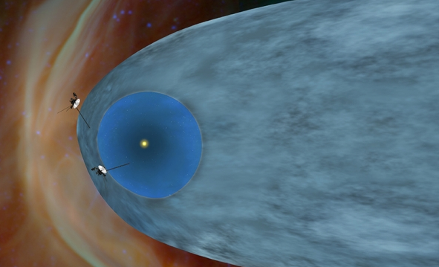
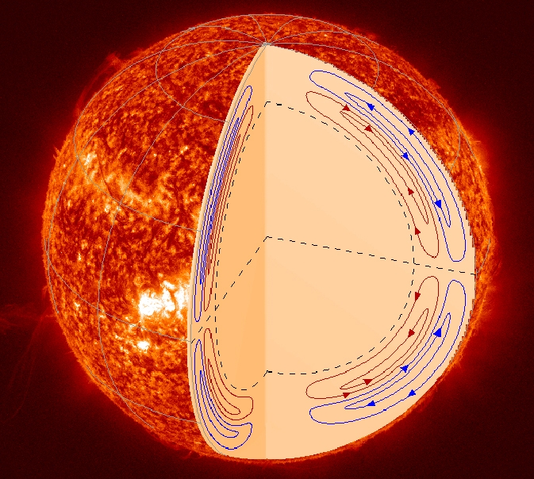
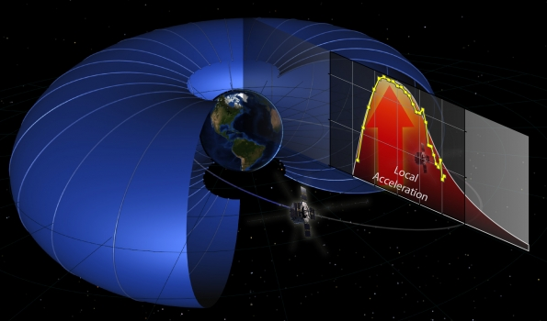
Major Recent Accomplishments –Science
Sept. 12, 2013 - NASA's Voyager 1 Embarks on a Historic Journey into Interstellar Space: Voyager 1 is officially the first human-made object to venture into interstellar space. New data indicate Voyager 1 has been traveling for about one year through the plasma present in the space between stars.
July 25, 2013 - NASA's Van Allen Probes Discover Particle Accelerator in the Heart of Earth’s Radiation Belts: New results from the Van Allen Probes show that acceleration energy comes from within the belts themselves rather than a more global process. Particles inside the belts are sped up by a local energy source that accelerates them to speeds of 99 percent the speed of light.
Aug. 28, 2013 - NASA's SDO Mission Untangles the Motion Inside the Sun: Using the Helioseismic and Magnetic Imager, or HMI, on NASA’s Solar Dynamics Observatory, scientists have mapped out the flow of the material inside the sun. Recent results reveal a double layer of circulation, with two cycles of flow on top of each other.

Slide 15
Looking Forward
CCMC working with NOAA on Geospace Model Selection (FY13), R2O collaboration and SW Testbed
NOAA identified Space Weather research needs
  Forecasting flares & proton events
  IMF Bz and density in CME
  Radiation at aircraft altitudes and LEO (driven by FAA concerns and NASA/HEO needs)
Data continuity and increased capability
  Senior Review recommended SOHO continuation solely to support its role in nation’s space weather infrastructure
  DSCOVR, Sunjammer
  Investigate role of small spacecraft (e.g., cubesats, nanosats) to fulfill Space Weather needs

Slide 16
Decadal Survey Research Recommendations
(Recommends the Heliophysics budget grows from ~$650M to ~$750M by 2024)
Recommendations | Science | Cost
0.0 Complete the current Program | Support the existing program elements that constitute the Heliophysics Systems Observatory (HSO) and complete missions in development (RBSP, IRIS, MMS, SOC, SPP). | Assumes no cost growth for any of these elements
1.0 DRIVE (Diversify, Realize, Integrate, Venture, Educate) | Strengthen observational, theoretical, modeling, and technical advances with additional R&A capabilities: small satellites; MO&DA funding augmentation, LCAS augmentation, science centers and grant programs; instrument development | Program rebalance: move up to ~$33M/yr into Research by 2022
2.0 Accelerate and expand Heliophysics Explorer Program | Launch every 2-3 years, alternating SMEX & MIDEX with continuous Missions of Opportunity. | Program rebalance: move $70M/yr extra into Explorers
3.0 Restructure STP line as a moderate scale, PI-led flight program. Implement three mid-scale missions. | Mission 1: Understand the interaction of the outer heliosphere with the interstellar medium; includes L1 space weather observations Mission 2: Understand how space weather is driven by lower atmosphere weather. Mission 3: Understand how the magnetosphere-ionosphere-thermosphere system is coupled and responds to solar forcing. | $520M per mission in FY12$; launches in 2021, 2025, 2029
4.0 Start another LWS mission by the end of the decade. | Mission 4: Study the ionosphere-thermosphere-mesosphere system in an integrated fashion. | $1B mission, Launch 2024
Notes: 1) Recommendations listed above are top level. Each contains a number of sub-elements
2) Recommendations are listed in priority order, pending budget constraints
3) Recommendations are separable by Agency. Only NASA Recommendations are listed here
16

Slide 17
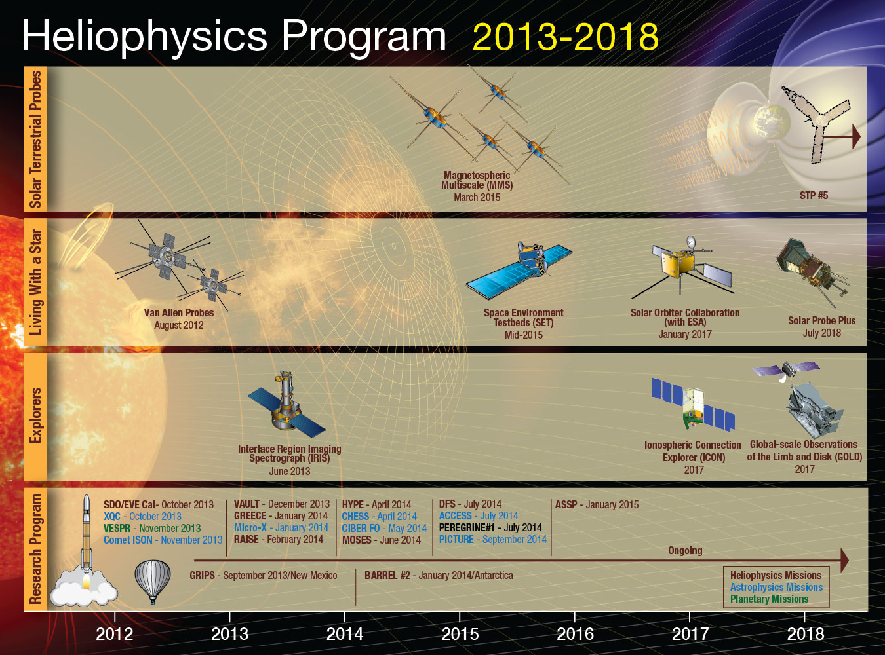

Slide 18
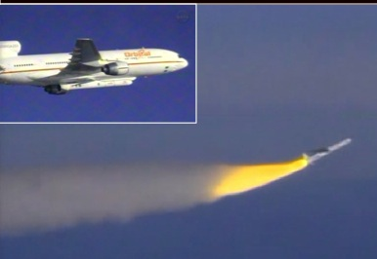
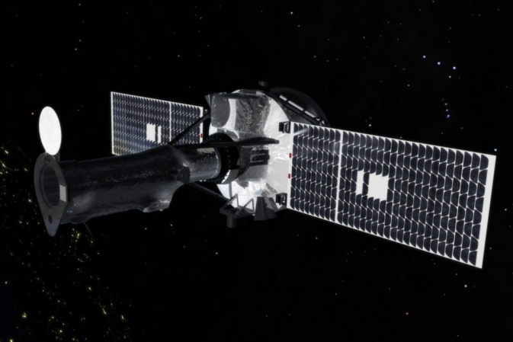
NASA Launches Its Newest Solar Observatory
The Interface Region Imaging Spectrograph (IRIS)
“A SMall EXplorer mission to understand how the solar atmosphere is energized”
IRIS was successfully launched on June 27, 2013 from Vandenberg Air Force Base, Calif. by an Orbital Sciences Corporation Pegasus XL rocket.
Orbit insertion was near perfect
Spacecraft health is excellent
Telescope door successfully opened
on July 17
First light media event July 25

Slide 19
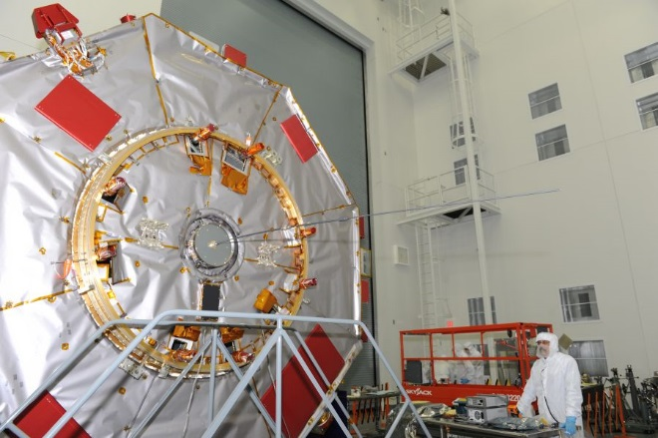
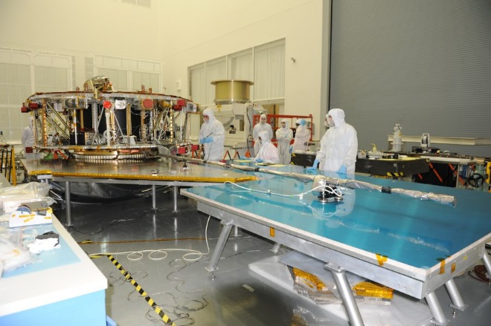
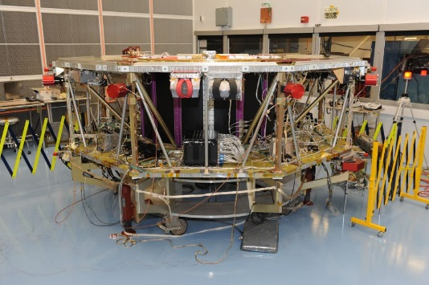
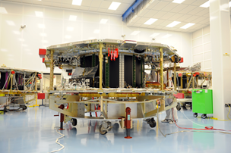
MMS launching in 2015
Observatory #1
Observatory #2
Observatory #4
Observatory #3

