Slide 1
GSFC Space Science Mission Operations (SSMO) and Space Weather
Rick Harman
Space Science Mission Operations

Slide 2
SSMO Spacecraft

Slide 3
SSMO Spacecraft
Stereo Behind
LRO, ARTEMIS
Sun
GEO: SDO
L1: ACE, SOHO, WIND
LEO: AIM, Fermi, IRIS, RHESSI, Swift, TIMED
HEO: THEMIS, IBEX, Van Allen
Stereo Ahead

Slide 4
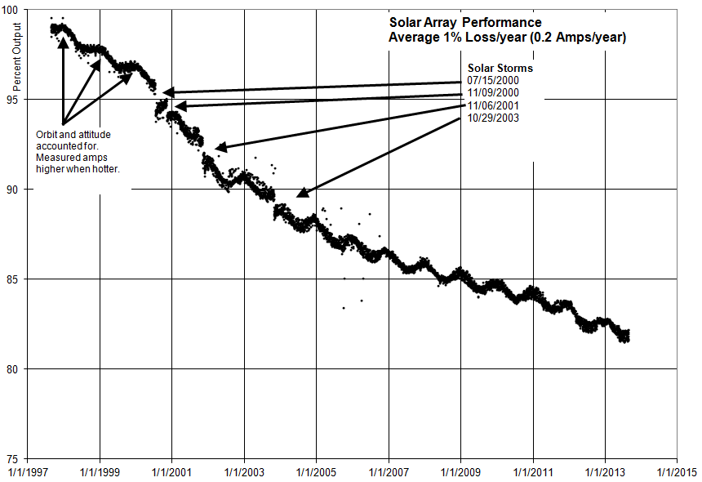
ACE Solar Panel Degradation

Slide 5
Space Weather Effect on SDO Hardware

Slide 6
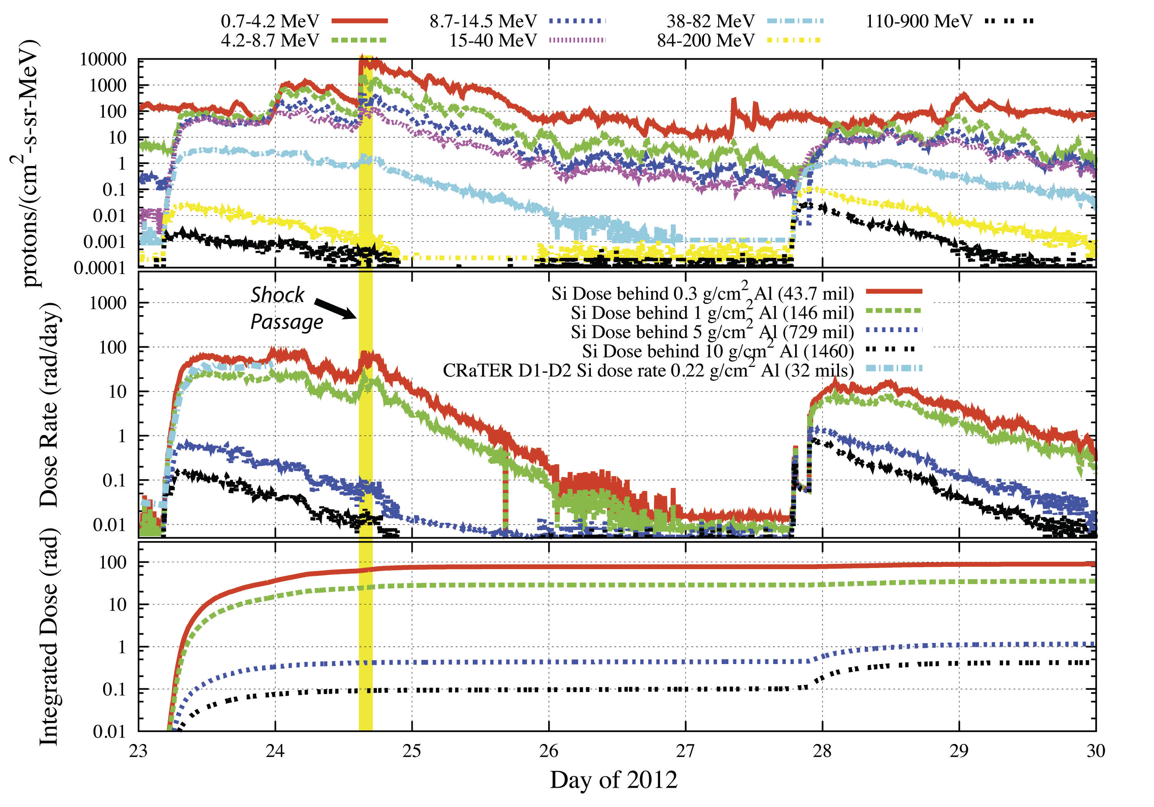
Space Weather Effects on LRO
Cosmic Ray Telescope for the Effects of Radiation (CRaTER)
January 23, 2012 & January 27, 2012 (x class flare)

Slide 7
SSMO Space Weather Now and the Future
Now
Space Weather used to explain spacecraft anomalies and degradation
Future
Integrate space weather observations and predictions into telemetry databases
Better correlate which events correspond to which spacecraft anomalies
In an ideal world, use this correlation to be proactive as necessary and desirable with the spacecraft (i.e. turn off hardware, change attitude, etc)
Pass back information to design engineers to help future missions

