Slide 1
Space Weather Tools Update
Marlo Maddox
and the CCMC/SWRC Team
674 / Space Weather Laboratory
587 / Science Data Processing Branch
http://ccmc.gsfc.nasa.gov http://swrc.gsfc.nasa.gov

Slide 2
CCMC & SWRC: An Agile Development Team
Customers & domain experts work directly with the development team.
Agile processes accept the reality of change.
Our systems are built with guidance from domain experts on a daily basis.
You are part of the team, and your input/feedback is valuable!

Slide 3
The Dynamic CCMC/SWRC Ecosystem
Agile Software Development
Facilitate Community Research & Development
R20 Transition Support
Customers & domain experts work directly with the development team.
Unique NASA Needs
CCMC+ v2013

Slide 4
The Dynamic CCMC/SWRC Ecosystem
Agile Software Development
Facilitate Community Research & Development
R20 Transition Support
Customers & domain experts work directly with the development team.
Unique NASA Needs
CCMC+ v2013

Slide 5
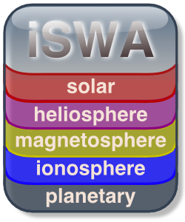
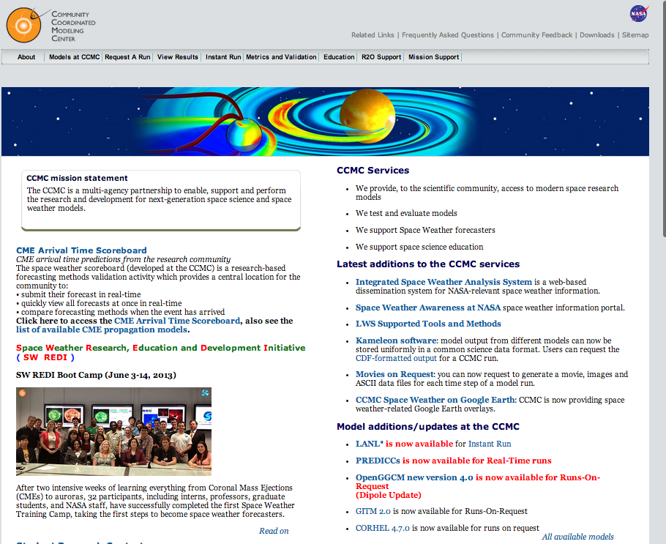
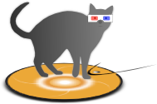
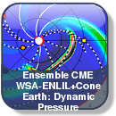
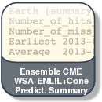
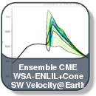
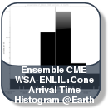
Tools For Space Weather
Runs-On-Request
ISWA
Mobile
Web Services
ISEP
Unique NASA Needs
StereoCat
CME Ensemble
Scoreboard
OneClick
DONKI
SEA⁵
Space Environment Automated Alerts & Anomaly Analysis Assistant

Slide 6
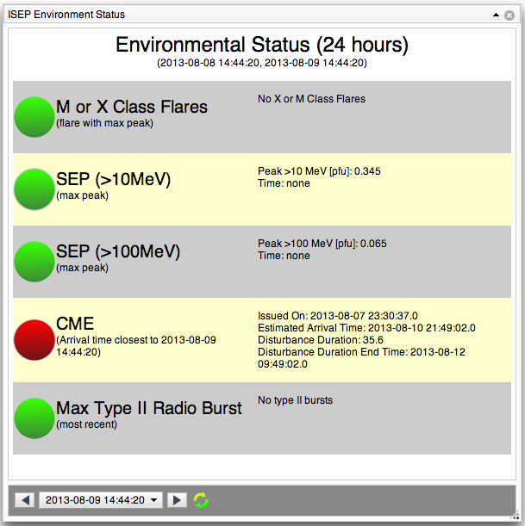
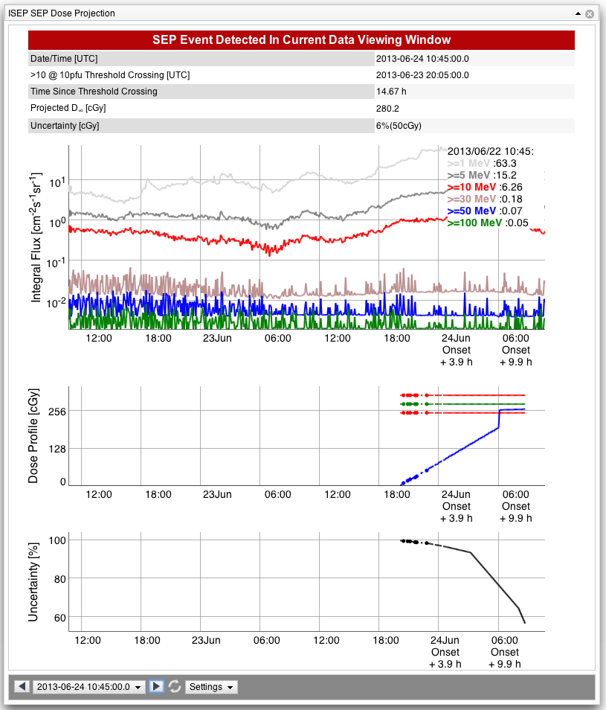
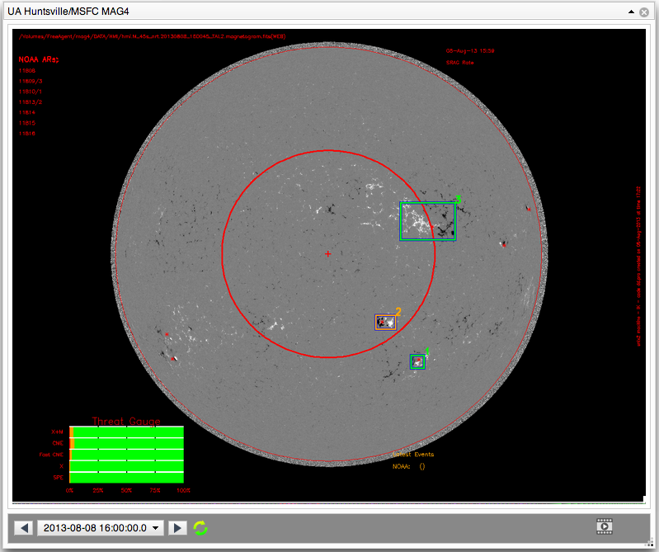
Advanced Radiation Project: ISEP ( Integrated Solar Energetic Proton Event Alert Warning System )
Dedicated/Custom iSWA Control Panel.
Tailored space weather products and displays.
Full iSWA functionality and support.

Slide 7
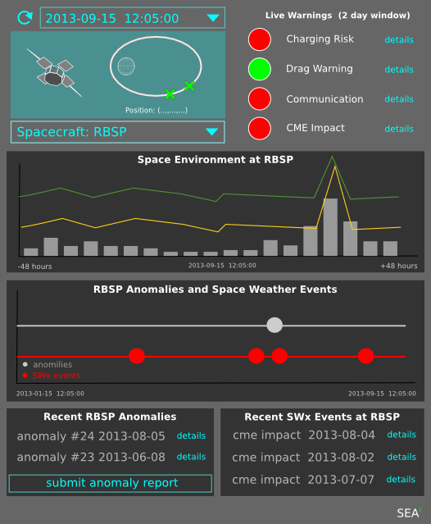
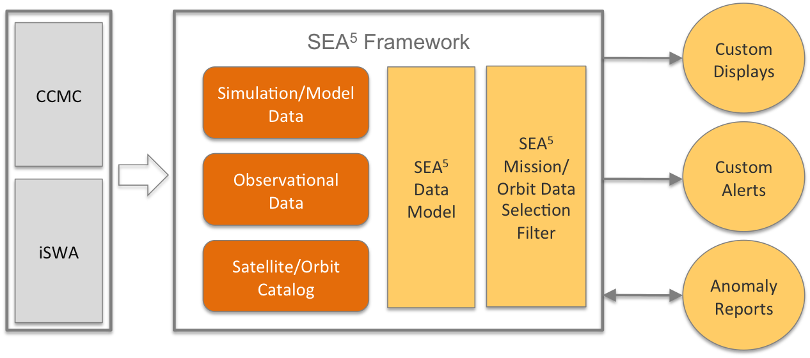
SEA⁵ Space Environment Automated Alerts & Anomaly Analysis Assistant
SEA⁵ 2014 IRAD Project
view space environment conditions for specific missions/orbits
provide automated space weather alerts for specific missions/orbits
assimilate and display spacecraft anomaly information
manage and display spacecraft/mission data

Slide 8
DEMO

