Slide 1
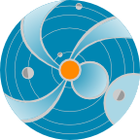
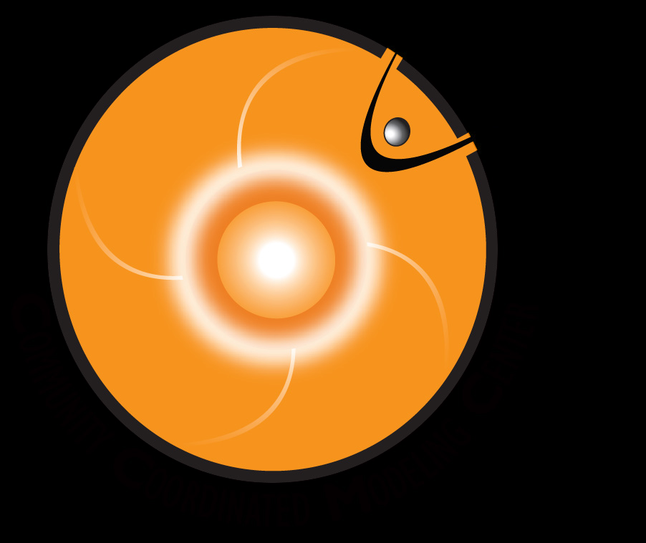
Overview of Significant SWx Events in 2012
Yihua Zheng
NASA Goddard Space Flight Center
http://swrc.gsfc.nasa,gov

Slide 2
Outline
Types of Space Weather Storms
Solar energetic ion storms (everywhere)
Radiation belt electron storms (Earth/Earth-like planets)
Geomagnetic storms (Earth and Earth-like)
Radio Blackouts
Significant SWx Events in 2012

Slide 3
The Sun
Maker of Space Weather
CME, Flares, and Coronal Hole HSS
CME, Flares, and Coronal Hole High speed solar wind
Three very important solar wind disturbances/structures for space weather
Flare
Solar energetic particles
Radiation storm
proton radiation (SEP) <Flare/CME>
electron radiation <CIR HSS/CME>
Radio blackout storm <Flare>
Geomagnetic storm
CME storm (can be severe)
CIR storm (at most moderate)
Flare and CME demo

Slide 4
Types of Storms

Slide 5
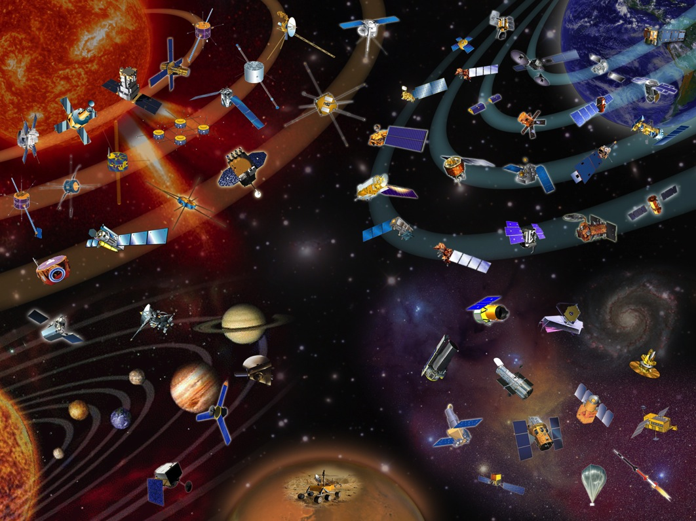
STEREO A
CME
Orientation
SOHO/ACE
*
SDO
Earth
STEREO B

Slide 6
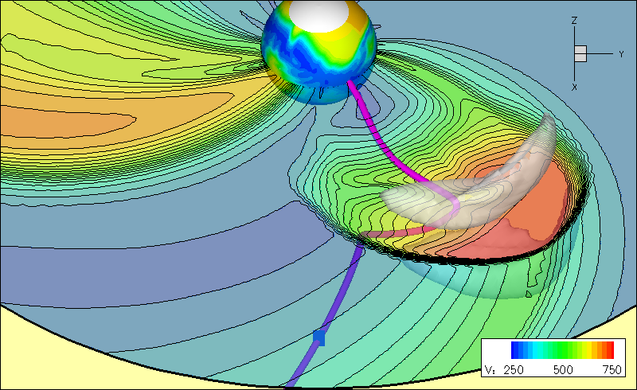
CME and SEP path are different
CME
CME
Courtesy: Odstrcil
SEPs
CME: could get deflected, bended, but more or less in the radial direction

Slide 7
Important distinction
Ion Radiation storm vs Geomagnetic storm
CME impact and SEP (Solar Energetic Particle) impact are different
CME
CME impact @ Earth: Geomagnetic Storm
Radiation storm @ Earth from SEPs
CME speed: 300 – 3500 km/s
SEPs: fraction of c
Light speed c: 3 x10^5 km/s

Slide 8
SEPs: ion radiation storms
Potentially affect everywhere in the solar system
Courtesy: SVS@ NASA/GSFC
Notes:
SEPs: applicable and potentially damaging everywhere that they have influence

Slide 9
Geomagnetic Storms:
CME interaction with Earth (magnetic field)
Courtesy: SVS@ NASA/GSFC
Geomagnetic storms due to CIRs are at most moderate

Slide 10
Electron Radiation:
Radiation belt (Earth, Jupiter, Saturn, Uranus, Neptune)
Courtesy: SVS@ NASA/GSFC
RBSP: launched successfully on August 30, 2012
Notes:
High speed solar wind streams: peak flux around geosynchronous orbit
Intense CMEs; peak flux get pushed much inward

Slide 11
Two types of external solar wind drivers for Outer Radiation Belt
CME storms peak flux penetrate closer to Earth
CIR storms (due to high speed solar wind streams) peak around geosynchronous orbit

Slide 12
Significant SWx Events in 2012
Increase in solar activities in comparison to 2010 and 2011

Slide 13
Significant SEP Events
Three major SEP events
Around Earth:
Jan 23, 2012 event: peak flux 6310 pfu @ Jan 24/15:30 UT – largest since November 2003
March 7, 2012 event: peak flux 6530 pfu@ Mar 08/11:15 UT – largest since November 2003
Around STEREO A
23 July 2012 event: peak flux 454 pfu/MeV for 13 -100 MeV protons → ~ 4.5x10^4 pfu
Extreme SEP events since 1976 (the > 10 MeV proton flux @ geo orbit >10^4 pfu)
1989 Oct 20 40,000 pfu
1991 Mar 24 43,000 pfu
2000 Jul 15 24,000 pfu
2000 Nov 09 14,800 pfu
2001 Sep 25 12,900 pfu
2001 Nov 06 31,700 pfu
2001 Nov 24/0555 18,900 pfu
2003 Oct 29/0615 29500 pfu
SEP event trend (The > 10 MeV proton flux exceeding 10 pfu @ Earth)
2010 1 event
2011 8 events
2012 14 events
>100 pfu
2010 -2011: 0 event
2012: 6 events
First GLE event of Solar Cycle 24
May 17, 2012
AR 1476

Slide 14
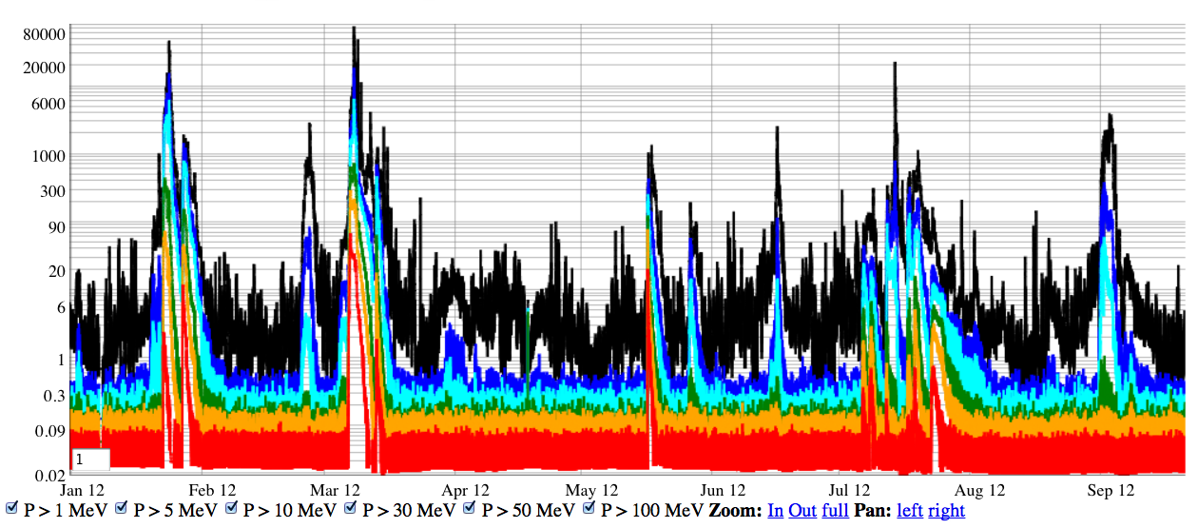
SEPs @ Earth 2012
Cyan: for the > 10 MeV proton flux
S3
S2
S1
S1 (>10 pfu): 14 events
S2 (>100 pfu): 6 events
S3 (>1000 pfu): 2 events
Rick Mullinix and David Berrios

Slide 15
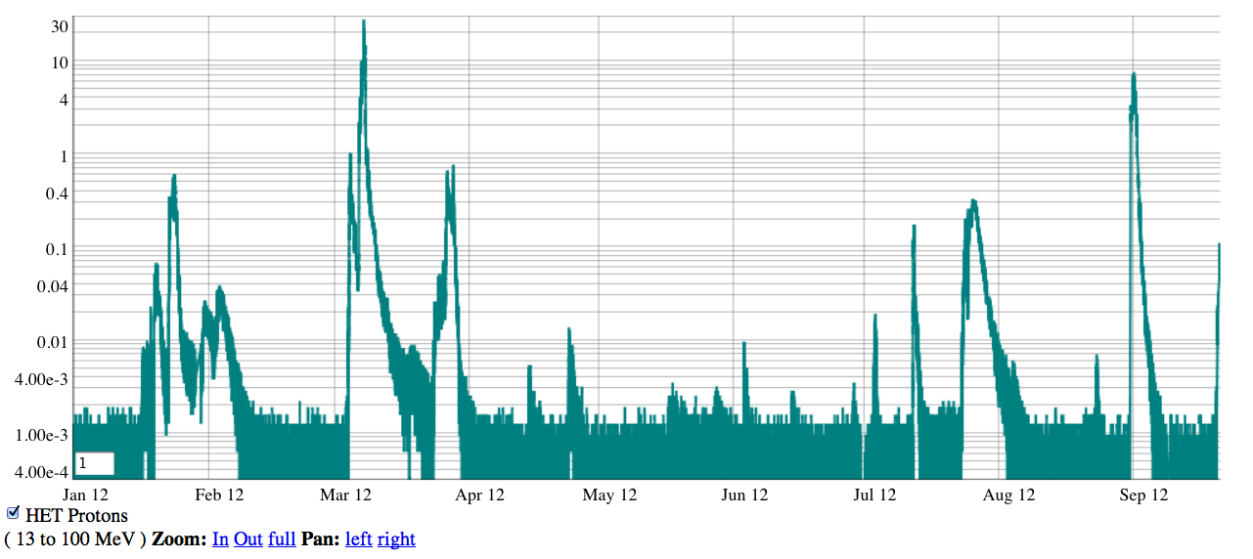
SEPs @ STEREO B (year 2012)
13 – 100 MeV protons (unit pfu/MeV)
S3
S2
S1
Exceeding 10 pfu 9 events
Exceeding 100 pfu: 2 events
Exceeding 1000 pfu: 1 event
Rick Mullinix and David Berrios

Slide 16
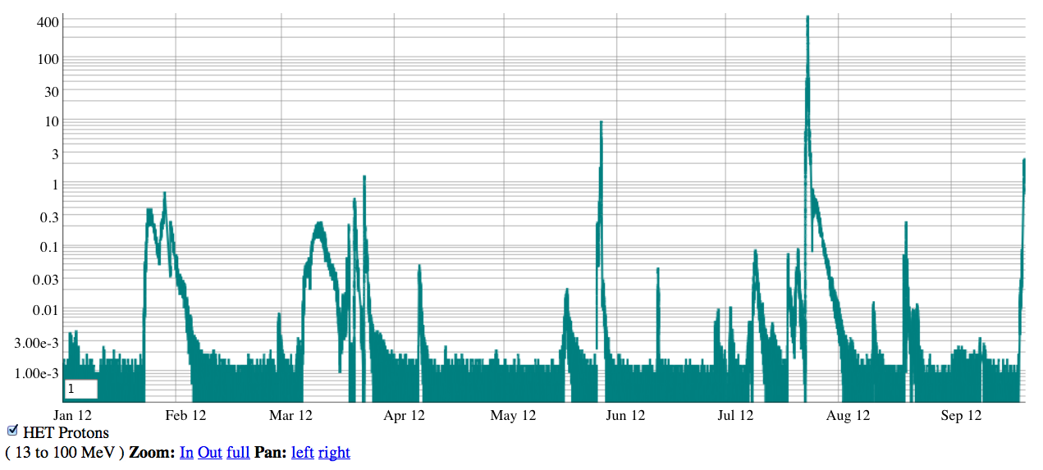
SEPs @ STEREO A (year 2012)
23 JULY 2012 event
13 – 100 MeV protons (unit pfu/MeV)
S4
S3
S2
S1
Exceeding 10 pfu 9 events
Exceeding 100 pfu: 5 events
Exceeding 1000 pfu: 1event
Rick Mullinix and David Berrios

Slide 17
SEP event spatial distribution
> 10 pfu 9 events
> 100 pfu: 5 events
> 1000 pfu: 1 event
>10 pfu 14 events
> 100 pfu: 6 events
> 1000 pfu: 2 events
>10 pfu 9 events
> 100 pfu: 2 events
> 1000 pfu: 1 event

Slide 18
Significant Geomagnetic Storms in 2012
Two major geomagnetic storms
March 7, 2012 CMEs → Dstmin = -133 nT on March 9, 2012 (the largest SEP event too)
July 12, 2012 CME → Dstmin = -127 nT on July 15, 2012
AR 1520, also responsible for the 23 July 2012 space weather event
Similar to year 2011 (two major geomagnetic storms)
A few outstanding active regions
AR 1429 - produced 10 major flare/CME events and was active for about 28 days
AR 1476 - produced the first GLE event of solar cycle 24
AR 1520 – produced 5 major flare/CME events in 21 days

Slide 19
Significant Geomagnetic Storms in 2012
Two major geomagnetic storms
March 7, 2012 CMEs → Dstmin = -133 nT on March 9, 2012 (the largest SEP event too)
July 12, 2012 CME → Dstmin = -127 nT on July 15, 2012
AR 1520, also responsible for the 23 July 2012 space weather event
Similar to year 2011 (two major geomagnetic storms)
A few outstanding active regions
AR 1429 - produced 10 major flare/CME events and was active for about 28 days
AR 1476 - produced the first GLE event of solar cycle 24
AR 1520 – produced 5 major flare/CME events in 21 days

Slide 20
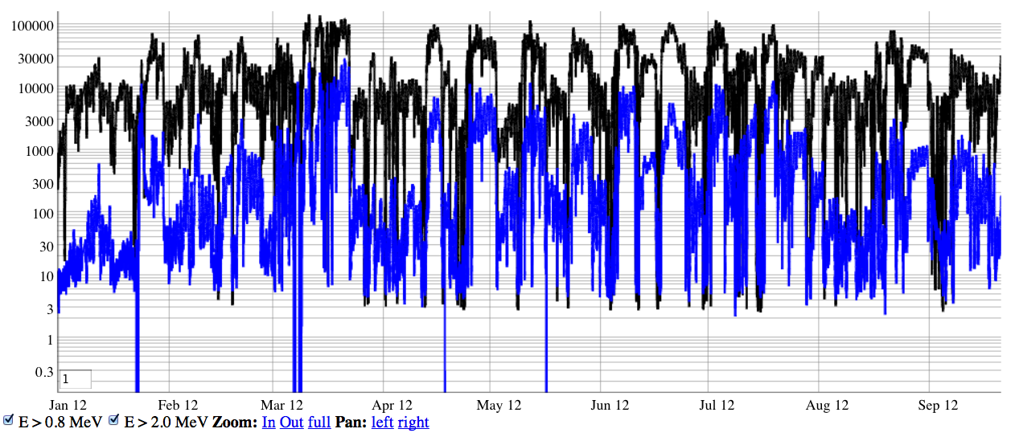
Electron radiation measured @ GOES
Most of them: from aftermath of CME(s)
One: High Speed Solar Wind Streams from a coronal hole
Rick Mullinix and David Berrios

Slide 21
The 7 March 2012 event

Slide 22
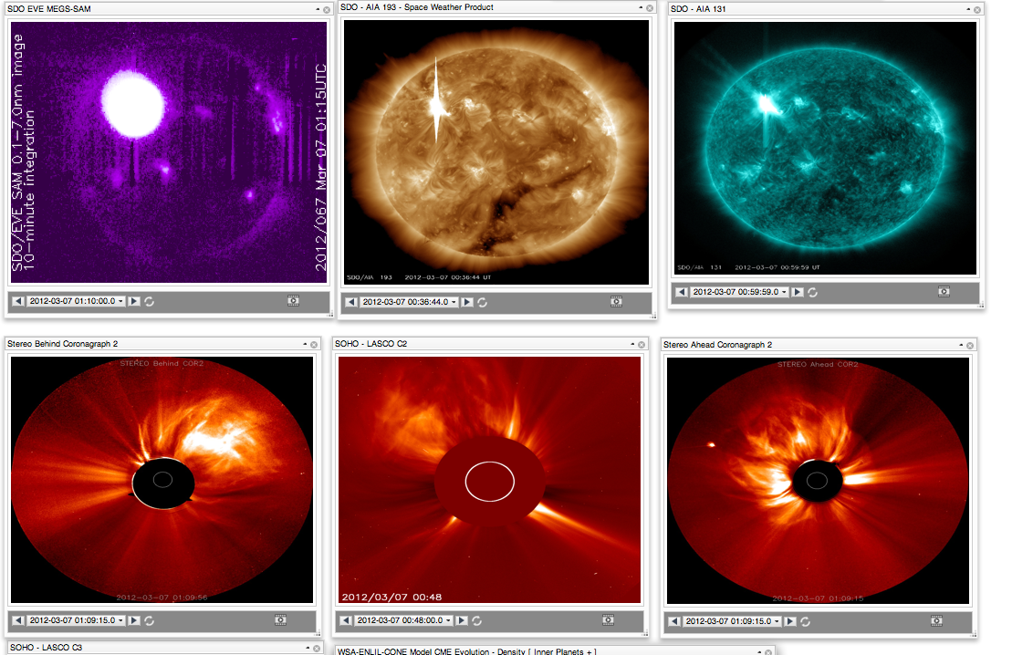
2012 March 7 X5.4/X1.3 flares
Most pronounced in x-ray and EUV
EUV
EUV
X-ray
Blended
EUV

Slide 23
The 7 March 2012 CMEs

Slide 25
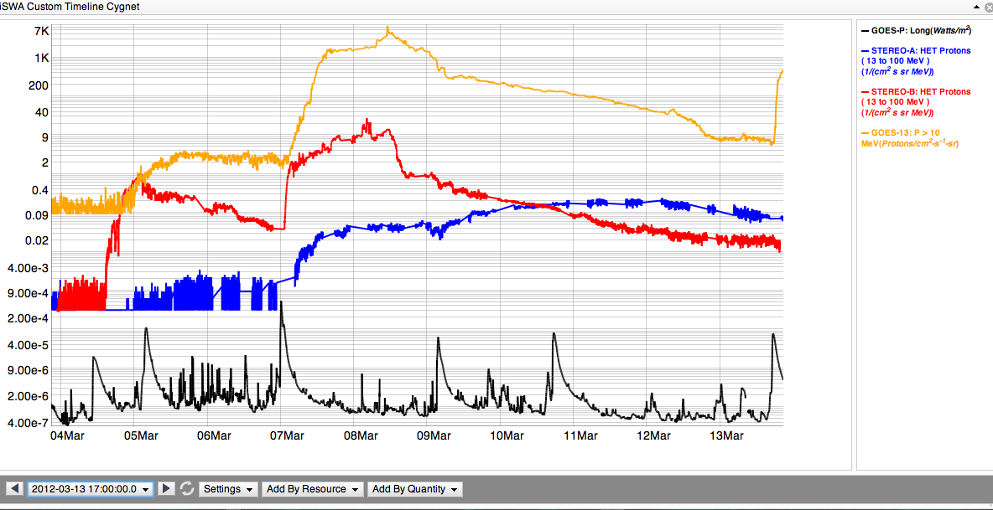
SEP: proton radiation
Both the CME(s) and flare(s) contribute to the SEP enhancement
GOES >10 MeV
13-100 MeV STEREO B
13-100 MeV STEREO A
X5.4/2200 km/s
X1.3/1800 km/s
M7.9
VCME=2100 km/s
X1.1
VCME=1360 km/s
M8.4
VCME=1500 km/s
M2.0
VCME=1540 km/s
M6.3/CME=1125 km/s
GOES x-ray

Slide 26
CME impact at Earth
Dstmin = -133 nT

Slide 27
The 23 July 2012 event

Slide 28
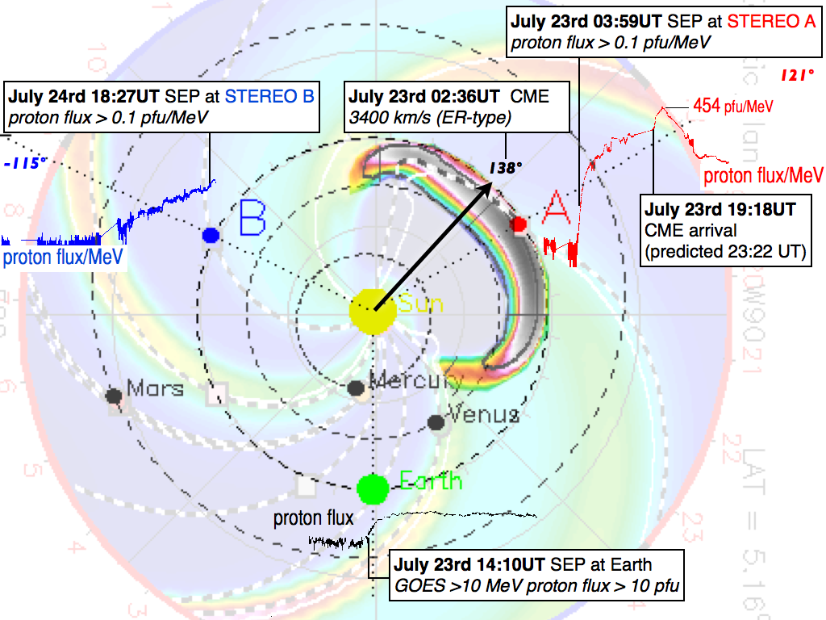
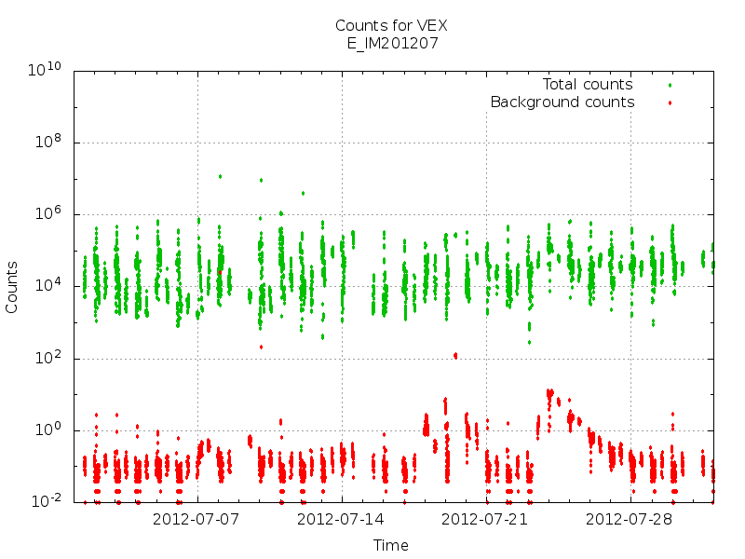
VEX/ASPERA
Y. Futaana, S. Barabash and J. Luhmann
Courtesy M. Mays

Slide 29
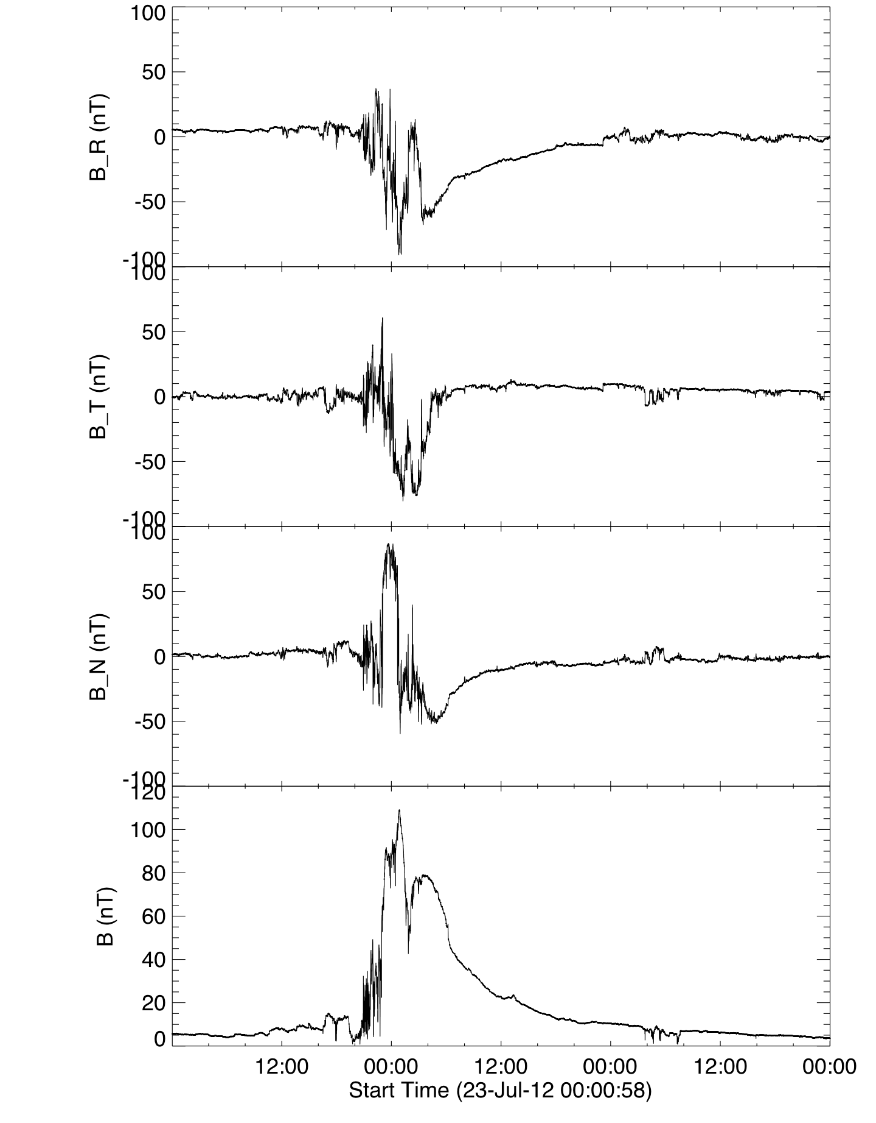
STEREO A IMPACT Data
M. Leila Mays

