Slide 1
Nowcast of Atmospheric Ionizing Radiation for Aviation Safety (NAIRAS) Model
Christopher J. Mertens
NASA Langley Research Center Hampton, VA
4th NASA Space Weather and Robotics Mission Operations Workshop
NASA Goddard Space Flight Center
September 27, 2012

Slide 2
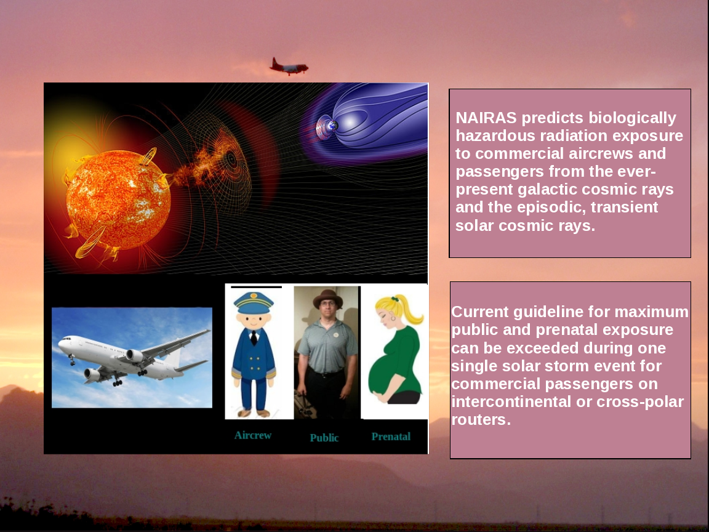

Slide 3
Outline
Model Schematic Overview
Results From March 2012 SEP Event
Initial Model V&V
NAIRAS Partnerships, Future Plans and Activities

Slide 4
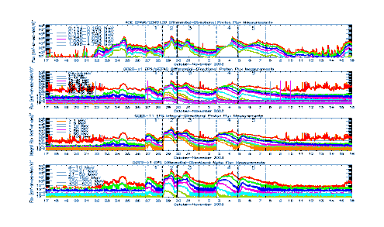
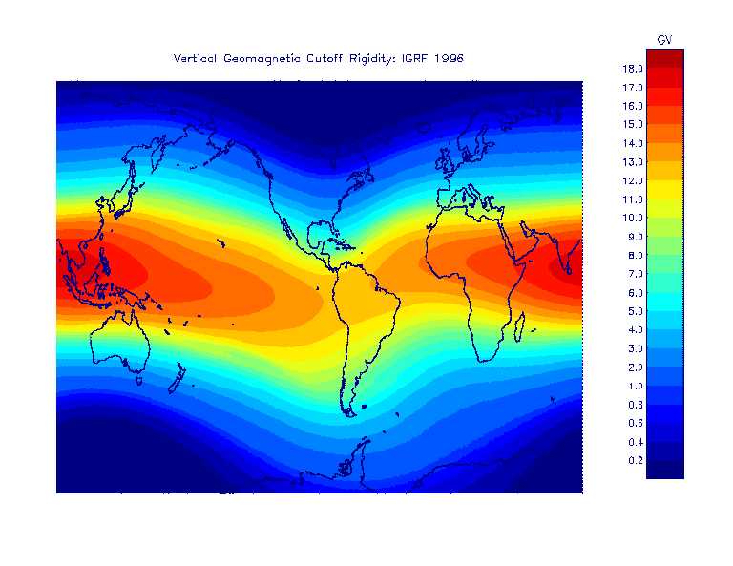
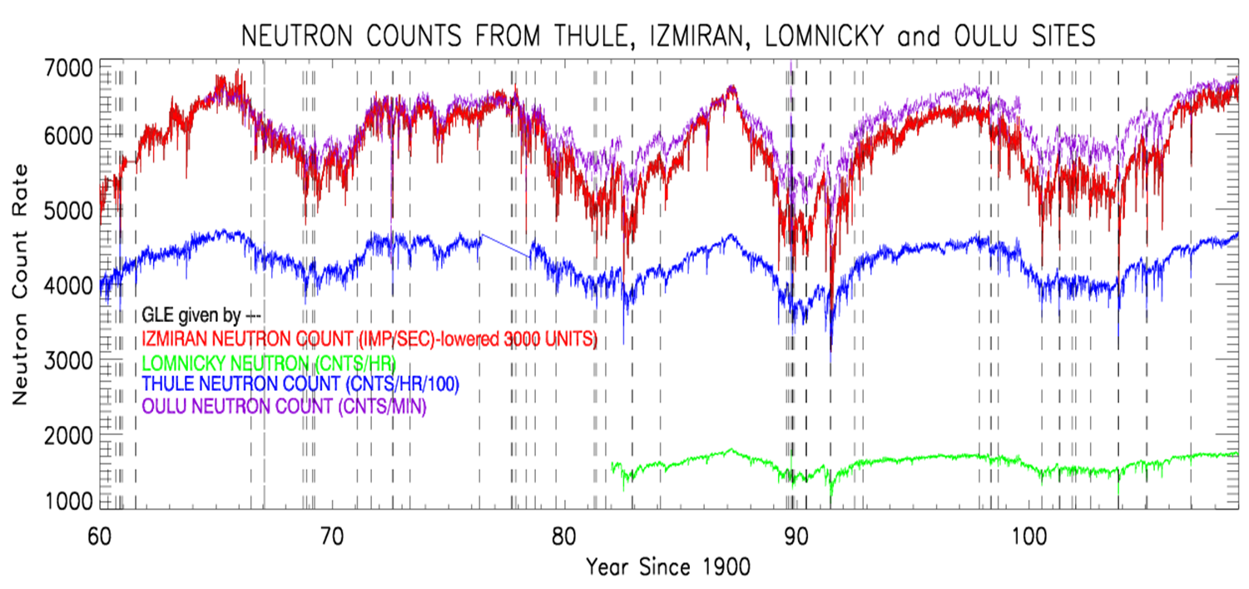
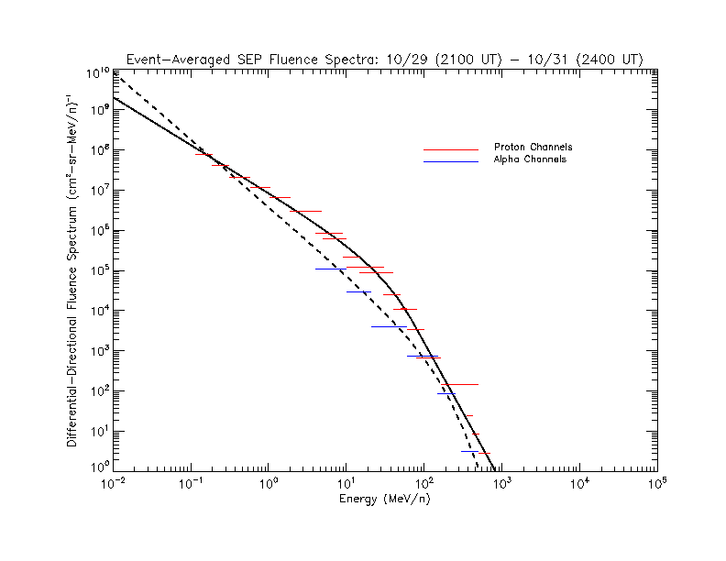
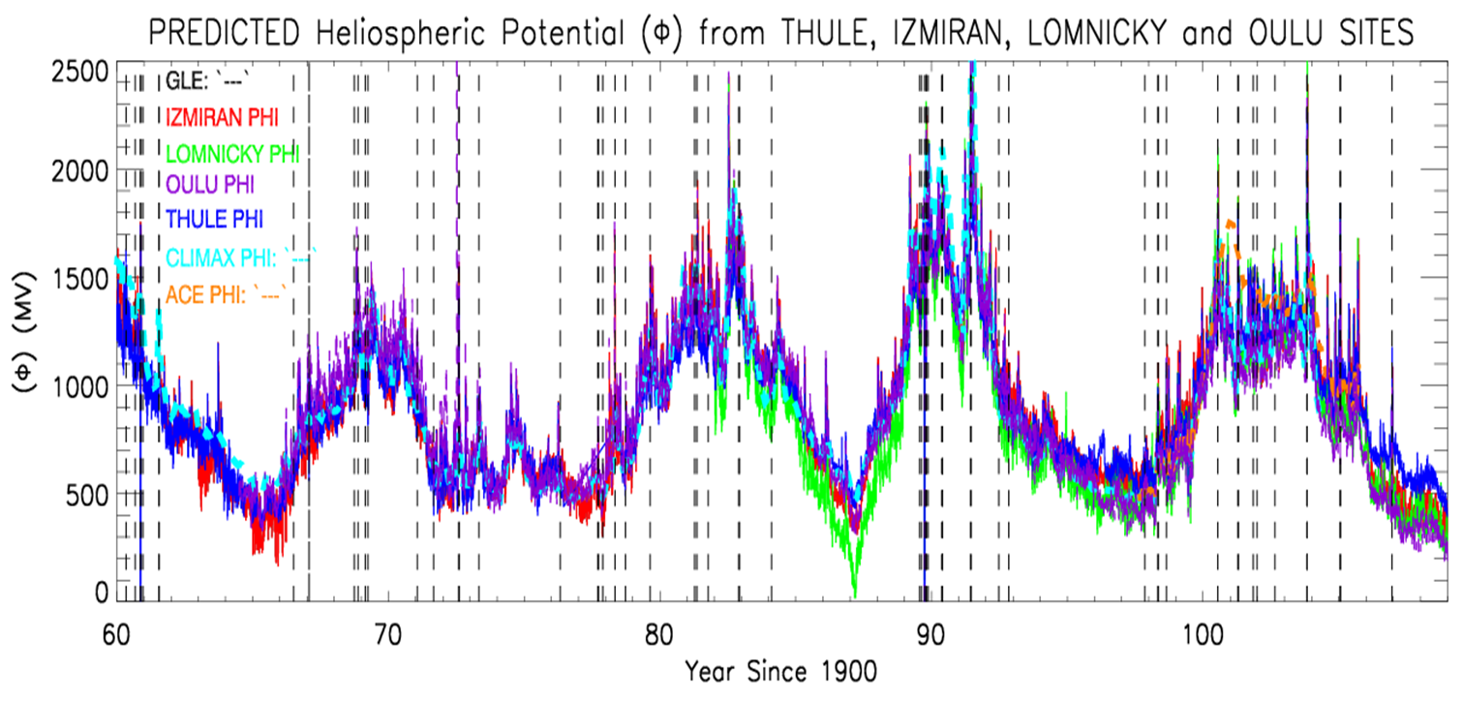
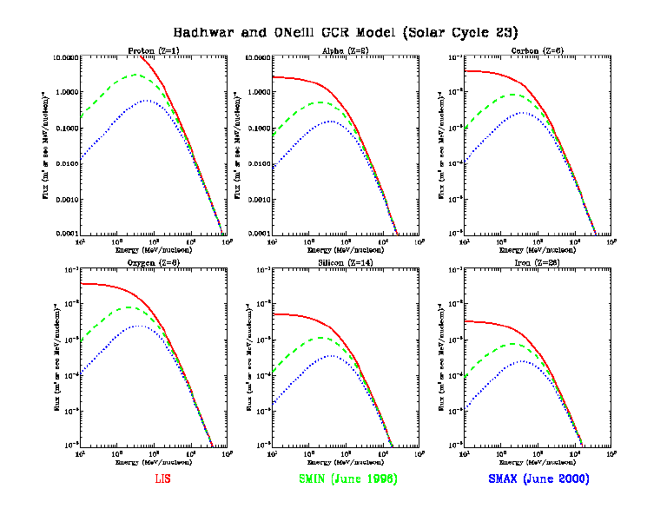
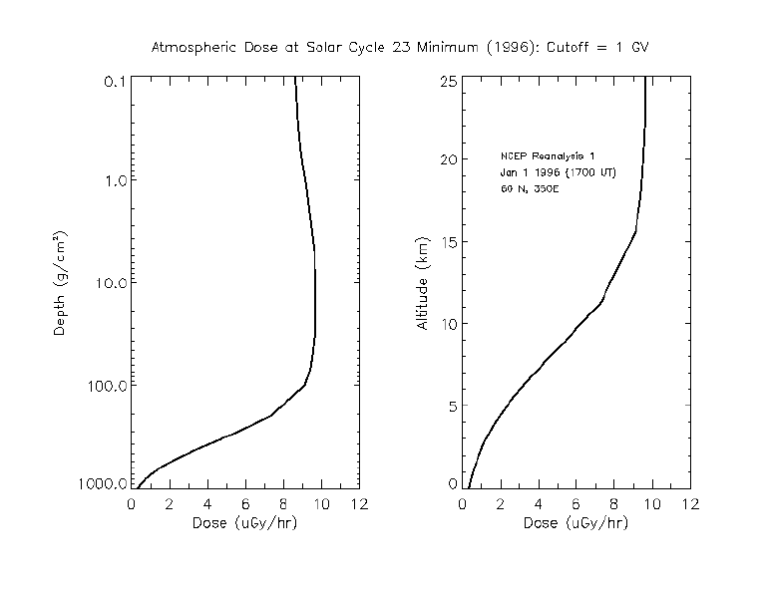
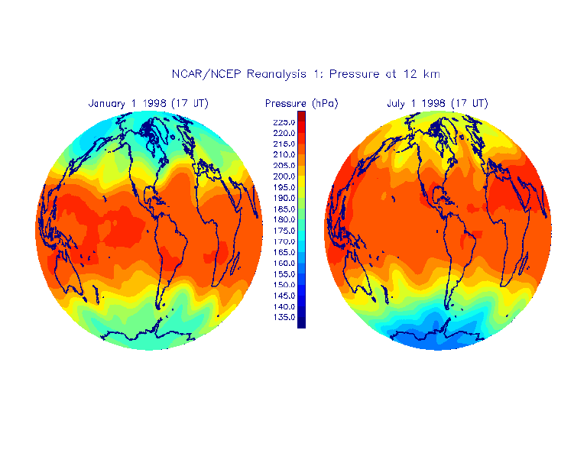
Nowcast of Atmospheric Ionizing Radiation for Aviation Safety (NAIRAS) Model
NOAA/GOES +NASA/ACE Data
Cutoff Rigidity (IGRF)
Real-time Neutron
Monitor Data
(e.g., IZMIRAN and
LOMNICKY)
Fit to Climax HP
Spectral Fitting
Magnetospheric
Magnetic Field
(e.g., T05)
Effects on
Cutoff Rigidity
NASA/ACE Solar
Wind and IMF Data
Badhwar+O’Neill GCR Model
HZETRN
+
Dosimetry
Atmospheric Density
Atmospheric Dose
and Dose Equivalent
NCEP/GFS

Slide 5
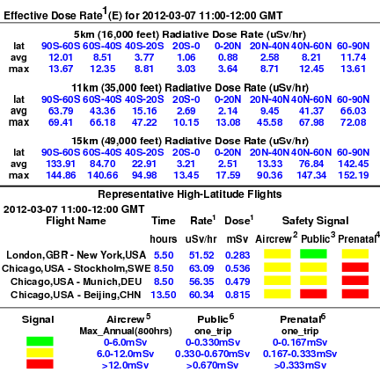
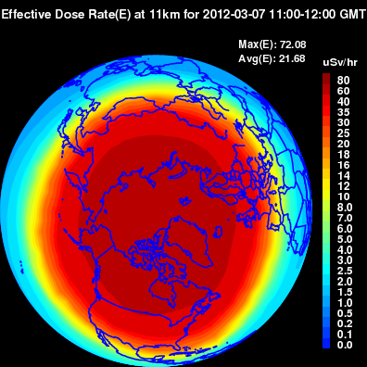
NAIRAS Model Predictions During March 2012 Solar Storm Events
Public Web site: http://sol.spacenvironment.net/~nairas/ (or google NAIRAS)

Slide 6
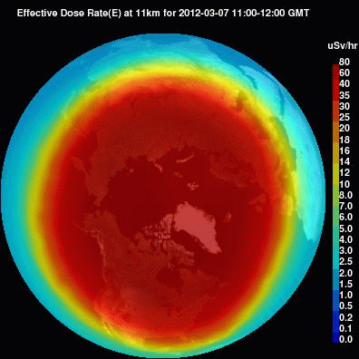
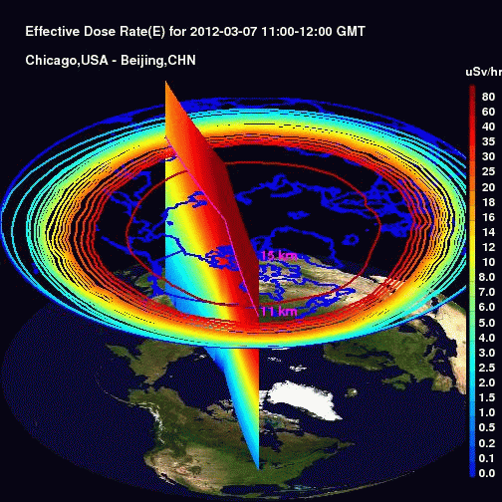
NAIRAS Model Predictions During March 2012 Solar Storm Events
Public Web site: http://sol.spacenvironment.net/~nairas/ (or google NAIRAS)

Slide 7
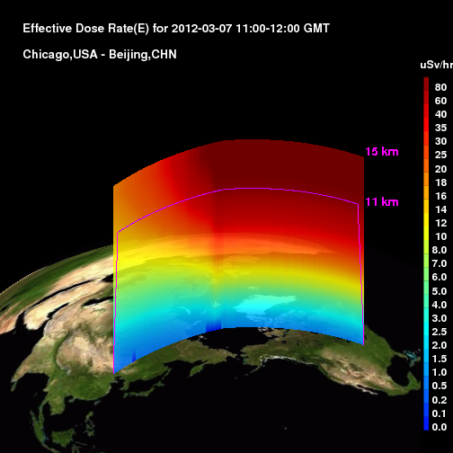
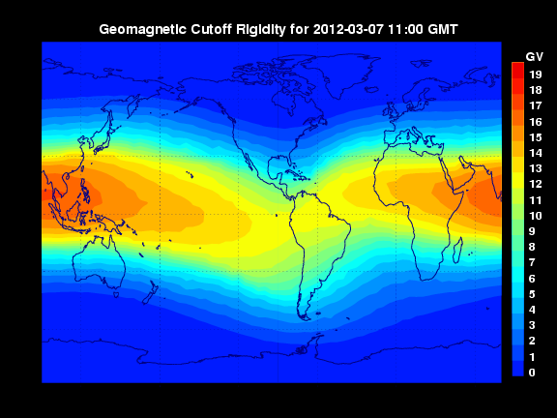
NAIRAS Model Predictions During March 2012 Solar Storm Events

Slide 8
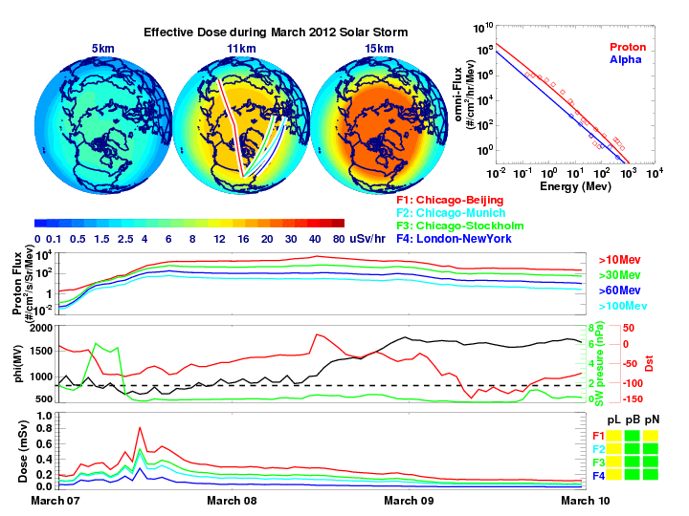
NAIRAS Model Predictions During March 2012 Solar Storm Events

Slide 9
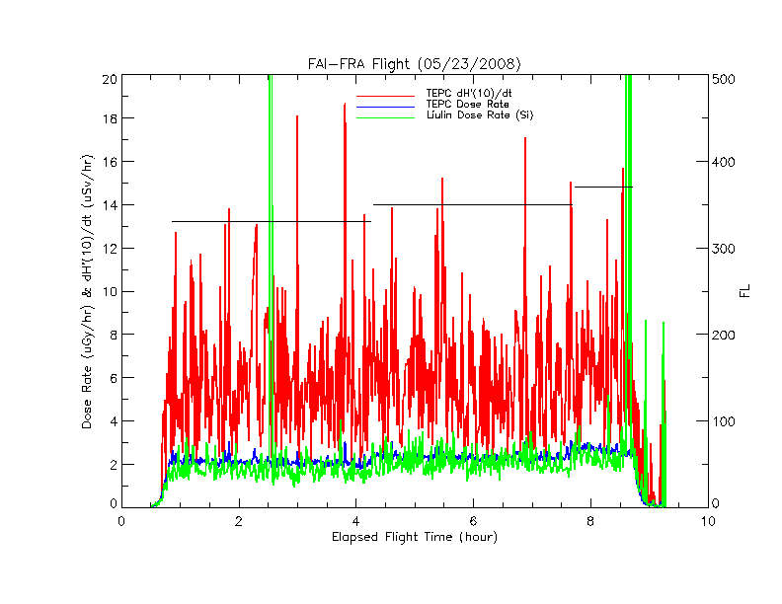
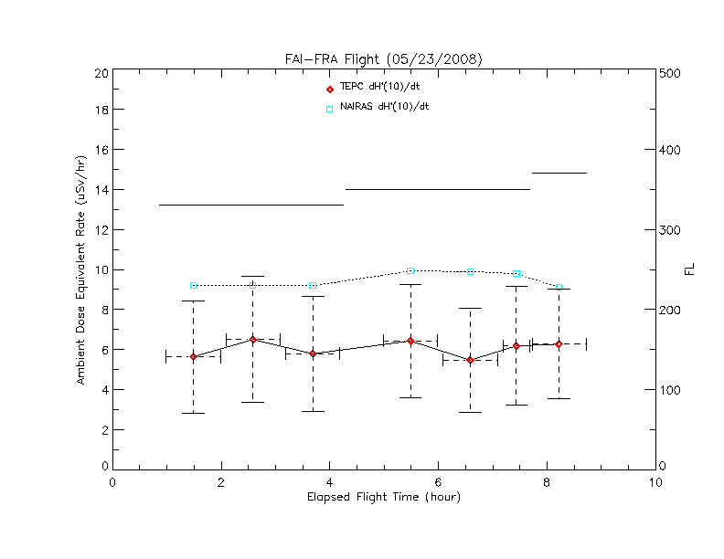
NAIRAS/DLR-TEPC Comparisons
High-Latitude Flight
TEPC data courtesy of Matthias Meier

Slide 10
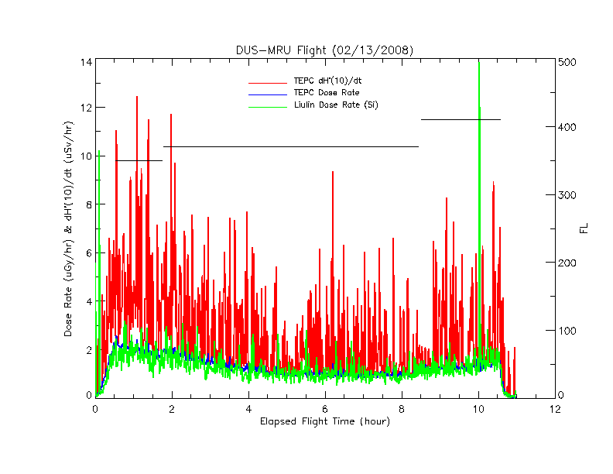
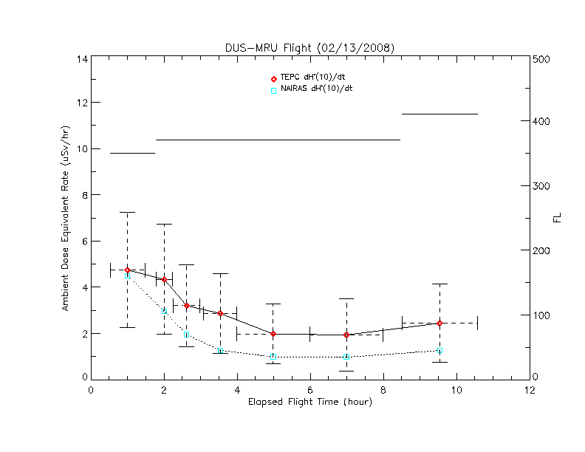
NAIRAS/DLR-TEPC Comparisons
Low-Latitude Flight
TEPC data courtesy of Matthias Meier

Slide 11
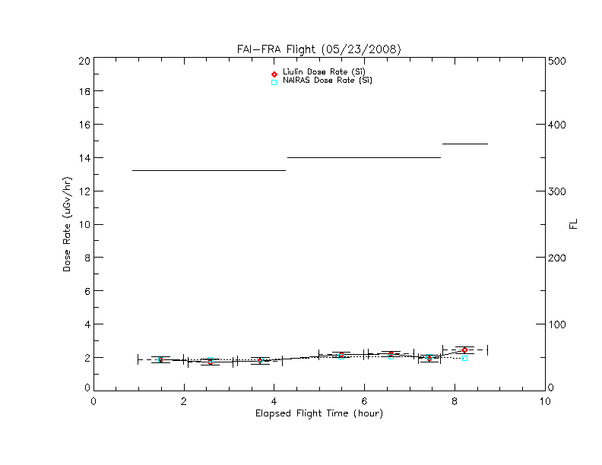
NAIRAS/DLR-Liulin Comparisons
High-Latitude Flight
Liulin data courtesy of Matthias Meier

Slide 12
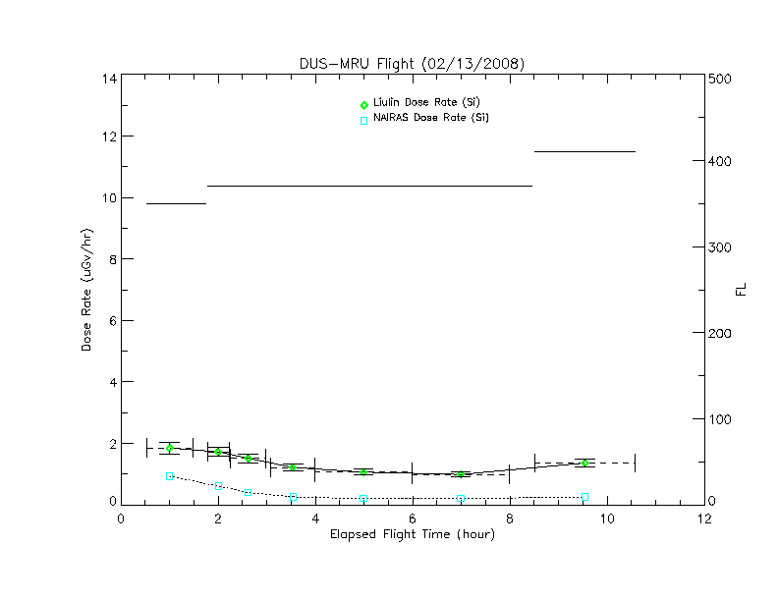
NAIRAS/DLR-Liulin Comparisons
Low-Latitude Flight
Liulin data courtesy of Matthias Meier

Slide 13
NAIRAS Partnership Structure
Research
NAIRAS Model Development
V&V
Operations
NOAA/SWPC/NWS
Commercial
Real-time Measurements (ARMAS)
Data Assimilation (ARMAS)
Cockpit Availability
Automated Aircrew Exposure Log

Slide 14
NAIRAS Future Plans and Activities
Atmospheric Radiation Measurements
Automated Radiation Measurement for Aviation Safety (ARMAS) Project
  Phase II SBIR awarded to Space Environment Technologies
  Measurement/Technology Goal: Global, real-time radiation measurements (FedEx partner)
  Modeling Goal: Data assimilative nowcast/forecast
Cosmic Ray KitSat Project
  Proposal to Hands-On Flight Experience (HOPE-4)
  High-altitude balloon Flight (~30-35 km)
  Science Objective: High-altitude radiation measurements and NAIRAS V&V
  Technology Objective: Develop CubeSat infrastructure for multi-satellite space weather monitoring

Slide 15
NAIRAS Future Plans and Activities
Model Development
NAIRAS Enhancements/Extensions Proposed to ROSES in March 2012
  Aircrew Interface
    Add a web interface customized for pilots
    Enable user entry of flight coordinates for exposure assessment
    Enable easy access of current and archived data/graphical products
  Civil/Commercial Space Transportation
    Extension to LEO
  Model Development
    SEP high-energy tail and spatial anisotropy
    Directional effects (cutoffs, transport ray trace)
    Pion/EM-cascade effects

Slide 16
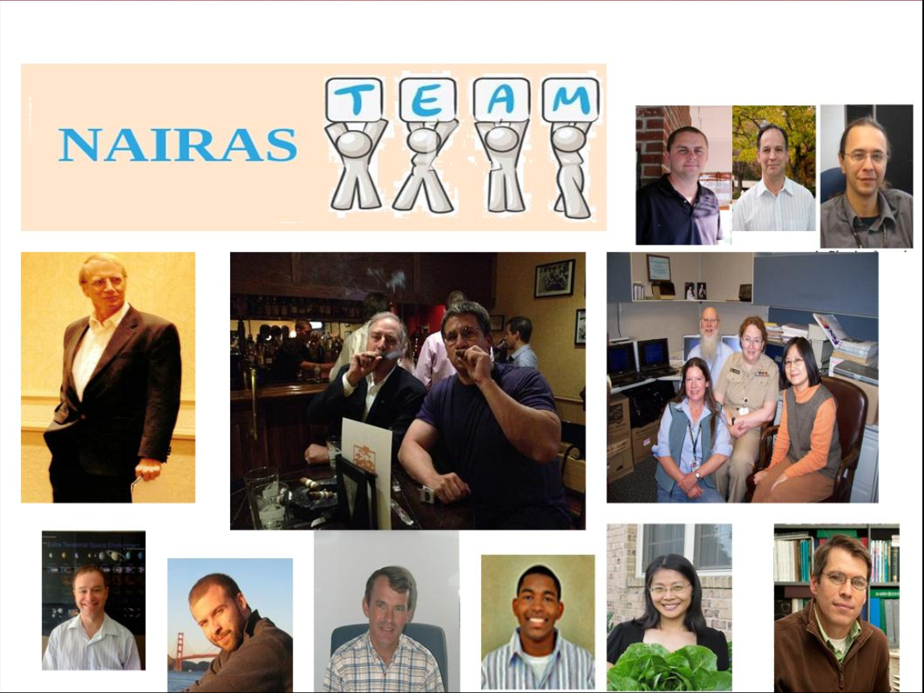

Slide 17
NAIRAS Team
Chris Mertens (PI), NASA Langley Research Center, Hampton, VA
  Cosmic ray transport; integration of NAIRAS models and data; V&V
  Kent Tobiska (Co-I; ARMAS PI), Space Environment Technologies, Inc, Pacific Palisades, CA
    Distributed data nerve center and conduit for input data – models – output data
  Brian Kress (Co-I), Dartmouth College, Hanover, NH
    Real-time magnetospheric transport / geomagnetic shielding model
  Mike Wiltberger and Stan Solomon (Co-I), NCAR/HAO, Boulder, CO
    Benchmark MHD magnetospheric magnetic fields
  Joe Kunches (Collaborator), NOAA/Space Environment Center, Boulder, CO
    Guidance on research-to-operations; interaction with commercial aviation industry
  Barbara Grajewski (Collaborator), CDC/NIOSH, Cincinnati, OH
    Aircraft radiation measurement data for V&V; epidemiological studies
  Steve Blattnig (Collaborator), NASA Langley Research Center, Hampton, VA
    Cosmic ray nuclear interactions; transport physics
  Xiaojing Xu (Collaborator), SSAI, Hampton, VA
    Scientific programming and data visualization tools
  Ryan Norman (Post-Doc Fellow), NASA Langley Research Center, Hampton, VA
    Cosmic ray nuclear interactions; transport physics

Slide 18
Backup Slides

Slide 19
Aircraft Radiation Exposure Recommendations and Actions
Europe
  EU Directive 96/29/EURATOM (1996)
  Legal regulations on radiation protection of aircrew implemented into national law with EU member states by 2000
  Exposures must be assessed if 1 mSv/yr is likely to be exceeded
  6 mSv/yr “action level” (ALARA principle)
    Individual record keeping and medical surveillance required
  Monitoring recommended under 6 mSv/yr
  German implementation
    Operational GCR radiation exposure assessment using approved code
    No approved operational SEP radiation exposure assessment
    Some airlines interested in concomitant radiation measurements
Japan
  State regulations recommend airlines try to keep aircrew exposure below 5 mSv/yr, which is the exposure dose limit for other occupationally exposed workers in Japan

Slide 20
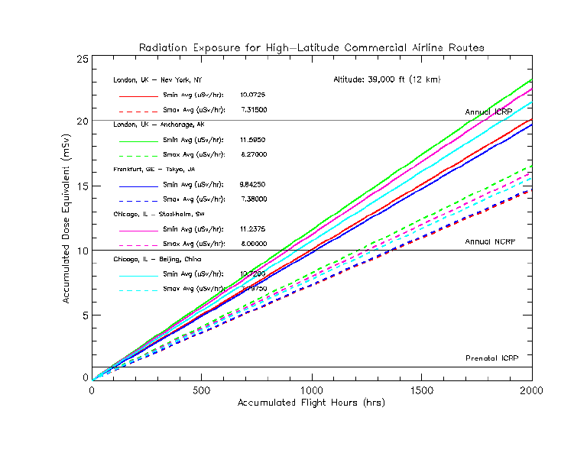
GCR Exposure
EU Action Level
ICRP Public/Prenatal

Slide 21
Aircraft Radiation Exposure
Medical Research
Cosmic rays can directly break DNA strands in biological tissue, or produce chemically active radicals in tissue that alter the cell function [Wilson et al., 2005, 2003]
  Both can lead to cancer
Other adverse health effects include, but are not limited to, reproductive disorder and prenatal injury [Lauria et al., 2006; Waters et al., 2000; Aspholm et al., 1999]
Because aircrew total career dose is received is low doses per flight, and accumulated slowly over the length of a flying career, the direct evidence that a person can develop cancer as a result of cosmic radiation is inconclusive
  Other lifestyle risk factors exist over a flying career
However, radiation protection community accepts the Linear No Threshold (LNT) theory
  Every radiation exposure will have an effect on human health

Slide 22
NIOSH’s flight crew program
(Grajewski)
Flight attendants may be at increased risk for adverse reproductive outcomes and certain cancers
Studies have also reported cancer excesses among pilots
Air cabin exposures with potential health impact include cosmic ionizing radiation and circadian rhythm disruption
NIOSH has a research program to address these issues
NIOSH studies include the first studies to assess career exposure to Solar Energetic Particle (SEP) events and retrospectively estimate dose based on records of flights flown by each crewmember

Slide 23
Grajewski
NAIRAS data can be expected to improve epidemiologic studies of flight exposures markedly compared to current methodology
NAIRAS has already improved NIOSH’s exposure assessment of this occupational group

Slide 24
Aircraft Radiation Exposure Recommendations and Actions
USA
  ICRP recommendations for occupational exposures (< 20 mSv/yr, < 1 mSv during pregnancy)
  ICRP recommendation during pregnancy (< 0.5 mSv in any month)
  ICRP recommendation for public (< 1 mSv)
Current development of SpWx/aircraft radiation requirements
Radiation measurements/predictions
CPWG
SpWx User Needs
ICAO
WMO
SpWx User Requirements
Radiation assessment
FAA SpWx AWG User Needs
FAA
NOAA/SWPC
ICAO: International Civil Aviation Organization

Slide 25
Cross Polar Working Group (CPWG)
(Kunches)
The 10th meeting of the CPWG was held at ICAO November 3-5, 2010
The user needs for space weather services were ratified
The user needs explicitly state the need to specify and predict the radiation environment for commercial aviation
NAIRAS is exactly designed to provide the information required by the CPWG mandate

Slide 26
Halloween 2003 Geomagnetic Storm
Cutoff Latitude of ~ 20 MeV protons
TS05 cutoff latitude accuracy: ~ 2-degrees
TS05 cutoff accuracy significantly better
LFM/MHD code
2-degree cutoff uncertainty in latitude
can translate into factor ~2 or greater aircraft
dose uncertainty

