Slide 1
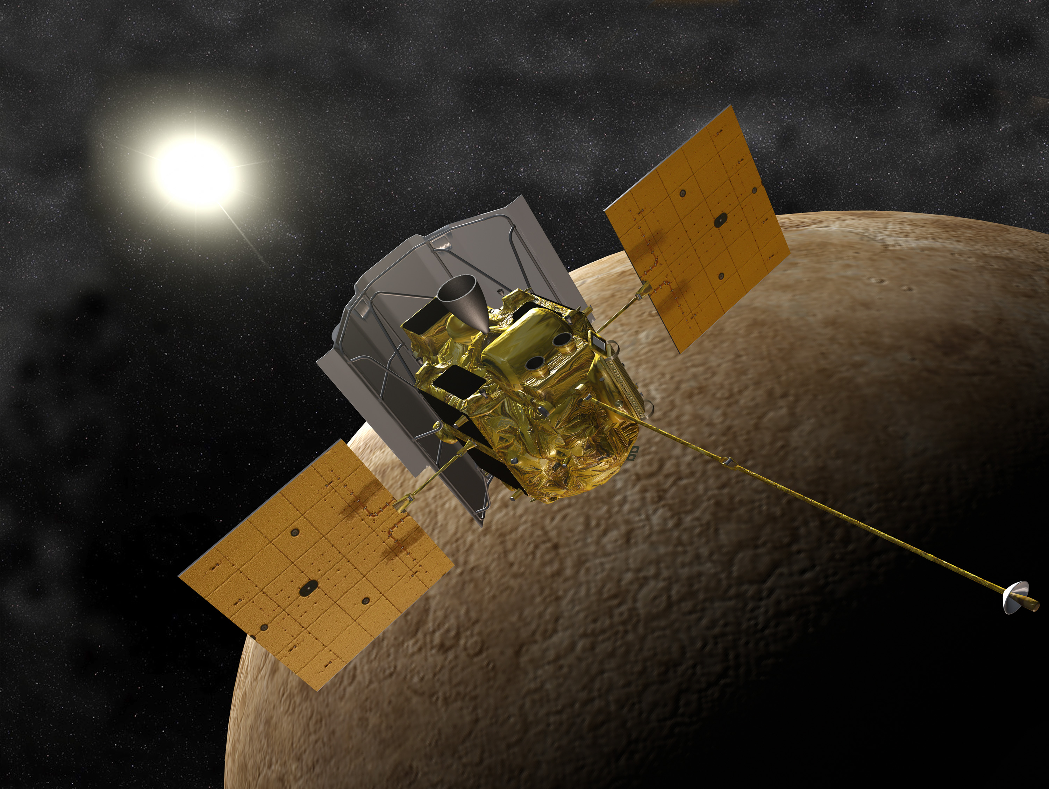
MESSENGER: Effects of AR1429
Robert E. Gold, and the MESSENGER Team
Johns Hopkins University Applied Physics Laboratory, Laurel, MD 20723, USA

Slide 2
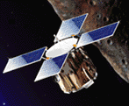
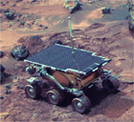
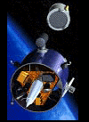
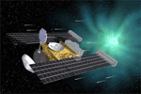
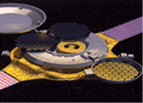
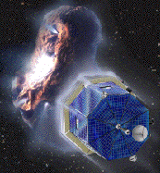
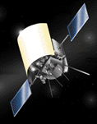
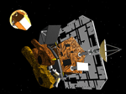
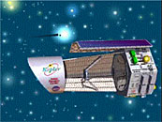
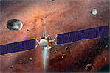
…is the 7th Discovery Mission
Discovery began as a NASA Program in FY 1994.
Program goal is frequent, small, scientifically focused missions.
Missions are led by a Principal Investigator
Mission proposals are competed and undergo rigorous scientific and technical reviews.
NEAR
Mars Pathfinder
Lunar Prospector
Genesis
Stardust
CONTOUR
MESSENGER
Deep Impact
Kepler
Dawn

Slide 3
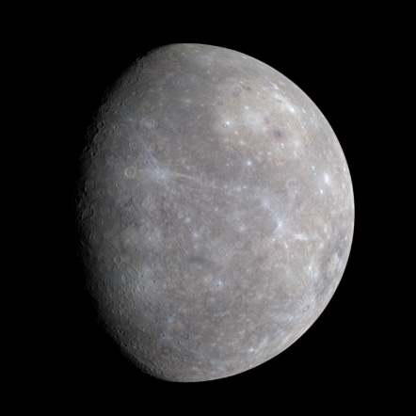
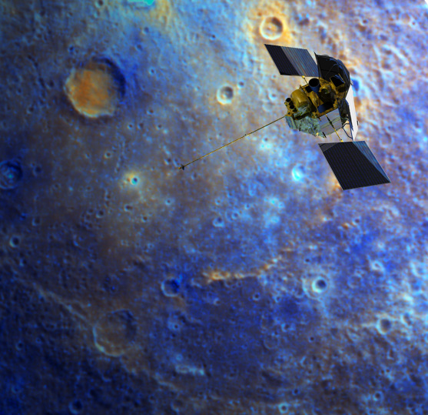
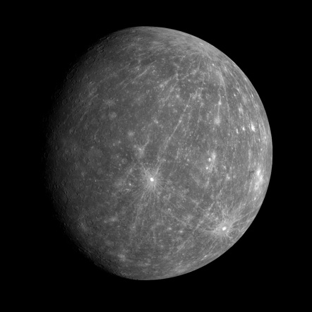
Team Members
Sponsor
Principal Investigator Sean C. Solomon, Carnegie Institution of Washington
Science Team: 47 scientists from 21 institutions
Project Management: APL
Spacecraft Development/Operations: APL
Propulsion: Aerojet
Structure: Composite Optics
Instruments: APL, Goddard Space Flight Center, University of Colorado Laboratory for Atmospheric and Space Physics, University of Michigan Space Physics Research Laboratory
NASA Headquarters Science Mission Directorate Discovery Program Office

Slide 4
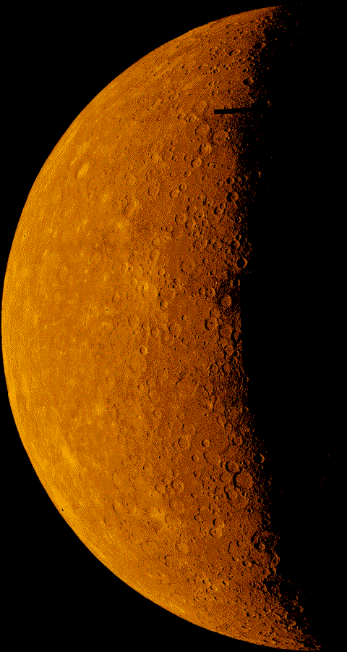
Mercury is a Planet of Extremes
Highest uncompressed density
Highest diurnal variation in temperature • 470 to -185 °C (875 to -300 °F)
Only solar system object in 3:2 spin-orbit resonance • Mercury solar day lasts 2 Mercury years
Geological history ended earliest among the terrestrial planets
Smallest planet with global magnetic field
Most Earth-like magnetosphere

Slide 5
Science Questions
MESSENGER Objectives
Map the elemental and mineralogical composition of Mercury’s surface
Globally image the surface at a resolution of hundreds of meters or better
Determine the structure of the planet’s magnetic field
Measure the libration amplitude and gravitational field structure
Determine the composition of the radar-reflective materials at Mercury’s poles
Characterize exosphere neutrals and accelerated magnetosphere ions
Why is Mercury so dense?
What is the geologic history of Mercury?
What is the nature of Mercury’s magnetic field?
What is the structure of Mercury’s core?
What are the unusual materials at Mercury’s poles?
What volatiles are important at Mercury?

Slide 6
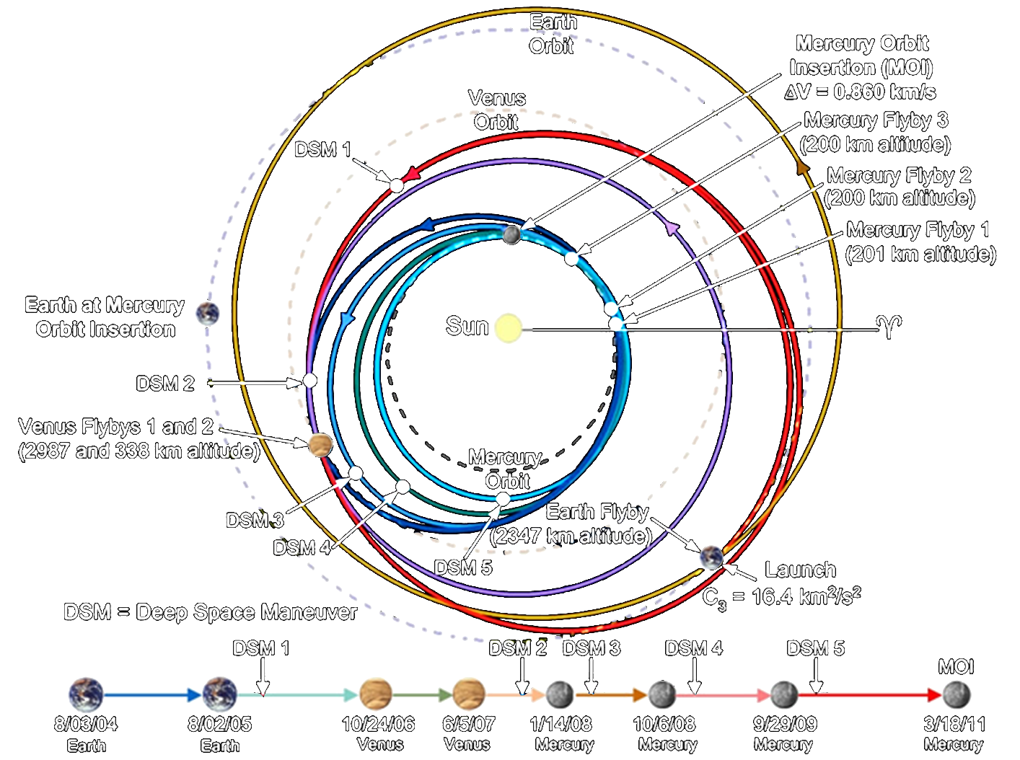
MESSENGER’s journey
to Mercury
over 15 trips around the Sun
Notes:
7.9 Billion km journey (1 AU ~ 150 Million km)
MESSENGER needs to speed up to catch Mercury
- Mercury orbital velocity about 48 km/s versus Earth’s orbital velocity of 30 km/s

Slide 7
Technology Challenges
Severe thermal environment
>14 kW/m² thermal input at Mercury (>130 W/ft²)
Front of S/C > 360° C (680° F)
S/C can be sandwiched between Sun and planet
Desire to use standard space electronics
Extreme propulsion required
> 2300 ms⁻¹ (5150 mph) in-space propulsion to get into Mercury orbit
Implies very tight mass constraints
Power generation at high temperatures
Solar panels can reach 270° C (520° F)
Communications reliability
Keep antenna from thermal extremes
Return > 75 Gbits from Mercury
Need to operate cryocooled detector at Mercury

Slide 8
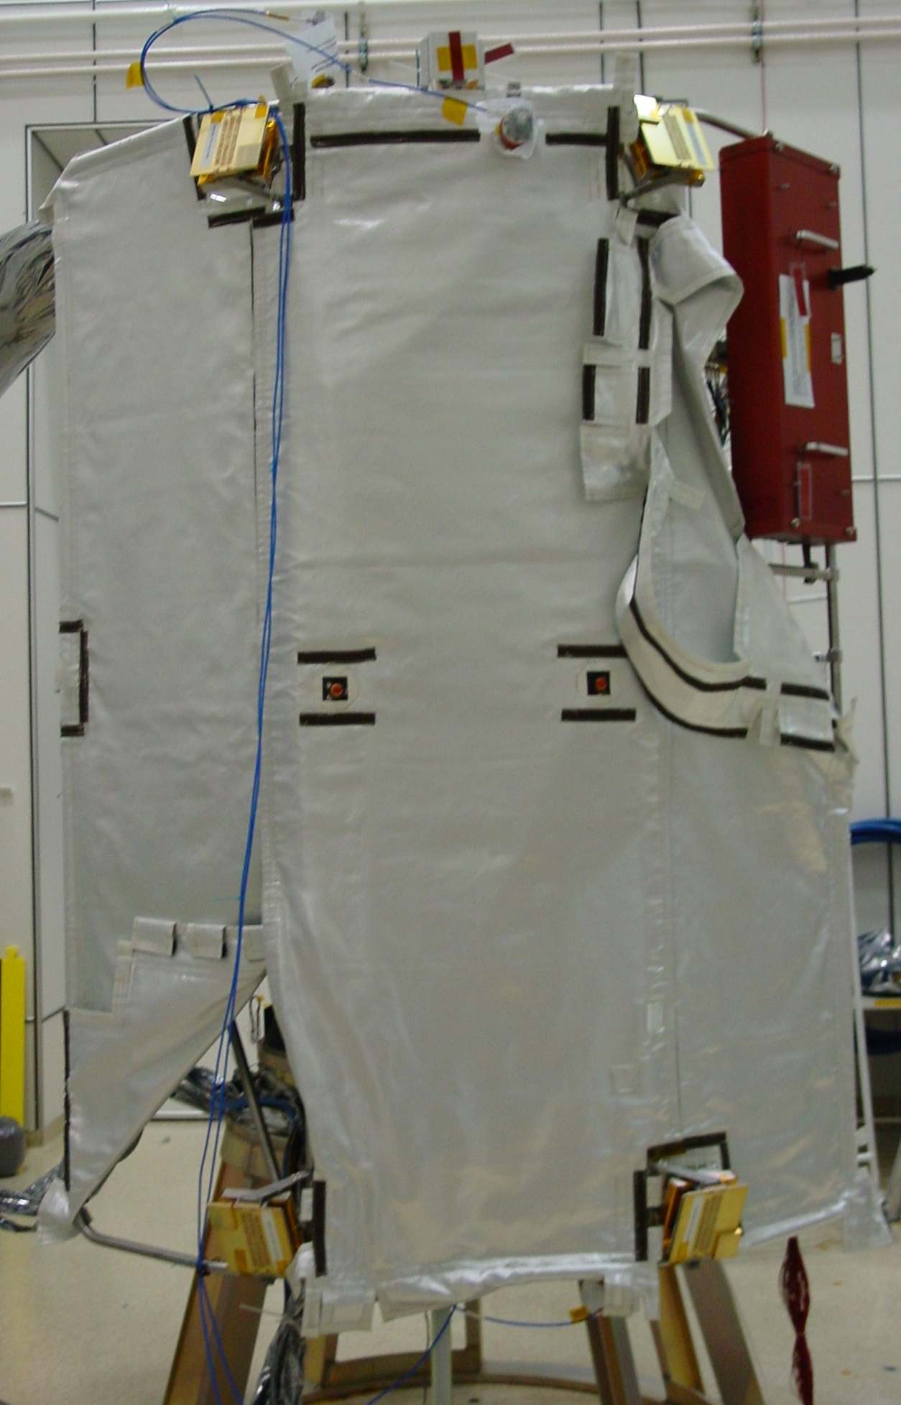
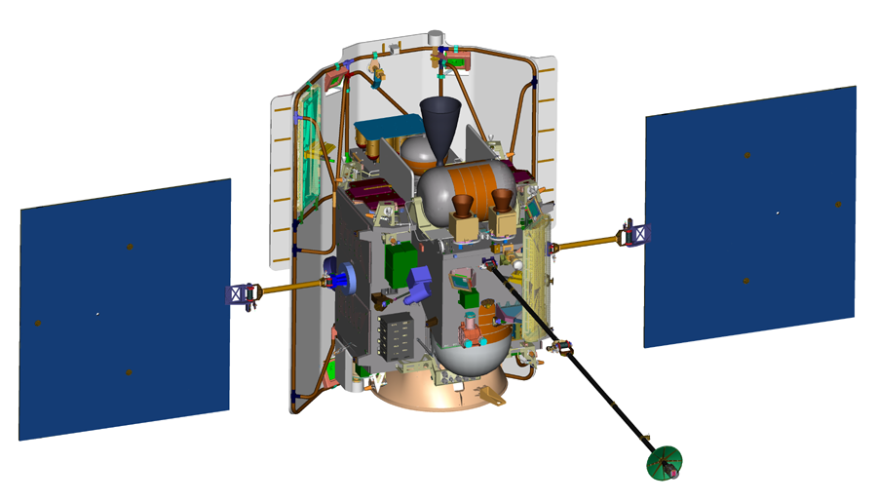
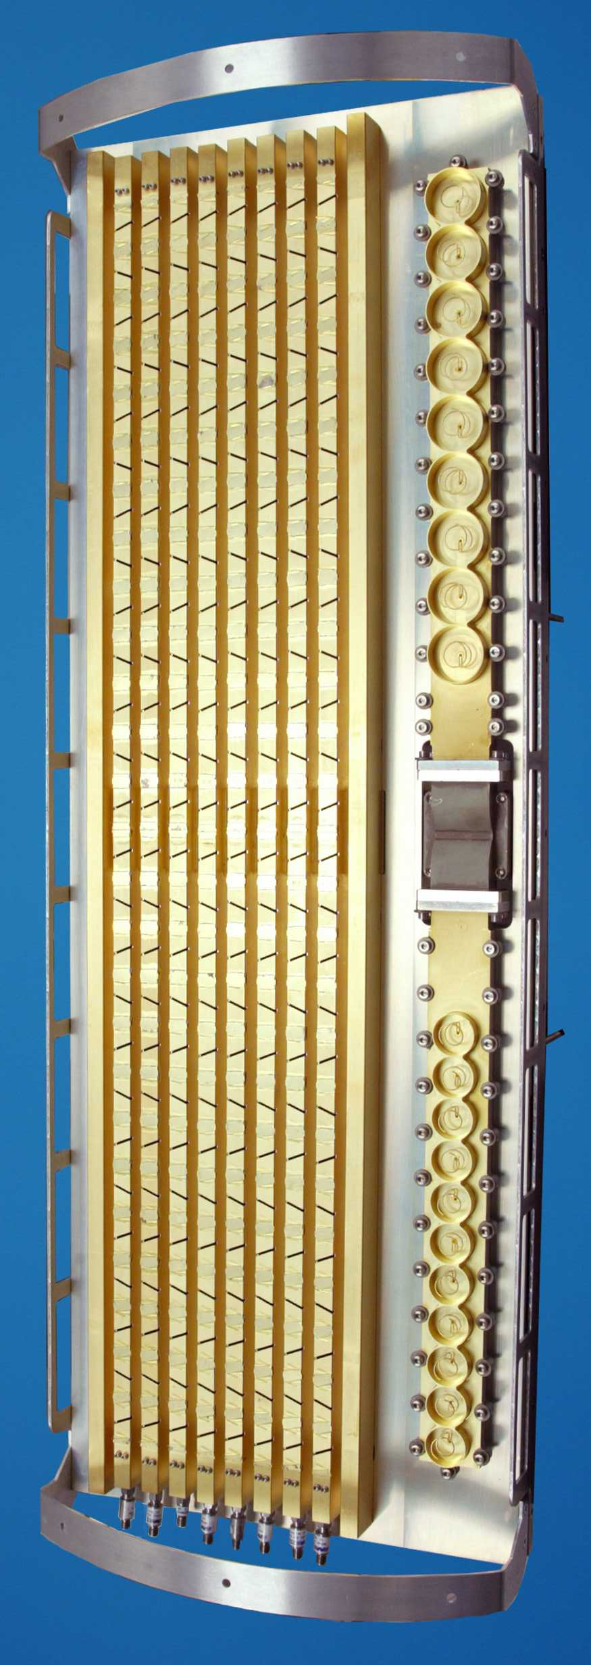
Spacecraft Enabling Technologies
Ceramic cloth sunshade
667-N bi-prop thruster
Low mass, carbon fiber structure
Phased array high-gain antenna
3 large custom propellant tanks
Key Characteristics:
1100 kg total mass
2300 m/s ΔV capable
>720 W orbit power
Solar panels are 2/3 mirrors
Custom aluminum launch vehicle adapter

Slide 9
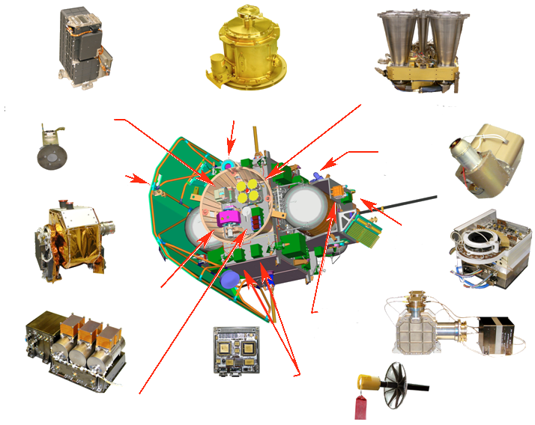
Comprehensive Payload
Mercury Atmospheric and Surface Composition Spectrometer (MASCS)
Gamma-Ray Spectrometer (GRNS/GRS)
Mercury Laser Altimeter (MLA)
Fast Imaging Plasma Spectrometer (EPPS/FIPS)
X-Ray Spectrometer Solar Assembly (XRS/SAX)
Energetic Particle Spectrometer (EPPS/EPS)
Mercury Dual Imaging System (MDIS)
Neutron Spectrometer (GRNS/NS)
Data Processing Unit (DPU)
Magnetometer (MAG) [at end of boom - not shown]
X-Ray Spectrometer Mercury Unit (XRS/MXU)

Slide 10
Spacecraft Must Be Robust
MESSENGER is the innermost space weather monitor in the solar system
It is vulnerable, being so close to the Sun
An attitude upset at 0.3 – 0.5 AU could quickly be fatal
Solar particle events can be extreme at 0.3 AU
Solar panels will degrade above 180 C
MESSENGER built with rad-hard parts
Some parts were not as hard as advertised

Slide 11
Solar Activity
Increased solar activity may lead to temporary data corruption in some instruments during solar particle events, but no permanent damage is anticipated.
XRS, GRS, and NS all have internal protection that will put them into safe mode during the peak of the events.
Prevents excessive rates in photo-multiplier tubes and proportional counters
MASCS and MDIS data may see high backgrounds near the peak of particle events.
EPS and FIPS can handle very large event rates without problems; rates above those will temporarily saturate the data.
MAG and MLA are mostly immune to large particle fluxes.
Instrument memory chips have proven to be slightly more vulnerable to bit flips than originally anticipated.
About a half dozen bit-flip events have been seen in seven years.
Routine instrument memory checking was instituted during the cruise phase.
If flipped bits are detected, the instrument is power cycled.

Slide 12
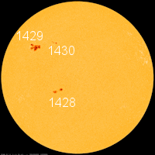
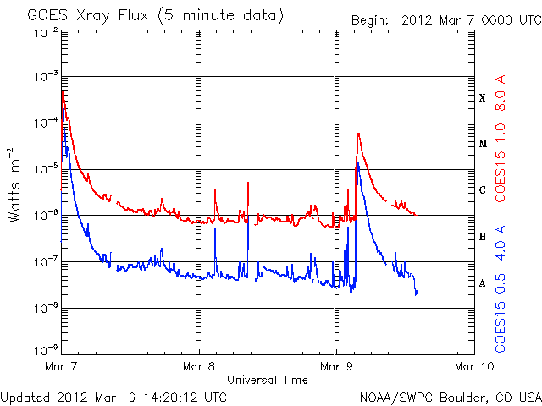
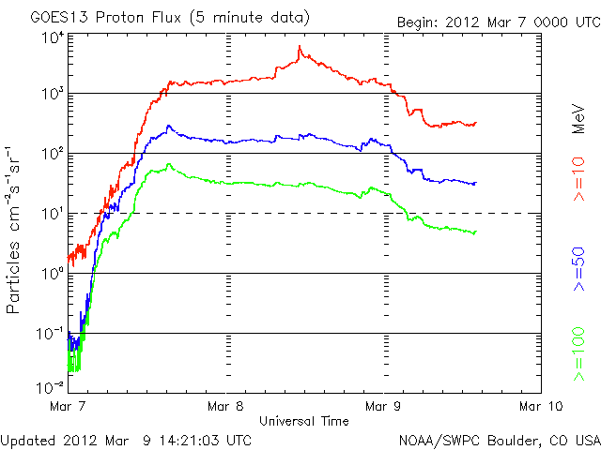
Active Region 1429
Large active region appeared on the Sun in early March, 2012
Region produced several large flares
Most intense observed during 8 years of mission
X5.4 flare on March 7 and additional large flares over the next few days
X5.4 X-Ray Flare
>100 MeV Protons

Slide 13
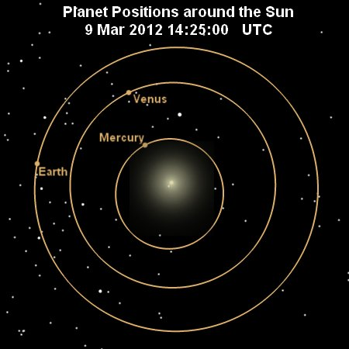
Effects of AR 1429 Events
MESSENGER well-connected to flare site at ~0.4AU
11 anomalies from solar events
Temporary effects in attitude control and 5 of the 7 instruments
Some changes were permanent
Loss of sensitivity, resolution, gain
Partially fixed by anneal or voltage adjustment
All other subsystems were unaffected

Slide 14
Specific Effects of AR1429
CCD-based star trackers would not lock onto stars; power cycled to fix
Images had hot pixels and “stars” from penetrating particles
Gamma-ray (GRS) and Neutron (NS)spectrometers had very high counting rates and went into safe mode that turned off high voltages
GRS processor had single event upset in code space and automatically turned instrument off
GRS high-purity germanium detector sustained radiation damage that degraded energy resolution
NS had single event upset outside code area

Slide 15
Specific Effects of AR1429 -2
Very high NS count rates caused PMT gain shift
Energetic Particles and Plasma Spectrometer (EPPS) had multiple single event upsets
X-Ray Spectrometer (XRS) solar monitor radiation damage increased its leakage current
Mercury Atmospheric and Surface Composition Spectrometer (MASCS) processor RAM had single event upset in code path that turned it off
Magnetometer and Laser Altimeter were unaffected

Slide 16
Mitigations
Single event upsets were fixed by power cycling or manual content restoration
No permanent effects
Radiation damage in GRS germanium detector and XRS solar monitor were partially removed by annealing the detectors
Only partially recoverable
Gain loss in the NS PMT was corrected by raising its voltage

Slide 17
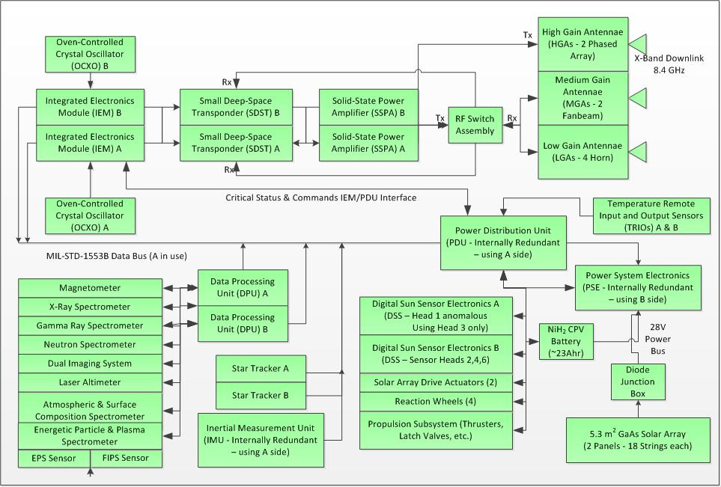
Affected Subsystems
Data Quality
SEU
Rad Damage
Gain Shift

Slide 18
What is the Future?
In Mercury orbit ~1.5 yrs (6 Mercury yrs)
MESSENGER continues to discovery the morphology and history of this exciting planet
Just approaching solar max, so future AR1429s may arise
Stretched color image of Mercury

Slide 19
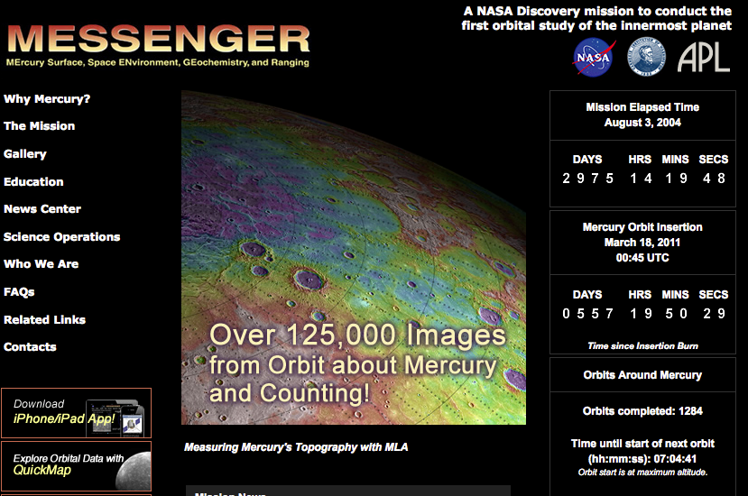
Follow Mission Progress
http://messenger.jhuapl.edu

