Slide 1
Inner Magnetosphere Transport
and Acceleration Model
(IMPTAM)
Natalia Ganushkina
University of Michigan, Ann Arbor MI, USA
Finnish Meteorological Institute, Helsinki, Finland/
The 11th CCMC Community Workshop, June 3-7, 2024, College Park, Maryland, USA

Slide 2
IMPTAM
(Inner Magnetosphere Particle Transport and Acceleration Model)
The inner magnetosphere particle transport and acceleration model:
follows distributions of ions and electrons with arbitrary PA
from the plasma sheet to the inner L-shell regions
with energies reaching up to hundreds of keVs
in time-dependent magnetic and electric fields.
distribution of particles is traced in the guiding center, or drift, approximation
In order to follow the evolution of the particle distribution function f and particle fluxes in the inner magnetosphere dependent on the position, time, energy, and pitch angle , it is necessary to specify:
(1) particle distribution at initial time at the model boundary;
(2) magnetic and electric fields everywhere dependent on time;
(3) drift velocities;
(4) all sources and losses of particles.
Magnetic field model: T96 (Dst, P_{sw}, IMF B_{y} and B_{z}) (TS05)
Electric field model: Boyle (V_{sw}, IMF B, B_{y}, B_{z})
Boundary conditions:
n and T by Dubyagin et al. (2016) (V_{sw}, IMF B_{z}, N_{sw})
Losses given as electron lifetimes: Shprits and Orlova (2014) and Orlova et al. (2016) electron lifetimes due to chorus and hiss WPI (Kp, magnetospheric magnetic field)

Slide 3
IMPTAM driving parameters and output
IMPTAM is driven by
(1) Solar wind number density NSW,
(2) Solar wind dynamic pressure PSW,
(3) Solar wind velocity VSW,
(4) IMF BY , BZ, and BIMF,
(5) Dst index,
(6) Kp index.
If these driving parameters are available in near real time, IMPTAM can provide the nowcast of keV electron fluxes in the inner magnetosphere.
If the parameters can be forecasted some time in advance, then IMPTAM can forecast these keV electrons.
The output from IMPTAM model for electrons:
4D electron distribution functions dependent on the radial distance R, the
longitude (MLT), particle pitch angle and particle energy.
The IMPTAM grid consists of
30 intervals in R from 2 to 10, 60 intervals in MLT,
23 steps in pitch angle from 0◦ to 90◦, and
45 intervals in energy from 1 to 300 keV.

Slide 4
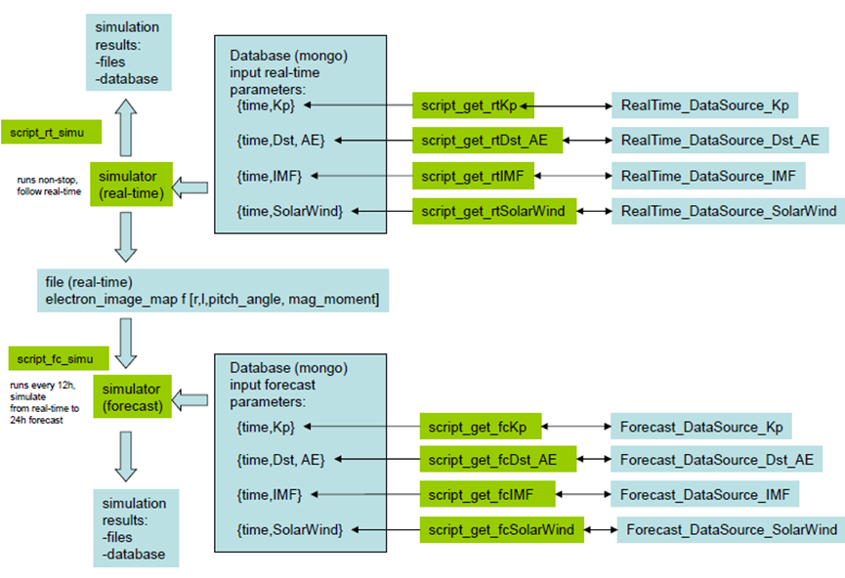
IMPTAM architecture
Near real time
Forecast
IMPTAM for keV electrons has been run online in near-real time, although not continuously, at different platforms since February 2013.
Two simulations which can go in parallel: real-time and forecast simulations.
All the input parameters go to the Mongo database .The simulator downloads the input parameters from the database, runs the simulation and outputs the results.

Slide 5
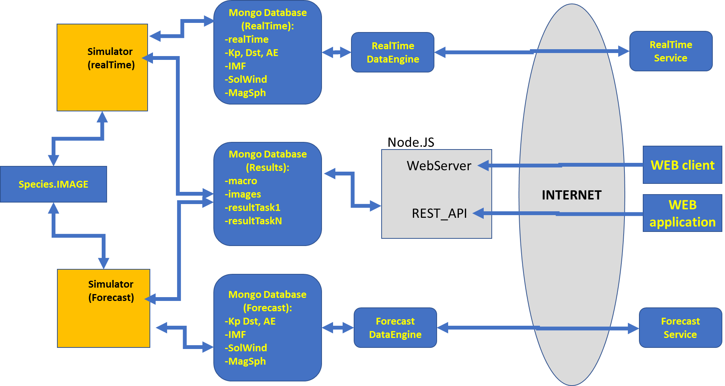
A web service to present and deliver
IMPTAM simulation results
imptam.engin.umich.edu
imptam.fmi.fi
The IMPTAM web service is connected to MongoDB, where IMPTAM simulation results can be stored and downloaded. The IMPTAM web service presents IMPTAM simulation results as different plots and saves current and past output data files into the archive.

Slide 6
IMPTAM at CCMC
No MongoDB, json file inputs
Near real time
Input parameters provided inside CCMC
Run on request
RoR
Run on request:
Time period is
set by user
1 day can be simulated in 1 hour (low resolution and other tricks)
Input parameters provided inside CCMC

Slide 7
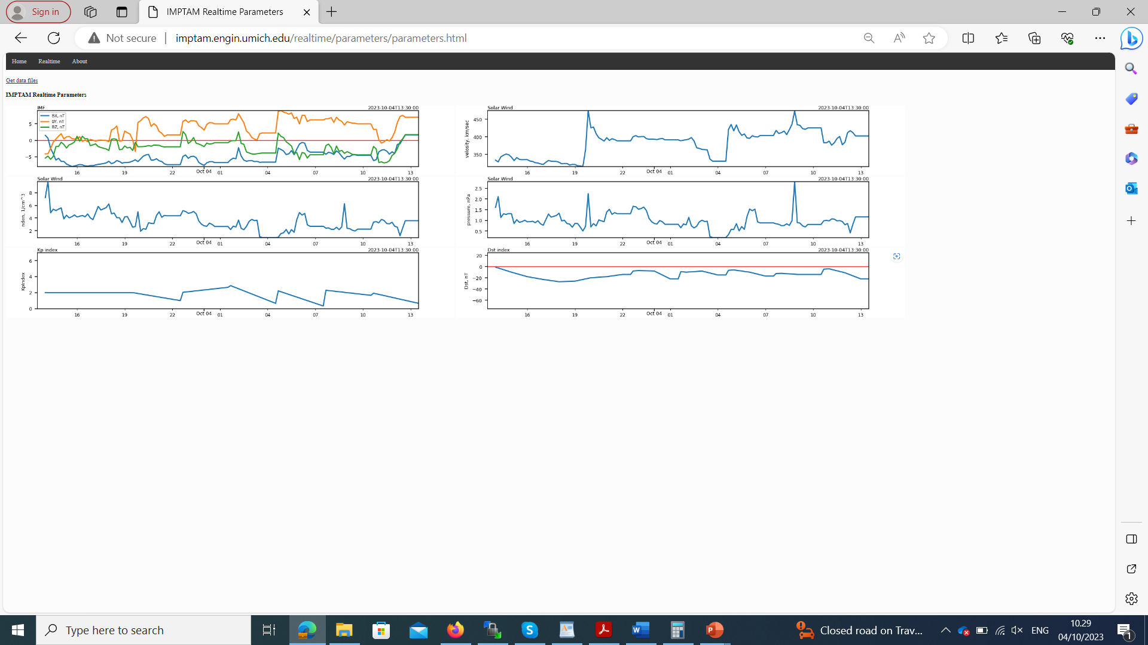
Real time IMPTAM driving parameters
Get data files
(1)
(2)
(3)
(4)
(5)
(6)
IMPTAM is driven by
IMF B_{Y} , B_{Z}, and B_{IMF},
Solar wind velocity V_{SW},
Solar wind number density N_{SW},
Solar wind dynamic pressure P_{SW},
Kp index,
Dst index.
Solar wind and IMF data: http://services.swpc.noaa.gov/products/solar-wind/,
Kp index:
http://www-app3.gfz-potsdam.de/kp_index/qlyymm.tab,
Dst index:
http://wdc.kugi.kyoto-u.ac.jp/dstae/index.html.

Slide 8
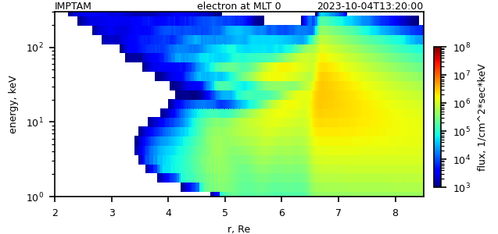
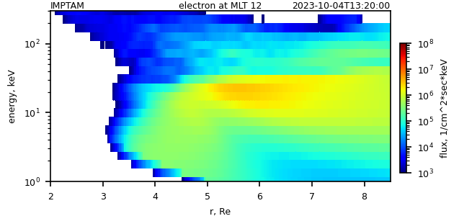
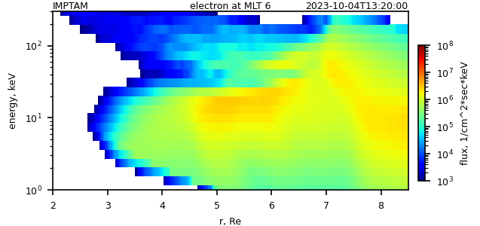
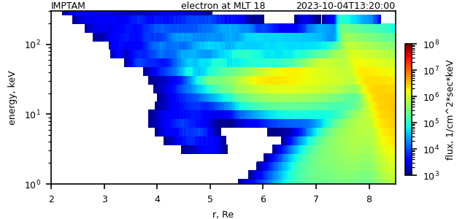
Real time IMPTAM maps and spectrograms for keV electron fluxes (also for H+, O+, He+)
Get data files

Slide 9
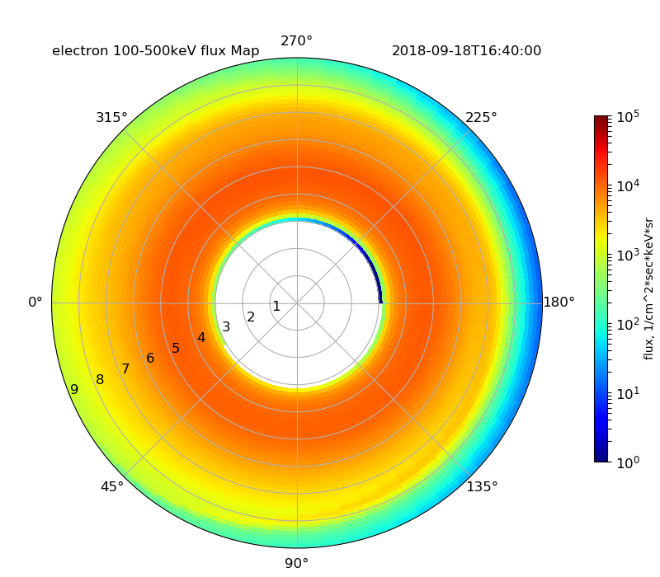
Real time IMPTAM keV electron fluxes at GEO
Get data files
GEO
MEO
VAP

Slide 10
Real time IMPTAM keV electron fluxes at MEO
Get data files
GEO
MEO
VAP

Slide 11
Real time IMPTAM keV electron fluxes at GTO
Get data files
GEO
MEO
VAP

Slide 12
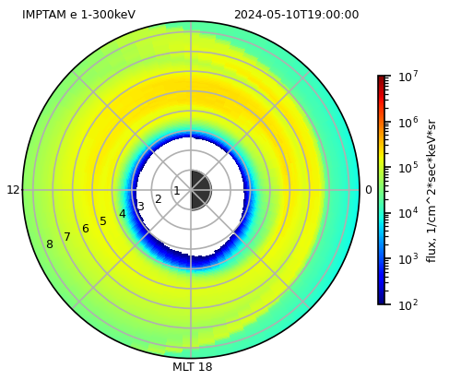
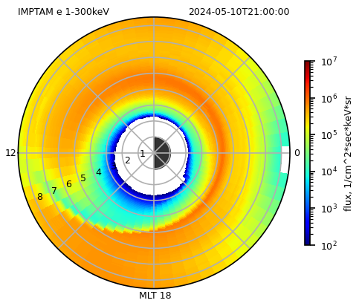
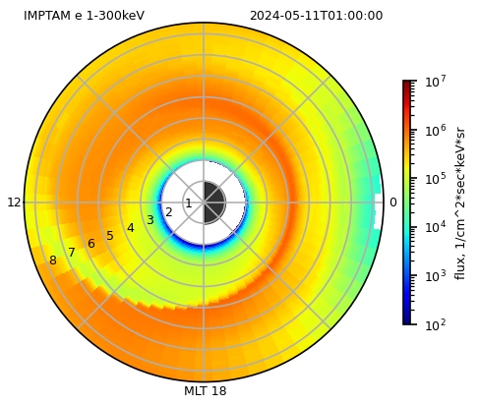
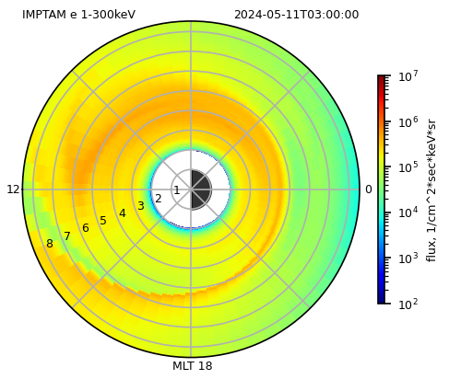
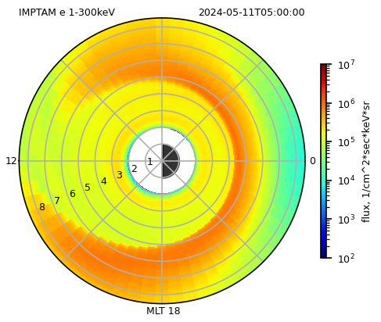
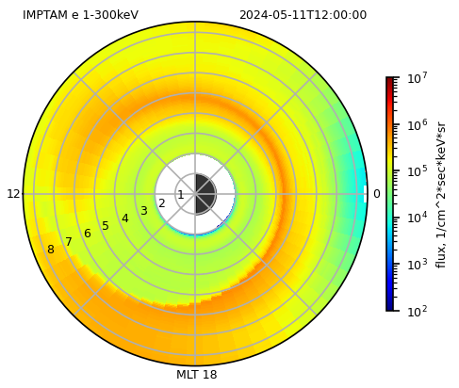

Slide 13
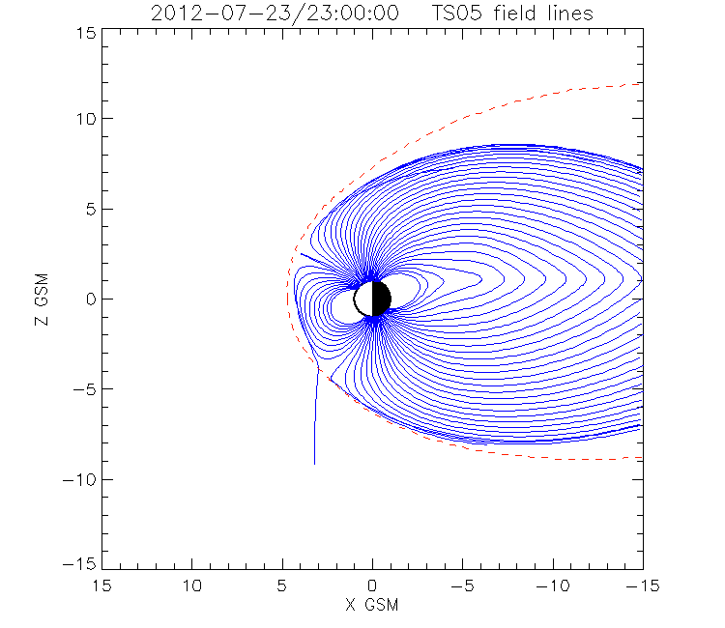
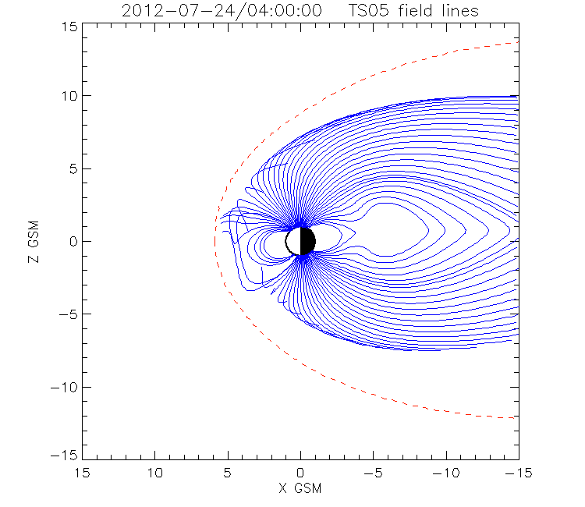
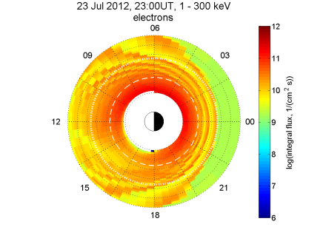
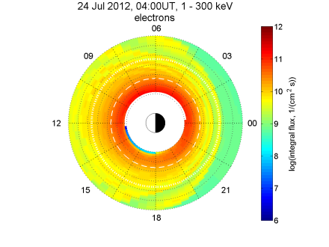
Large CME-driven storm, July 23-24, 2012
(event that missed the Earth)
Dst = -500 nT, Psw=300 nPa, Vsw = 3000 km/s
1st Dst drop
Dst min
STEREO-A observations,
Wang-Sheerley-Arge, ENLIL model,
Temerin and Li (2006) Dst predictive model
Magnetosphere becomes so compressed on the dayside and so stretched on the nightside that electrons are lost, they happen to be on larger L-shells.

