Slide 1
AMPS (Adaptive Mesh Particle Simulator)
Valeriy Tenishev, Yinsi Shou

Slide 2
Adaptive Mesh Particle Simulator (AMPS)
Adaptive Mesh Particle Simulator (AMPS)
  Semi-implicit PIC
  Numerical Scheme: Direct Simulation Monte Carlo (DSMC)
  Modeling of the neutral and charged species, neutral and charged dust
  AMR with cut cells
Kinetic description
    Boltzmann equation – dusty gas and plasma
    Parker, Focused transport equations – SEP and GCR
    The evolution of the system is modeled by tracing the model particles
    Collision regimes: transitional to collisionless
Two-phase flow modeling (neutrals, ions, neutral and charged dust)
Relativistic
Included processes
  Electron impact, charge exchange, photolytic reactions
  Gas/surface interaction (adsorption, desorption, scattering)
  Charging of the dust grains
Valeriy Tenishev
Technical Presentation

Slide 3
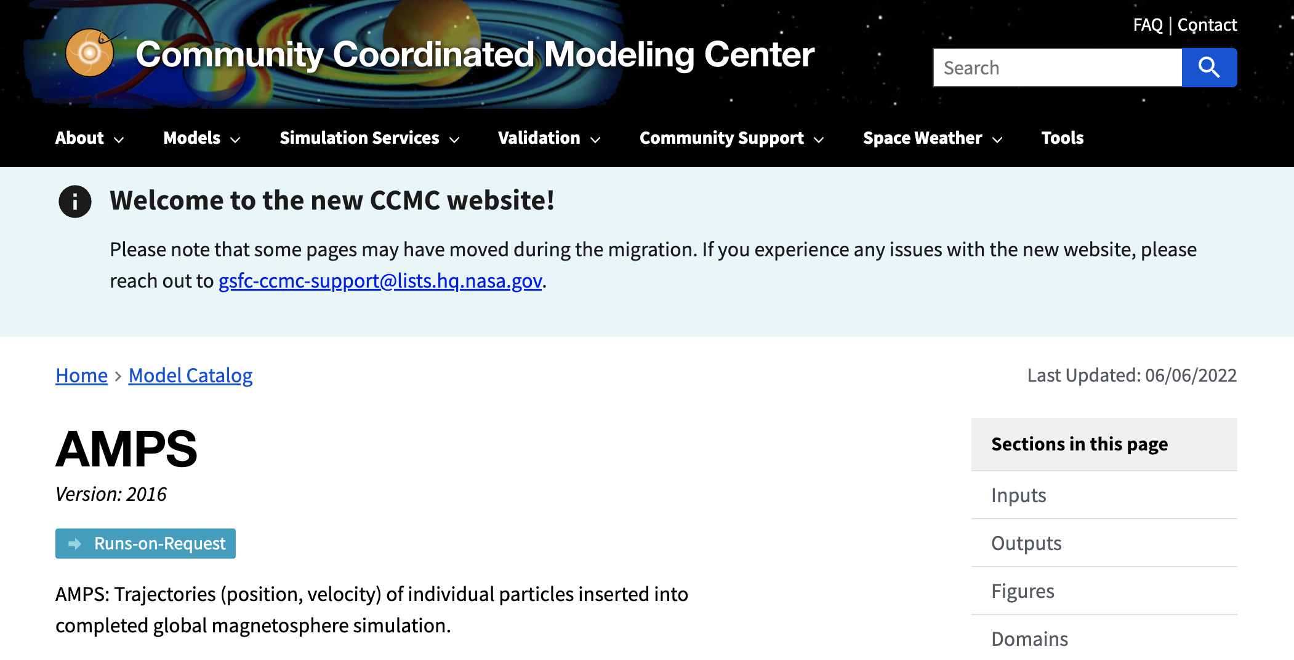
AMPS in CCMC
Valeriy Tenishev
CCMC Workshop, 2022

Slide 4
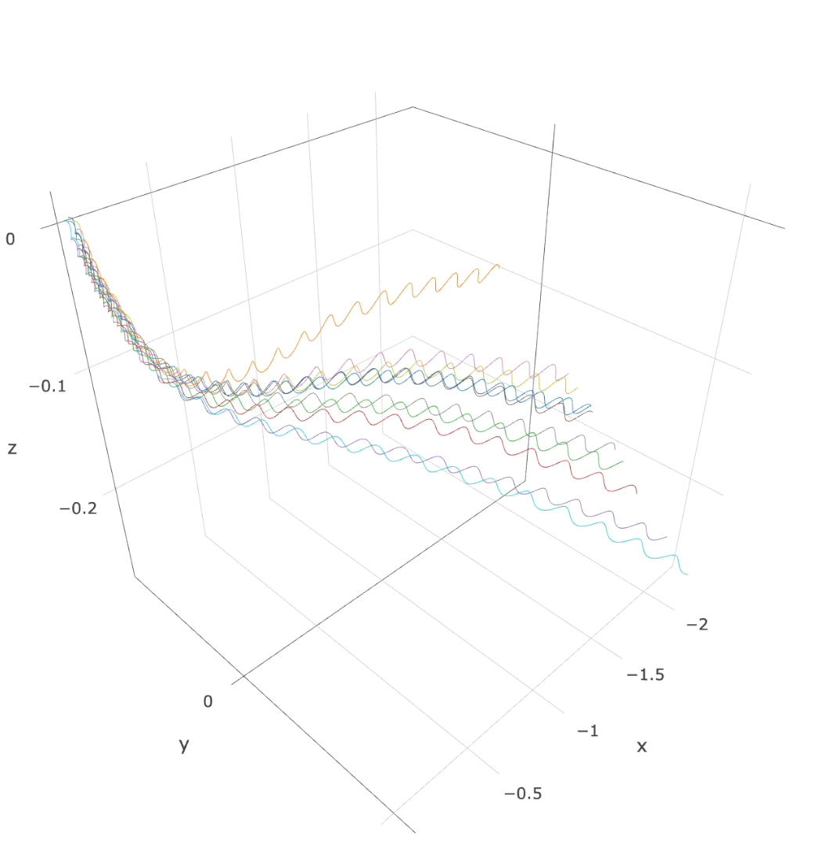
AMPS in CCMC
Analyze charged particle trajectories moving in plasma
  Post processing tool: use pre-calculated plasma and magnetic field
Import of the plasma flow simulations into AMPS
  Time-dependent results of the plasma modeling is saved in files
Output
  Individual particle trajectories
  Samples of the distribution functions
Particle trajectory integration in AMPS
  Trajectory affected by the Lorentz force
  Particle tracking along a magnetic field line
Valeriy Tenishev
CCMC Workshop, 2022

Slide 5
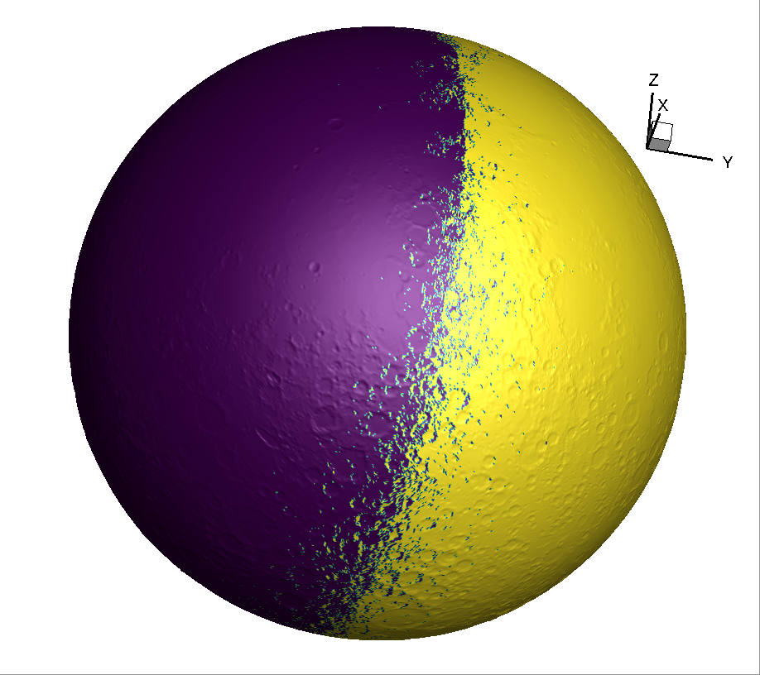
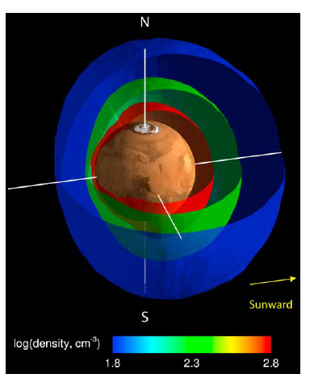
AMPS in Planetary Applications
Applications:
Planetary exospheres:
Using the surface topology and shadow calculations in modeling exospheres
Three-dimensional representation of the Martian
hot corona.

Slide 6
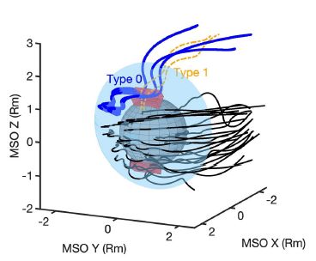
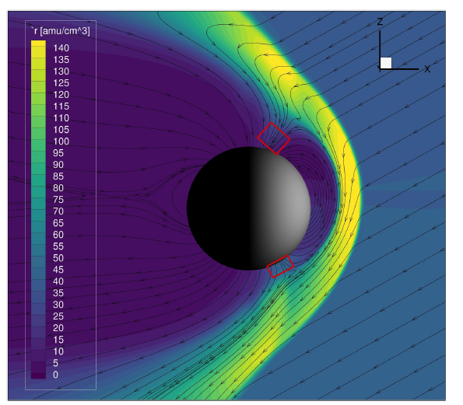
AMPS in Magnetospheric Research
Applications:
Planetary exospheres
Kinetic ion dynamics in magnetospheres
A global view of sample NA+ ion trajectories in Mercury’s magnetosphere

Slide 7
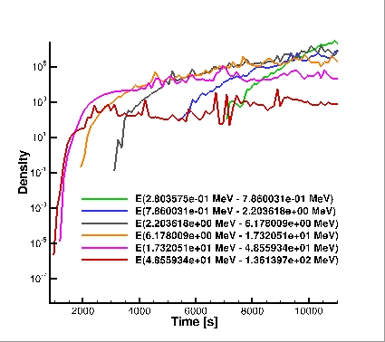
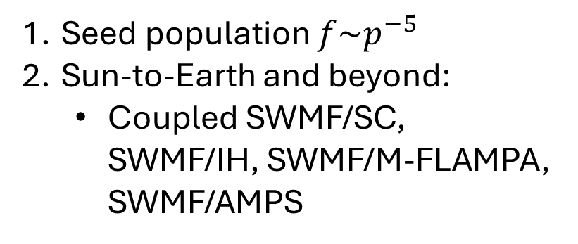
AMPS for SEP in heliosphere
Seed population $f\sim p^{−5}$
Sun-to-Earth and beyond:
  Coupled SWMF/SC, SWMF/IH, SWMF/M-FLAMPA, SWMF/AMPS
Valeriy Tenishev
CCMC Workshop, 2022

Slide 8
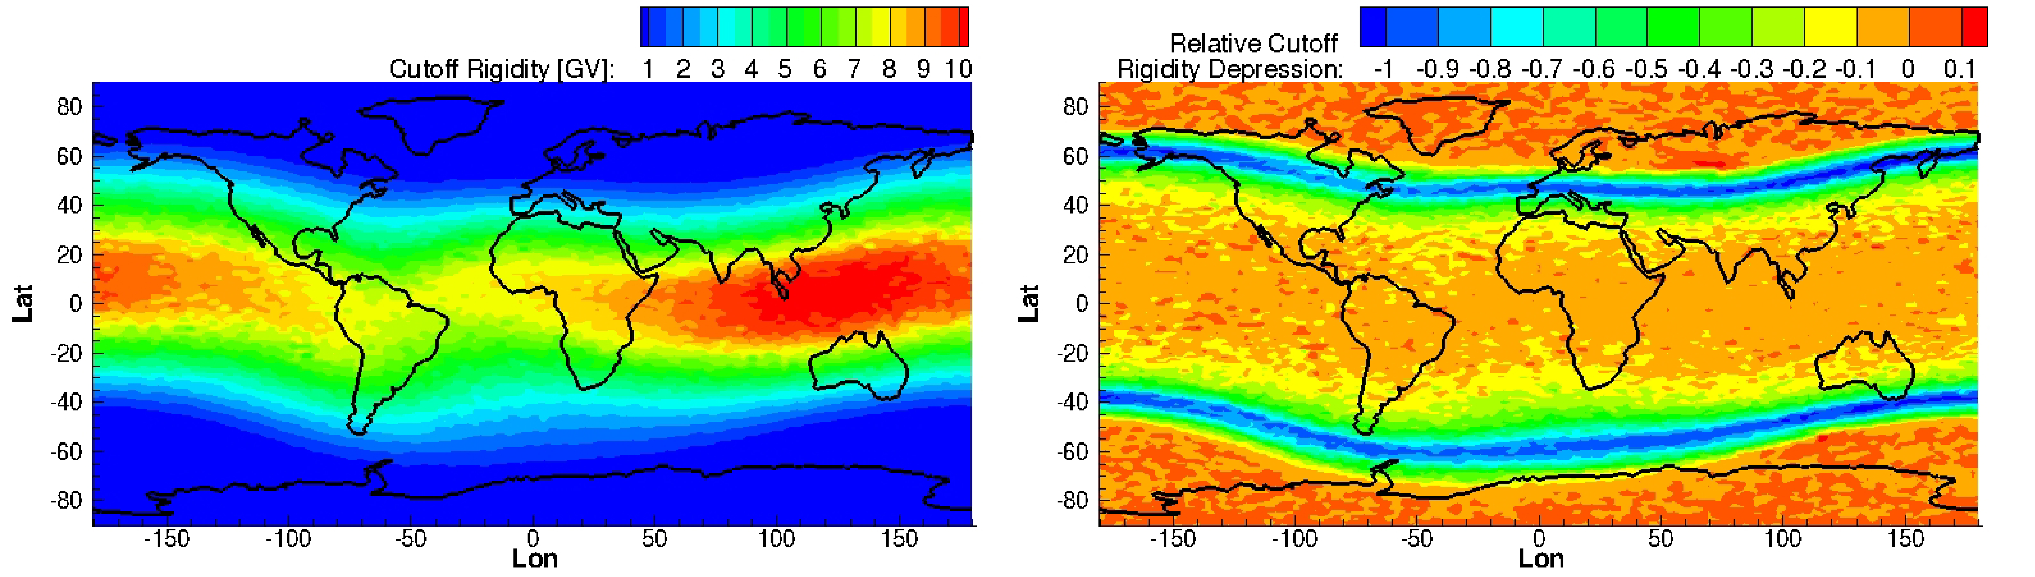
AMPS in geospace: Rigidity cutoff
Suppression of the rigidity cutoff during a geomagnetic storm.
The calculation was performed for conditions of the geomagnetic storm on March 17, 2015. In general, rigidity cutoff suppression is more significant in the mid-latitude region.
Rigidity cutoff map
The map is calculated for an altitude of 500 km.
Rigidity cutoff map calculated for quiet geomagnetic conditions.
Valeriy Tenishev
CCMC Workshop, 2022

Slide 9
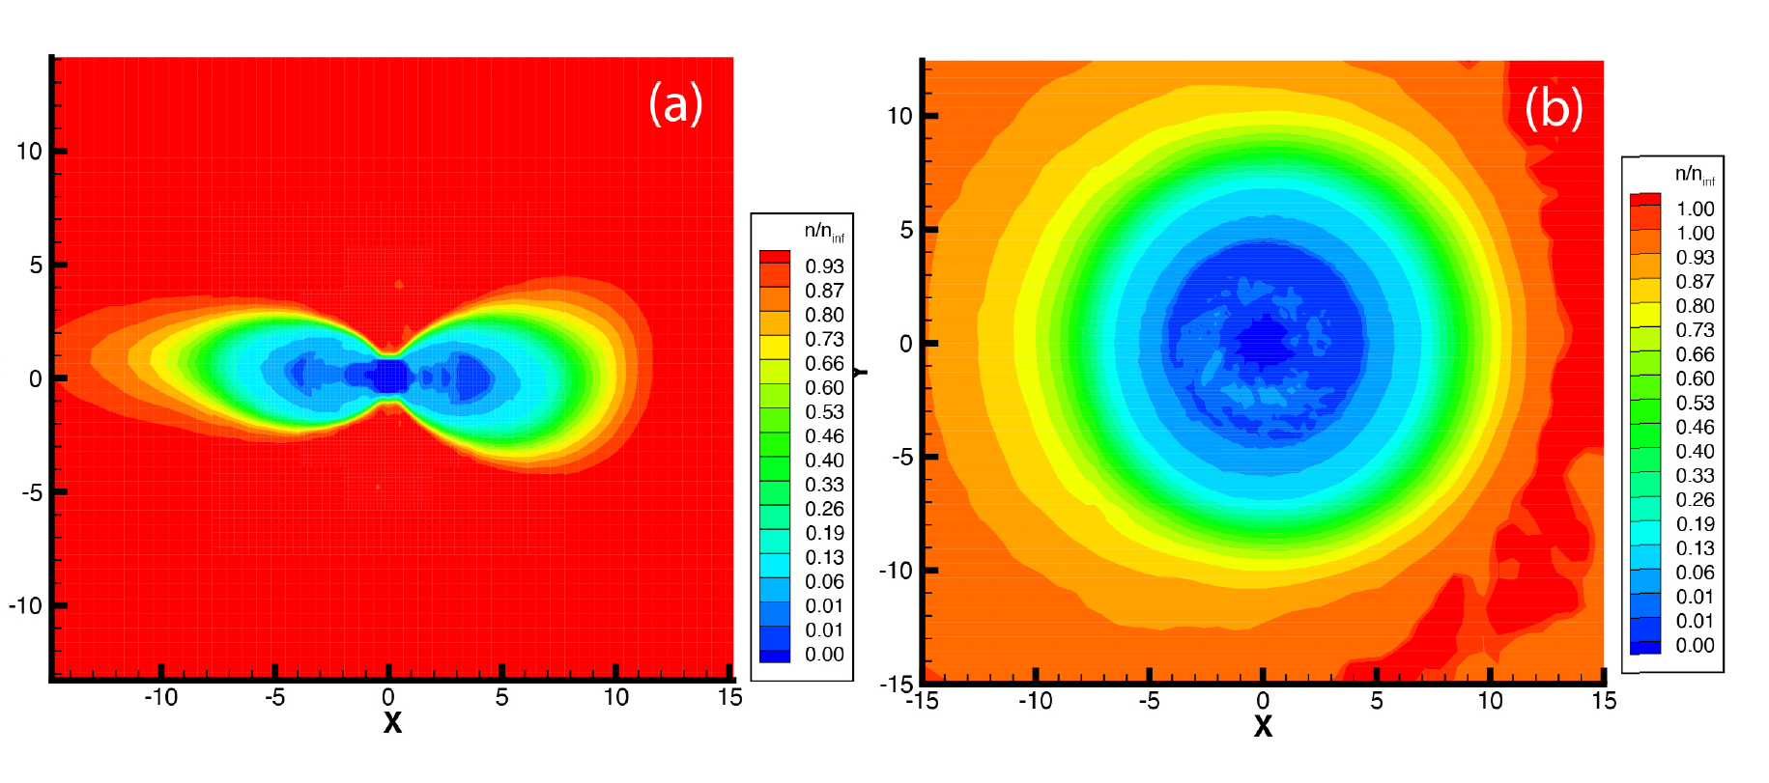
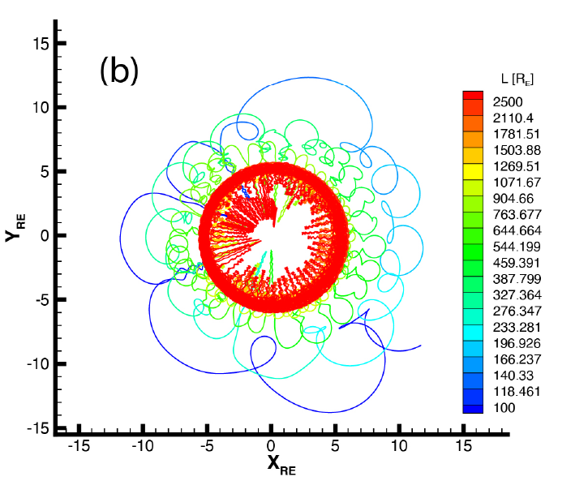
AMPS in geospace: transient effects
The conditions of the geomagnetic storm on March 17, 2015.

Slide 10
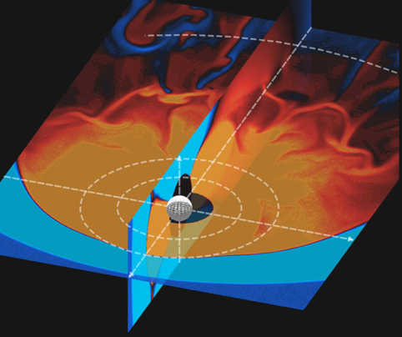
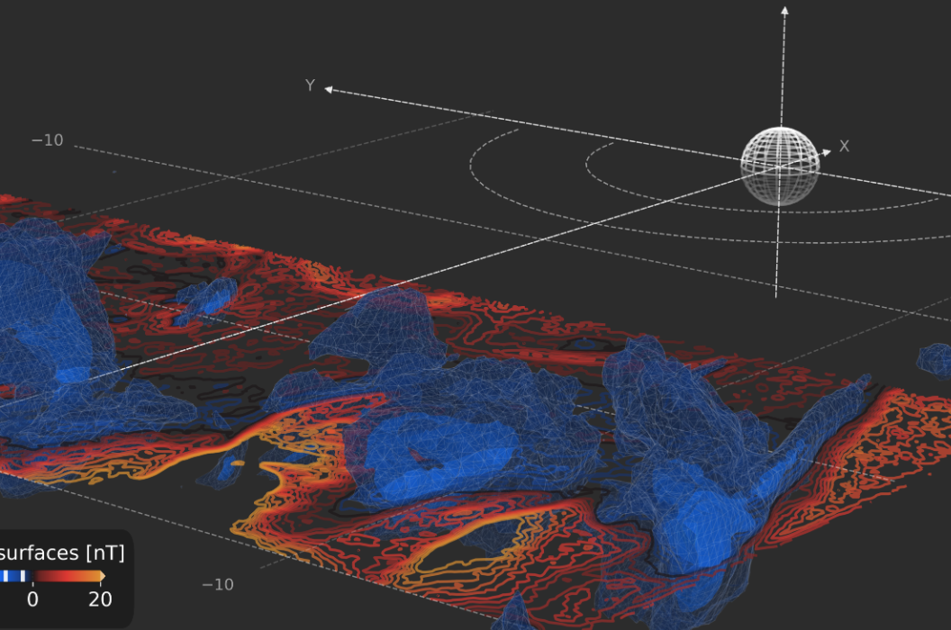
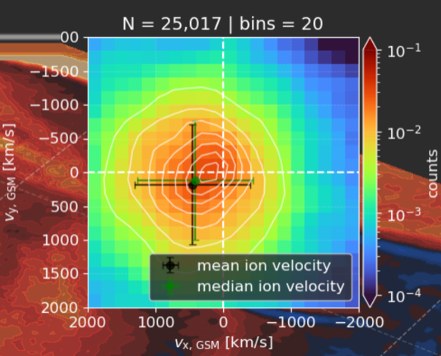
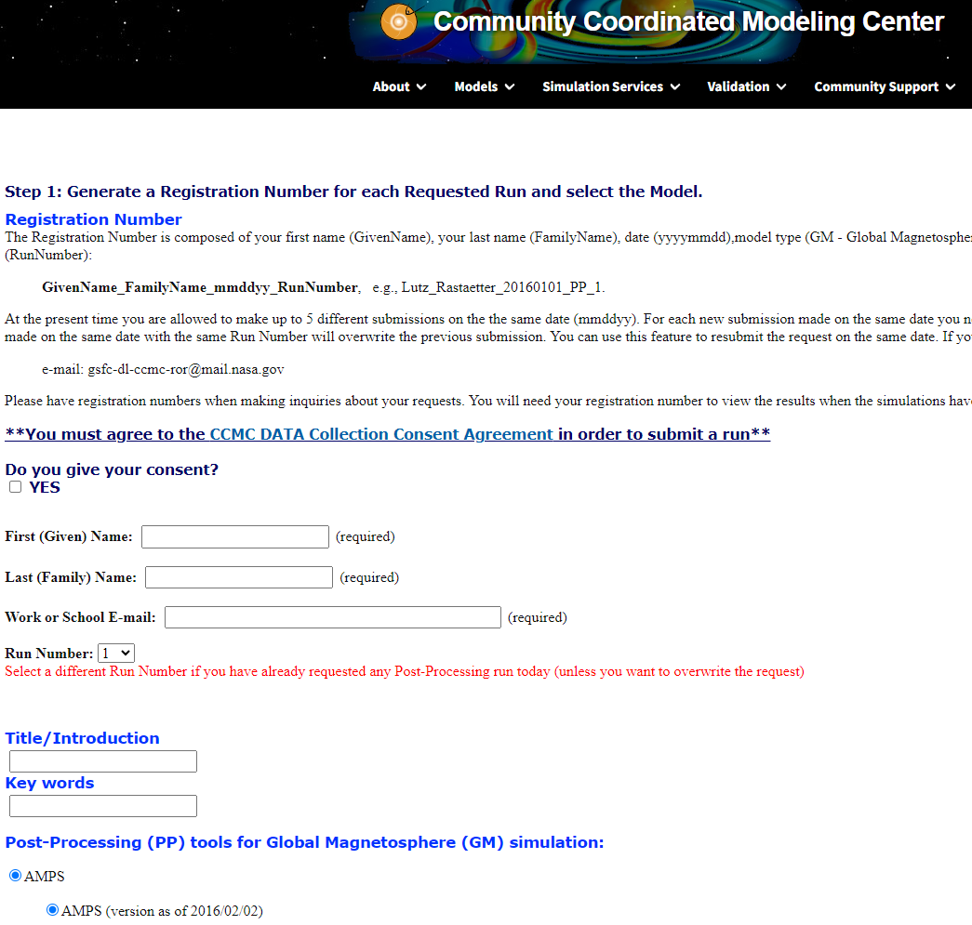
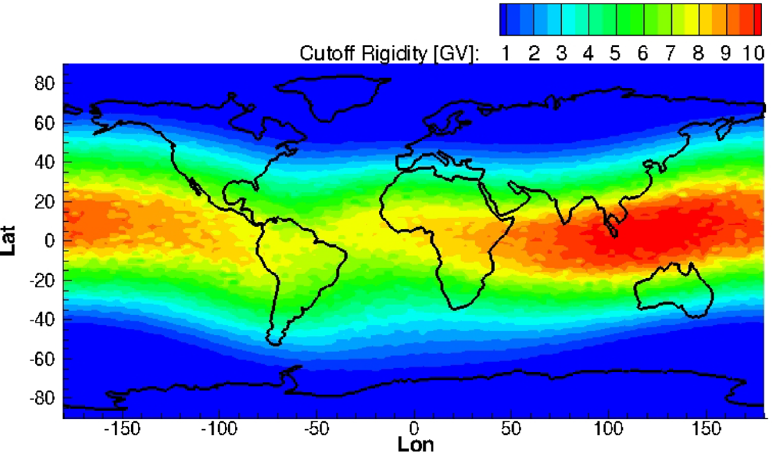
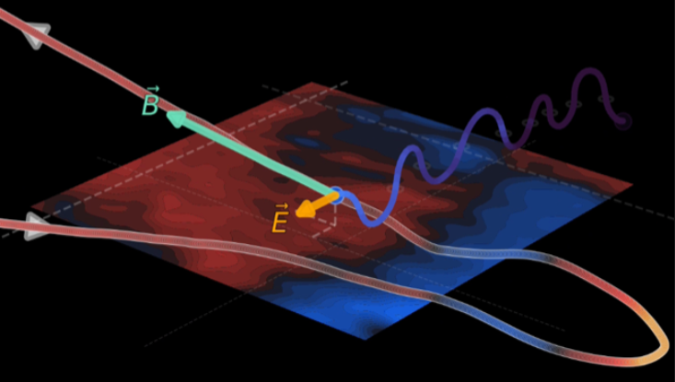
AMPS in CCMC – plans new development
Visualization
Cut through 3D data
\
NASA JSC/SRAG
AFRL
Communicate Space
Weather User Needs
Feedback on model development
Data for validation
Isosurfaces
AMPS for SEP modeling in geospace
\
\
MSFC/ST13
MSFC/ST11
GSFC/CCMC
Distribution functions
SEP Model
Web Interface
Use GOES data stream
Results presented online
Particle trajectories

