Slide 1
Using Amateur Radio Links to Test Ionospheric Models
CCMC Workshop 2024
A.T. Chartier¹, J. Steele¹, G. Sugar^{1,2}, D. R. Themens³, S.K. Vines¹, J.D. Huba⁴
¹Johns Hopkins Applied Physics Lab, Laurel, Maryland, USA.
²Now at SpaceX, 1 Rocket Road, Hawthorne, CA 90250
³Department of Physics, University of New Brunswick, Fredericton, New Brunswick, Canada.
⁴Syntek Technologies, Fairfax, VA, USA
Acknowledge NASA 80NSSC21K1557. CSA 21SUSTCHAI. Thanks to Hams for WSPRNet, UMass Lowell GIRO for Digisonde data, MIT for the GPS data, Australian DST for PHaRLAP raytracer

Slide 2
Outline
WSPRnet data
2024 eclipse case study
Homing raytracing analysis
Code availability

Slide 3
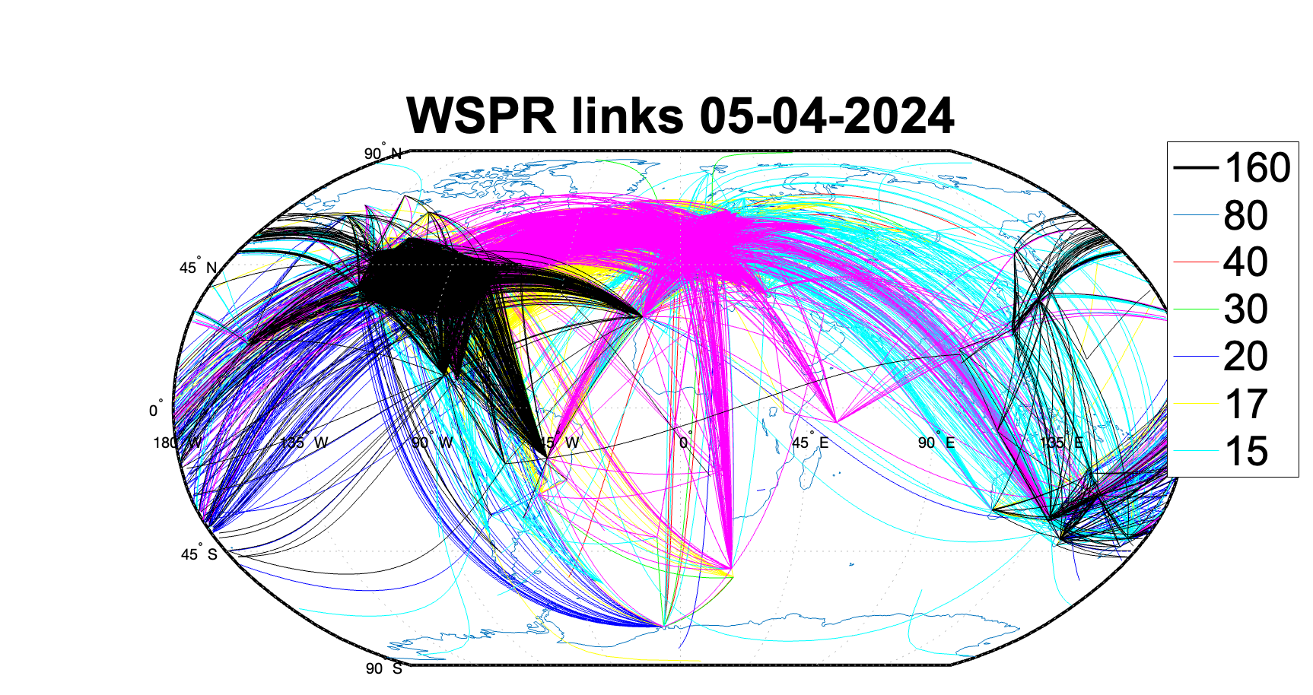
Weak Signal Propagation Reporter
WSPR protocol logs amateur radio ‘links’, including:
Transmitter location
Receiver location
Time
Frequency
Band (m)
Figure shows one day of WSPR links:
Max 10k links/band
>250-km great circle
160 – 15 m bands (~2 – 20 MHz)

Slide 4
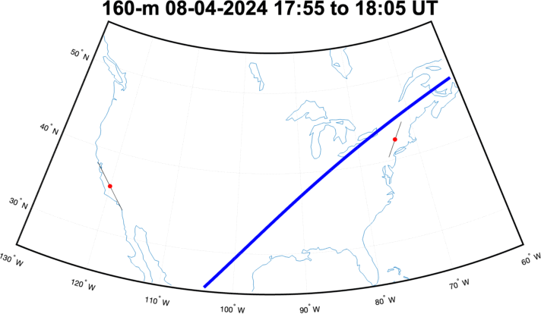
WSPR shows effects of 2024 eclipse
F-layer ionosphere is almost always dense enough to reflect 160-m band (~2 MHz)
At low power, D/E-region absorption is the limiting factor -> 160-m links are most commonly received at night
2024 eclipse provided a low-absorption channel supporting 160-m propagation
2X usual traffic on 8 April
Eclipse-related propagation

Slide 5
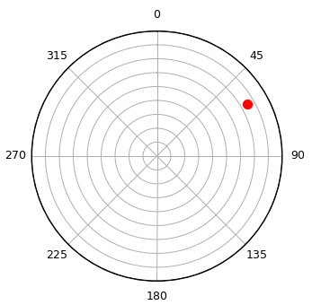
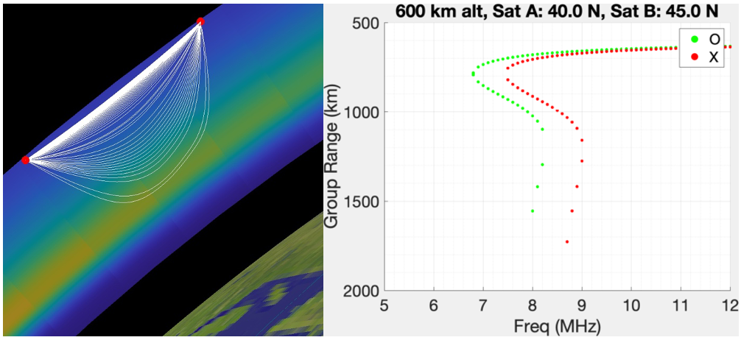
Testing models with WSPR data
Raytracers (e.g. PHaRLAP) calculate signal propagation through model ionospheres
Homing algorithm (developed for this project) uses optimized iterative search over ray azimuth/elevation to find point-to-point solutions
Azimuth/Elevation search space
Rays ‘home’ from A to B
Output ionogram
B
A

Slide 6
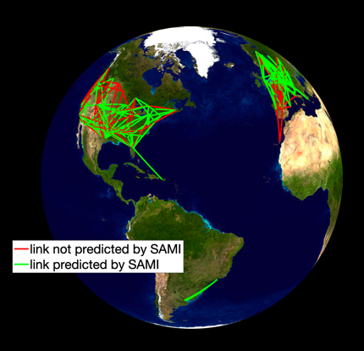
Testing models with WSPR data
#1 Grab list of point-to-point HF links from WSPRnet database
#2 Pull out the links between 500-2000 km great circle distance (likely single hop)
#3 Use homing raytracing to test whether SAMI3 predicts the observed propagation paths
Overall: 55% success during March 2019
70% from 6 – 18 LT, 38% from 18 – 6 LT

Slide 7
Open-source tools created by this project
Optimized multilateration algorithm to assess model ability to mitigate ionospheric effects on GPS position
ML algorithm to ‘clean’ autoscaled ionogram parameters prior to use in data assimilation or validation
Homing raytracing algorithm to test ionospheric models’ ability to predict HF comms

Slide 8
Summary
WSPR amateur radio data used to test ionospheric models
Project also delivered GPS and ionosonde test algorithms
New validation tools available at: https://github.com/alexchartier/raytracing
March 2019 test provides a baseline of SAMI3 performance:
Ionospheric err. on GPS 3D pos: 1.6m
Single-hop HF comm: 55% success
NmF2: 1x10¹¹ el. m³ overestimate (27%)

