Slide 1
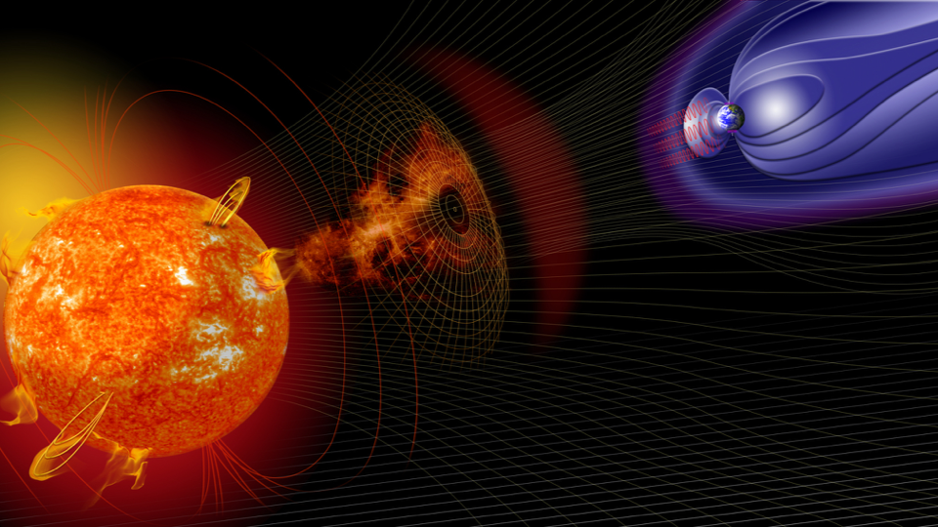
Using GEODYN-POD to Validate
Thermospheric Neutral Density Models
Zachary Waldron, SWxTREC CU Boulder
Katherine Garcia-Sage, NASA GSFC
Jeffrey Thayer, SWxTREC
Eric Sutton, SWxTREC
Vishal Ray, Kayhan Space
Marcin Pilinski, LASP
Tom Berger, SWxTREC
June 6, 2024, CCMC Workshop

Slide 2
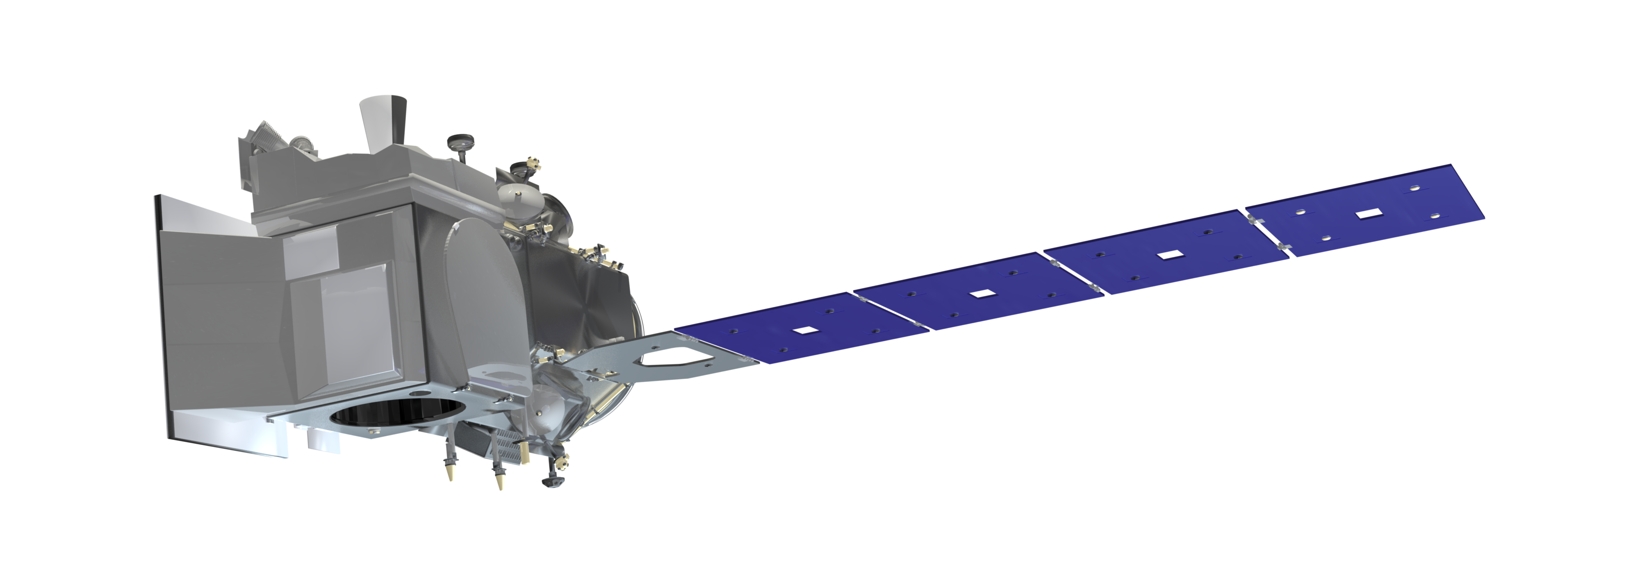
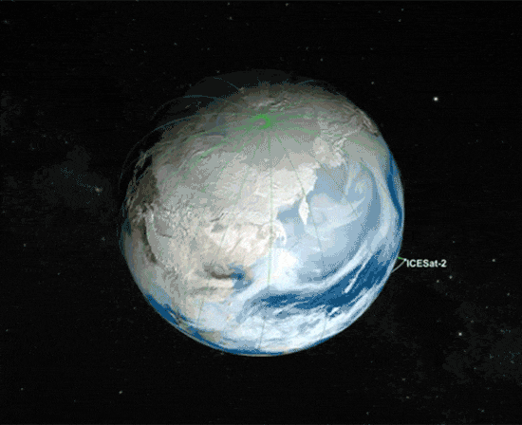
We use the GEODYN-II POD software to assess thermospheric neutral density models
Overview/Goals
Predictive ex.
GEODYN Desc.
Retrospective ex.
Density Extraction
Goals:
Use POD (via GEODYN) to assess upper atmospheric density models
Pseudo-predictive and retrospective methods
Provide a neutral density extraction along the orbit of candidate satellites using POD accelerometry methods (no electrostatic accelerometers needed!)
Image and logo from the ICESat-2 Visualization Gallery
 | ICESat-2
Altitude | ~490 km
$$i$$ | $$92°$$
$$e$$ | $$0.001398$$
Period | 94.22 mins
Animated GIF of the ICESat-2’s Polar Orbit from
the ICESat-2 Visualization Gallery
2

Slide 3
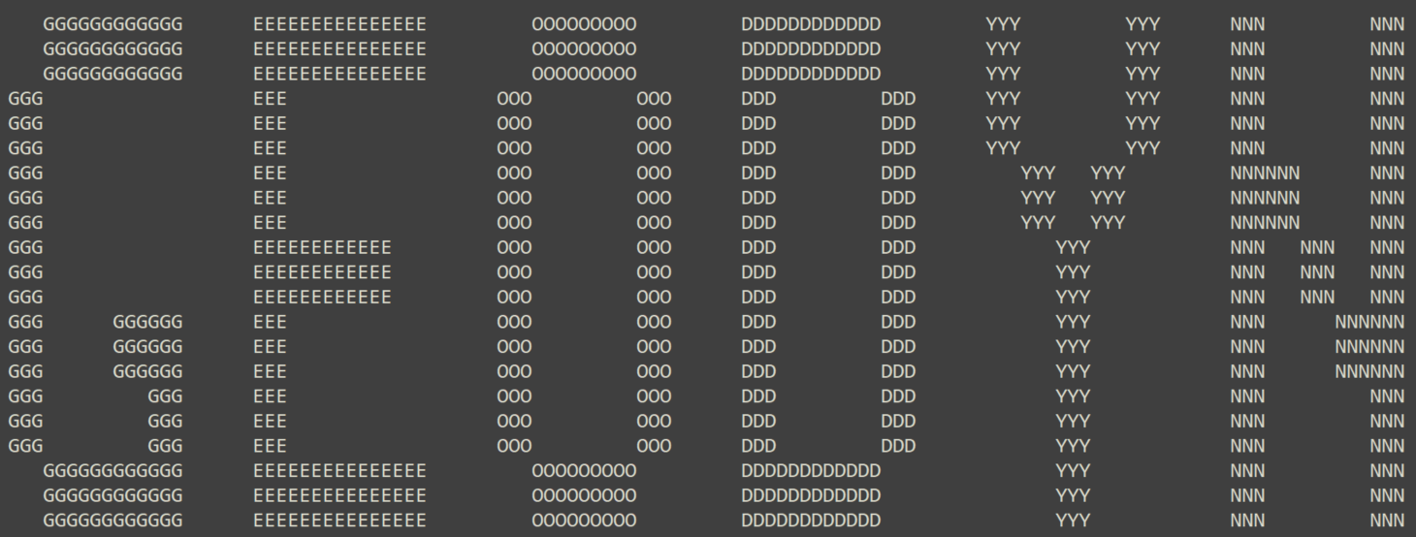
Overview/Goals
Predictive ex.
GEODYN Desc.
Retrospective ex.
Density Extraction
Why use GEODYN?
Very high-fidelity conservative force models
Relatively high-fidelity non-conservative force modeling
Long legacy as a space-geodetic POD program
GEODYN
High fidelity conservative force modeling
Panel model geometry, timeseries of quaternions
Non-drag, non-conservative forces are consistent across runs
Updated force model to include a physically calculate $C_{D}$ using DRIA
Precise Orbits
(treated as truth)
Choose density model
Choose density model
Choose density model
Choose density model
Orbit Fits
to the PSO
Model $ρ$
Orbit Fits
to the PSO
Model $ρ$
Orbit Fits
to the PSO
Model $ρ$
“Drag Study”
Orbits
Model $ρ$
Scaling Factors
Scaling Factors
Scaling Factors
Metrics
3

Slide 4
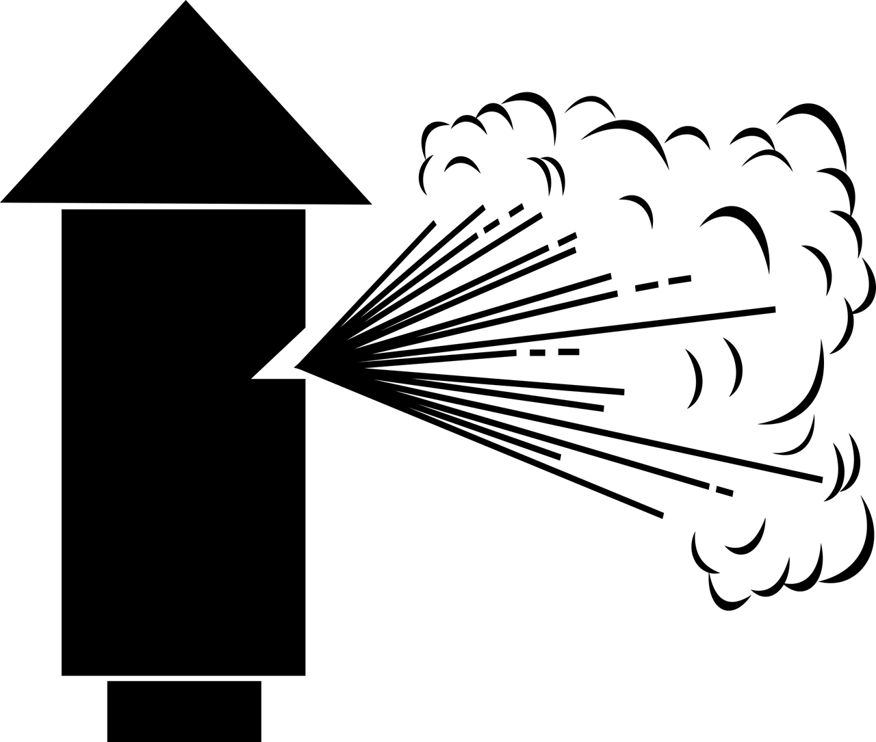
In an orbit prediction/propagation, we want to choose the model that reduces in track error
Overview/Goals
Predictive ex.
GEODYN Desc.
Retrospective ex.
Density Extraction
Model $ρ$
Orbit Fits
to the PSO
Model $ρ$
Precise Orbits
(gives initial conditions and “truth”)
Orbit Fits
to the PSO
Model $ρ$
Orbit Fits
to the PSO
Model $ρ$
Propagations
(predictive
capability)
GEODYN
Orbit Propagations
Scaling Factors
Choose density model
Scaling Factors
Choose density model
Scaling Factors
Choose density model
Choose density model
In-track Residuals, RMS, etc.
GEODYN can also be used to extract scaling factors for each model which identify the amount of adjustment needed on the density.
Model $ρ$
Model $ρ$
Model $ρ$
Orbit Fits
to the PSO
Model $ρ$
Orbit Fits
to the PSO
Orbit Fits
to the PSO
Precise Science Orbits
(PSO,
treated as truth)
Orbit Fits
to the PSO
GEODYN
Scaling Factors
Orbit Fits
(retrospective)
Scaling Factors
Scaling Factors
Scaling Factors
Choose density model
Choose density model
Choose density model
Choose density model
Residuals, RMS, etc.
Residuals, RMS, etc.
Residuals, RMS, etc.
Residuals, RMS, etc.
4

Slide 5
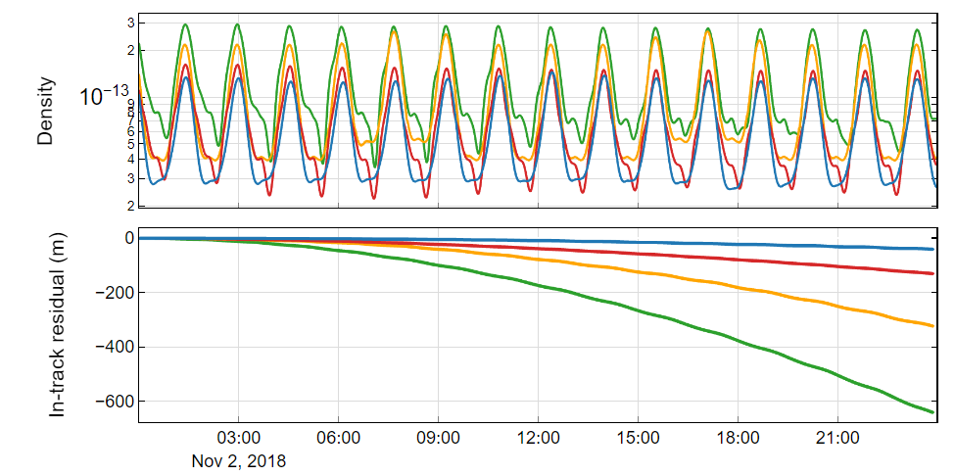
Predictive Exercise: 24-hour Orbit Propagation
Overview/Goals
Predictive ex.
GEODYN Desc.
Retrospective ex.
Density Extraction
24-hour Propagations of ICESat-2
Imagine we are back in November 2018…
we have been given an orbit predictive solution
Which density model will give the least in-track error?
Can aid operators in choosing appropriate density model for propagation
This is moving in the direction of offering forecast verification
In-track residuals are the assessment metric for orbit propagations!
JB2008
DTM2020
MSIS2
SET-HASDM
5

Slide 6
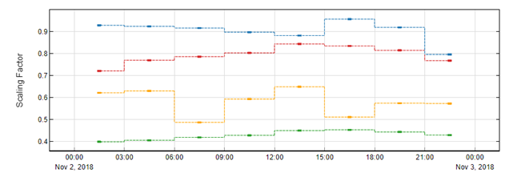
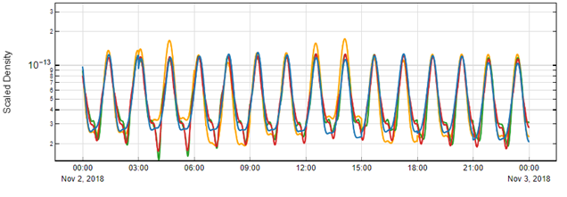
Retrospective Exercise: 24-hour Orbit Fit
Overview/Goals
Predictive ex.
GEODYN Desc.
Retrospective ex.
Density Extraction
JB2008
DTM2020
MSIS2
SET-HASDM
Kp
Some time has passed, and we have received a POD solution of the orbit. We now go back and construct orbit fits using GEODYN
Extract 3-hourly scaling factors that fit the density model orbit to the POD solution
Shows which model provides the best fit to the true orbit
Density
0.9
0.8
0.7
Scaling Factor
0.6
Scaling factors are the primary assessment metric for retrospective orbit fits
0.5
0.4
Note that error from the drag coefficient has been minimized by physically calculating CD with DIRA
Scaled Density
6

Slide 7
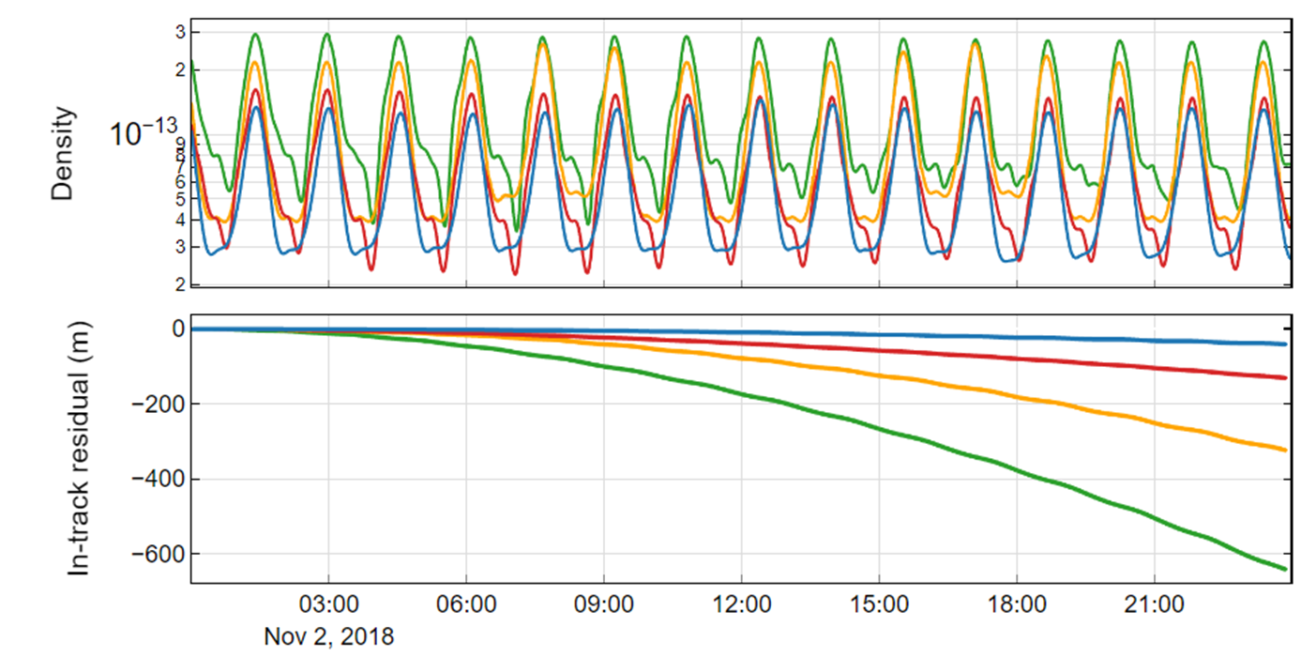
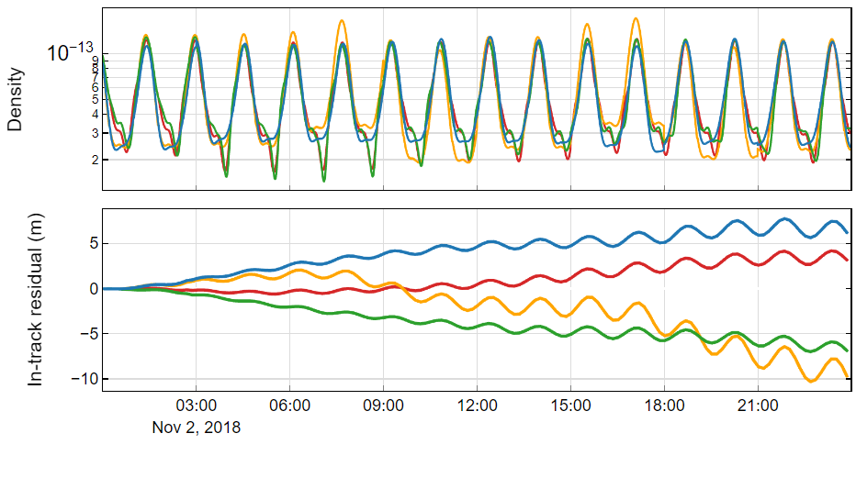
Retrospective Exercise: Run scaled densities through a propagation
Overview/Goals
Predictive ex.
GEODYN Desc.
Retrospective ex.
Density Extraction
Can compare the original density propagations to the scaled density propagations.
Unscaled Density Propagation
Scaled Density Propagations
Scaled
Density
Density
In-Track Residual (m)
In-Track Residual (m)
JB2008
DTM2020
MSIS2
SET-HASDM
7

Slide 8
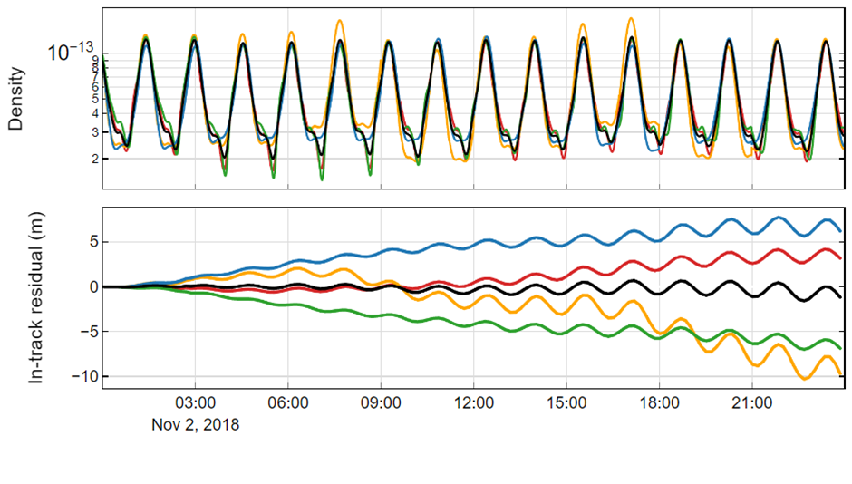
Retrospective Exercise: Run scaled densities through a propagation
Overview/Goals
Predictive ex.
GEODYN Desc.
Retrospective ex.
Density Extraction
Can compare the original density propagations to the scaled density propagations.
Unscaled Density Propagation
Scaled Density Propagations
Scaled
Density
Density
In-Track Residual (m)
In-Track Residual (m)
JB2008
DTM2020
MSIS2
SET-HASDM
$${{\overline{ρ}}^{∗}}_{scaled, avg}=\frac{\sum_{i=1}^{m}{\left(ρ_{i, scaled}∗w_{i}\right)}}{\sum_{i=1}^{m}{w_{i}}}$$
8

Slide 9
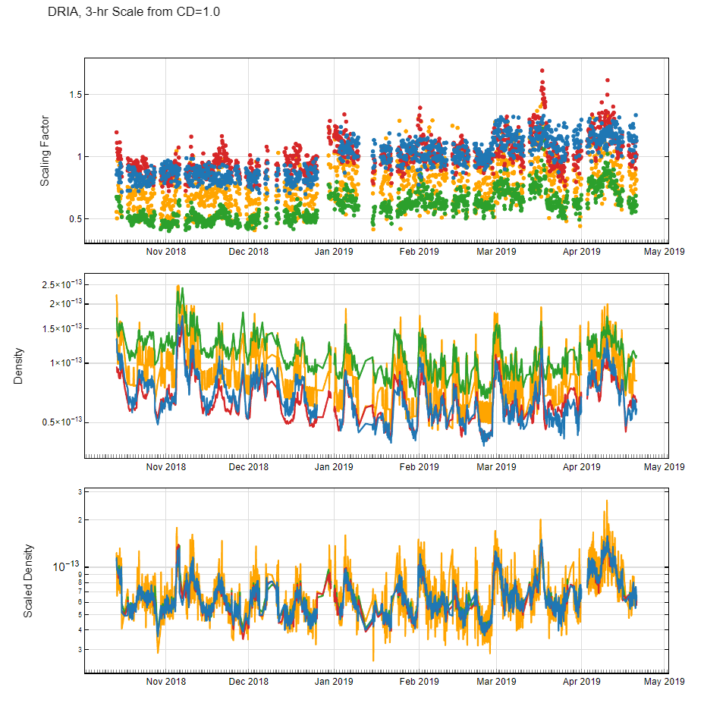
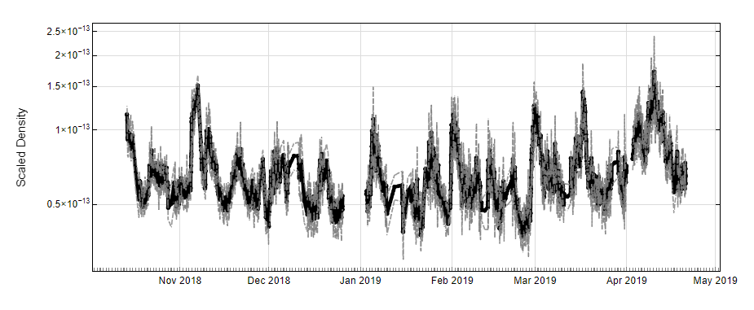
This procedure has been done for 6-months and is being expanded
Overview/Goals
Predictive ex.
GEODYN Desc.
Retrospective ex.
Density Extraction
6-Month Retrospective with ICESat-2
Assessments for 6-months of ICESat-2
Propagation Analysis
In-track Residuals and RMSe
Retrospective Analysis
Model Scaling Factors
Scaled Densities
Extracted Weighted Average Scaled Density
$${{\overline{ρ}}^{∗}}_{scaled, avg}$$
JB2008
DTM2020
MSIS2
SET-HASDM
9

Slide 10
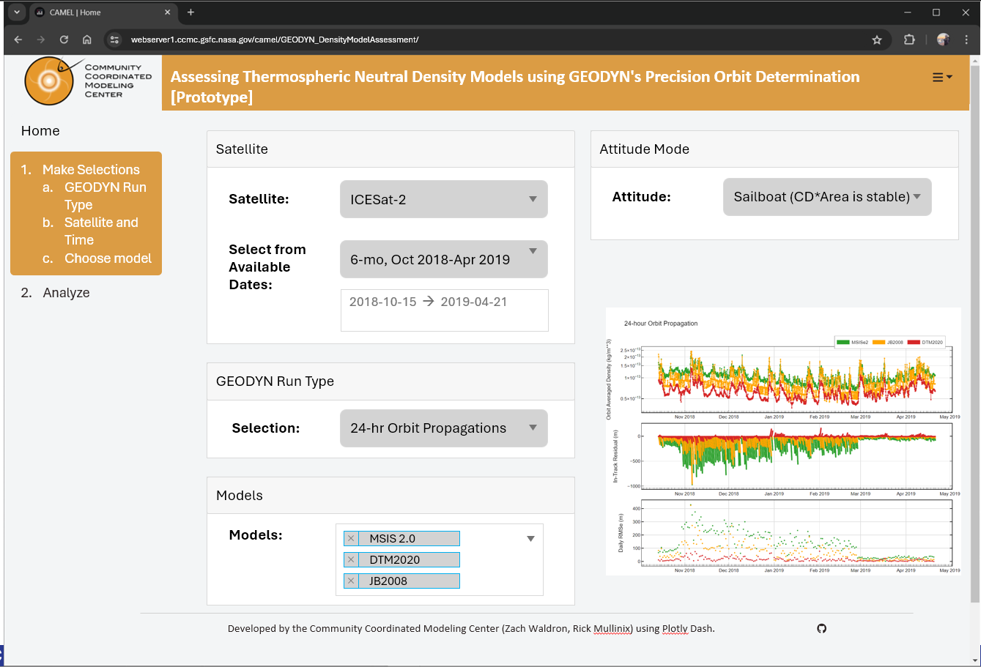
Summary
We can use POD solutions and methods to
assess and validate neutral density models
scale the density models and retrieve an along orbit density estimates
Our results are coming to CAMEL
Future work
Expand ICESat-2 time-period
Cross validation with GRACE-FO
Apply method to commercial constellations
Apply method to physics-based models
Thank You!
10

Slide 11
BACKUP SLIDES

Slide 12
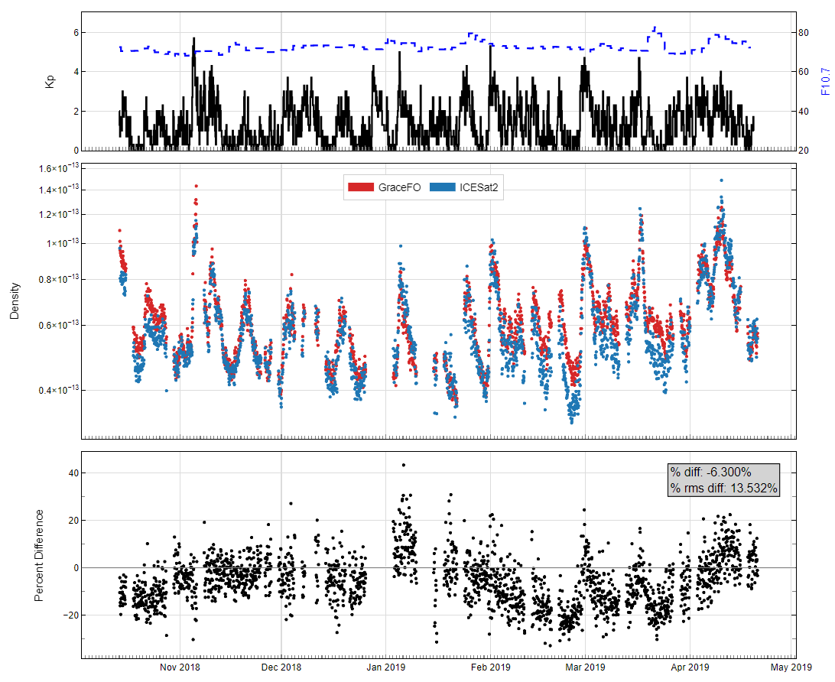
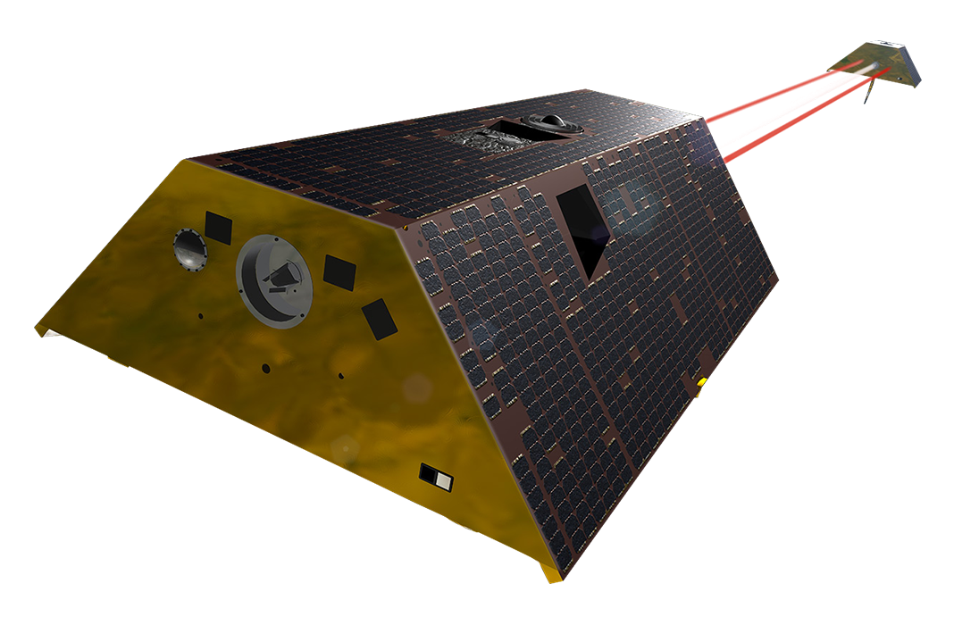
ICESat-2 (POD Accelerometry)
vs
GFO (Electrostatic Accelerometer)
Kp
Orbit Average Density (kg/m³)
 | ICESat-2 | GRACE-FO-C
Perigee | 479 km | ~481.7 km
Apogee | 482 km | ~506.3 km
$$i$$ | $$92°$$ | $$89°$$
$$e$$ | $$0.001398$$ | $$0.00179$$
Period | 94.22 mins | 94.5 mins
Percent Difference
Overview
GEODYN Description
Predictive Exercise
ICESat-2 as Density Extraction
Retrospective Exercise

Slide 13
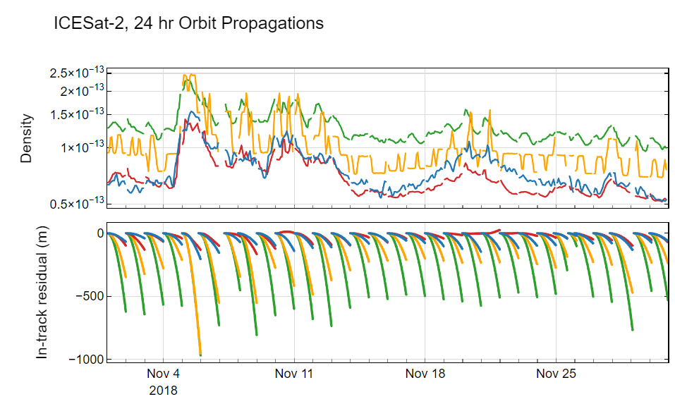
24-Hour Propagations of ICESat-2, Unscaled Density
JB2008
DTM2020
MSIS2
SET-HASDM

Slide 14
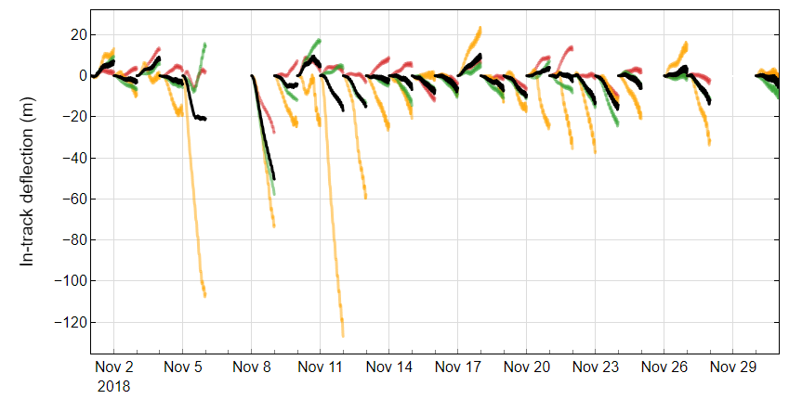
24-Hour Propagations of ICESat-2, Scaled Density
JB2008
DTM2020
MSIS2

Slide 15
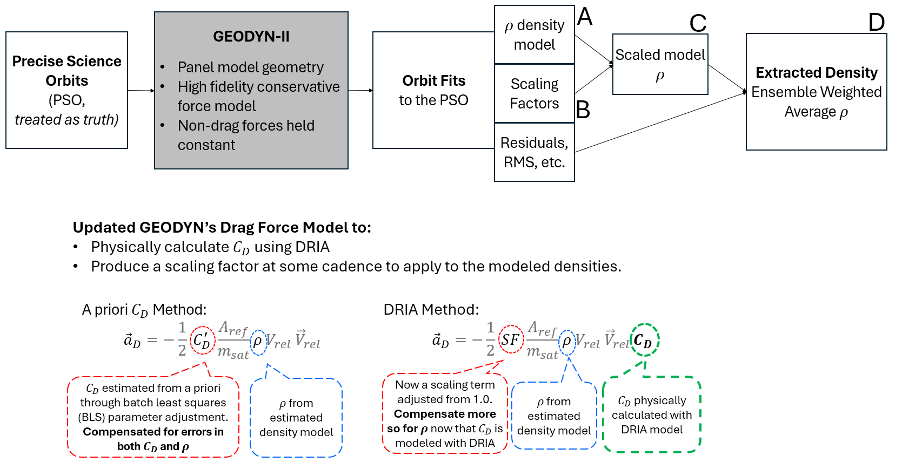
Updated GEODYN’s Drag Force Model

Slide 16
Visualize the scaling process, step-by-step
Model Densities along ICESat2’s Orbit
Determine the model densities from along the orbit of ICESat-2
3-hour scaling factors from GEODYN. DRIA is used to calculate $C_{D}$ in the drag force model. The DRAG card in GEODYN becomes a scaling term to be adjusted from 1.0 using the batch least squares reduction.
Scaling Factors, 3-hourly
Densities are scaled and an ensemble weighted average is calculated. The ensemble weighted average is our estimated density extraction.
${{\overline{ρ}}^{∗}}_{scaled, ensemble}=\frac{\sum_{i=1}^{m}{\left(ρ_{i, scaled}∗w_{i}\right)}}{\sum_{i=1}^{m}{w_{i}}}$
$w_{i}=\frac{1}{RMS_{i, arc}}$
Scaled Model Densities
Ensemble Weighted Average

Slide 17
Scaling Factors
JB2008
DTM2020
MSIS2
Changes in ICESat-2 attitude mode as depicted by the $C_{D}∗A_{ref}.$
$$C_{D}∗A_{ref}$$
Nov 2018
Dec 2018
Jan 2019
Feb 2019
Mar 2019
Apr 2019

