Slide 1
Space Weather Operational Readiness Development A NASA Space Weather Center of Excellence
Advancing orbital space weather forecasting through model development, data assimilation, and machine learning research
Eric Sutton
University of Colorado at Boulder
Space Weather Technology, Research, and Education Center (SWx TREC)
And the SWORD Team:
PI: Tom Berger
Co-I’s: Dan Baker, Tuija Pulkkinen, Tamas Gombosi, Julia Putt (Project Manager), Enrico Camporeale, Phil Chamberlin, Fazlul Laskar, Greg Lucas, Naomi Maryuma, Mark Miesch, Yang Chen, Zhenguang Huang, Mike Liemohn, Aaron Ridley, Gabor Toth, Dan Welling, Shasha Zou, Allison Jaynes, Marty Mylnczak, Doğacan Ozturk, Nick Pedatella, Liying Qian
Notes:
Good Morning. I’m going to be giving a quick overview of the Space Weather Operational Readiness Development Center, a NASA Space Weather Center of Excellence.
My name is Eric Sutton with CU/Space Weather TREC, and I’m a co-I on this project. Tom Berger, also from TREC, is the PI of the project.
Here is a list of the other co-I’s, who are spread across several institutions as you can see in the next slide [next slide]

Slide 2
Space Weather Operational Readiness Development A NASA Space Weather Center of Excellence
Advancing orbital space weather forecasting through model development, data assimilation, and machine learning research
Notes:
Most of the responsibilities are split between CU and Michigan, but we also have large contributions from several other institutions.
We also have collaborators from industry, be they users of space weather products to support their own operations, or providers of data or support for the project.

Slide 3
SWORD mission and vision
Vision:
The Space Weather Operational Readiness Development (SWORD) Center will be an international, multi-disciplinary research center where scientists, operational forecasters, industry partners, and the space weather user community will collaborate on transformative research to improve forecasts and nowcasts of the orbital and cis-lunar space environment.
5-year Mission:
Produce a physics-based, machine learning enhanced, data assimilative, fully coupled Magnetosphere-ITM orbital space weather forecasting model for transition to operations.
Primary application goal: an accurate and reliable probabilistic neutral density forecast for LEO operations.
Notes:
The overall goal of the project is to improve forecasts and nowcasts of the near-earth space environment, specifically for the benefit of low-earth orbital operations as well as cis-lunar operations.
And our primary goal within the 5-year mission is to provide an accurate and reliable neutral density forecast model for LEO

Slide 4
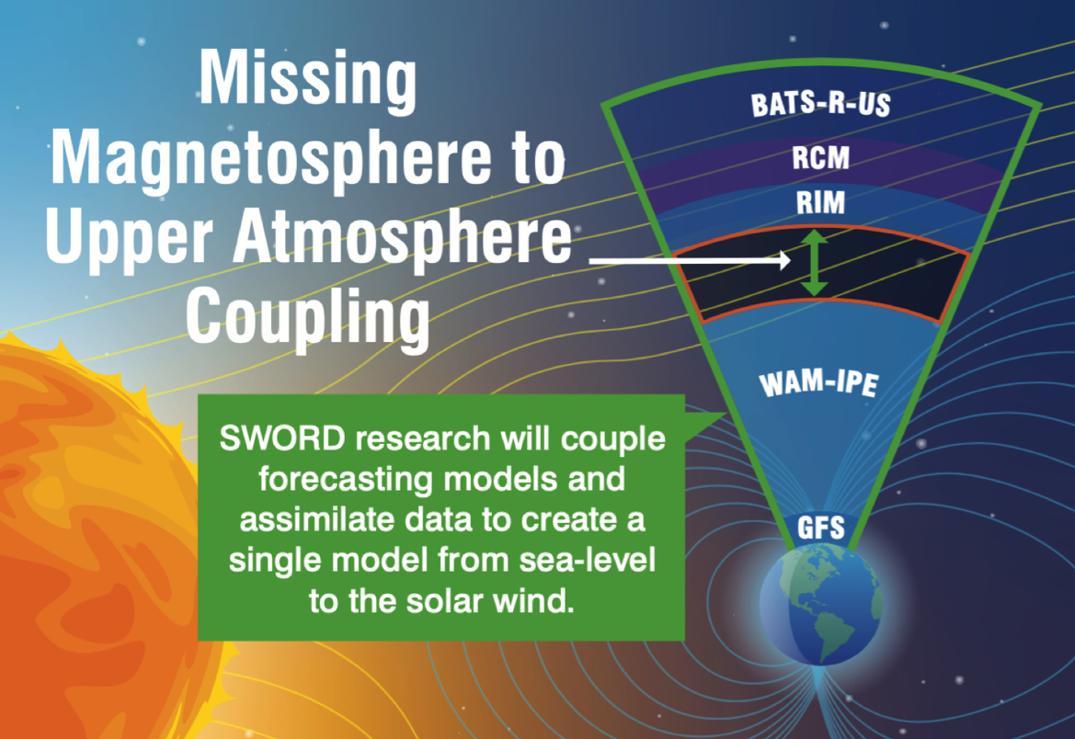
SWORD: “From Sea Level to the Solar Wind”
U. Michigan SWMF/Geospace
NOAA Magnetosphere model
Whole Atmosphere Model –
Ionosphere Plasma Electrodynamics
NOAA ITM model
Global Forecasting System
NOAA Tropospheric
weather model
Notes:
To tackle that problem, we have decided to adopt several already operational systems.
Here I’m showing the Michigan Geospace model, as well as SWPC’s WAM-IPE model build on the NOAA global forecast system (or GFS).
The objective here is to take these two systems, both currently operational, and couple them together.
In addition, we will add a layer of data assimilation that will correct the IT model in the presence of in situ data.

Slide 5
Two Tracks of SWORD applied research & development
Track 1
Track 2
Integrate NOAA/SWPC operational SWMF/Geospace and WAM-IPE models
Conduct advanced ITM Model data assimilation research
1.1 Integrate WAM-IPE into SWMF
2.1 Real-time GOES/EXIS data integration into WAM-IPE
1.2 IDEA data assimilation implementation
2.2 NOAA/JEDI-based data assimilation research
AWS Cloud-based model validation, forecast verification, and transition
Notes:
Here is how the project is laid out. We have two tracks:
The first focuses on coupling the Michigan Geospace model with WAM-IPE and implementing a data assimilation scheme that has already been demonstrated with WAM-IPE.
The second track focuses on advancing the state-of-the-art in data assimilation and integration:
The team will replace F10.7 with a model of EUV and FUV driven by GOES/EXIS
We’ll also start building up tools and methods using the JEDI framework
Some of this research will work with WAM-IPE, while other components will work with WACCM-X to engage a wider research community

Slide 6
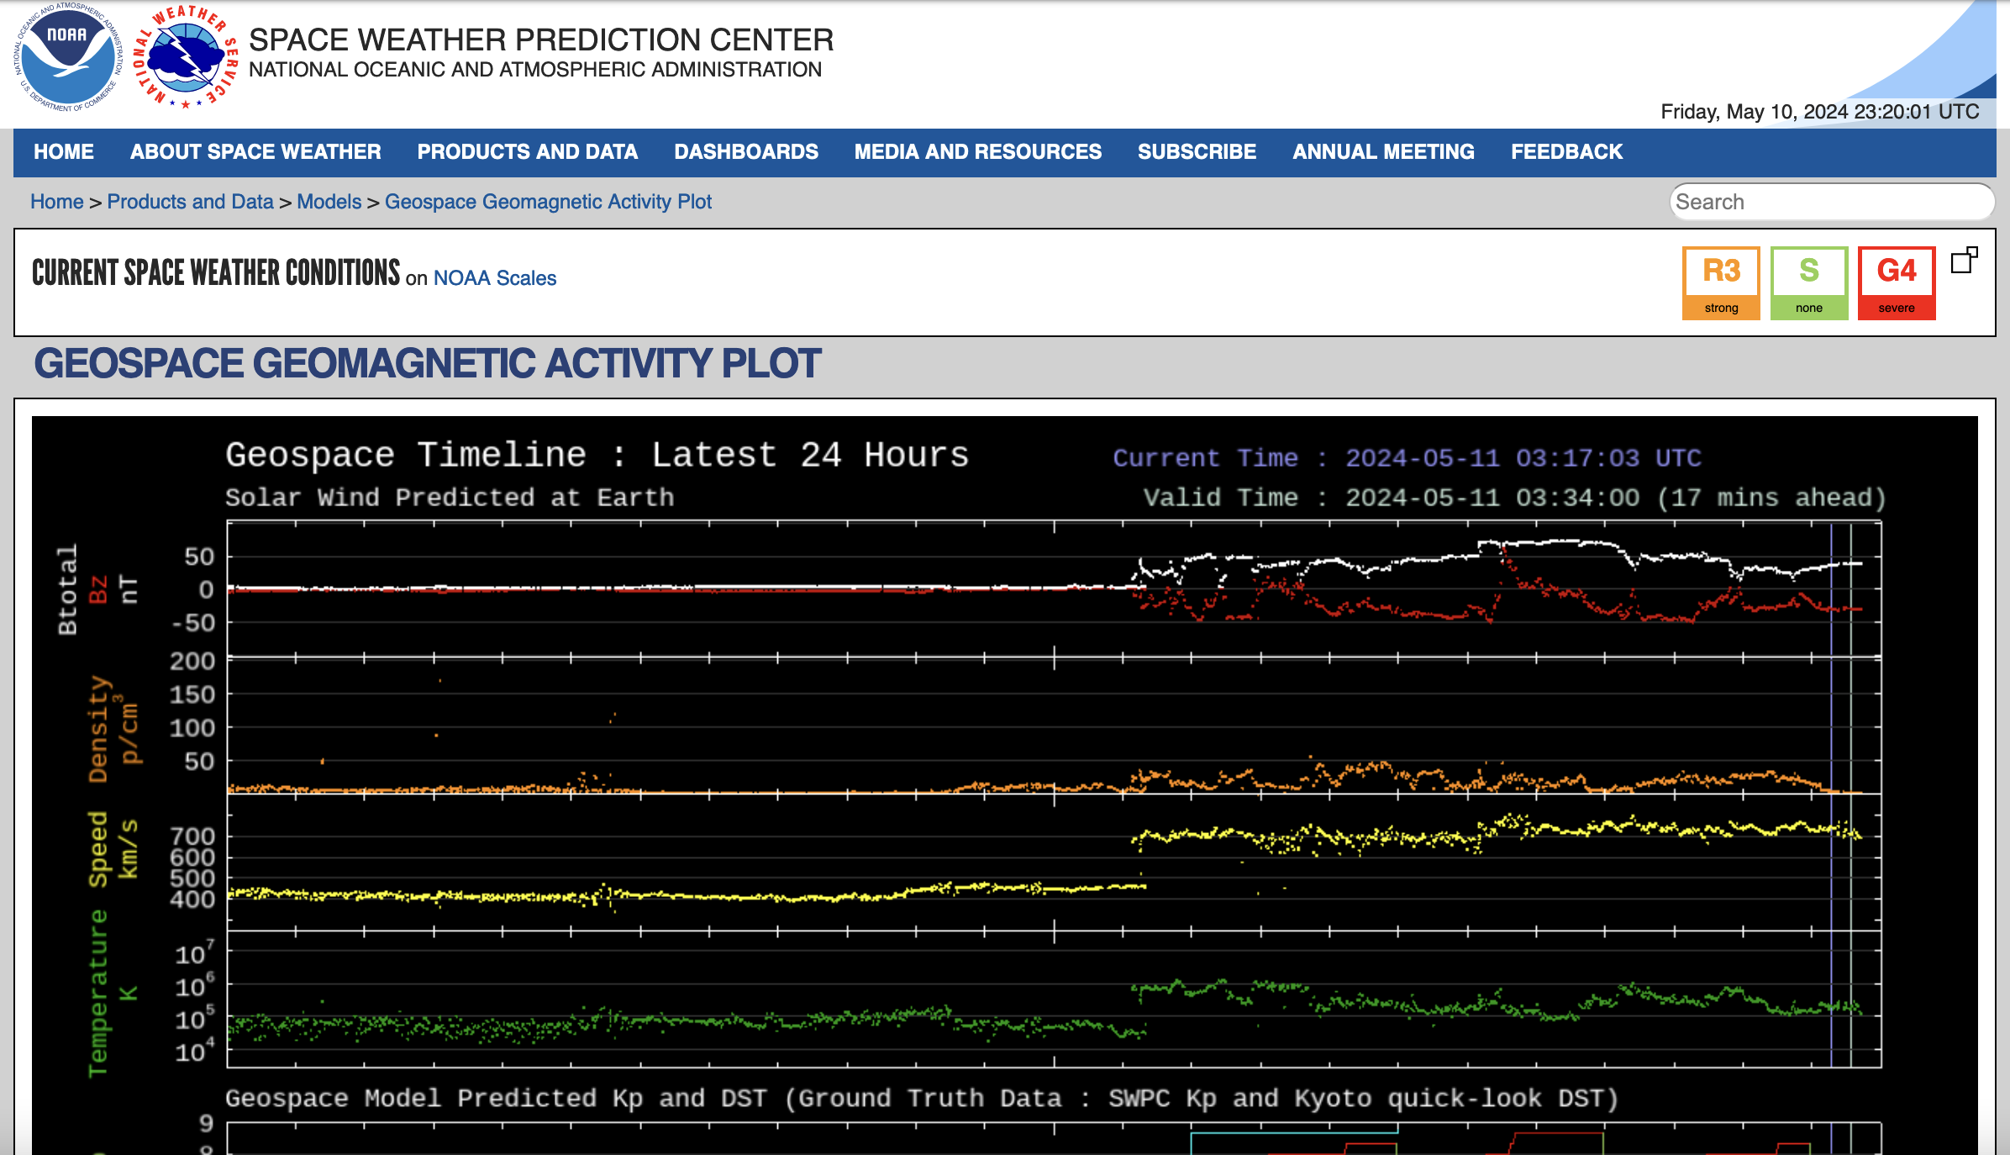
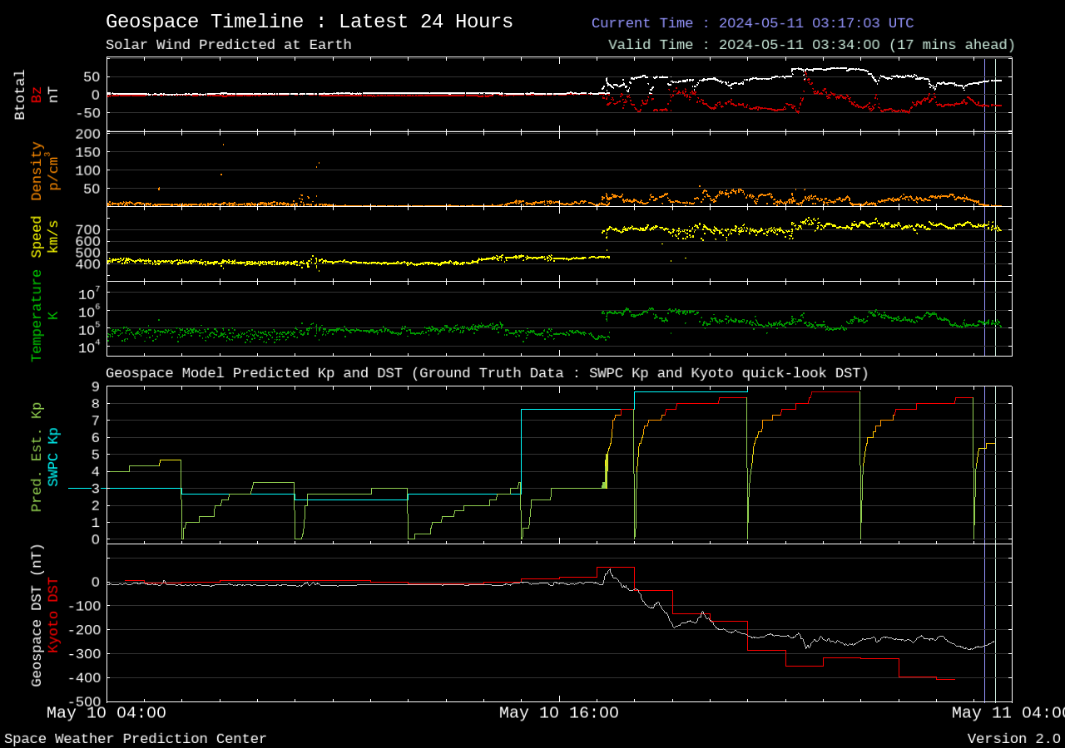
SWMF/Geospace model at NOAA/SWPC
1.1 Integrate WAM-IPE into SWMF
Operational since 2016
Extensive modifications to enable real-time runs on NOAA/NWS supercomputers.
Driven by real-time solar wind data from NASA/ACE or NOAA/DSCOVR
~30-minute propagation time = forecast lead-time
Warm restarts enabled for solar wind gaps of > 15 minutes.
Cold restarts when solar wind conditions jump, or data gap exceeds 2 hours. Requires time to equilibrate.
Notes:
The Michigan Geospace model has been operational since about 2016, and is based on the Space Weather Modeling Framework (SWMF)
It runs in real-time, driven by solar wind data from ACE and DSCOVR at the L1 point, which gives it about a 30-minute lead time (sometimes more/sometimes less depending on solar wind speed).
Back on the 11th of May, it was more like 17 minutes lead-time

Slide 7
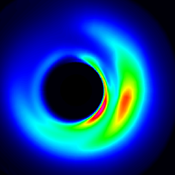
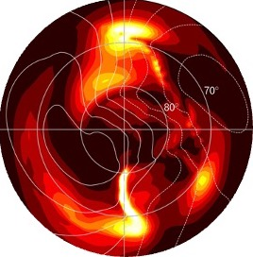
UMich SWMF/Geospace model
1.1 Integrate WAM-IPE into SWMF
Magnetic Field &
Plasma
Electric Field
Ridley Ionosphere Model
Solar Wind
F10.7
Density & Pressure
Rice Convection Model
Inner Magnetosphere Model
Interplanetary
Magnetic
Field
Electric Field
Field Aligned Currents
BATSRUS
Outer Magnetosphere Model
Notes:
30 seconds
Currently, the models are coupled in the SWMF as shown here: BATSRUS supplies magnetic field and plasma conditions to the Rice Convection Model of the inner magnetosphere which returns accurate plasma density and pressure conditions to BATSRUS.
BATSRUS also supplies field aligned current information to the Ridley Ionosphere Model (or RIM). RIM takes UV irradiance into account via the F10.7 index and returns the ionospheric electric field conditions to both RCM and BATSRUS.

Slide 8
SWORD Track 1 Coupled Model
1.1 Integrate WAM-IPE into SWMF
Magnetic Field &
Plasma
Electric Field
Ridley Ionosphere Model
Solar Wind
Density & Pressure
Rice Convection Model
Inner Magnetosphere Model
Interplanetary
Magnetic
Field
Electric potential &
Diffuse aurora
Electric Field
Discrete Aurora
Conductance
Replace Weimer Model
Field Aligned Currents
F10.7
Neutral winds &
Field aligned currents
BATSRUS
Outer Magnetosphere Model
Lower
Atmos.
Ionospheric outflow
Notes:
30 seconds
The models are coupled in the SWMF as shown here: BATSRUS supplies magnetic field and plasma conditions to the Rice Convection Model of the inner magnetosphere which returns accurate plasma density and pressure conditions to BATSRUS.
BATSRUS also supplied field aligned current, or particle precipitation, information to the Ridley Ionosphere Model. The RIM takes solar ultraviolet irradiance into account via the F10.7 index and returns the ionospheric electric field conditions to both the RCM and the BATSRUS outer magnetosphere model.

Slide 9
WAM-IPE model at NOAA/SWPC
1.1 Integrate WAM-IPE into SWMF
Operational since 2020
Runs on regular 6-hour NWS forecast cadence.
Driven by F10.7, SW or Kp.
Forecasts out to 48 hours:
Thermospheric density, composition, temperature, winds
Ionospheric density, temperature, drifts
TEC, MUF, etc.
Thermospheric neutral density analysis for 2015 St. Patrick’s Day Storm
Notes:
WAM-IPE has been operational since about 2020, I believe.
Every 6 hours, the simulation is propagated forward for a 2-day forecast. The nowcast uses solar wind observations, then transitions to a predicted Kp value for the 2-day forecast.

Slide 10
CU/NOAA WAM-IPE model
1.1 Integrate WAM-IPE into SWMF
WAM = Whole Atmosphere Model
Extension of the NOAA Global Forecast System (terrestrial weather forecasting model) with a spectral hydrostatic dynamical core. (Will be upgraded to new UFS non-hydrostatic dy-core soon.)
T62 spectral model ~1.9° resolution (or ~210 km at the equator)
150 vertical levels on a hybrid pressure-sigma grid, with a model top of approximately 3 x 10⁻⁷ Pa or ~400-600km depending on levels of solar activity.
Self-consistent O, O₂, O₃, N₂, and H₂O chemistry, parameterized NO emission based on Kp input.
Parameterized solar flux based on F10.7 input.
Currently 1-way coupled, sending information to (but not receiving from) IPE.
IPE = Ionosphere Plasmasphere Electrodynamics
Time-dependent, global 3D model of the ionosphere and plasmasphere from 90 km to approximately 10,000 km.
The flux-tube solver is based on the Field Line Interhemispheric Plasma (FLIP) model and flux-tube structures are defined by the International Geomagnetic Reference Field (IGRF).
Empirical Weimer model provides polar cap electric potential based on Kp input.
Flux-tube gridded IPE communicates with pressure gridded WAM via ESMF.
Notes:
I won’t go too deep into this, but Adam may give more details in his talk in the next session.
But, WAM was built on the NOAA Global Forecast System (or GFS) model. It runs at about 2 degree resolution and goes up to about 4-600 km.
IPE is a parallelized version of the FLIP model, along with several other modifications and additions.

Slide 11
CU/NOAA WAM-IPE model
1.1 Integrate WAM-IPE into SWMF
WAM = Whole Atmosphere Model
Extension of the NOAA Global Forecast System (terrestrial weather forecasting model) with a spectral hydrostatic dynamical core. (Will be upgraded to new UFS non-hydrostatic dy-core soon.)
T62 spectral model ~1.9° resolution (or ~210 km at the equator)
150 vertical levels on a hybrid pressure-sigma grid, with a model top of approximately 3 x 10⁻⁷ Pa or ~400-600km depending on levels of solar activity.
Self-consistent O, O₂, O₃, N₂, and H₂O chemistry, parameterized NO emission based on Kp input.
Parameterized solar flux based on F10.7 input.
Currently 1-way coupled, sending information to (but not receiving from) IPE.
IPE = Ionosphere Plasmasphere Electrodynamics
Time-dependent, global 3D model of the ionosphere and plasmasphere from 90 km to approximately 10,000 km.
The flux-tube solver is based on the Field Line Interhemispheric Plasma (FLIP) model and flux-tube structures are defined by the International Geomagnetic Reference Field (IGRF).
Empirical Weimer model provides polar cap electric potential based on Kp input.
Flux-tube gridded IPE communicates with pressure gridded WAM via ESMF.
Notes:
One thing to note is that GFS, and therefore WAM, both assimilate data into the lower and middle atmosphere for the purposes of terrestrial weather forecasting and, in the case of WAM, in hopes of establishing a realistic spectrum of upward propagating waves and tides. These observations go up to about 60 km. It does add variability, the kind that you wouldn’t typically see in TIEGCM or GITM.
However, this does not adequately constrain the thermosphere or ionosphere. So we plan to incorporate a data assimilation system that is specifically designed to handle the unique features and requirements of the IT system.

Slide 12
Model Validation vs. Forecast Verification
Both are critical steps in determining model suitability for R2O transition to operations, however, these terms are not interchangeable:
Model Validation:
The process of comparing model output to observations from past events.
Model is sometimes tuned during the process to optimize performance.
Demonstrates that the model is operating as expected in known conditions.
Forecast Verification:
The process of comparing model output to operational, previously unseen, observations.
Model cannot be tuned during forecast verification.
Only way to show whether changes to the model are improving forecasting skill.
Notes:
The last thing I just want to touch on, is related to model validation and forecast verification.
These two things are similar, but different enough that we need to start the conversation.
Model validation is an assessment not necessarily based on real-time performance. This can take place outside of the operational framework, using historical case studies and scientific data.
While Forecast verification does need to take place in a more operational setting where it cannot be tuned.

Slide 13
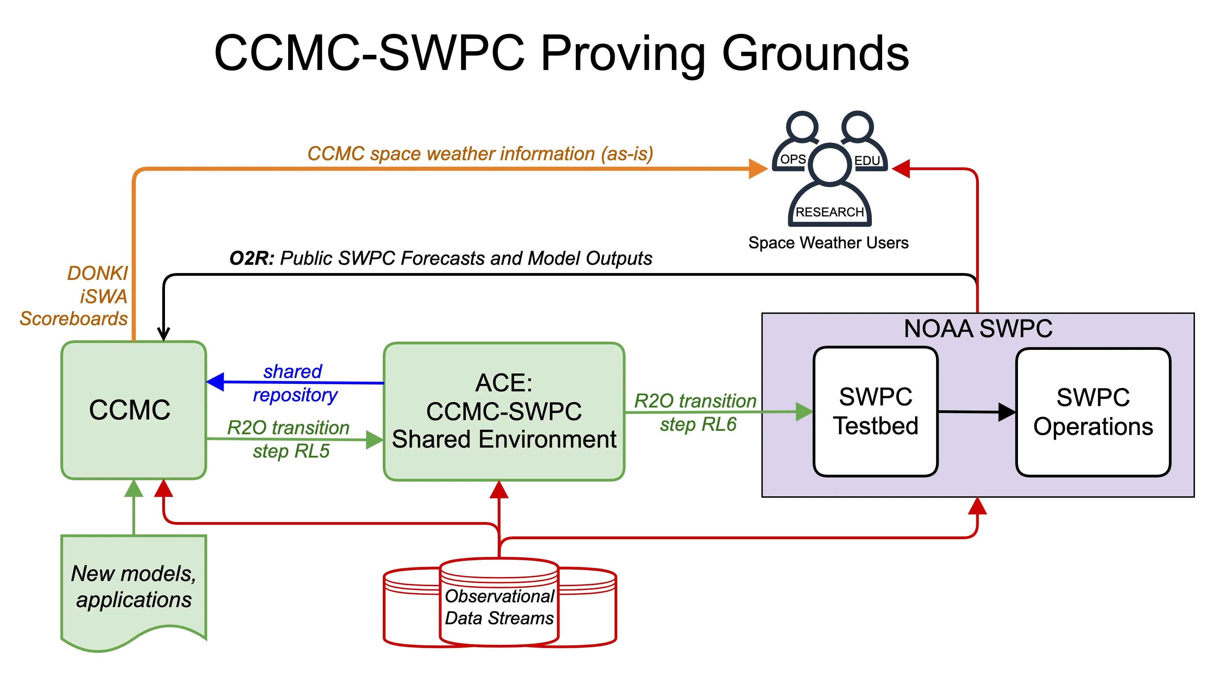
Model Validation vs. Forecast Verification
Both are critical steps in determining model suitability for R2O transition to operations, however, these terms are not interchangeable:
Model Validation:
The process of comparing model output to observations from past events.
Model is sometimes tuned during the process to optimize performance.
Demonstrates that the model is operating as expected in known conditions.
Forecast Verification:
The process of comparing model output to operational, previously unseen, observations.
Model cannot be tuned during forecast verification.
Only way to show whether changes to the model are improving forecasting skill.
Notes:
And of course it would be ideal if the centers could leverage the tools and methods that CCMC has built up, such as the ACE environment, while also leveraging the resources that SWPC has setup, like the Testbed.
So the question is, how best to approach these tasks? Do NASA and CCMC have a strategy in place with SWPC in this regard? And it’s ok, if not yet, but again, this is something we would like to discuss as we’re getting the pieces in place for this development.

Slide 14
Q & A

