Slide 1
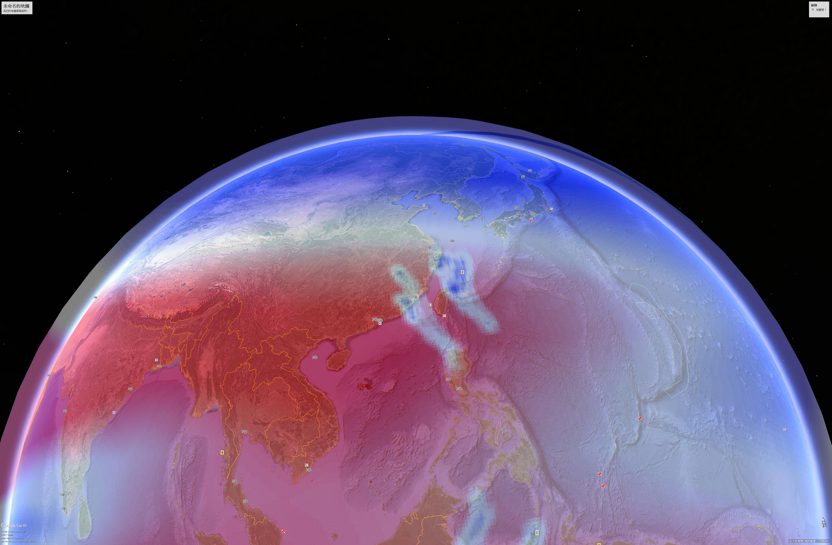
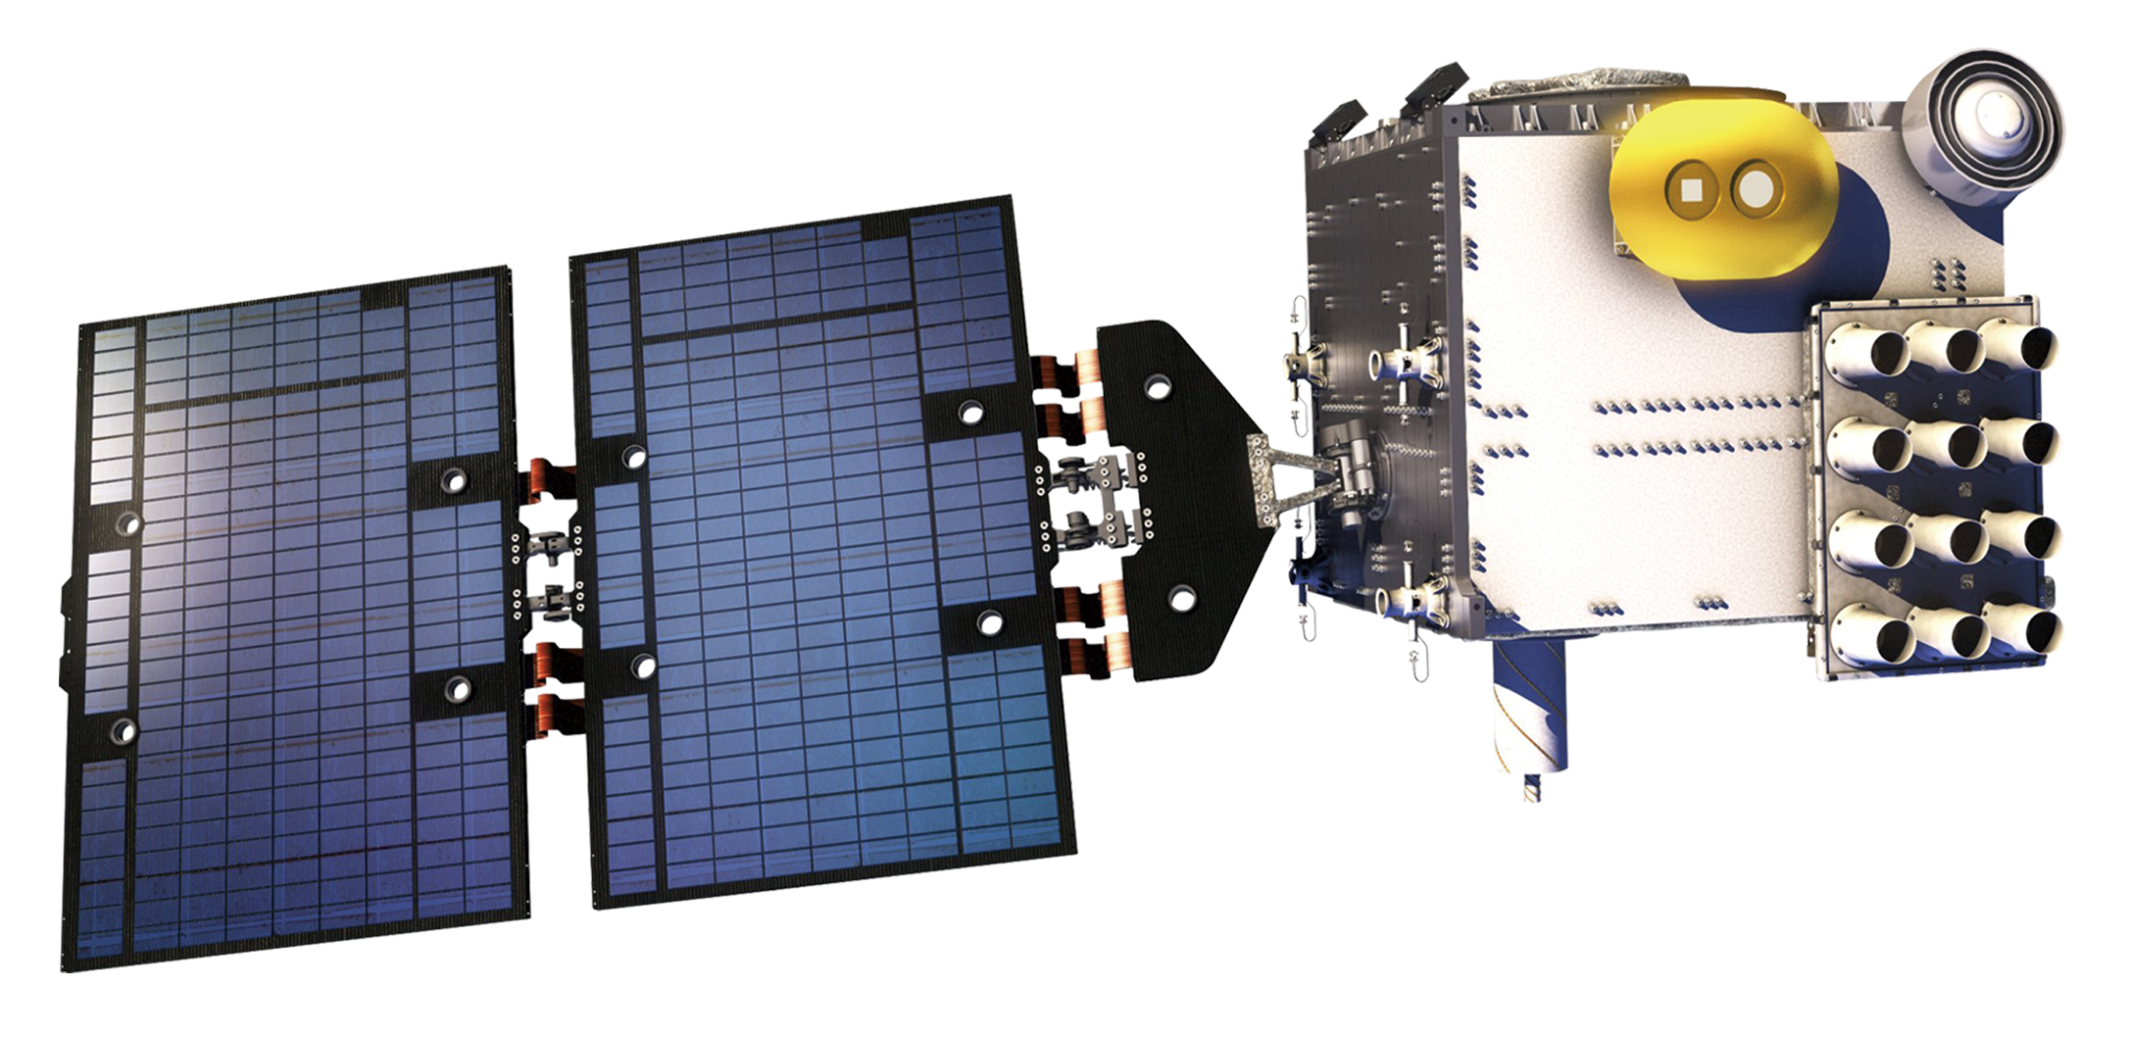
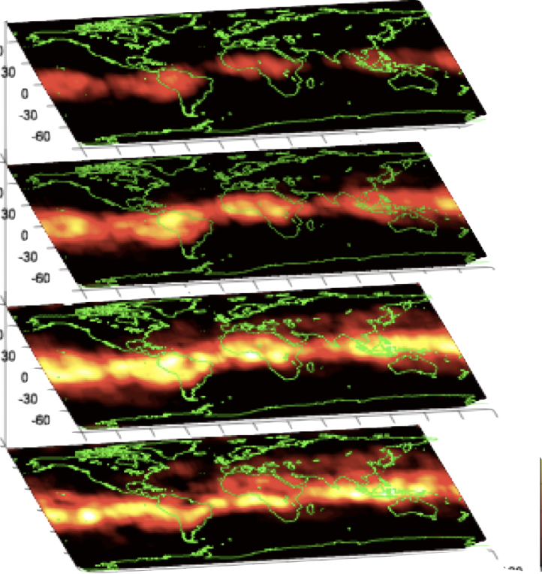
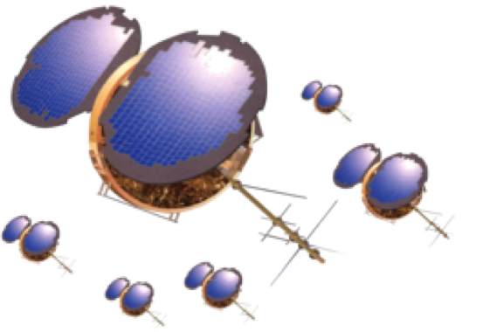
Observations of ionosphere responses to forcing from Sun to Earth's surface using global ionosphere specifications (GIS) and FORMOSAT-7/COSMIC-2
Charles Lin, P. K. Rajesh, SP Chen, JT Lin
National Cheng Kung University (NCKU), Taiwan,
Chi-Yen Lin, Jann-Yenq (Tiger) Liu, National Central University, Taiwan
Tomoko Matsuo,
University of Colorado Boulder, USA
Minyang Chou, Jia Yue,
NASA Goddard Flight Center, USA
FORMOSAT-3/COSMIC-1
FORMOSAT-7/COSMIC-2

Slide 2
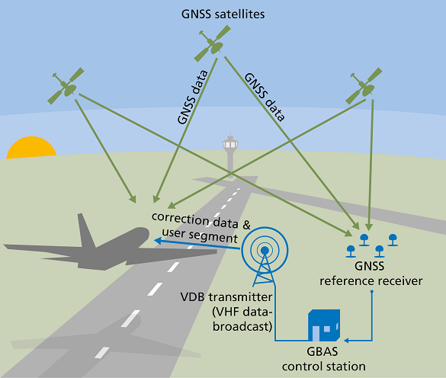
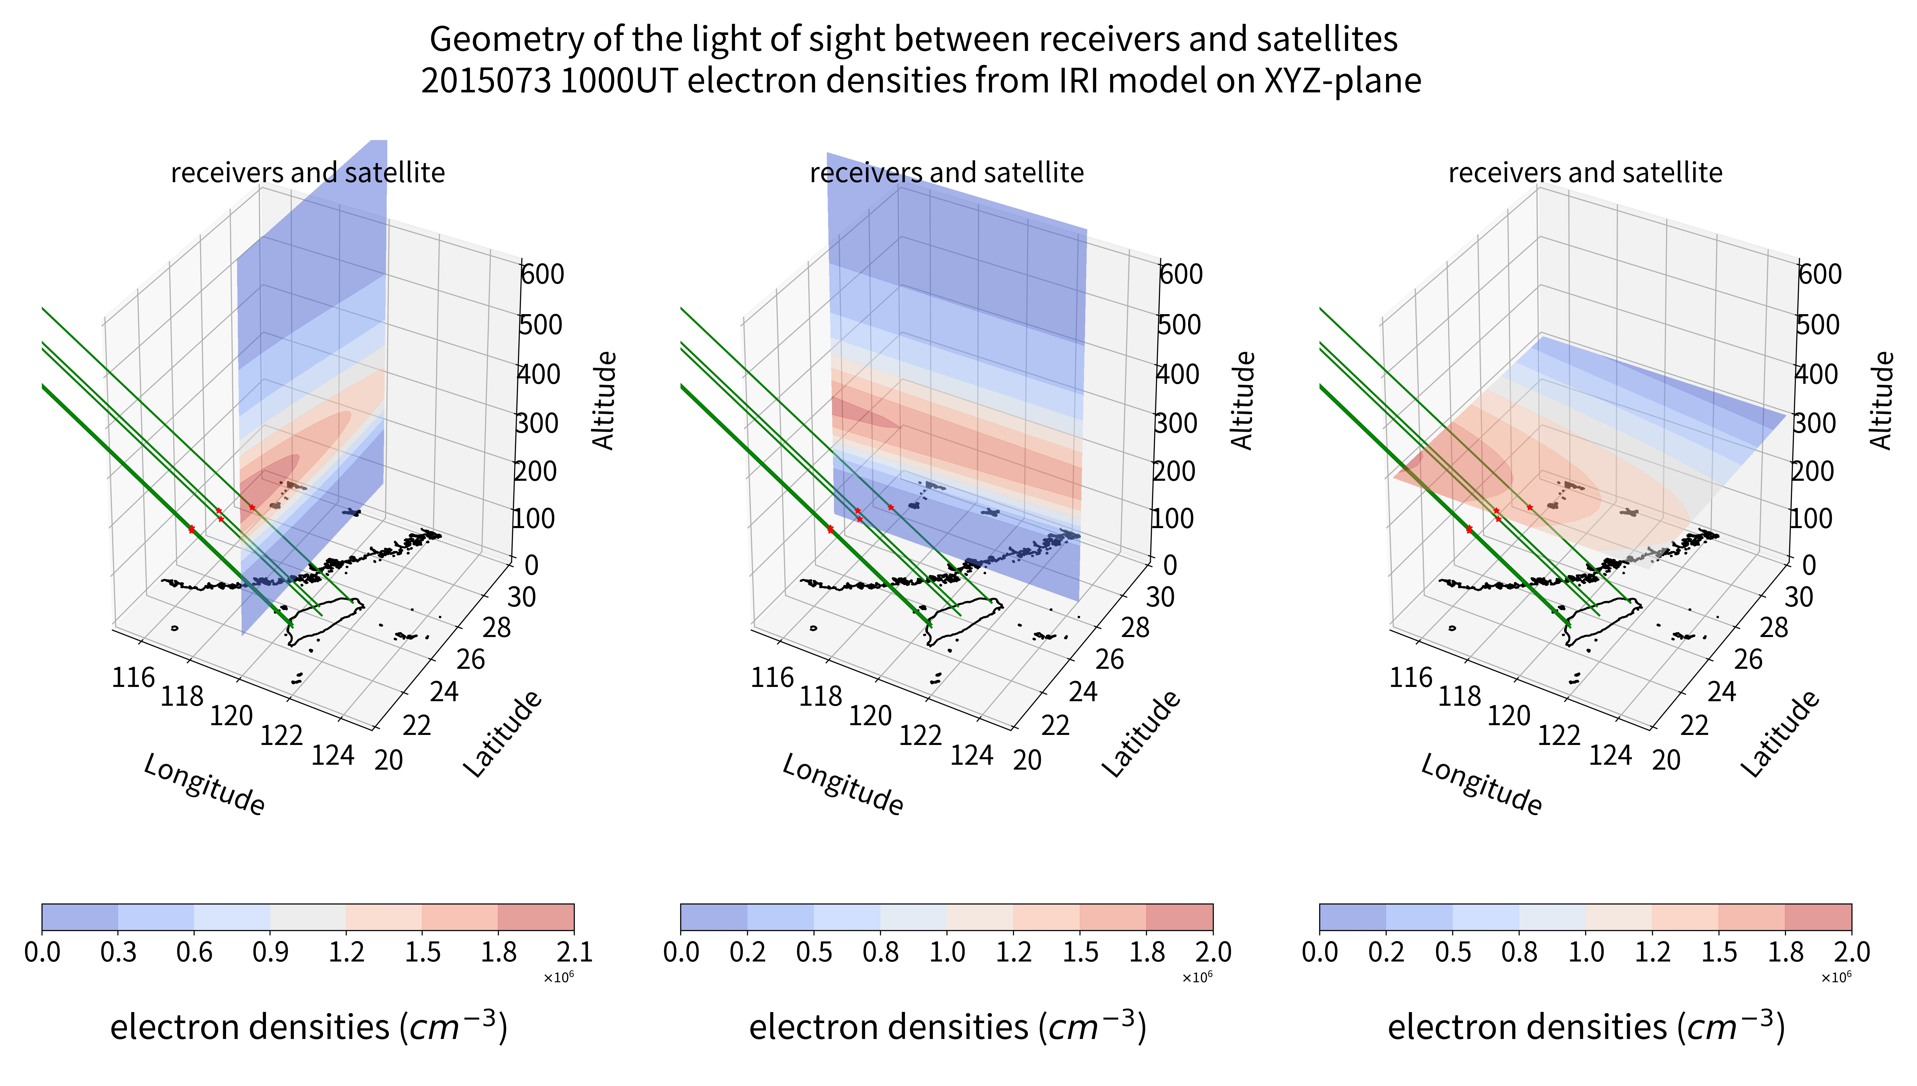
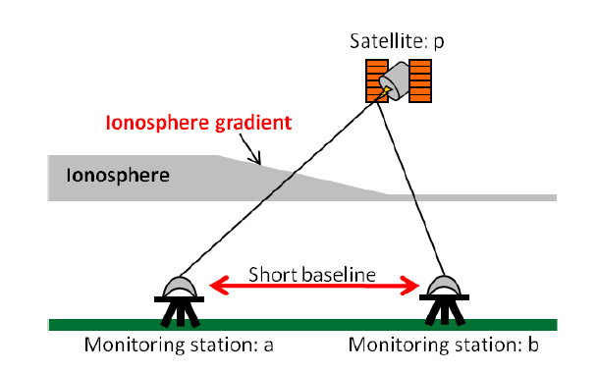
Why 3-D ionosphere?
GNSS-Aided Civil Aviation utilizes single frequency difference to remove ionosphere delays
TEC (background) & single diff. ionosphere delays @ receivers

Slide 3
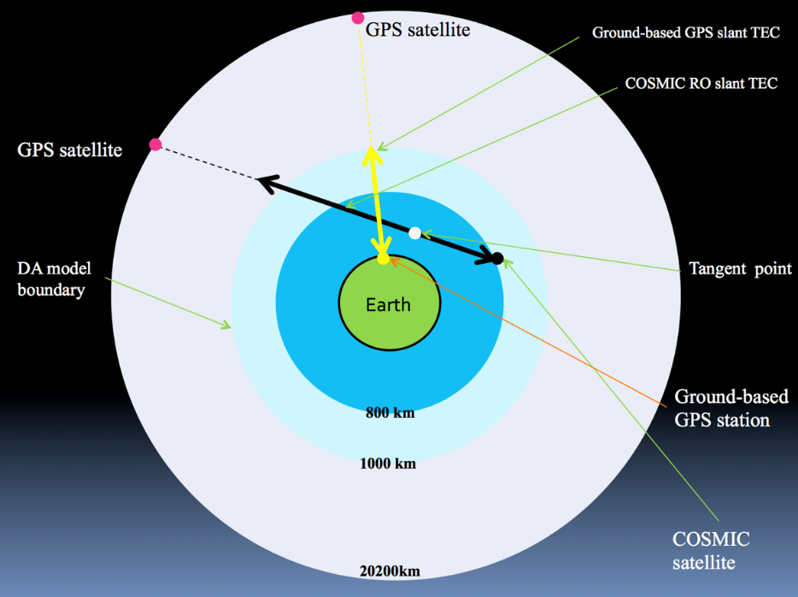
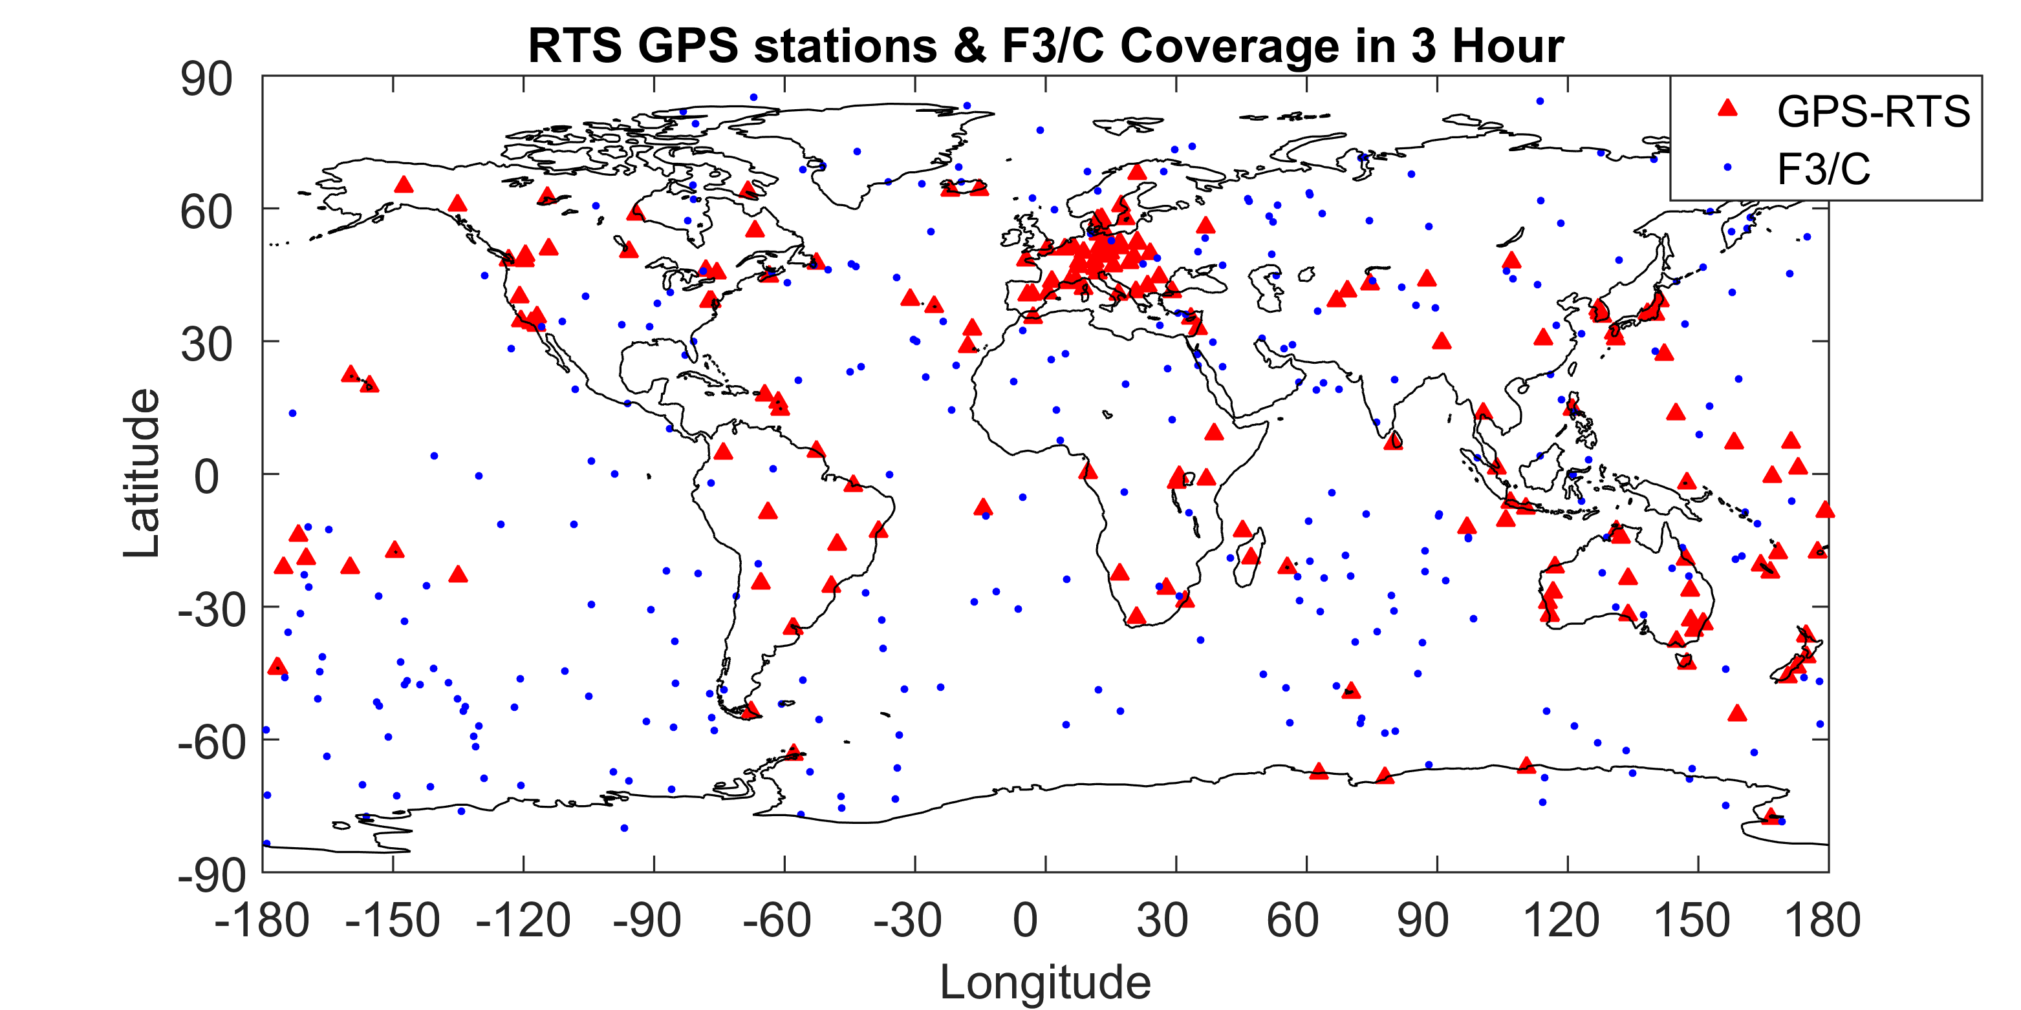
3-D Global Ionospheric Specification (GIS): Gauss-Markov Kalman Filter
[C. Y. Lin et al., AMT 2015, JGR 2017, 2020]
Develop nowcast three-dimensional(3-D) ionospheric electron density model by assimilating both ground-based GPS and space-based radio occultation slant total electron contents (sTEC) - 1 hour latency
The model is written in FORTRAN MPI code that takes 10-15 mins to output 1 hour data
Coverage: Global 100-1,000 km
Grid resolution:
Longitude: 5° / 2.5°
Latitude: 2.5°
Altitude: 20 / 5km
Time resolution: 1 hour / 20 mins
realtime GNSS
realtime RO

Slide 4
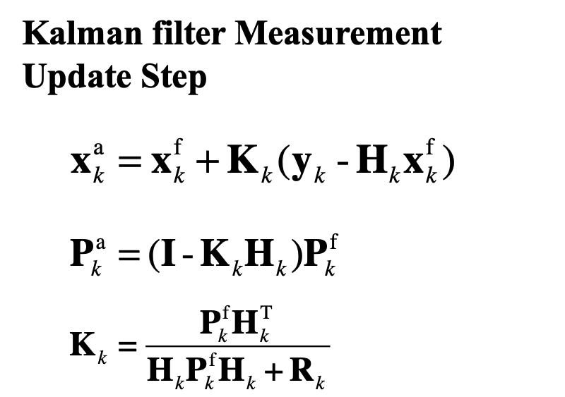
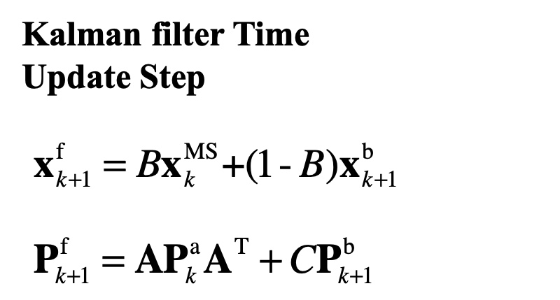
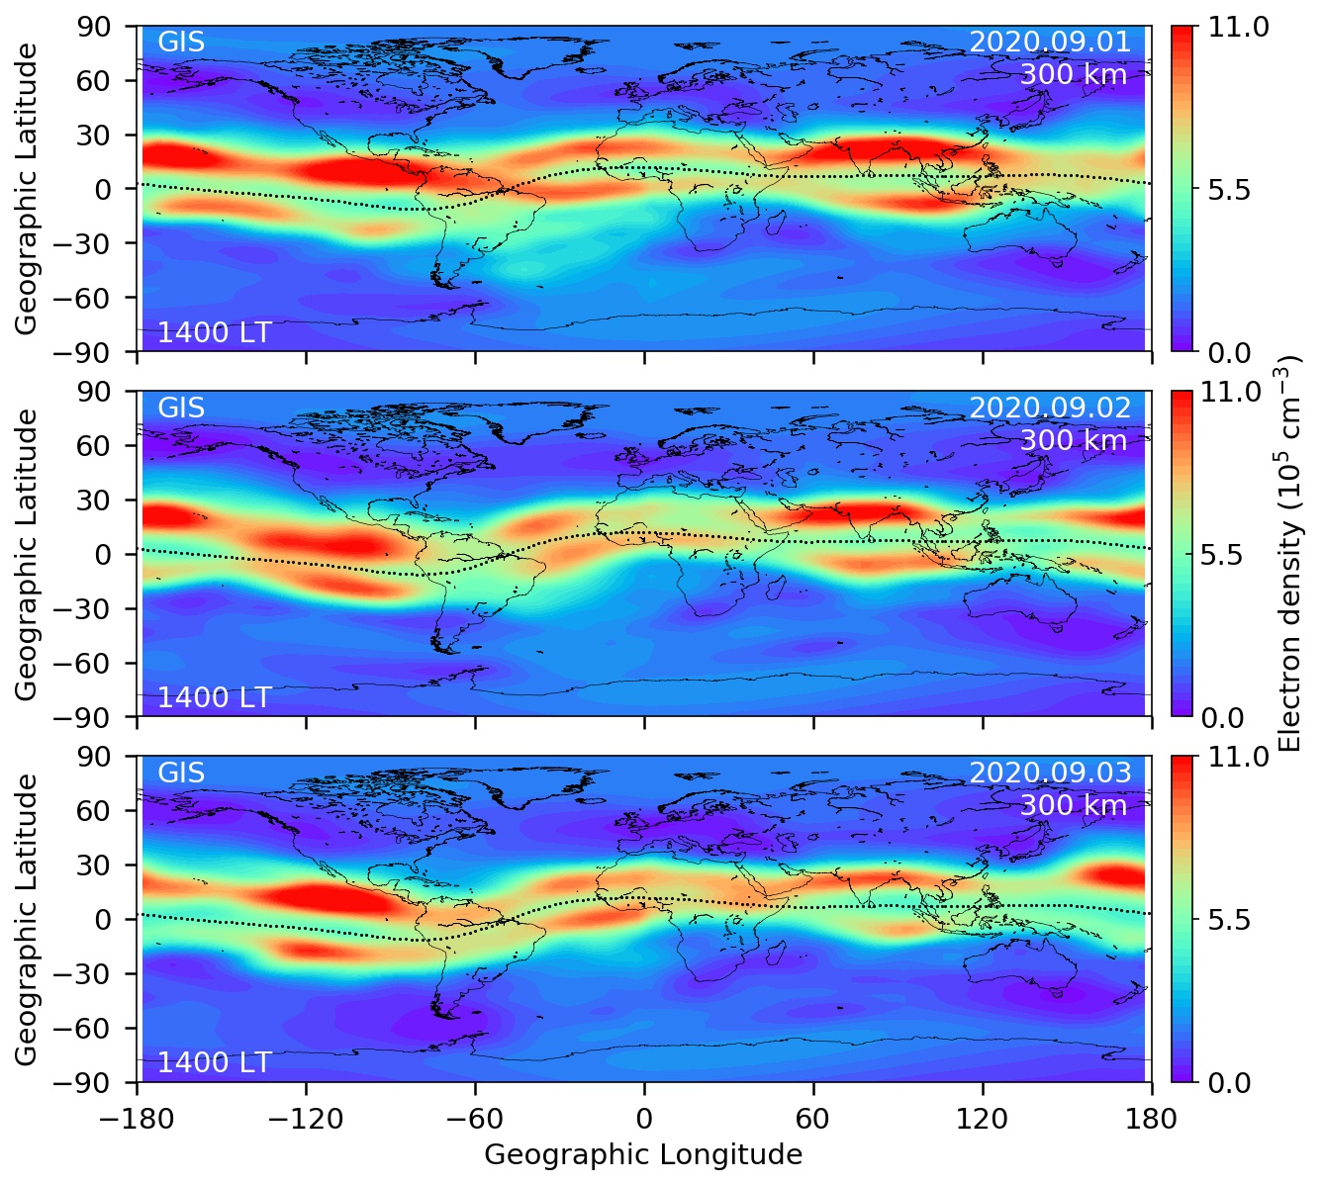
F7/C2 3-D Global Ionospheric Specification (GIS)
Gauss-Markov Kalman Filter
Touring Point
ROs - TEC < G-based GNSS
ROs - TEC > G-based GNSS
[C. Y. Lin et al., AMT 2015, JGR 2017, 2020]
[Rajeshet al., 2021]

Slide 5
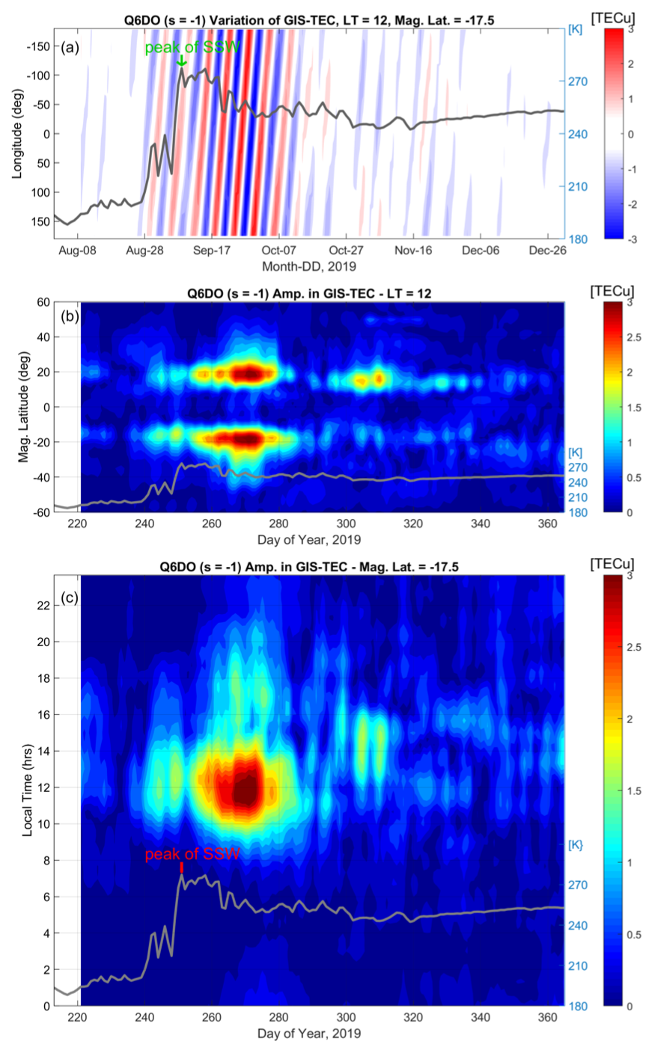
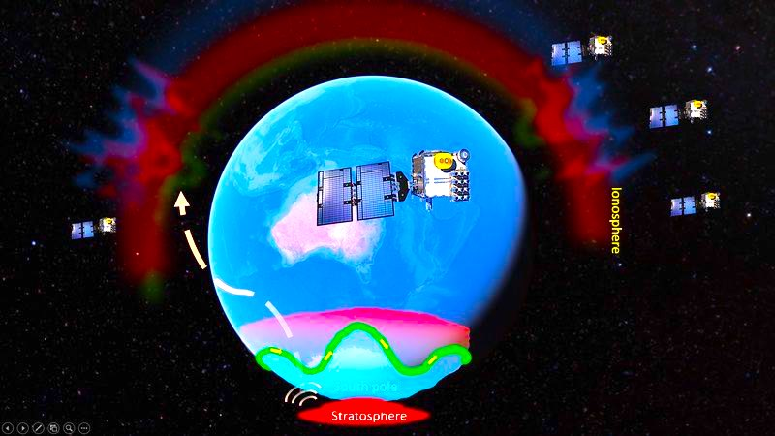
2019 Antarctic Stratospheric Sudden Warming
60K Temperature increase
3rd time in the history strongest for rapid temp. increase
Yamazaki et al., 2020
Extracting the quasi 6-day oscillation (Q6DO) in ionosphere from F7/C2 GIS
Fitting amplitude of Q6DO in latitude and local time
[J. T. Lin et al., 2020]

Slide 6
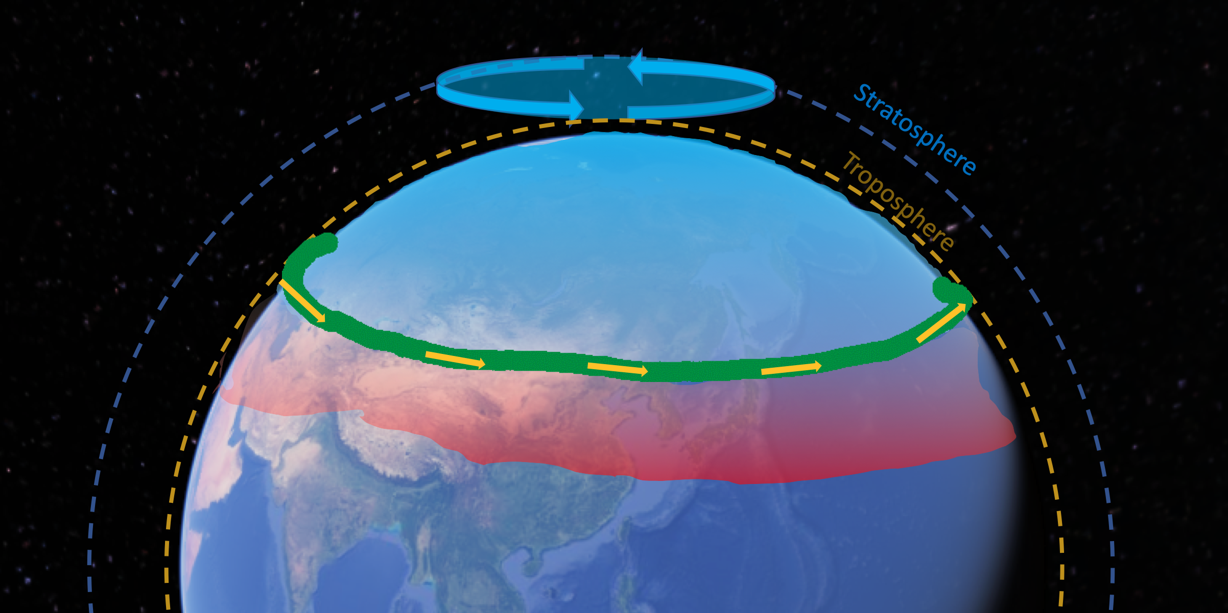
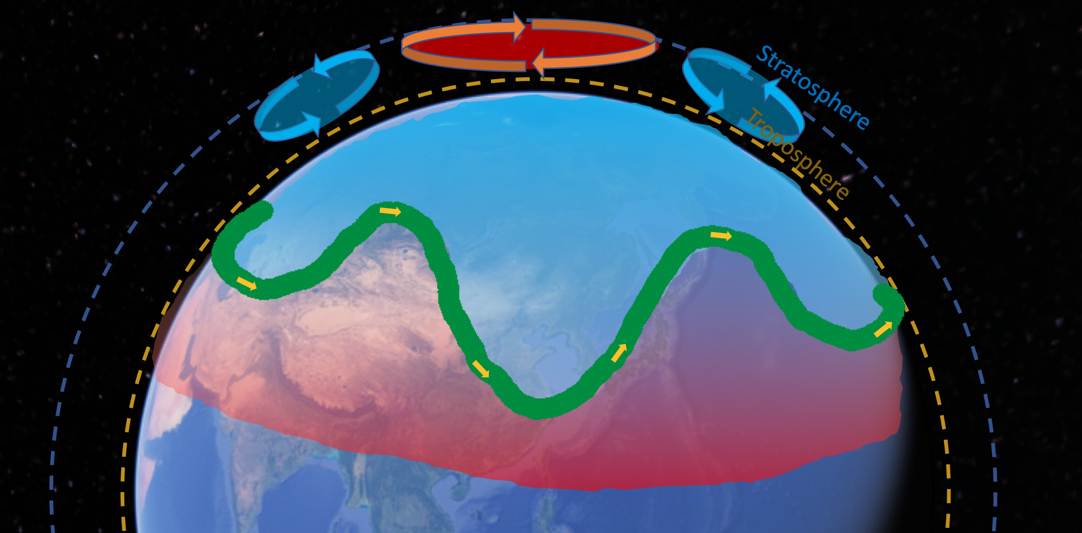
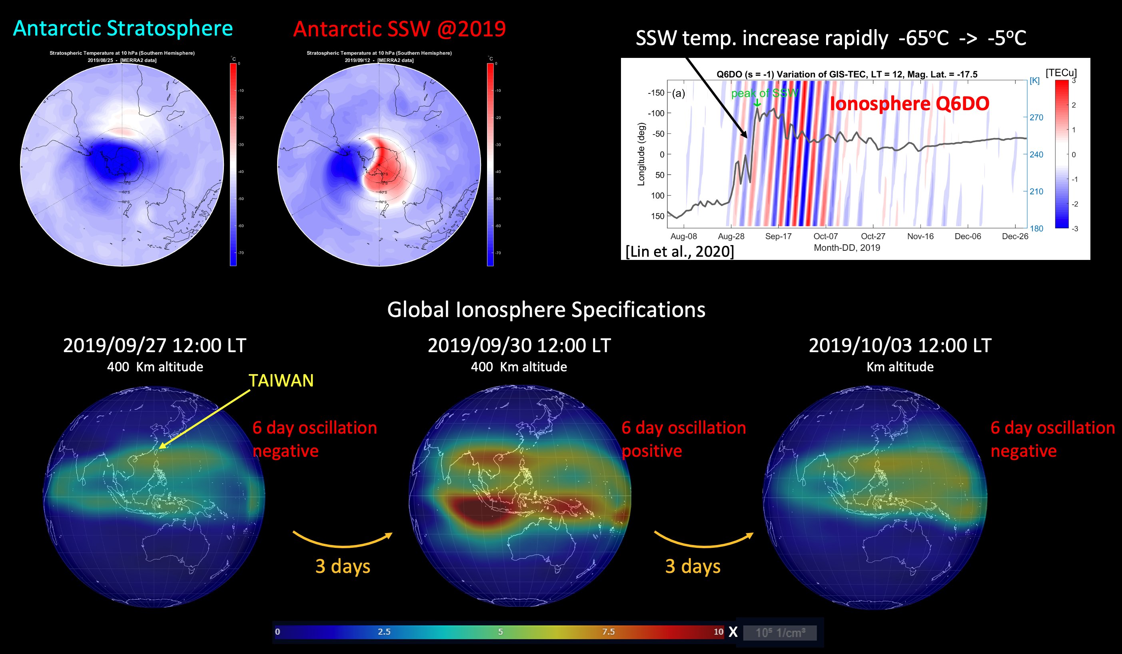
2019 Antarctic Stratospheric Sudden Warming
60K Temperature increase
3rd time in the history strongest in the history for rapid temp. increase
Strongest 6 day oscillation in ionosphere ~ 30%

Slide 7
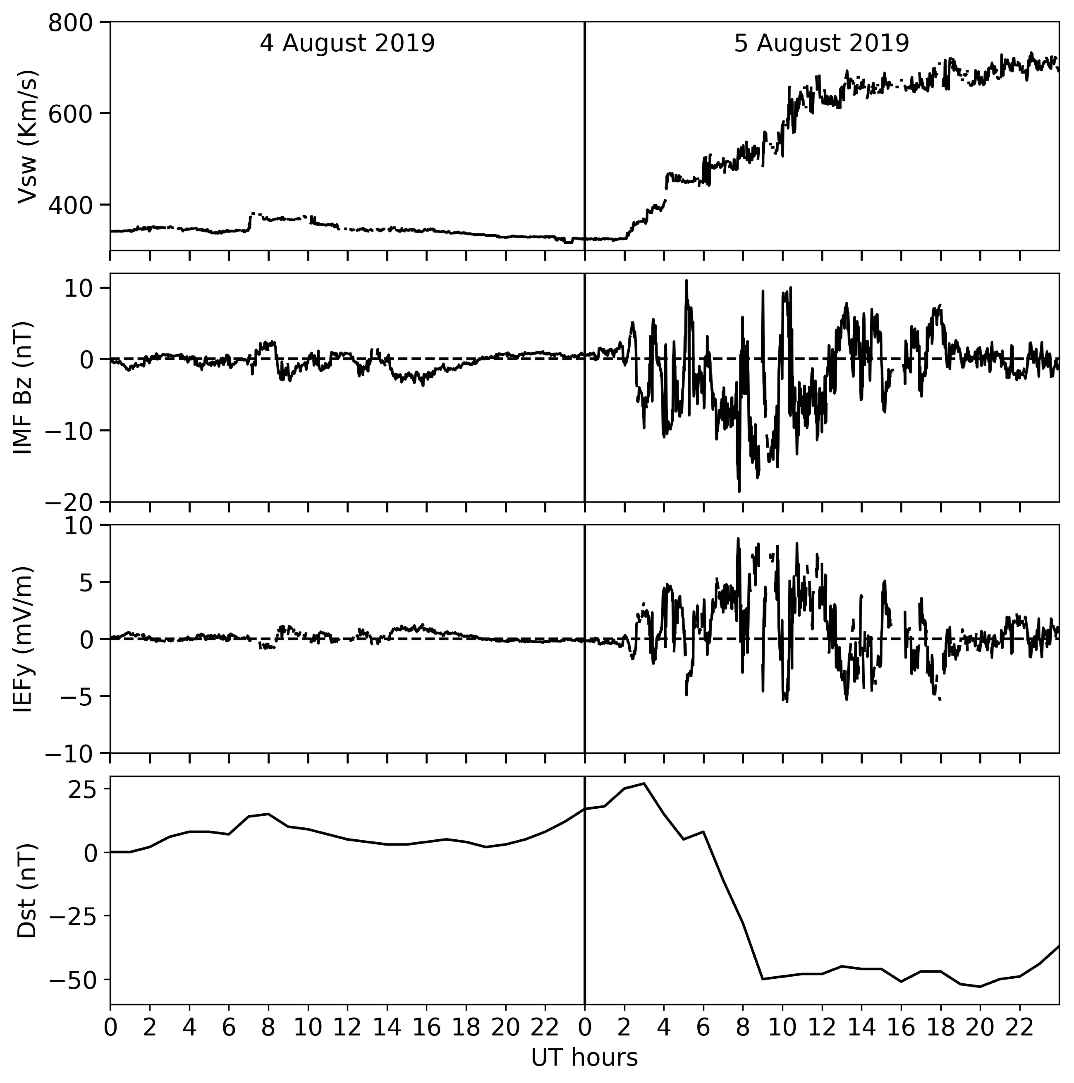
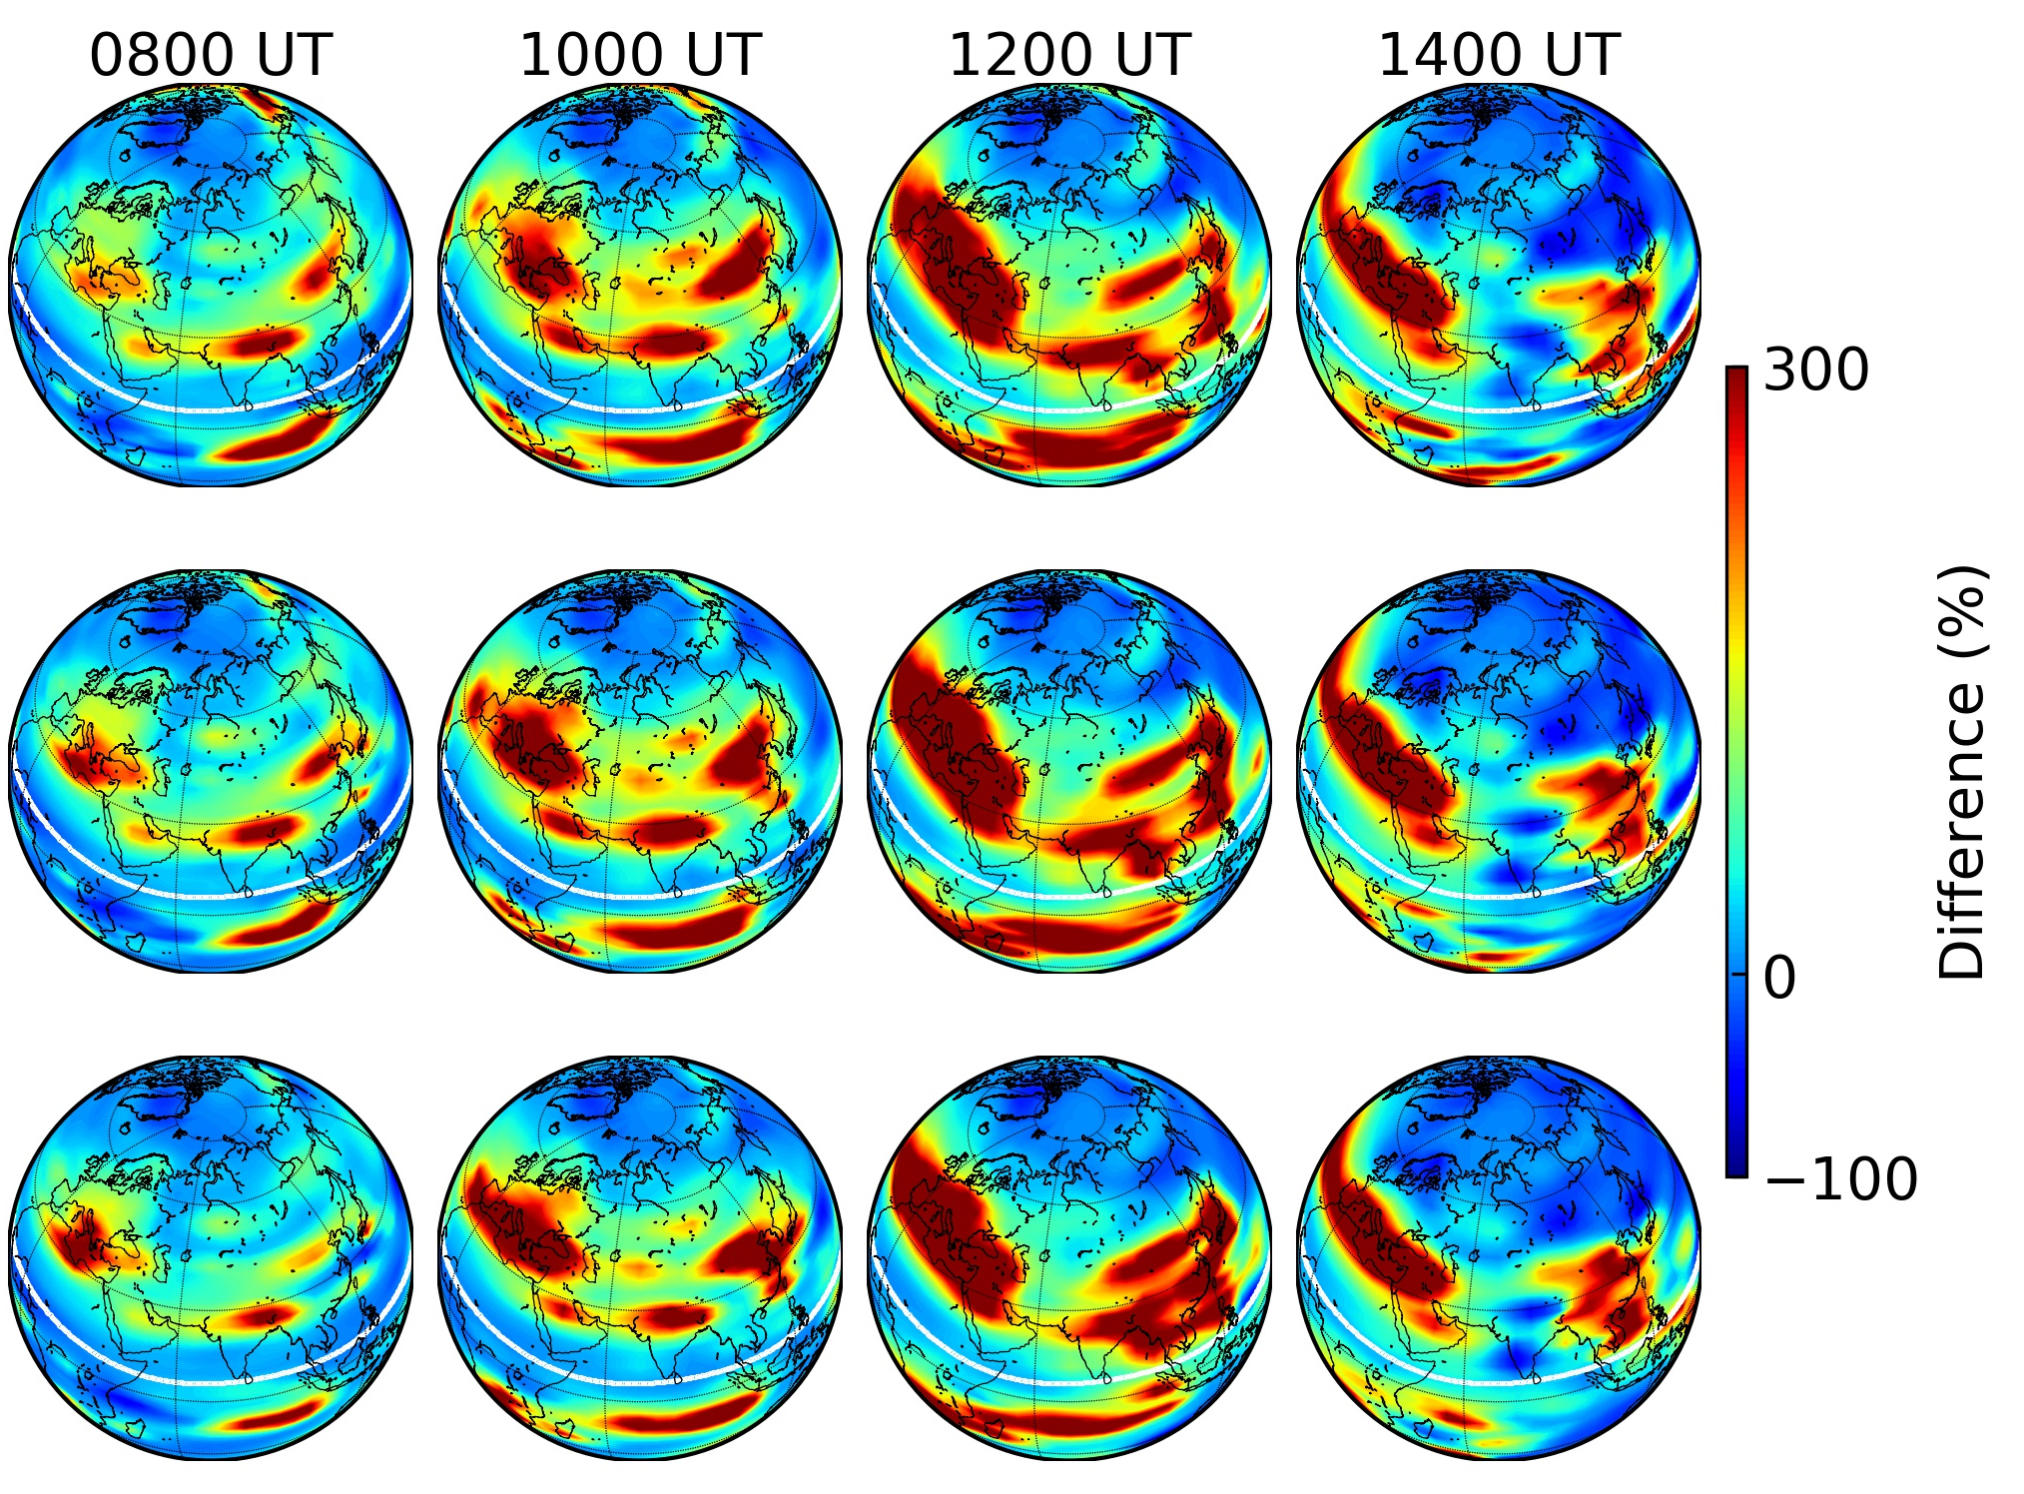
2019-08-05 G1 Minor Magnetic Storm
Rajesh, P. K., Lin, C. H., Lin, C. Y., Chen, C. H., Liu, J. Y., Matsuo, T., et al. (2021), Extreme Positive Ionosphere Storm Triggered by a Minor Magnetic Storm in Deep Solar Minimum Revealed by FORMOSAT‐7/COSMIC‐2 and GNSS Observations, Journal of Geophysical Research: Space Physics, 125, e2020JA028261https://doi.org/10.1029/2020JA028261
High Latitude convection intensified
Triggered strong ionosphere electron density increase
@ India、Europe、Africa with 300-800% increase
Solar Wind Vsw
300 km
IMF B
260 km
Storm E-field
220 km
Dst

Slide 8
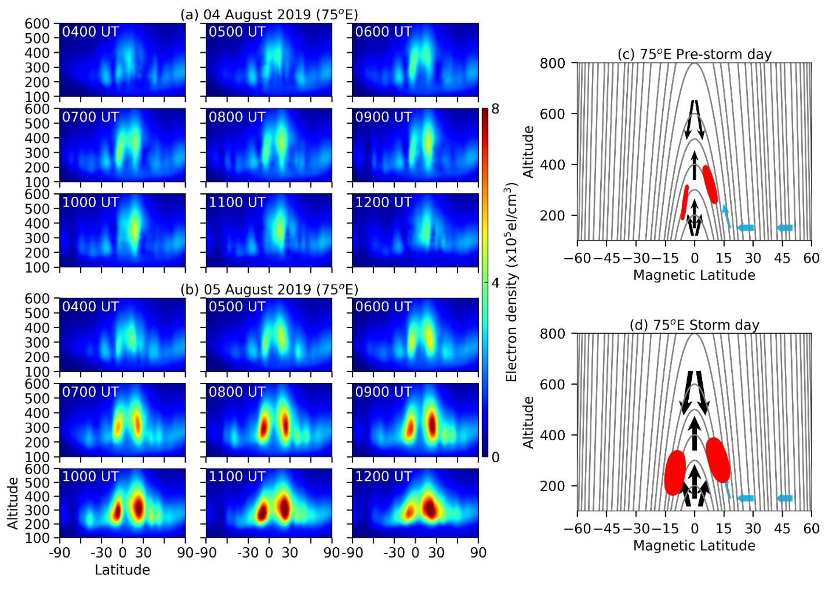
2019-08-05 G1 Minor Magnetic Storm
Latitude-Altitude-Ne @ 75ºE Longitude
Pre-storm
[Rajesh et al., 2020]
Storm

Slide 9
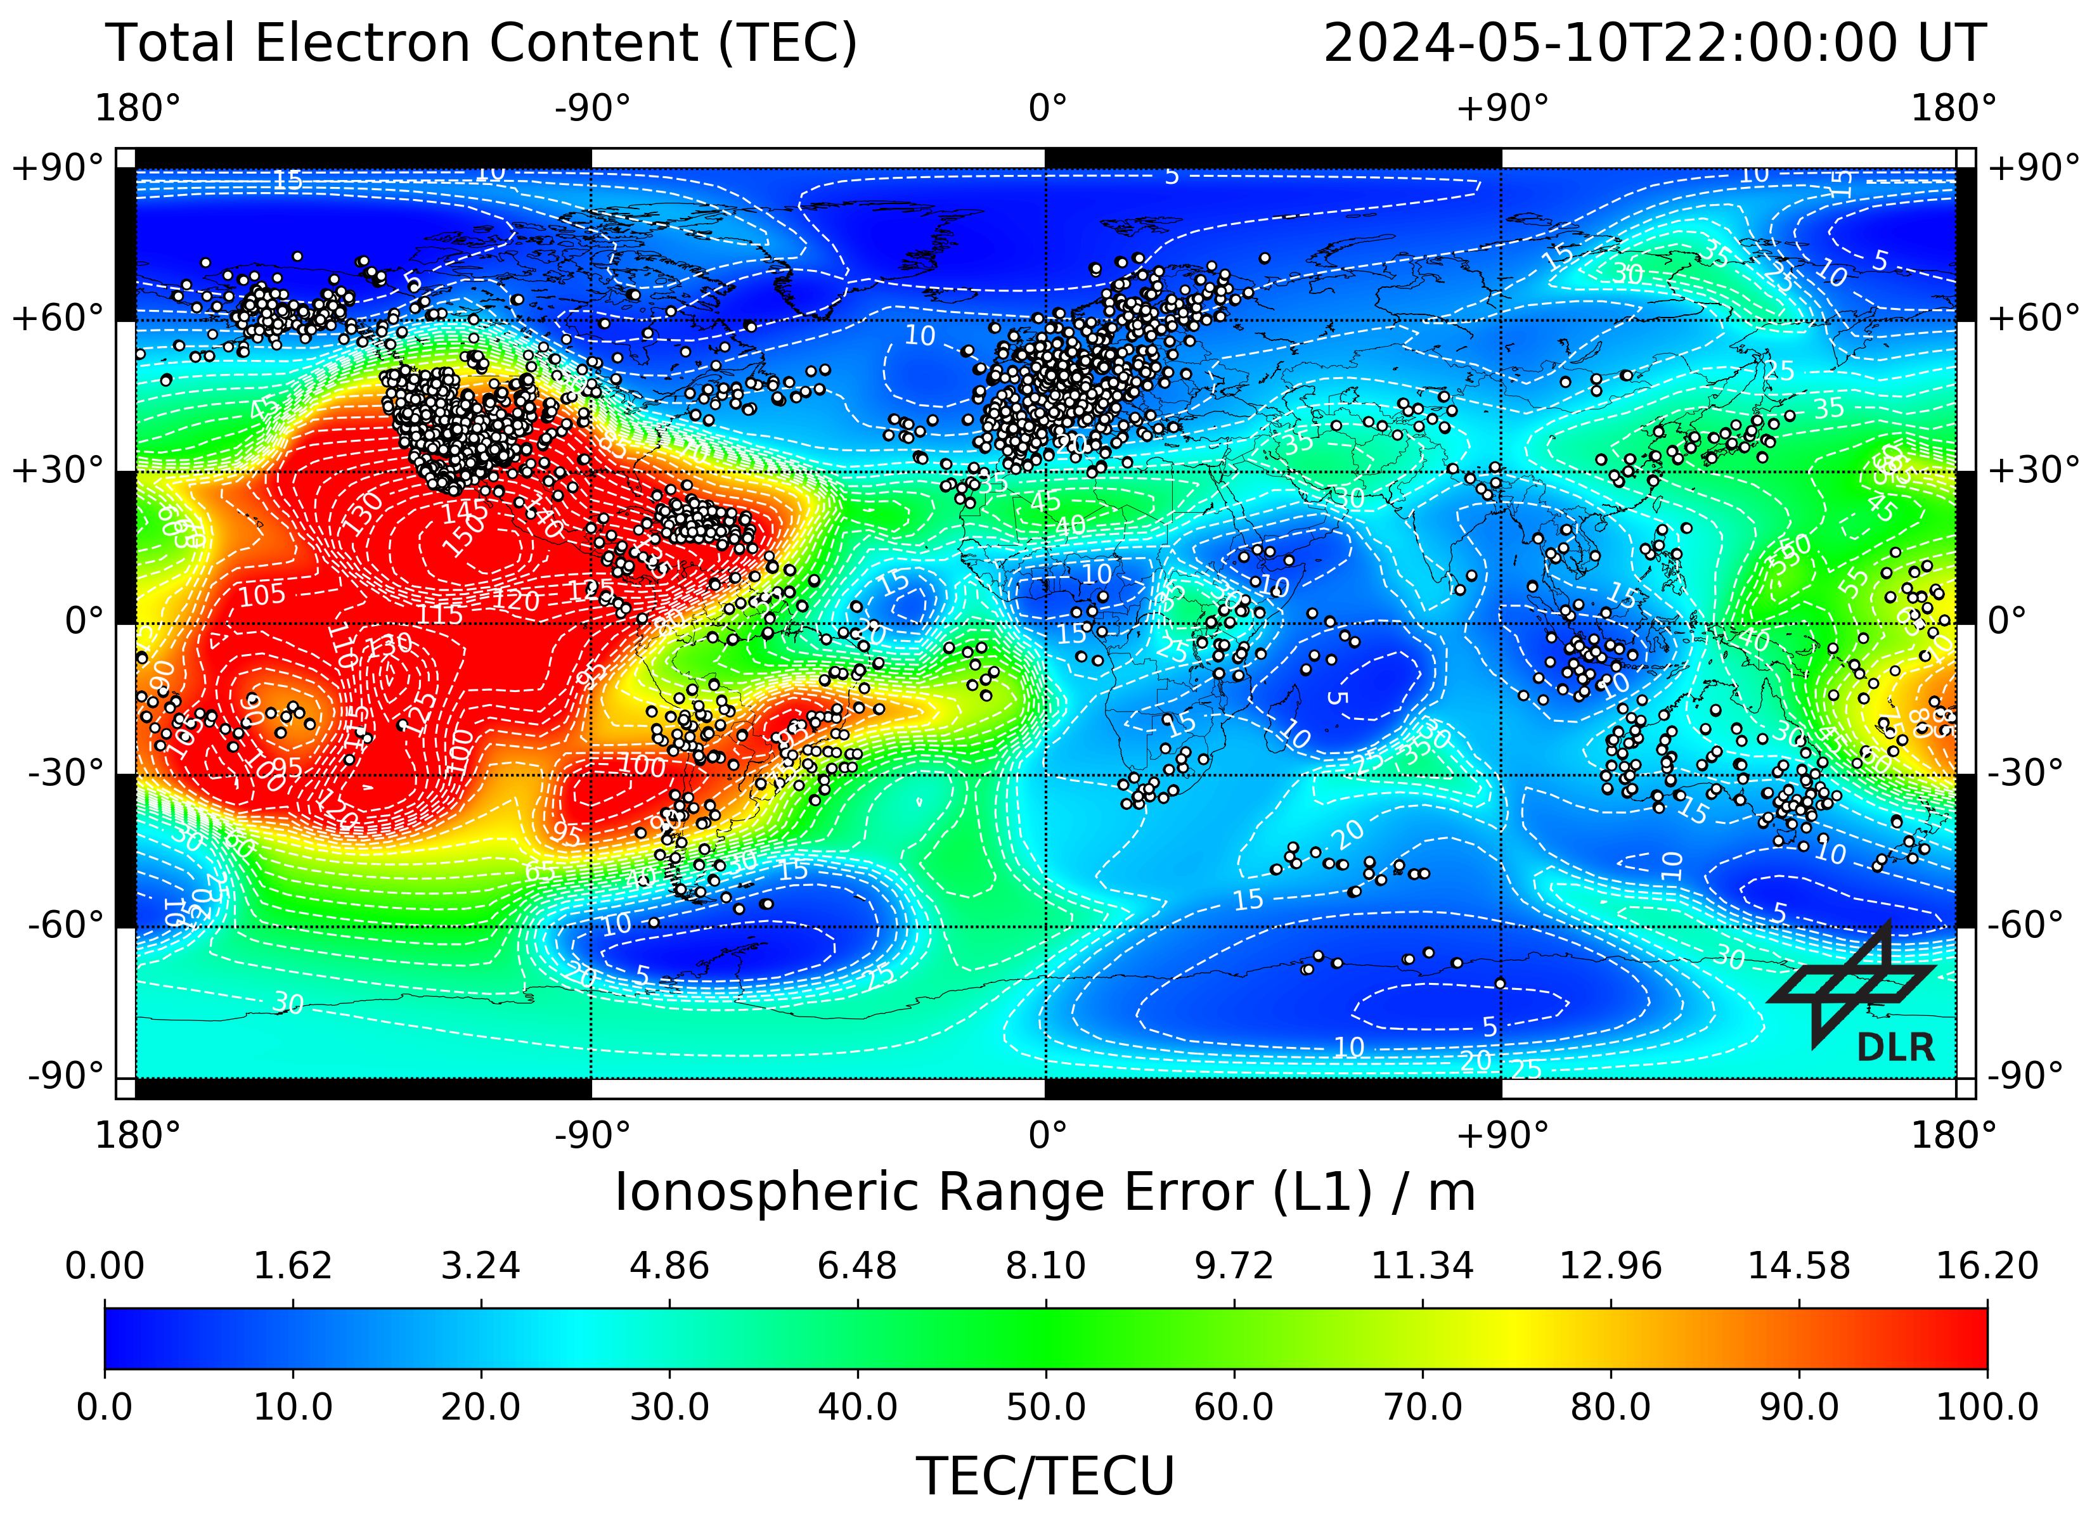
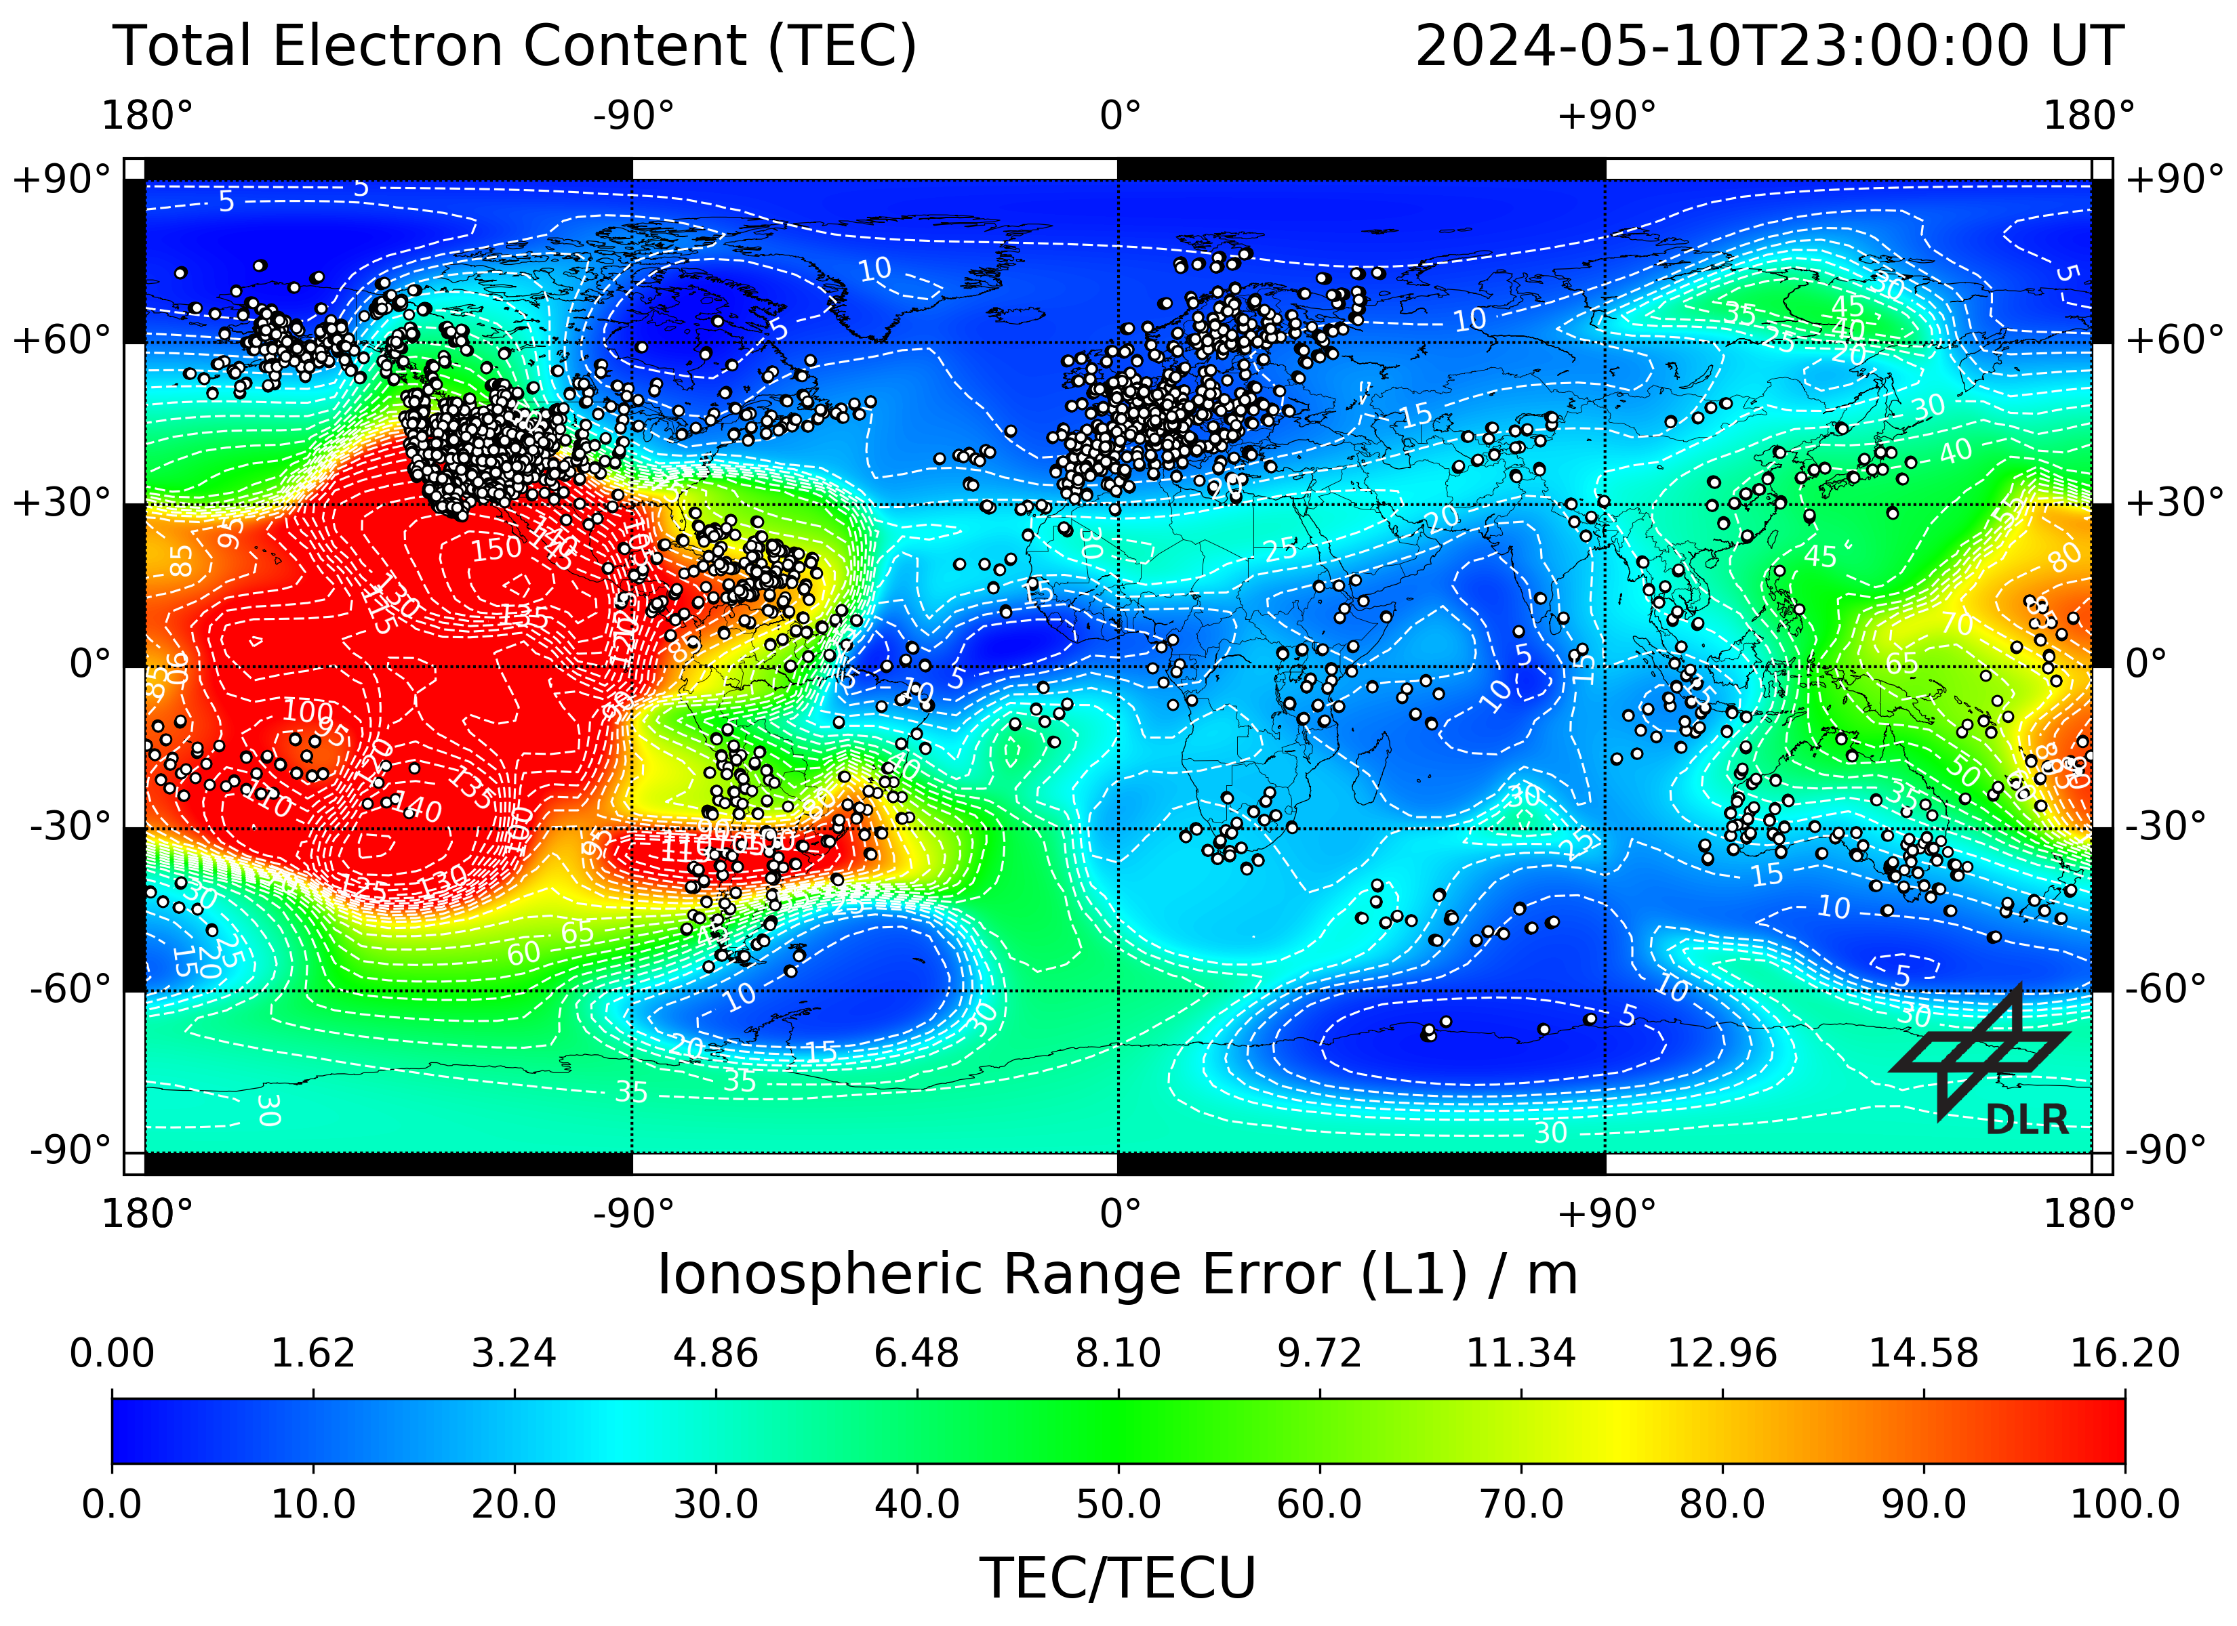
Magnetic storm (G5) on 10-11 May 2024; @ 300 km
Storm Enhanced Density & PPEF
Real-time GIS @ 20-mins during
2200-2300 UT 2300-0000 UT
Reference day
Regular GIS
TEC @ CCMC iSWA

Slide 10
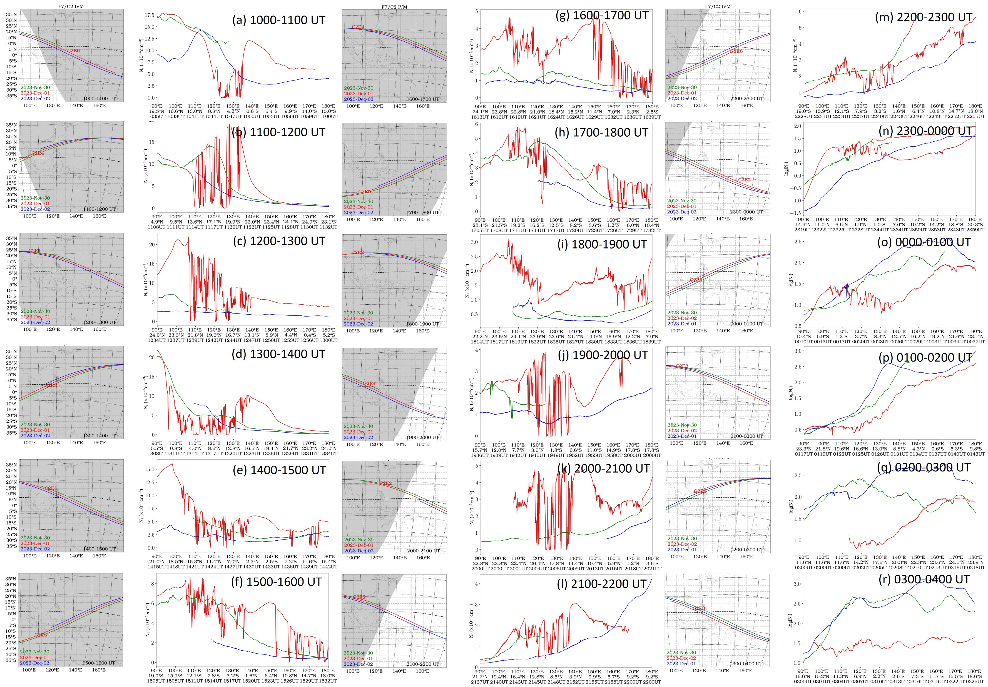
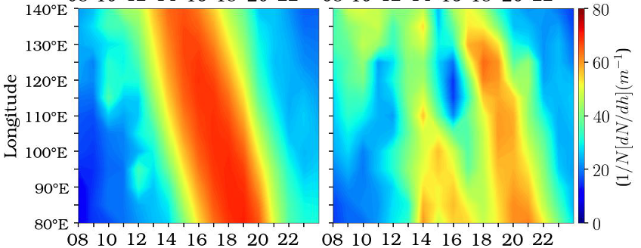
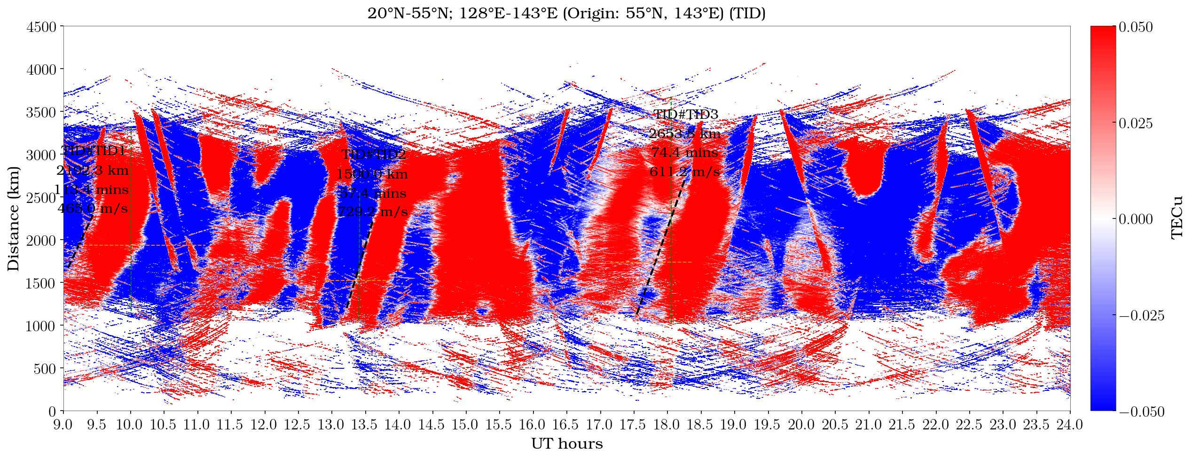
Magnetic storm (G3) on 1 Dec. 2023
Strong equatorial plasma bubbles (EPBs) appeared earlier LT at DUSK
EPBs last until DAWN
Pre-storm
Storm
Ne gradient
LSTID#1
LSTID#2

Slide 11
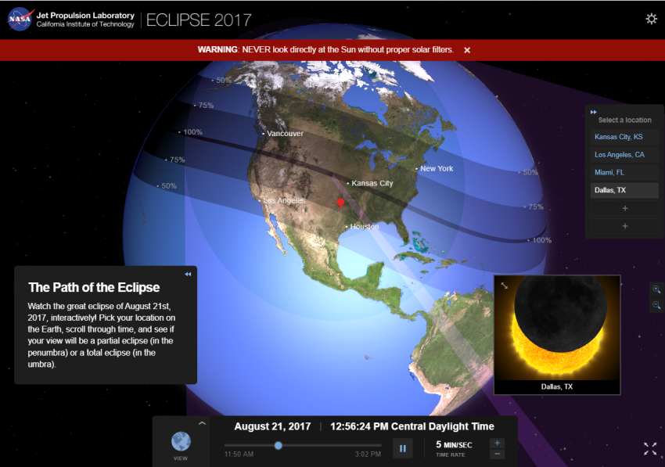
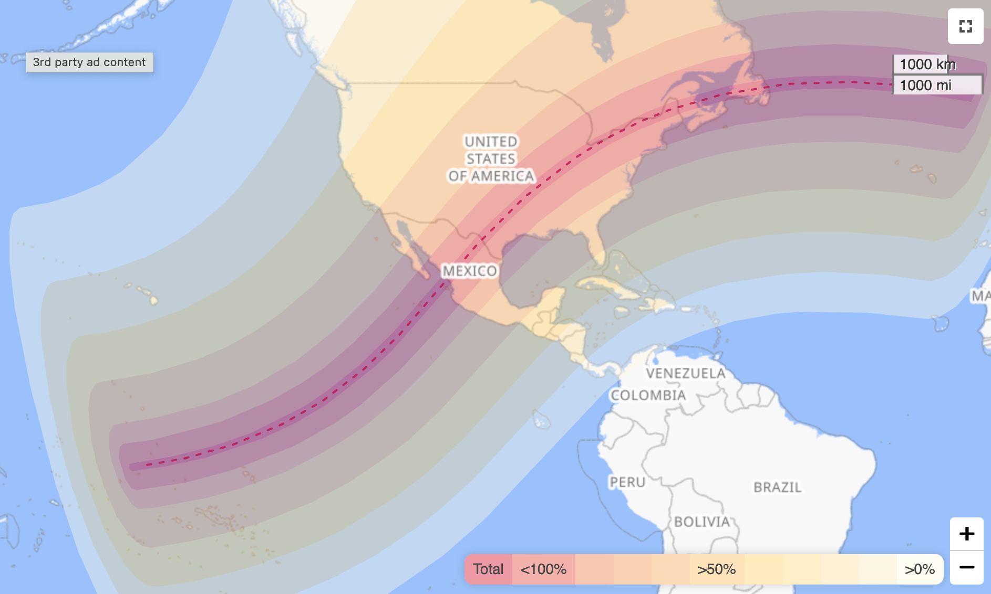
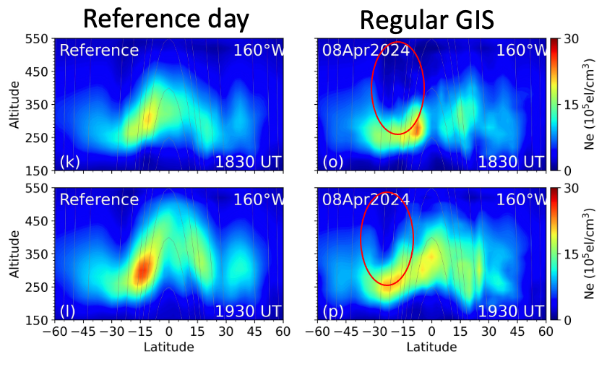
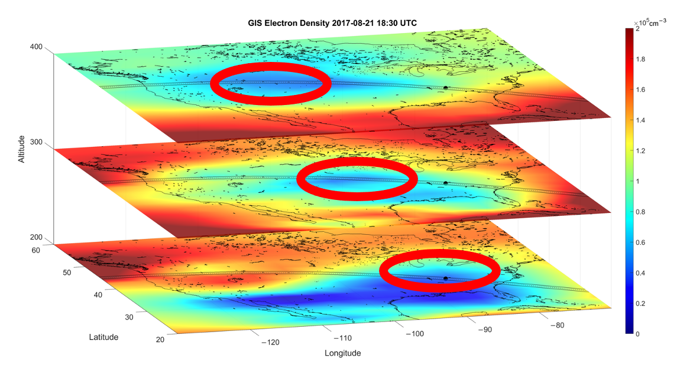
2017 Solar Eclipse using FORMOSAT-3/COSMIC
8 April 2024 Solar Eclipse
Lin et al., 2023

Slide 12
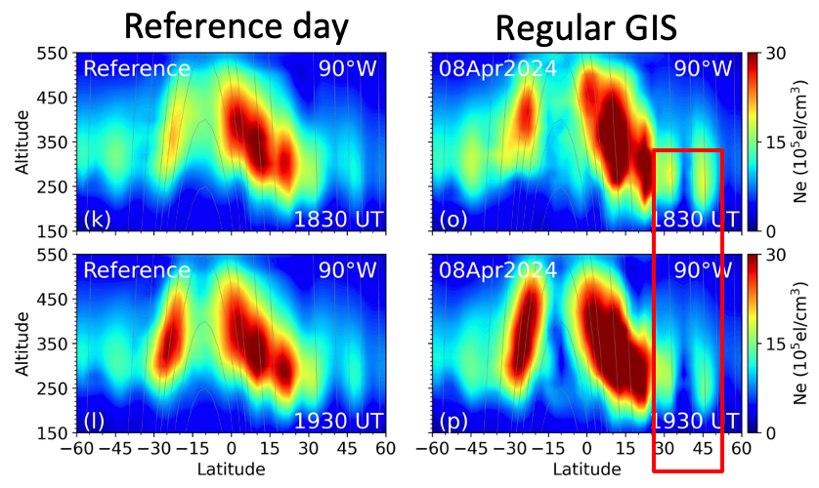
2017 Solar Eclipse using FORMOSAT-3/COSMIC
8 April 2024 Solar Eclipse
Lin et al., 2023

Slide 13
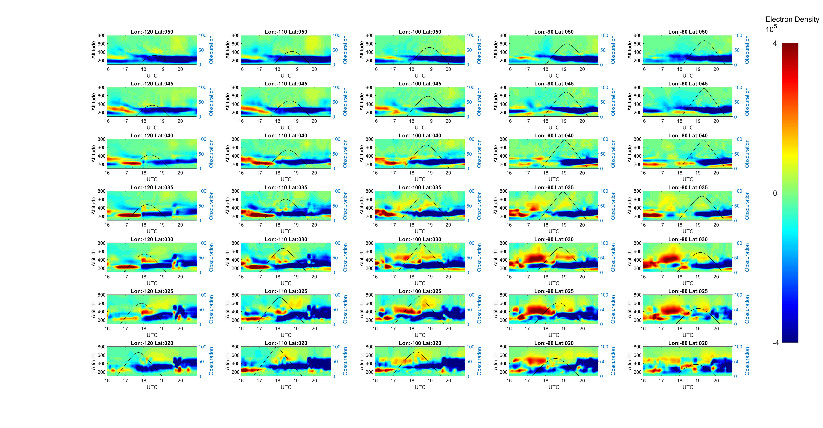
8 April 2024 Solar eclipse effects – depletion at lower heights then extending to higher altitudes

Slide 14
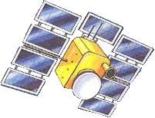
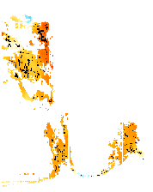
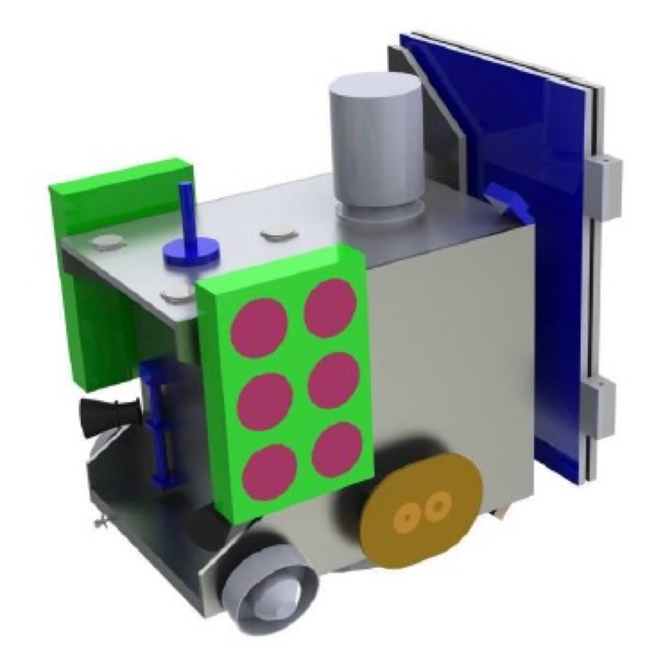
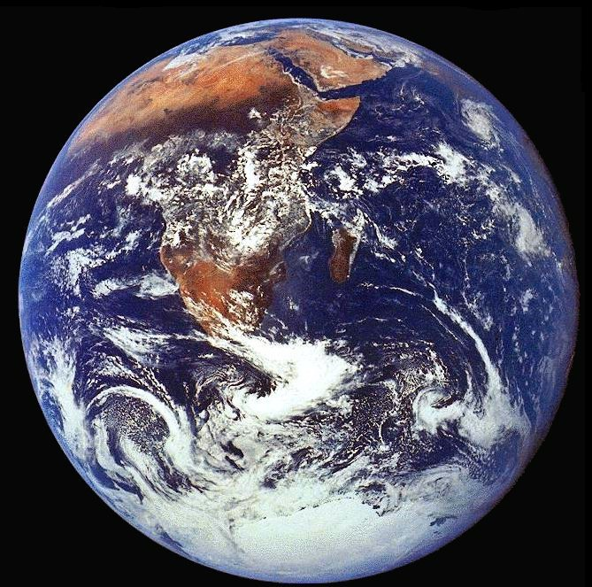
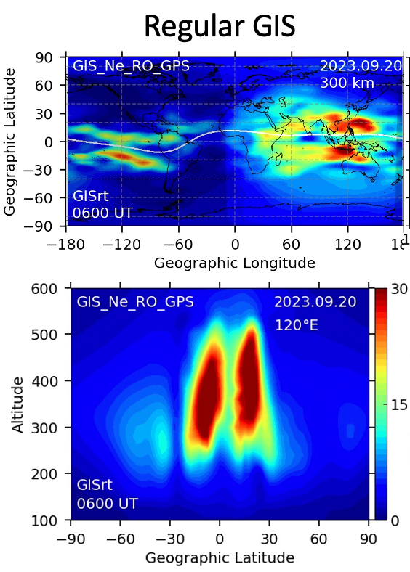
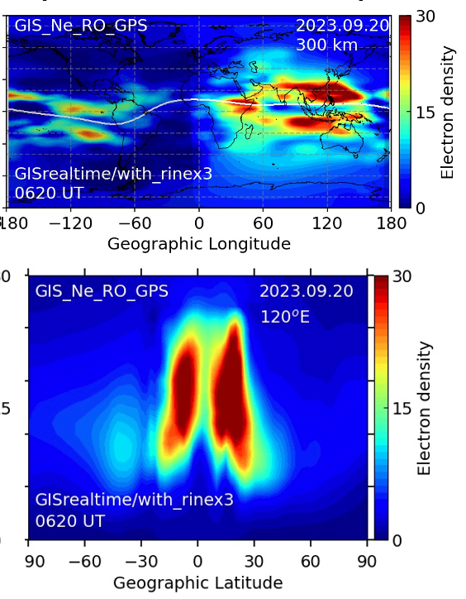
Summary
F7/C2 based GIS has shown prominent day-to-day variability of ionosphere
Day-to-day obs. are useful to see the vertical coupling (SSW & quasi 6 day oscillation).
GIS has been applied to investigate 3 storms (G1, G3 & G5) showing peculiar phenomena.
GIS observes eclipse induced plasma depletions showing tilting depletion in altitudes
Next: making real-time and adaptive grid GIS & assimilate commercial data at mid- high latitudes
2-Day Latency GIS
2-hr latency Real-time GIS
Current GIS (1 hr time resolution) waits for two days latency because of ground-based GNSS stations.
We are making it to 2 hrs latency with 20 mins resolution as real-time GIS.
Mid- and high-latitude observations are important. Commercial data may help.
We’re testing a version having upper boundary at 20,200 km

Slide 15
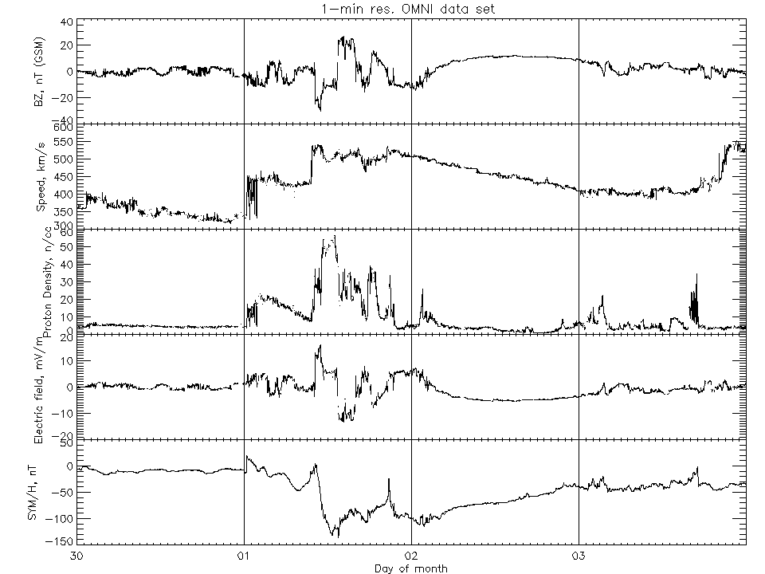
First CME after 0000UT on 01 December 2023
Second CME at ~1000 UT on 01 December 2023
IMF Bz suddenly turns northward at 1330 UT
Weakens and becomes southward around 1700 UT
Turns back northward after about 1-hour (1800 UT)
Become southward again ~2030 UT and remains negative for about 5 and half hours
Source: https://omniweb.gsfc.nasa.gov/
Figure 1. Solar wind, interplanetary and geomagnetic indices during the G3 geomagnetic storm during 30 November – 03 December 2023 (https://omniweb.gsfc.nasa.gov). (top-bottom) (a) IMF Bz, (b) solar wind velocity, (c) solar wind proton density, (d) interplanetary electric field (IEFy), and (e) SYM/H.

Slide 16
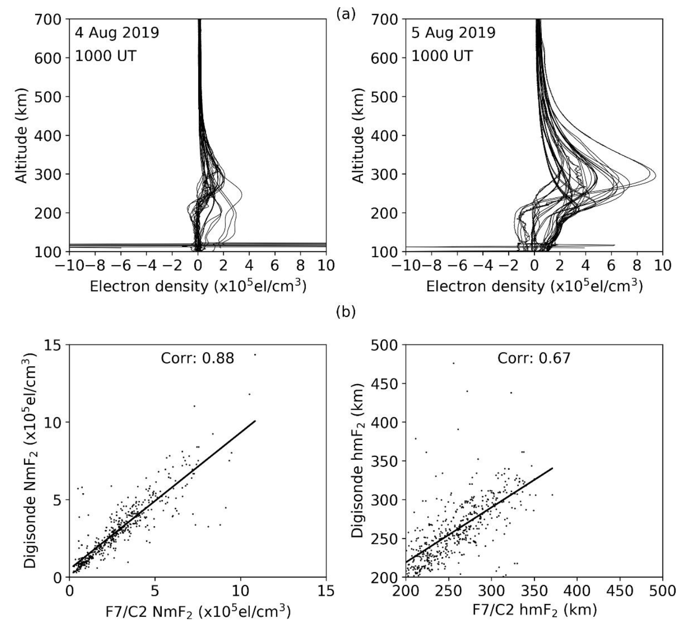
Validation of the Ne-profiles

Slide 17
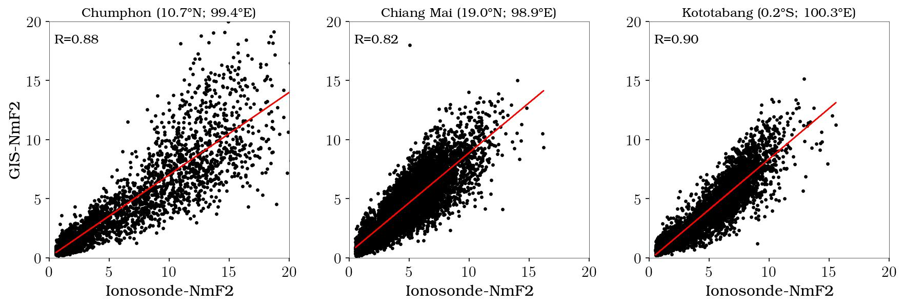
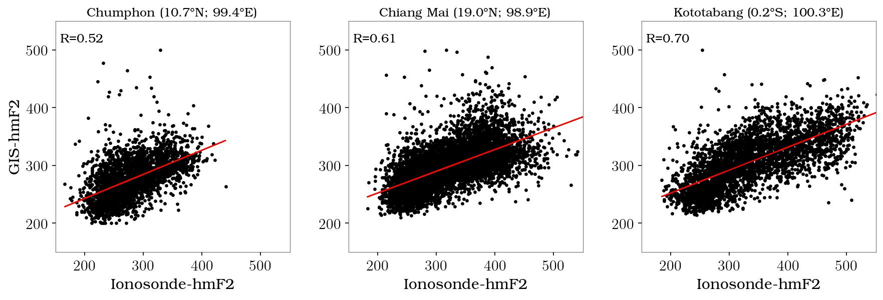
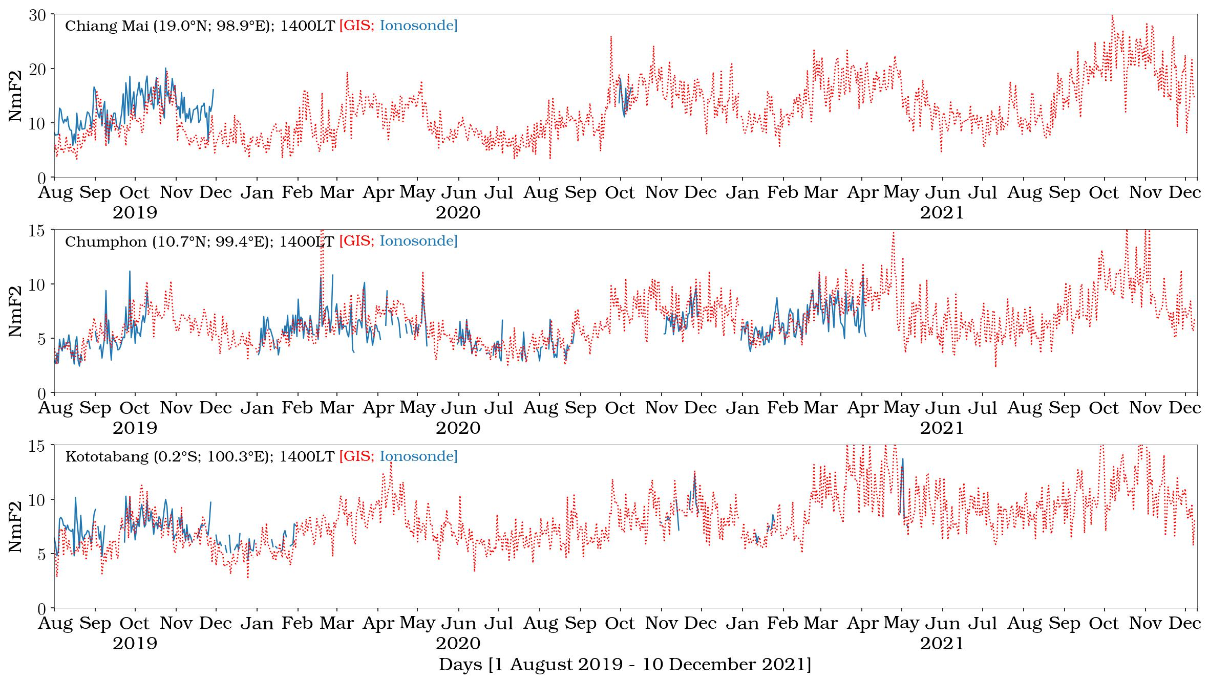
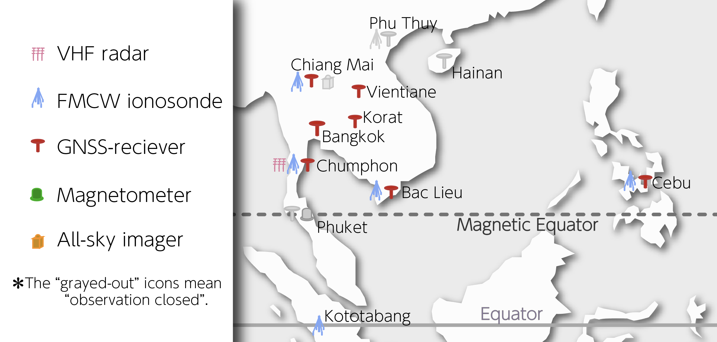
GIS –validation using NICT SEALION network
GIS and Ionosonde NmF2 (2019-2021)
GIS and Ionosonde hmF2 (2019-2021)
NmF2 shows a correlation of about 0.8 to 0.9
hmF2 gives a correlation of about 0.5 to 0.7
NICT SEALION project

