Slide 1
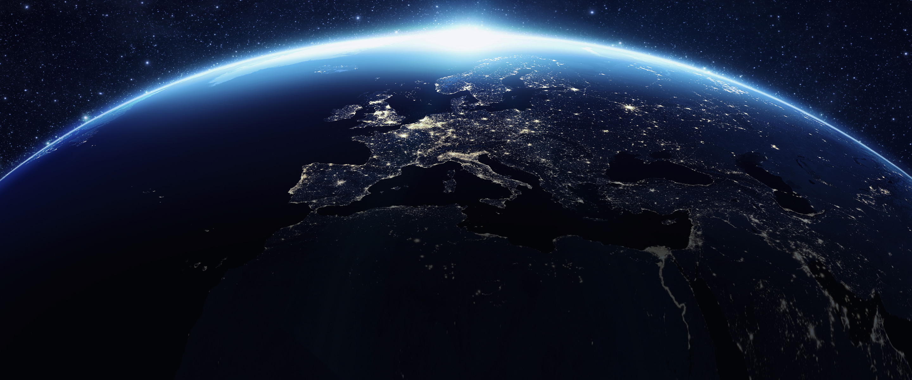




Vlasiator
-- A hybrid-kinetic (beyond-MHD) 3D global code
Minna Palmroth
Professor, University of Helsinki and Finnish Meteorological Institute
Director, Finnish Centre of Excellence in Research of Sustainable Space
Chair of Board, Technology Academy Finland
See also:
Palmroth et al., Living Reviews of Computational Astronomy, 2018

Slide 2
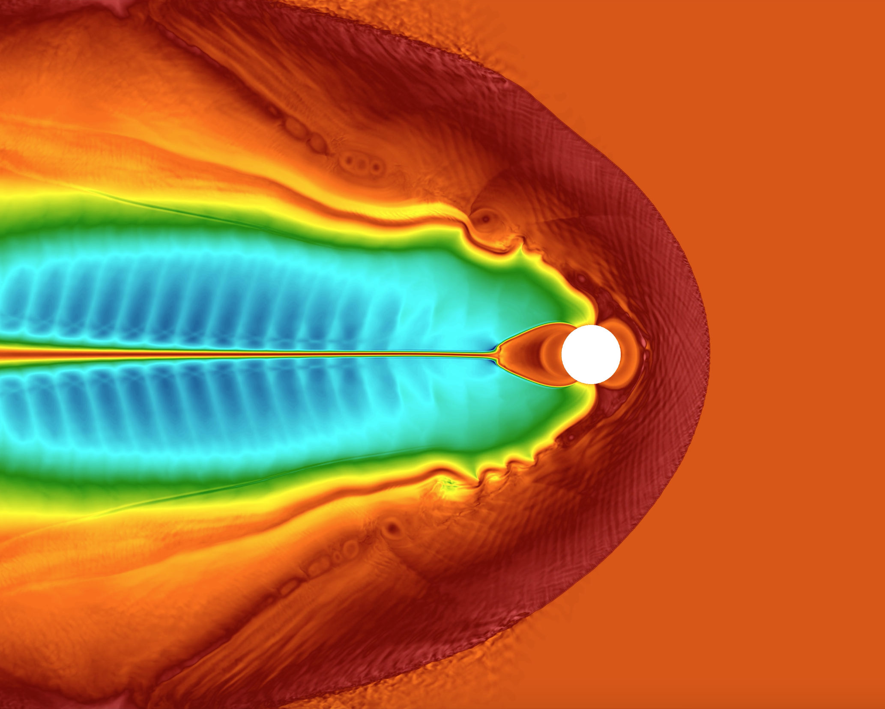
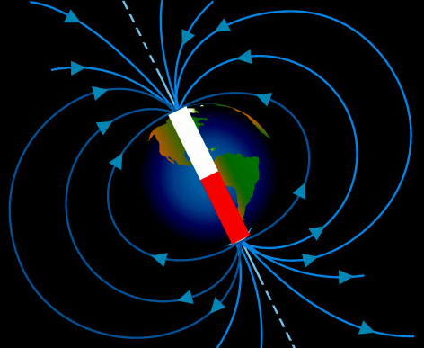
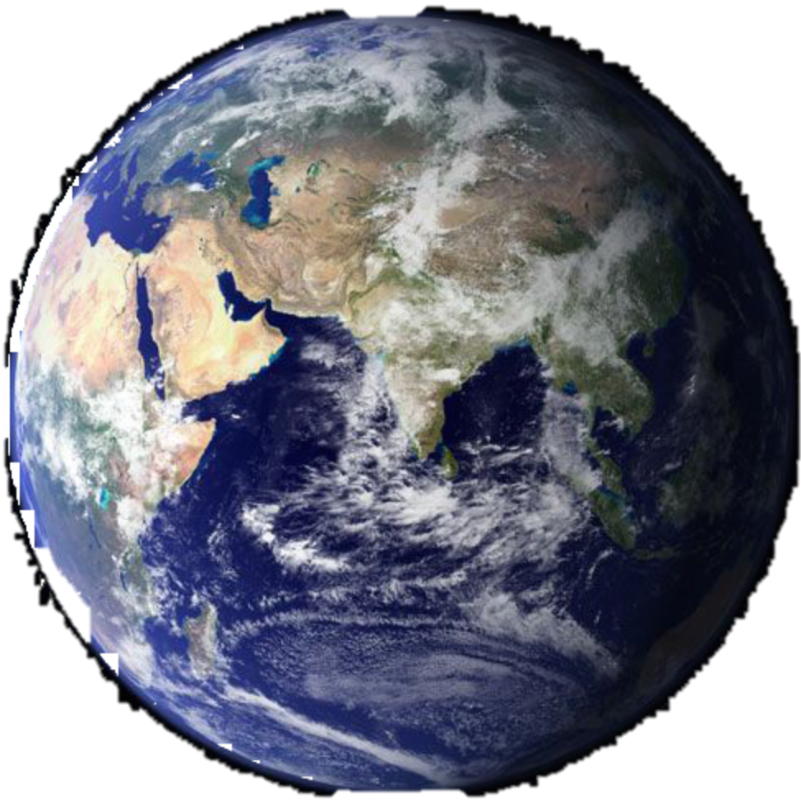
630 000
kilometres
S
N
Solar wind
You are here
1 million kilometres

Slide 3
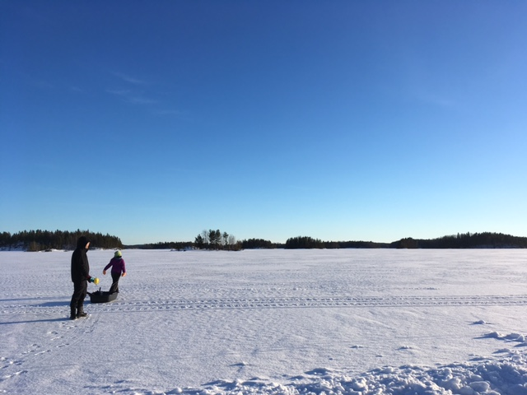
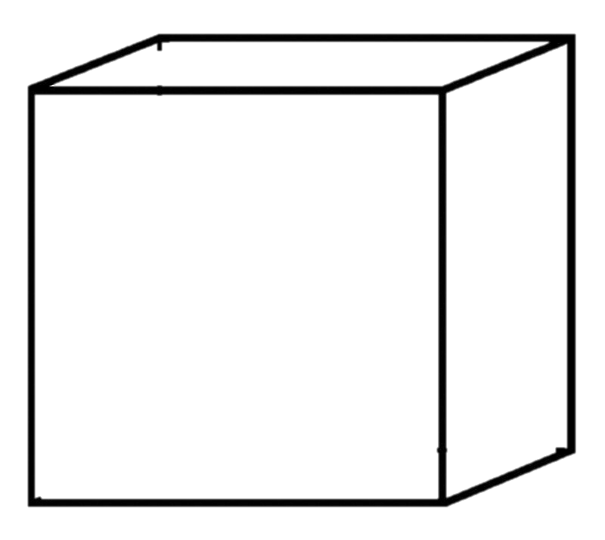
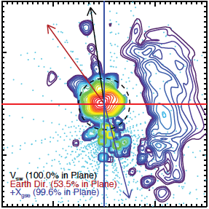
First approximations: Fluid simulations
Number of particles
-15°
Velocity of particles
Pic: Minna Palmroth
Distributions in space

Slide 4
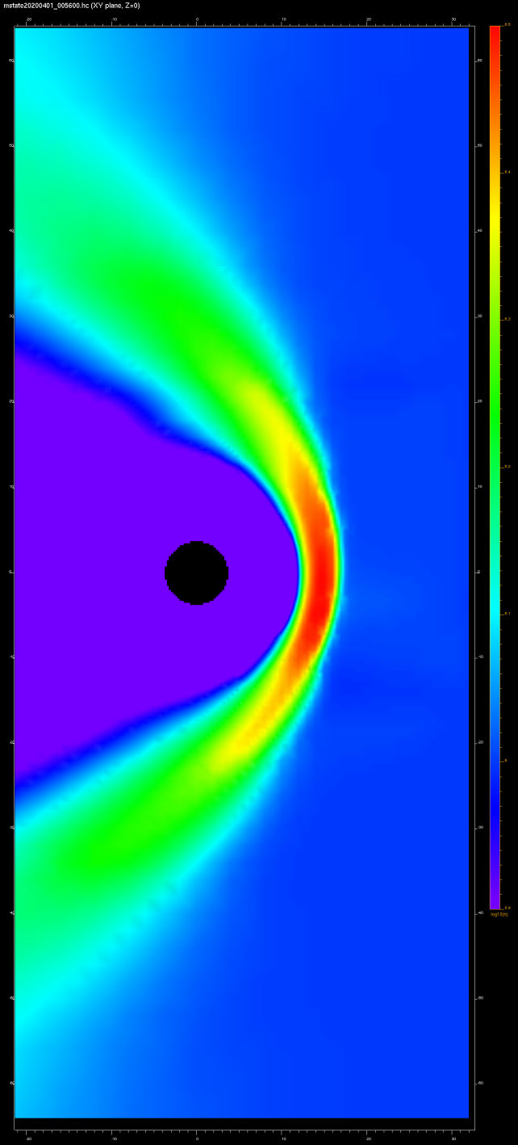
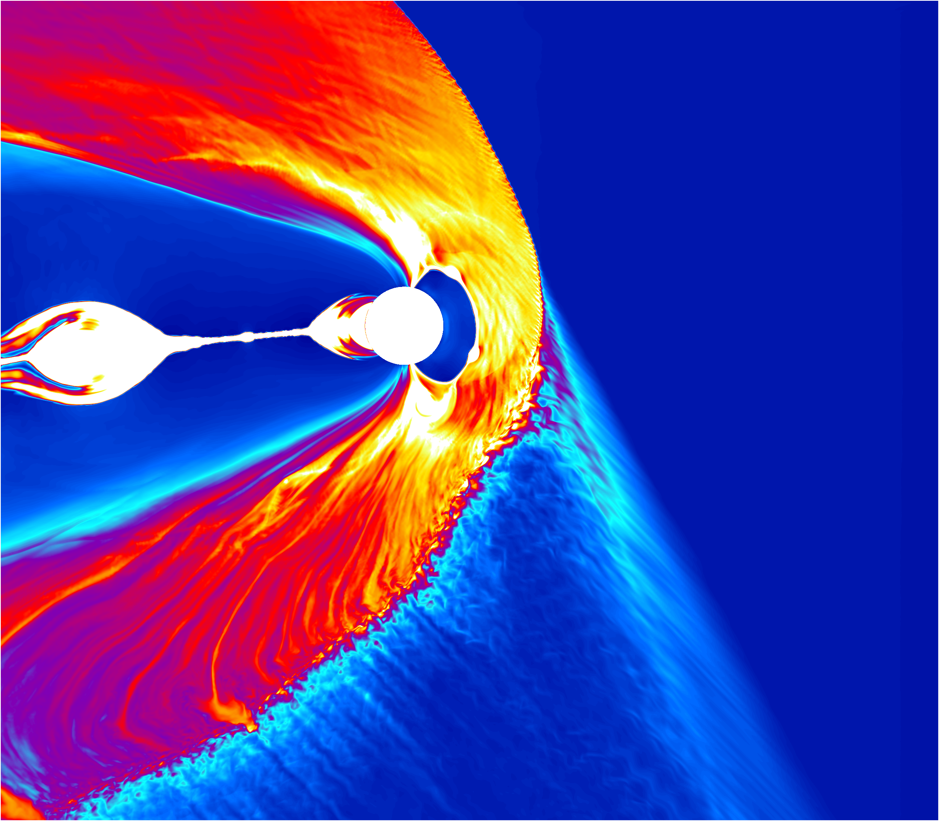
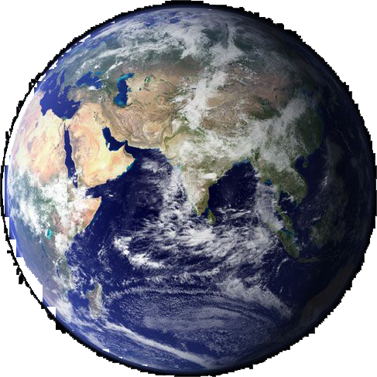
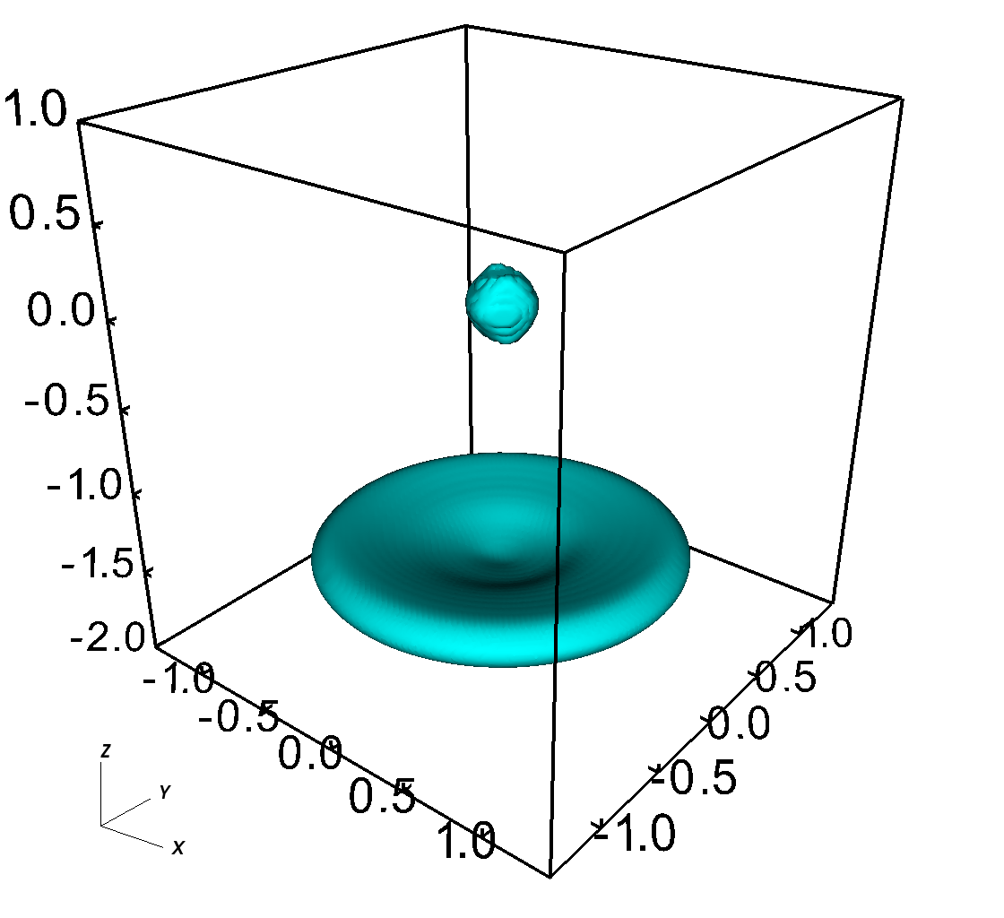
Everything depends on how to model the plasma distribution function
MHD
Observations (THEMIS spacecraft)
Blanco-Cano et al. [2006]
VLASIATOR
Particle-in-cell (PIC). Distribution is constructed from particle statistics.
Vlasiator: Distribution function is modelled perfectly. No assumptions.
MHD: Distribution function is not modelled. Single value is used for temperature.

Slide 5
Global modelling techniques
GUMICS-4, FMI
Karimabadi et al., 2014
helsinki.fi/vlasiator
 | Global fluid (MHD) | Hybrid-kinetic (particle-in-cell) | Hybrid-kinetic (Vlasov)
Ions | Fluid | Particles | Distribution functions
Electrons | Fluid | Fluid | Fluid
Run time | Real-time to weeks | Weeks | Weeks – months
Scale of applications | Fluid scale (1000 km) Now: Solar system | Ion kinetic effects (10 – 1000 km) Global = Solar wind, magnetosphere (+ ionosphere)
Notes:
In modelling large spatial volumes there are presently two practical approaches, MHD and hybrid simulations, that can be divided into hybrid-particle-in-cell or hybrid-PIC, and hybrid-Vlasov. MHD, from which I did my Phd, describes plasma as a fluid and is computationally feasible. Applications can cover presently scales comparable to the Solar system. Hybrid approach treats ions kinetically and electrons as fluid. Hybrid-PIC is computationally demanding and describes physics kinetically but with an inherent sampling noise due to the number of launched particles. Vlasiator is the world’s only global hybrid-Vlasov simulation, it is computationally very demanding but it describes the physics kinetically and accurately.

Slide 6
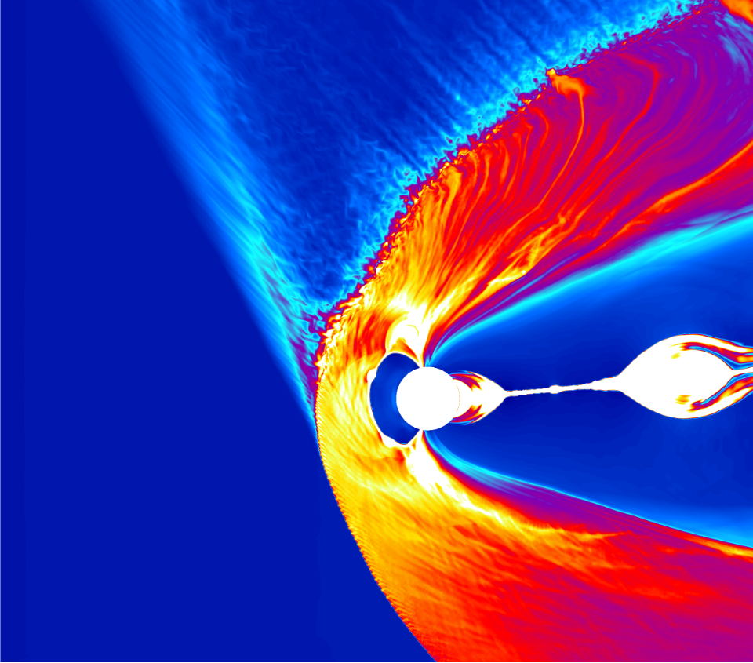

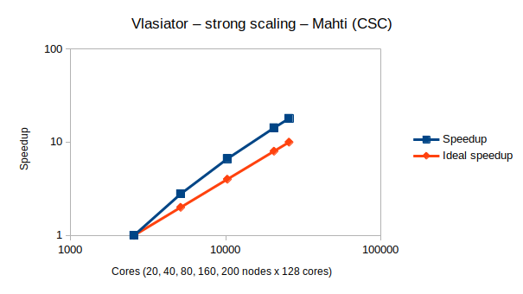
6D model
Within each 3D location, solve also the 3D particle distribution
Total number of cells: 10¹²
Over 10⁵ timesteps
Compute at scale using CPUs and GPUs, without idling cores
  More information: http://helsinki.fi/vlasiator
  Contact PI: Minna.Palmroth@helsinki.fi
Notes:
probleemakoko on sopiva vrt. nodejen lukumäärä, saadaan muistin lukemisiin ja kirjoittamisiin parempi hyöty välimuistista (eli cache). Jos kaikki operaatiot tapahtuu datalla jonka saa mahtumaan välimuistiin, homma hoituu rivakammin.

Slide 7



The story
2007: First ERC grant (Starting)
2011: 6D Test-Vlasov in MHD fields
2012: Access to Europe’s supercomputers
First 5D runs (2D3V)
2015: Second ERC grant (Consolidator)
2019: Towards 6D (AMR)
First preliminary run @CSC
2021: (Jan 13)
First 6D production run @HLRS
Around 15 MCPUh
Data per run: ~30 T
2023: Dynamic ionosphere added
Verification and further development ongoing

Slide 8
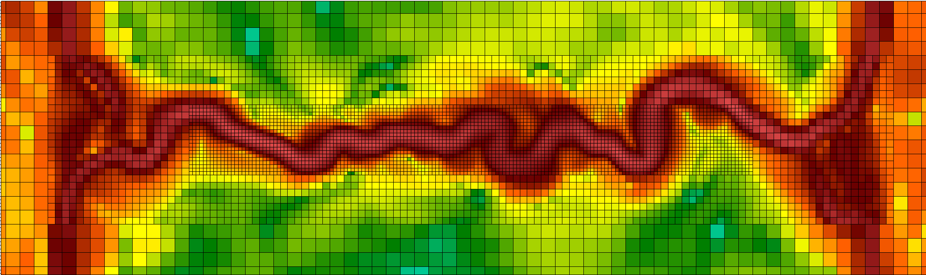
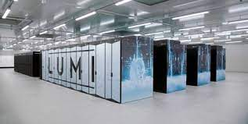
High-performance computing
6
Plasma sheet in YZ plane
- Adaptive mesh (cell-by-cell)
0
Work by Leo Kotipalo
-6
-20
-10
0
10
20
Adaptive mesh refinement
LUMI: Top 3 (world), Top 1 (Europe)
Velocity space → GPU
  Initial results: 10-20x faster
Part of European Centre of Excellence in Code development (EuroHPC).

Slide 9
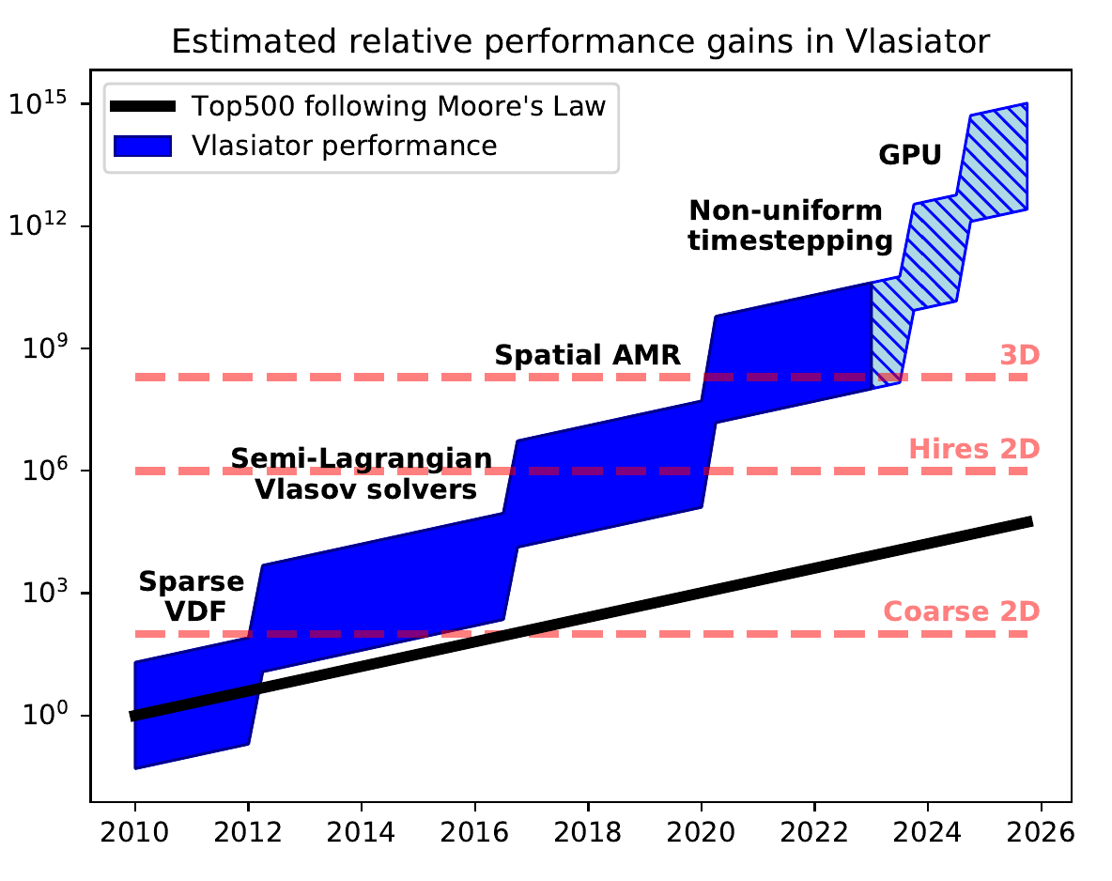
High-performance computing
Image by Y. Pfau-Kempf

Slide 10
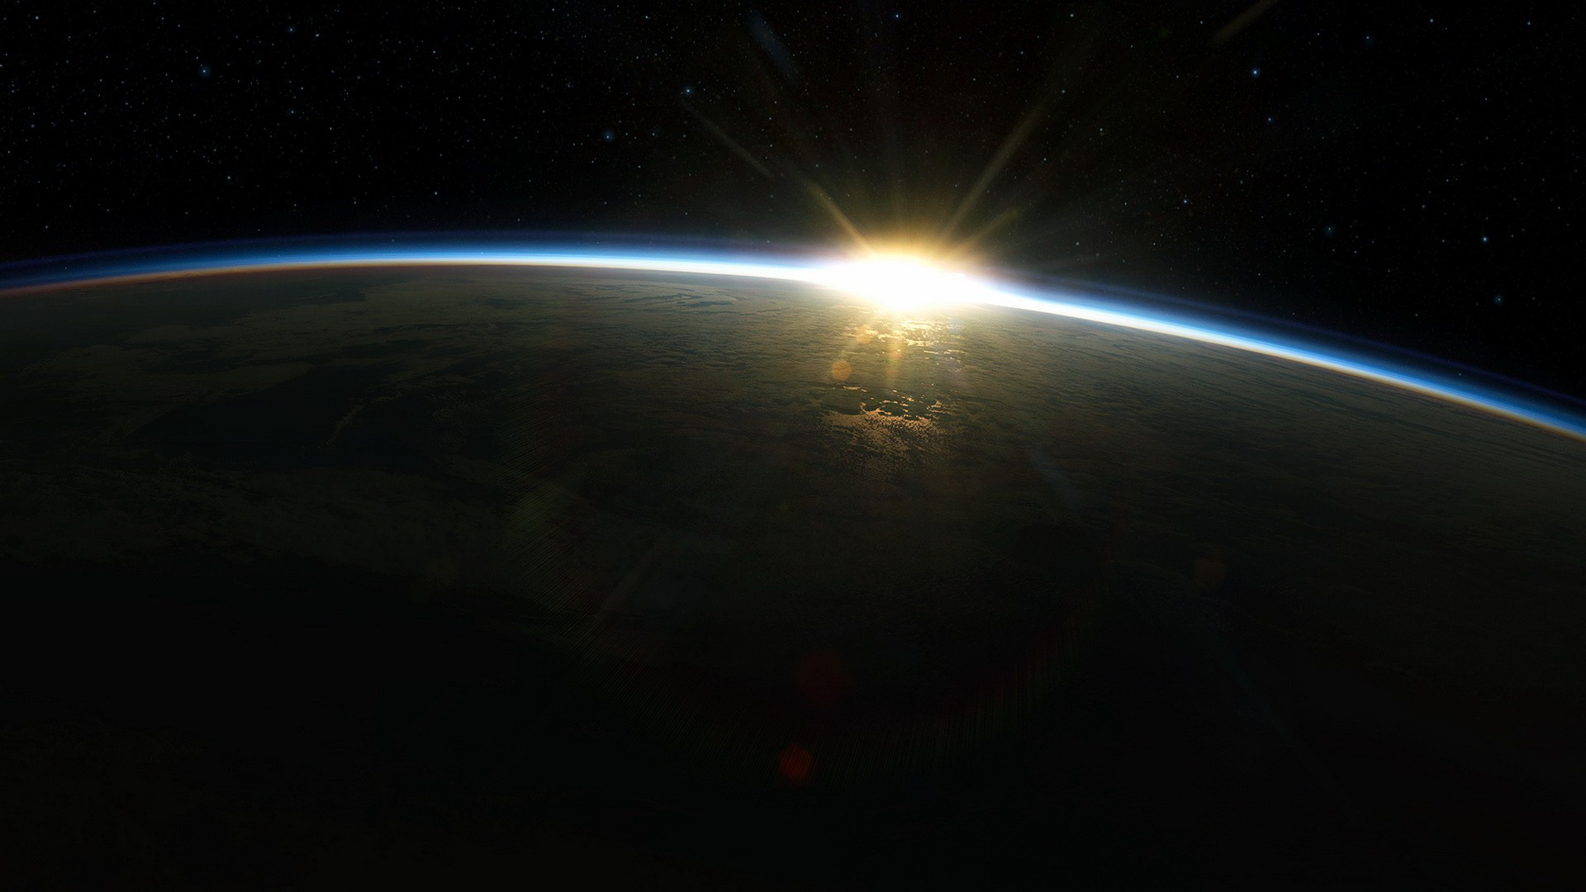
Examples of
New methods and capabilities
Picture: NASA

Slide 11
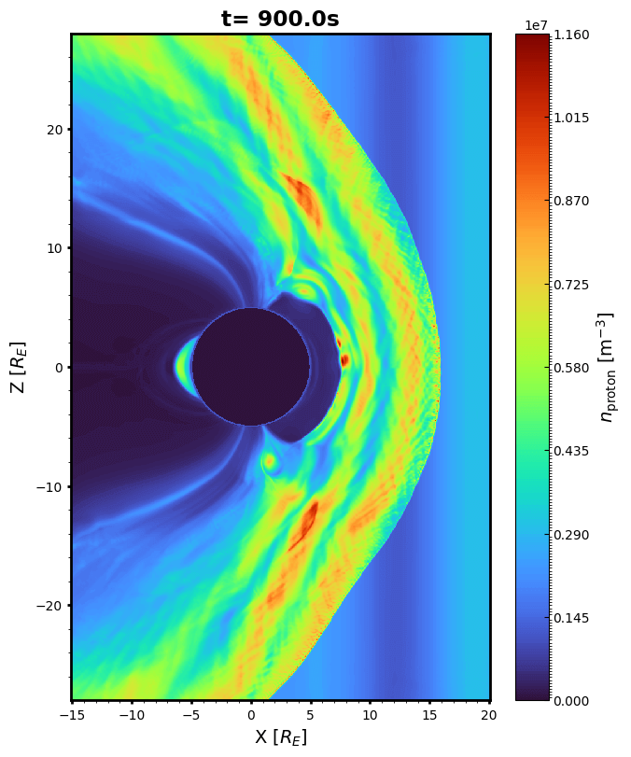
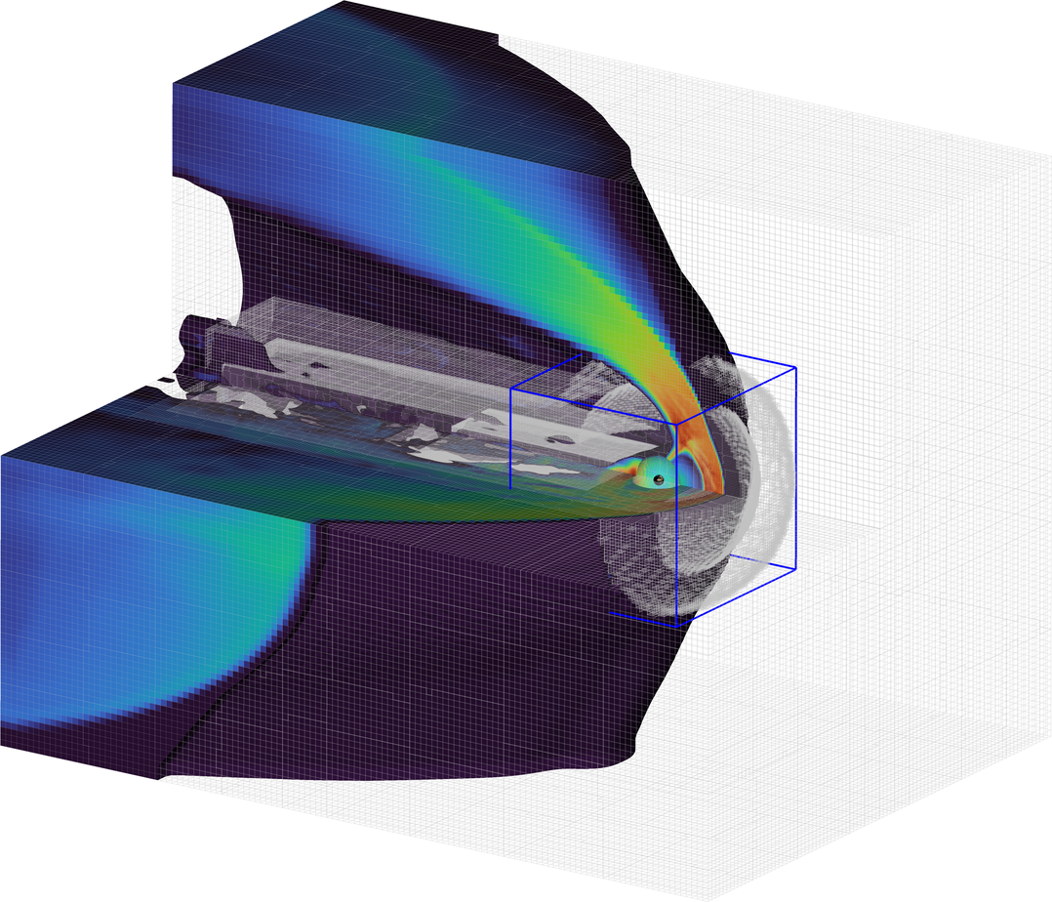
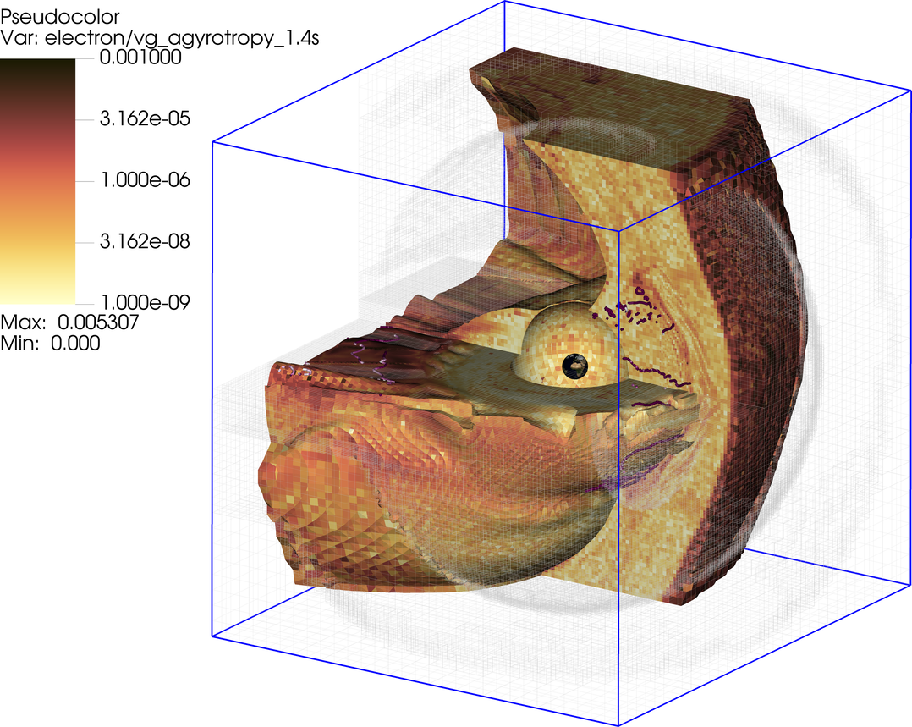
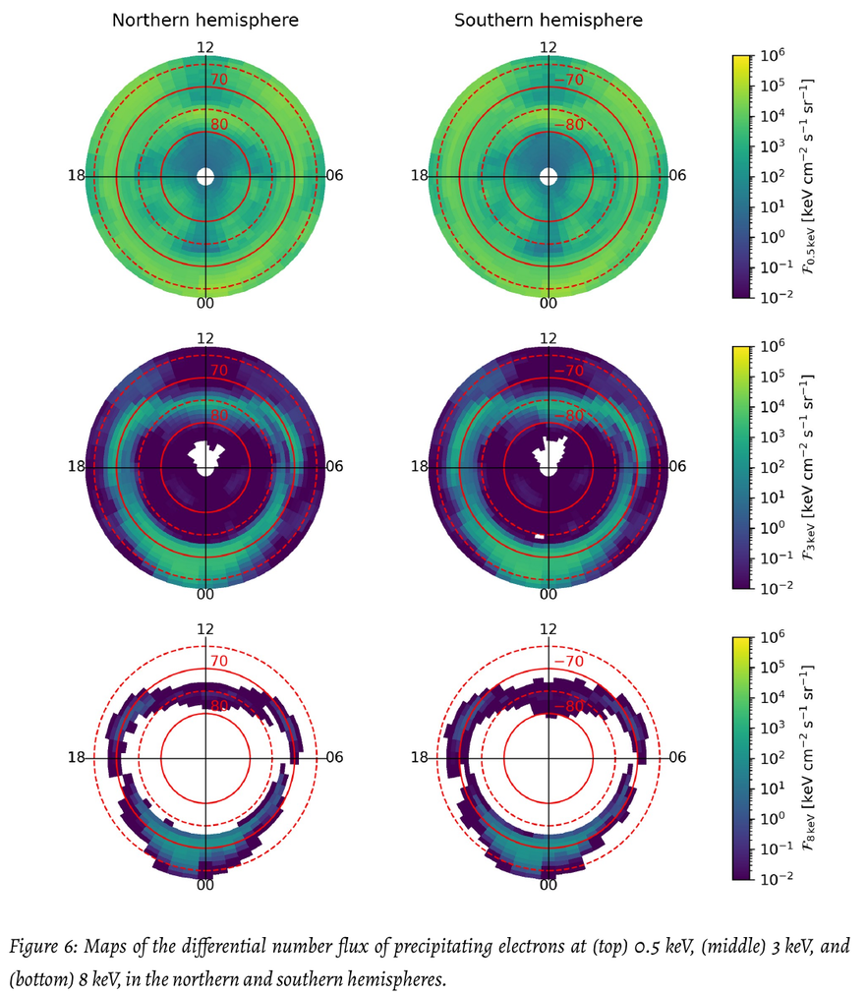
Time-varying solar wind conditions (work by H. Zhou)
eVlasiator: 3D global Vlasov electrons
Electron precipitation
See also:
Battarbee+ AnnGeo 2021
Alho+ GRL 2022
[Zhou+ 2022 Frontiers]

Slide 12
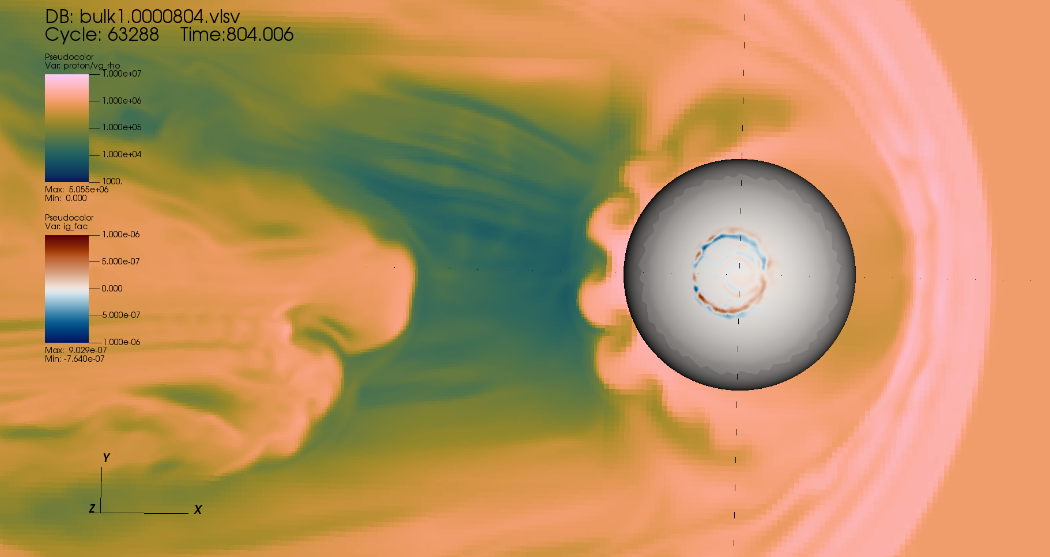
Electrostatic ionosphere
Similar philosophy for coupling as in MHD simulations
Ganse+ (in prog)
Image by J. Suni

Slide 13
Recent highlights
Picture: NASA

Slide 14
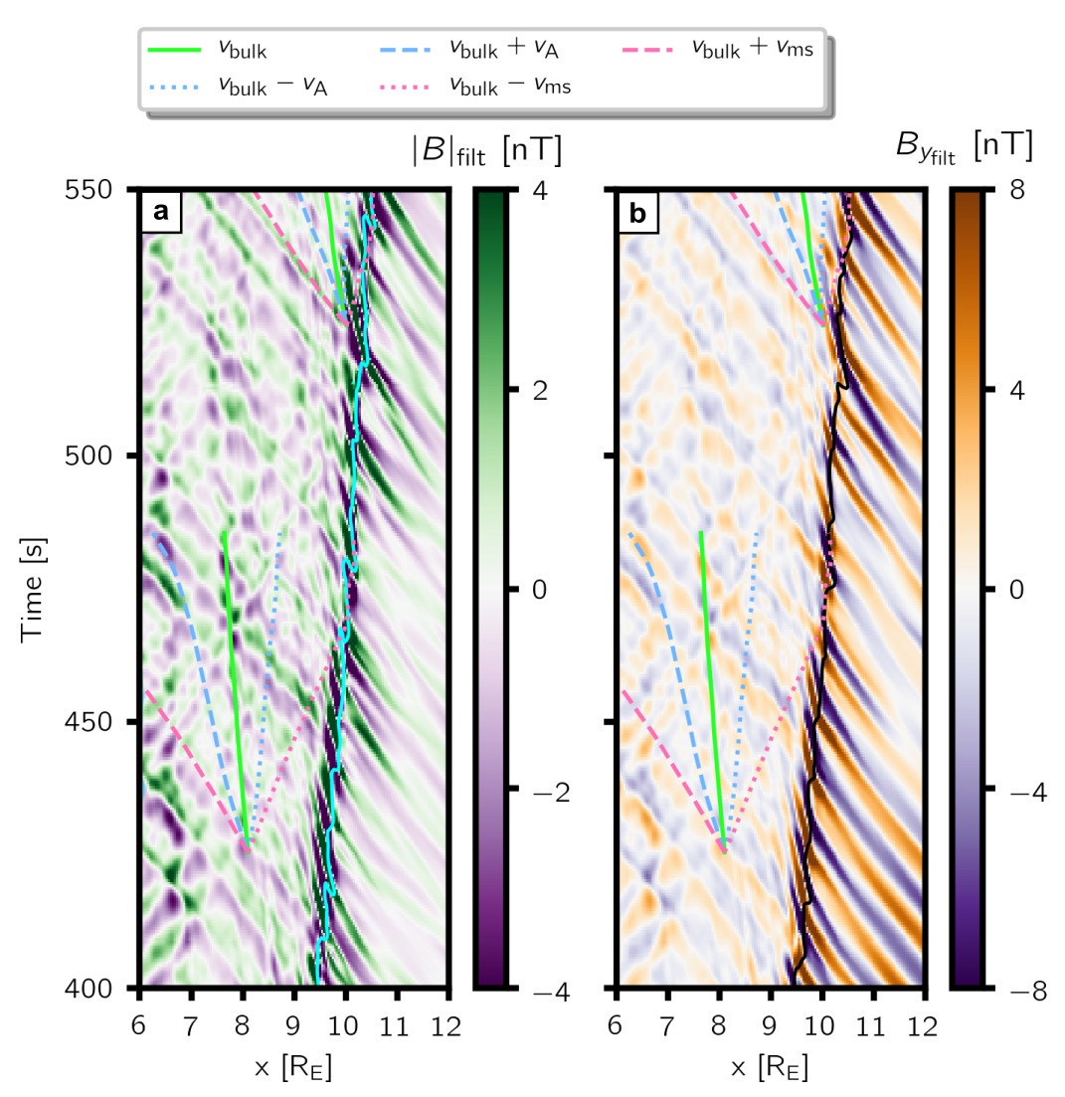
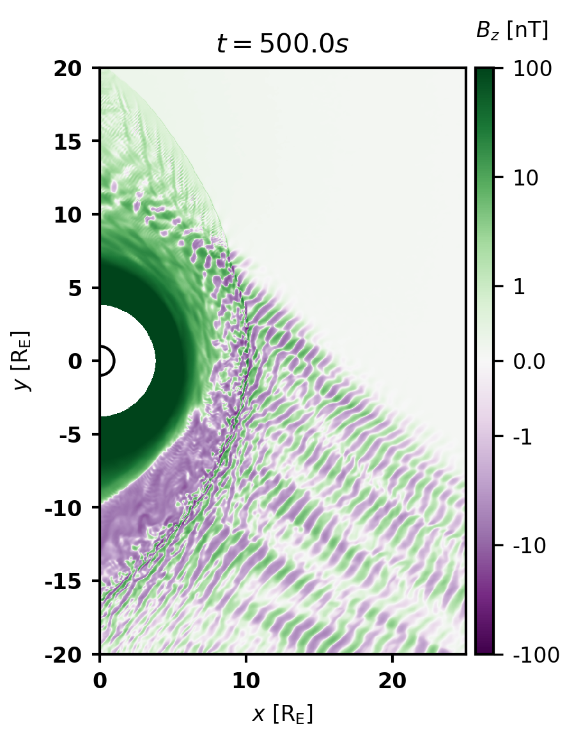
Foreshock wave transmission problem solved
Using 2D Vlasiator simulations, we showed that foreshock waves propagate through the magnetosheath as fast-mode waves.
These waves are however not just “directly transmitted” through the shock, but are created by the foreshock waves modulating the plasma parameters just upstream of the shock
Turc et al., 2022
Turc et al., 2023
Foreshock waves
Downstream fast-mode waves
Turc et al., 2023, Nature Physics
https://www.nature.com/articles/s41567-022-01837-z

Slide 15
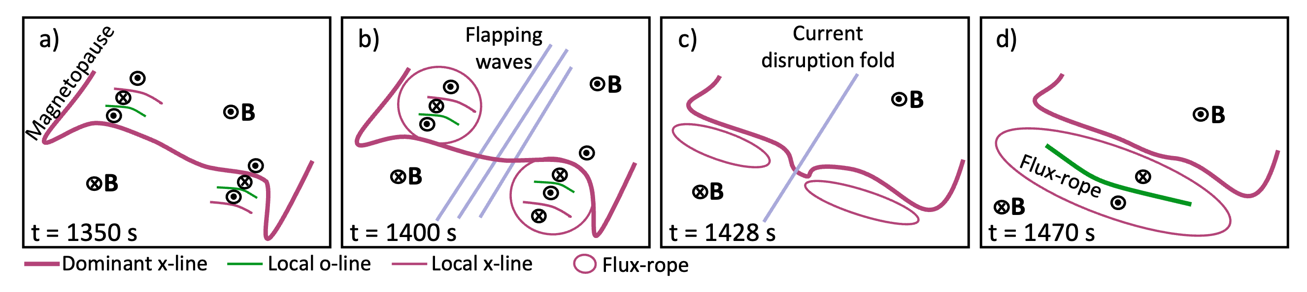


Plasmoid release in Vlasiator
Vlasiator suggests reconciliation:
NENL: Reconnection – current disruption – plasmoid
  BUT: Current disruption not in the same local time as reconnection AND NOT due to fast flows
CD: Current disruption @ transition region – spreads outwards – large-scale reconnection – plasmoid
  BUT: CD caused by flapping, which is caused by reconnection
scenario:
Two reconnection sites @flanks move to centre: plasmoid
Centre disrupts the current due to current sheet flapping
Palmroth et al., Nature Geoscience 2023 https://doi.org/10.1038/s41561-023-01206-2

Slide 16
Current resources
Several 2D and 3D runs ready and more coming (next: 3D foreshock-magnetosheath)
  Hundreds of Terabytes of data
Code is open source
  Multiple groups working on results or running the code (USA and Europe)
Rules-of-the-road: https://helsinki.fi/vlasiator
How running works:
  Apply for computational resources (~30 million core hours), do a config file and a test run, babysit production (because supercomputer facilities have all sorts of problems)
Config files applied for other systems exist
  Mars, Mercury
  Local boxes

Slide 17
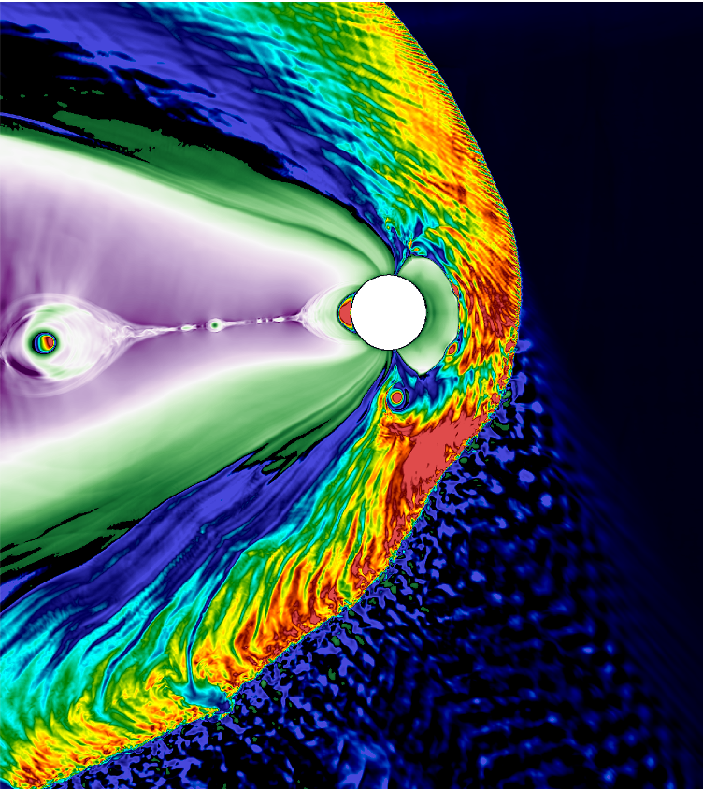
Thank you!
Contact: minna.palmroth@helsinki.fi

