Slide 1
Integrating GEOS & JEDI and expanding GEOS capabilities for SWDA.
Ricardo Todling
NASA/Global Modeling and Assimilation Office
11th CCMC Workshop, College Park MD, 3-7June 2024

Slide 2
Joint Effort for Data-assimilation Integration (JEDI)
Why a framework for DA? Who coordinates & contributes?
What is it? How does it work?
Where is it hosted? When will it be adopted (operationally)?
… and about JEDI-based SWDA?

Slide 3
JEDI: Why a Framework for DA?
Most existing DA prediction systems are Fortran-based. Though many have evolved to become modular, they don’t employ code abstraction and generic concepts (viz., Fortran abstraction is a relatively new concept).
A consensus grew in the community that it needed software to allow for:
Enhanced collaboration across institutions.
Separation of concerns (i.e., avoid interdependency and developers from “stepping on each other’s toes”).
Ease of software maintenance.
Flexible code optimization.
Quick implementation of novel science features
Quick transitioning of changes to real-time operational applications.
Nearly 15 years ago Yannick Tremolet and Mike Fisher (back then, both at ECMWF) introduced the Object-Oriented Prediction System (OOPS): an abstract layer (written in C++) to manipulate DA objects without need for specifics on model, observation operators, and similar entities necessary for DA.
ECMWF committed to the OOPS effort making it operational a couple of years ago.
The rest of the DA community recognized the power of OOPS and agreed for it to form the basis of the Joint Effort for Data assimilation Integration (JEDI) through a partnership with various US institutions.
Obviously the story is never this smooth, quite a lot of debate, disagreement, concerns and resistance to change had to be overcome, before the dust settled.

Slide 4
JEDI: Who coordinates & contributes?
Formal Partnership
JEDI is a collaborative effort coordinated by the Joint Center for Satellite Data Assimilation in partnership and support with four major US agencies.
The collaboration also benefits from associated partners on an informal basis, whose contributions has been of paramount significance.
JCSDA: Coordination
NESDIS
National Weather Service
Office of Atmospheric Research
Earth Science Division
Heliophysics Division
Informal Partnership
Naval Research Laboratory
Oceanographers of the NAVY
NRL Washington DC
Airforce Weather

Slide 5
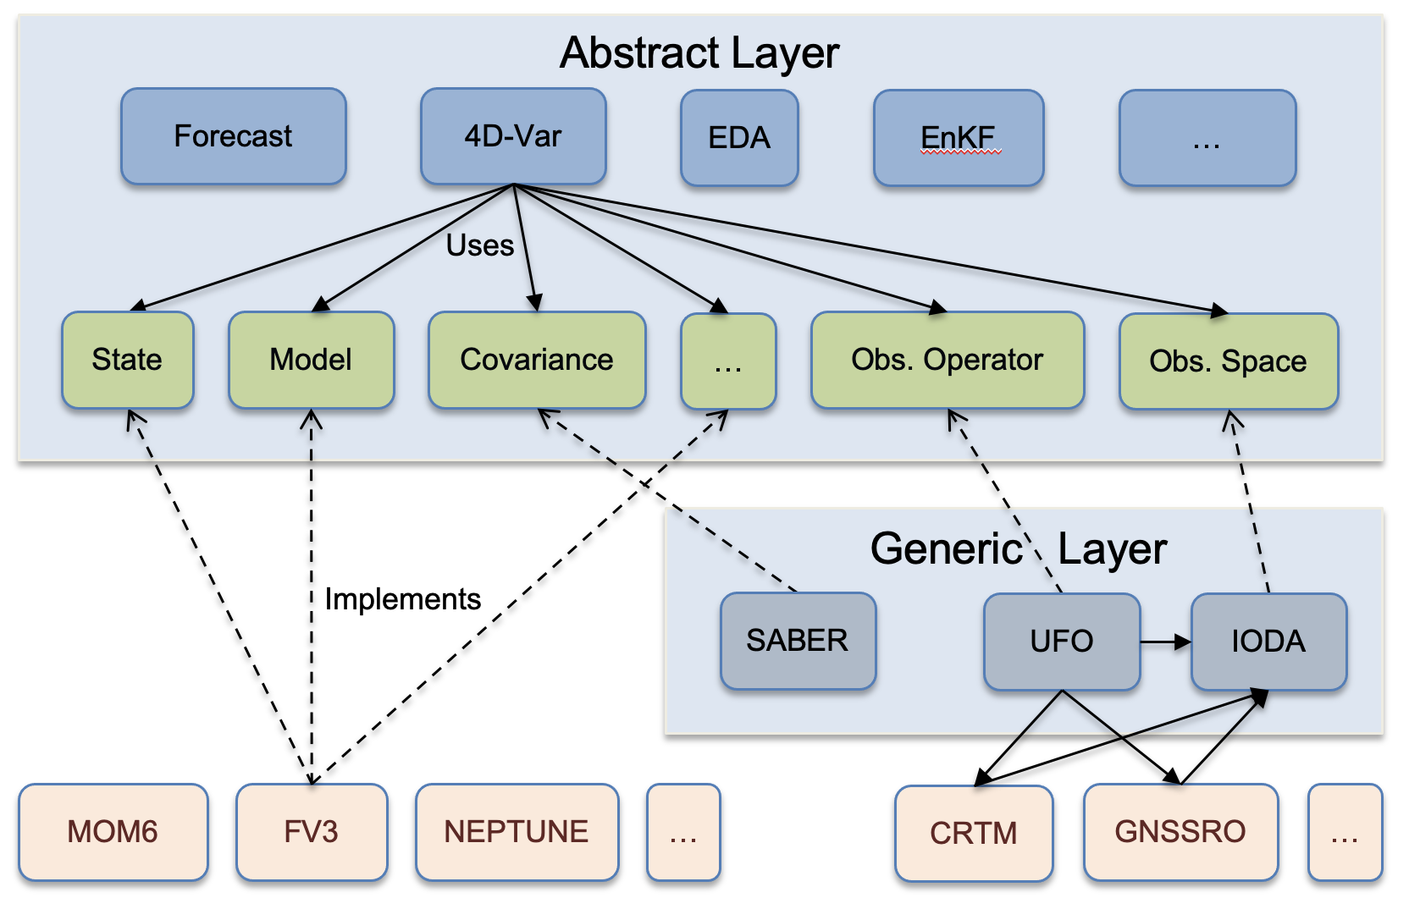
JEDI: What is it?
OOPS
Generic
Algorithms
Model agnostic DA
Abstract
Interfaces
Generic Layer provides link to specific key DA operators: covariance models; observation operators, etc.
Generic
Implementations
Specific
Implementations
Original slide from JCSDA Tutorial
Remarks on Software & Infrastructure:
OOPS is largely written in C++.
C++ to FORTRAN interfacing allows use of heritage code (that’s been properly sanitized).
Support for multiple computing architectures; advanced optimization (GPUs, etc).
Interfacing to Python and ML capabilities in works.

Slide 6
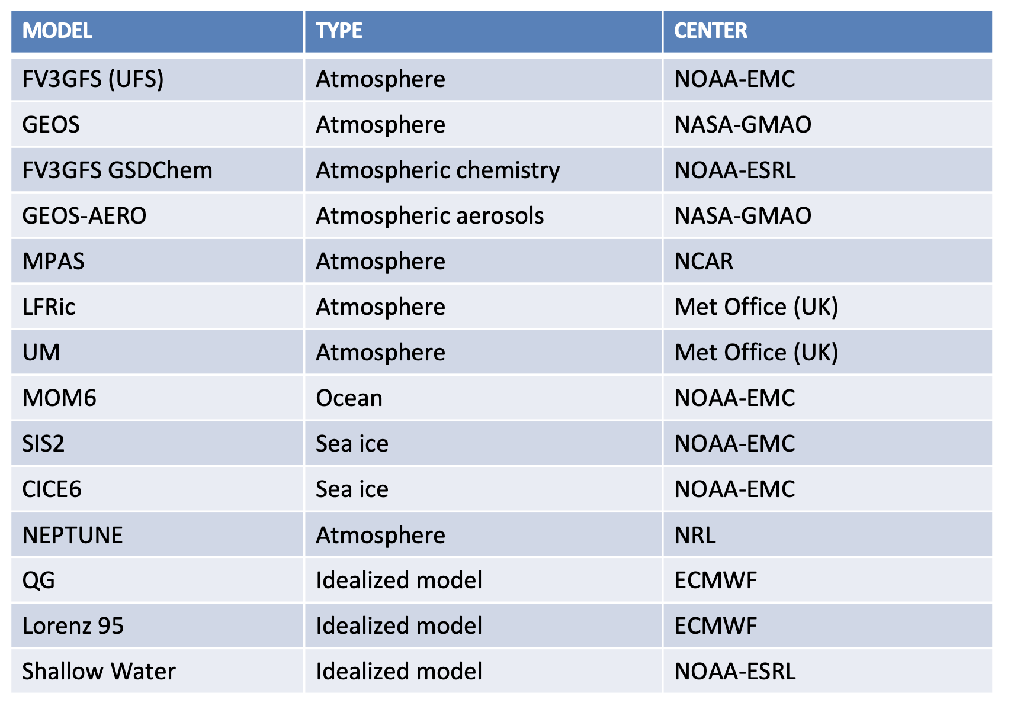
JEDI: What is it?
Interfaced Models (so far)
Interfaced Observers (so far)
Make up Unified Observation Operator (UFO)
The OOPS capabilities (still adding)
OBSERVER | TYPE
CRTM | Atmosphere
RTTOV | Atmosphere
Marine | Atmos/Ocean
Aerosol (multi-chan AOD) | Atmosphere
GNSSRO (multiple opts) | Atmosphere
Radar (Reflectivity) | Atmosphere
Radar (Radial Velocity) | Atmosphere
Insitu | Atmos/Ocean/Compo
Scatterometer | Atmos/Ocean
Chem Composition | Compo/Atmos
Algorithms
3D/4D-Var
Hybrid 3D/4D-Var
3D/4D-EnVar
Hybrid 3D/4D-EnVar
WC-Var
LETKF
GETKF
Particle Flow Filter
EDA
Primal/Dual Minimizers
Preconditioned-CG (PCG)
Derber-Rosati PCG (DRPCG)
Inexact PCG
Inexact DRPCG
DRP-Lanczos
MINRES
DRGMRES
Saddle-point
Variations on the above
Original list from JCSDA Tutorial
A key benefit to the common infrastructure is the shared nature of the
observation operators and their immediate availability to any (meaningful)
model. UFO is where any institution most directly benefits from other’s efforts.
(cont.)

Slide 7
JEDI: How does it work? (GEOS integration as an illustration)
The current GMAO hybrid 4DEnVar Atmospheric Data Assimilation System supports variations applications:
The 12.5 km GEOS-FP (near-real-time, quasi op).
A 25 km GMAO OSSE.
A 25 km MERRA-21C (about to).
The ADAS Workflow also supports other Var flavors, in particular, traditional 3DVar which is used for multiple purposes, from research to Instrument Teams deliverables.
GMAO is transitioning to JEDI in a phased approach:
Replace deterministic atmos analysis (Hyb 4DEnVar).
Replace ensemble analysis (EnSRF to LETKF or EDA).
Replace workflow (SWELL).
Schematic of Current GEOS Forward Processing (FP; near-real-time)
BCs
OBS
Hybrid GSI
25 km
GOES AGCM
12.5 km
BKG
IAU
BKG
ICs
Ens for hybrid Analysis
Recenter Ensemble
Deterministic ADAS
Ensemble Analysis
(EnSRF)
50 km
BCs
OBS
En-OmB
Ensemble of GSI-Based Observers
En-IAU
En-BKG
Ensemble of
GEOS AGCM’s
50 km
En-BKG
En-ICs
Ensemble ADAS

Slide 8
JEDI: How does it work? (GEOS integration as an illustration)
The current GMAO hybrid 4DEnVar Atmospheric Data Assimilation System supports variations applications:
The 12.5 km GEOS-FP (near-real-time, quasi op).
A 25 km GMAO OSSE.
A 25 km MERRA-21C (about to).
The ADAS Workflow also supports other Var flavors, in particular, traditional 3DVar which is used for multiple purposes, from research to Instrument Teams deliverables.
GMAO is transitioning to JEDI in a phased approach:
Replace deterministic atmos analysis (Hyb 4DEnVar).
Replace ensemble analysis (EnSRF to LETKF or EDA).
Replace workflow (SWELL).
Schematic of Current GEOS Forward Processing (FP; near-real-time)
BCs
OBS
Hybrid JEDI-VAR
25 km
GOES AGCM
12.5 km
BKG
IAU
BKG
ICs
Ens for hybrid Analysis
Recenter Ensemble
Deterministic ADAS
Ensemble Analysis
(EnSRF)
50 km
BCs
OBS
En-OmB
Ensemble of GSI-Based Observers
En-IAU
En-BKG
Ensemble of
GEOS AGCM’s
50 km
En-BKG
En-ICs
Ensemble ADAS

Slide 9
JEDI: How does it work? (GEOS integration as an illustration)
The current GMAO hybrid 4DEnVar Atmospheric Data Assimilation System supports variations applications:
The 12.5 km GEOS-FP (near-real-time, quasi op).
A 25 km GMAO OSSE.
A 25 km MERRA-21C (about to).
The ADAS Workflow also supports other Var flavors, in particular, traditional 3DVar which is used for multiple purposes, from research to Instrument Teams deliverables.
GMAO is transitioning to JEDI in a phased approach:
Replace deterministic atmos analysis (Hyb 4DEnVar).
Replace ensemble analysis (EnSRF to LETKF or EDA).
Replace workflow (SWELL).
Schematic of Current GEOS Forward Processing (FP; near-real-time)
BCs
OBS
Hybrid JEDI-VAR
25 km
GOES AGCM
12.5 km
BKG
IAU
BKG
ICs
Ens for hybrid Analysis
Recenter Ensemble
Deterministic ADAS
JEDI-LETKF
50 km
BCs
OBS
En-OmB
Ensemble of UFO
En-IAU
En-BKG
Ensemble of
GEOS AGCM’s
50 km
En-BKG
En-ICs
Ensemble ADAS

Slide 10
JEDI: How does it work? (GEOS integration as an illustration)
The current GMAO hybrid 4DEnVar Atmospheric Data Assimilation System supports variations applications:
The 12.5 km GEOS-FP (near-real-time, quasi op).
A 25 km GMAO OSSE.
A 25 km MERRA-21C (about to).
The ADAS Workflow also supports other Var flavors, in particular, traditional 3DVar which is used for multiple purposes, from research to Instrument Teams deliverables.
GMAO is transitioning to JEDI in a phased approach:
Replace deterministic atmos analysis (Hyb 4DEnVar).
Replace ensemble analysis (EnSRF to LETKF or EDA).
Replace workflow (SWELL).
Schematic of Current GEOS Forward Processing (FP; near-real-time)
BCs
OBS
Hybrid JEDI-VAR
25 km
GOES AGCM
12.5 km
BKG
IAU
BKG
ICs
Ens for hybrid Analysis
Recenter Ensemble
Deterministic ADAS
JEDI-LETKF
50 km
BCs
OBS
En-OmB
Ensemble of UFO
En-IAU
En-BKG
Ensemble of
GEOS AGCM’s
50 km
En-BKG
En-ICs
Ensemble ADAS

Slide 11
JEDI: Where is it hosted?
JEDI is hosted on github: https://github.com/JCSDA-internal
General access (for those not in the collab): https://github.com/JCSDA
Its active community of developers exchanges ideas via slack: http://jcsda.slack.com/
Development is managed:
via pull requests,
reviewers are required/provided by community members,
incorporation of changes is managed by JCSDA in an agile mode of working.
Regular meetings and code sprints provide avenues for planning, organizing & implementing development.
Tutorials and training are available, JEDI Academy (in the process of being updated).
The flexibility of JEDI is such that institutions do not necessarily need to have their models exposed, i.e.,
Specific components (models, etc) can reside in private repos.
Though it is to the benefit of the community that codes are made available and shared.
Sharing motivates tests in JEDI Skylab, a platform for testing DA for multiple applications.
Containerized versions of Skylab releases are available.

Slide 12
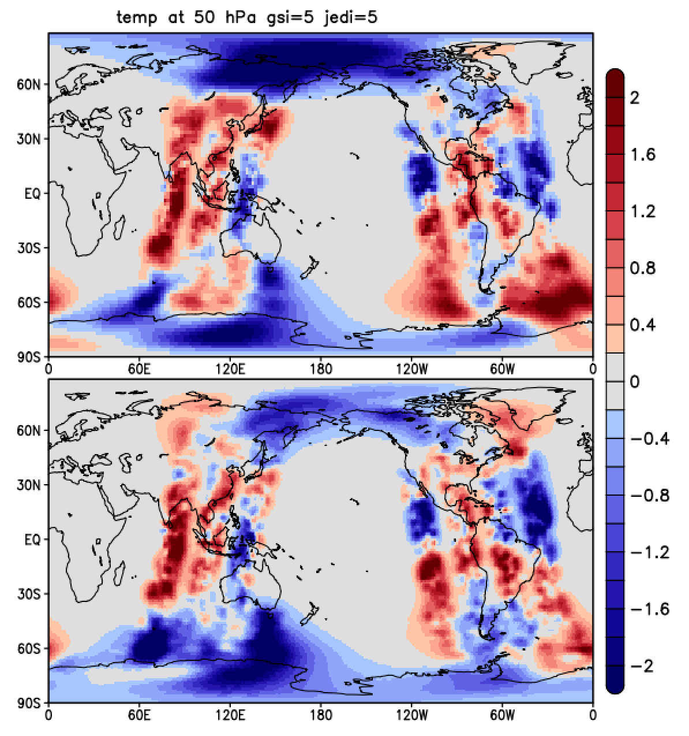
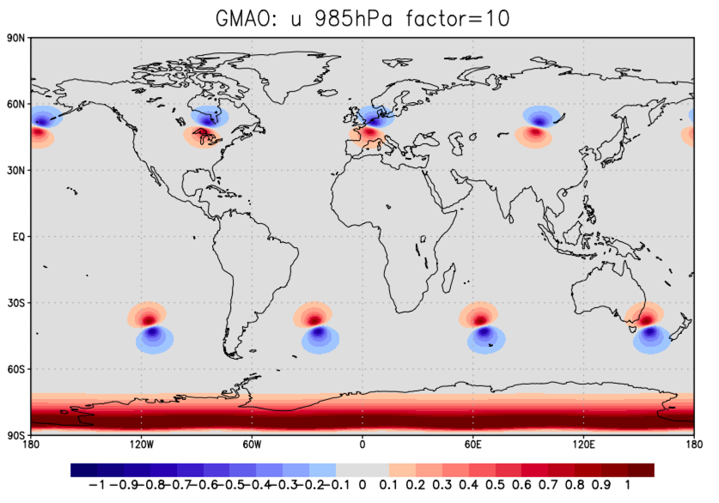
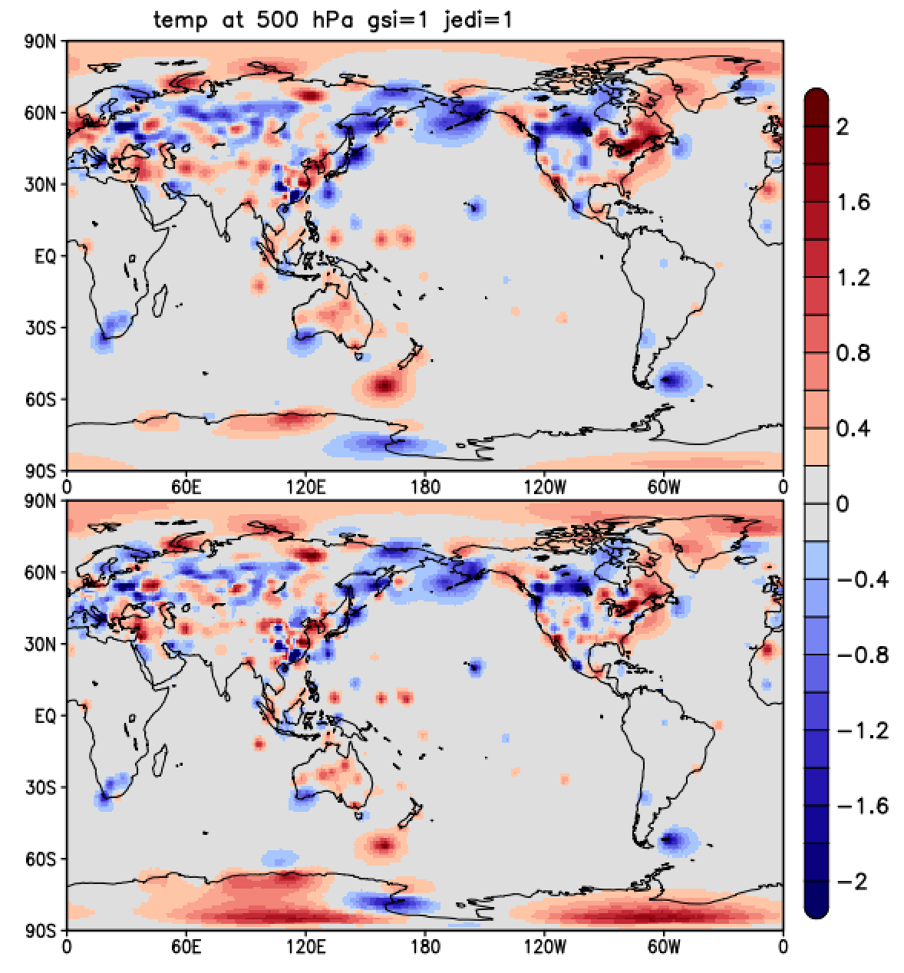
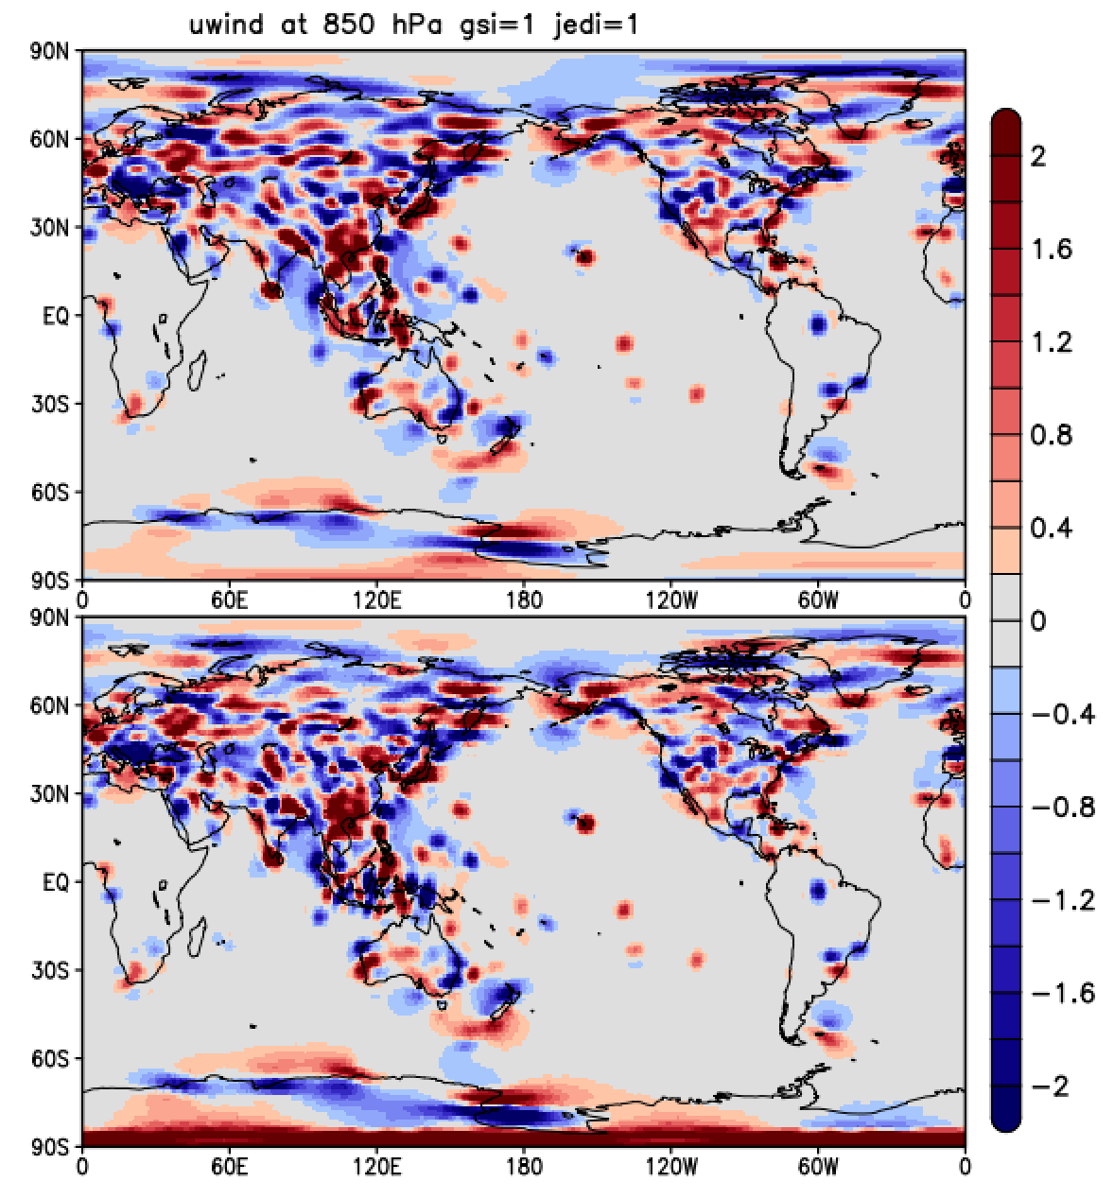
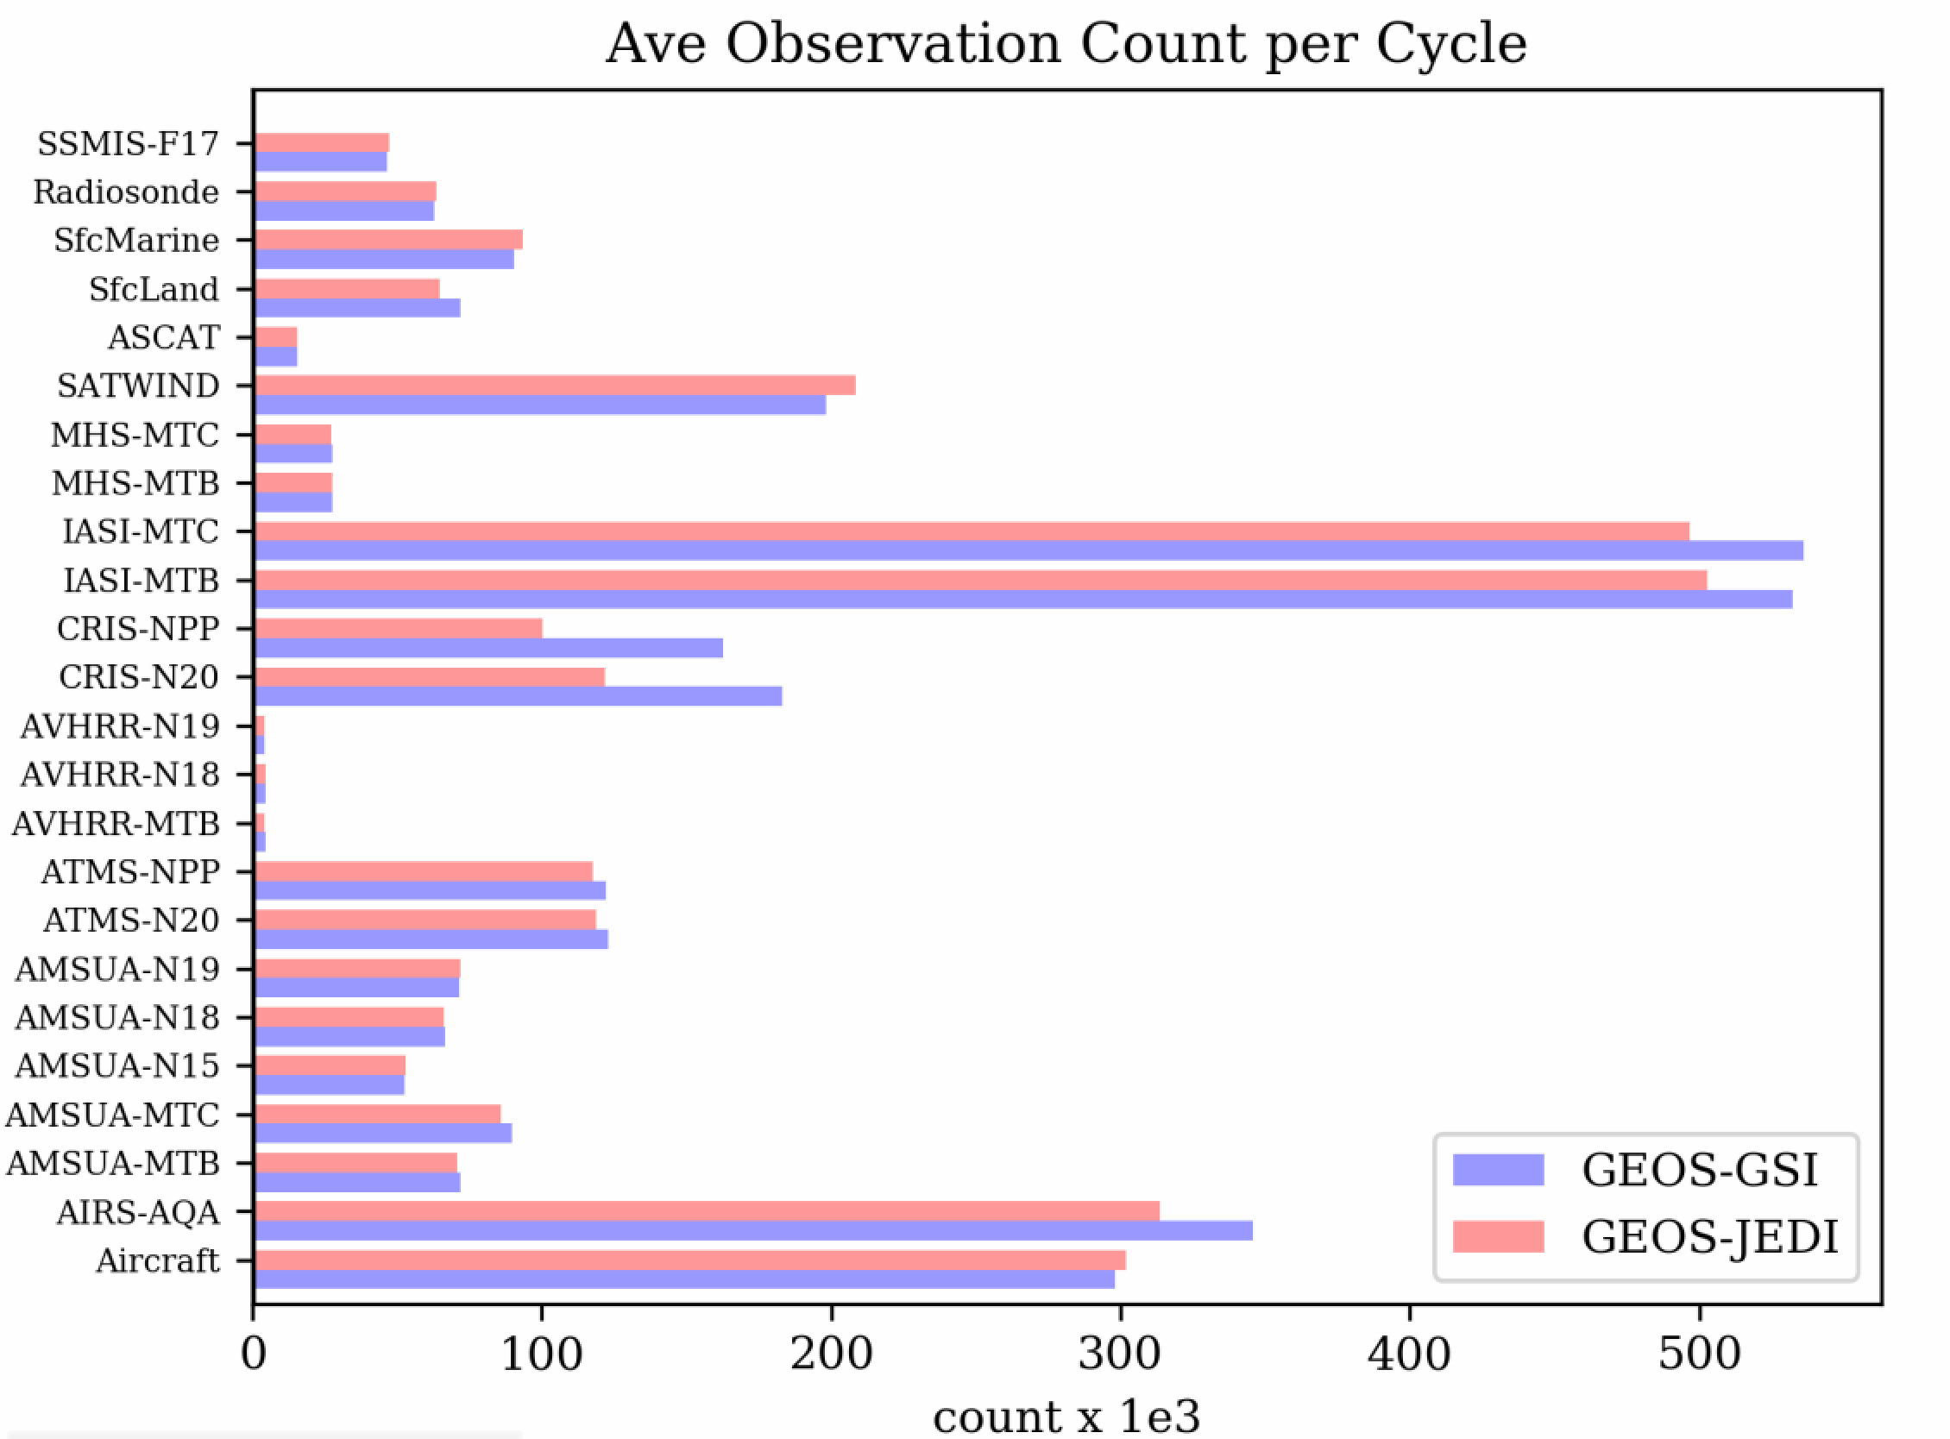
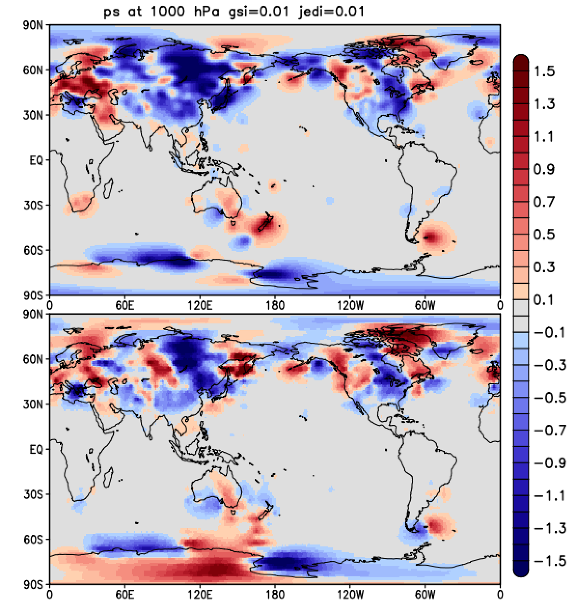
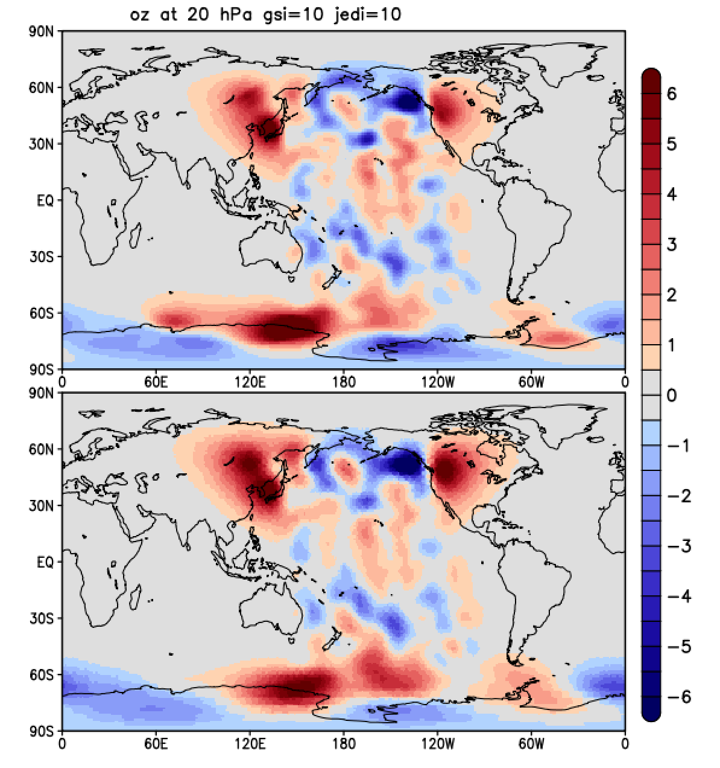
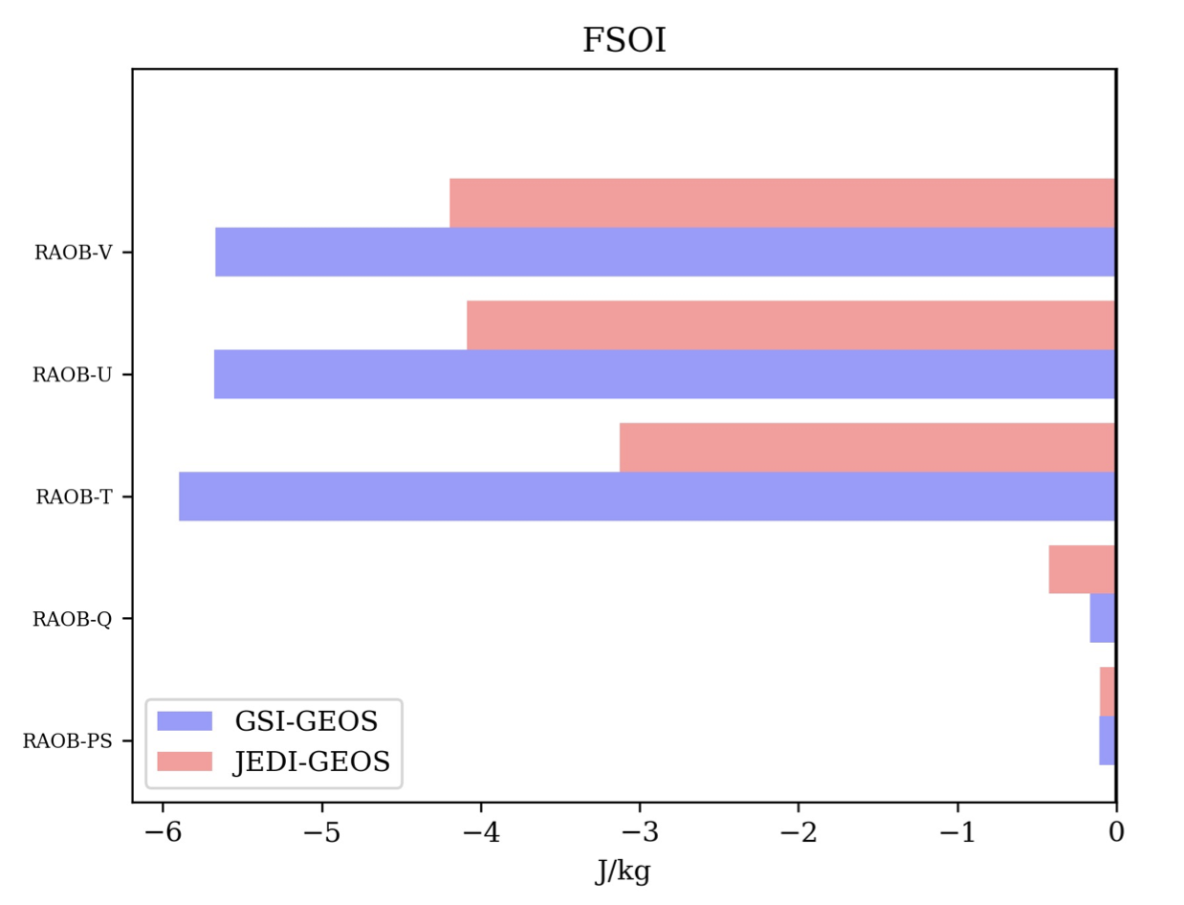
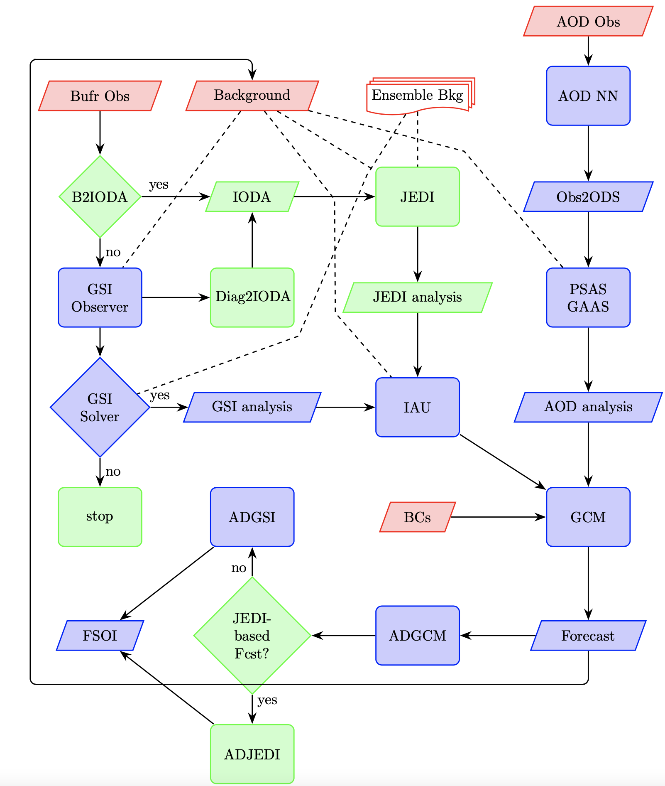
JEDI: When will it be adopted (operationally)?
As mentioned earlier, the core of JEDI, that is, OOPS is already operational at ECMWF (but not through JEDI itself).
Each institution has its own schedule for operationalizing JEDI.
Each institution is deciding on how to transition to JEDI: wholesale or piecemeal.
As discussed earlier, NASA GMAO has a phased approach to transition to JEDI in its GEOS-FP application. Once all phases complete, other applications of GEOS will immediately benefit from the transition, e.g., MERRA-3.
GEOS JEDI ADAS Testbed (GEOS-JAT)
Single Instrument
Single Variable
In the illustration here, only the yellow writing corresponds to components transitioning at first (the atmospheric analysis and its adjoint).
This configuration is presently under testing, an actual implementation if expected before end of 2024.
Single
Observation
Single Instrument
Multiple Variable
We have gone from a multitude of standalone (single-case) tests to fully cycled GEOS-JEDI.
Near Complete
Obs Cycling
Multiple Instrument
Multiple Variable
Reduced
Obs Cycling
Enhanced
Cycling
Workflow

Slide 13
GEOS-JEDI extension to Mesosphere Lower Thermosphere (GEOS-MLT) DA
Lifting GEOS Lid from 80 to 150 km.
Upper boundary parameterization.
Molecular diffusion.
Heating and Cooling rates adjustments to compensate for missing complex physics.
Gravity wave drag retune.
Sassi et al. are establishing a collaboration among Codes 675, 610.1, 674 & GMU to develop the capabilities for a GEOS-based MLT DA system.
Additional Observing Systems in JEDI.
AURA/MLS (retried Temperature already used in MERRA-2)
TIMED/SABER (retrieved Temperature) e.g., Hoppel et al. 2008
GOLD (retrieved Temperature) e.g, Laskar et al. 2021
Long range significant add-ons:
TIDI winds
ICON winds and temperature
AIM SOFIE temperature
This work is not expected to require structural to be added to JEDI’s framework. This means that once the current effort to integrate GEOS
with JEDI is complete, GEOS-MLT-JEDI should be basically available.

Slide 14
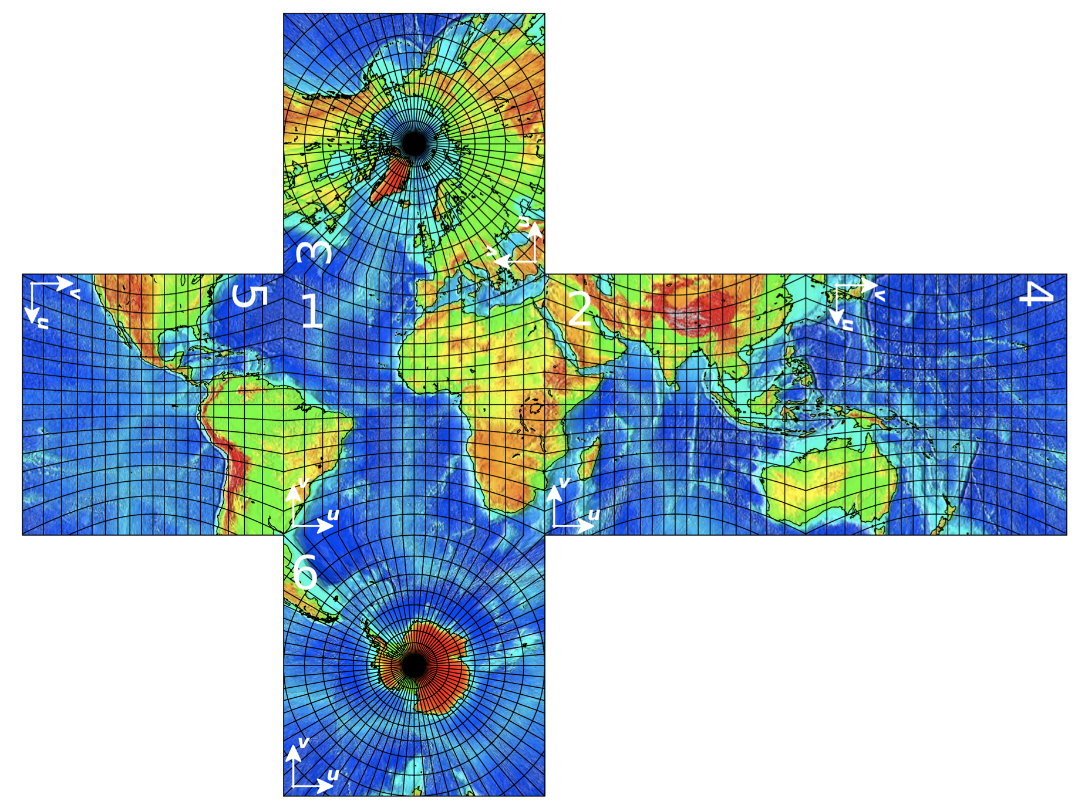
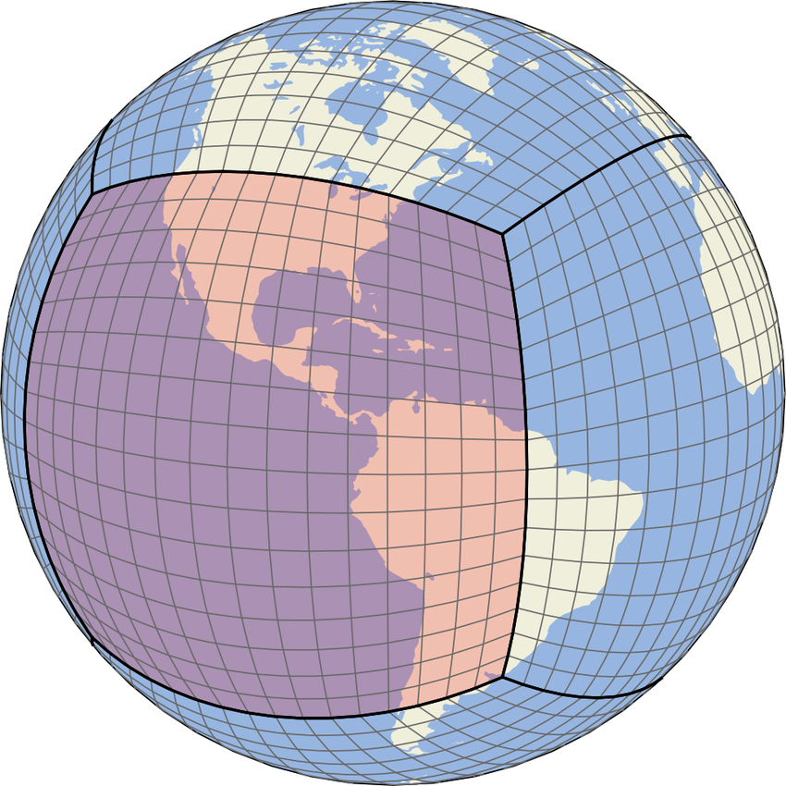
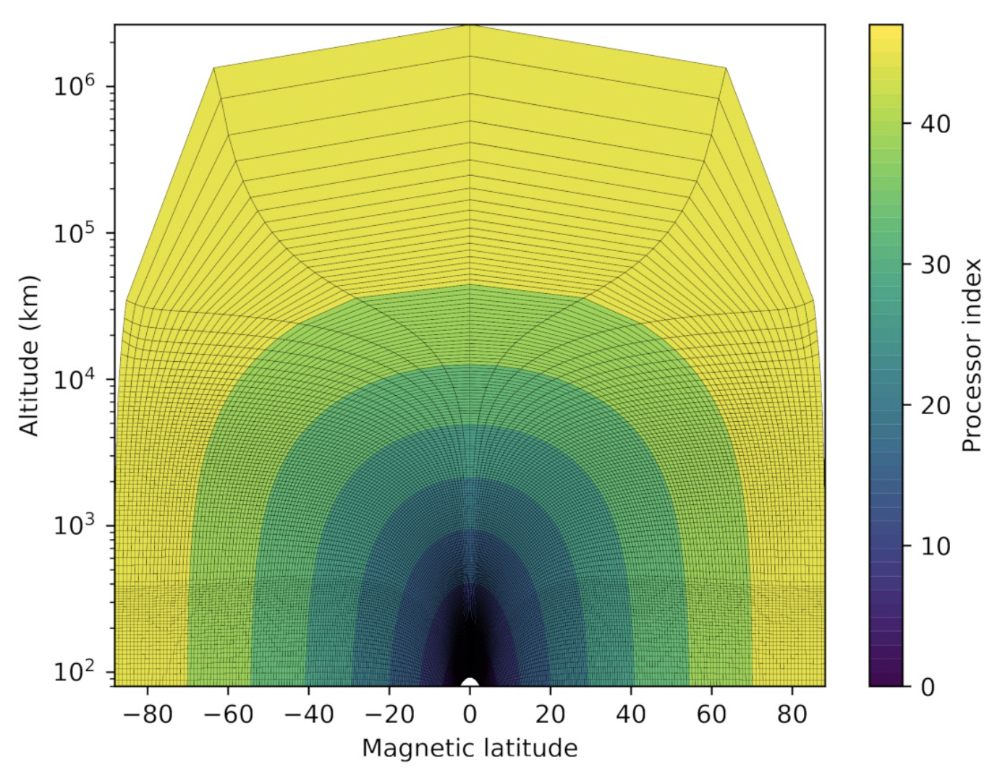
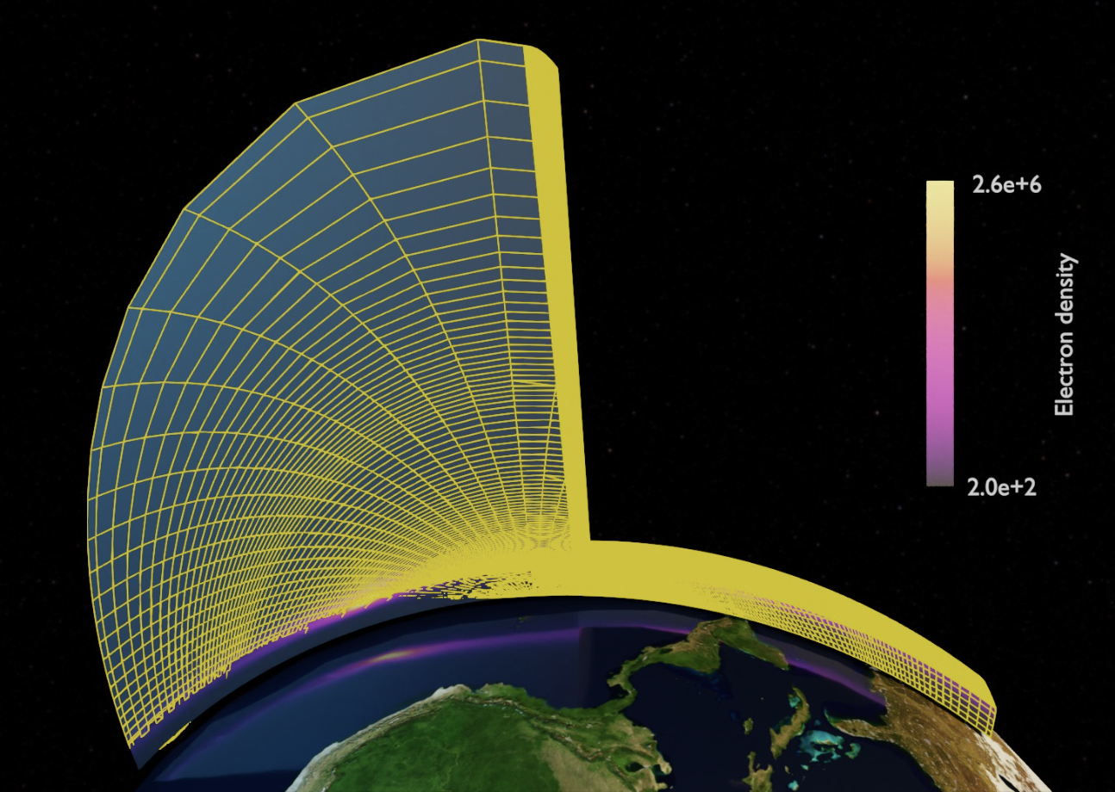
Enabling JEDI beyond Terrestrial Applications: Ionospheric DA
Terrestrial Weather Models
On the Modeling Side …
On the Observations Side …
Unlike the previous application, this does require some extension in JEDI.
None of the changes should be structural; namely, the framework is easily extendable.
Truly SWDA enabling.
Final goal is to implement ionosphere-neutral atmosphere using LETKF.
Future plans include JEDI thermosphere LETKF, followed by coupled ionosphere–thermosphere LEKF.
 | Terrestrial Weather Models | Space Weather Models
Coordinate system | Geographic (lat/lon/lev) | Geographic, Geomagnetic, Earth-centered Cartesian or 2D (height or field line integrated).
Grid | Varied, but vertical columns over common spherical shells. | May follow magnetic field lines; grid cells may not align in vertical columns.
Equations | Adapted from Navier-Stokes plus thermodynamics (PE, either shallow Earth or relaxed in WAM); maybe chemistry. | Euler’s plus subset of Maxwell’s.
 | Terrestrial Weather Models
Obs | GNSS-RO TEC & Ionosondes.
IODA | Requires extension to accommodate more exotic coordinate system. (how observations are ingested in JEDI)
UFO | Requires addition of TEC and Ionosondes operators (how model views these observations).
Space Weather Models
Will required parameter estimation approach to be added to JEDI.
Adapted from J. Haiducek & D. Kuhl’s integration of NRL’s
PyIRI and SAMI3 into JEDI, May 2024.

Slide 15
Enabling JEDI beyond Terrestrial Applications
From M Kuznetsova & CCMC Team 2020: Into to CCMC

Slide 16
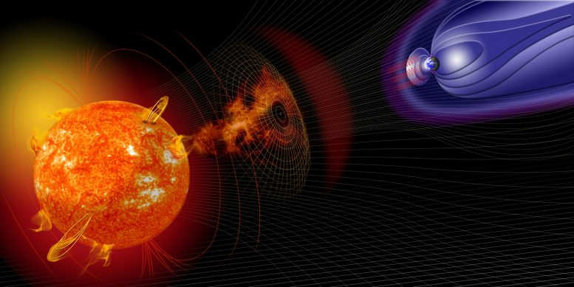
Enabling JEDI beyond Terrestrial Applications
Magnetosphere:
EnKF (Doxas et al. 2007)
EnKF (Koller et al. 2007)
Particle Filter (Nakano et al. 2008)
OI (Merkin et al. 2016)
EnKF-based (Godinez et al. 2016)
SplitOp KF (Cervantes et al. 2020)
Photosphere:
ETKF, LETKF (Hickmann et al., 2015)
Scale-Dep EnKF (Hickmann et al. 2016)
Corona:
EnKF (Butala et al. 2010)
Thermosphere-Ionosphere & WAM:
3D-Var (Wang et al. 2011)
EAKF (Morozov et al. 2013)
EnKF (Chartier et al. 2016)
EnKF (Cheng et al. 2017)
ROM-POD-KF (Mehta & Linares 2018)
EnSRF (Cantrall et al. 2019)
EAKF (Pedatella et al. 2020)
EAKF (Hsu et al. 2021)
4D-LETKF (Koshin et al. 2022)
Flares:
4D-Var (Bélanger et al. 2007)
From a methodology perspective, most of those used in the applications referred to here are available in JEDI, those that are not can be added.
CME & Solar Wind:
LETKF(Lang et al. 2017)
VarDA (Lang et al. 2018, 2021)
Ionosphere:
SGM-KF & EnKF (Scherliess et al. 2011)
Nudging (Petry et al. 2014)
EnKF (Chen et al. 2016)
LETKF (Durazo et al. 2017)

Slide 17
THANK YOU QUESTIONS?

Slide 18
DISCLAIMER
I am an outsider to the SW Community.
I have a biased Terrestrial Weather Quasi-Operational (NASA) perspective.
Years of collab with NOAA brought me to understand their R2O concerns.
My talk on JEDI should only be seen as a small part of the broader JCSDA vision of (for) JEDI. I speak for NASA GMAO.

