Slide 1
Overview of EZIE (Electrojet Zeeman Imaging Explorer) Mission
CCMC Meeting
University of Maryland
June 4, 2024
Sam Yee, Jesper Gjerloev, Nelofar Mosavi, Rebecca Wind-Kelly,
Applied Physics Laboratory, Johns Hopkins University,
Sidharth Mistra, Jet Propulsion Laboratory, and
the EZIE Science Team
Acknowledgment: NASA Heliophysics Division

Slide 2
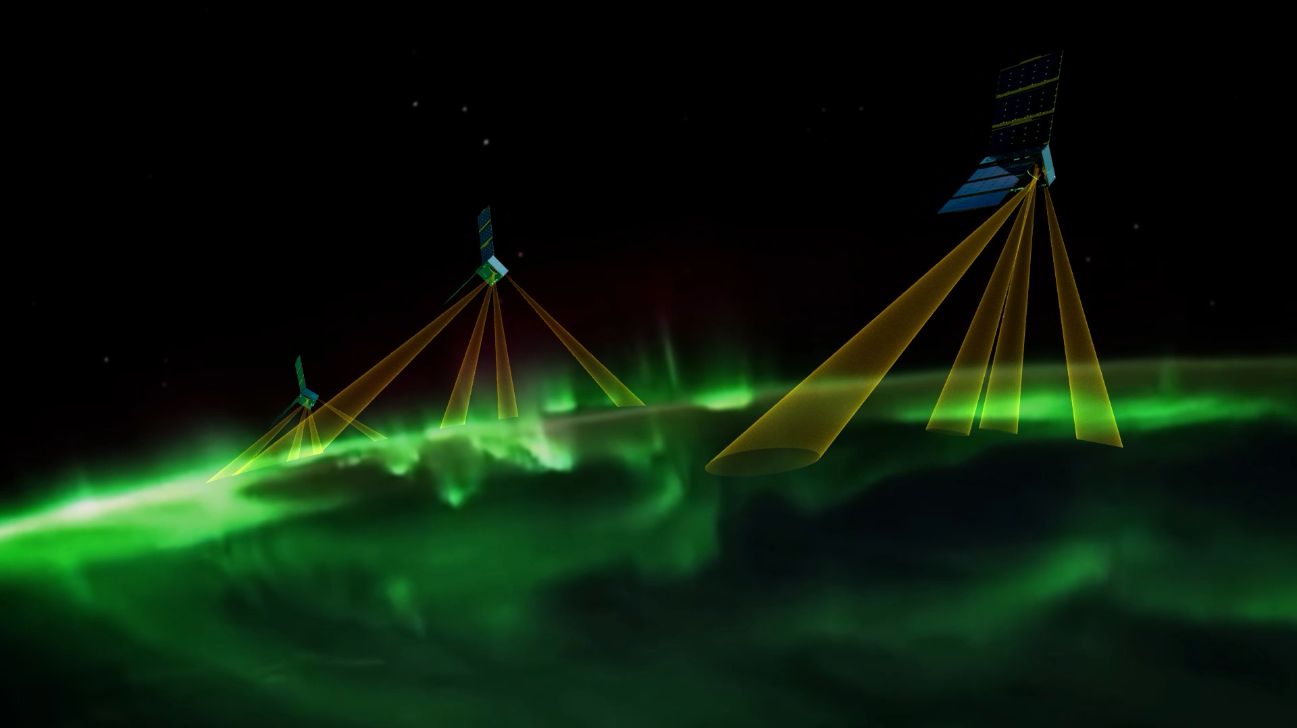
EZIE Focuses on A New Frontier of Near-Earth Magnetic Field Measurements to Study the Mesoscale Variations of Electrojets
“EZIE is a 3-CubeSat mission flying in a pearls-on-a-string configuration that uses compact multi-beam instruments and Zeeman sensing technique to image, for the first time, the electrojets. These electrical currents flow at altitudes of ~100–130 km and are notoriously difficult to explore. EZIE will study the spatial structure and temporal evolution of these electrojets, important for our understanding of space-weather processes.”
CCMC Meeting
Sam Yee

Slide 3
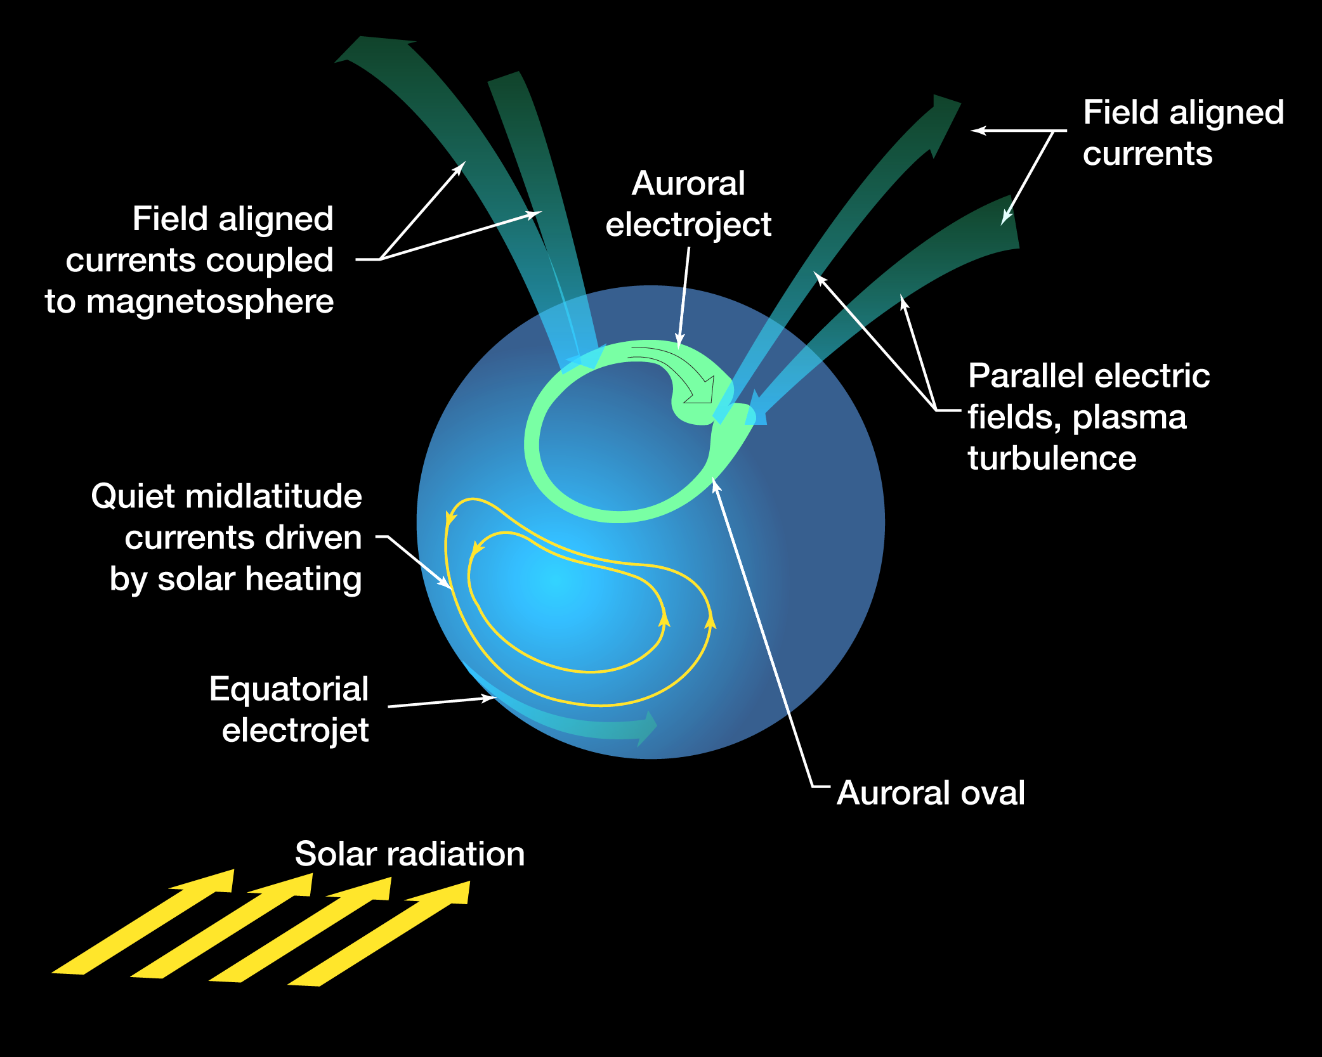
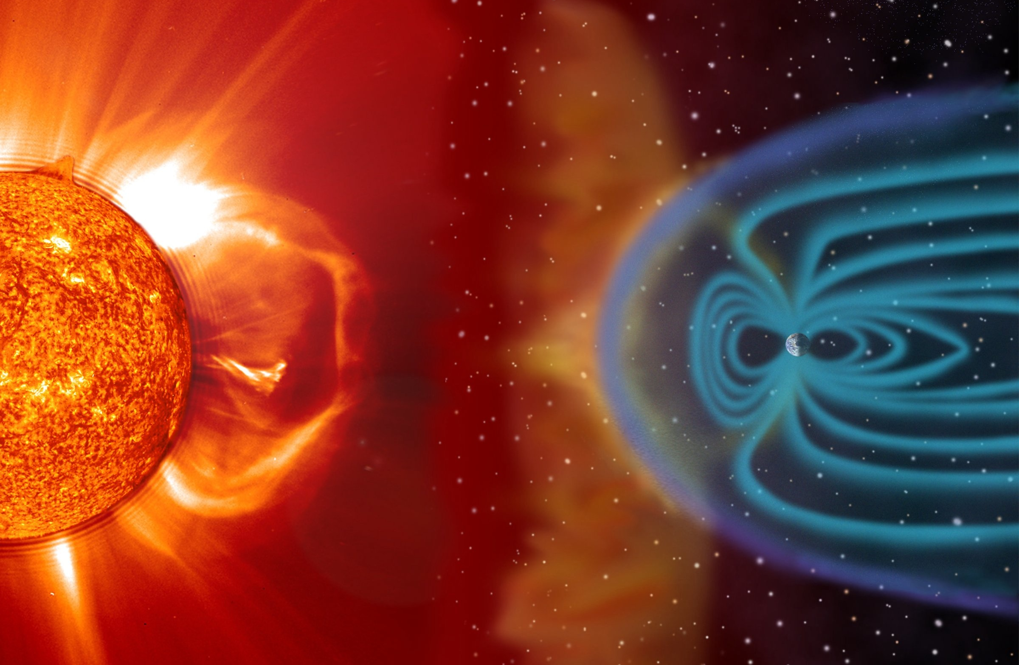
EZIE Studies the Electrical Currents in the Earth Ionosphere, Fundamental to Energy Transfer within the Sun-Earth System
CCMC Meeting
Sam Yee

Slide 4
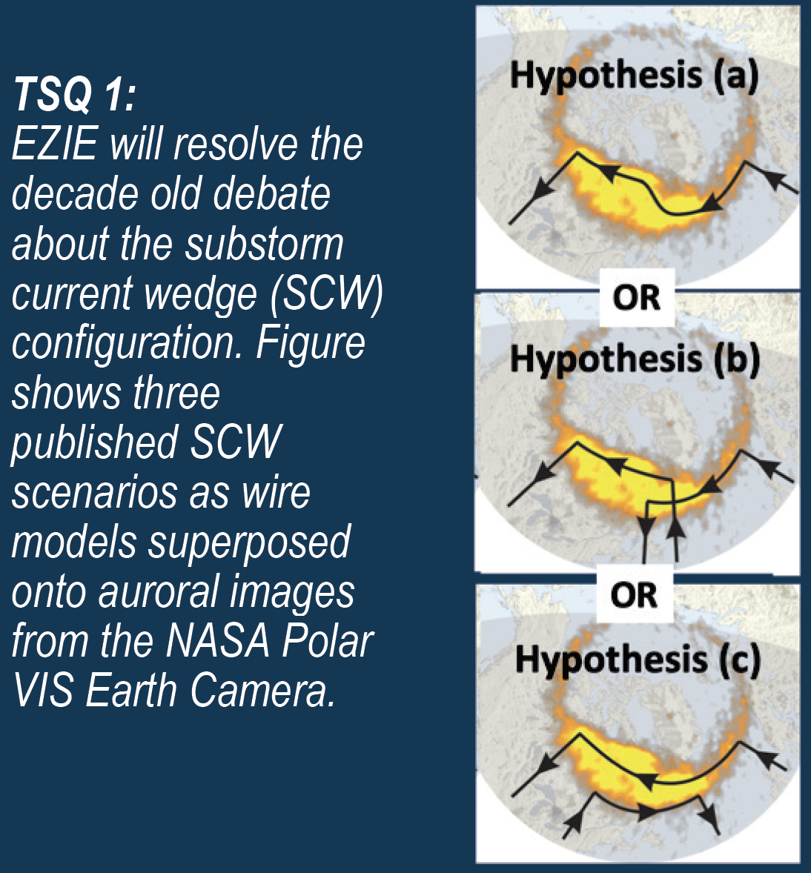
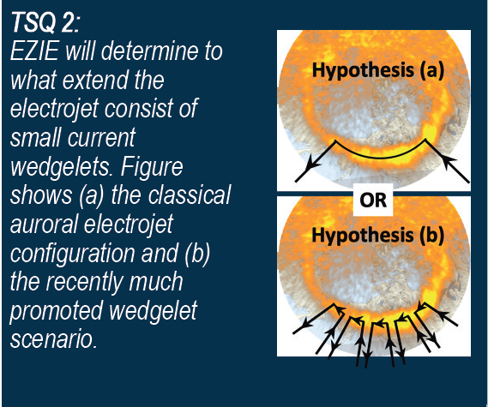
EZIE Objectives are to Resolve Fifty Year-old Debates on the Structures of the High-Latitude Current System
CCMC Meeting
Sam Yee
4

Slide 5
EZIE Measurement Objectives and Implementation Approach
The primary objective of the EZIE measurements is to reveal the mesoscale spatial structure of the aurora electrojets and their temporal evolution to discern the physical mechanism of its generation.
Measurement of Electrojet Temporal Evolution:
  3 6U CubeSat flying in a pearls-on-a-string formation with varying separation managed by differential drag.
  Measurement of Electrojet Spatial Structure:
  - A compact payload consisting of four identical O₂ 118 GHz spectro-polarimeters to remotely measure and image electrojet induced magnetic fields.
CCMC Meeting
Sam Yee

Slide 6
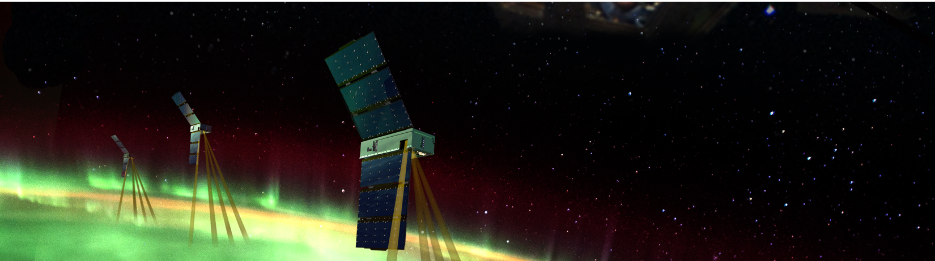
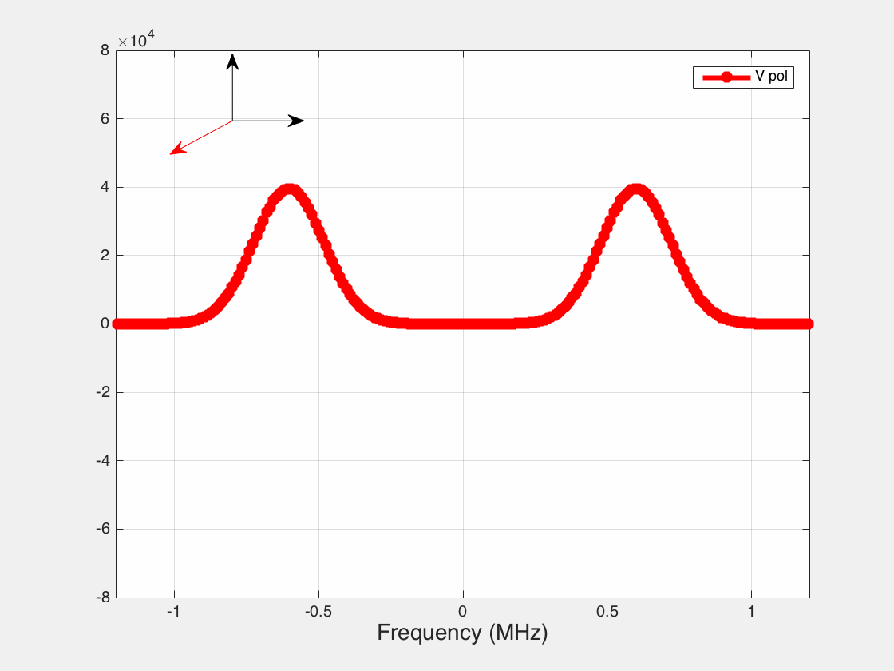
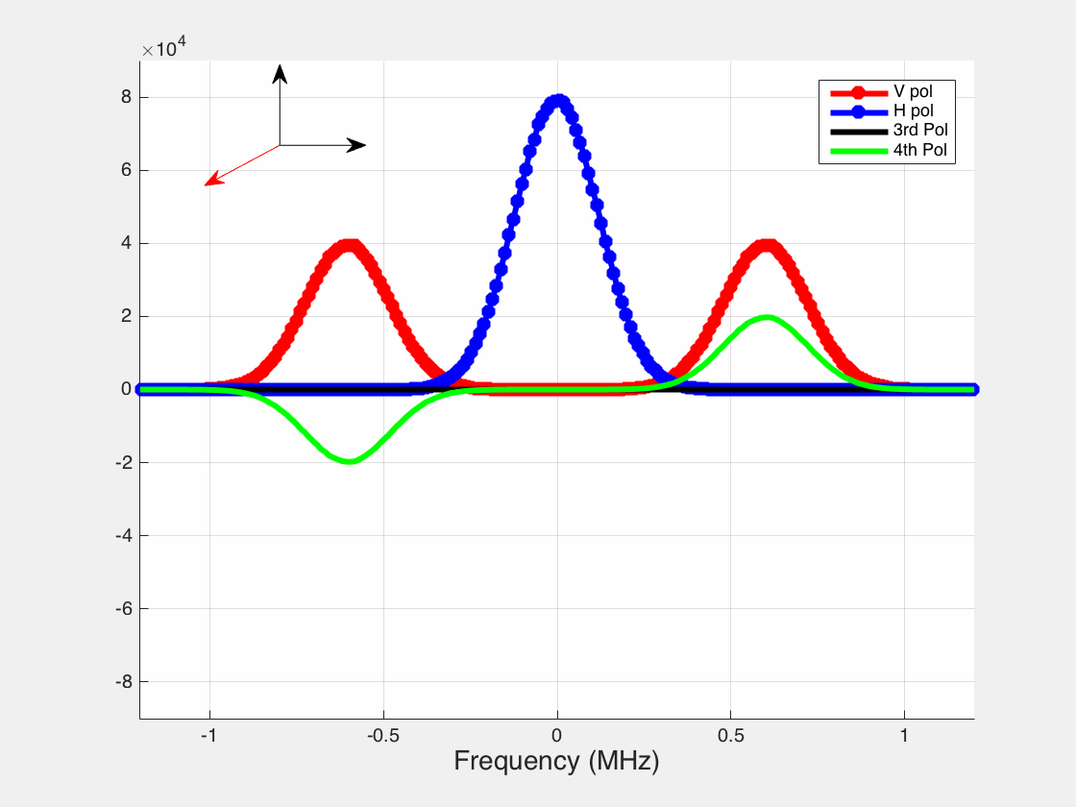
EZIE Maps the Electrojet By Measuring Current-Induced Magnetic Fields From Spectral Radiances of the O₂ Line at 118 GHz
Splitting Method
Polarization Method
Key EZIE O₂ 118-GHz thermal emission line measurement characteristics:
Covers the entire Zeeman spectra and resolves the three split lines
  Spectral split → Total magnetic field
Measures the full polarization state of the three lines
  Polarization → Vector B-field
-8
-6
-4
-2
0
2
4
6
8
V Stoke vs B mag
Unsplit Line Position (B=0)
V Pol
H Pol
3rd Pol
4th Pol
B magnitude
V Pol
Peak separation
-1 -0.5 0 0.5 1
Frequency (MHz)
-1 -0.5 0 0.5 1
Frequency (MHz)
CCMC Meeting
Sam Yee

Slide 7
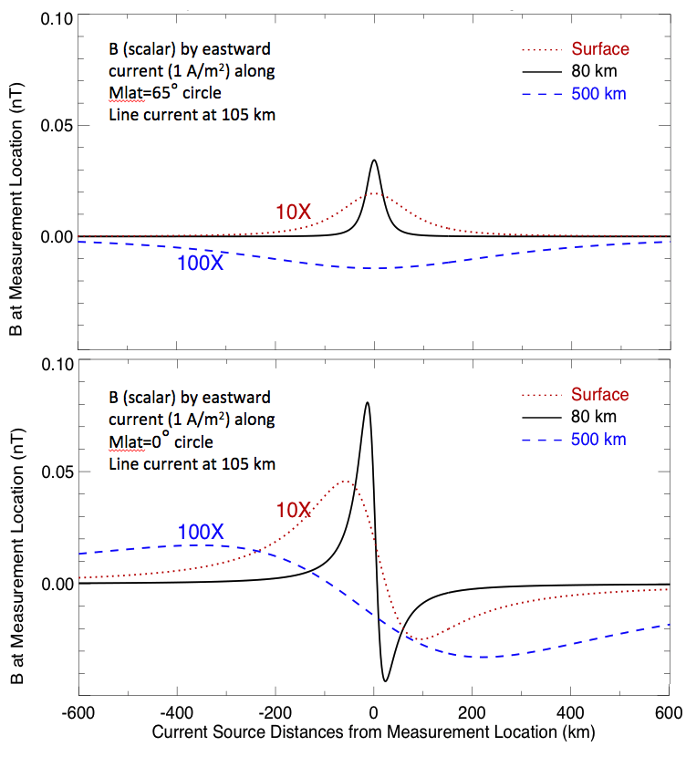
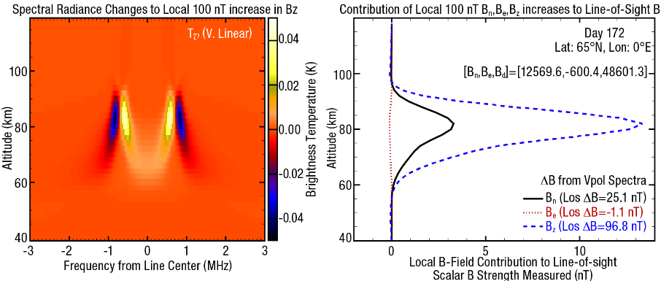
Advantages of EZIE B-Fields Measurements by Viewing Nadir
Higher Spatial Resolution
Close to the Electrojet
CCMC Meeting
Sam Yee

Slide 8
Simulated EZIE Observations in one Data Collection Event
EX
EZIE Observations Summary
1 Microwave Electrojet Magnetogram (MEM), a 118 GHz spectropolarimeter sensor package per s/c.
4 cross-track downward-looking receivers per MEM suite.
4 polarized radiance measurements per receiver, V, H, S3 & S4
One ~14 min Data Collection Event (DCE) per orbit (space look -> science -> space look)
~9 min science observations per DCE.
CCMC Meeting
8

Slide 9

EZIE OSSEs Test and Verify Data Retrieval Algorithms
(Example: Simulated Retrievals of $\overset{⃑}{B}$ versus Input $\overset{⃑}{B}$)
MEM 2.0 seconds, 49 kHz/channel, 256 Channel Simulation
Radiance Noises: 2.45 K
Simulated Tυ, Beam 3
Tυ sensitivity to 1 nT change in B_{z}
Simulated Retrievals of Vector B
CCMC Meeting

Slide 10
Secondary Science Products (Line-of-Sight Winds)
EZIE also obtains line-of-sight winds every 2 seconds from the Observed Doppler shifts and of the O₂ 118 GHz spectral radiances
CCMC Meeting
10

Slide 11
Secondary Science Products (Temperature Profiles)
EZIE also can apply the temperature sounding technique to obtain temperature profiles every 2 seconds from the measured brightness temperature of the O₂ spectral radiances
Contribution Function (T_{υ}: Vertical Linearized Radiance)
Contribution Function (T_{h}: Horizontal Linearized Radiance)
CCMC Meeting
11

Slide 12
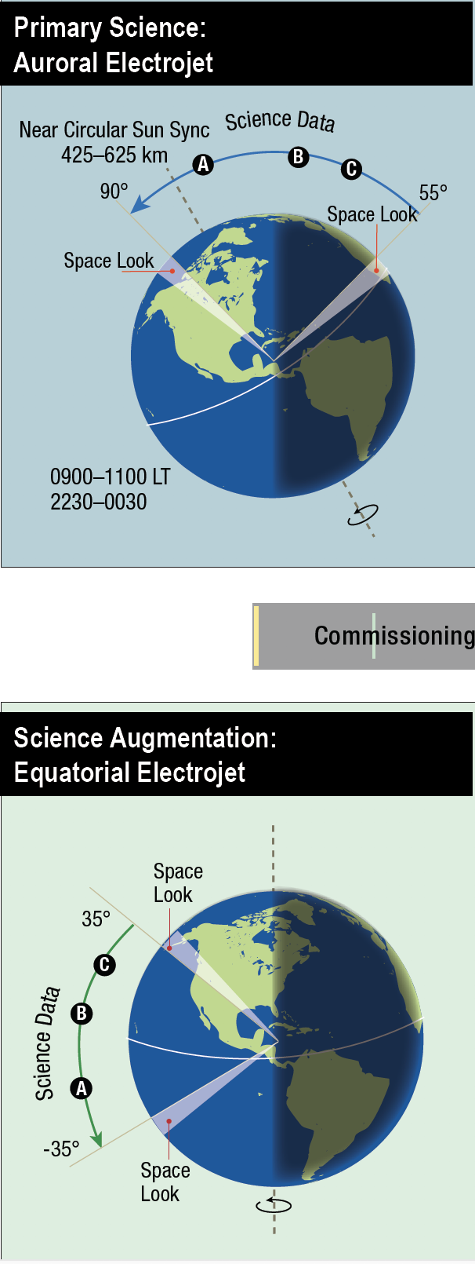
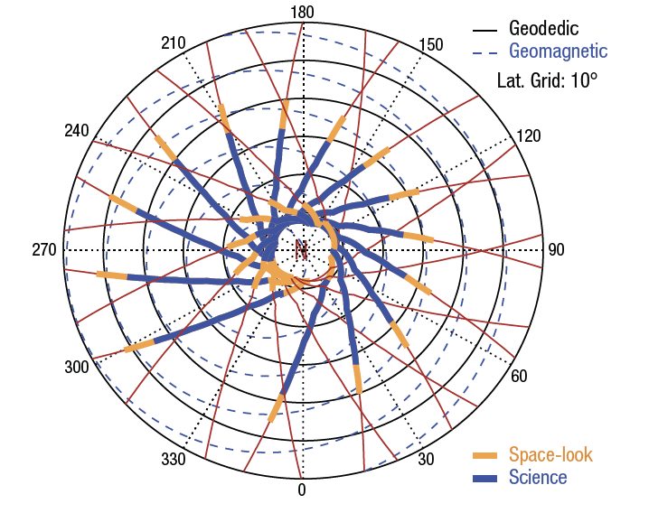
EZIE Observation Plan Optimizes Resource and Science Needs
Primary Science: Auroral Electrojet
One Day of Auroral Electrojet Observations
Science Augmentation Equatorial Electrojet
Northern
Summer
Equinox
Southern
Summer
Equinox
CCMC Meeting
Sam Yee

Slide 13

EZIE Mission and Measurement Products Summary
Mission Summary
A NASA Heliophysics Mission of Opportunity Mission
Spacecraft: three 6U CubeSat
Payload: 4-beam Full-Stokes Radiometers
Orbit:
Circular: 325-675 km (Operational)
480-625 km (Deployment)
Inclination: Sun-Sync
LTAN: 010:00-12:30 or 22:00 to 02:00
Mission Lifetime:
Commissioning: 2 months
Operations and Data Analysis : 16 months
Launch Date: Late 2024 (Oct. 2024) or Early 2025a
Launch: Secondary on Falcon-9
Measurement Products Summary
Physical Measurements: Full Stokes O₂ 118 GHz spectral radiances
Measurement Products:
$\overset{⃑}{ B }$ fields at `80 km
equivalent current maps at ~105 km
line-of-sight winds near 80 km
temperature profiles from ~45 -90 km
Retrieval Algorithm Development: Use of OSSEs to test the accuracy of the retrievals and verify predicted precisions
Status:
$\overset{⃑}{ B }$ fields: developed and tested
currents: developed & tested
line-of-sight winds: developed and tested
temperature: under development
CCMC Meeting
13

Slide 14
EZIE
Thank You and
Collaborations are Welcome!
EZIE Web Site: https://ezie.jhuapl.edu
Open Science Workshop :
When: 9/25-9/27 2024
Format: Virtual and On-site at APL
Registration: Open
CCMC Meeting
Sam Yee

Slide 15
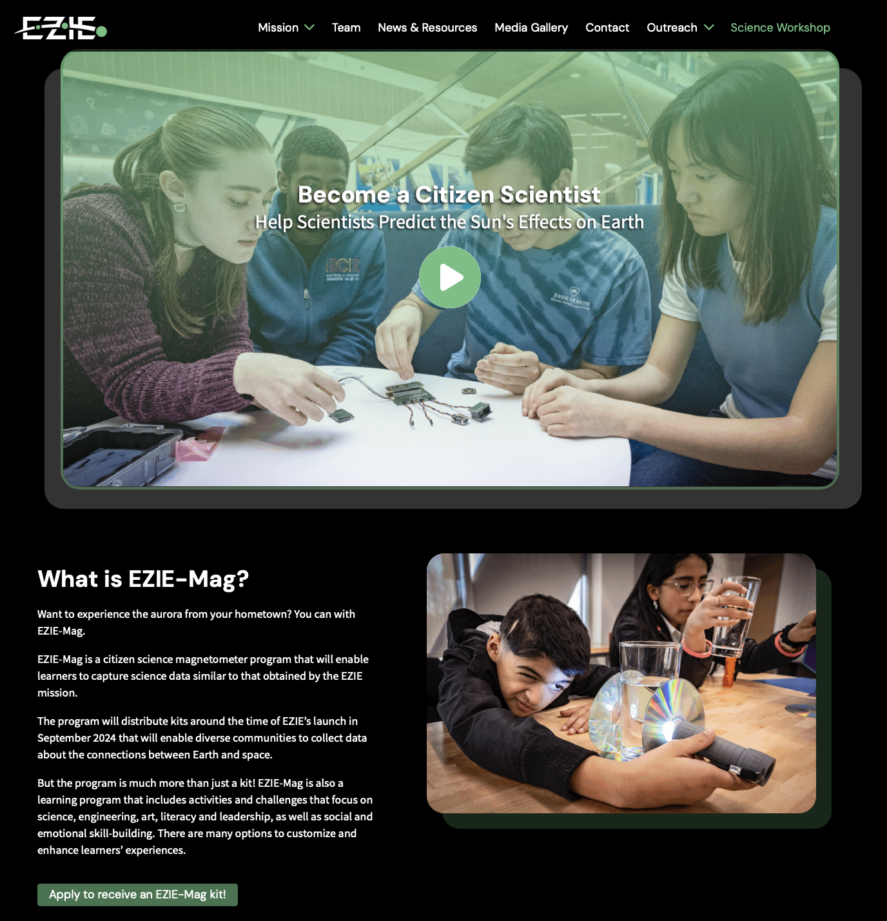
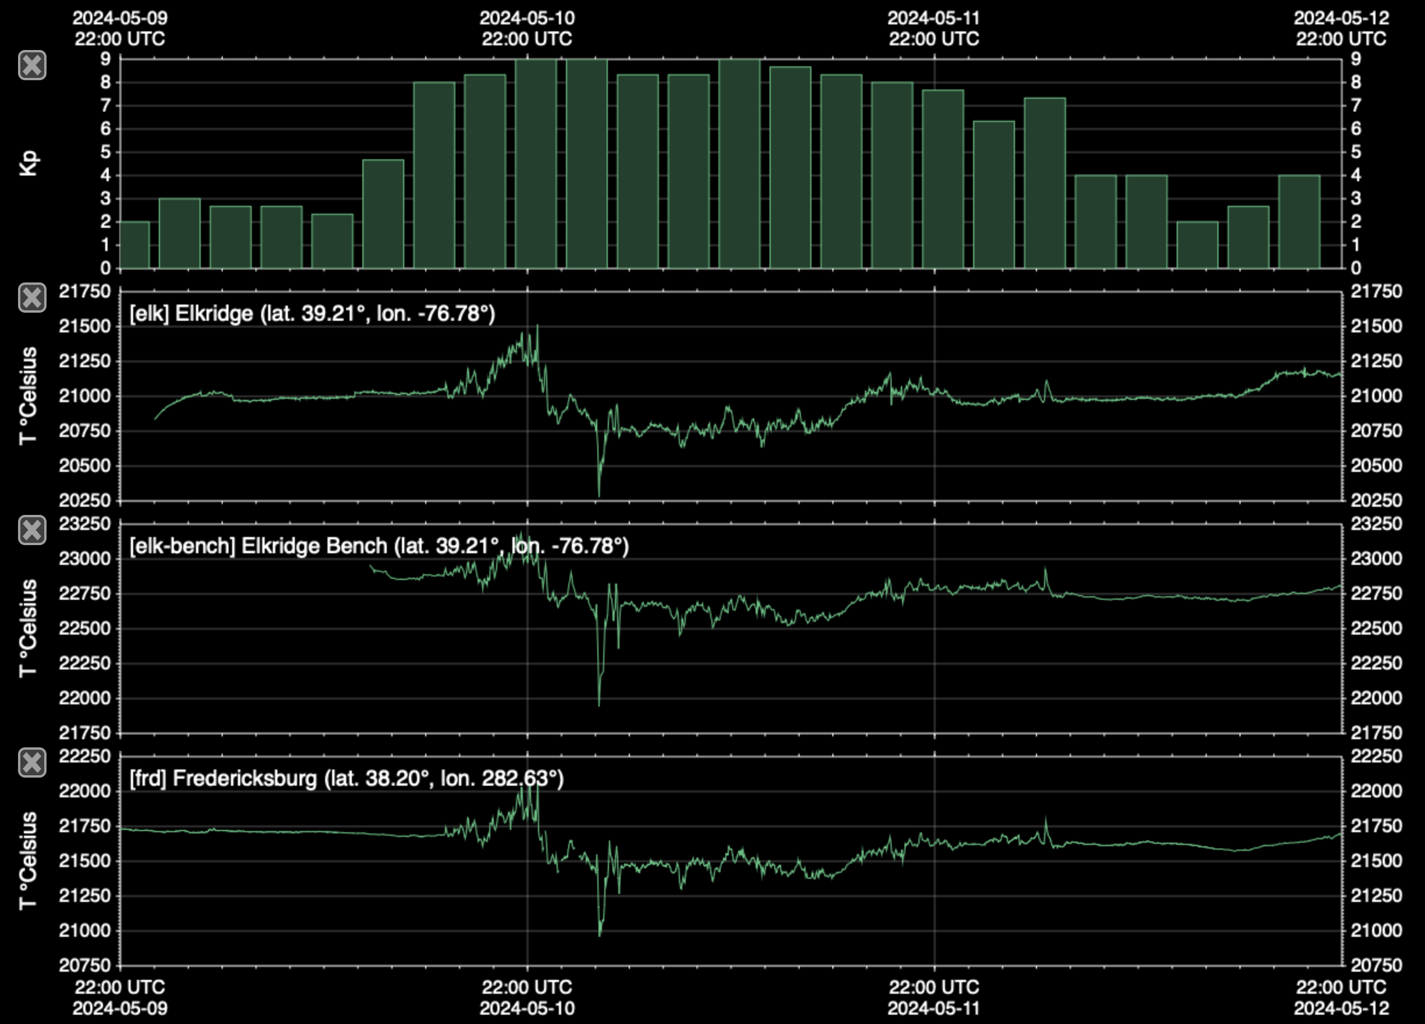
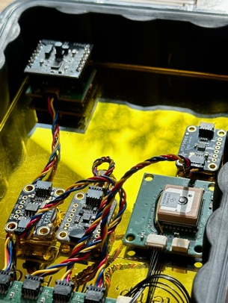
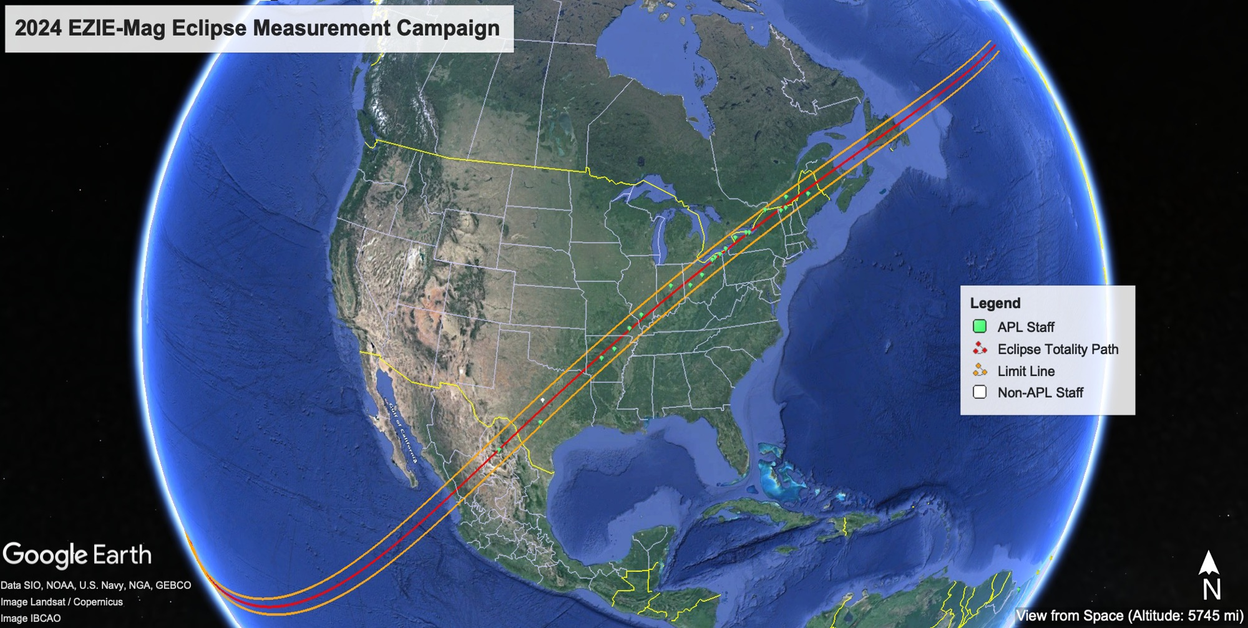
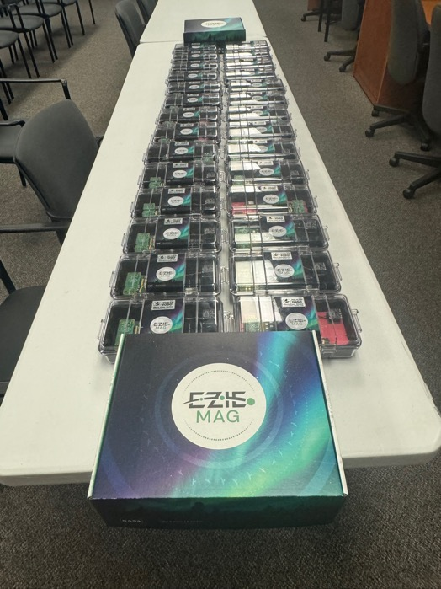
EZIE Outreach and Citizen Science Program: EZIE-Mag
Great Solar Storm of 2024
EZIE-Mag
CCMC Meeting

Slide 16
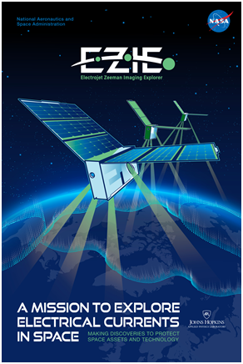
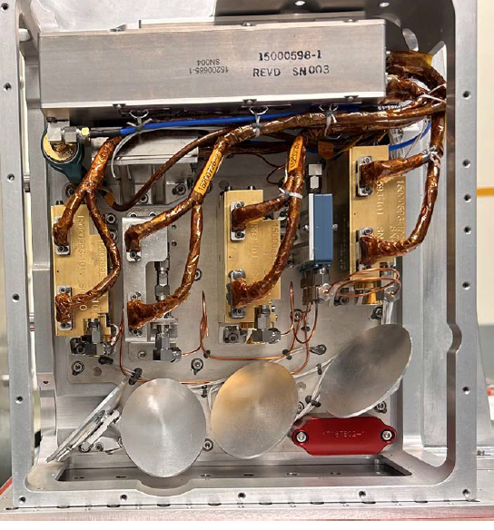
Mission Overview
The Major Significance of EZIE
EZIE Highlights
  Study the Mesoscale Structure of the Electrojets
  Use Different Drag to Manage the Multi-Satellite Required Configuration
  Image the Spatial Structure and Study Temporal Evolution of the Electrojet
Use Compact and Light-Weight Spectropolarimeter
Spacecraft (BCT)
6U CubeSats x3
Oversees spacecraft
bus and SV System I&T
  Utilize Zeeman Technique to Remote Measure the Magnetic fields induced by the Electrojets
Utilize OSSEs to mature, verify, and demonstrate science measurement closure Data
Microwave Electrojet Magnetogram Instrument (JPL)
x3 MEM instruments, one per SV
Four 118-GHz radiometer sensors per instrument
Key Mission Requirements
Mission Programmatic
Mission Design Life | 18 months (2 months early ops, 16 months science)
Operational Orbit | 375-675 km altitude, 0900-1330, or 2100-0300 LTAN
Deployment Orbit | 480-625 km altitude, 1000-1230, or 2200-0200 LTAN Sun-synchronous
Orbit Configuration | Pearls-on-a-string with 2-10 min separation using differential drag maneuvers (i.e. propulsion not required)
Satellite Mass Limit | 16 kg per satellite, 6U Class
Orbit Average Power | 38 W, End-Of-Life
Science Data Volume | 75 MB / Day / Sat, 361 GB science life 16 months for all satellites at Level 0-3
Launch | SpaceX Falcon 9, Secondary Payload Rideshare, Fall 2024
40 months (Phase B-D), 18 months operations, 6 months Phase F: $64M
Principle Investigator: Dr. Sam Yee, APL
Project Manager: Dr. Nelli Mosavi, APL
Mission System Engineer: Rebecca Wind-Kelly, APL
Instrument: JPL
Spacecraft: BCT
Mission Operations: BCT / APL
Science Operations: APL
Launch Service: Maverick Space Systems

Slide 17
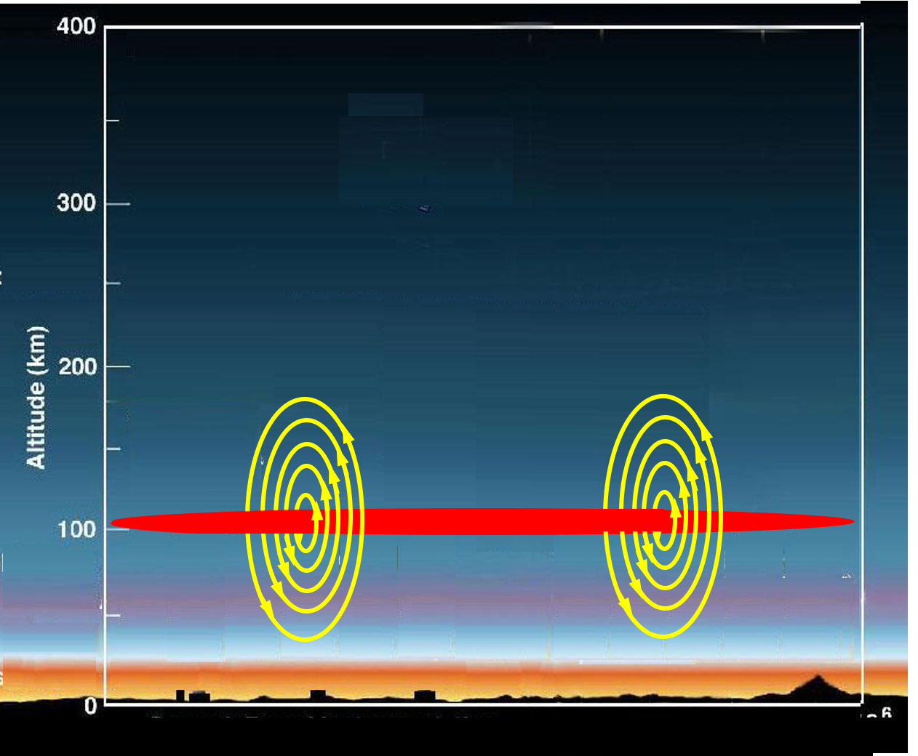
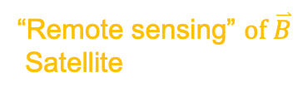
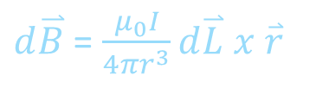


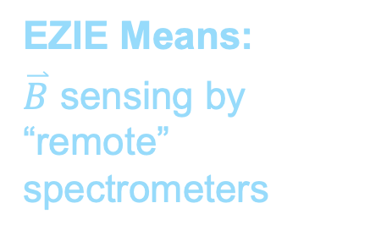

EZIE Observes Currents Remotely by Measuring Magnetic Field Perturbations Using an Old Technique Applied in a New Way
Currents are inferred from the measurements of the strength and direction of their induced magnetic fields.
“In situ” $\overset{⃑}{B}$ Satellite
“Remote sensing” $of \overset{⃑}{B}$
Satellite
  Conventional Means:
  $\overset{⃑}{B}$ sensing by “in situ” magnetometers
Radiation affected by $\overset{⃑}{B}$
Rocket
  EZIE Means:
  $\overset{⃑}{B}$ sensing by “remote” spectrometers
Biot-Savart law:
Electrojet
$d\overset{⃑}{B}$ = $\frac{μ_{0}I}{4πr^{3}}d\overset{⃑}{L} x \overset{⃑}{r}$
Magnetometers
CCMC Meeting
Sam Yee

Slide 18
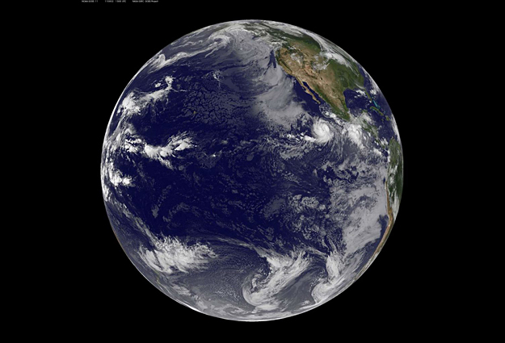
EZIE Implementation Reduces Required Number of Spacecraft
Miniaturized 4-Beam Imaging Sensor
on Identical 6U CubeSats
12 spacecraft with in situ magnetometers
3 spacecraft with 4-beam imaging MEM
CCMC Meeting

Slide 19
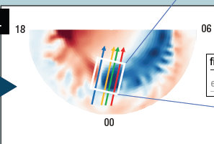
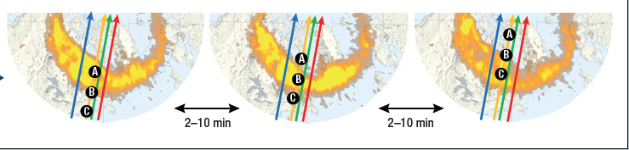
EZIE Science Measurement Implementation Approach
The primary objective of the EZIE measurements is to reveal the mesoscale spatial structure of the aurora electrojets and their temporal evolution to discern the physical mechanism of its generation.
“mesoscale” (~150–500 km) spatial structure => 4-look remote sensors
temporal evolution (~2-20 min) => 3 spacecraft on a pearls-on-a-string
near the midnight sector at auroral latitudes (poleward of 55º Mlat) with a precision of better than 200 nT => low-noise remote sensor on sun-sync orbits
06
Electrojet
80 km
CCMC Meeting
Sam Yee
Sam Yee
Sam Yee

Slide 20
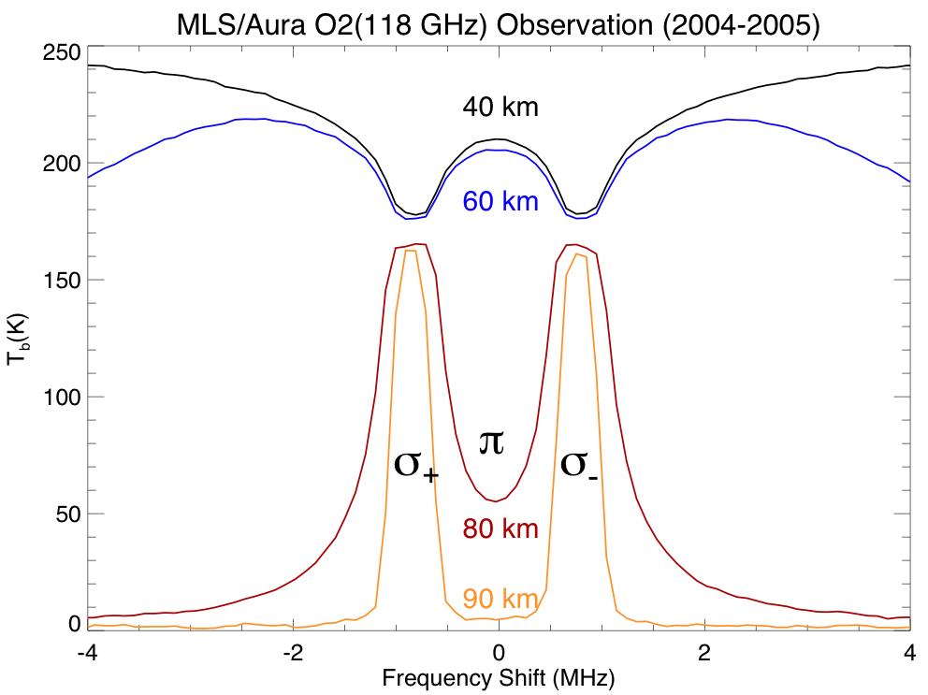

EZIE Uses Zeeman Effects on the O₂ 118 GHz Thermal line to Obtain Magnetic Field Strengths Near the Current Altitudes of ~105 km
The O₂ (J=1 to J=0) transition at ~118.751 GHz. It has three Zeeman components (Δm=+1, 0, -1), while the splitting in typical geomagnetic fields (30000-60000 nT) is of order 1 MHz.
MLS/Aura Vertical Polarized Measurements
Δν (MHz) =1.4012x10⁻⁵*B (nT)
Rafael Perez
The Zeeman effects of the O₂ 118 GHz lines
- the splits can be seen in both emission
(high altitudes) and absorption (low
altitudes) lines;
- the splits can be spectrally resolved. The
splitting is larger than the width of the lines.
- the polarization states can be measured and
used to obtain the information about the
angles between the B-vector and viewing
line-of-sight.
70°N
100ºE
~58400 nT
John Cavo (BCT)
Absence of $\overset{⃑}{B}$
CCMC Meeting
Sam Yee

Slide 21
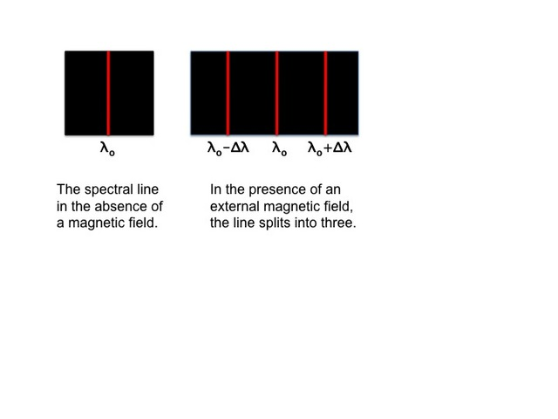



EZIE Utilizes the Zeeman Effect on an Atmospheric Emission Line to Remotely Sense the B-Field
In spectroscopy, Zeeman effect is the effect of splitting of a spectral line emission into several components in the presence of a magnetic field. The relative strengths of split lines and their polarization states depend on the angle between the viewing angle and the magnetic field vector.
Rafael Perez
Δλ ≈ |B|
Polarizations
Frequencies
John Cavo (BCT)
ν_{ο}−Δν
ν_{ο}
ν_{ο}+Δν
ν_{ο}−Δν
ν_{ο}
ν_{ο}+Δν
Observation
$$\overset{⃑}{B}$$
Absence of $\overset{⃑}{B}$
Presence of $\overset{⃑}{B}$
CCMC Meeting
Sam Yee

