Slide 1
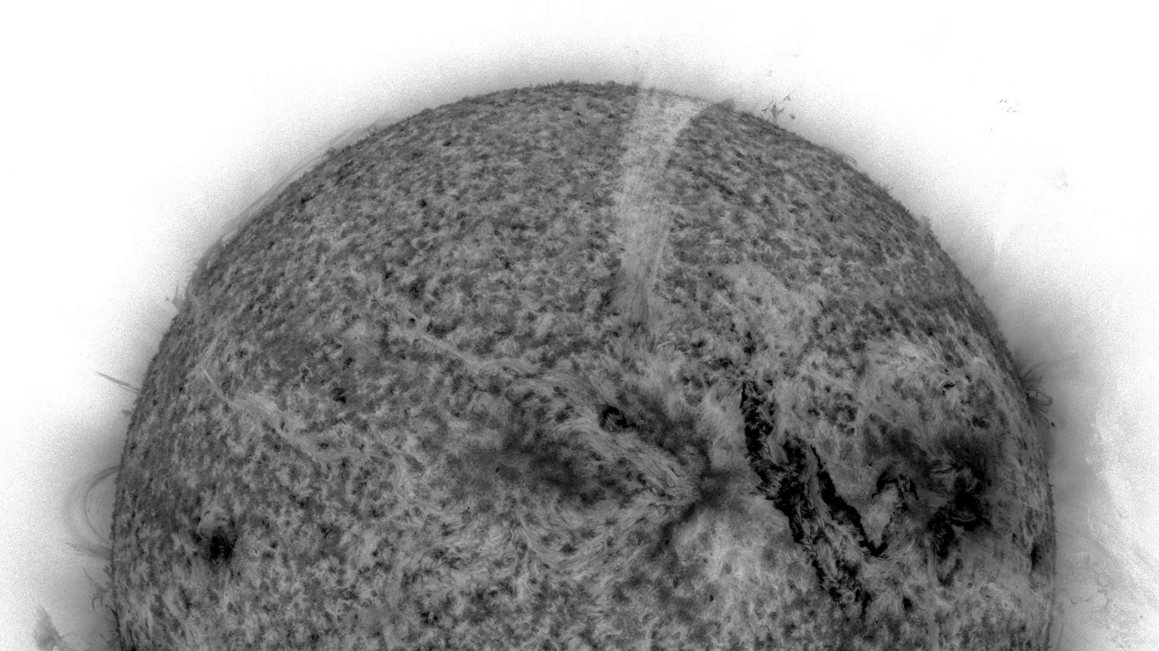


SEPMOD: Current Implementation at CCMC and Plans for Future Improvements
CCMC Workshop
June 3–7, 2024
College Park (MD), USA
Erika Palmerio¹ • Janet G. Luhmann²
¹Predictive Science Inc., San Diego, CA 92121, USA
²Space Sciences Laboratory, University of California, Berkeley, CA 94720, USA
epalmerio@predsci.com

Slide 2


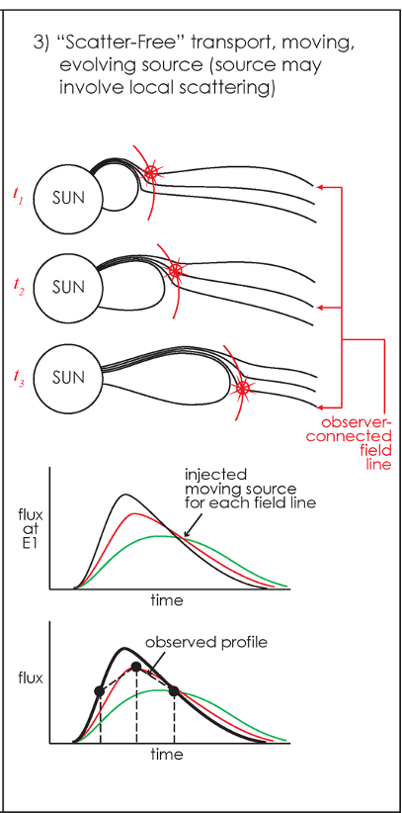
CCMC Workshop 2024
SEPMOD: The basics behind the model
• SEPMOD is based on the (CME-driven) shock–observer magnetic connection concept
Particles (usually 1–1000 MeV protons) propagate along magnetic field lines
Transport is assumed to be scatter-free (no cross-field diffusion)
• In brief, it forward-models SEPs along field lines that connect a CME-driven shock to a specific observer, using shock-source injections followed by a constant-energy, guiding-centre transport approximation (and following diffusive shock acceleration equation)
Goal: Computationally rapid model that can generate predictions at multiple observers and can be employed in real time, easy to use and to analyse
• Needs shock & connectivity info from a 3D MHD coronal and/or heliospheric model
So far, it has been run as a post-processing procedure on WSA–Enlil sim outputs
• Widely used in real-time applications bc of its computational efficiency and bc it can be run "on default" on a pre-computed CME run without having to tune free parameters
(e.g., regularly run in real time at CCMC and results can be found on the SEP Scoreboard)
• Has also been used in research, some example applications: Luhmann et al. [2010, 2017, 2018], Palmerio et al. [2022, 2024]
Figure: Luhmann et al. [2007]
epalmerio@predsci.com

Slide 3
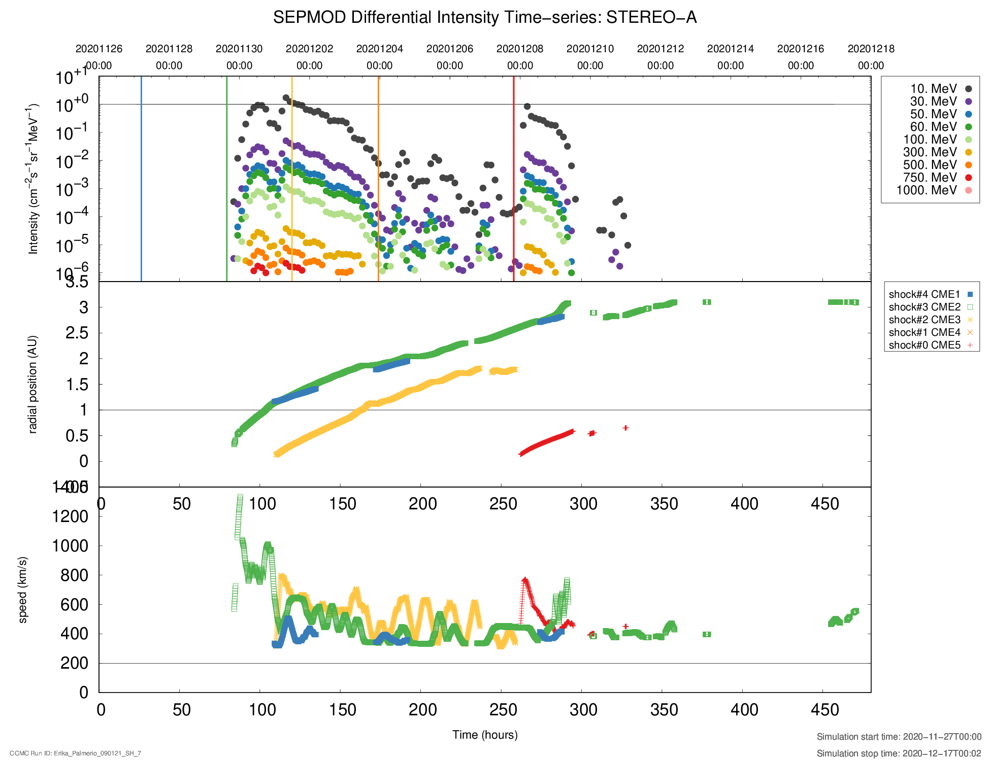
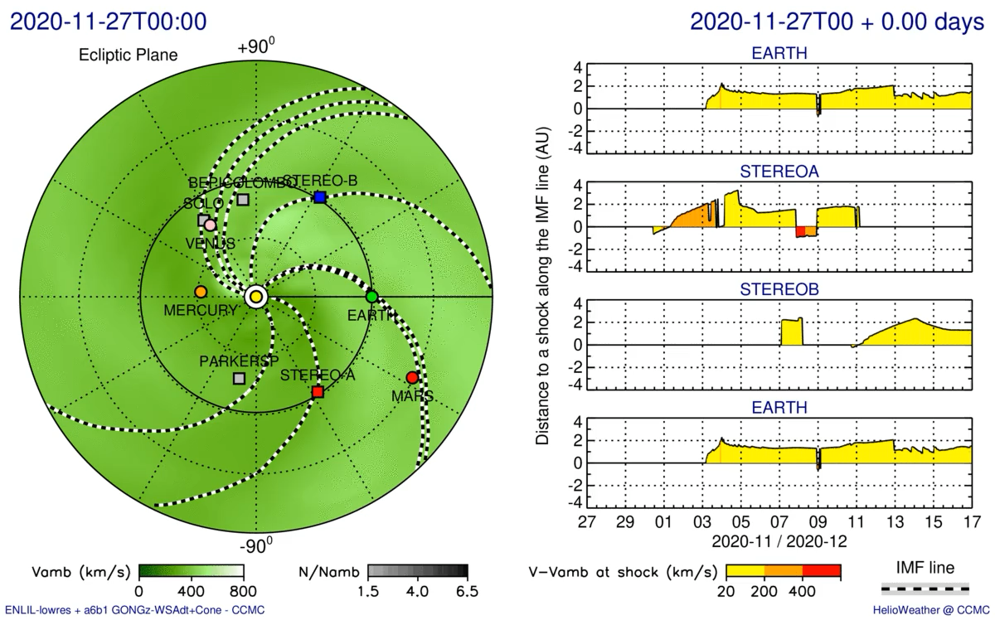
CCMC Workshop 2024
SEPMOD: Using WSA–Enlil results to spread particles in the heliosphere
After a WSA–Enlil run is completed, time-dependent magnetic field and interplanetary shock information is used to forward model SEPs (typically protons), which are injected onto the field line connected to a specified observer
→ Can be run on an Enlil simulation containing a single eruption or multiple CMEs!
Results shown here: Palmerio et al., SpWea, 20, e2021SW002993 (2022)
epalmerio@predsci.com

Slide 4
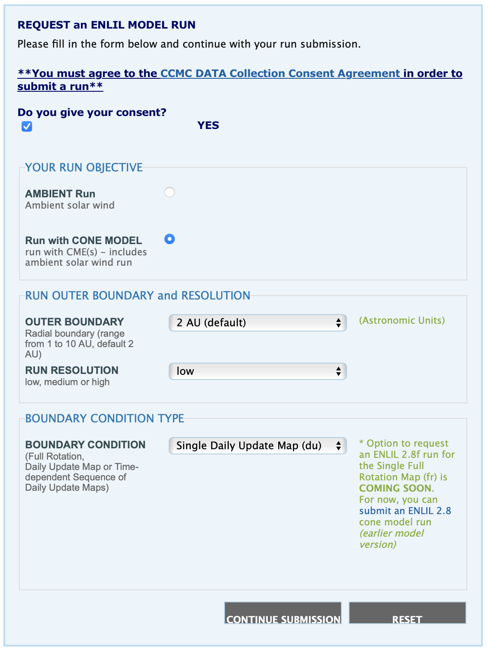
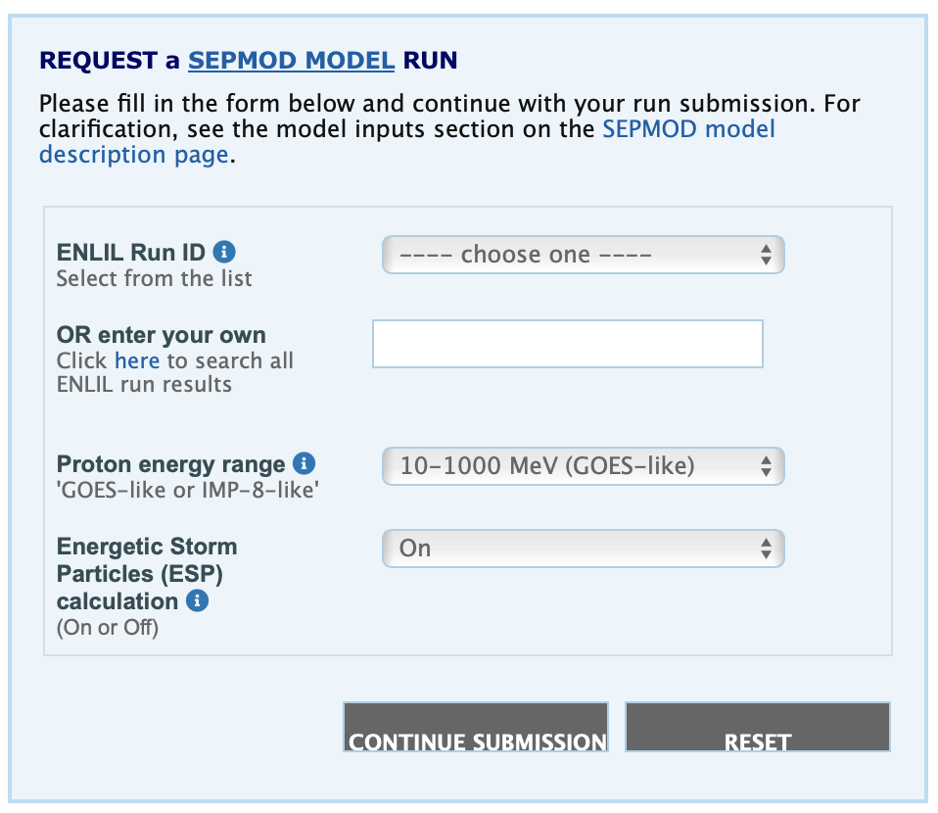


CCMC Workshop 2024
SEPMOD: How to run it at CCMC
SEPMOD is conveniently available at NASA CCMC via RoR → Can be run by anyone!
ROR pages for Enlil and SEPMOD at CCMC
Workflow for requesting a SEPMOD run:
Request a WSA–Enlil run of the CME or select an existing run
→ "Special" requirements for the run:
- Hourly 3D output (default: 6 hr)
- # of simulation blocks = # CMEs + 1
Request a SEPMOD run on the WSA–Enlil results (using the related Enlil Run ID)
As of now, SEPMOD outputs can be requested in "GOES-like" (10–1000 MeV) or "IMP-8 like" (1.2–72 MeV) format of energy ranges
Enlil RoR
SEPMOD RoR
epalmerio@predsci.com

Slide 5
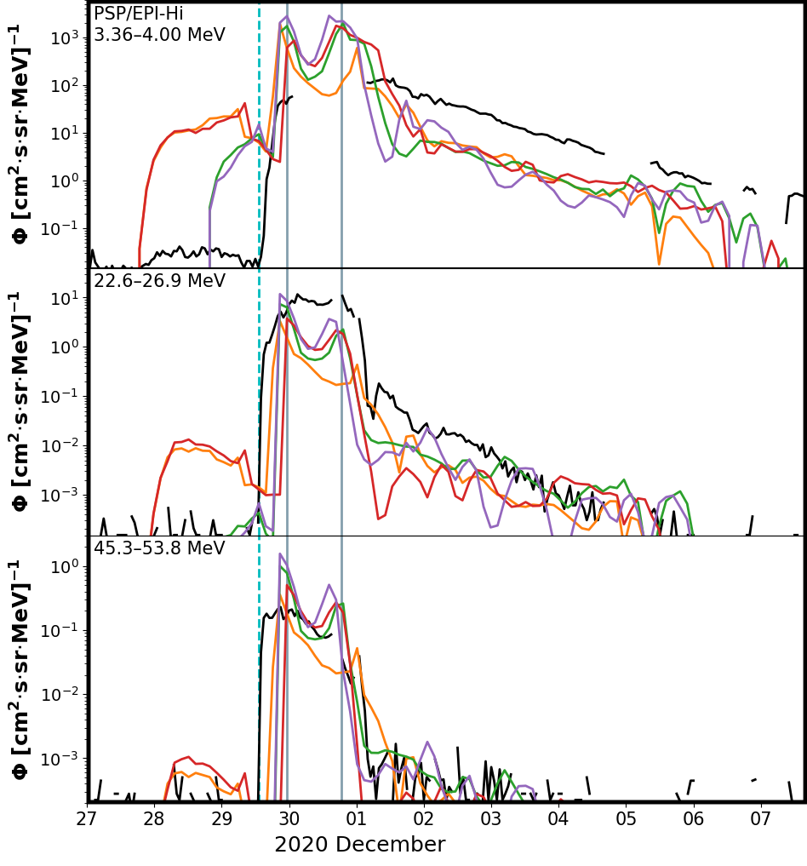
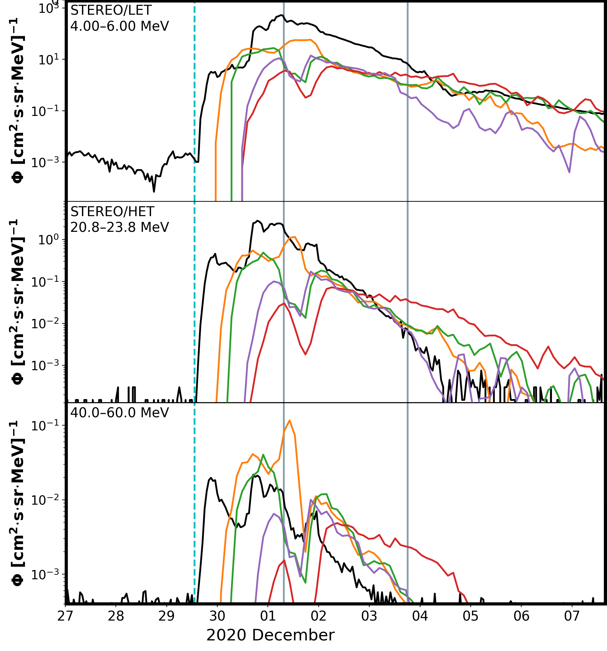
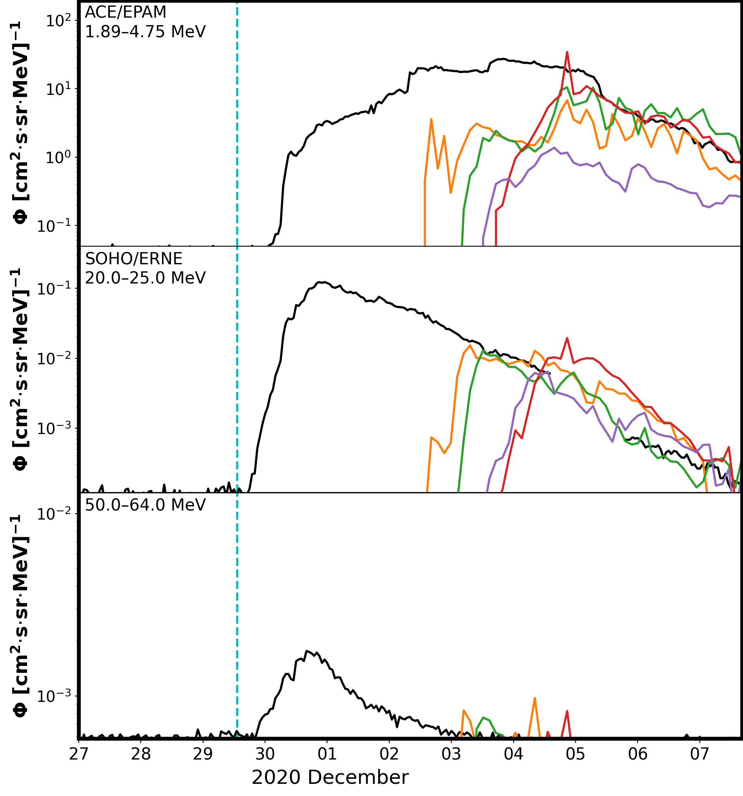
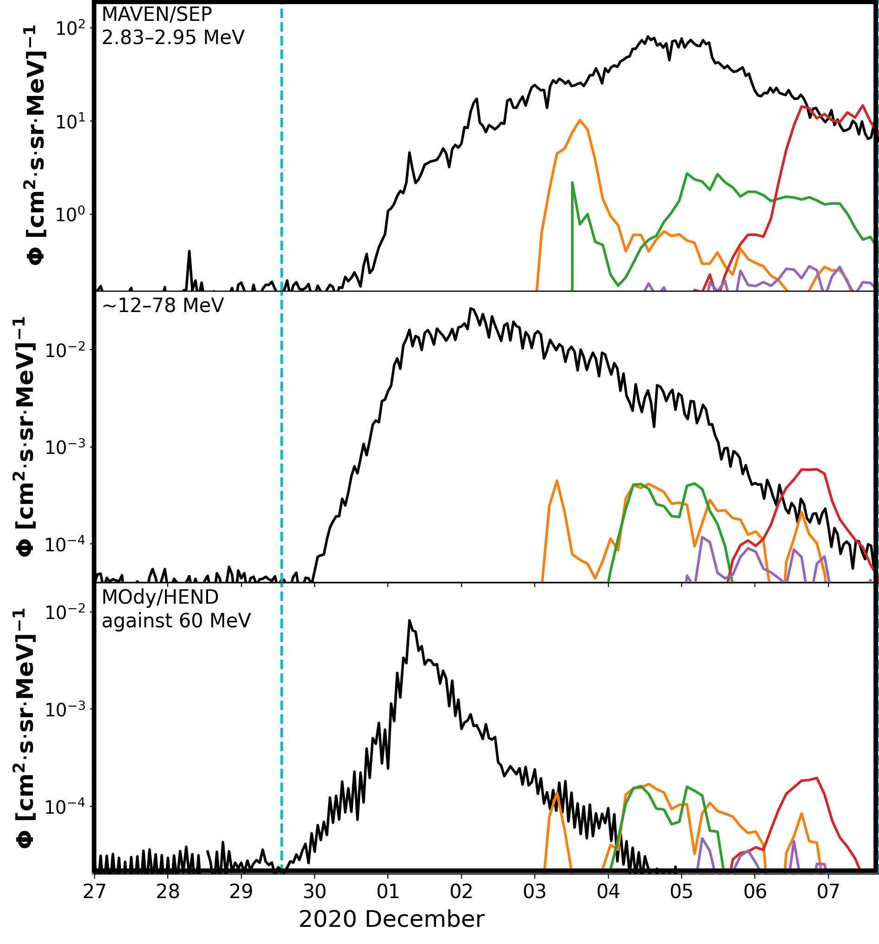
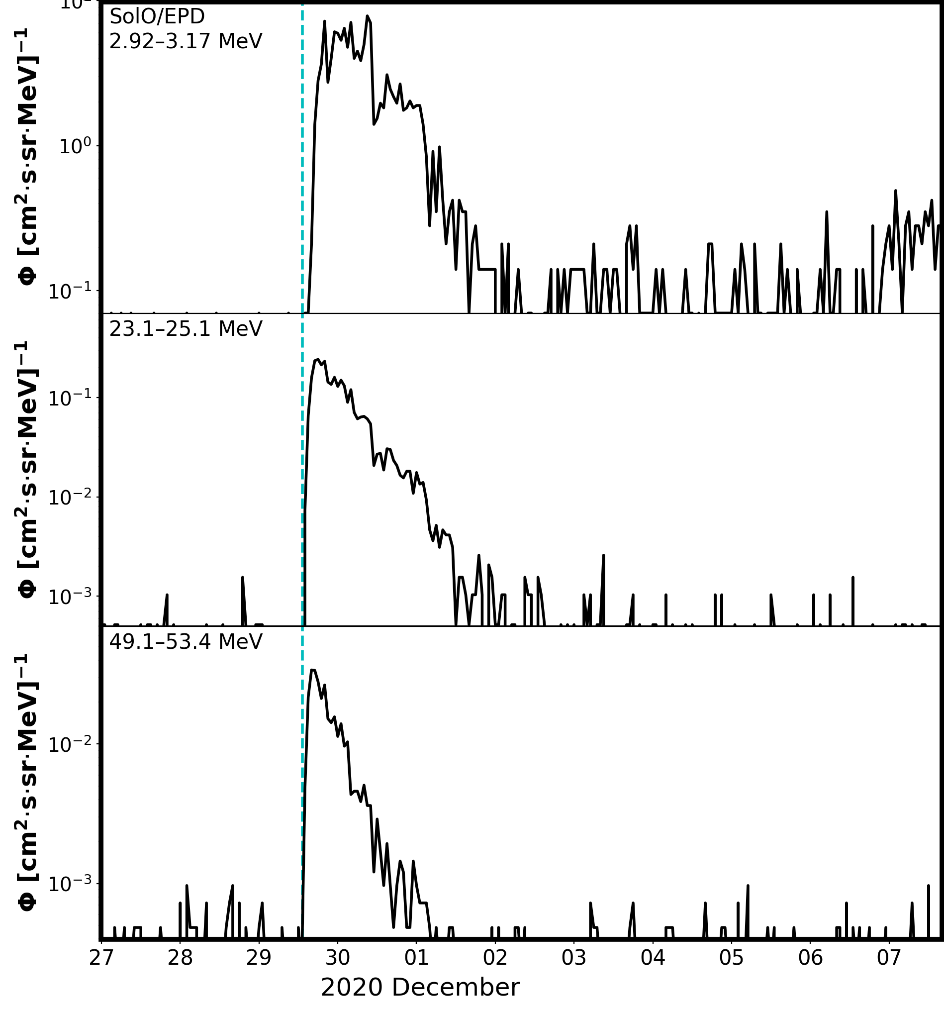
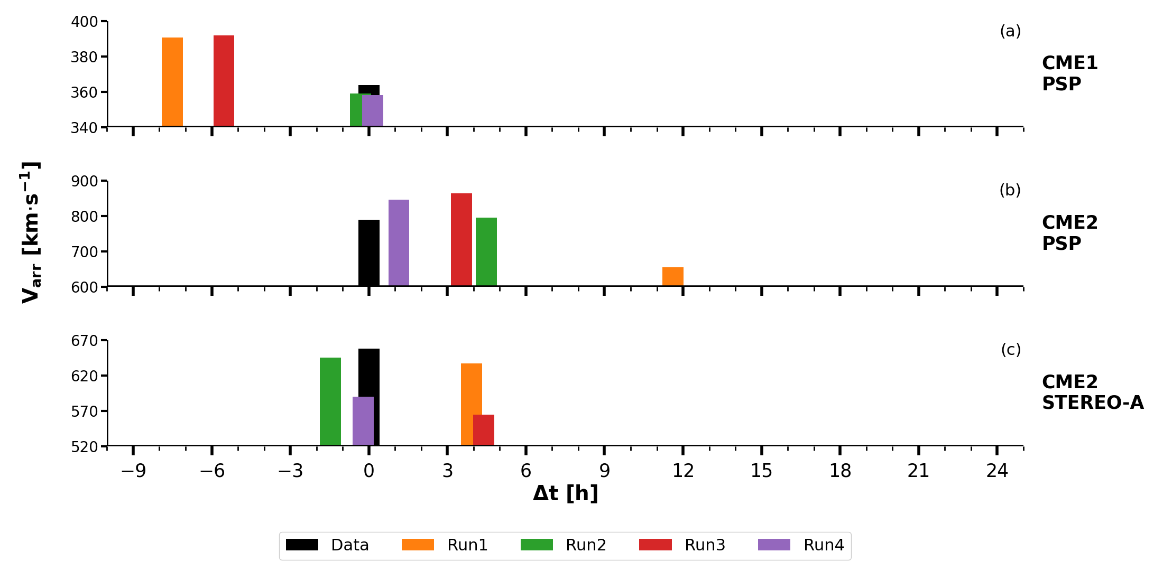
CCMC Workshop 2024
SEPMOD: Addressing the onset time problem
Parker Solar Probe
STEREO-A
Earth
Mars
Solar Orbiter
Data in countrates
Data in countrates
Let’s take a look at an example: The 2020 November 29 widespread SEP event
• Parker and STEREO-A: Well-connected to the shock since early on
• Earth and Mars: magnetically connect to the shock much later
• Orbiter: never reaches connection with the shock modelled in WSA–Enlil
→ SEPMOD results improve for well-connected observers, but also in the best cases we have a delay of a few hours in the event onset → We are missing coronal SEP acceleration (<21.5 R☉)!
SolO
PSP
Bepi
STA
Earth
Mars
Results shown here: Palmerio et al., SpWea, 20, e2021SW002993 (2022)
epalmerio@predsci.com

Slide 6
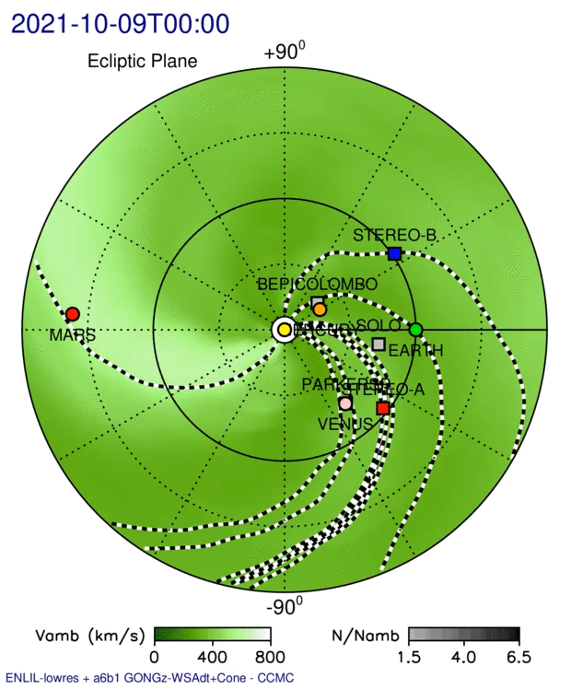
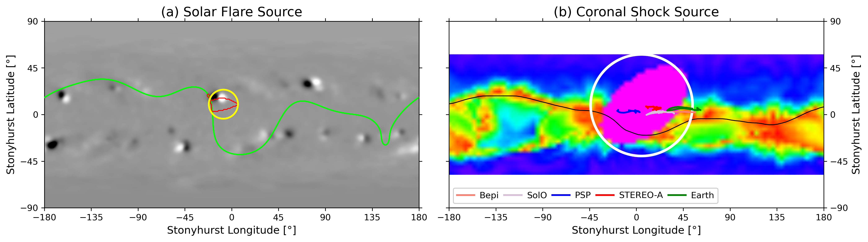
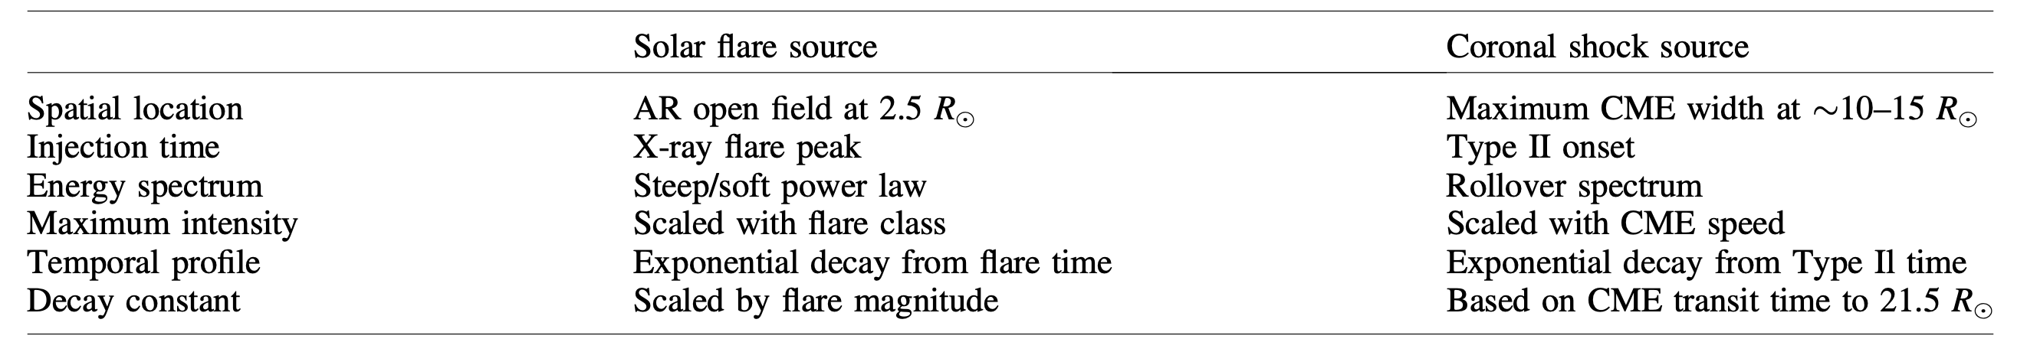
CCMC Workshop 2024
The fixed-source option in SEPMOD
Goal: To improve the modelled onsets of SEP events with WSA–Enlil–SEPMOD by inserting an “artificial” source of acceleration on the 21.5 R☉ sphere to compensate the lack of transients in the 1–21.5 R☉ coronal domain.
We have designed two fixed-source options to emulate the two traditional particle acceleration sites:
Solar flare source (acceleration very close to the solar surface) & Coronal shock source (acceleration in the corona)
Initial design and application of the SEPMOD fixed-source options to the 2021 October 9 SEP event:
In-depth description of the current SEPMOD fixed-source option implementation: Palmerio et al., JSWSC, 14:3 (2024)
epalmerio@predsci.com

Slide 7
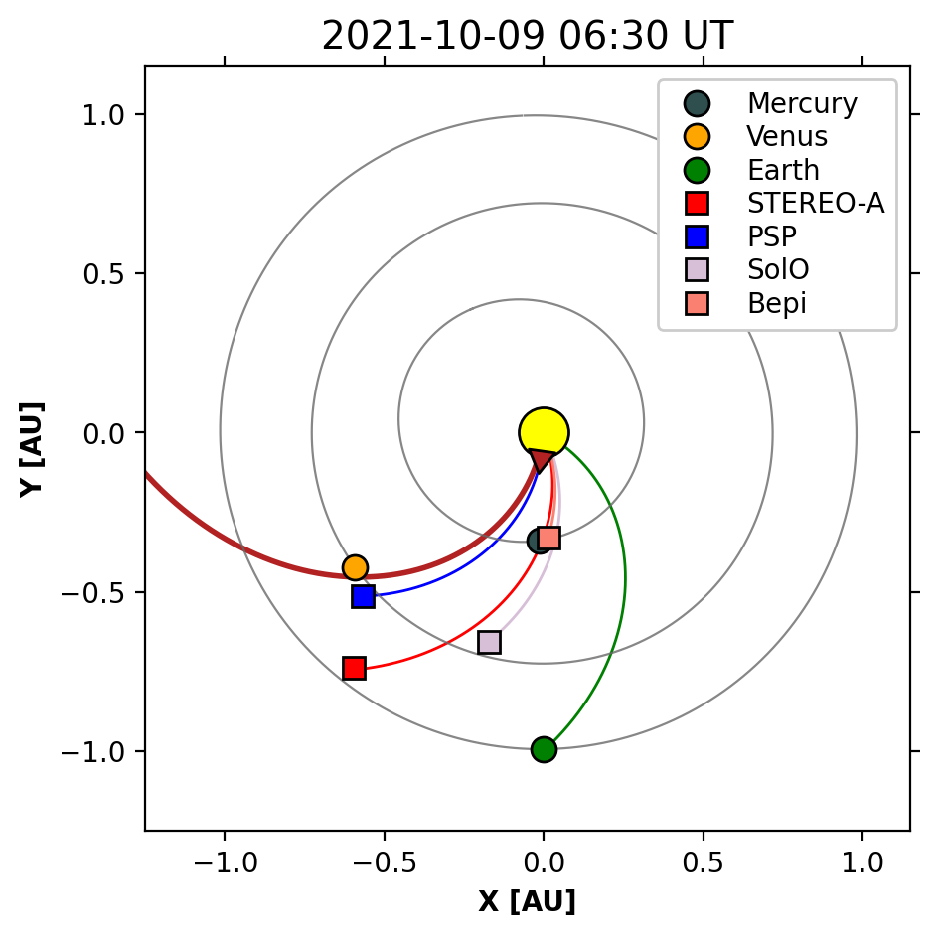
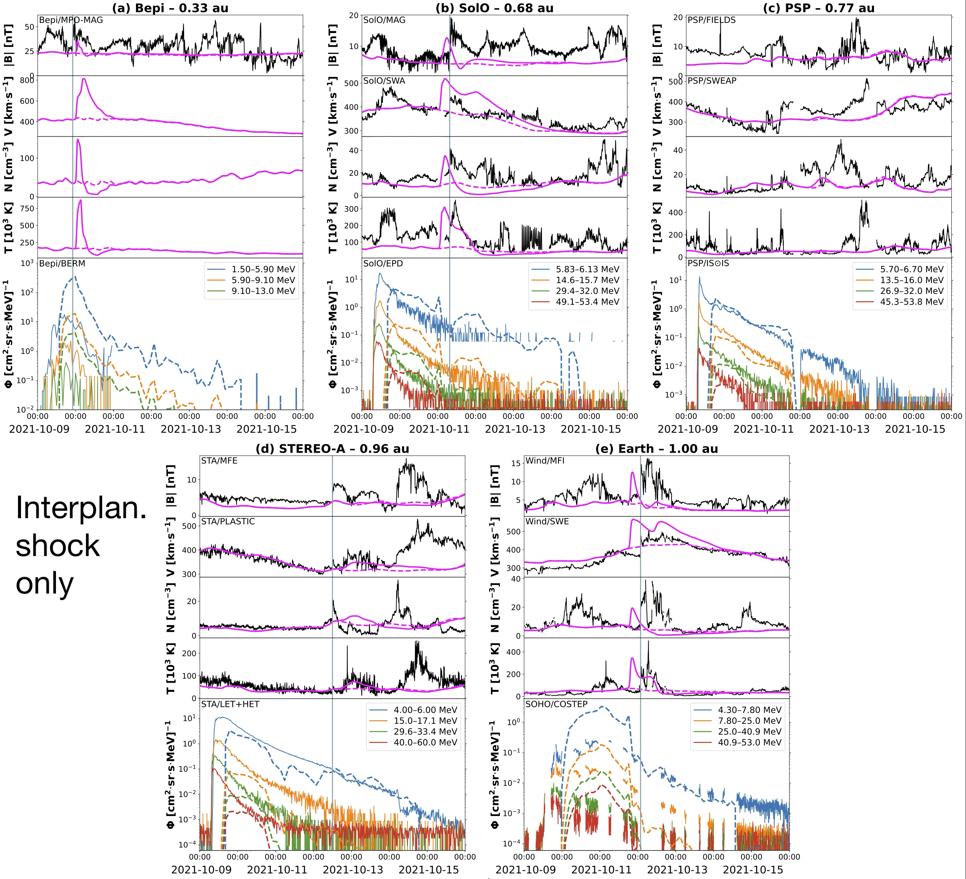
CCMC Workshop 2024
IP shock source vs Solar flare source vs Coronal shock source
The coronal shock source seems to perform better (not surprising, since this event was characterised by a strong shock-accelerated component)
The observed SEP profiles at Parker (best-connected observer) display a narrow but abrupt onset that is akin to the solar flare source behaviour—contributions from both acceleration mechanisms at this location?
Overall:
Onset time greatly improved with either fixed source!
BUT: This event has all more-or less well-connected observers, how well does this work for random s/c configs?
Results shown here:
Palmerio et al., JSWSC, 14:3 (2024)
epalmerio@predsci.com

Slide 8
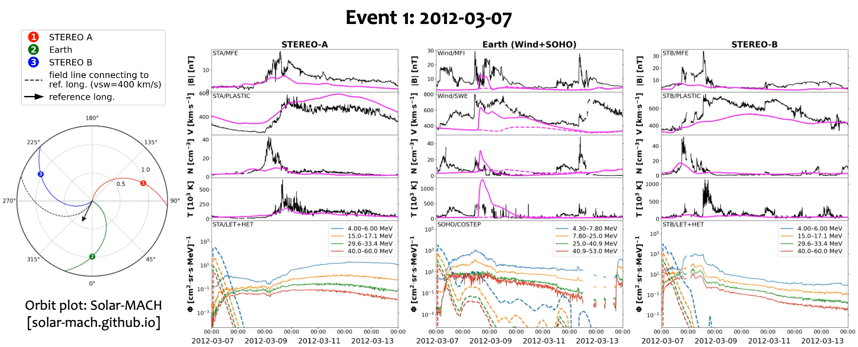
CCMC Workshop 2024
Fixed-source option testing: Applying the coronal shock source to SHINE challenge events
As a first validation, we have applied the coronal shock source description to the original 10 SHINE challenge events, covering a wide range of s/c separations and CME–observer geometries → Mixed results!
epalmerio@predsci.com

Slide 9

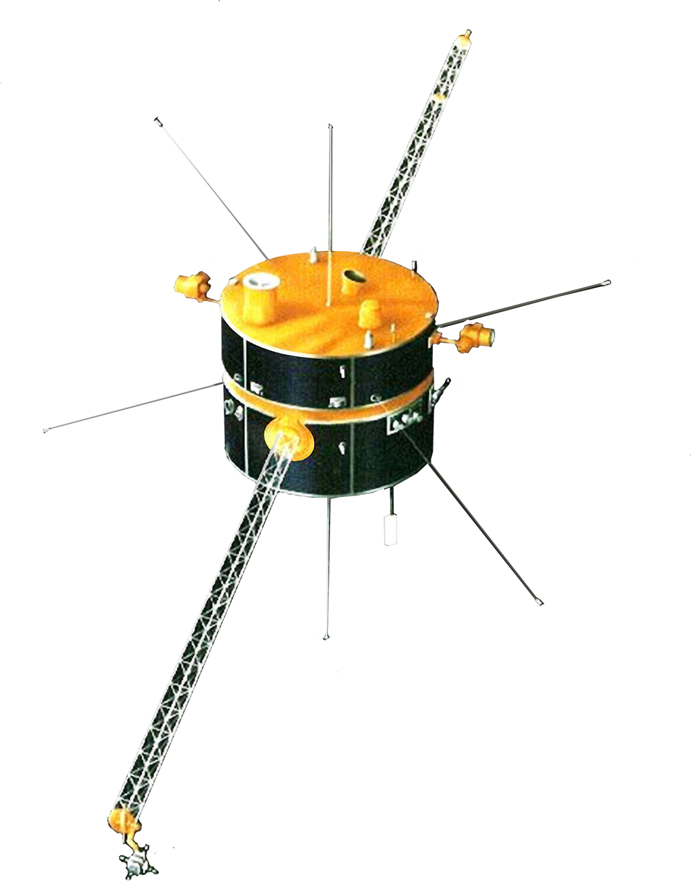

CCMC Workshop 2024
SEPMOD: Summary & plans for the near future
• SEPMOD implementation at CCMC going well 👍🏻
Regularly run in real time, results featured on the SEP scoreboard
• We are working towards mitigation of one of the biggest issues in the WSA–Enlil–SEPMOD framework, i.e. the lack of transients—and thus shocks and thus particle acceleration—in the coronal domain of the model (i.e., in WSA)
• The fixed-source descriptions presented here seem to perform generally okay when CME nose and observer are well connected, results worsen with longitudinal distance
• We plan on delivering the coronal shock source option to the CCMC, but we are still testing which observables to use to constrain parameters such as SEP injection time and intensity
Brilliant ideas to propose and/or discuss? Let us know!!!
• Since one of the major strengths of SEPMOD is its computational efficiency, one of the greatest challenges in this regard is the attainment of an optimal balance between physics-based formulations and semi-empirical approximations that can provide sufficient physical insight whilst maintaining simulation runs executable over short time scales
epalmerio@predsci.com

Slide 10


Thank you for your attention!
E. Palmerio acknowledges support from NASA’s Parker Solar Probe Guest Investigators (PSP-GI; no. 80NSSC22K0349), Operations to Research (O2R; no. 80NSSC20K0285), Living With a Star (LWS; no. 80NSSC19K0067), and LWS Strategic Capabilities (LWS-SC; no. 80NSSC22K0893) programmes.

