Slide 1






Designing a real-time SEP forecast/nowcast pipeline with iPATH under the space weather R2O2R framework
Junxiang Hu^{1,2}, Gang Li^{1*}, Claudio Corti³, Clayton Allison⁴, M. Leila Mays³
1. University of Alabama in Huntsville, 2. NASA GSFC,
3. NASA GSFC CCMC, 4. NASA SRAG

Slide 2
Quick Overview for real-time iPATH pipeline
Physics-based SEP model developed at UAHuntsville.
The real-time pipeline pulls all input parameters from iSWA/DONKI online API
Fully automated – no manual input!
Two type of triggers:
  iPATH-CME: mainline, more accurate
  iPATH-flare: experimental, earlier prediction
Output: full time-intensity profiles at different locations (Earth, Mars, STEREO etc.)
Time efficiency: Provides predictions within 30 mins of CME/flare detection on DONKI.
Improved Particle Acceleration and Transport in Heliosphere model

Slide 3
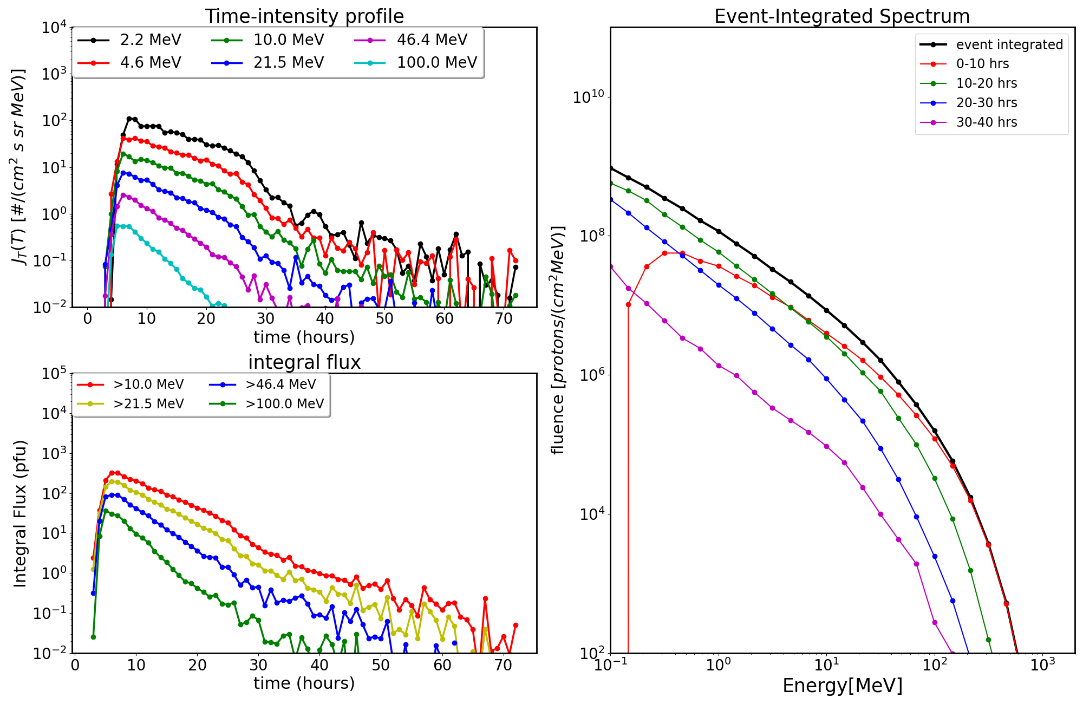
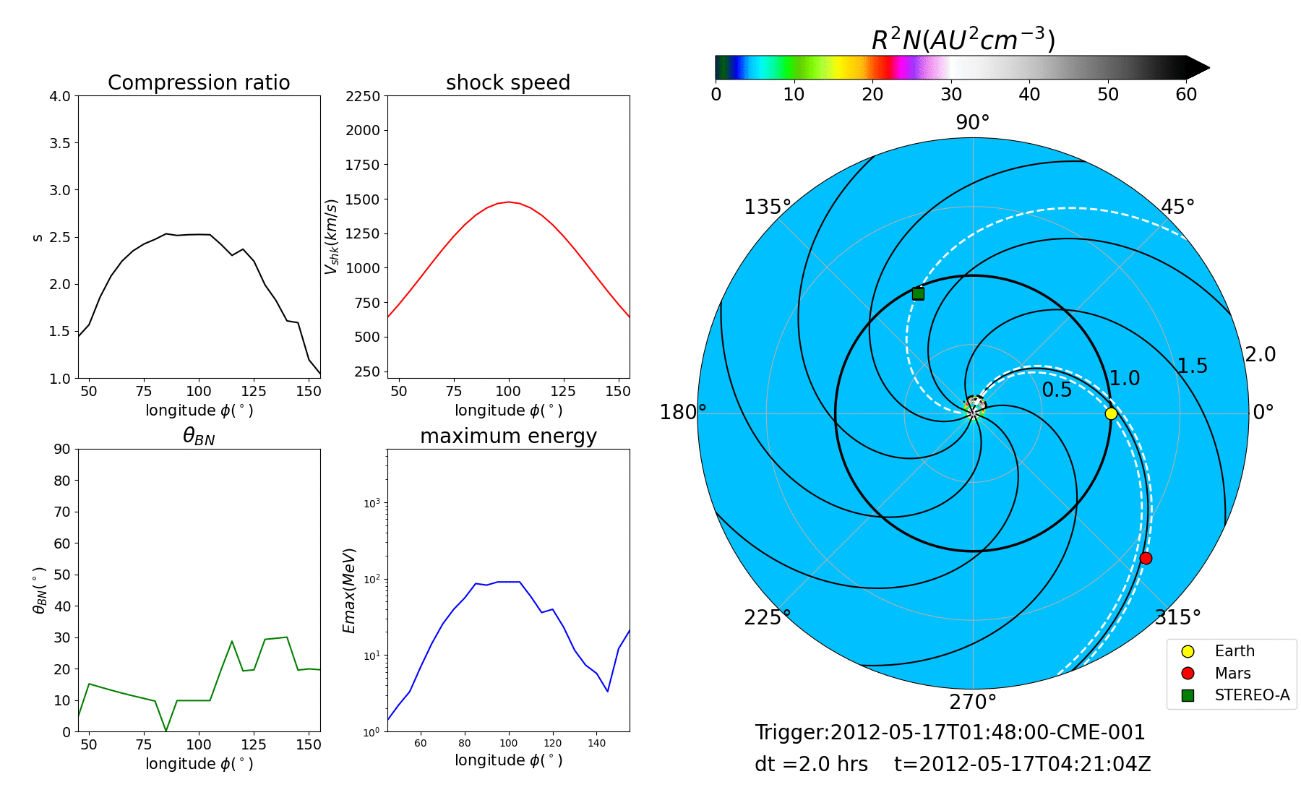
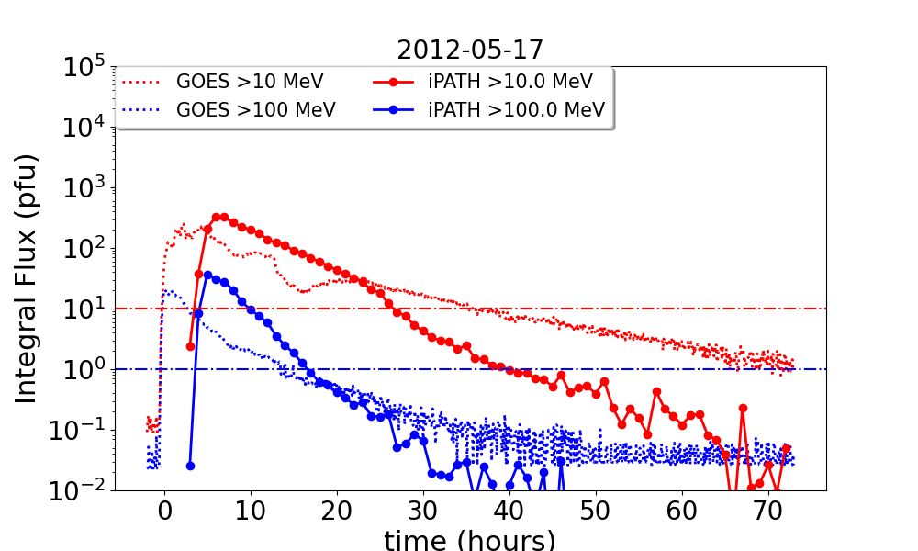
Model output
Example output: May 17, 2012 event
CME MHD simulation with shock parameters:
Comparison with GOES:
Currently operating in real-time at CCMC. Results available at iSWA:

Slide 4
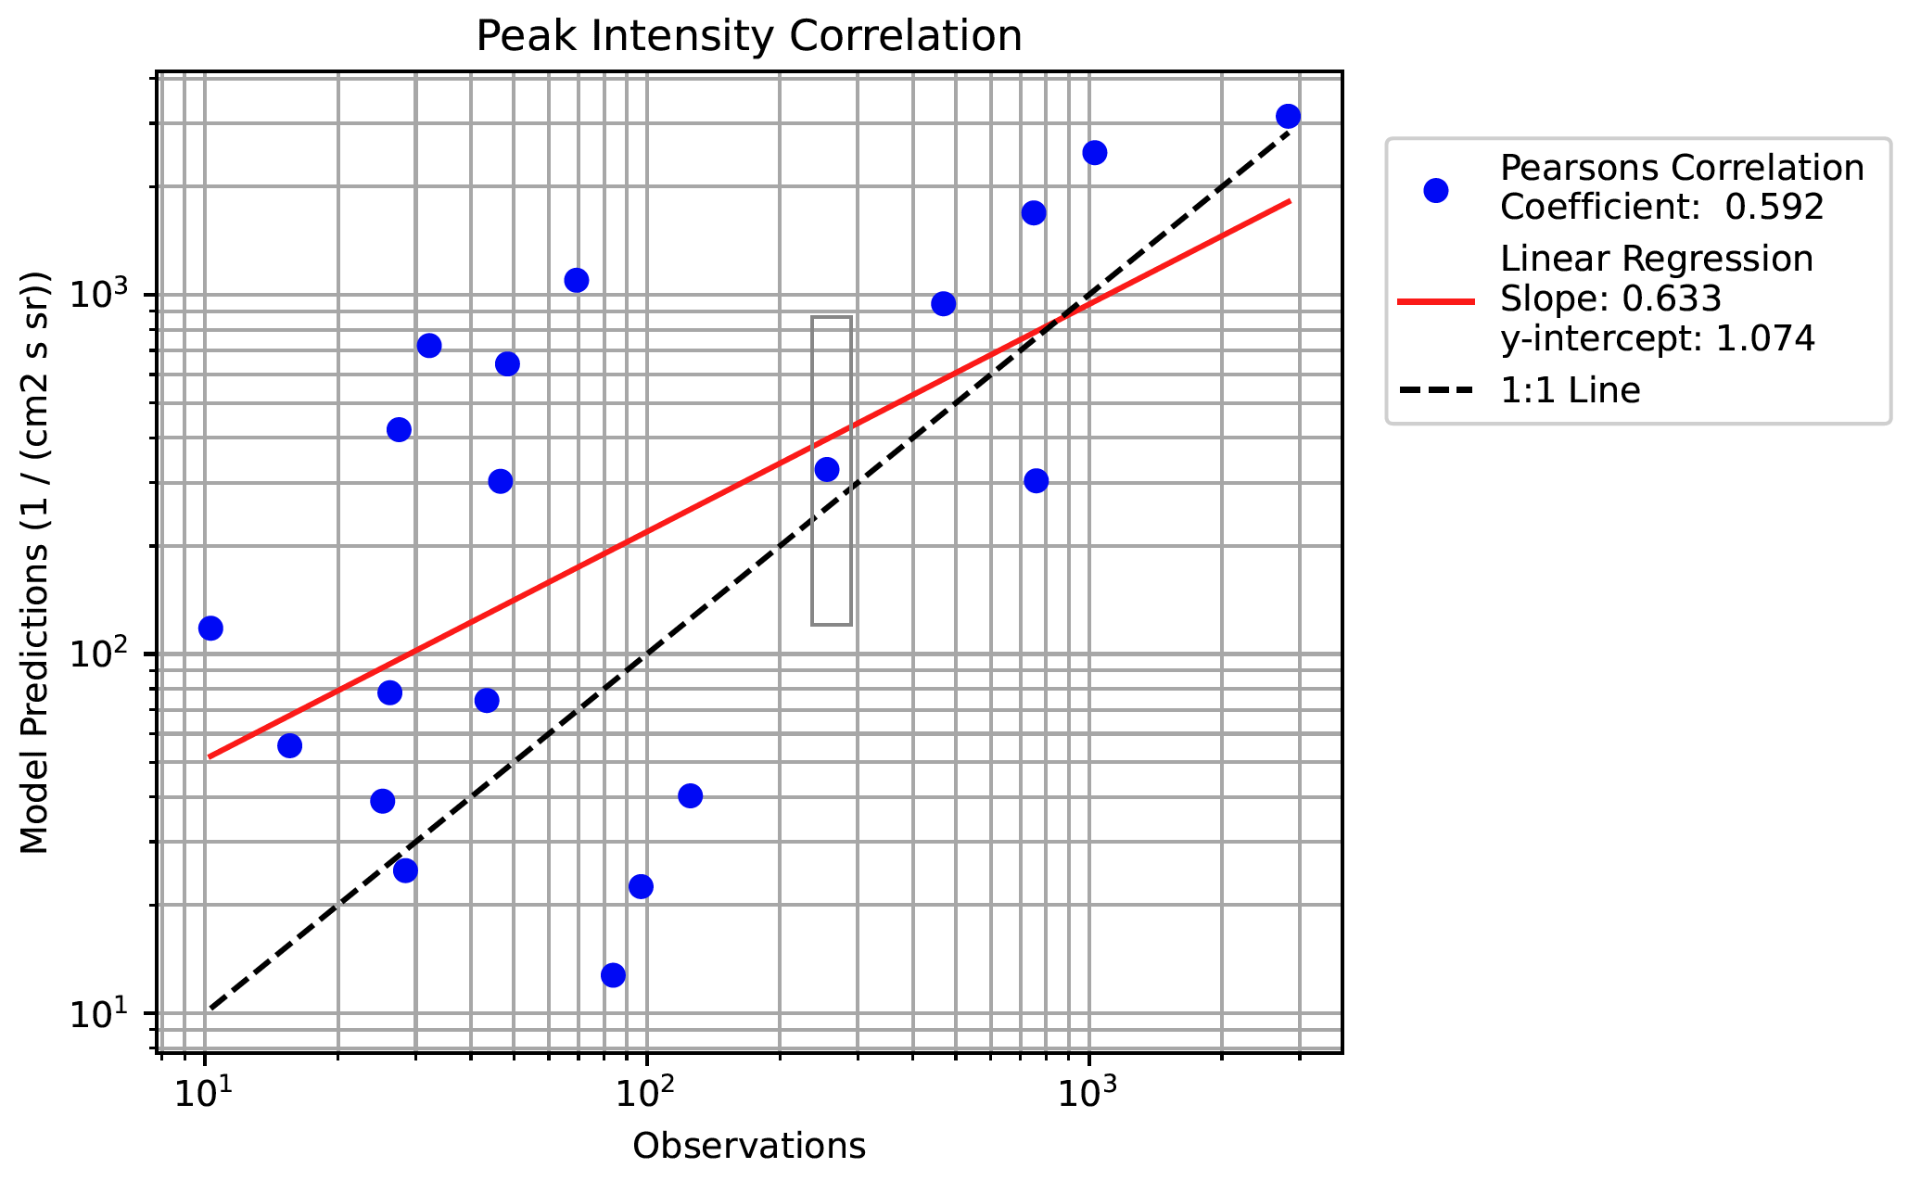
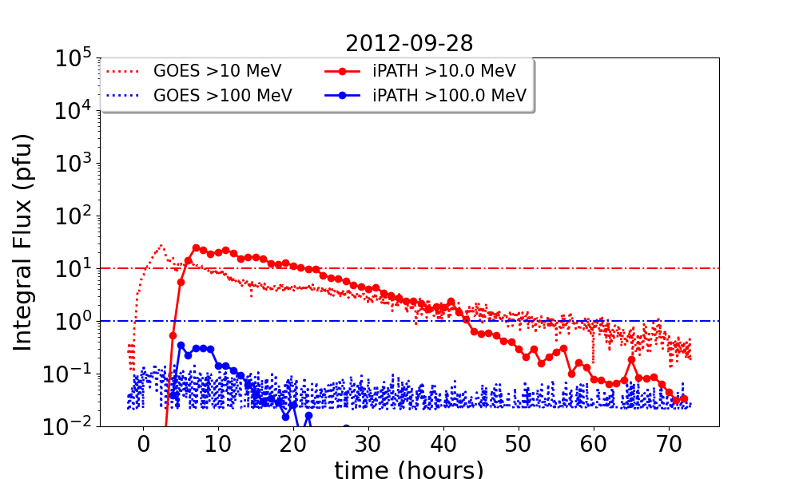
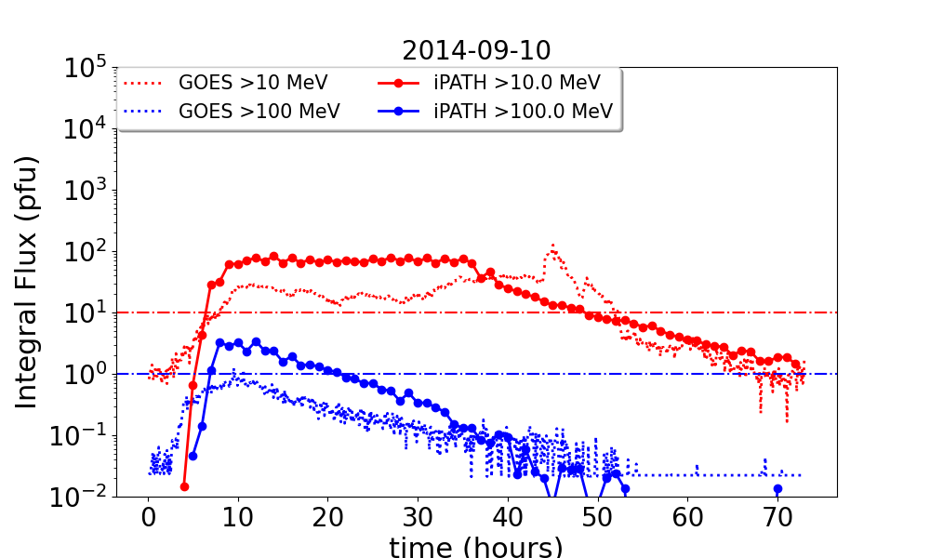
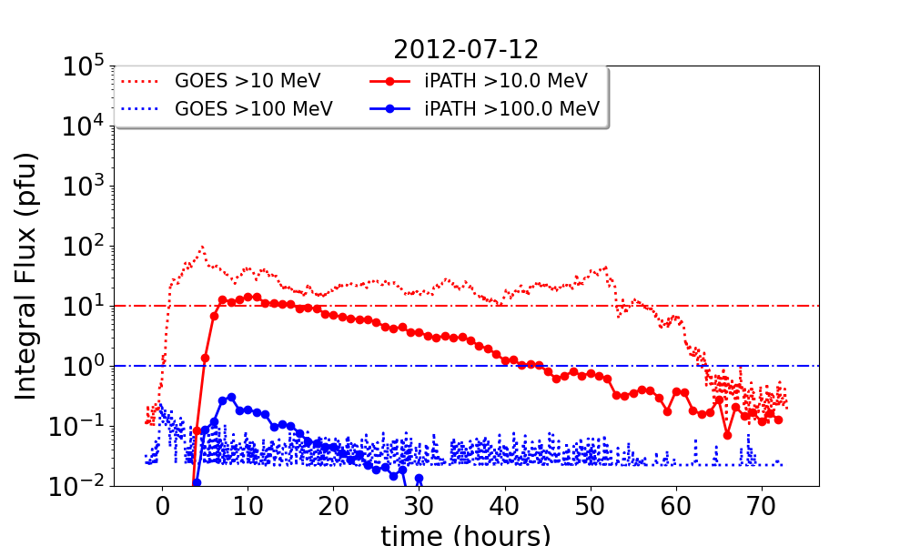
Real-time Performance
Real-time iPATH participated in the SEPVAL validation effort, tested with ~30 SEP events and ~30 non-SEP events (CME but no SEP)
Accuracy: In the >10 MeV flux channel, iPATH-CME has a hit rate of ~70% among SEP events and ~86% correct all clear among non-SEP events.
We also have very good peak intensity prediction vs observation (bot-left figure)
Currently tends to overestimate >100 MeV flux
More examples from SEPVAL

Slide 5
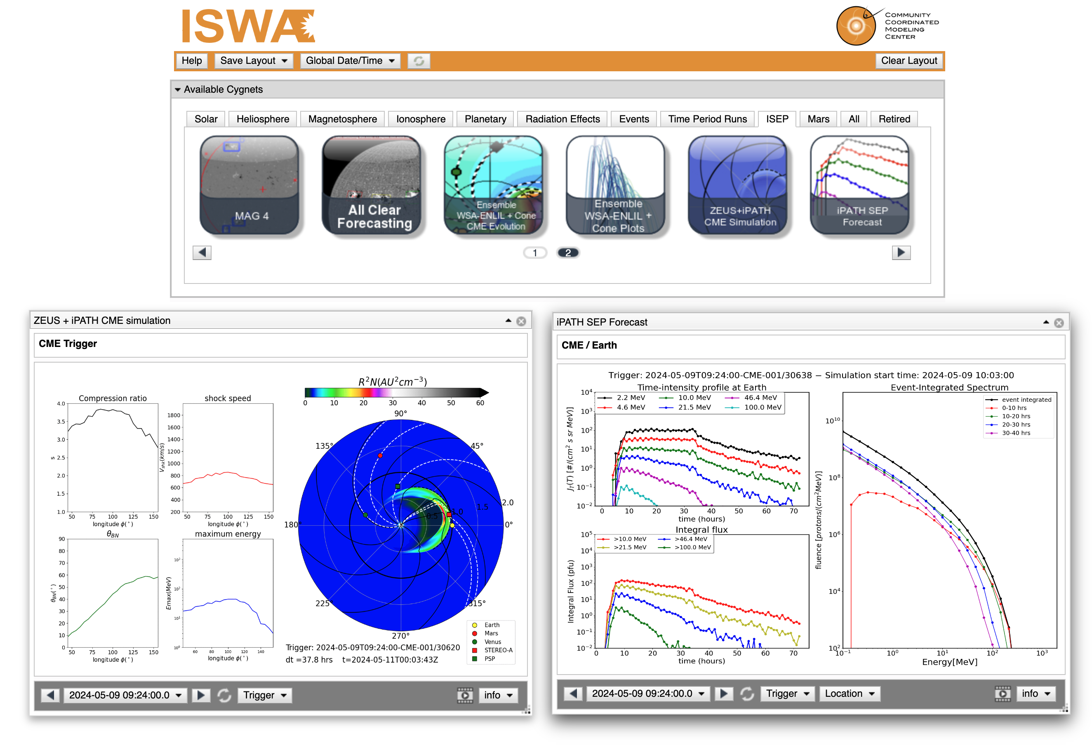
Now available at iSWA and SEP Scoreboard!
iPATH has recently been added to the CCMC iSWA (integrated Space Weather Analysis) system and SEP intensity Scoreboard.
The implementation received tremendous help from the ISEP collaboration from SRAG and CCMC
iPATH Cygnet on ISWA
https://iswa.gsfc.nasa.gov/IswaSystemWebApp/

Slide 6
Development Processes – R2O
Before going operational:
  Typical workflow: Design/build the code – find an interesting event – fine-tuning parameters so that simulation results match observations – publish a paper and call it a day
  Are all the fine-tunings physical? – We didn’t know.
What could go wrong when going operational? – Everything!
  First step is to fight with all the real-time data, code robustness, data storage, automation, etc.
  Much less freedom in fine-tuning. Each modification must be thoughtful, physics-based, and needs to work for all events.
  Disagreement with observations pushed us to further investigate our implementations of physical processes.

Slide 7
Development Processes – O2R
Superthermal seed population
  Superthermal particles (several to tens of KeV) is an important but little-known input parameter for physics-based SEP models (hard to measure at this energy range)
  Actions: iPATH team members has participated across multiple superthermal FST teams in the LWS program
  Results: we developed a way to auto-retrieve superthemal intput from real-time data and getting good modeling results (reflected in the 10MeV peak intensity)
The role of turbulence in SEP modeling
  Turbulence plays an important role in SEP modeling – diffusive shock acceleration, diffusive transport of energetic particles, etc.
  Actions: We have been organized SHINE sessions on the turbulent transport of SEP for three years in a row, effectively bridging the turbulence and SEP communities
  Results: improved turbulence parameter implementation, which leads to correct prediction for observers at multiple locations and with different magnetic connectivities.
And more: application to stellar environment, collaborations with other MHD models

Slide 8
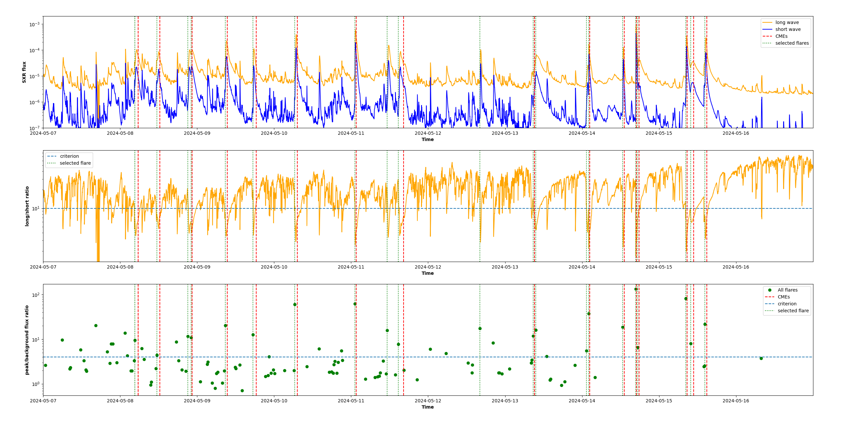
Development Processes – O2R
Recent example: the “Gannon” geomagnetic superstorm brought headaches for SEP modelers.
100+ M to X class flares with only a few slow CMEs. Crazy false alarms across the SEP scoreboard.
Forced us to look deeper into flare-CME connections and find a way to predict whether a flare is confined.

Slide 9
Conclusion
Real-time iPATH has onboarded CCMC after intensive validations
iPATH-CME is showing promising performance, while the iPATH-Flare mode needs more work
We have been pushing the scientific researches forward all things SEP related through the R2O2R process.
Some questions:
  What’s the focus, Operation or Research? (R2O2R2O?)
  How do we communicate with end users (other than SRAG)?
For more info: junxiang.hu@nasa.gov

