Slide 1
University of Michigan Models at the CCMC for Simulating SEP and CME events
University of Michigan team, multiple authors:
EEGGL (Nishtha Sachdeva)
Coupled CME/SEP simulations (together with the CCMC team)
  Stream-Aligned MHD
  New: the Poisson bracket transport scheme (Weihao Liu)
  New and hot: GCR transport toward the Sun (same + Ofer Cohen, UMass)
  Real-time (delegated to Lulu Zhao’s talk)
  Need: extension to 6 AU:
    BC for all particles
    New model for turbulence.

Slide 2
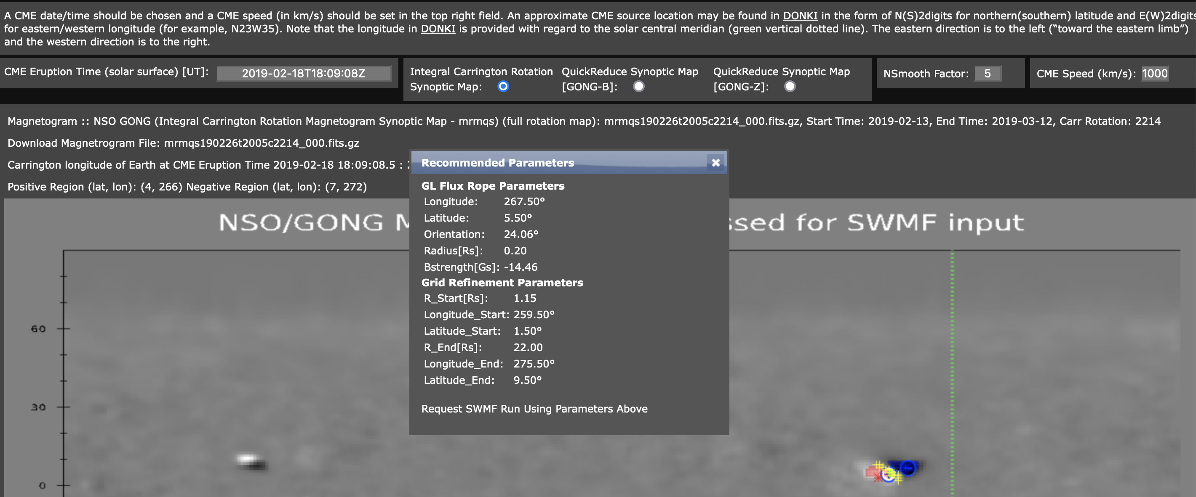
#CME
267.50 LongitudeCme
6.08 LatitudeCme
98.26 OrientationCme
0.28 Radius
9.65 BStrength
-1 iHelicity
0.60 aStretch
0.48 ApexHeight

Slide 3
CR2214, CME Speed = 1000
Map = mrmqs190226t2005c2214_000.fits.gz
Parameter | CCMC | EEGGL
Lon Lat | 267.5 5.50 | 267.5 6.08
Radius | 0.20 | 0.28
Strength | -14.46 | -9.65
Orientation | 24.06 (24.87, when tried again) | 98.26

Slide 4
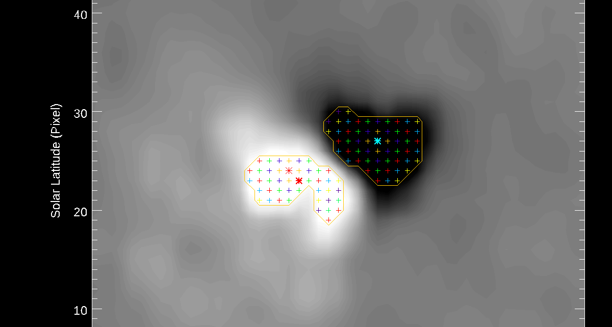
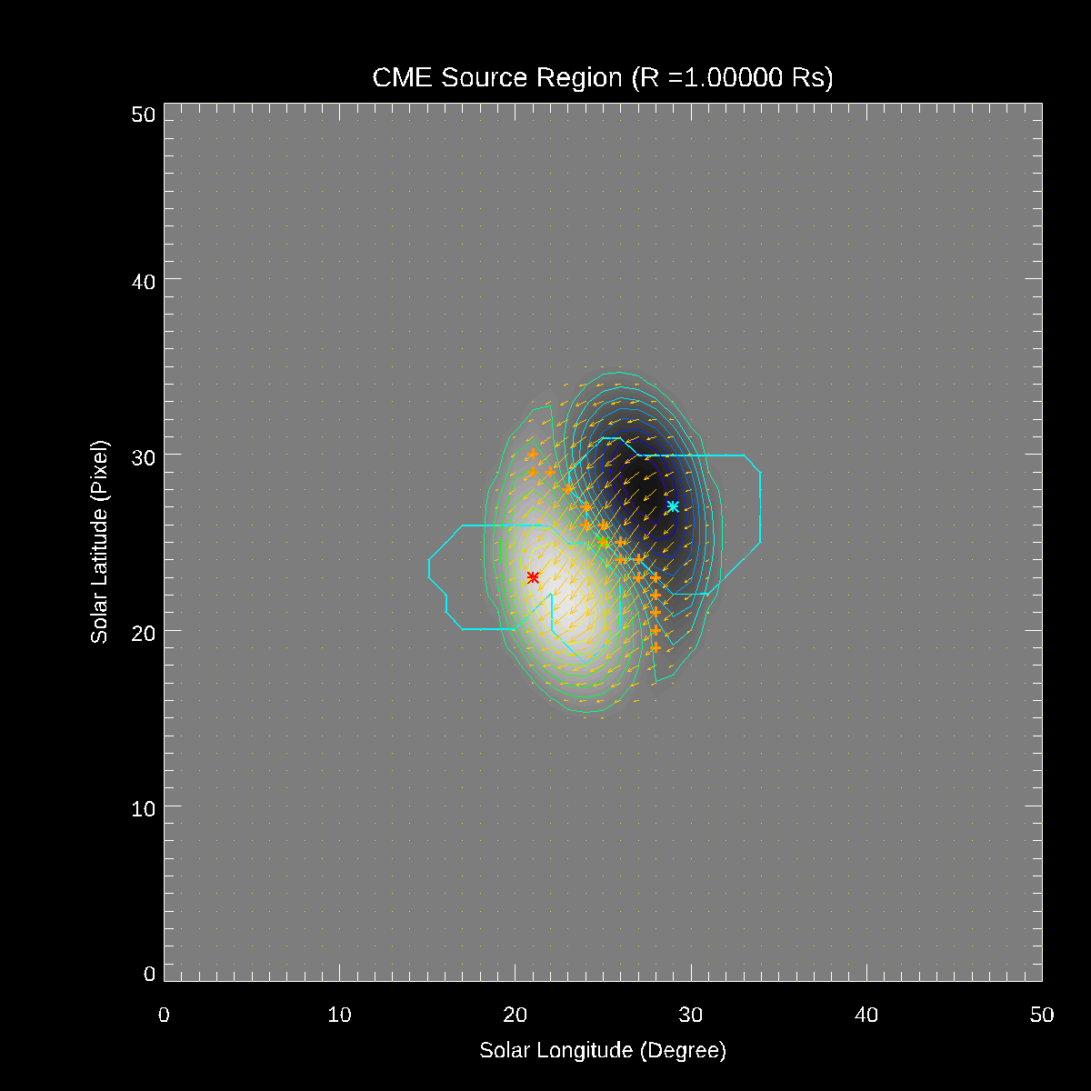
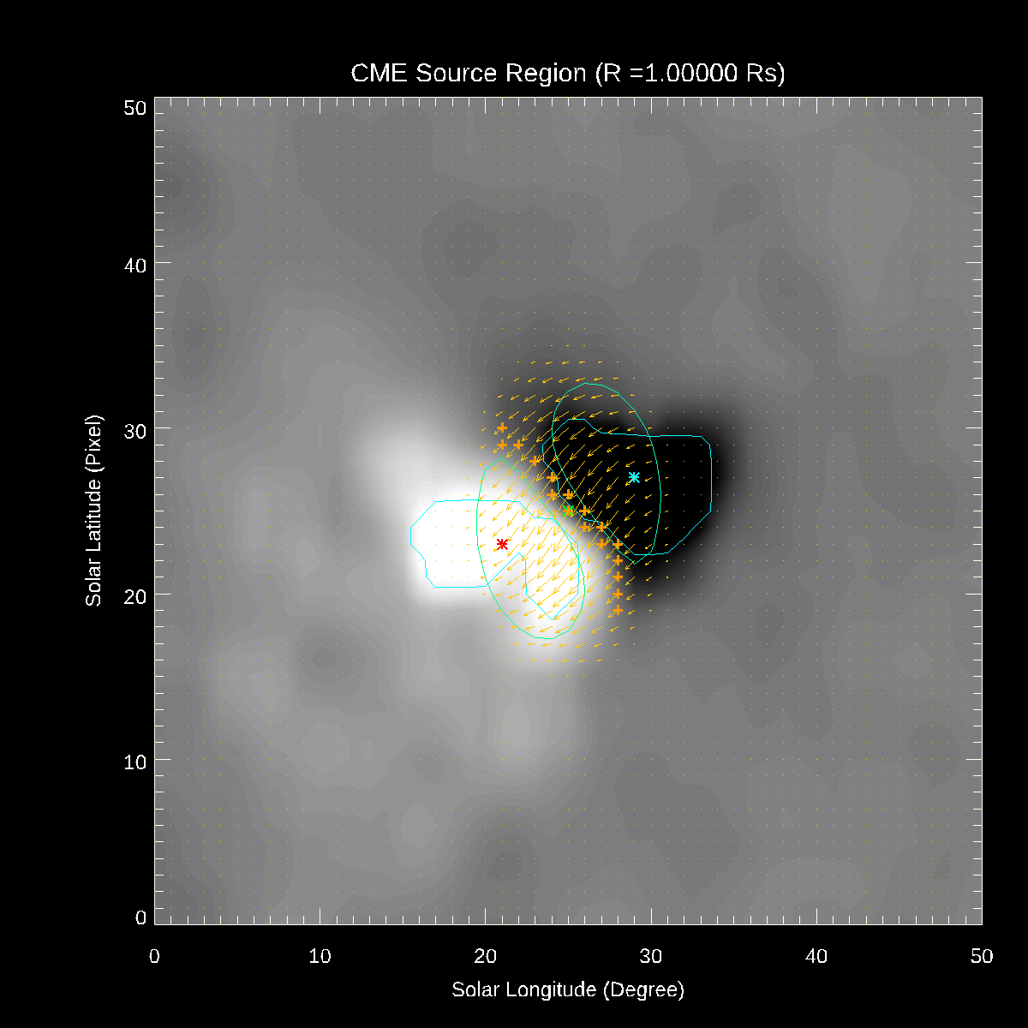
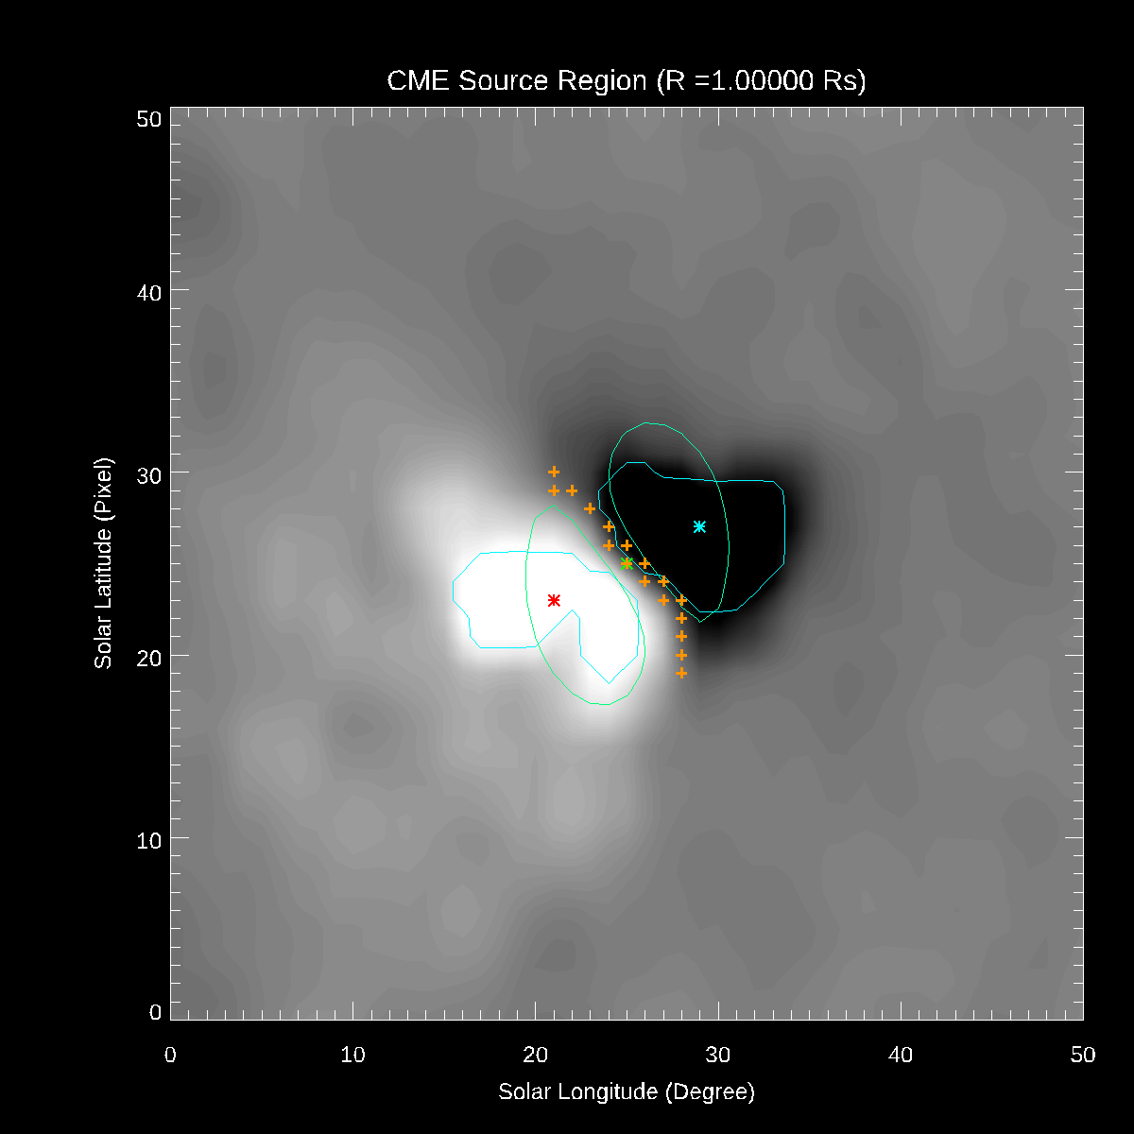
EEGGL/SWMF

Slide 5
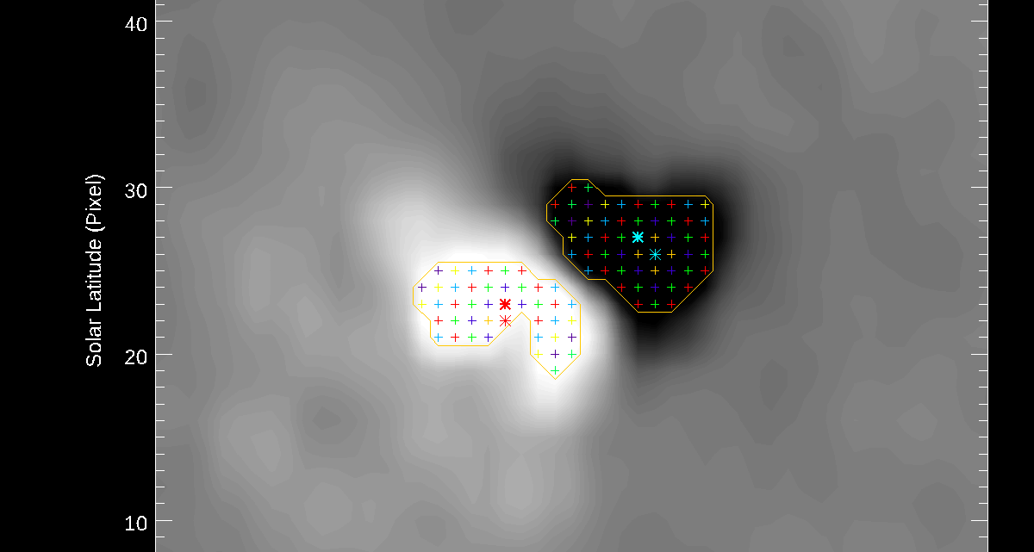
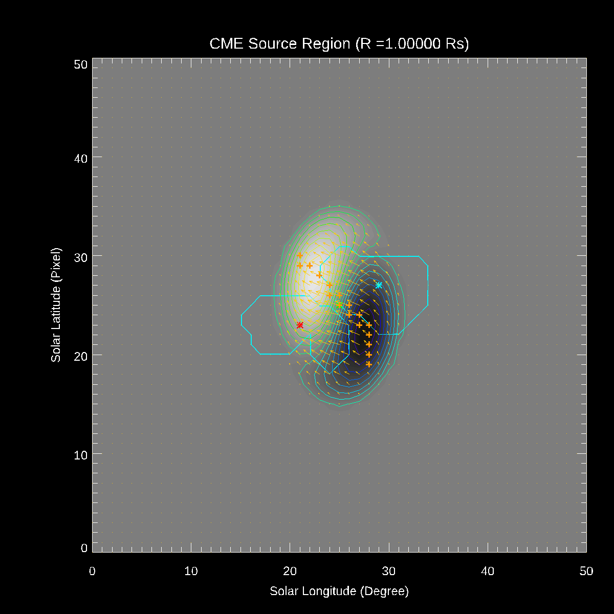
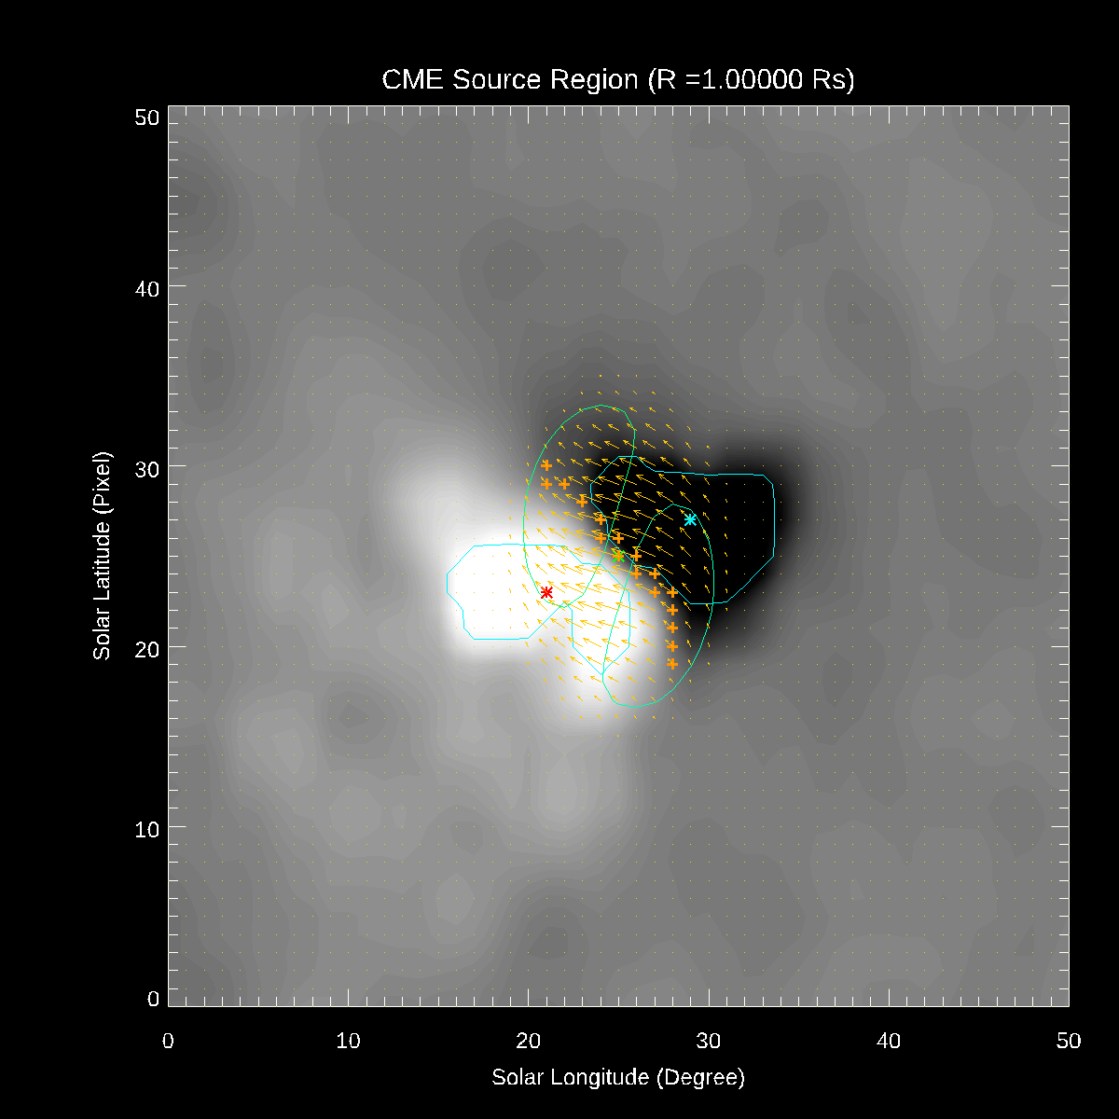
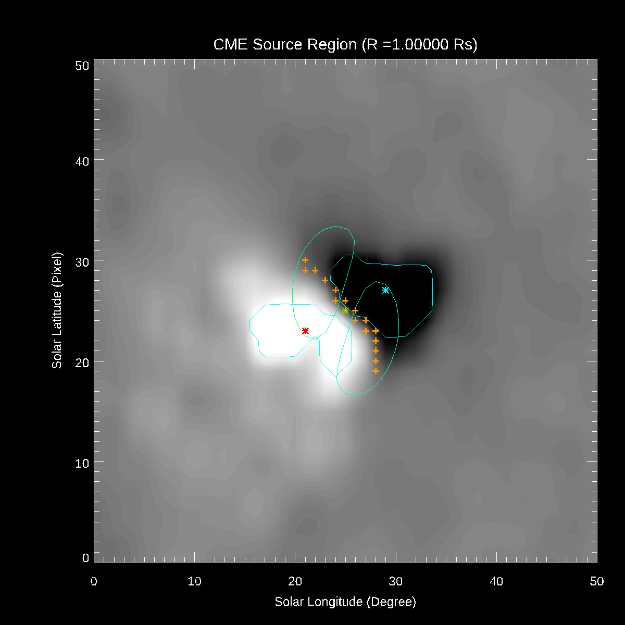
EEGGL/SWMF with Orientation set to same value as from CCMC

Slide 6
Run-on-Request, the Latest Capabilities
Regular run-on-request, new options
  Stream-Aligned MHD, no SEP, no SEP grid
  Same with the SEP grid (advected magnetic field line)
  Same with the Parker equation transport
Under beta-testing:
  Ambient
  Restart: CME, SEP, 10 hours
  Restart: SEP (no CME) + 20 hours
  Restart: SEP (no CME) + 20 hours
  Restart: Second CME, SEP + 10 hours
  Continue: 5 days of heliosphere simulation
New: the Poisson bracket particle transport scheme (Weihao Liu)
  New: the steady-state (local time stepping) Poisson bracket scheme
    Galactic Cosmic Rays
    Ambient (seed) population of the energetic particles

Slide 7
New and Hot: GCRs at R<1AU:
Simulation, figures : Ofer Cohen, UMass (Lowell)
Scheme implementation: Weihao Liu

