Slide 1
Improving the Arrival-Time Prediction of CMEs
by Heliospheric Imagery and Ensemble Modeling
NASA Space Weather Science Application Research-to-Operations-to-Research (R2O2R)
Dusan Odstrcil^{1,2}
J. A. Davies³, S. Gonzi⁴, J. Zhang², V. J. Pizzo⁵, E Adamson⁵, A. Chulaki¹, L. M. Mays¹
¹NASA/GSFC, ²George Mason Univ, ³STFC Rutherford Appleton Lab, ⁴UK Met Office, ⁵NOAA/SWPC
CCMC 2024 Workshop College Park, MD, June 3-7, 2024

Slide 2
Currently Used Forecasting Scheme at NOAA & NASA — Single ENLIL Run
3-D magnetohydrodynamic (MHD) numerical heliospheric code
Observationally driven, near-real time, “hybrid” modeling system
Routine simulation of background solar wind (BSW) & coronal mass ejections (CMEs), event-by-event, much faster than real-time
Input data: WSA coronal model (used GONG magnetograms) and Cone model (uses SOHO and STEREO coronagraph CME observations)
Run-on-request service at NASA/CCMC Operational predictions since 2010
ENLIL is implemented and used at: NOAA/SWPC, NASA /CCMC, UK/MetOffice, Korean Space Weather Center, and Australian Bureau of Meteorology

Slide 3
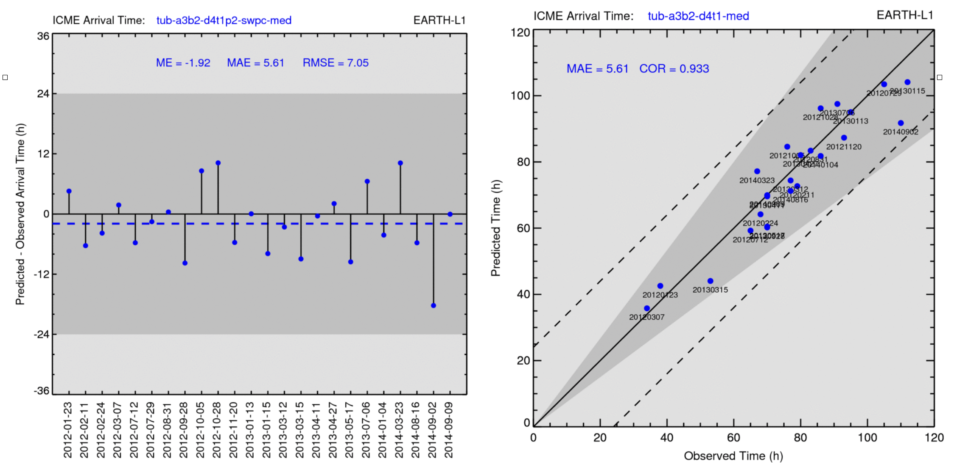
Predicting the Time of Arrival (ToA) — Data from NOAA & NASA Report
NASA-NOAA project evaluated the WSA-ENLIL-Cone model for predicting ToA at Earth
We computed 24 CMEs with the MAE of 5.81 hours (left) and within 25% of relative error (right)
These results can be used as benchmark to measure progress in predicting ToA

Slide 4
CCMC / CME ScoreBoard — Predictions with ENLIL. — 2020-12-07 CME
# | Predicted arrival time at Earth | Error (h) | Forecasted by (Submitted on) | Solar wind model | Cone model parameters | Case
1 | 2020-12-09T05:23 | -20.10 | M2M (2020-12-07T20:49) | wsa22-a4b1-lowres | 2020-12-07T16:24 lat=-21 lon=12 rad=41 vel=1383 | CME1
2 | 2020-12-09T08:00 | -17.48 | BoM (2020-12-08T04:10) | N/A | N/A
3 | 2020-12-09T21:00 | -4.48 | MOSWOC (2020-12-08T10:30) | wsa22-a3b2-medres | 2020-12-07T20:00 lat=-17 lon=5 rad=47 vel=900 | CME2
4 | 2020-12-09T19:00 | -6.48 | SWPC by CCMC (2020-12-08T12:30) | N/A | N/A
5 | 2020-12-09T06:54 | -18.58 | CCMC ensemble (2020-12-08T16:55) | N/A | N/A
6 | 2020-12-09T05:00 | -20.48 | KSWC (2020-12-09T01:04) | wsa22-a5b1-lowres | 2020-12-07T18:37 lat=-12 lon=6 rad=40 vel=1490
Why the predicted arrival time had such large differences?
Can we use heliospheric imagery to suggest relevant predictions before the CME arrival?

Slide 5
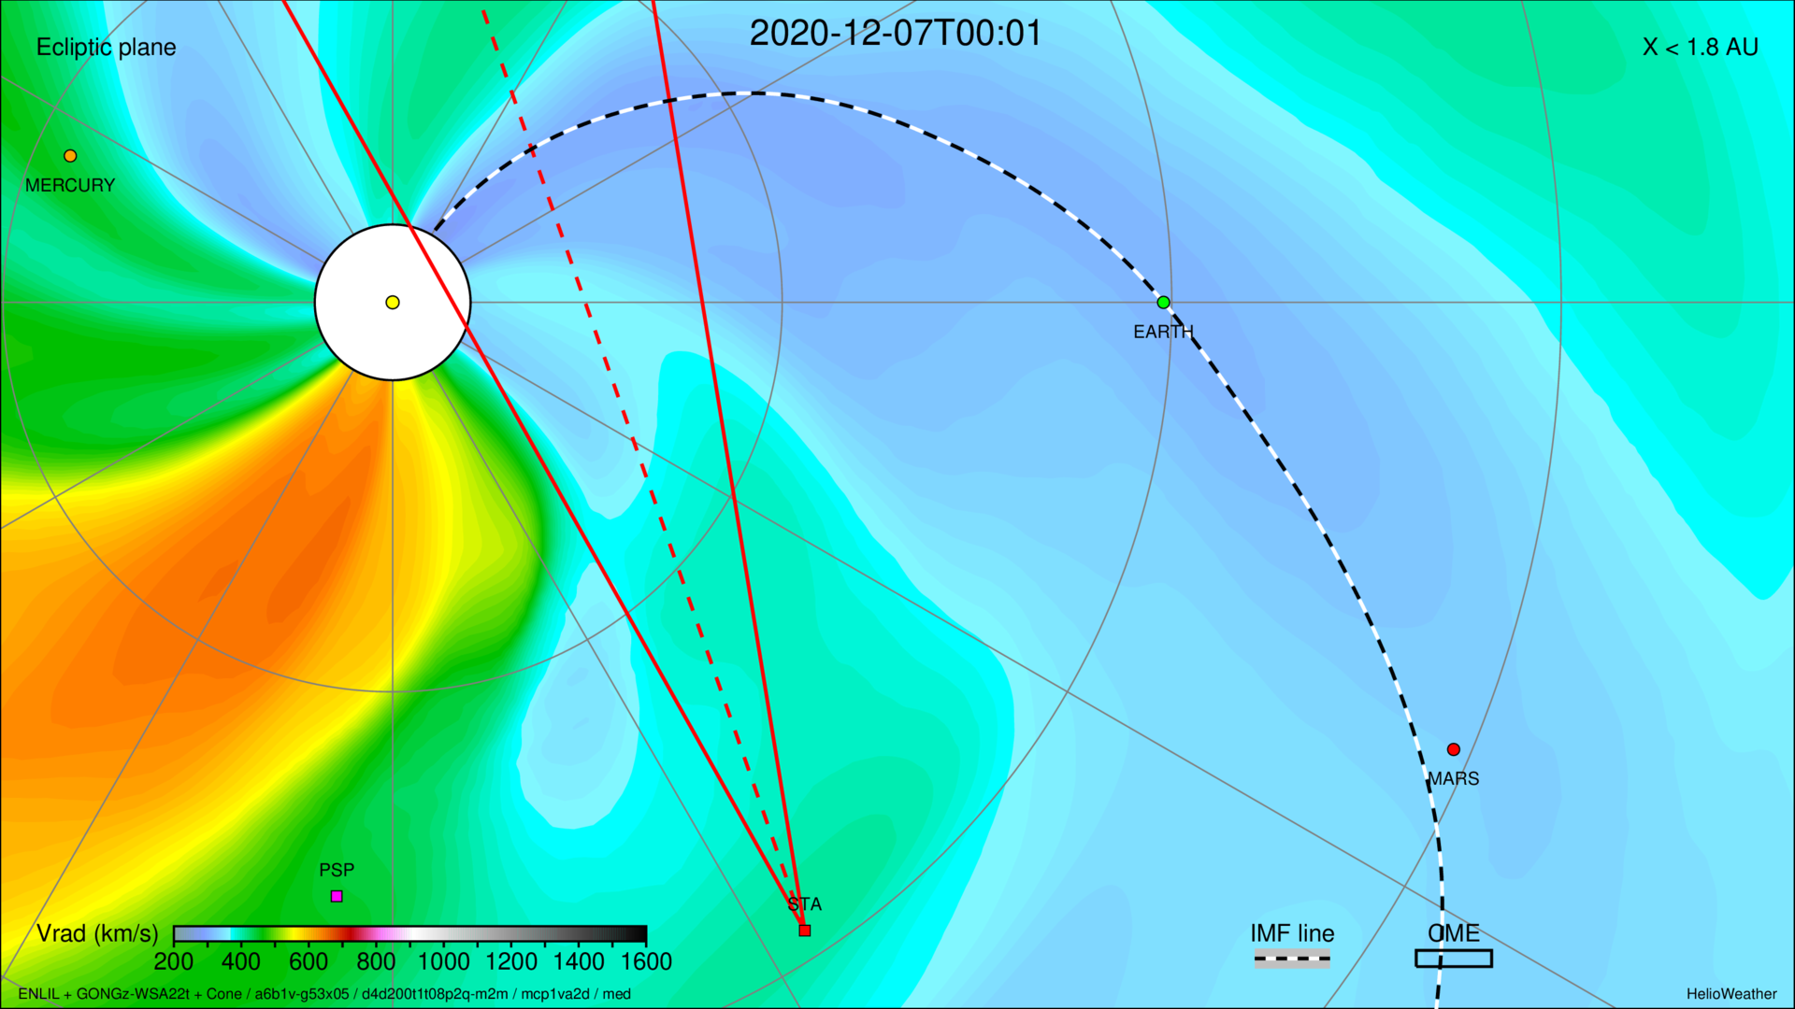
Solar Wind Speed at Ecliptic Plane — 2020-12-07 CME (M2M)
Earth
Sun
STEREO-A
VIGIL at L5-Point

Slide 6
Solar Wind Speed at Ecliptic Plane

Slide 7
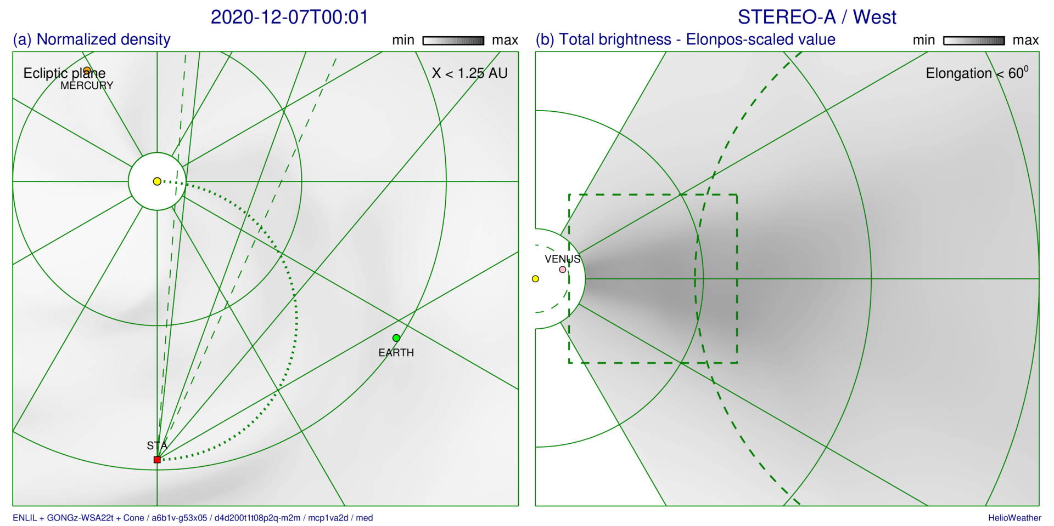
Solar Wind Density & Synthetic White-Light Imaging — CME 2020-12-07 (CME1)
Sun
ε = 60⁰
ε = 20⁰
ε = 40⁰
ε = 20⁰
HI-1 FOV
ε = 40⁰
Sun
ε = 60⁰
STEREO-A
Earth
HI-1 FOV
Thomson curve

Slide 8
Solar Wind Density & Synthetic White-Light Imaging. — CME 2020-12-07 (CME1)

Slide 9
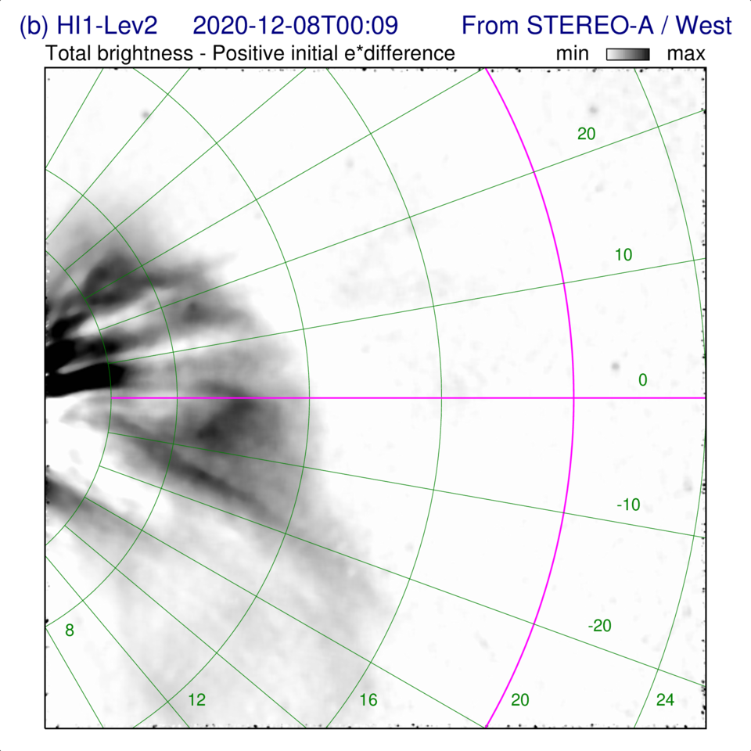
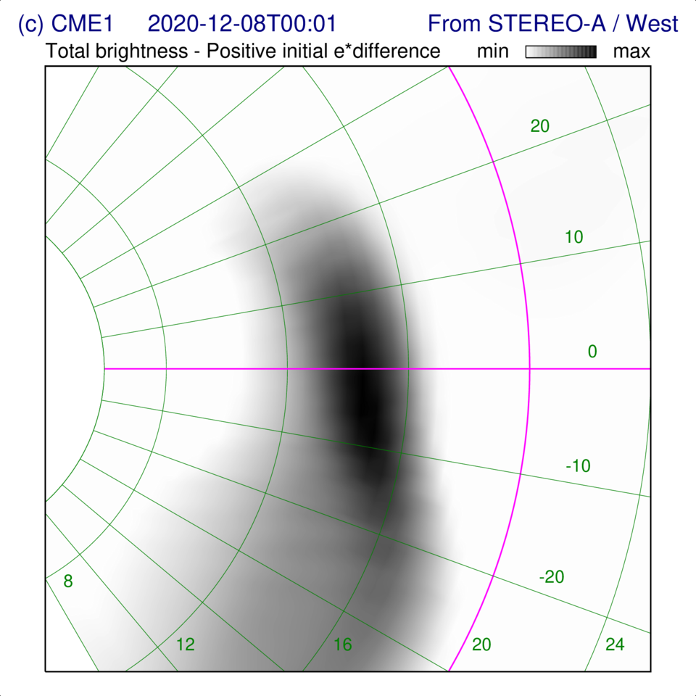
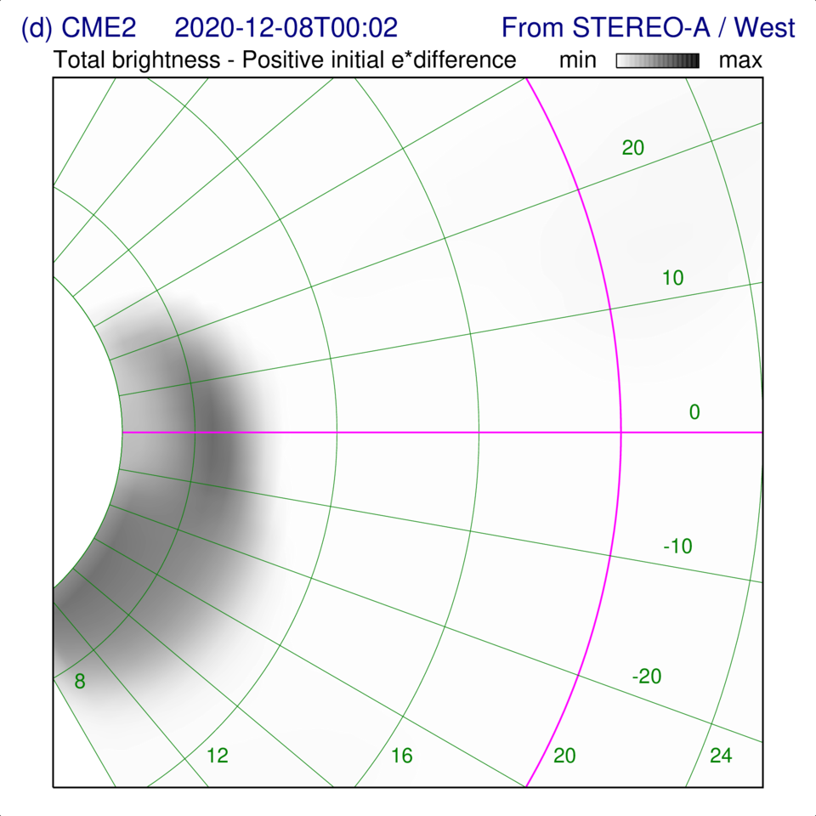
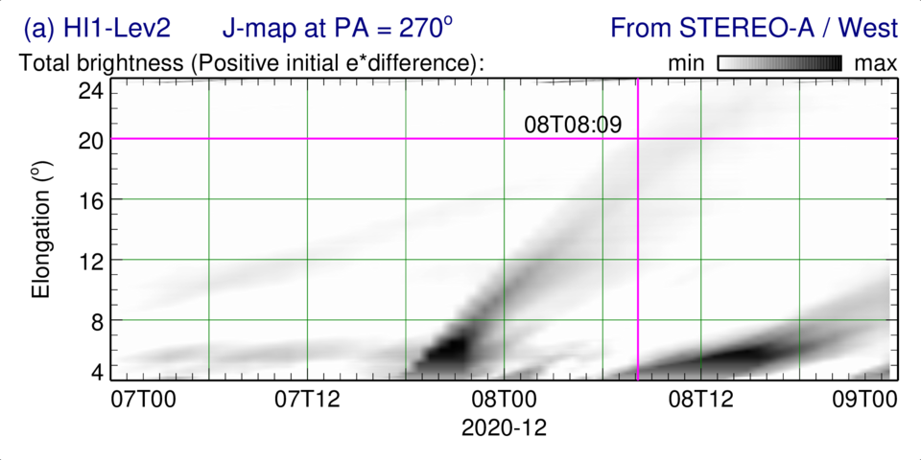
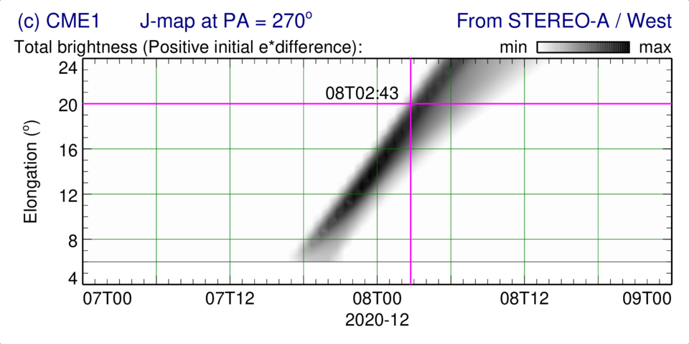
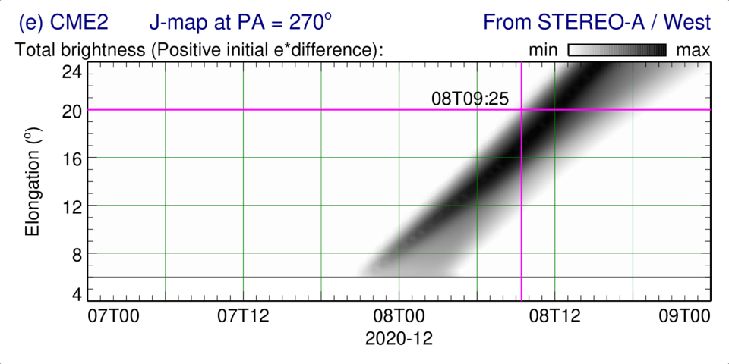
Observed & Synthetic White-Light — CME Images (top) & J-maps (bottom)
HI-1A — Level 2
CME1-a3b2 run
CME2-a3b2 run

Slide 10
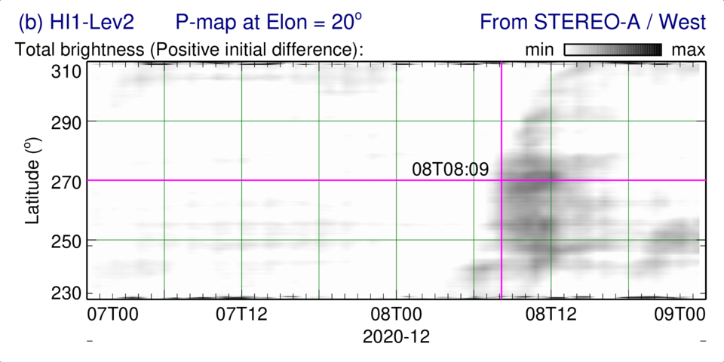
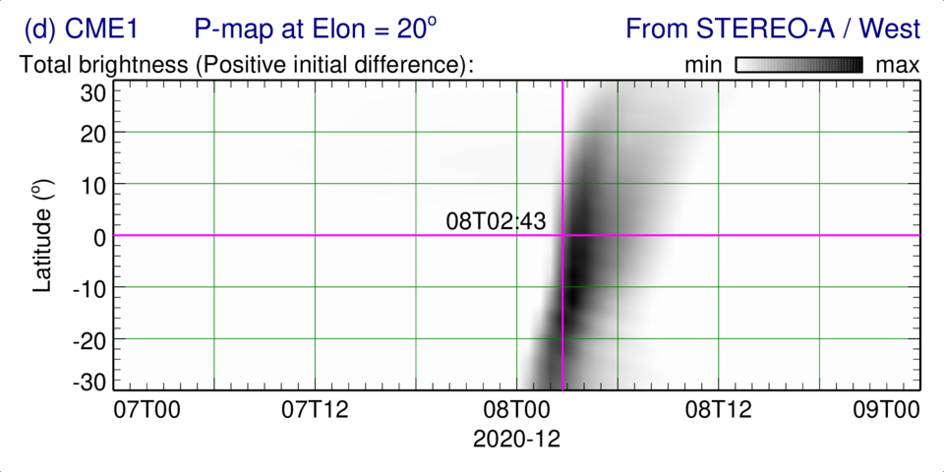
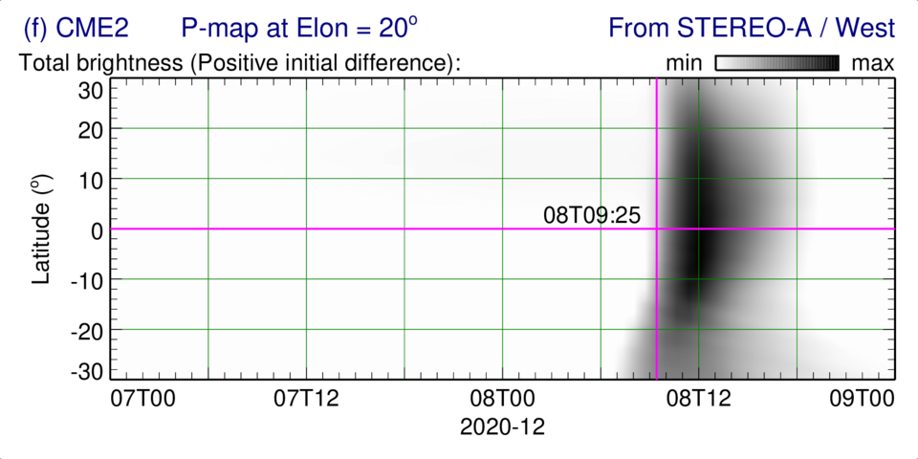
Observed & Synthetic White-Light — CME Images (top) & P-maps (bottom)
HI-1A — Level 2
CME1-a3b2 run
CME2-a3b2 run

Slide 11
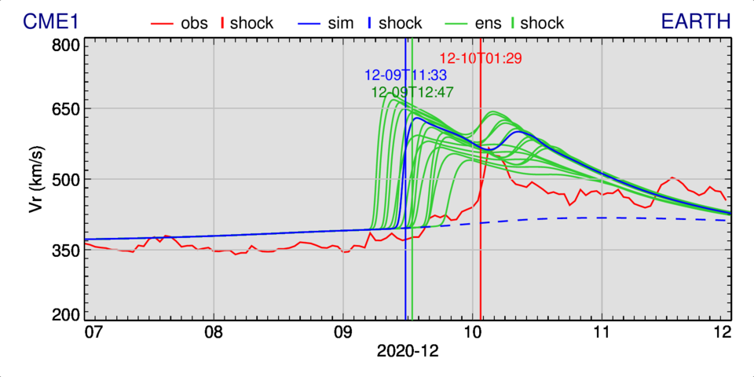
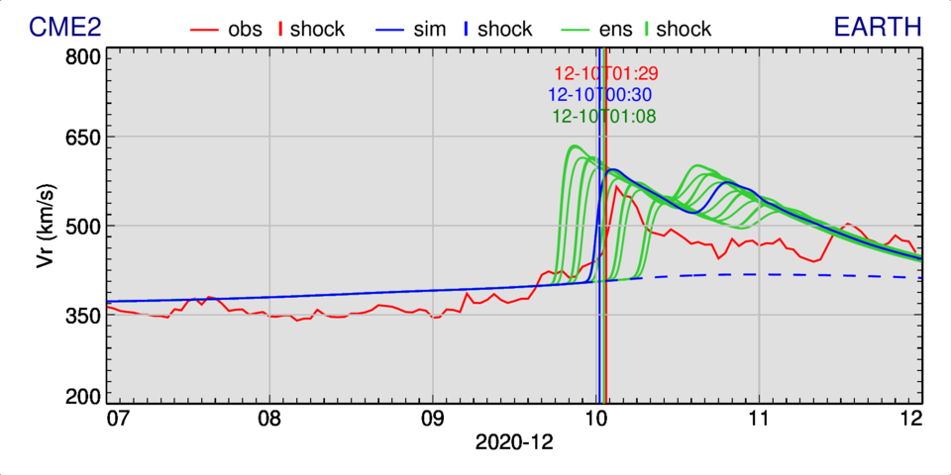
15-Member Ensemble Predictions — 2 CMEs in “a3b2” BSW

Slide 12
15-Member Ensemble Runs — CME1 in “a3b2” BSW
Run | Vcme (%) | Longitude (deg) | WLToA | WLToA error (min)_ | ToA at Earth | ToA error (h)
1 | -20% | -15 | 08T04:40 | -209 | 12-09T16:42 | -8.783
2 | -20% | 0 | 08T04:45 | -204 | 12-09T17:08 | -8.350
3 | -20% | 15 | 08T04:45 | -204 | 12-09T20:28 | -5.016
4 | -10% | -15 | 08T03:25 | -274 | 12-09T13:33 | -11.933
5 | -10% | 0 | 08T03:24 | -285 | 12-09T14:05 | -11.400
6 | -10% | 15 | 08T03:24 | -285 | 12-09T17:39 | -7.833
7 | 0% | -15 | 08T02:44 | -325 | 12-09T10:55 | -14.566
8 | 0% | 0 | 08T02:43 | -326 | 12-09T11:33 | -13.933
9 | 0% | 15 | 08T02:43 | -326 | 12-09T15:12 | -10.283
10 | 10% | -15 | 08T02:00 | -369 | 12-09T08:46 | -16.716
11 | 10% | 0 | 08T02:04 | -365 | 12-09T09:11 | -16.300
12 | 10% | 15 | 08T02:04 | -365 | 12-09T13:01 | -12.466
13 14 | 20% | -15 | 08T01:23 | -406 | 12-09T06:36 | -18.883
14 | 20% | 0 | 08T01:21 | -408 | 12-09T07:11 | -18.300
15 | 20% | 15 | 08T01:22 | -407 | 12-09T11:05 | -14.400
— | — | — | — | — | 12-09T12:52 | -12.611

Slide 13
15-Member Ensemble Runs — CME2 in “a3b2” BSW
Run | Vcme (%) | Longitude (deg) | WLToA | WLToA error (min) ( (min) | ToA at Earth | ToA error (h)
1 | -20% | -15 | 08T12:00 | 231 | 12-10T07:35 | 6.100
2 | -20% | 0 | 08T11:25 | 196 | 12-10T07:28 | 5.983
3 | -20% | 15 | 08T11:25 | 196 | 12-10T08:09 | 6.666
4 | -10% | -15 | 08T10:44 | 155 | 12-10T03:46 | 2.283
5 | -10% | 0 | 08T10:44 | 155 | 12-10T03:40 | 2.183
6 | -10% | 15 | 08T10:44 | 155 | 12-10T04:28 | 2.983
7 | 0% | -15 | 08T10:00 | 111 | 12-10T00:30 | -0.983
8 | 0% | 0 | 08T09:25 | 76 | 12-10T00:30 | -0.983
9 | 0% | 15 | 08T10:06 | 117 | 12-10T01:18 | -0.183
10 | 10% | -15 | 08T09:25 | 76 | 12-09T21:44 | -3.750
11 | 10% | 0 | 08T08:43 | 34 | 12-09T21:36 | -3.883
12 | 10% | 15 | 08T08:42 | 33 | 12-09T22:31 | -2.966
13 14 | 20% | -15 | 08T08:05 | -4 | 12-09T19:10 | -6.316
14 | 20% | 0 | 08T08:05 | -4 | 12-09T19:08 | -6.350
15 | 20% | 15 | 08T08:03 | -6 | 12-09T20:01 | -5.466
— | — | — | — | — | 12-10T01:10 | -0.312

Slide 14
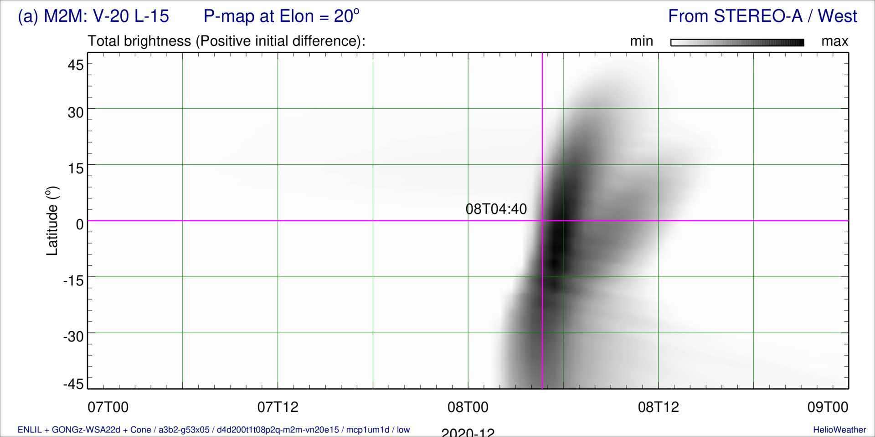
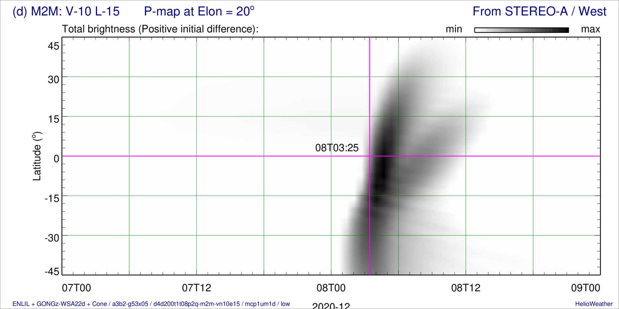
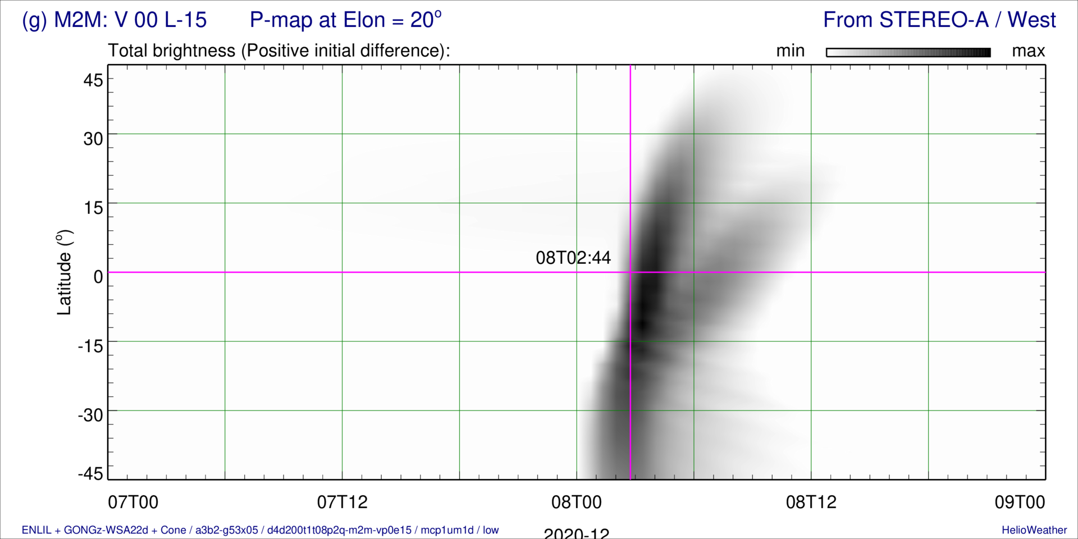
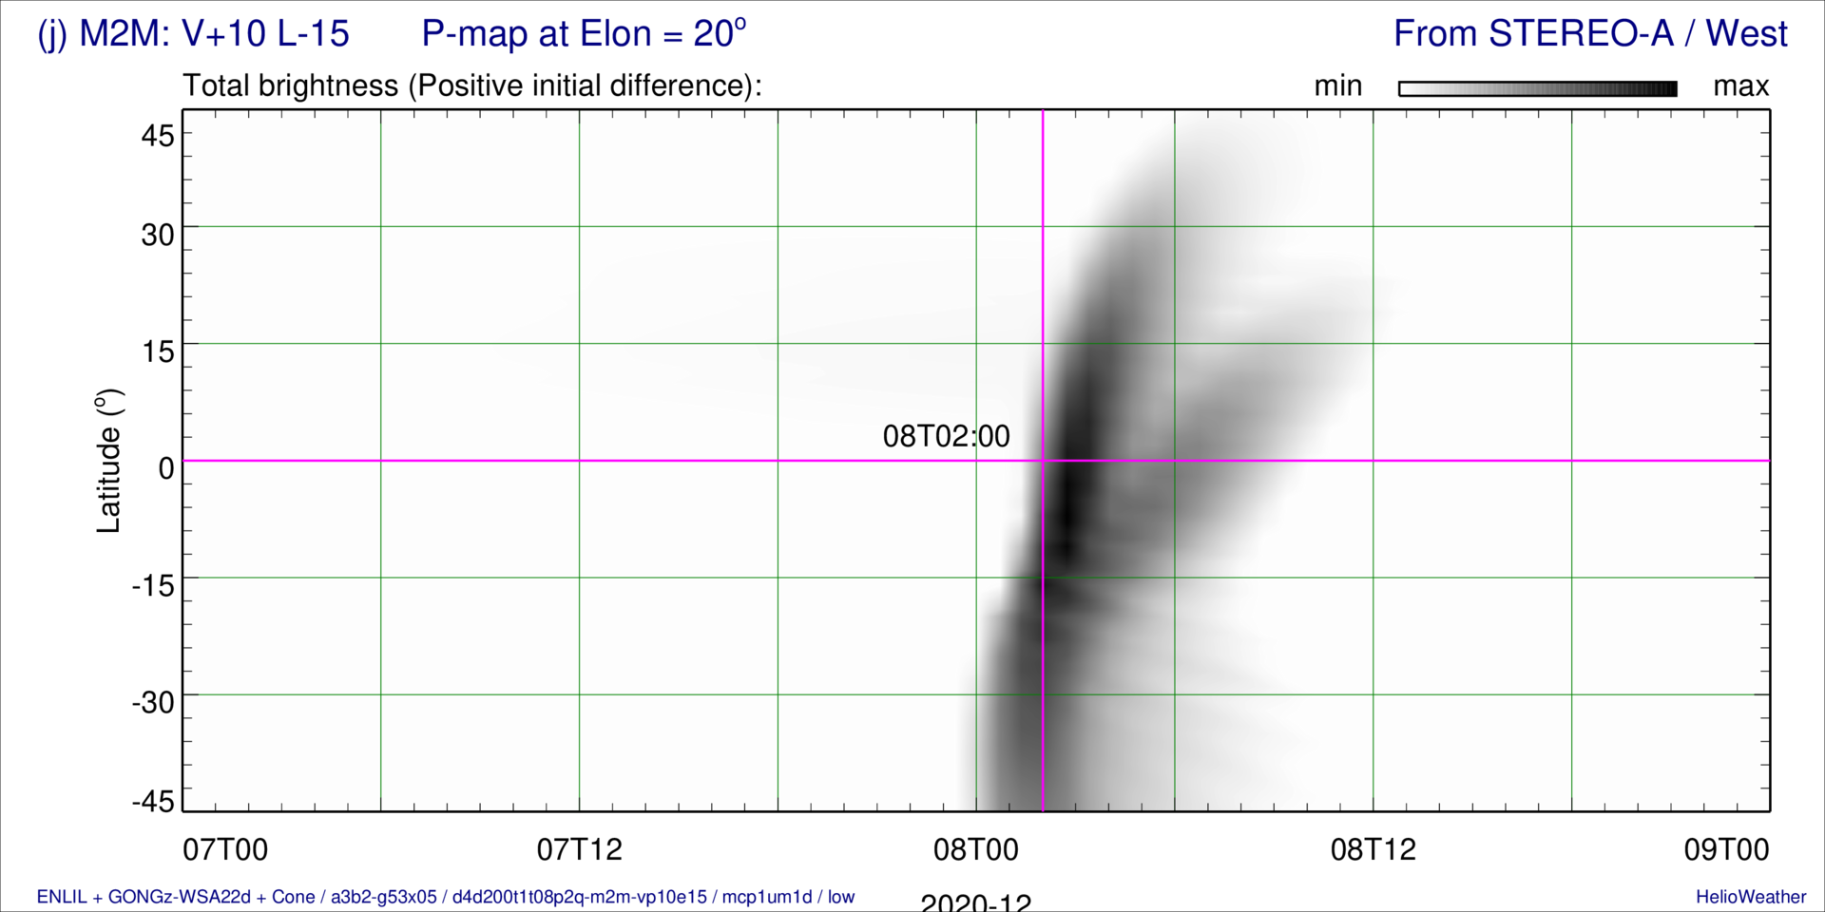
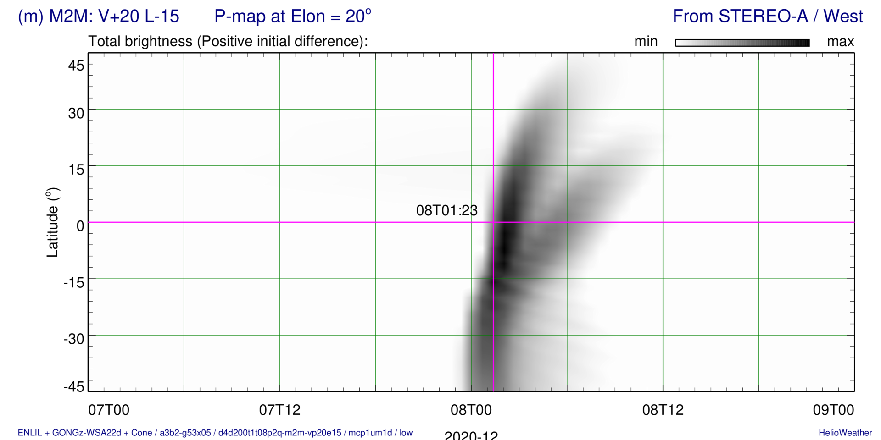
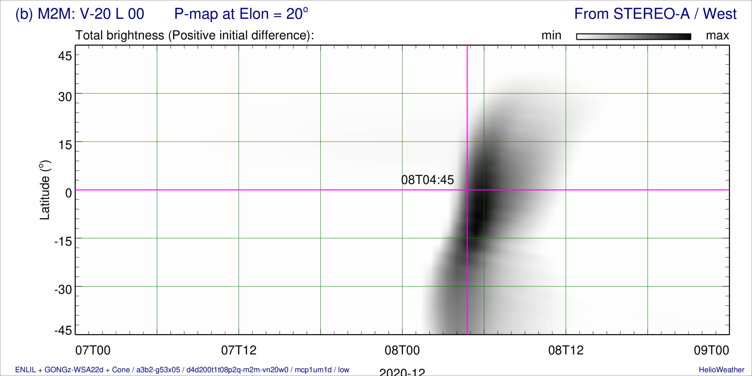
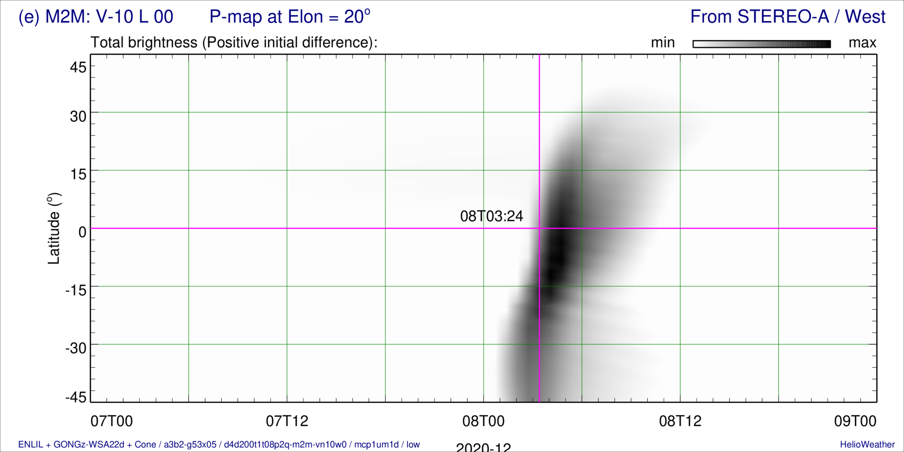
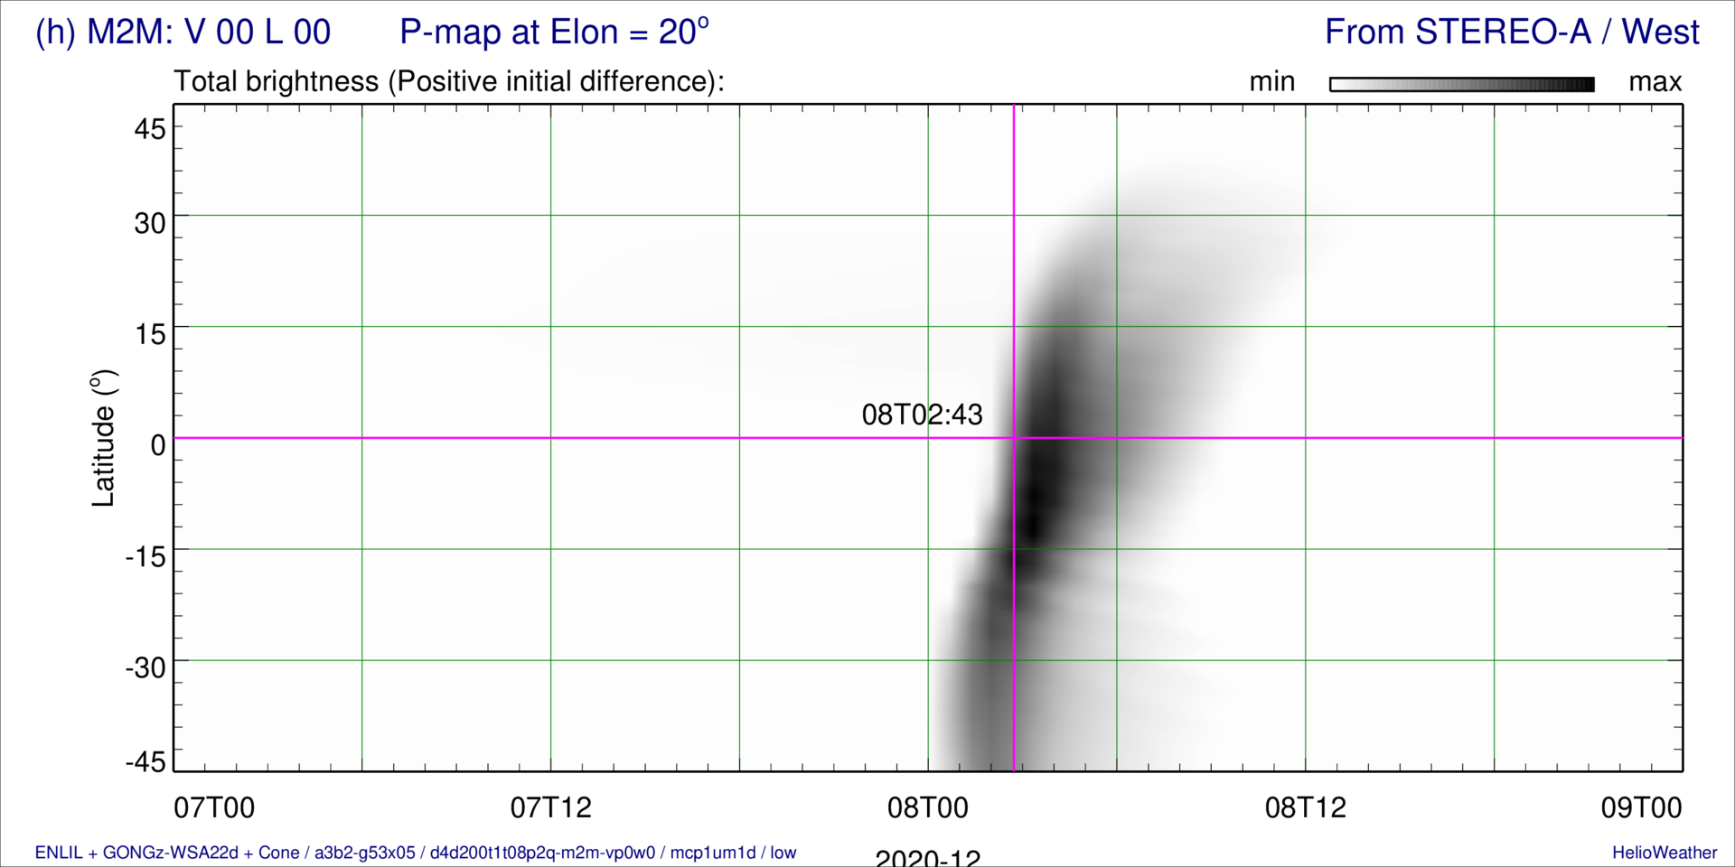
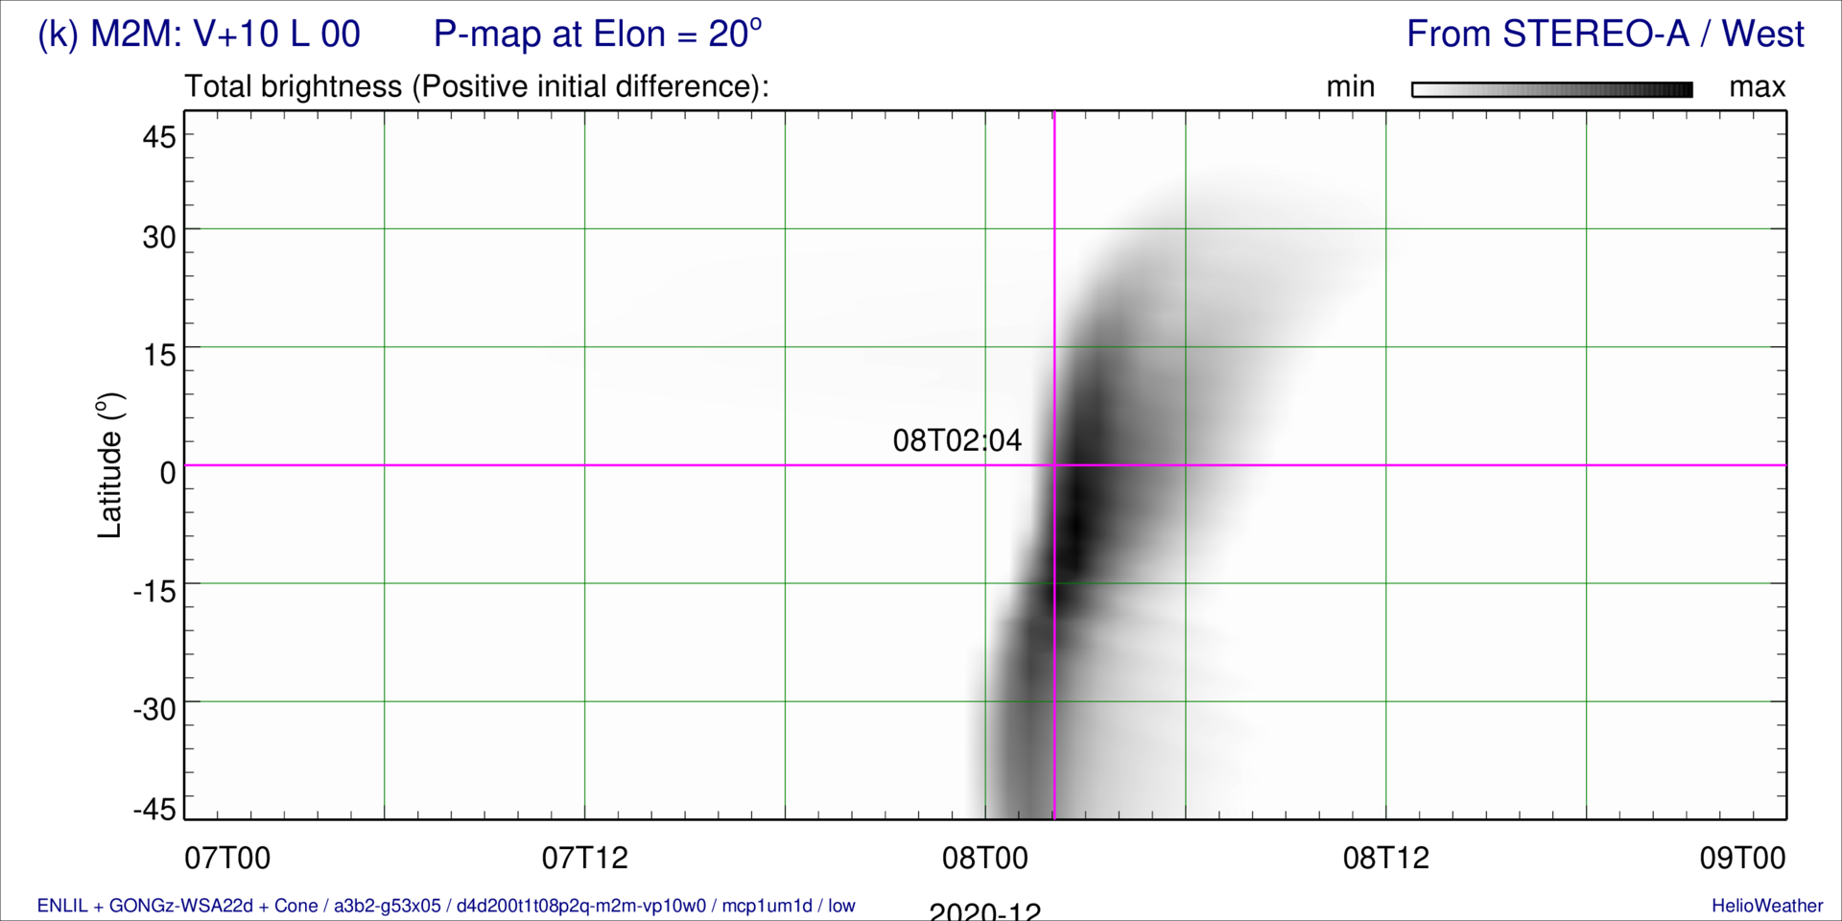
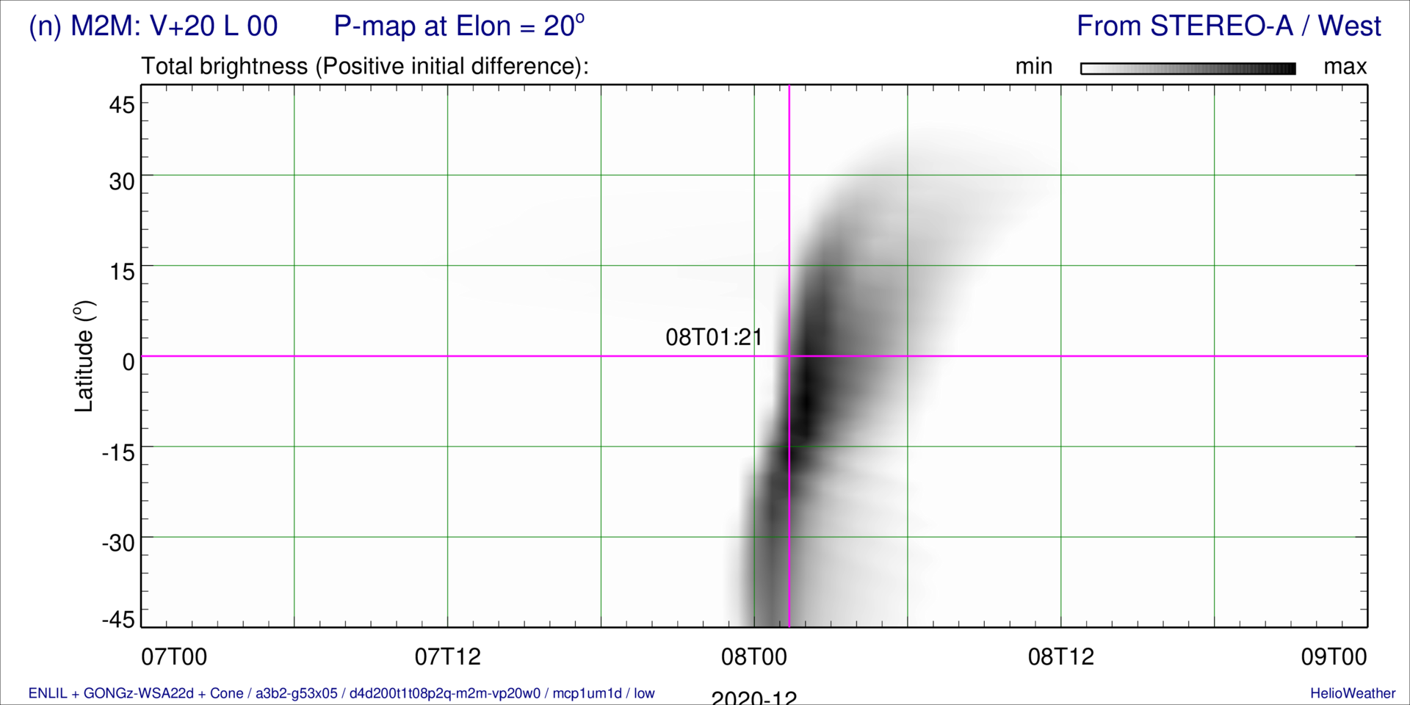
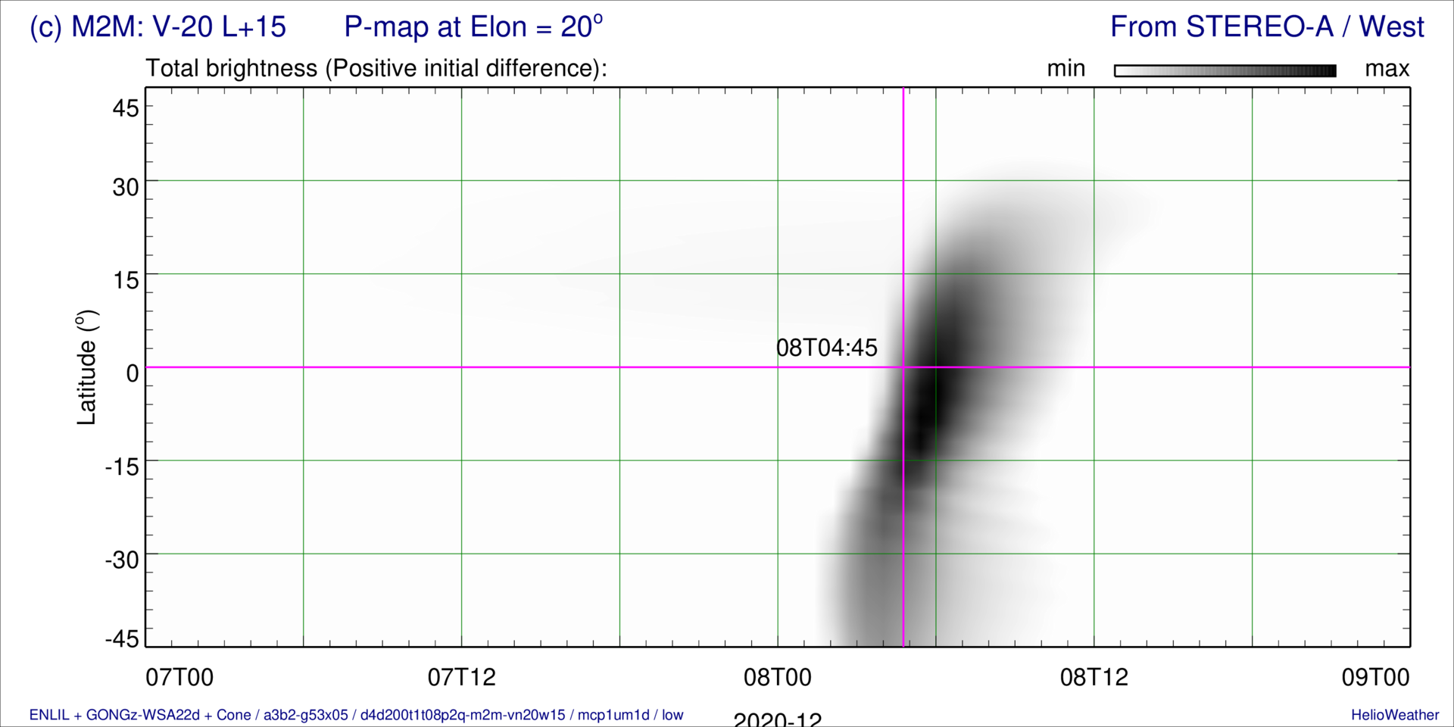
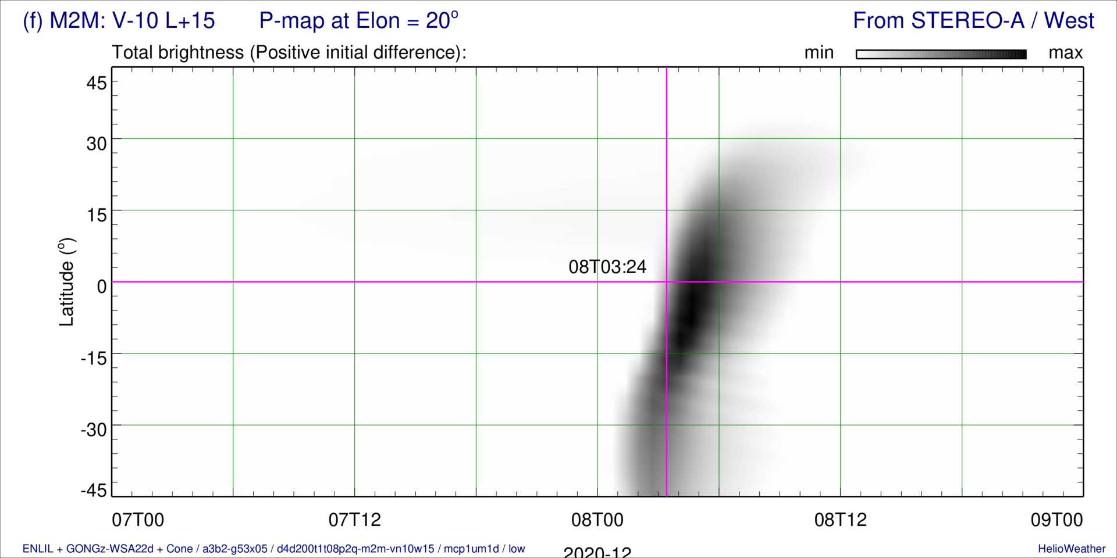
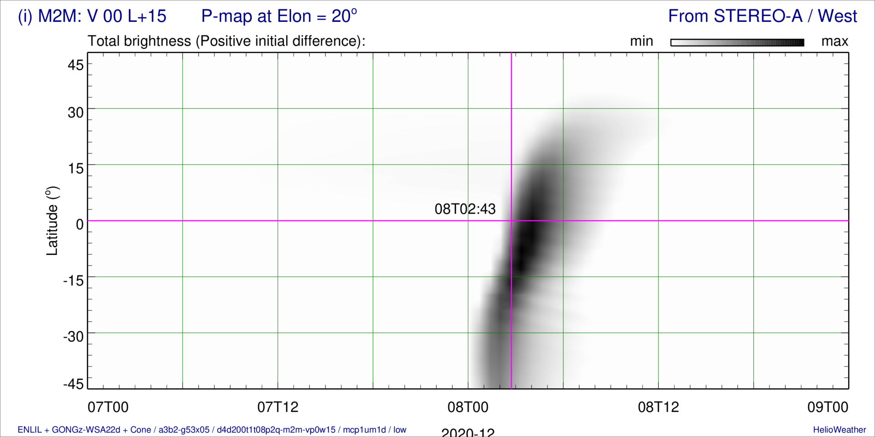
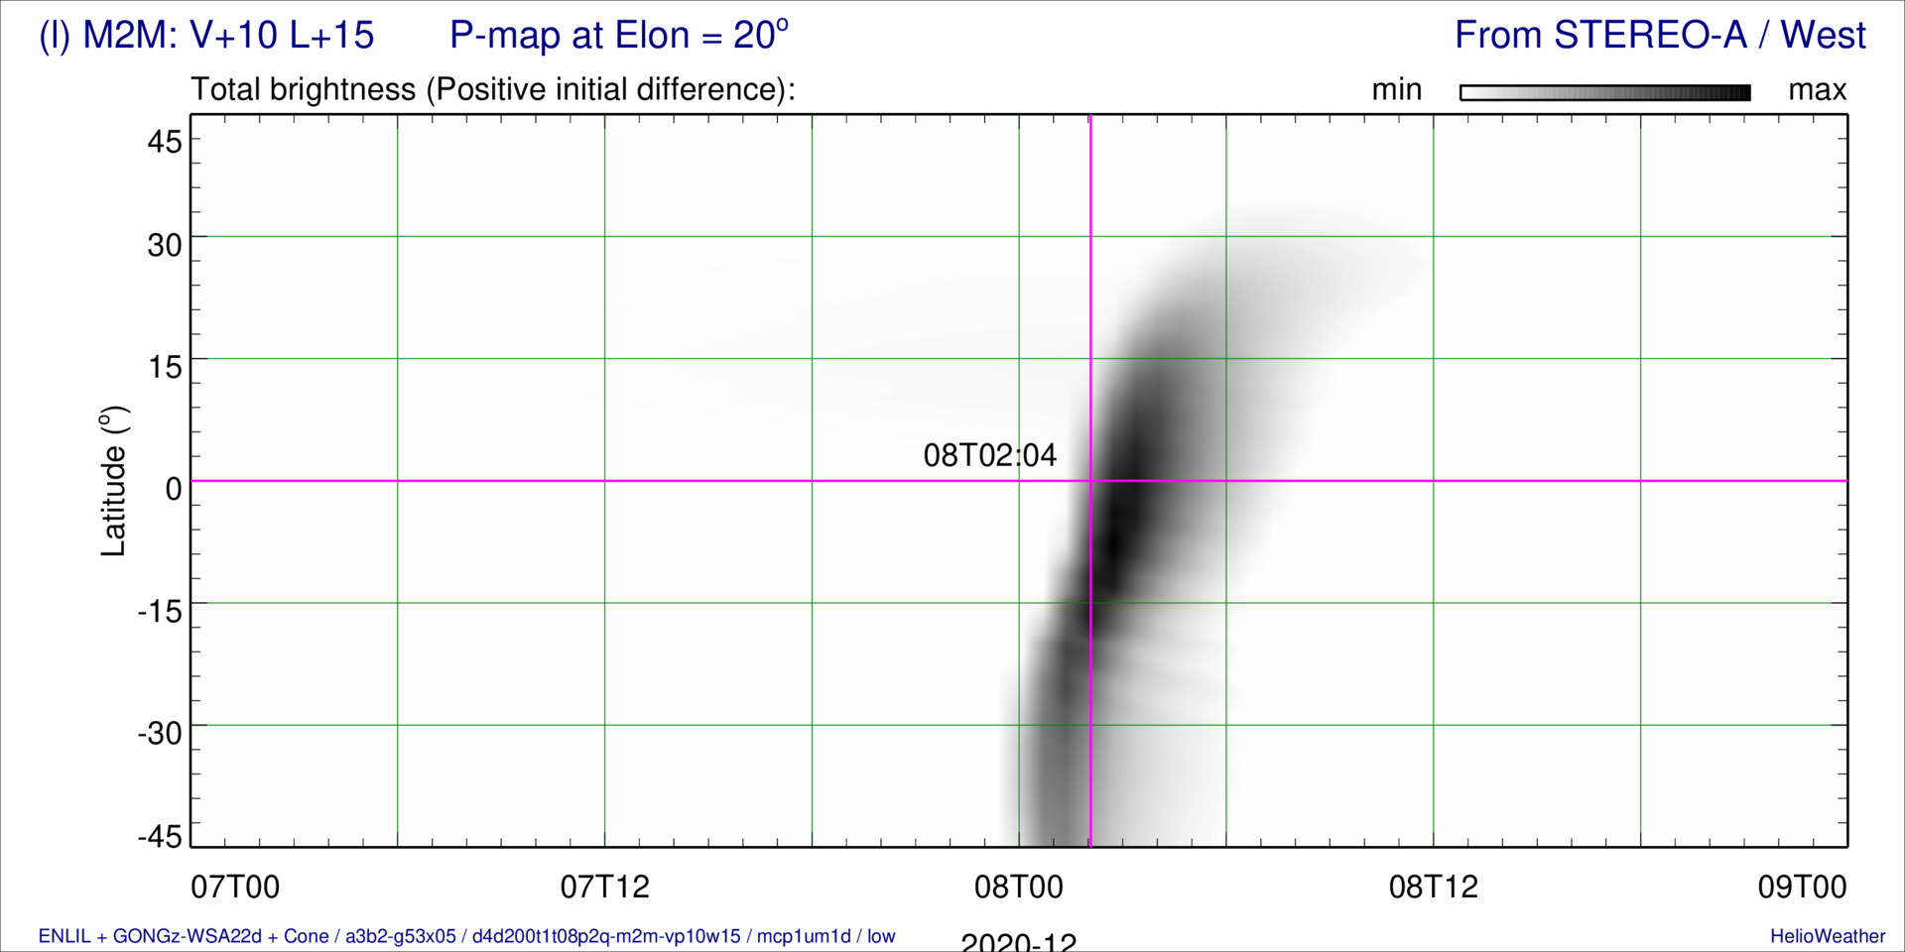
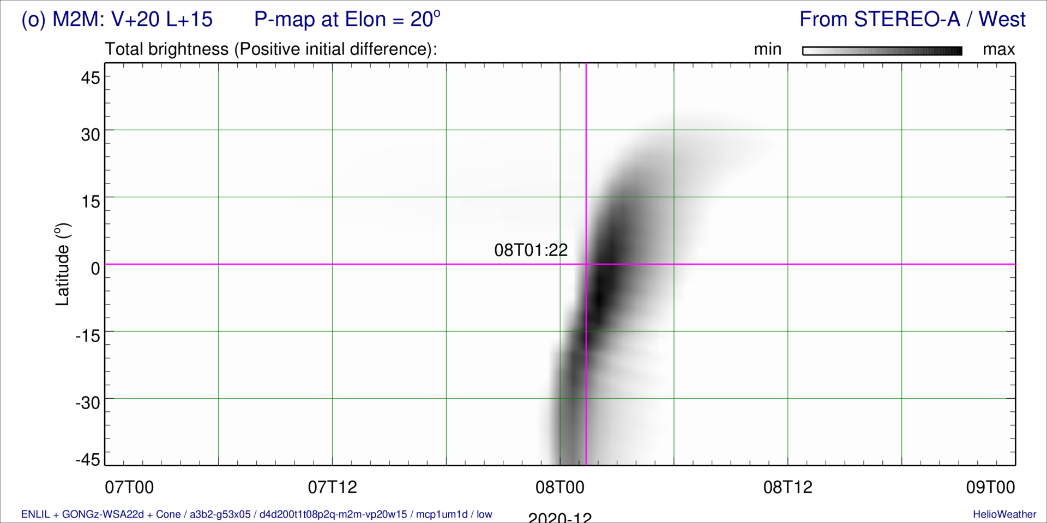
15-Member Ensemble P-maps — CME1 in “a3b2” BSW
Err = -209 min
Err = -284 min
Err = -325 min
Err = -369 min
Err = -406 min
Err = -204 min
Err = -285 min
Err = -326 min
Err = -365 min
Err = -408 min
Err = -204 min
Err = -285 min
Err = -326 min
Err = -365 min
Err = -407 min

Slide 15
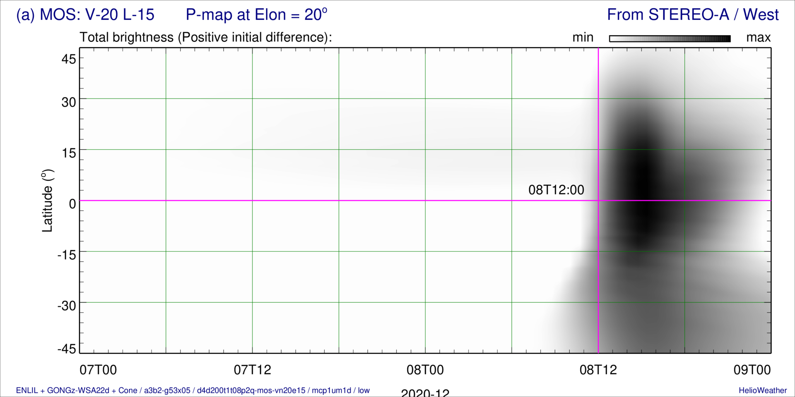
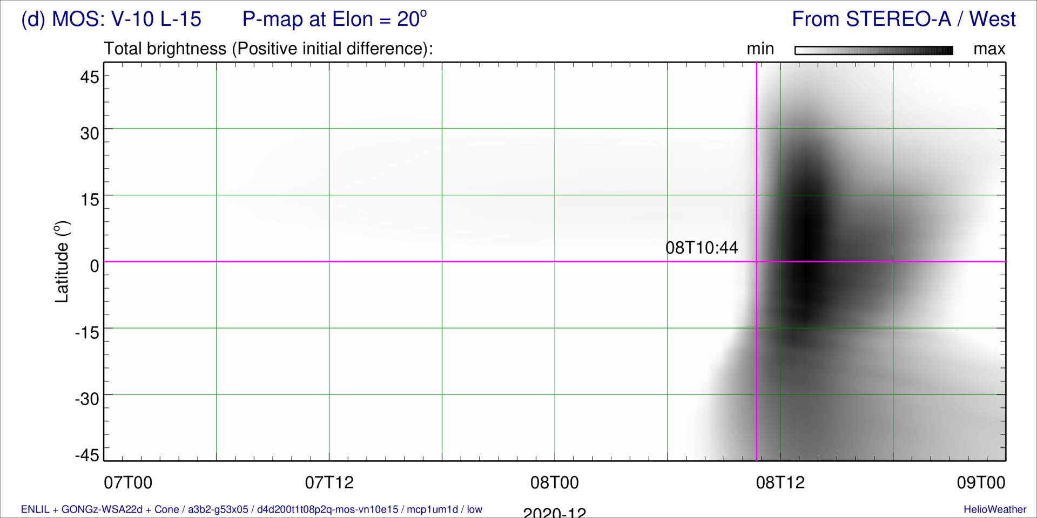
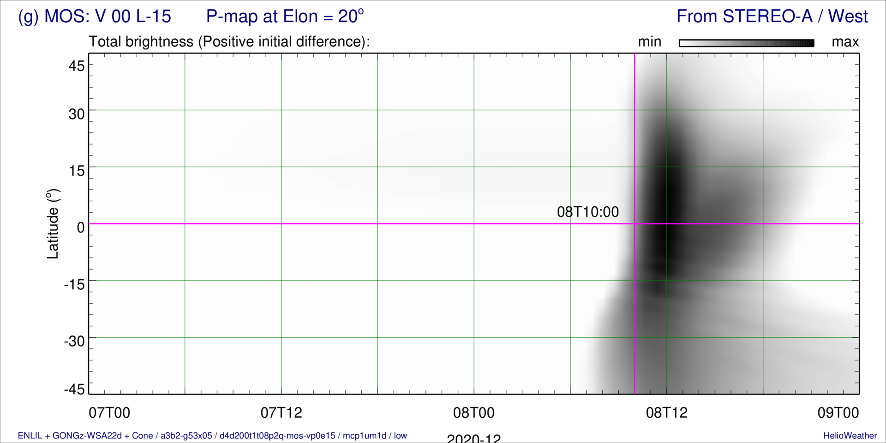
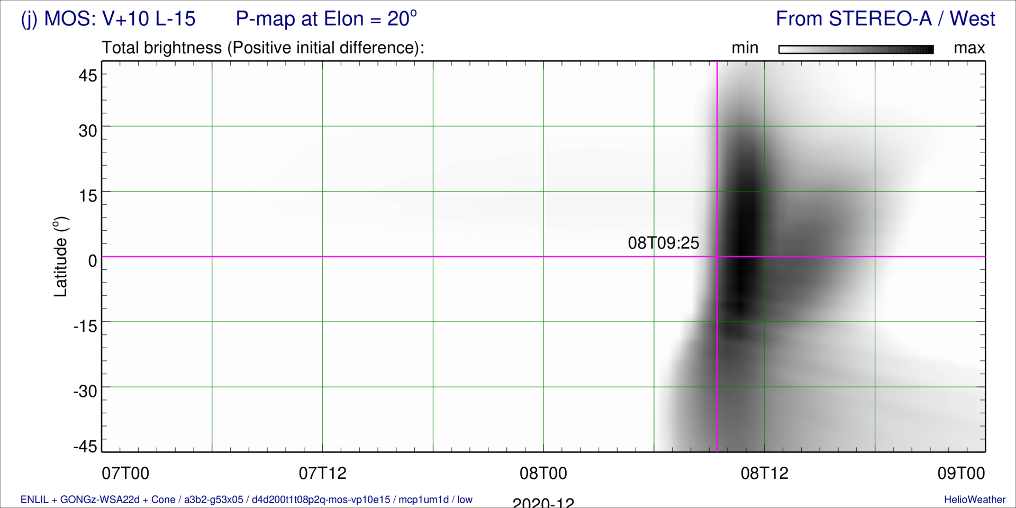
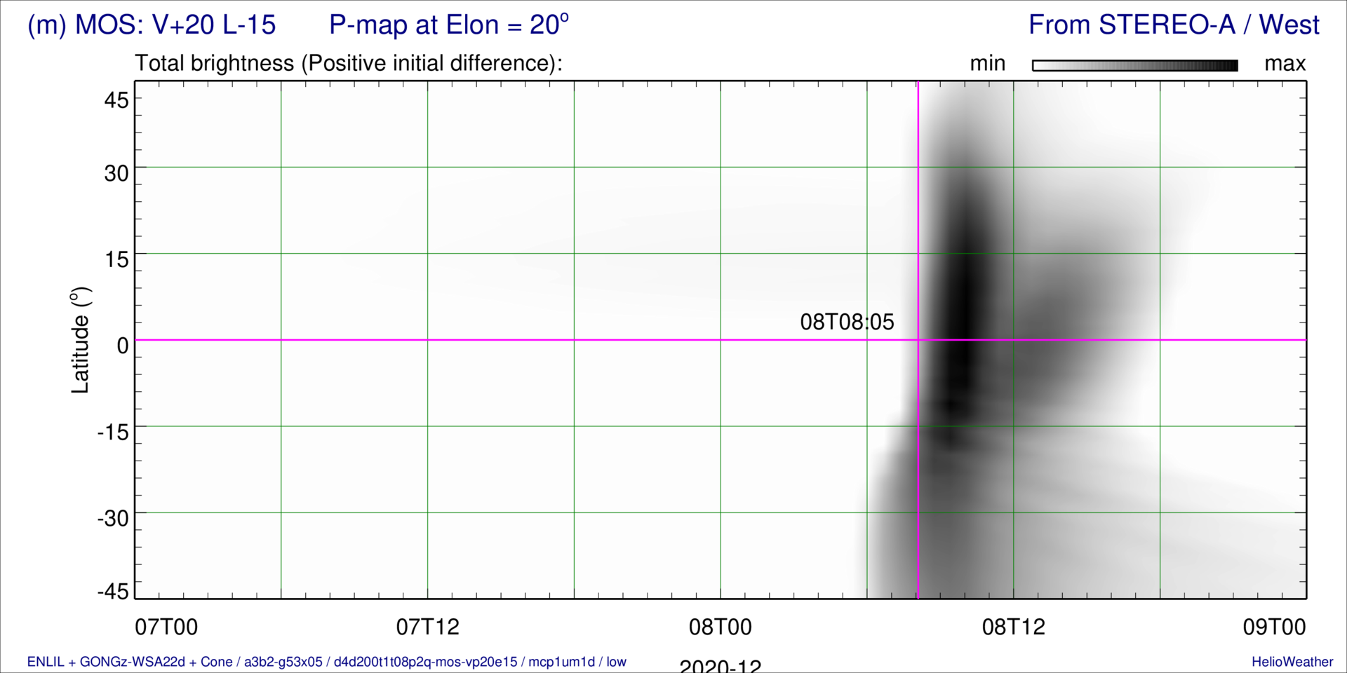
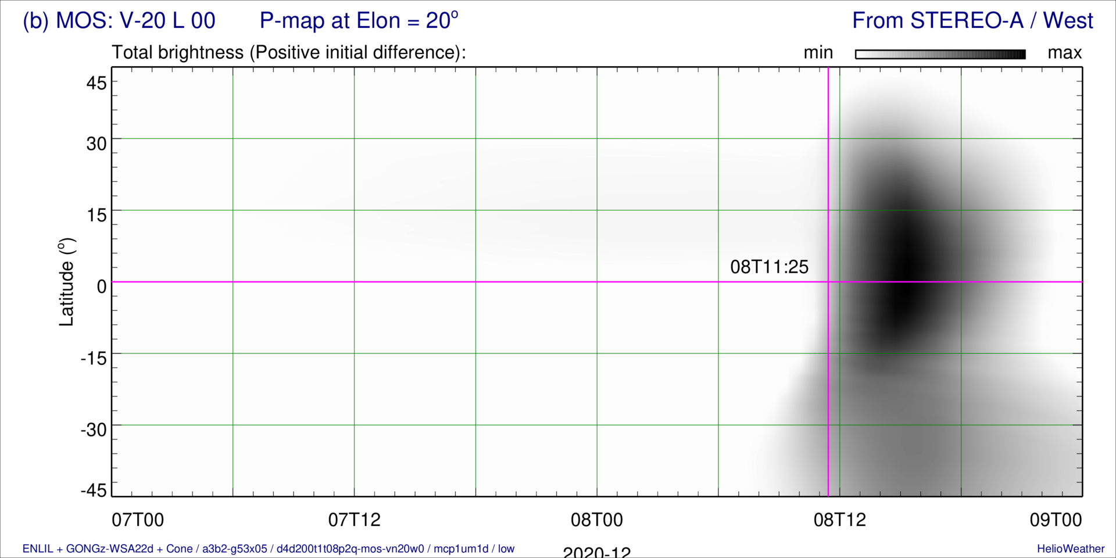
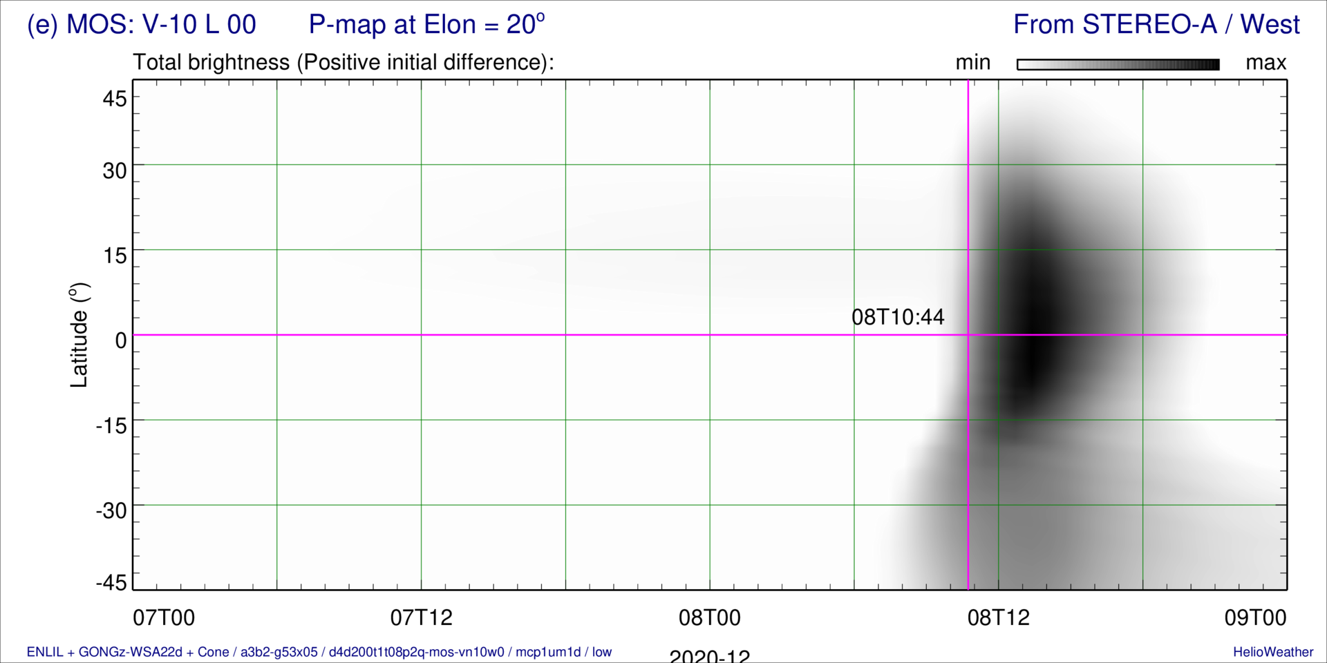
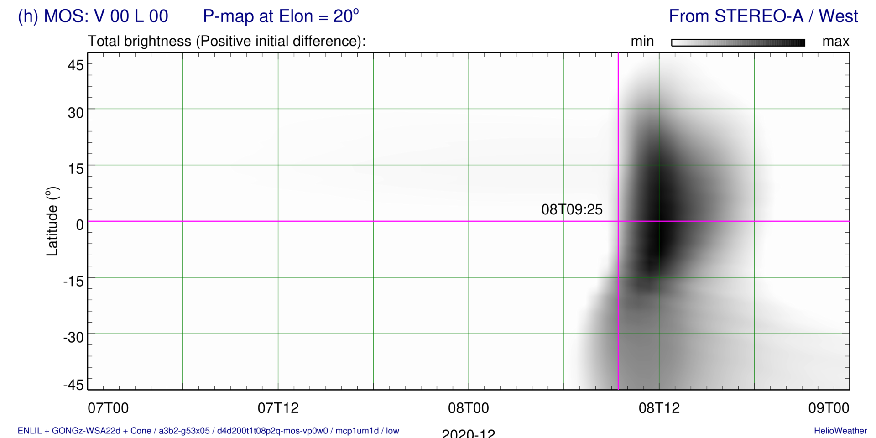
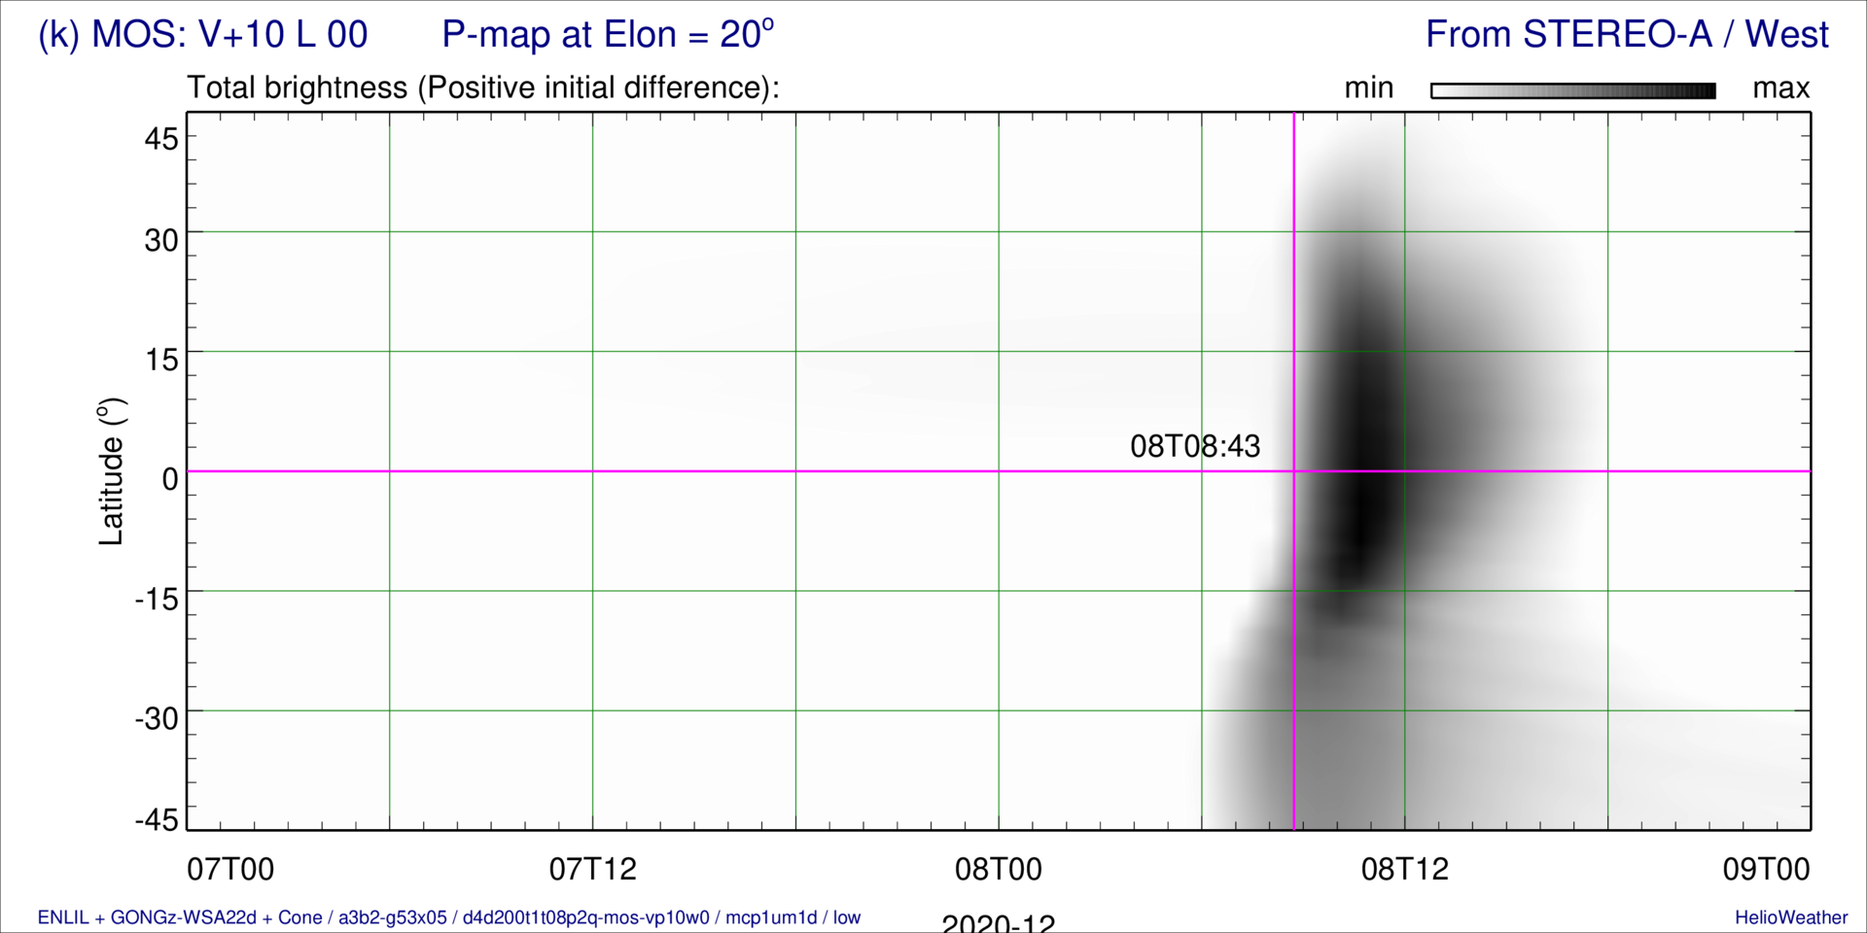
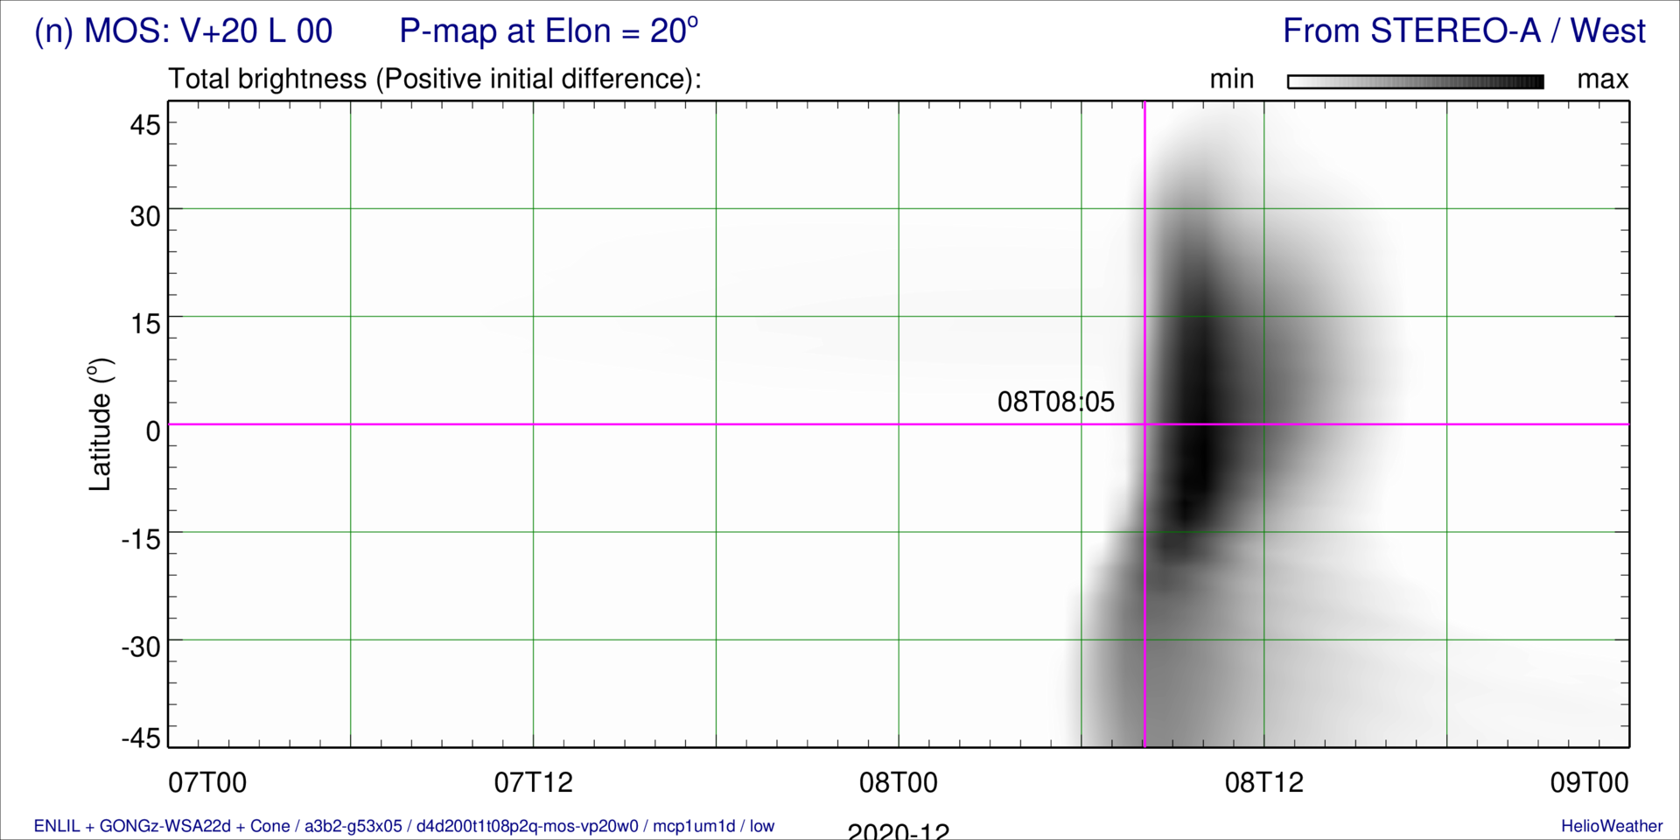
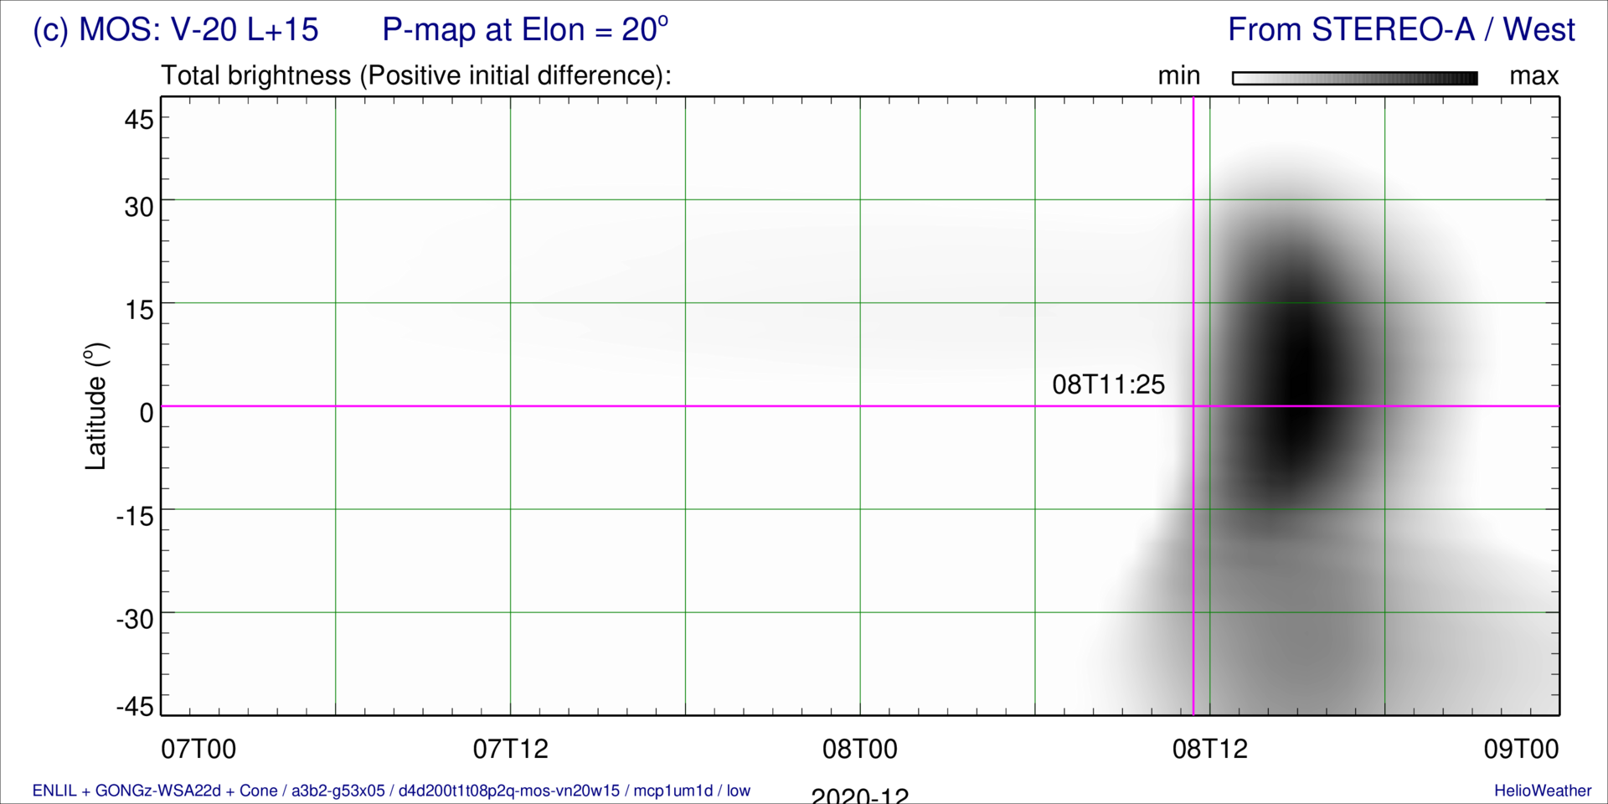
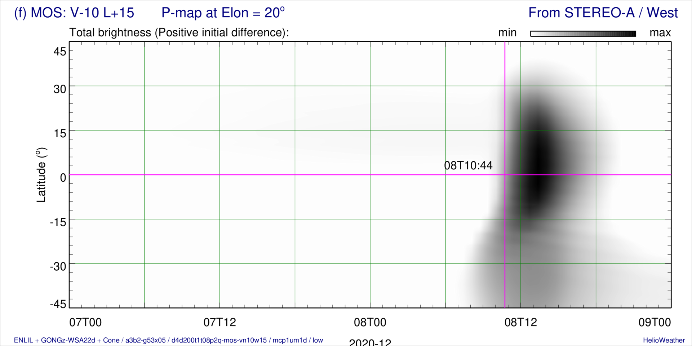
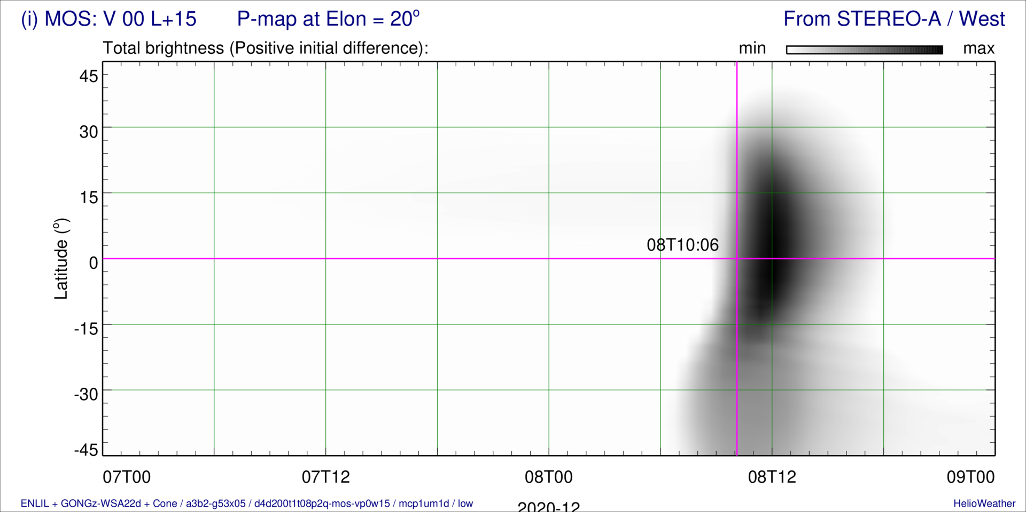
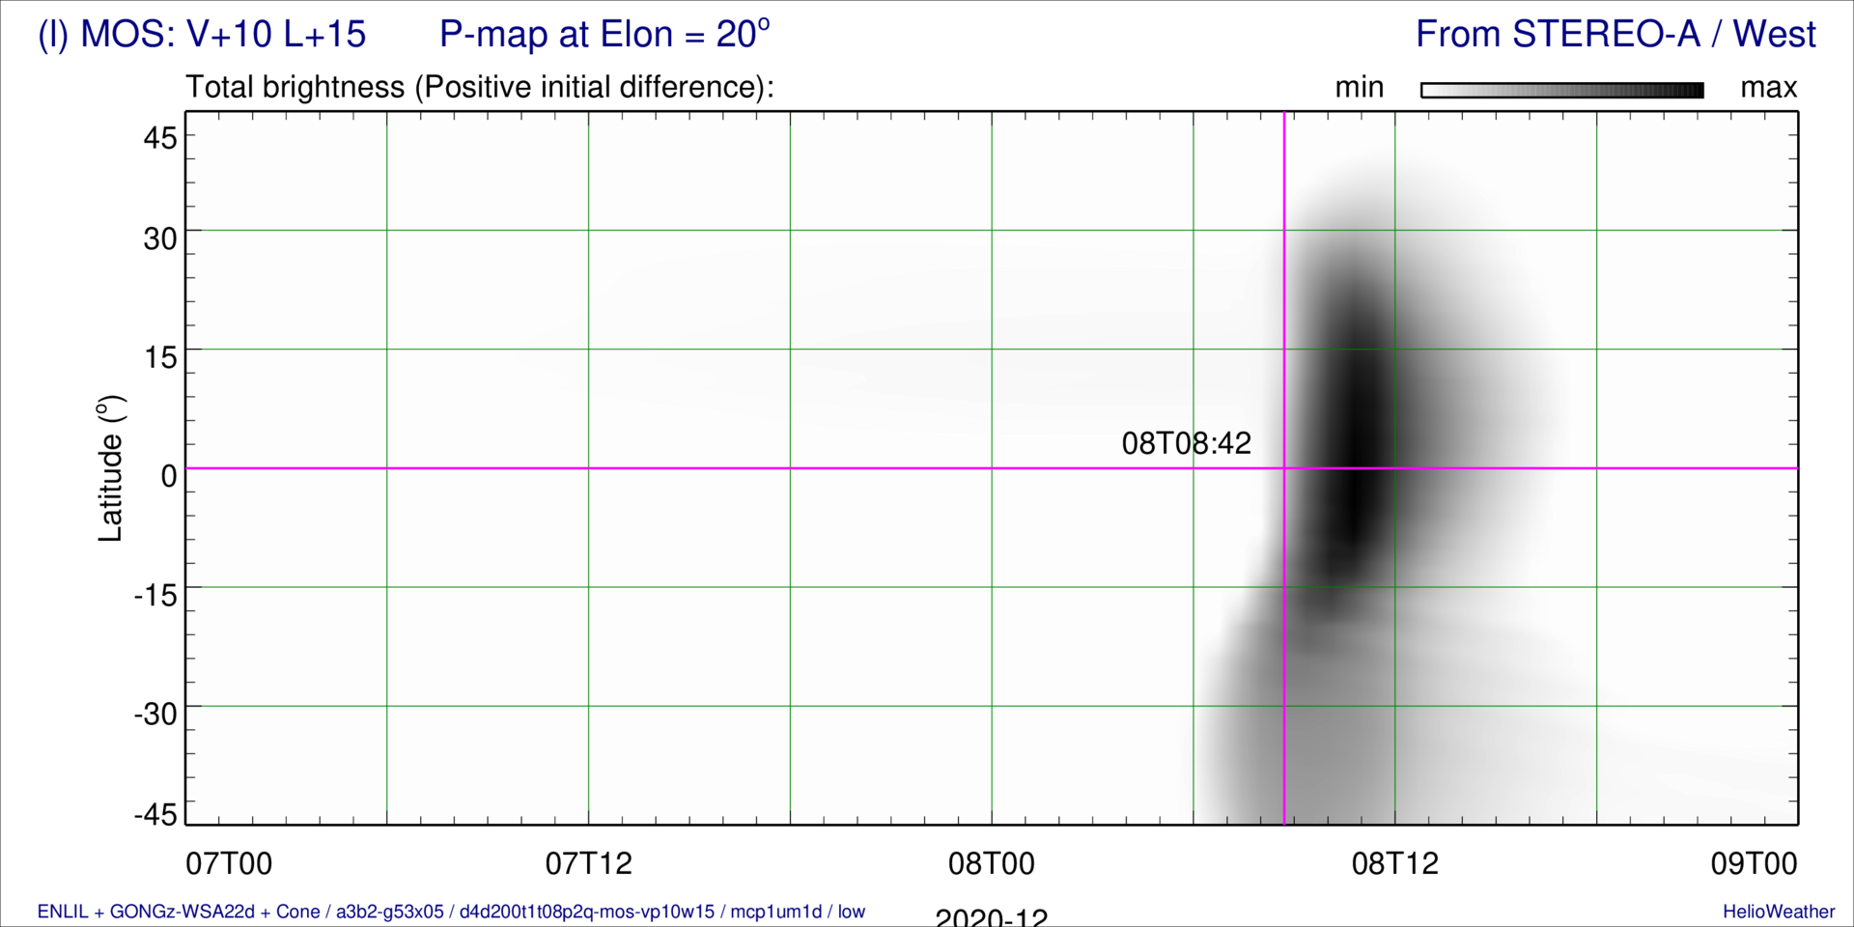
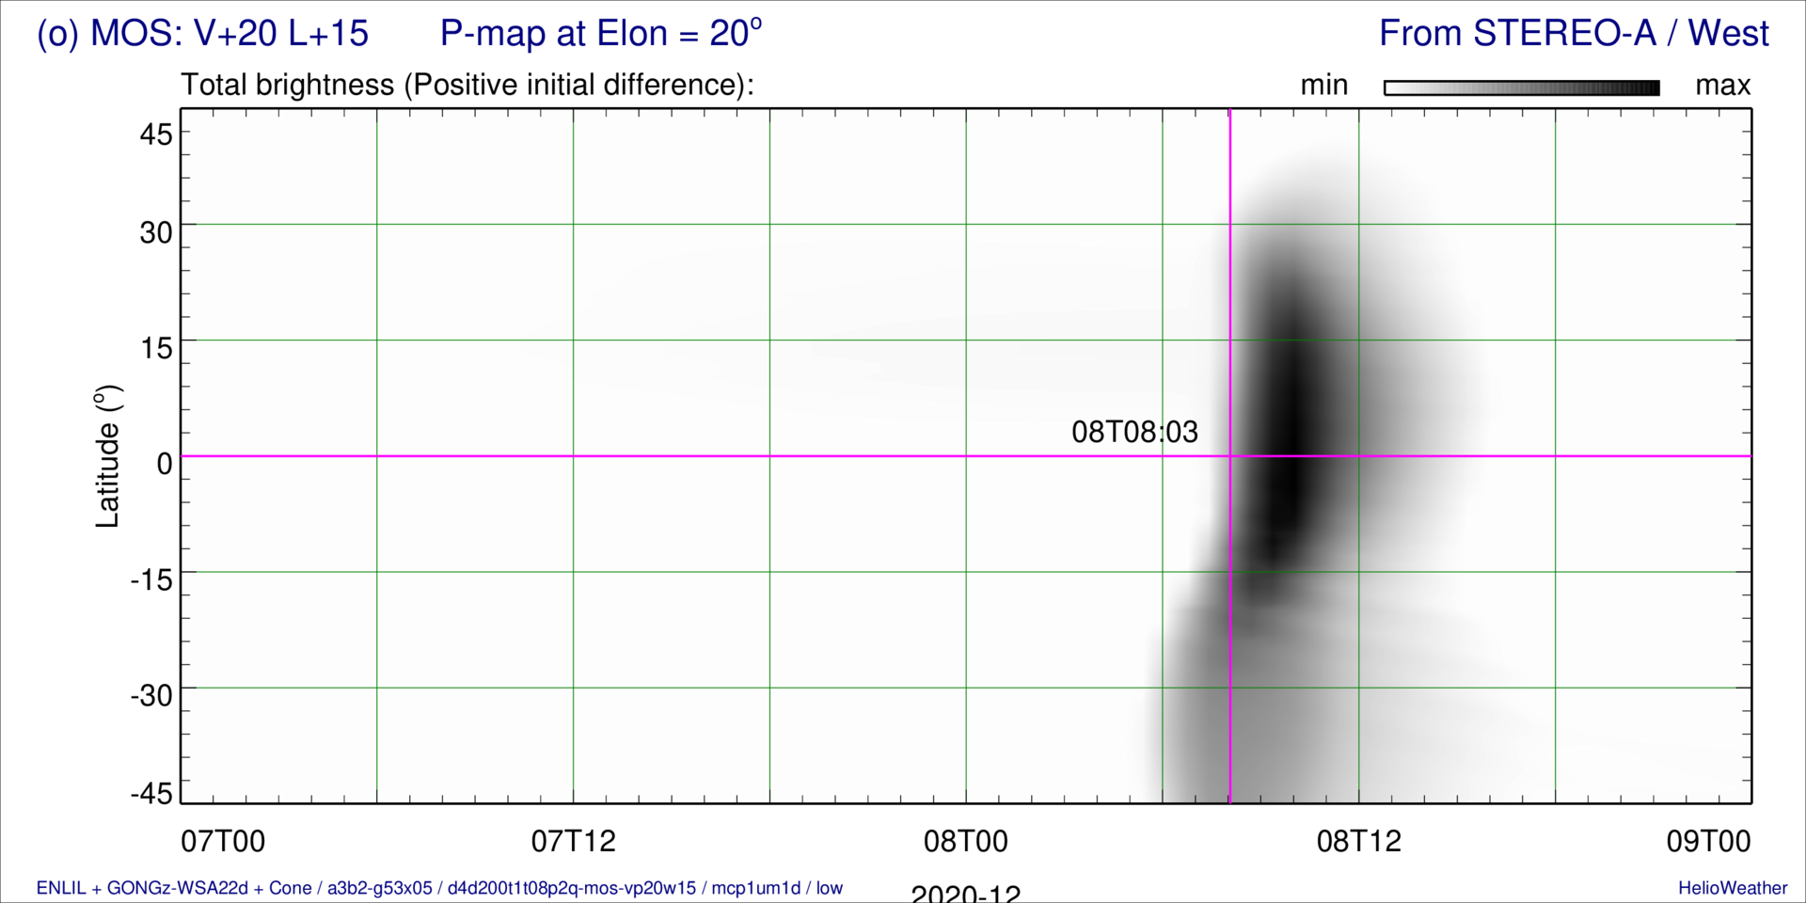
15-Member Ensemble P-maps — CME2 in “a3b2” BSW
Err = +231 min
Err = +155 min
Err = +111 min
Err = +76 min
Err = -4 min
Err = +196 min
Err = +155 min
Err = +76 min
Err = +34 min
Err = -4 min
Err = +196 min
Err = +155 min
Err = +117 min
Err = +33 min
Err = -6 min

Slide 16
Heliospheric Space Weather in December 2025
(~ 30-days Long Artemis III Mission => Sep 2026)
Planetary and spacecraft positions as in 2025 December
Solar wind density and 36 CMEs using 2014 data (11-year cycle of solar activity)

