Slide 1
CCMC Team Report

Slide 2








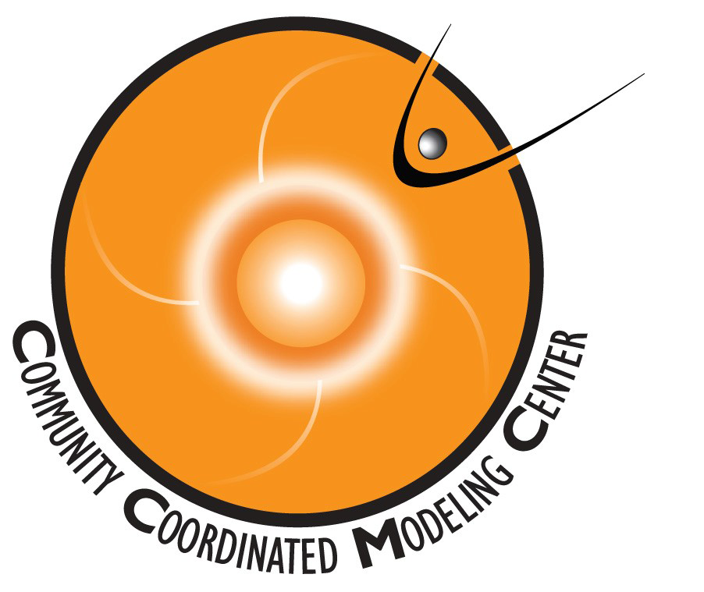
Multi-agency strategic investment in US space weather program
CCMC Goals
  Facilitate
  space weather & space science
  research &
  model development
  Support
  transition of
  advances in research to
  space weather operations
Notes:
Established in 2000 as an essential element
of the National Space Weather Program
to facilitate research & development for the
next generation of space environment modeling capability.

Slide 3
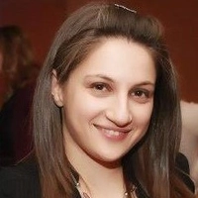





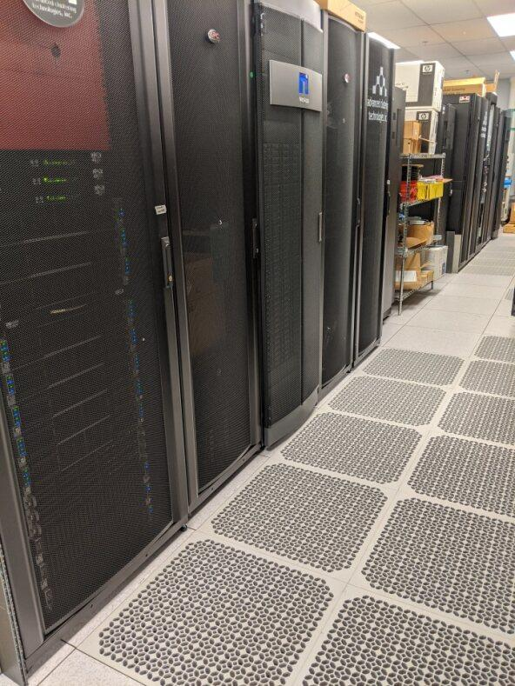
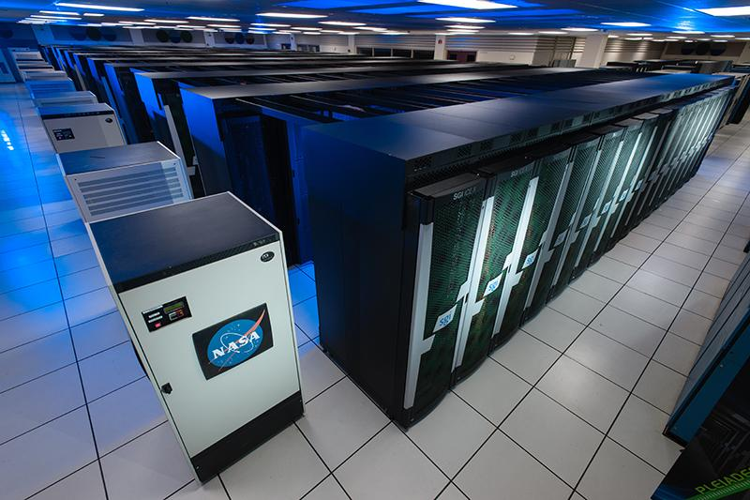
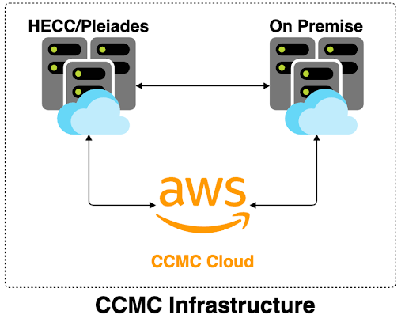
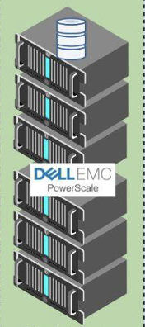

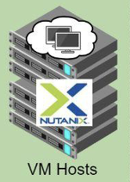


Infrastructure: Prerequisite for all Functions
Infrastructure team
Design and maintain CCMC hybrid infrastructure
(On-Prem, AWS Cloud, HECC/Pleiades)
System engineering support for scientists, software developers and partners (modelers, users)
Explore and implement new technologies and innovative system engineering solutions
Respond to NASA security requirements
Maintain shared environments on CCMC Cloud and Pleiades critical for collaborative on-boarding and R2O pipelines
Enhance operations with NG storage systems, virtual machines and file transfer pipeline innovation
Tina Tsui
Poly Manessis
Matt Lesko
Karen Scheiber
Edgar Russell
Damian
Barrous-Dume
Phil Poole
Damian
Barrous-Dume
Cloud Engineer
Phil Poole
Infrastructure

Slide 4







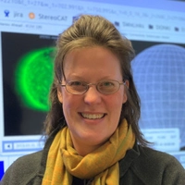










Software
Simulation services software
Runs-on-request
Real-time runs
Instant runs
DONKI
Maksym Petrenko
CAMEL
Chinwe Didigu
Chiu Wiegand (Lead)
Software for model-data & multi-model comparisons
Space Weather Database
Integrated Space Weather Analysis system for space environment monitoring, anomaly assessment, system science
Tyler Schiewe
Rick Mullinix
Joycelyn Jones
Scoreboard - world-wide ensemble forecasts
Jack Topper
Anders Lundkvist
Maya Levisohn
Visualization and analysis software
Darren
De Zeeuw
CCMC-Vis
Lutz Rastaetter
Elon Olsson

Slide 5




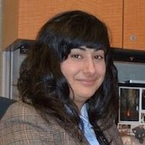



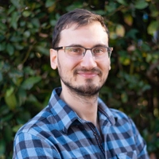



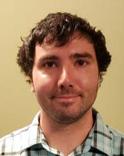




Solar/Helio
Near Earth
Radiation & Plasma Environment
Scientists
Magnetosphere
ITM
SEP
Peter Macneice (Lead)
Mostafa El Alaoui
(Lead)
Yihua Zheng (Lead)
Jia Yue (Lead)
Leila Mays (Lead)
Domain experts
Model POCs
Community Projects
Validation
Sandro Taktakishvili
Lutz Rastaetter
Claudio Corti
Kinetic
Min-Yang Chou
Jack Wang
Martin Reiss
Liutauras Rusaitis (postdoc)
Masaru
Kogure
(postdoc)
Chris Light (postdoc)
Joshua Petit
(postdoc)
Kukkai
Hozumi
(postdoc)
Yuta Hozumi
(postdoc)
Christine Verbeke (postdoc)

Slide 6




Management, Support, Coordination, Financial
Masha Kuznetsova
Director
Elana Resnick
Project Support Specialist
Education
Leila Mays
Deputy Director
Michelle Mendoza
Runs-on-Request
Coordinator
Robert Hagstrom
Resource Analyst

Slide 7
Relevance to the Implementation Plan for National Space Weather Strategy and Action Plan
Scoreboards: Facilitate community-wide pre-event ensemble predictions (2.5.7)
CAMEL: platform for model validation and performance analysis, generation of Scorecards, and tracing progress over time based on historic time periods (2.5.1).
Impact-based validation (2.5.1, 2.5.6, 2.2.12).
OpenSpace: interactive visualization of wpqce weather phenomena in classrooms and planetariums to improve public awareness & education (3.2.2).
Access to real-time run outputs via APIs (2.5.4)
Evaluating new computational technology to improve space weather predictions (2.5.2)
Partnership and leadership in COSPAR ISWAT teams to facilitate multiplying efforts (3.2.1)
Collaborative environments (CCMC-SWPC and CCMC-SRAG-M2M shared proving grounds to demonstrate potential of new understanding, models and applications to improve operational space weather capabilities (2.5.1, 2.5.7, 2.7)

Slide 8
CCMC and Open Science
  Enabling open use of models and model outputs for over 20 years.
Modelers are proposing implementation at CCMC (for LWS SC as well as other programs that does not have this requirement).
Modelers are requesting CCMC to take a lead in introducing standards, hosting model repositories, maintaining open source.
CCMC is maintaining shared collaborative environments on the AWS cloud and at NASA HECC systems. Enables CCMC staff, modelers, expert users to work together.
Working with model development projects (e.g., LSW SC, DRIVE Centers) from early stages. Enable community use of early results.
Distribution of source code: with explicit approval from developers only
  Outputs of all runs-on-requests are archived. Online visualization and downloads of any simulation results are open to everyone.
Notes:
Initial reluctance to deliver models to CCMC. It took 5-10 years to build the trust
Initial reluctance to deliver models to CCMC. It took 5-10 years to build the trust
Modelers started seeing the value of Runs-on-Request.Growing number of projects proposed to deliver models to CCMC.
NASA LWS Strategic Capabilities program
all deliverables must be installed and tested at CCMC by the end of performance
development efforts include on-going inputs from CCMC
Modelers are proposing implementation at CCMC for other programs that does not have this requirement.
Rules-of-the Road: do not distribute source code without approval from developers.

Slide 9
CCMC and Open Science (cont.)
All CCMC staff members are taking Open Science 101 training
CCMC-developed software are NASA open source
    Establishing and following best practices. Shared GitLab repositories are possible (facilitate transition to open source)
  On-boarding simulation outputs for runs produced outside of CCMC
  On-boarding of post-processing, visualization and analysis software
  Support containerizing models and applications
  Infrastructure is ready to support community modeling
  Maintain transparency in model validation projects
Notes:
Initial reluctance to deliver models to CCMC. It took 5-10 years to build the trust
Initial reluctance to deliver models to CCMC. It took 5-10 years to build the trust
Modelers started seeing the value of Runs-on-Request.Growing number of projects proposed to deliver models to CCMC.
NASA LWS Strategic Capabilities program
all deliverables must be installed and tested at CCMC by the end of performance
development efforts include on-going inputs from CCMC
Modelers are proposing implementation at CCMC for other programs that does not have this requirement.
Rules-of-the Road: do not distribute source code without approval from developers.

Slide 10
Open Science – linking CCMC services to publications
Number of Publications
List of publications mentioning CCMC services (Runs on Request, Real Time runs/iSWA)
We are creating database linking the list to simulation runs using CCMC models
We sort the publications by model domain, simulation type, time period, phenomena
Work in Progress (so far):
Input from users needed
Total: 1,225
Number of Runs Used for Papers
Total: 1,223
 | SH | GM | ITM | Total
# of Papers Published | 50 | 75 | 57 | 182
# of Runs | 338 | 339 | 546 | 1,223

Slide 11

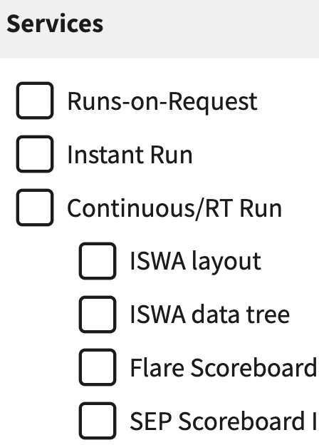
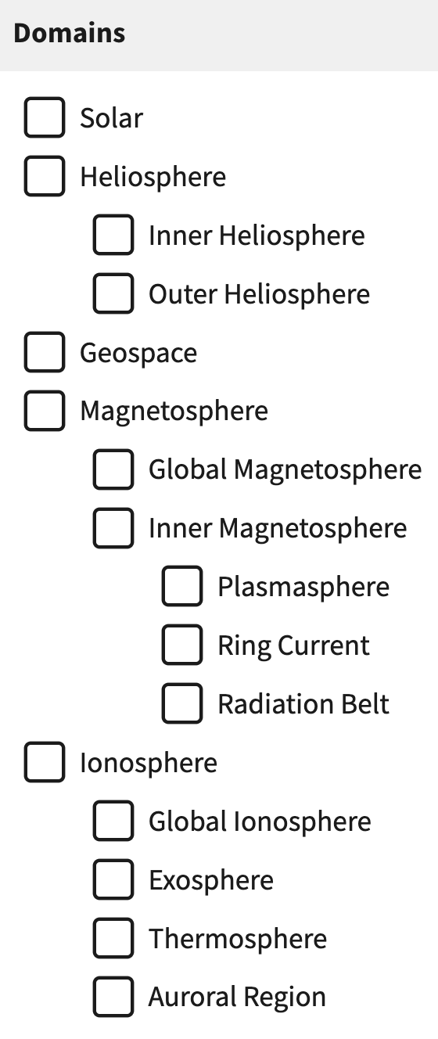
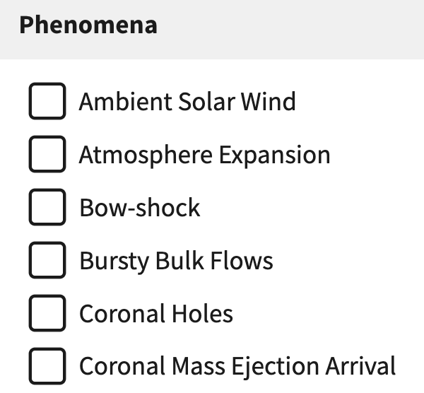
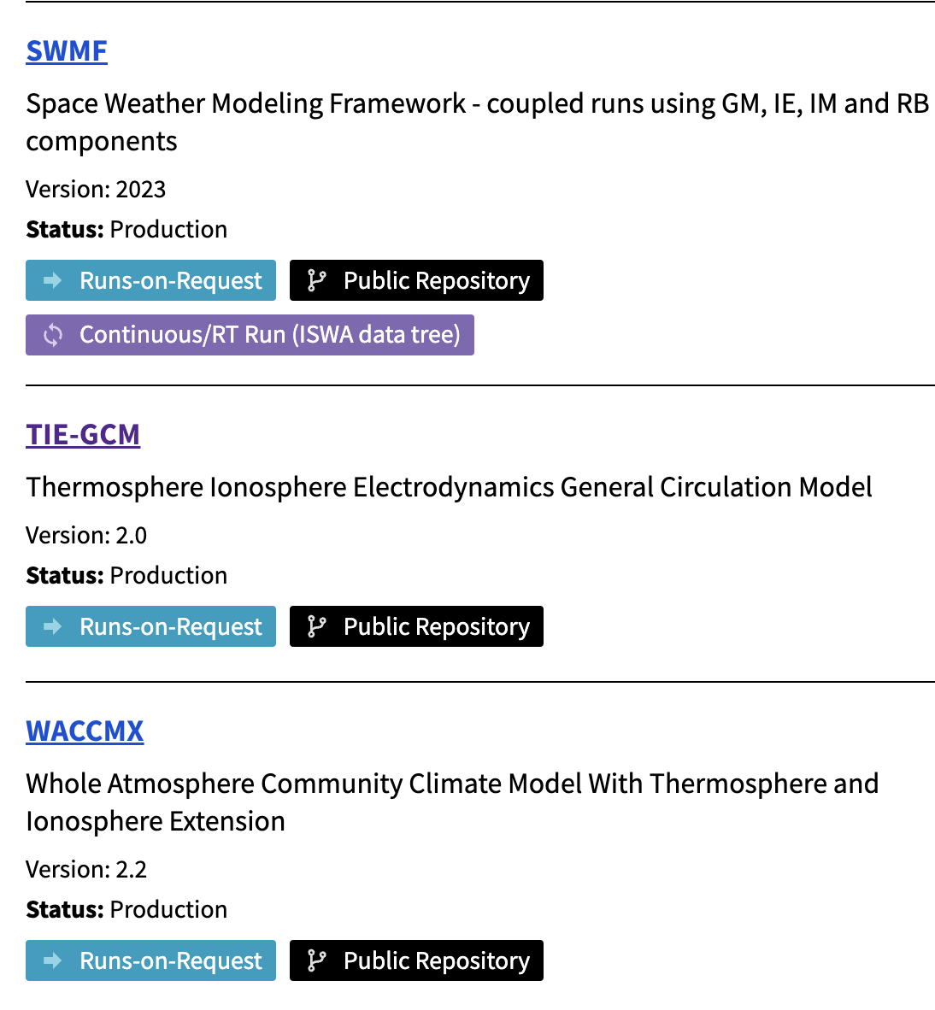
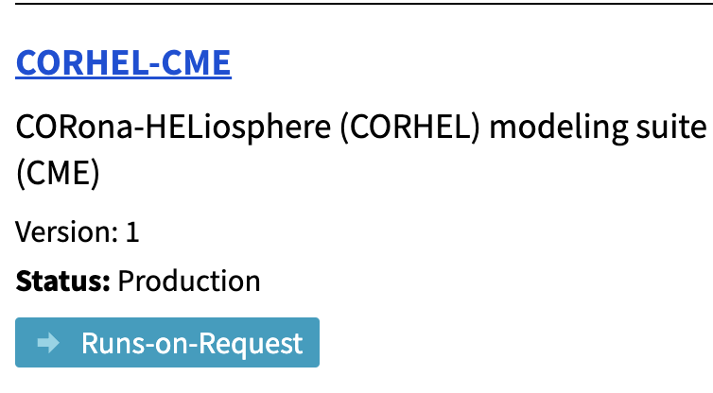
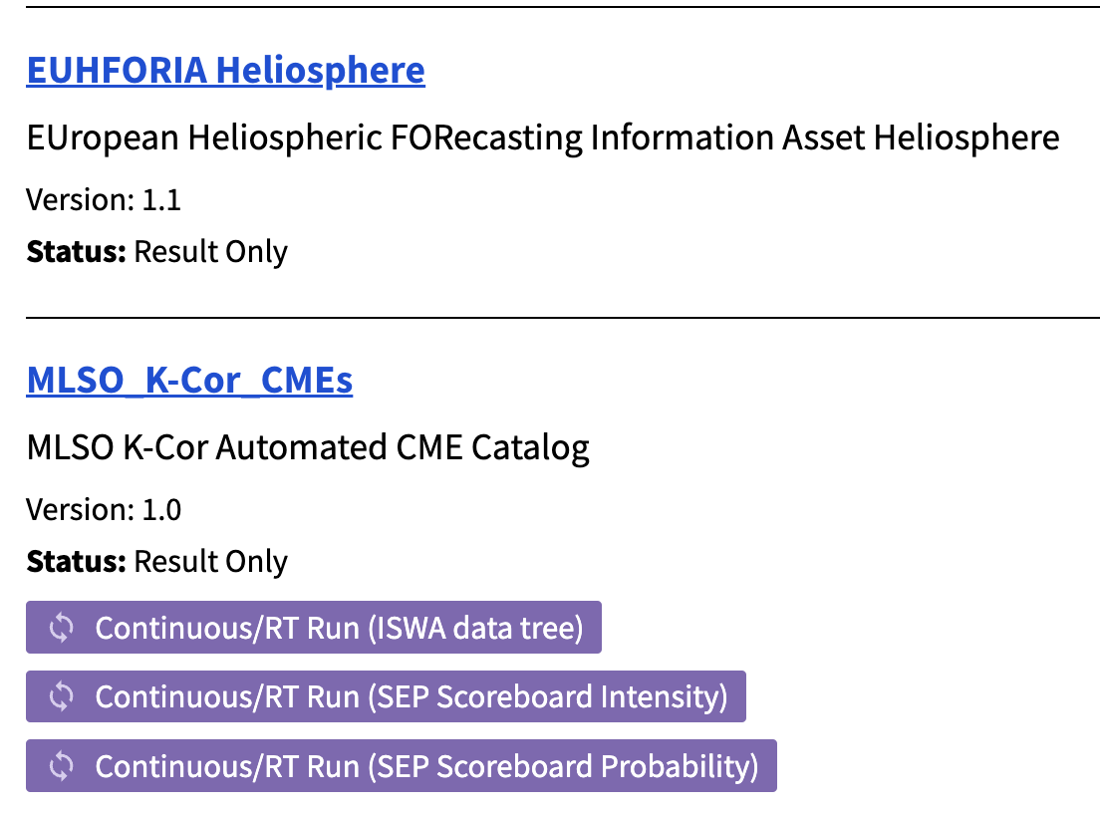
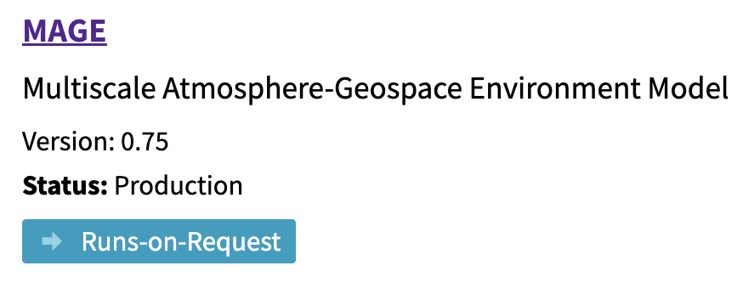
CCMC Model Catalog
includes links to public repositories
Search by …
CCMC Model Catalog

Slide 12
Next generation models, tools and services:
Facilitate innovation: move towards high-quality, high-resolution. Facilitate community access to latest-greatest developments. Go beyond ideal MHD, utilize GPU and other innovative solutions
Developing of next generation tools.
Continue maintaining and evolving highly utilized legacy tools, services and models.

Slide 13
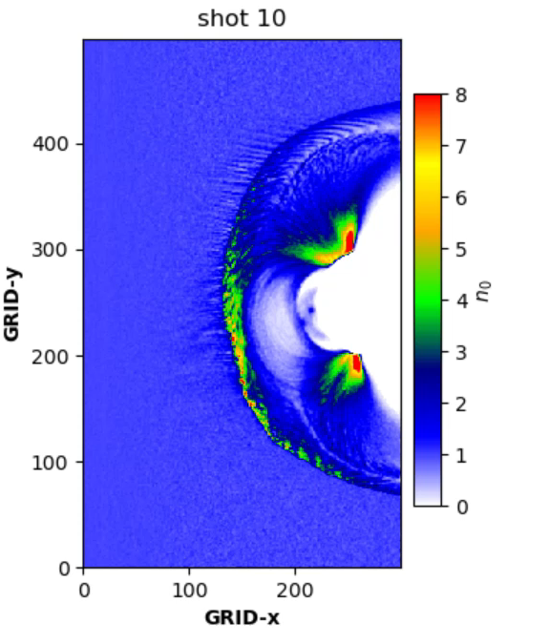
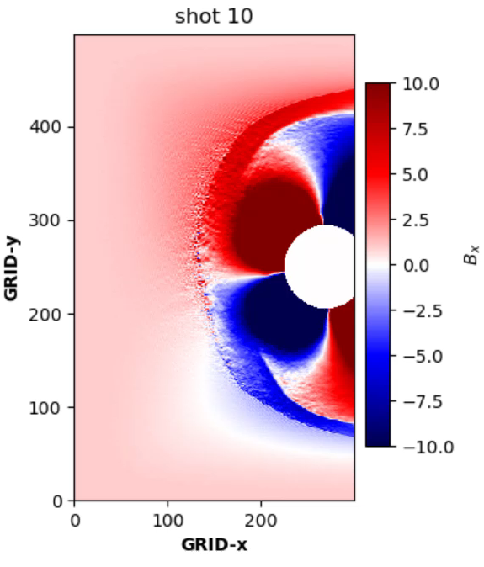
CCMC is Moving Beyond Single-Fluid MHD
Density
Magnetic field (Bx)
Hybrid and particle-in-cell (PIC) approaches enable addressing problems such as
  Reconnection
  waves particle interactions
  particle energization and transport at different regions
Global hybrid models can address turbulence on multiple scales.
Simulations of the solar wind interaction with the Earth’s magnetosphere
with Hybrid Particle Event-Resolving Simulator - HYPERS [Omelchenko]

Slide 14
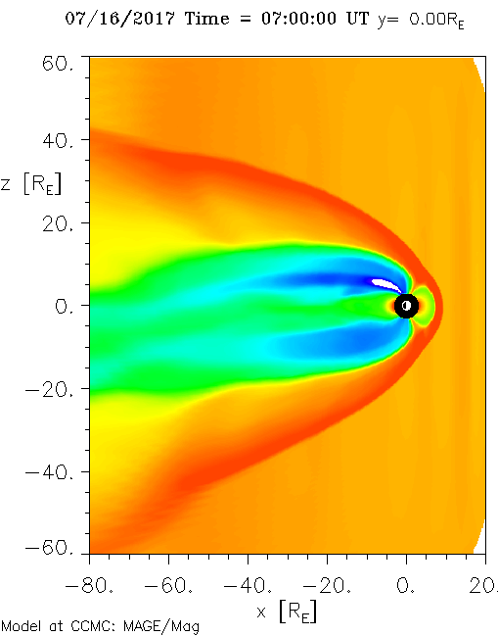
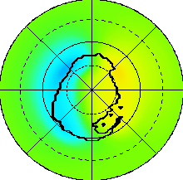
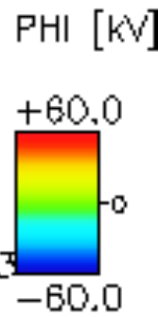
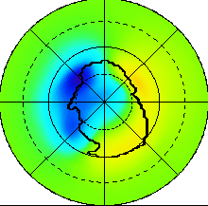

MAGE is the First Deliverable to CCMC from NASA DRIVE Science Center for Geospace Storms (CGS)
Density
As of April 2024, the MAGE is now available to the community through the CCMC Runs-On-Request service
The MAGE model is a comprehensive geospace modeling framework. that includes
coupled GAMERA global magnetosphere,
ReMIX ionosphere electrostatics solver,
RCM ring current.
CCMC scientists and software developers have been working together with the CGS team at the CCMC-CGS collaborative environments on Pleiades and CCMC Cloud
On-going on-boarding of visualization tools developed by CGS.

Slide 15
SWMF/Geospace upgrade and new interface
  The latest SWMF/Geospace implementation for Runs-on-request (V2023) offers preset and custom simulation settings
  Preset options include:
  simulation settings similar to what is utilized in operations at NOAA/SWPC;
  high resolution settings tailored for geomagnetic storm studies by the SWMF team at the U. of Michigan
  Generate runs series for popular phenomena (e.g., geomagnetic storms).
  CCMC is executing run series with pre-set simulation setting for over 100 time periods (starting with recent storms):
  https://kauai.ccmc.gsfc.nasa.gov/CMR/TimeInterval/viewAllTI

Slide 16
SWMF/Geospace new interface for custom runs:
Multiple options for ionosphere conductance
  Ridley Legacy Model (RML) uses an inverse-exponential fitting function derived from assimilative maps to specify auroral conductance based on FAC strength. Conductances are further enhanced in regions of high FACs using an empirical auroral oval [Ridley et al., 2004].
  Conductance Model for Extreme Events (CMEE) is designed for stronger solar wind drivers to improve simulated ground-based magnetic perturbation during extreme events [Mukhopadhyay et al., 2020].
  COnductance Model based on PFISR And SWARM Satellite (COMPASS) utilizes conjugate FACs measured by SWARM and conductance derived from PFISR observations [Wang and Zou, 2022].
  AMPERE-Derived Electrodynamic Parameters of the High Latitude Ionosphere (ADELPHI) utilize a linear relationship between the AMPERE-measured FACs and PFISR derived conductances [Robinson et al., 2020]
Coming soon

Slide 17
SWMF/Geospace new interface: custom runs
setting Inflow boundary location between 24 Re and ~200 Re
selection of solar wing propagation technology from L1 to the inflow boundary
setting inner boundary location at 2.5 Re or 1.25 Re
setting density and temperature at the inner boundary
selection of tailored simulation grids with resolution up to 1/16 Re at the inner boundary
turning on ionosphere outflow based on empirical formula [Strangeway et al, 2005]
setting location of low latitude boundaries for IE solver
doubling spatial resolution in the IE domain
changing type of boundary conditions for magnetic field radial component at the inner boundary: floating (default), reflecting, partially reflecting
selection of resistivity type in the GM domain: numerical only, constant, anomalous
Coming soon

Slide 18
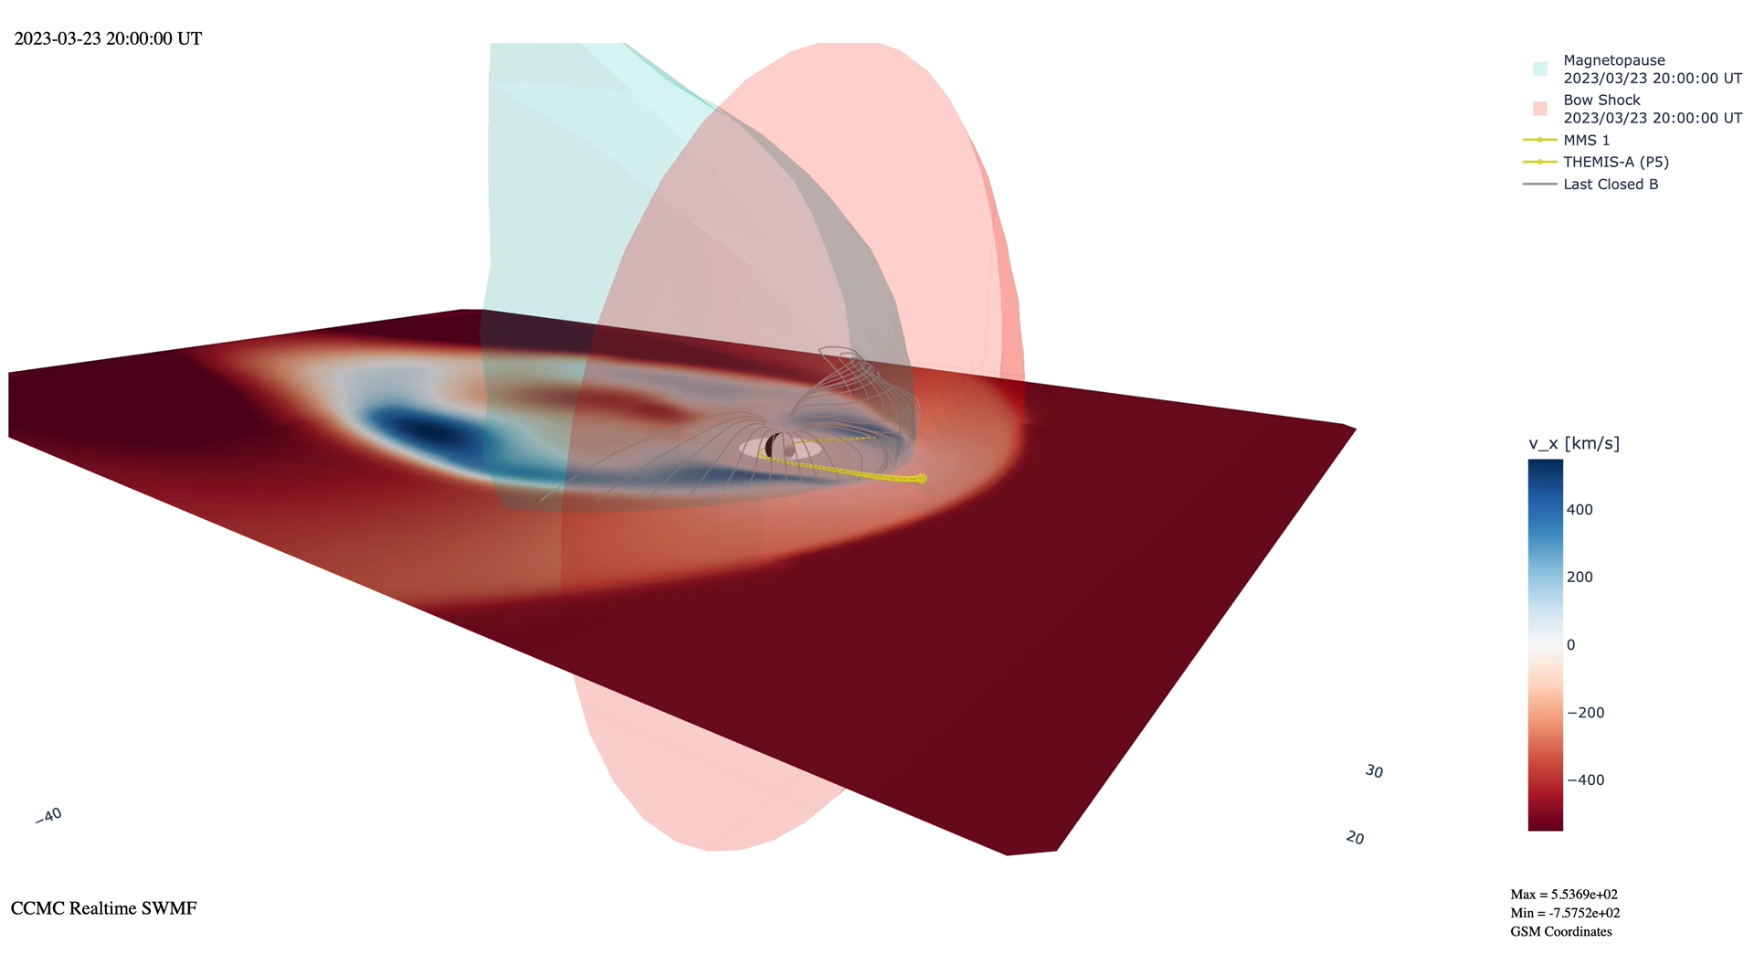
New 3D Visualization
Interactive viewing
  rotate, pan, zoom
Extracted surfaces
  bow shock, magnetopause
Magnetic field line tracing
  last closed
Satellite position overlays
Darren De Zeeuw

