Slide 1
Open Science Opportunities
at NASA
Steve Crawford
Science Data Officer

Slide 2
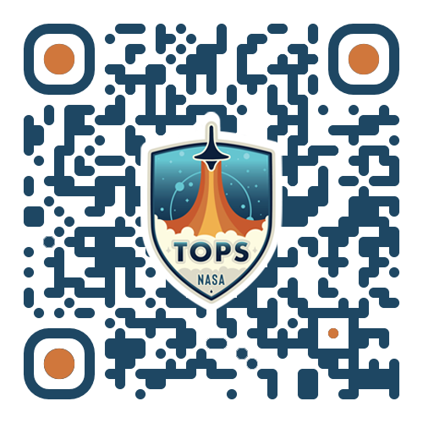
NASA’s Open-Source Science Initiative
NASA's Transform to Open Science (TOPS)
A 5-year mission to accelerate adoption of open science
Goals:
Increase understanding and adoption of open science principles and techniques
Broaden participation by historically excluded communities
Accelerate scientific discovery
Open Science 101
A community-developed introduction to core open science skills
https://nasa.github.io/Transform-to-Open-Science/

Slide 3
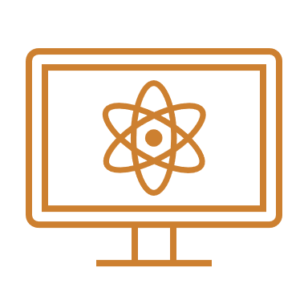
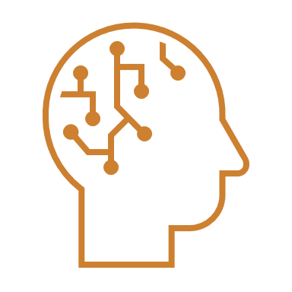
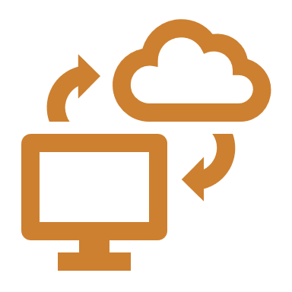
What Open Science Will NASA Fund?
NSPIRES https://nspires.nasaprs.com/
innovative, new ways to support Open Science
workshops,
conferences
Topical Workshops, Symposia, and Conferences
open source
tools
machine learning opportunities
F.14 High Priority Open-Source Science (HPOSS)
Supplement for open science and cloud computing
develop citizen science projects
F.7 Support for Open-Source Tools, Frameworks, and Libraries
F.19 Multidomain Reusable Artificial Intelligence Tools
F.8 Supplemental Open-Source Science Awards*
F.9 Citizen Science Seed Funding Program
* Requires an existing NASA grant or facility.
Bold: No Due Date programs - always open

Slide 4
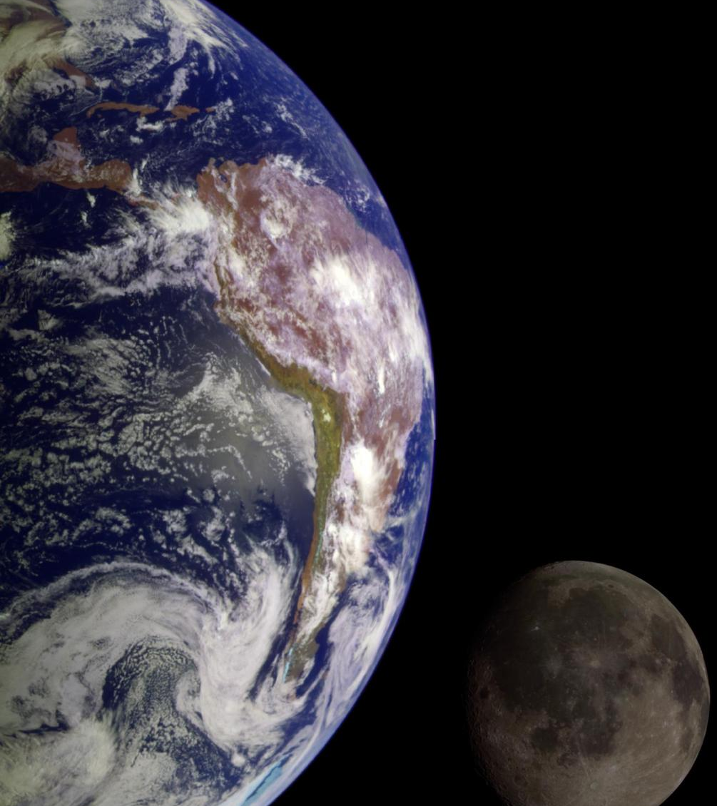
Open Science
is the principle and practice of making research products and processes available to all, while respecting diverse cultures, maintaining security and privacy, and fostering collaborations, reproducibility and equity.
Notes:
But What is Open Science?
Open Science is the principle and practice of making research products and processes available to all, while respecting diverse cultures, maintaining security and privacy, and fostering collaborations, reproducibility and equity.

Slide 5
Open Science and CCMC
CCMC is an Open Science Success Story: It is a great example how to make projects more accessible, reproducible, and reusable!
With the new policy development, we do have questions:
What data of models and simulations are scientifically useful to share and archive?
How does the community adopt open science practices to make their science more accessible, inclusive, and reproducible?
What are the impacts on your community and what do you need to help with adoption of the new policy requirements?

Slide 6
Backup

Slide 7
SCIENCE MISSION DIRECTORATE
ROSES F.7 Open Source Tools, Frameworks, & Libraries
Support for existing open-source software tools, frameworks, and libraries (OSTFL) that have significant usage in the NASA science community.
In ROSES-24, proposals should be one of two types:
Foundational Awards
Open source software tools, frameworks, and/or libraries that have a significant impact on two or more divisions of the SMD. These projects have significant usage by NASA missions, centers, repositories, and/or community.
Cooperative agreements. Up to 5 years.
Sustainment Awards
Open source software tools, frameworks, and/or libraries that have significant impact in one or more divisions of the SMD.
Grants or cooperative agreements. Up to 3 years.
Anticipating 3-5 foundational awards, 8-10 sustainment awards. Total budget ~$4M/year.
Notice of intent (NOI) due date May 3, 2024. Proposal due date June 7, 2024.
NSPIRES page | NASA Open Science Funding Opportunities
Notes:
HPOSS-24 talking points:
HPOSS offers 1 year awards to support innovative work to advance open science practices across SMD
Consistent with past years, HPOSS supports development of new technology to advance the sharing of SMD scientific information.
New in ROSES-24, HPOSS also supports the development of capacity building materials to support the adoption of open science practices (curricula, training materials, tutorials). This effectively absorbs the scope of TOPS-T into HPOSS.
Proposals may include one or both of these areas (technology and/or capacity building materials)
Proposals must explain how work will support the SMD science community and identify the relevant community(-ies). This may be as narrow as a particular disciplinary area represented by SMD or as wide as all SMD science communities.
Chelle and Rachel are the Program Officers and we are here to support you - please reach out.

Slide 8
SCIENCE MISSION DIRECTORATE
ROSES F.8 Supplement for Open-Source Science (SOSS)
Augmentation to existing ROSES awards to make NASA science more accessible, inclusive, and reproducible
Two types of proposals are welcome, both requiring an existing parent award:
Increase the accessibility, inclusivity, and reproducibility of the science from the parent award, and/or contribute back to the open-science communities relevant to the parent award.
Same scope as ROSES-22 SOSS, ~$50k/award
Provide cloud credits to further support or expand the parent award.
New since ROSES-23, $10–15k/award
Awards to support work for one year. Total program budget of ~$400k for ROSES-24.
Proposals will be reviewed on a rolling basis. Apply any time before March 28, 2025.
NSPIRES page | NASA Open Science Funding Opportunities
Notes:
SOSS-24 talking points:
SOSS offers 1 year awards to support increasing the ‘Open Scienceness” of a parent award, or to request cloud credits to be used for a parent award.
The parent award is automatically eligible for SOSS if it is from a ROSES program element. Projects funded by SMD directly through mechanisms other than ROSES at NASA Centers, other government agencies, or JPL may be considered under this program, but proposers should contact the POs prior to submitting to confirm relevancy and/or availability of funds.
The PI of the parent proposal must be part of the SOSS proposal, as either PI or Co-I.
Examples of a SOSS proposal may include:
Converting existing scientific software into modern code.
Publicly releasing a new software package, with appropriate documentation, from previously closed source software.
Making data produced or used in the parent award openly available and analysis-ready.
Writing tutorials for techniques, code, and/or data resulting from the parent award that increase the accessibility or usability of the results.
Contributing new functionality or optimizations developed through the parent award to community software packages (e.g., Numpy, Astropy).
Requests for Amazon Web Services (AWS) credits to support activities from the parent award, or to provide cloud services for a workshop or hackathon supporting Open Science.
Steve Crawford, Elena Steponaitis and J.L. Galache are the Program Officers.

Slide 9
SCIENCE MISSION DIRECTORATE
ROSES F.14 High Priority Open-Source Science (HPOSS)
Supporting innovative work to make NASA science more accessible, inclusive, and reproducible
In ROSES-24, two types of proposals are welcome:
Development of new technology to support open-source science, including tools, data formats, software, frameworks, or libraries.
Same scope as ROSES-22/23 HPOSS
Development of capacity building materials to advance open science adoption, including curricula, tutorials, or other training materials
New in ROSES-24; absorbs previously solicited TOPS-T
Awards of ~$100k to support work for one year. Total budget of ~$1.2 M for ROSES-24.
Proposals will be reviewed on a rolling basis. Apply any time before March 28, 2025.
NSPIRES page | NASA Open Science Funding Opportunities
Notes:
HPOSS-24 talking points:
HPOSS offers 1 year awards to support innovative work to advance open science practices across SMD
Consistent with past years, HPOSS supports development of new technology to advance the sharing of SMD scientific information.
New in ROSES-24, HPOSS also supports the development of capacity building materials to support the adoption of open science practices (curricula, training materials, tutorials). This effectively absorbs the scope of TOPS-T into HPOSS.
Proposals may include one or both of these areas (technology and/or capacity building materials)
Proposals must explain how work will support the SMD science community and identify the relevant community(-ies). This may be as narrow as a particular disciplinary area represented by SMD or as wide as all SMD science communities.
Chelle and Rachel are the Program Officers and we are here to support you - please reach out.

