Slide 1
HAPI Overview
HAPI = Heliophysics Application Programmer’s Interface
Jon Vandegriff for the HAPI Specification Team
Robert Weigel, Jeremy Faden, Sandy Antunes, Bernard Harris, Robert Candey, Aaron Roberts, Eric Grimes

Slide 2
What is HAPI?

Slide 3
What does HAPI enable?
It greatly simplifies the data access problem for time series data.
Where is the data?
What specific files do I need for my study?
What format?
What arrangement within that format?
How is time represented in the files?
No science in these answers!
Time consuming to find out!
HAPI offers interoperability.
The same, exact access mechanism (same code) for reading any time series data.
No longer need to care about formats, files, and data arrangements.
The data you want, shows up inside your own application in data structures
that you recognize.
Impedance matching of diverse data sources to scientists workflows.

Slide 4

How does HAPI simplify access?
Establish a common interface that ALL providers of time series data can implement.
users
Lowest Common Denominator
re-usable software
other providers
custom software
HAPI requests are
very, very simple:
dataset name
start time
end time
list of parameters (optional)
HAPI
HAPI
HAPI
custom
data
interface
HAPI
(standard
data
interface)
data provider

Slide 5
Reference page: Where to find more info
http://hapi-server.org
  one-page summary, video intro, links to Github repos, mailing lists, etc
R. Weigel et al, HAPI: An API Standard for Accessing Heliophysics Time Series Data
  JGR Space Physics: https://doi.org/10.1029/2021JA029534
The HAPI Specification
  Version 3.0 https://doi.org/10.5281/zenodo.4757597
  The development location for the latest spec and drafts and open issues, etc:
  https://github.com/hapi-server/data-specification
Lots of other HAPI projects:
  https://github.com/hapi-server
Try it out with this interactive way to explore known HAPI servers!
  http://hapi-server.org/servers/
Tutorial Notebooks for using HAPI in Python:
  https://github.com/heliophysicsPy/summer-school/tree/main/hapi-tutorial

Slide 6

What data is available now with HAPI?
Institution | Server | Type of Data | Number of Datasets
 | CDAWeb | Heliophyhsics | 2800
 | SSCWeb | Ephemeris | 250
 | CCMC | Space Weather | 250
 | AMDA | Heliophysics and Planetary Data and Ephemeris | 500
University of Iowa | DAs2 Server | Helio. & Planetary | 30
 | LISIRD | Solar Irradiance | 40
SWARM Mission | ViRES Data Server | Space Mag Data | 14
Note: Both European and US buy-in.

Slide 7
Coming soon
Institution | Server | Type of Data | Number of Datasets
 | ESAC | Heliophyhsics | 2073
JHU / APL | SuperMAG | global ground mag | ~500
JHU / APL | TIMED / GUVI | ionospheric images | ~10
Eventually
 | PDS PPI Node | Planetary Plasma, Particle, and Fields | ~1000
CEDAR / NSF | Madrigal | Space Weather | 1000+ (??)
Note: Heliophysics, Planetary Science, Geospace.

Slide 8
How to access HAPI data?
1. ready-made analysis tools
3. Explore what HAPI data is available
SPEDAS / PySPEDAS
http://spedas.org
Autoplot
http://autoplot.org
http://hapi-server.org/servers/
This site can generate a script stub for grabbing data:
from hapiclient import hapi
from hapiplot import hapiplot
server = 'https://cdaweb.gsfc.nasa.gov/hapi'
dataset = 'AC_K1_SWE'
parameters = 'Vp'
start = '2017-07-01T00:00:00Z'
stop = '2017-07-03T00:00:00.000Z'
data, meta = hapi(server,dataset,parameters,start,stop)
hapiplot(data, meta)
2. write your own code using libraries
that read HAPI data
Python, Matlab, IDL, R, Java
https://github.com/hapi-server

Slide 9
Why should I care?
Simplified access to time series data, and …

Slide 10
If you are a data provider
You can expose your data to many users through a standard API with very little effort.
(Most users nowadays want a computer API to access data.)
Approach:
Read the HAPI spec
Join the hapi-dev@groups.io mailing list
Choose an existing HAPI servers to put on top of your data (Python or Java or node.js)
--OR—
Adapt your current data interface to emit HAPI responses.
Test your server using the online HAPI server checking tool (verifies compliance with HAPI spec)
Issue a pull request to add your tested server to the official list of HAPI servers.
https://github.com/hapi-server/servers

Slide 11
If you want to do machine learning with Heliophysics data
You can get to many different datasets with a single API.
Approach:
See if the data you want is available via HAPI
Look for a HAPI reader library in your favorite language.
Write one piece of code to grab data from different places and recast it into your ML-ready content.

Slide 12
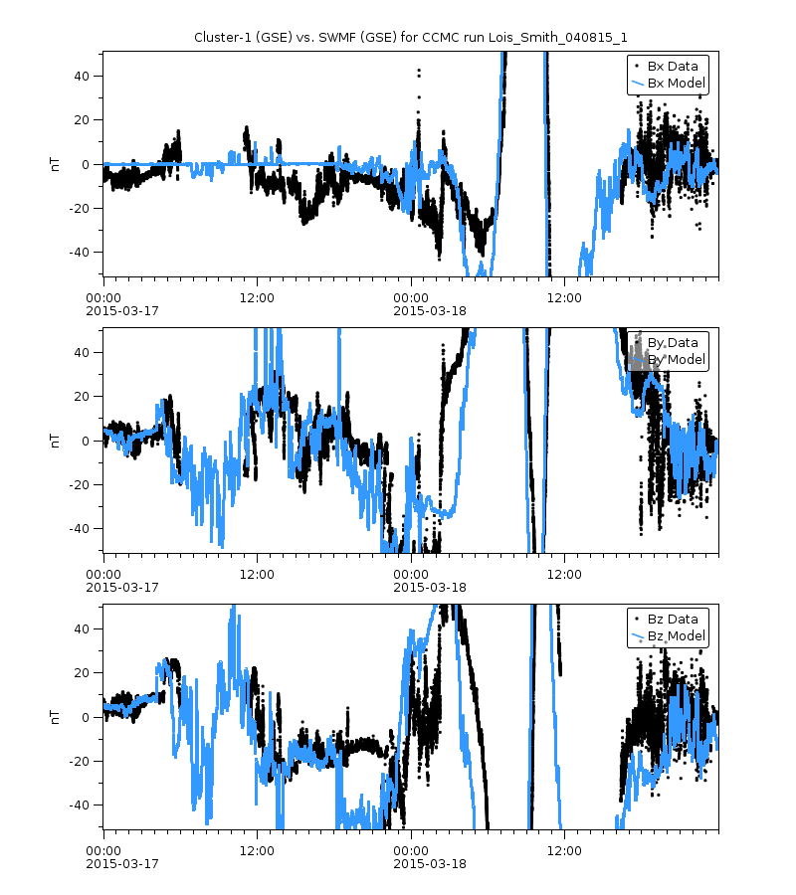
CCMC example: Data-Model Comparisons
Steps:
Use model data from SWMF.
Get Cluster-1 ephemeris from SSCWeb HAPI server.
Fly the Cluster-1 trajectory through the model output to get mag data along this trajectory
Get Cluster-1 mag data from CDAWeb HAPI server.
This example is from the CCMC web page:
https://ccmc.gsfc.nasa.gov/ungrouped/GM_IM/GM_analysis.php?Pid=12870&Pt=BO&Ps=Cluster-1
Work is by Darren De Zeeuw.

Slide 13
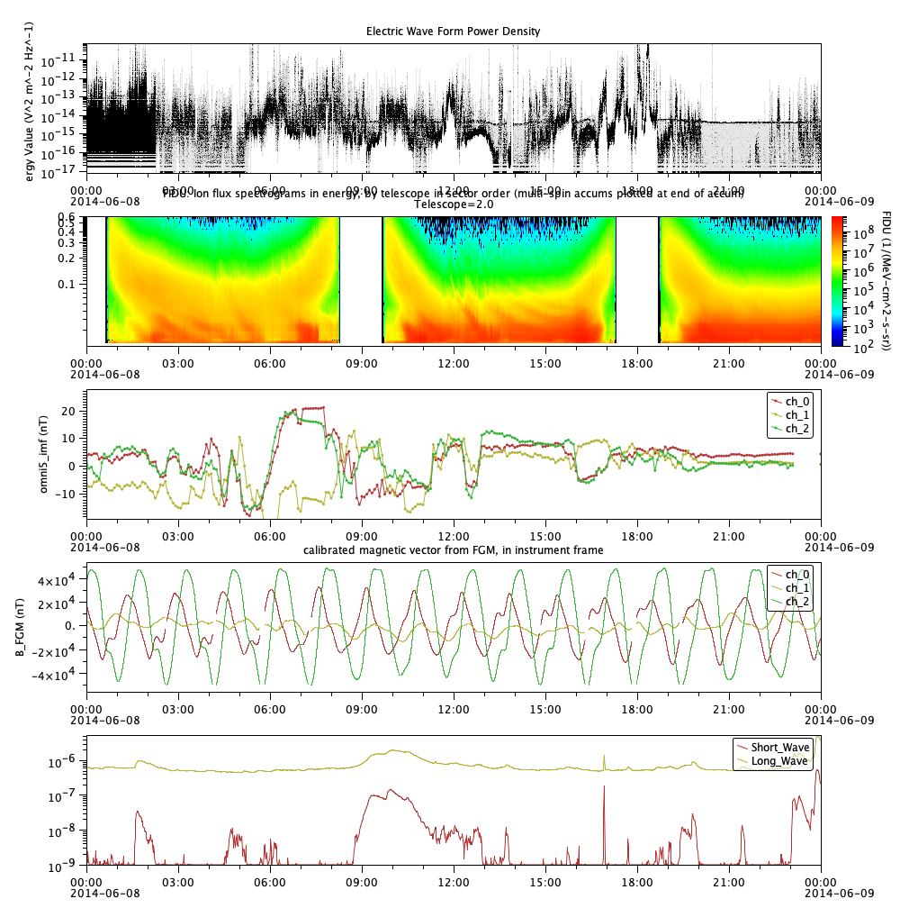
Not just line plots: higher dimensional data is supported by HAPI
2014-06-08
ESAC HAPI Server
Cluster-3 Electric Wave Form Power Density
CDAWeb HAPI Server
Van Allen Probes, RBSPICE Ion Energy Spectrogram
AMDA HAPI Server
Omni MAG data
ViRES HAPI Server
GRACE-A MAG Data
CCMC ISWAT HAPI Server
GOES X-ray flux

Slide 14
Future Plans
explore the use of HAPI for some kinds of model output
use HAPI in cloud-based analysis (data in the cloud and analysis in the cloud)
  working with HelioCloud effort – an emerging cloud-based analysis platform in Heliophysics.
promulgation: help more data centers deploy HAPI
more client tools that can read HAPI
easier on-ramp for smaller data providers

Slide 15
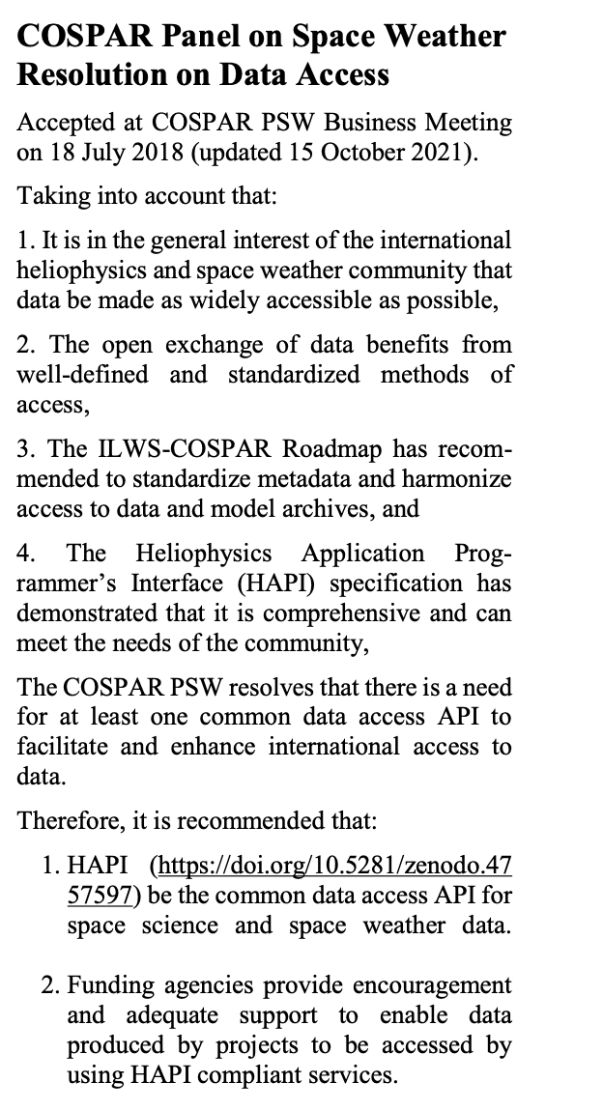
HAPI is a COSPAR endorsed standard for Space Weather data access

Slide 16
hapi-help@groups.io
hapi-server.org

Slide 17
Backup

Slide 18
The request interface: 5 HAPI Endpoints
All endpoints must be directly below a URL that ends with ‘hapi’
http://example.com/hapi/about
http://example.com/hapi/capabilities
    describes owner and options implemented by the server
http://example.com/hapi/catalog
    list of datasets at the server
http://example.com/hapi/info
    show metadata for one dataset at a time (basically a data header)
http://example.com/hapi/data
    retrieve a stream of data content for one dataset over a specific time range

Slide 19
The response data from a HAPI server
catalog (lists the datasets available) is JSON
info (metadata for each dataset as a list of variables with types, dimensions, fill values, "bins" for spectral data) is also JSON
data returns digital content as a stream of numbers
  CSV is a required format
  JSON (optional)
  binary (optional)
Key standardizations in the data include a common format for the time values (ISO 8601 strings)

