Slide 1
Space Physics Data Facility (SPDF) and Our Collaboration with CCMC
Lan Jian, Robert Candey, Tamara Kovalick,
and the SPDF Team
NASA Goddard Space Flight Center, Greenbelt, MD
CCMC Workshop June 10, 2022
The Hotel at University of Maryland, College Park, MD
Notes:
About 25 people, some of them work part time for SPDF.

Slide 2
Introduction to SPDF
spdf.gsfc.nasa.gov
SPDF is the active and final archive of non-solar data from NASA heliophysics missions and collaborative missions with other US and foreign agencies
Facilitate scientific analysis of multi-instrument and multi-mission data sets
Enhance the science return of many missions, providing context with other missions
Facilitate open science and long-term archiving
Make data available via many access methods (HTTP, FTP, REST, HAPI)
We also archive other data relevant to NASA heliophysics science objectives
Related data from planetary missions, such as MAVEN, New Horizons
Heliophysics data from some NOAA and DoD satellites, such as GOES, DSCOVR, LANL
Non-US missions such as Arase and Formosat upon request
Ground-based magnetometers, aurora cameras, radars, etc., which are funded by NSF or other agencies
We work closely with missions (some since their early development) on data issues and planning, particularly in implementing ISTP data standards
Notes:
SPDF archives non-solar measurements from throughout the solar system and now interstellar space, and makes them available through various search and display services.
The data at SPDF covers the space from the Sun to the local interstellar medium, including magnetosphere, ionosphere, thermosphere, and mesosphere (M-ITM) of Earth and other applicable planets

Slide 3
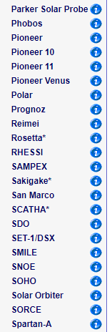
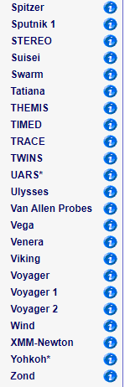
Over 200 Missions/Projects Supported by SPDF
* Only orbit data available
Total: ~3000 data sets, ~40 million data files, ~400 TB data
Recent average monthly data ingestion rate: ~0.6 million data files, ~14 TB data
Notes:
from missions and >120 Ground-Based investigations
Data from 90+ missions include some display/list services, ~175 Ground Stations and ~35 Balloons
SSCWeb/4D Orbit Viewer ephemeris DB ~180 missions
Number of datasets ~1500; distinct variables (CDAWeb) ~36,000
Total number of files archived ~40 M
including both new and reprocessed data

Slide 4
Science-Enabling Services Provided by SPDF
Coordinated Data Analysis Web (CDAWeb)
Primary SPDF data service for mission data
Present data set view rather than individual data files
List, plot, subset, and download data in CDF or ASCII format
Satellite Situation Center (SSCWeb)
List and plot the orbits of multiple s/c in a variety of coordinate systems
Query for satellite-satellite and satellite-ground station conjunction.
Include most heliospheric satellites and many ground stations.
4D Orbit Viewer: Interactive 4D animation of orbits
OMNI Web and COHO Web
Magnetic field, solar wind plasma, and energetic particle data in various locations of the heliosphere, especially the OMNI data mapped to Earth’s bow shock
Interface for plotting, filtering, and downloading the data

Slide 5
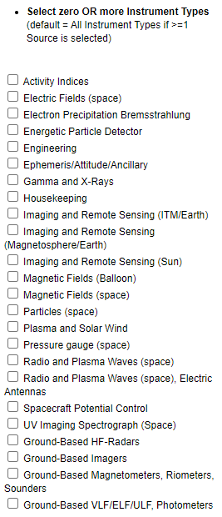
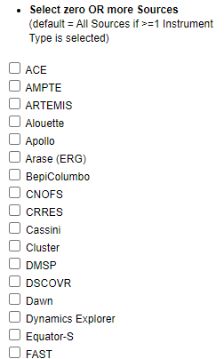
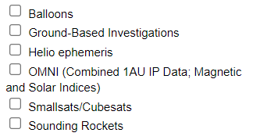
1. Coordinated Data Analysis Web (CDAWeb)
https://cdaweb.gsfc.nasa.gov/
~80 Missions/Sources
Enable multi-mission, multi-instrument science
Present data set view rather than individual data files
List, plot, and correlate data
Download full or a subset of data in CDF or ASCII format
…

Slide 6
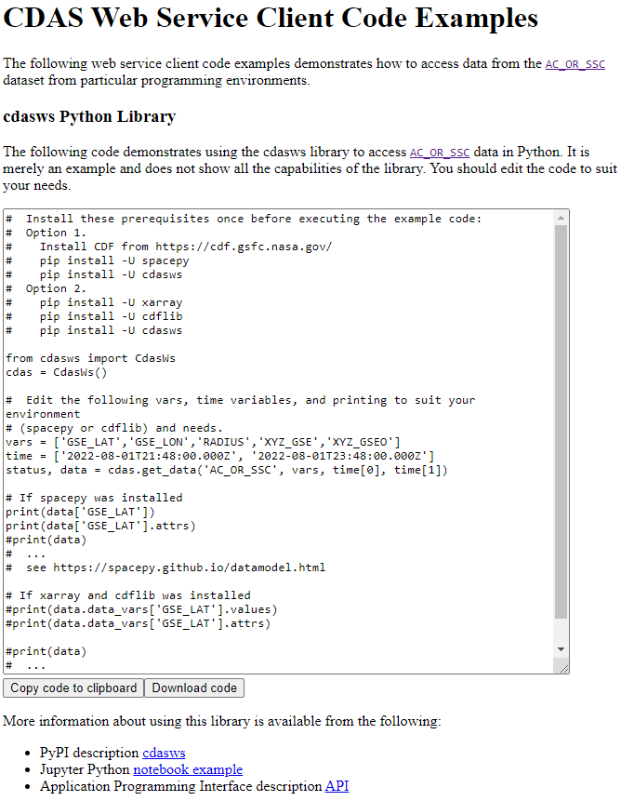
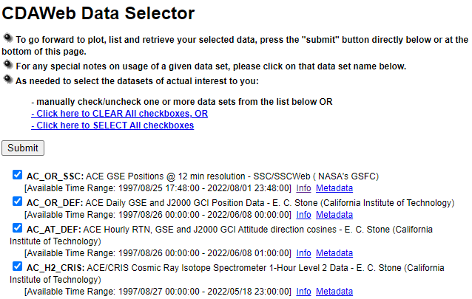
Link to SPASE (Space Physics Archive Search and Extract) Record, main description
CDA Web Service Client Codes for Python and IDL
Notes:
CDAS: CDA System

Slide 7
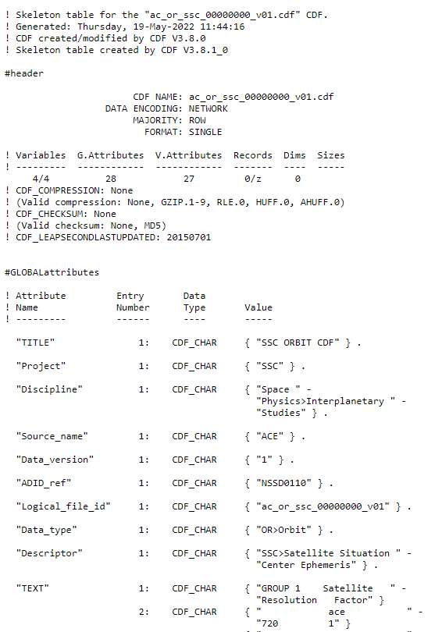
Metadata → Skeleton Table
Global & Variable Attributes

Slide 8
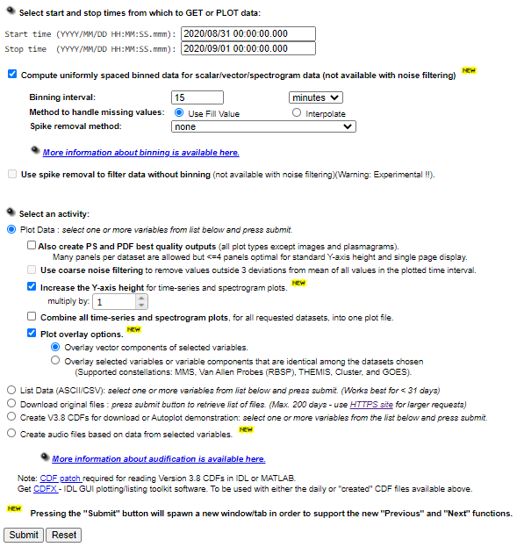
CDAWeb Data Explorer
Automatically set as the last available day of the selected datasets
Options:
bin averaging, spike removal, noise filtering, overlay plotting, audification, animation
Notes:
Interface: Simplicity and Multiple Missions

Slide 9
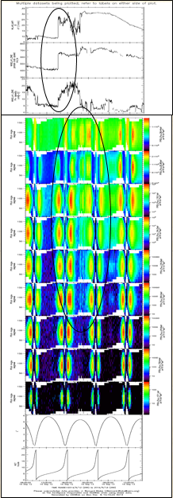
Example Plots from CDAWeb
CDAWeb has the internal capability to apply filters (quality flags) and display data graphically in different ways depending on variable dimensionality
WIND MFI & SWE
Van Allen Probe A ECT & MagEIS
GPS International GNSS Service Total Electron Content
TIMED/TIDI Wind Vectors Movie
Transverse Mercator Projection
Notes:
SPDF provides three main science-enabling services besides archiving and sharing data: CDAWeb, SSCweb and OMNIweb. The CDAWeb data browsing system makes it easy to display data quickly and download desired parameters and time ranges across missions, and provides many display and listing formats, including audification.
CDAWeb has the internal capability to apply filters (quality flags) and display data graphically in several ways depending on variable dimensionality. Like by default, a scalar (1-d w/ time) variable is displayed as a time_series plot, a 1-d (2-d w/ time) variable is displayed as a spectrogram, a 2-d (3-d, w/ time) array is displayed as an image. But if location data, geographic lat/long, is available, we can also display the same data as mapped plots.

Slide 10
Additional Resources at CDAWeb
Part of the Inventory Plot for Parker Solar Probe (PSP) Data in 2019
At CDAWeb, the inventory plots are available for every mission and they are updated daily.
There are also usage statistics for all the data sets.

Slide 11
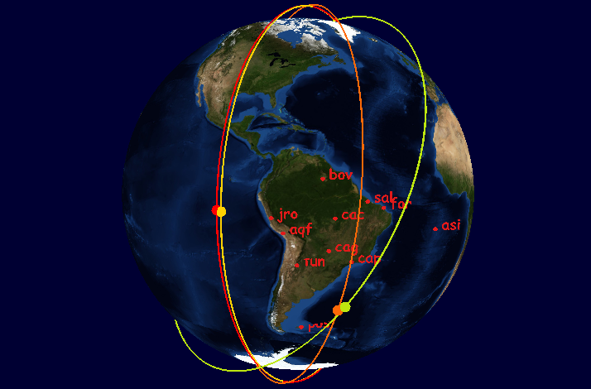
2. Satellite Situation Center (SSCWeb)
Upgrade Is Coming !
Include most heliospheric satellites and many ground stations
List and plot orbits of multiple s/c in a variety of coordinate systems
4D Orbit Viewer: Interactive 4D animation of orbits
Query for satellite-satellite and satellite-ground station conjunctions
Simulated ICON+SWARM coverage in GOLD FOV
Extended Orbit Predicts : August 2021
Notes:
4D Orbit Viewer uses SSCWeb application programming interface (API) to access s/c database
SSCWeb also computes radial and magnetic field line conjunctions between satellites and ground stations

Slide 12
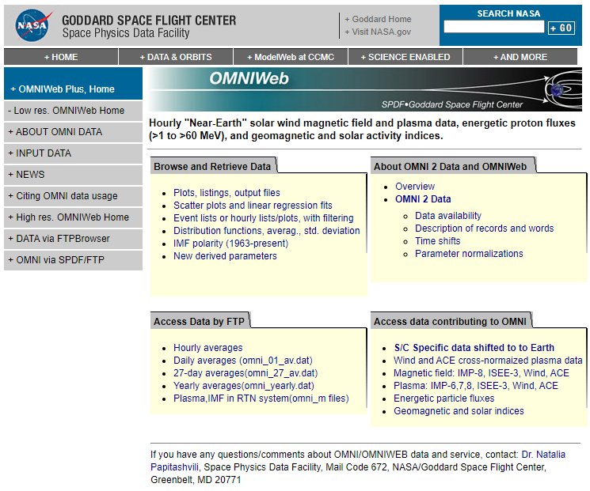
3. OMNI Web
https://omniweb.gsfc.nasa.gov/
Database of plasma and magnetic field from selected or combined L1 s/c mapped to the nose of the Earth’s bow shock
Based on a large volume of quality-controlled satellite measurements (since Nov. 1963)
OMNI: 1-min, 5-min
OMNI 2: hourly, daily, 27-day, yearly
Some statistical functions: scatter plots, linear regression, etc.

Slide 13
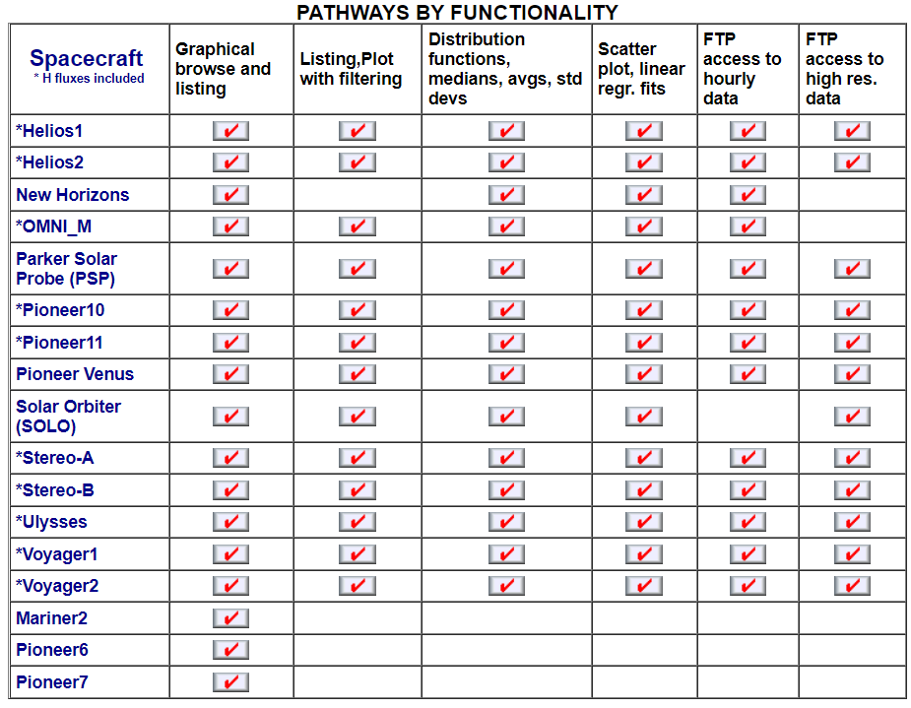
COHO Web (https://omniweb.gsfc.nasa.gov/coho/)
Hourly and daily merged plasma, magnetic field, proton fluxes and ephemerides data at various locations of the heliosphere
Useful to provide model input and to validate models
We can (urge the mission teams to) develop median-cadence data (e.g., 10-min for interplanetary space) of these parameters if needed
Contact: Natalia Papitashvili

Slide 14
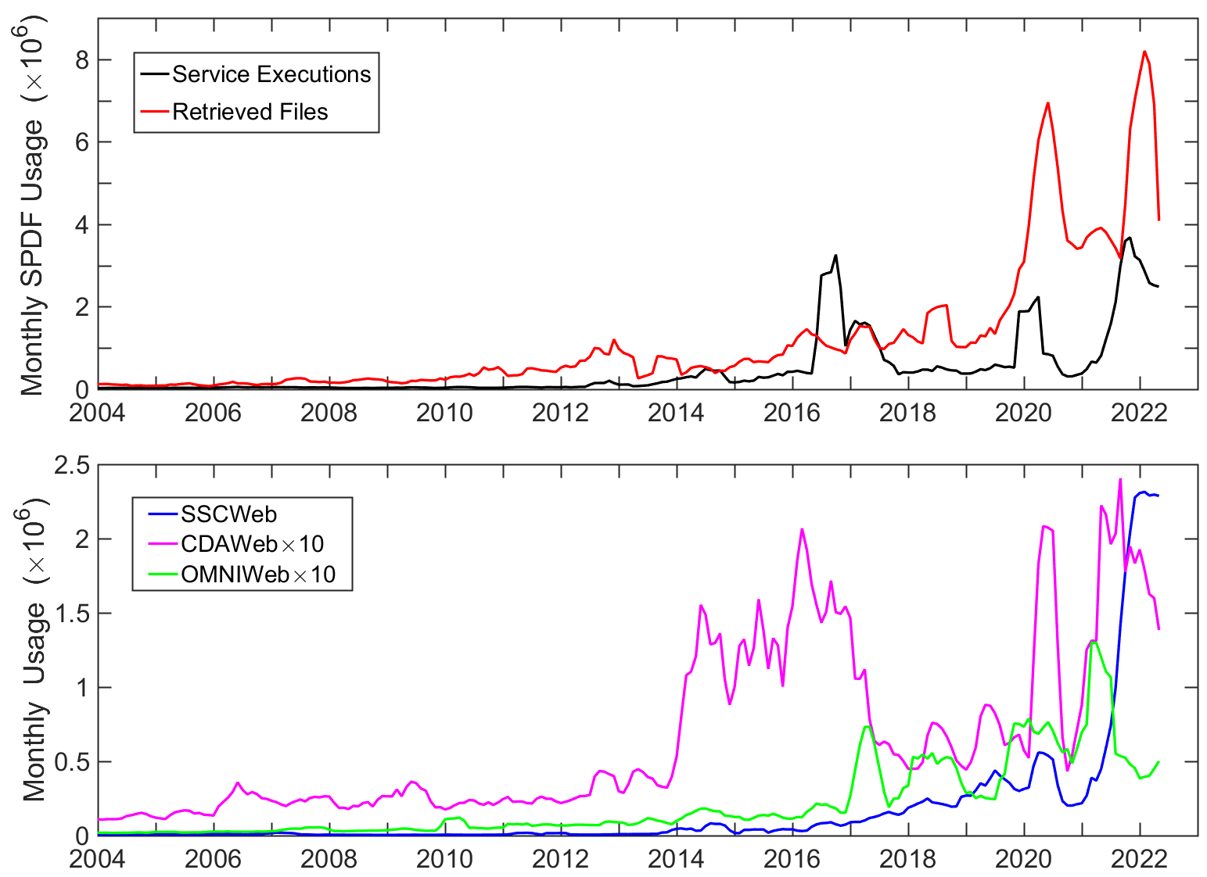
Extensive Use of SPDF Data & Services
Significant increase of SSCWeb usage since 2021 is probably related to CCMC and other users for model-observation comparison
In 2021, ~40% of papers in AGU’s JGR Space Physics and Space Weather journals acknowledged SPDF services and/or data
Notes:
14

Slide 15
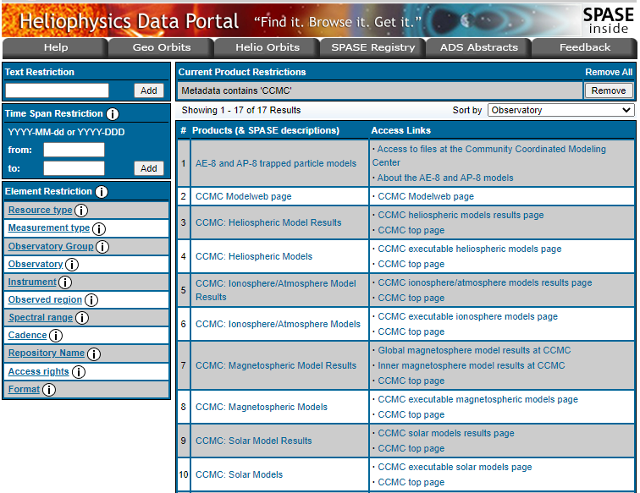
Heliophysics Data Portal (HDP)
https://heliophysicsdata.gsfc.nasa.gov/ ~3000 products
Products available at HDP
remote-sensing data
in-situ data
some CCMC models (17)
Catalogs (17)
Data authorities are defined in SPASE to track data provenance
SPASE metadata is used by HDP, and enables the search by data services
DOIs have been minted through datacite.org for ~360 data products for easy citation and tracking

Slide 16
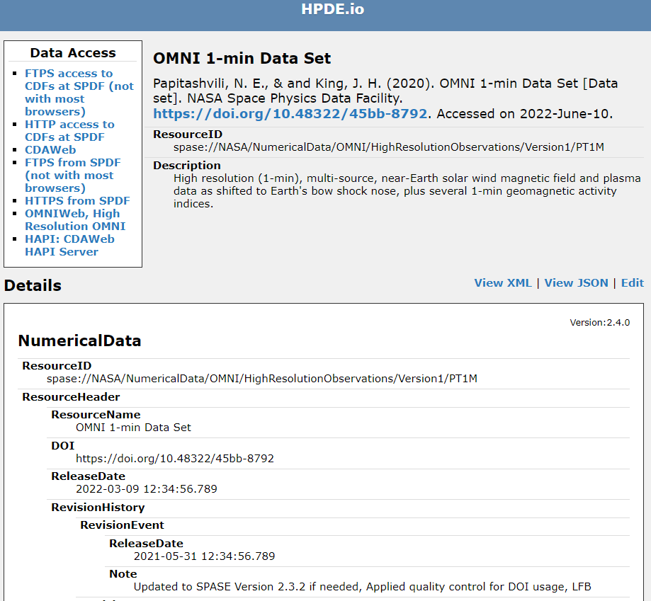
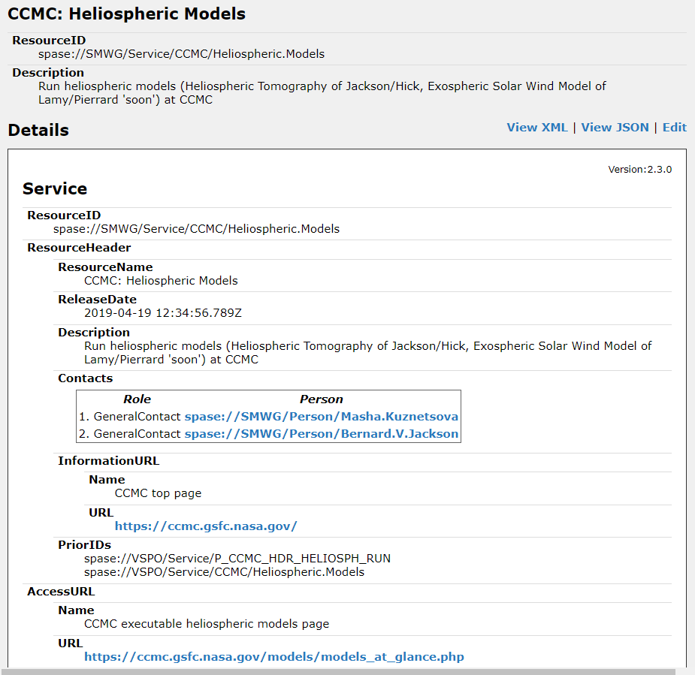
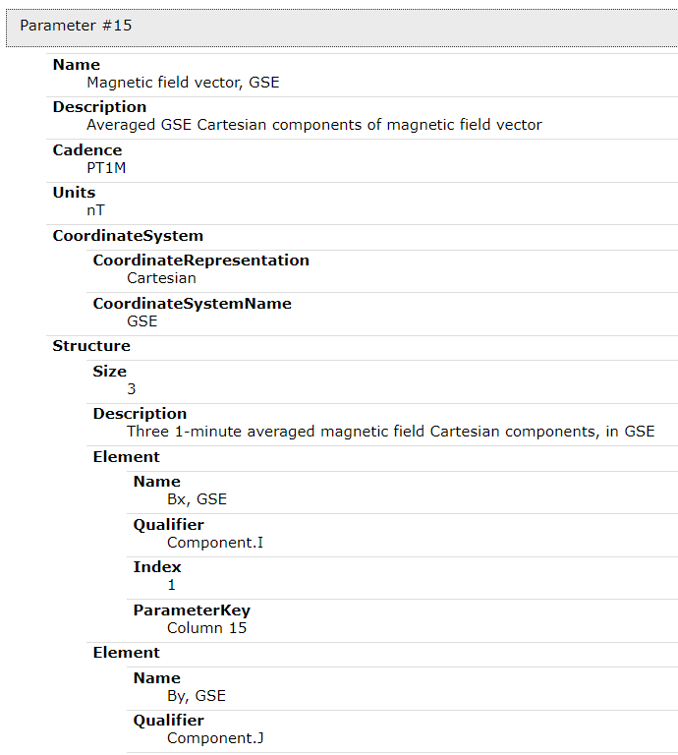
Examples of SPASE Records

Slide 17
Summary
As a critical element of HDRL, SPDF archives and serves non-solar data relevant to NASA heliophysics science objectives
Providing multi-project, cross-disciplinary access to data in order to promote correlative and collaborative research across discipline and mission boundaries
Maintaining the CDF self-describing science data format and associated software
Providing three main science-enabling services: CDAWeb, SSCWeb, and OMNIWeb
Tracking the usage of archived data and assisting mission data management
Collaboration with CCMC
Archiving and service of mission data based on observations and model simulations, e.g., ICON Level 4 TIEGCM data
Archiving and service of data products from NASA Research & Analysis programs
Developing observational data products tailored for model input and model validation
Upgrading SPDF webpages with new content management system by learning from CCMC’s experience
Developing the service for event lists which can be useful for CCMC model request and validation

