Slide 1


CCMC Collaboration with the Heliophysics
Digital Resource Library (HDRL)
CCMC Workshop, 10 June 2022
D Aaron Roberts
Code 672, NASA Goddard Space Flight Center
GSFC Project Scientists: SDAC – Jack Ireland
SPDF – Robert Candey, Lan Jian
HDRL – Aaron Roberts, Brian Thomas
Project Manager: HDRL – Tressa Helvey-Kasulke

Slide 2
Heliophysics Metadata: Observations and Simulations/Models
A Data Model (DM = “standard terminology and syntax”) facilitates data discovery and access
SPASE (COSPAR standard) terminology has unified observational data search and description
The EU IMPEx project generalized the SPASE DM to cover Models and Model Output: “The purpose of this project is to create an interface between planetary simulation databases and online data processing tools hosted in different institutes.”
CCMC has adopted the extended SPASE DM for the description of its models. Onboarding now requires a SPASE description
Further work is needed to truly unite the observational and simulation frameworks, enabling, e.g. search for model output and observations with the same query.
Notes:
If the information is needed, in FY22 SDAC is supporting 24 people (warm bodies), split as 1 CS FTE and 11.1 WYE across all funding vehicles.

Slide 3
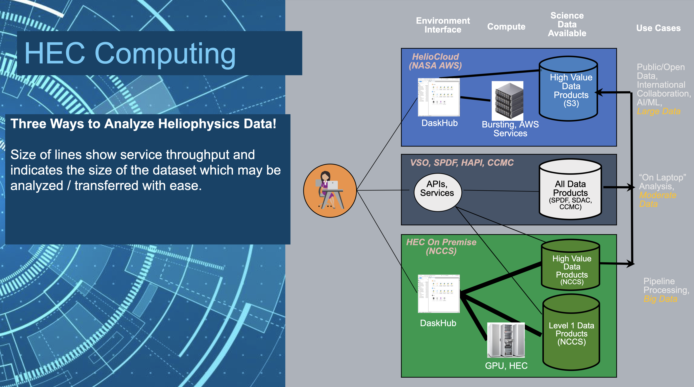
Sharing Resources in HelioCloud

Slide 4
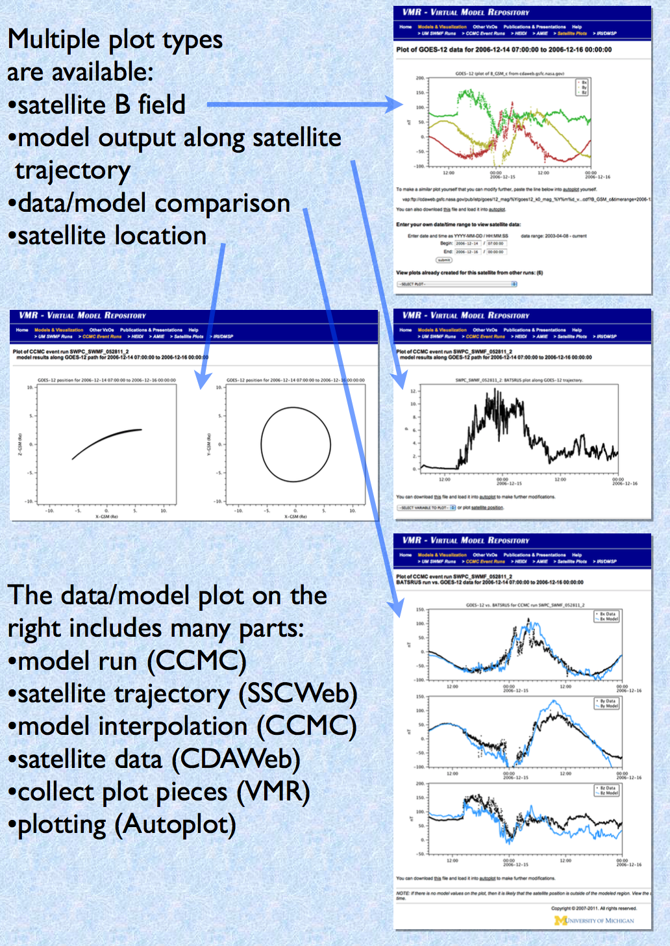
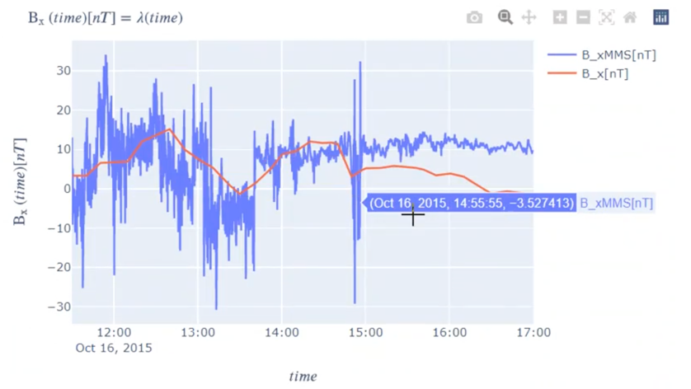
Data-Model Comparisons and Visualization
Notes:
If the information is needed, in FY22 SDAC is supporting 24 people (warm bodies), split as 1 CS FTE and 11.1 WYE across all funding vehicles.

Slide 5
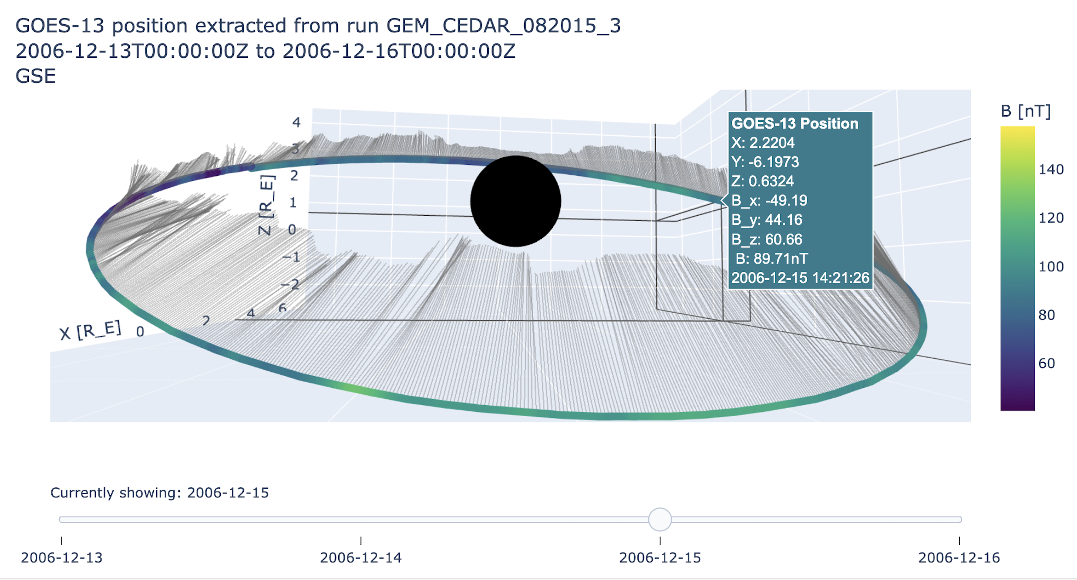
Kamodo enabled observations on a path/orbit
Notes:
If the information is needed, in FY22 SDAC is supporting 24 people (warm bodies), split as 1 CS FTE and 11.1 WYE across all funding vehicles.

Slide 6
ViSBARD: A prototype of future visualization tools

Slide 7
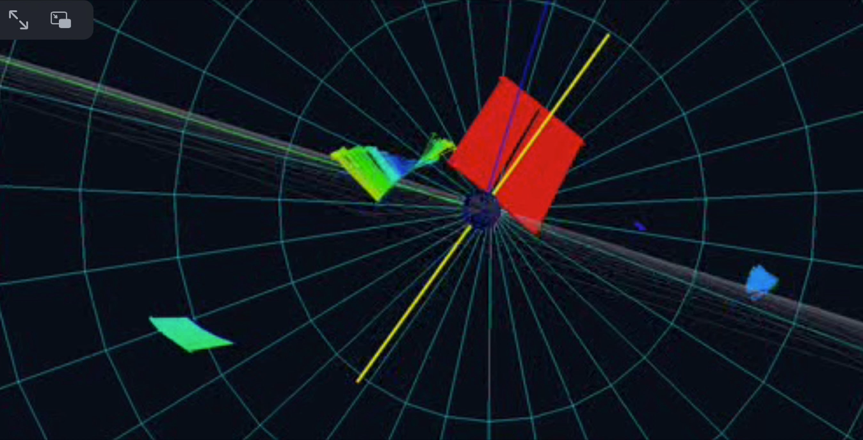
ViSBARD: A prototype of future visualization tools: observations

Slide 8
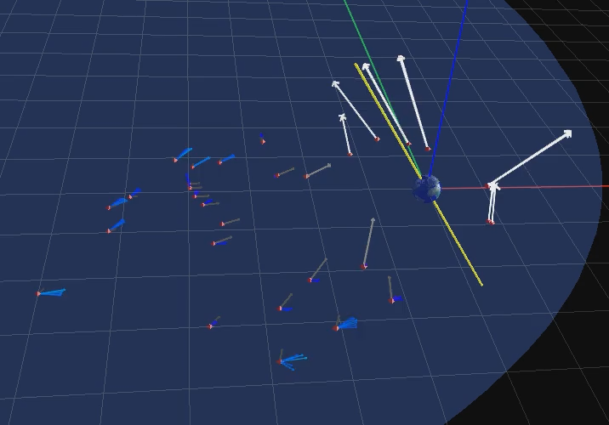
ViSBARD: A prototype of future visualization tools: CCMC runs

Slide 9

