Slide 1
eXtreme Benchmarks (XB) Framework
Pete Riley
Predictive Science Inc.
CCMC Workshop
9th June, 2022

Slide 2
Overview
Summary of XB Framework*
Illustration of XB using Dst
Extension to
  multi-variate analysis
  spatial analysis
“Combining” with mechanistic models
Summary
*Riley, Pete. "On the probability of occurrence of extreme space weather events." Space Weather 10.2 (2012).
Riley, Pete, and Jeffrey J. Love. "Extreme geomagnetic storms: Probabilistic forecasts and their uncertainties." Space Weather 15.1 (2017): 53-64.
Riley, Pete, et al. "Extreme space weather events: From cradle to grave." Space Science Reviews 214.1 (2018): 1-24.

Slide 3
Components of XB Framework

Slide 4
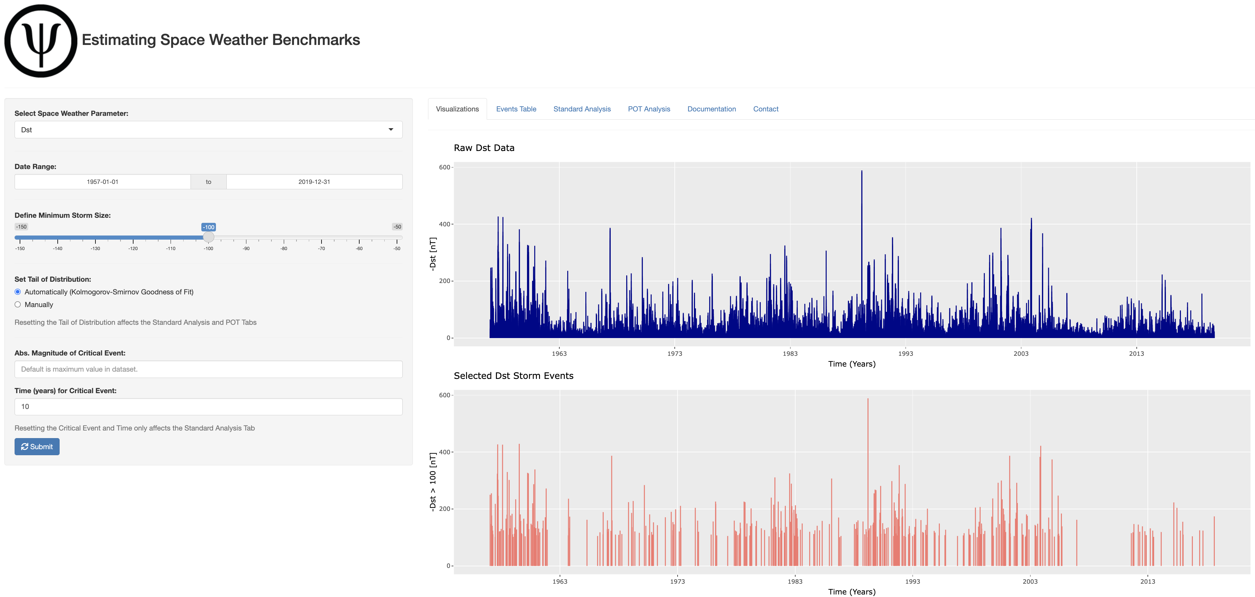
XB in action (https://www.predsci.com/solarExtremes/)

Slide 5
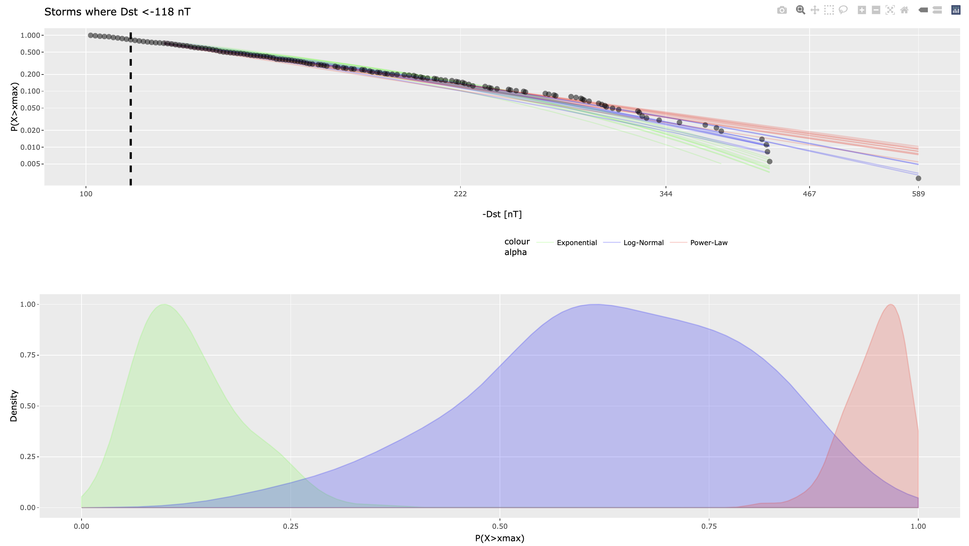
XB in action

Slide 6
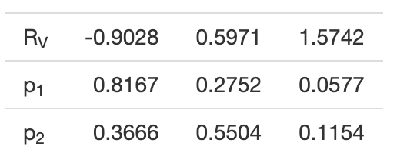
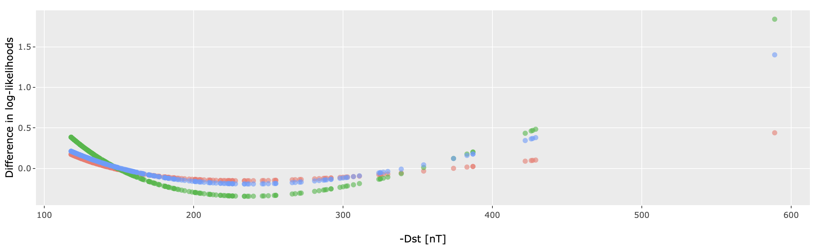
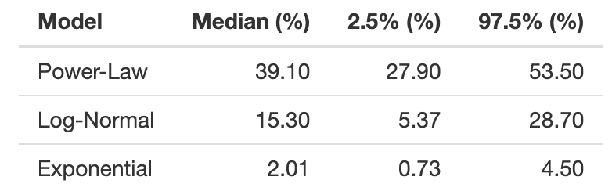
XB in action
Vuong's test statistic
PL vs. LN. PL vs. Expo. LN vs. Expo.
Estimates and Confidence Intervals for 10-Year Probabilistic Forecasts of | Dst | Exceeding 589 nT.

Slide 7
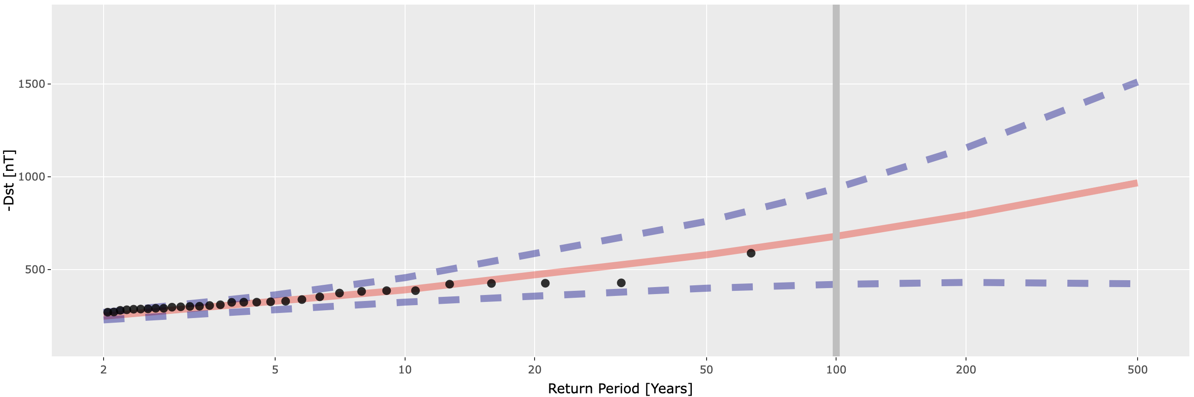
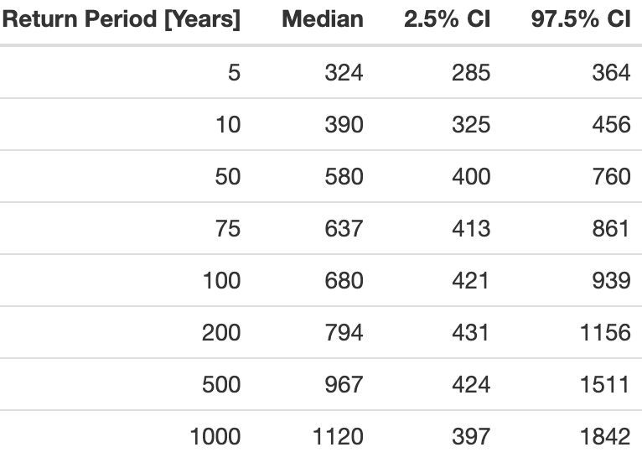
XB in action
Points Over Threshold (POT) Analysis

Slide 8
Multi-Variate Analysis

Slide 9
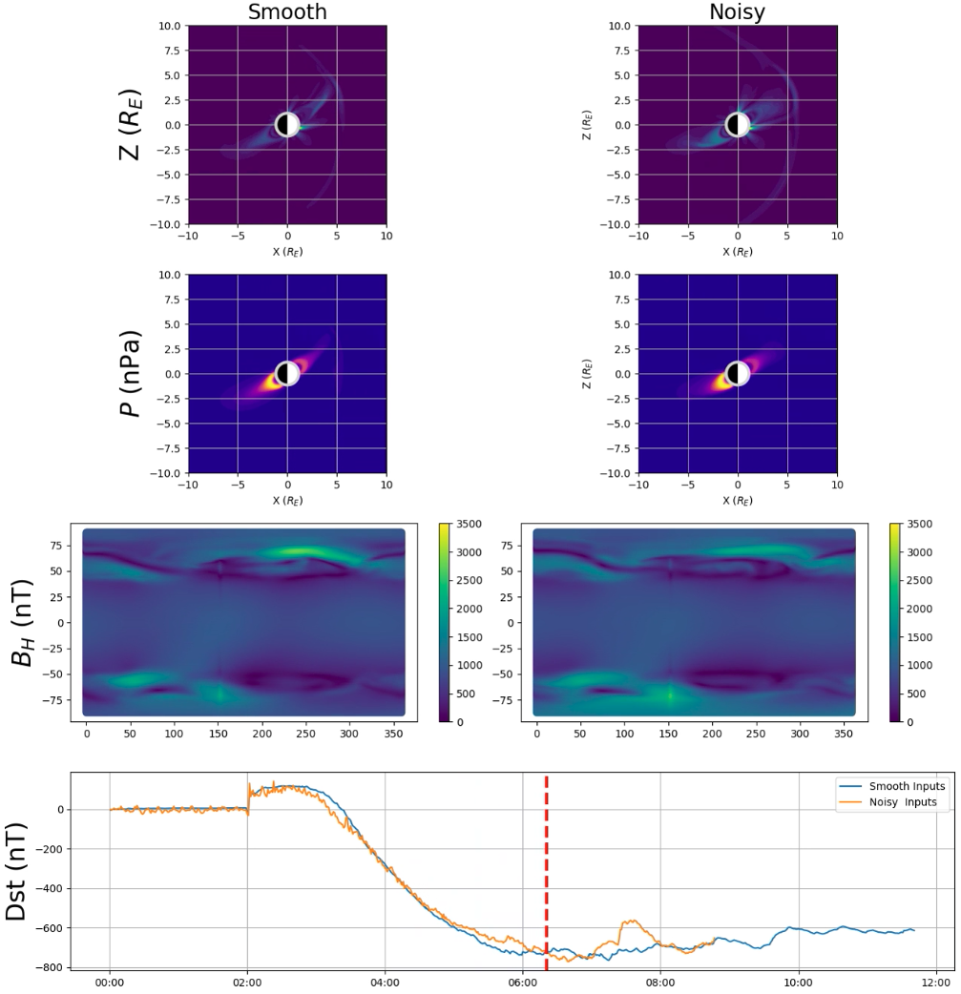
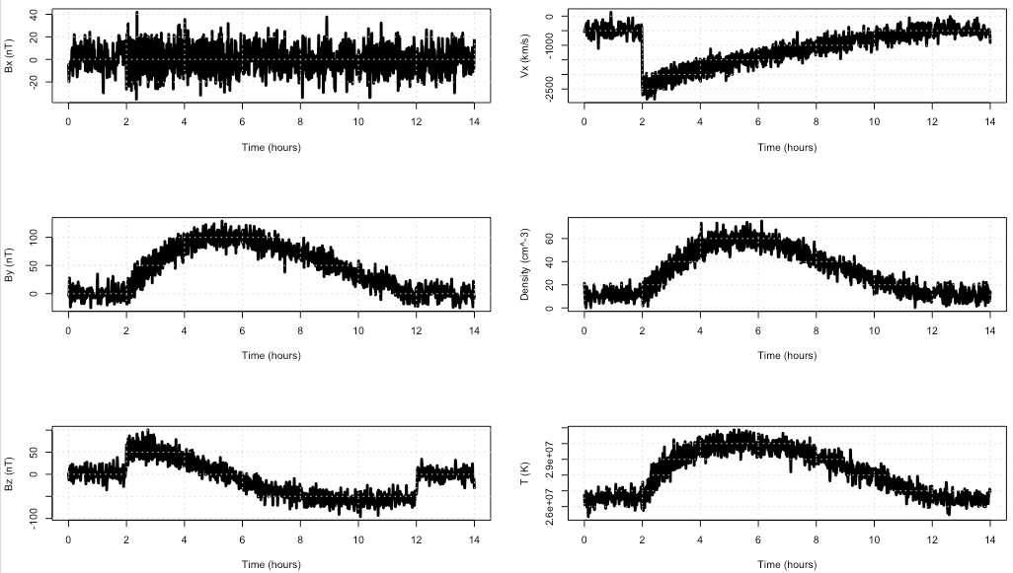
“Combining” XB with Mechanistic Models e.g., XB + sunRunner1D + BATS-R-US
Use XB to specify, say, 1-in-100-year parameters (speed, field, density) at Sun
Use sunRunner1D to propagate this pulse from 30 Rs to 1 AU
Use these outputs to drive a magnetospheric model
XB
sunRunner1D
BATS-R-US

Slide 10
Summary
XB is a useful tool for making climatological forecasts of space-weather-related parameters
Easy to extend to bivariate (and multi-variate) phase space if datasets available
Spatial analysis could be useful for some space weather datasets (e.g., electric field hazards)
XB can be “combined” with mechanistic models
  To provide the amplitudes of input boundary conditions; and
  As part of a multi-time-horizon forecast.

