Slide 1
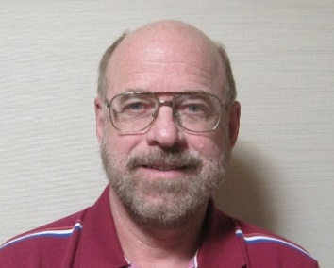
Recent Developments Using Interplanetary Scintillation (IPS) Tomography: Adjusting IPS-Driven ENLIL to Work Better?
Bernard Jackson (bvjackson@ucsd.edu)
Lucas Cota, Matthew Bracamontes, Andrew Buffington
Center for Astrophysics and Space Sciences, University of California,
San Diego, 9500 Gilman Drive, La Jolla, CA 92093-0424, USA
Dusan Odstrcil
George Mason University and NASA/GSFC
Munetoshi Tokumaru, Ken’ichi Fujiki
Institute for Space-Earth Environmental Research, Nagoya University, Nagoya, Japan
Richard Fallows
ASTRON, the Netherlands Institute for Radio Astronomy, Dwingeloo, The Netherlands
Mario Bisi, David Barnes, Oyuki Chang
RAL Space, STFC Rutherford Appleton Laboratory, Harwell Campus, Oxfordshire, OX11 0QX, UK
http://ips.ucsd.edu/ http://ips.ucsd.edu/stereo

Slide 2
Introduction:
Interplanetary Scintillation (IPS) and its use in forecasts of CMEs and corotating structure analyses in this new solar cycle.
The new UCSD Webpages now provide far more information globally, and to the distance of Jupiter.
Current studies for better future results and confirmation from inner spacecraft.
Tweaking ENLIL to provide better results in-situ.
Notes:
Introduction

Slide 3
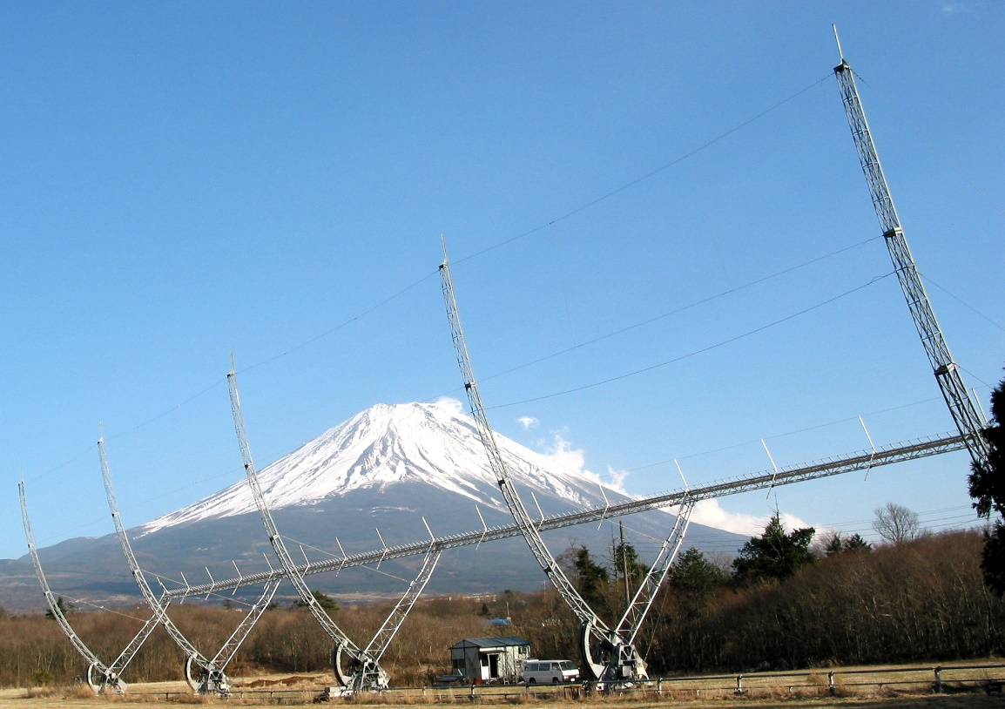
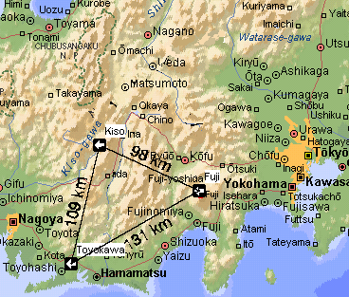
IPS Heliospheric Analyses from ISEE, Japan
ISEE IPS array near Mt. Fuji
ISEE IPS array systems
Notes:
The ISEE interplanetary scintillation 327 MHz remote-sensing cylindrical parabola near Mt. Fuji is shown. The array moves in declination to process has had much help in these analyses over the years.
ovide views of sources at different locations in the sky as they pass overhead. Another array of this type is at Kiso, to the north of Toyokawa. There is also a larger array at Toyokawa that electronically switches to different declination locations. (click) When more than one array is operating, the view of the same scintillating source at the same time provides heliospheric velocity by the correlation of the radio signal pattern across the surface of the Earth; a heliospheric density proxy is given by the level of the scintillation signal of each radio source.

Slide 4
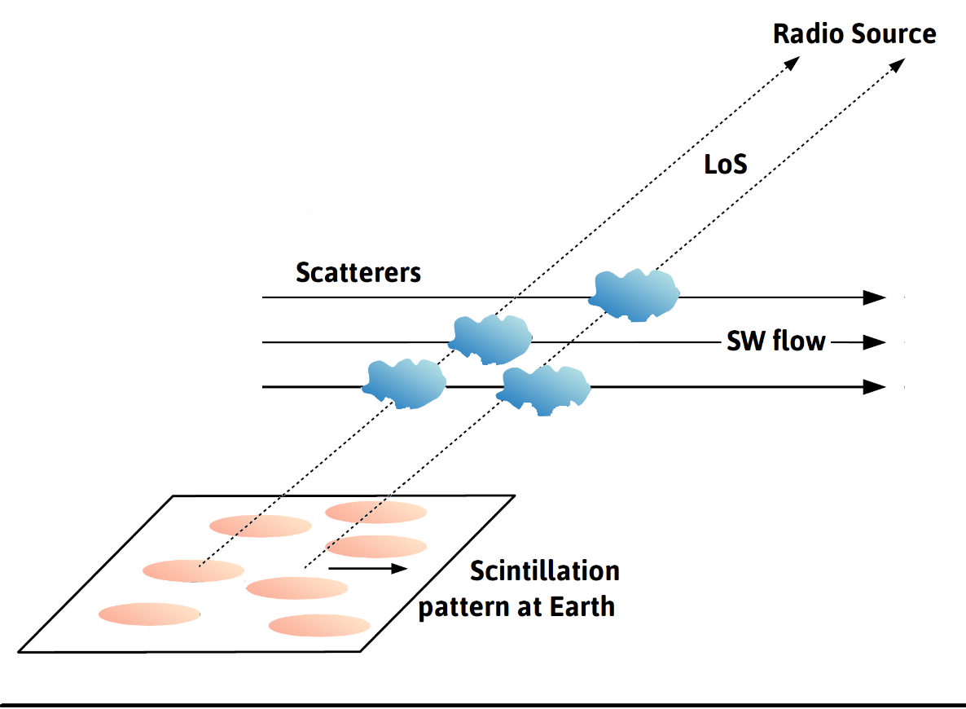
IPS Heliospheric Analyses from ISEE, Japan
ISEE IPS array near Mt. Fuji
ISEE IPS array systems
Notes:
The ISEE interplanetary scintillation 327 MHz remote-sensing cylindrical parabola near Mt. Fuji is shown. The array moves in declination to process has had much help in these analyses over the years.
ovide views of sources at different locations in the sky as they pass overhead. Another array of this type is at Kiso, to the north of Toyokawa. There is also a larger array at Toyokawa that electronically switches to different declination locations. (click) When more than one array is operating, the view of the same scintillating source at the same time provides heliospheric velocity by the correlation of the radio signal pattern across the surface of the Earth; a heliospheric density proxy is given by the level of the scintillation signal of each radio source.

Slide 5
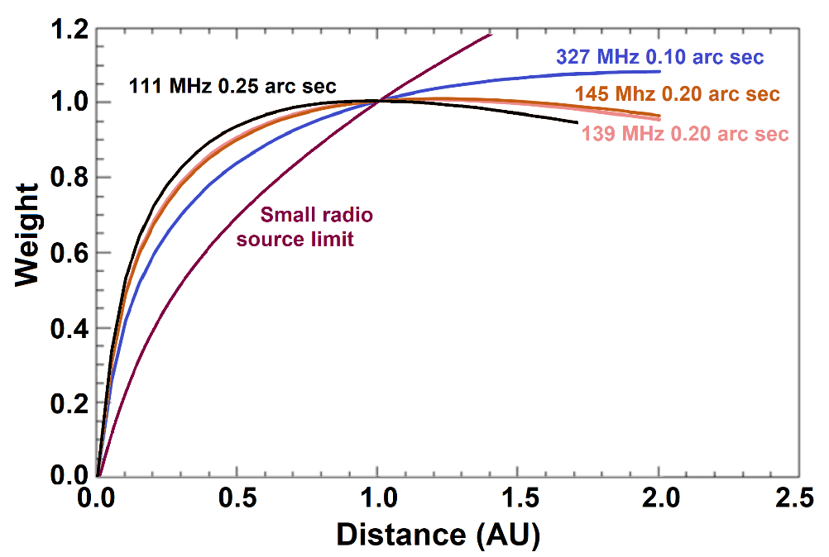
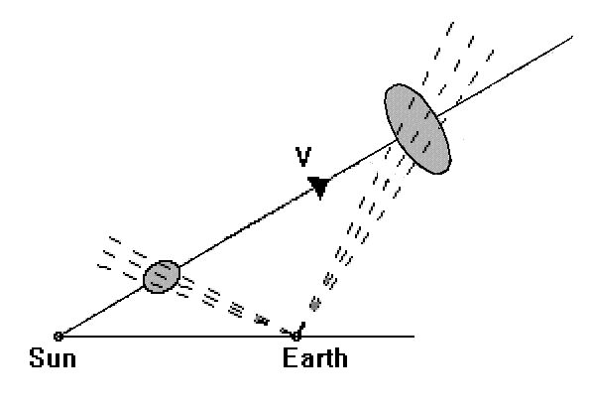
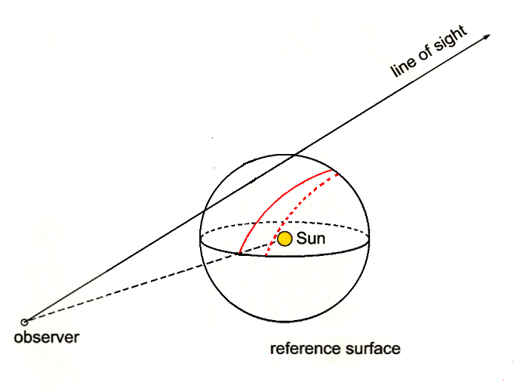
Line-of-sight Response
Jackson, B.V., et al., 2008, Adv. in Geosciences 21, 339
Jackson et al., 2020, Frontiers in Astronomy and Space Sci., doi: 10.3389/fspas.2020.568429
Interplanetary Scintillation
Heliospheric C.A.T. analyses: example line-of-sight distribution for each sky location to form the source surface weighting of the 3-D reconstruction.
Young, A.T., 1971, Astrophys. J., 168, 543
Interplanetary Scintillation
Remotely-sensed forecasts can be “preconditioned” using in-situ data near the observer.
Notes:
To the upper left is the weighting from the Thomson-scattering signal at three different elongations, 30, 60, and 90 degrees. I don’t like simulation very much but in this case, I have taken the SMEI tomographic analysis, and modified it to provide 3-D reconstructions with Thomson-Scattering pB data as well as from Brightness data. This modification will show how this iterative process works not only with brightness and tracking, but also including the pB/B ratio to converge to a solution of line-of-sight structure location for data that already has a 3-D location determined. By adding noise to the pB data we will then see how well the B-given structure survives. We also will find out how long it takes the current tomographic analysis to provide an answer at a given resolution over a given range of elongations.

Slide 6
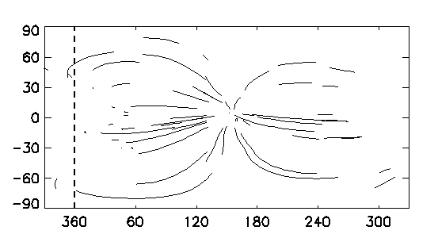
Line-of-sight Response
Jackson, B.V., et al., 2008, Adv. in Geosciences 21, 339
Jackson et al., 2020, Frontiers in Astronomy and Space Sci., doi: 10.3389/fspas.2020.568429
Interplanetary Scintillation
Heliospheric C.A.T. analyses: example line-of-sight distribution for each sky location to form the source surface weighting of the 3-D reconstruction.
Young, A.T., 1971, Astrophys. J., 168, 543
Interplanetary Scintillation
Bastille Day CME Event
(Jackson, B.V.,
et al., 2003, AIP Conf. Proc.
679, 75)
Each LoS segment multiplied by:
g = AR^{α} Np^{β}
α = 3.60
β = 0.70
A = fits LoS wt.
Remotely-sensed forecasts can be “preconditioned” using in-situ data near the observer.
14 July 2000
Notes:
To the upper left is the weighting from the Thomson-scattering signal at three different elongations, 30, 60, and 90 degrees. I don’t like simulation very much but in this case, I have taken the SMEI tomographic analysis, and modified it to provide 3-D reconstructions with Thomson-Scattering pB data as well as from Brightness data. This modification will show how this iterative process works not only with brightness and tracking, but also including the pB/B ratio to converge to a solution of line-of-sight structure location for data that already has a 3-D location determined. By adding noise to the pB data we will then see how well the B-given structure survives. We also will find out how long it takes the current tomographic analysis to provide an answer at a given resolution over a given range of elongations.

Slide 7
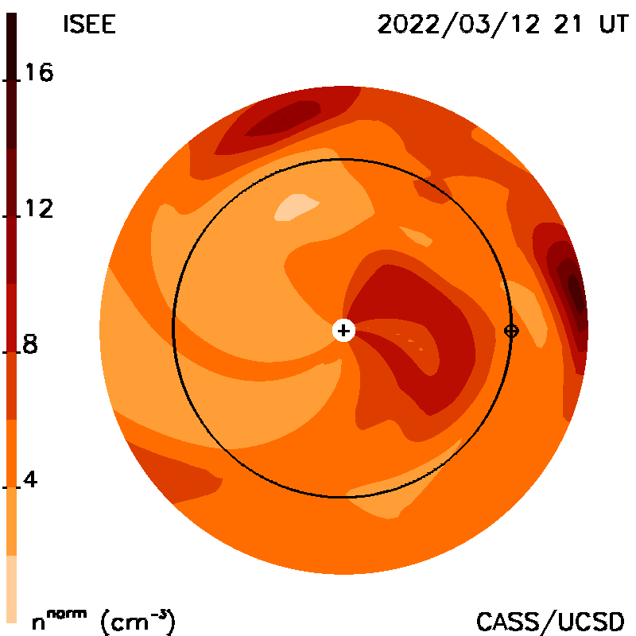
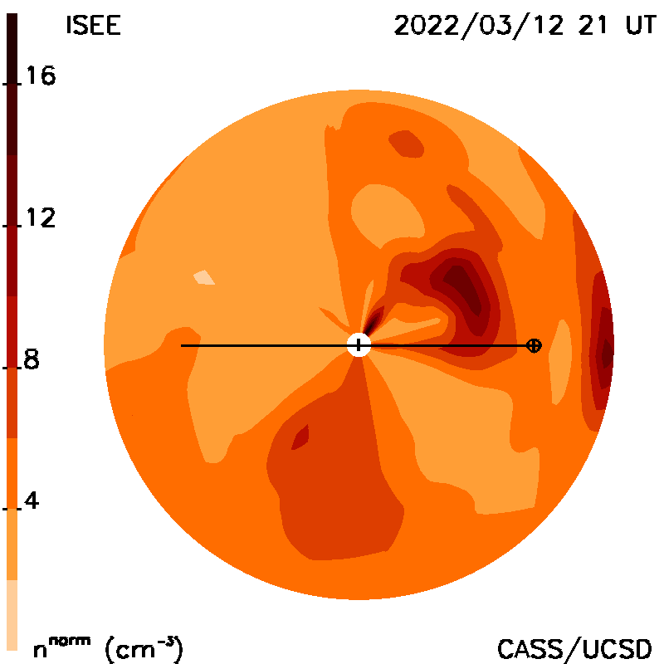
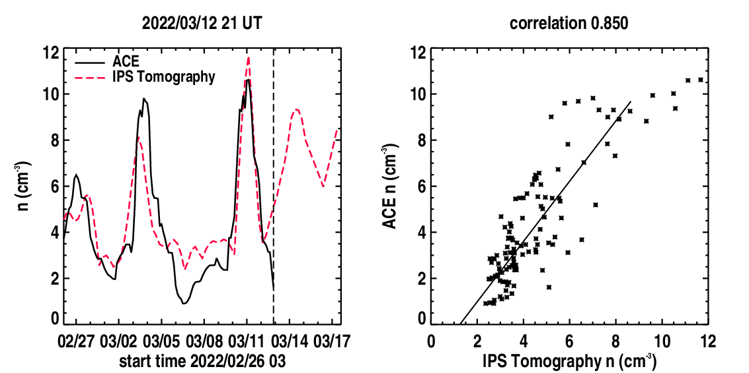
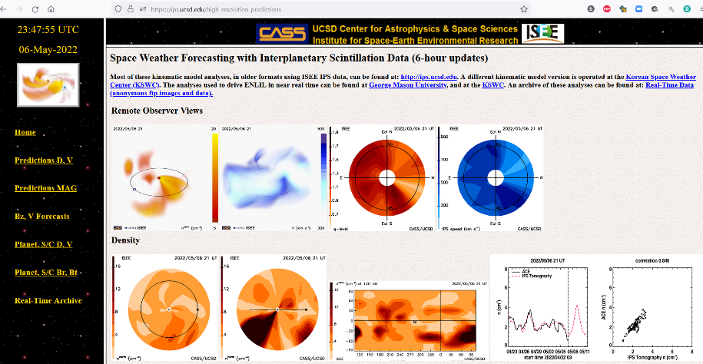
Jackson, B.V., et al., 2011, Adv. in Geosciences, 30, 93-115; Jackson et al., 2013, Solar Phys., 258, 151-165; Jackson et al., 2020 Frontiers, doi:10.3389/fspas.2020.568429
https://ips.ucsd.edu https://ips.ucsd.edu/high_resolution_predictions https://ips.ucsd.edu/experimentalforecasts
ISEE IPS Data
CME Forecast
UCSD and other IPS Web pages (2022/05/06)
Websites:
ISEE: http://stsw1.stelab.nagoya-u.ac.jp/index-e.html
USCD: https://ips.ucsd.edu/high_resolution_predictions
CCMC: https://iswa.ccmc.gsfc.nasa.gov/IswaSystemWebApp/
Ecliptic cut Meridional cut
KSWC: http://www.spaceweather.go.kr/models/ips
Time Series Comparison Pearson’s “R” Correlation
(2022/03/12 21 UT)
GMU: http://spaceweather.gmu.edu/projects/enlil/
Soon at the UK Met
(Python scripting of UCSD analysis finished,
Siegfried Gonzi, UK Met)
ENLIL Python scripting underway?
2022/03/10 CME
Web analysis runs “automatically” using Linux on a P.C.
Notes:
UCSD has forecast background and CME solar wind conditions in real time at the Earth and throughout the heliosphere globally since the year 2000 with updates over this period at UCSD and at other locations around the world using a variety of different visualizations. Recently this has been used to drive the ENLIL 3-D MHD model, and to use ENLIL as a kernel in the tomographic result to provide comparative modeling results that can be accessed from this website (shown at top left on the website panel).

Slide 8
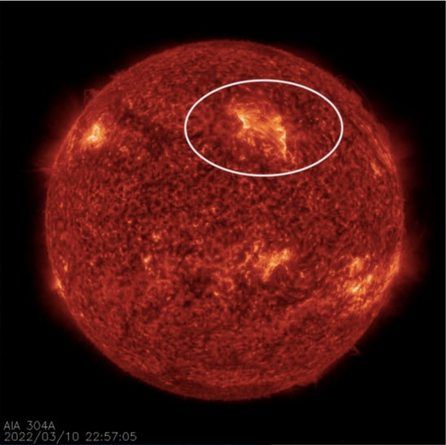
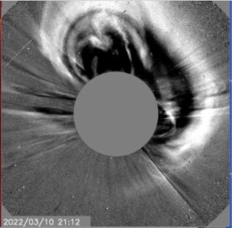
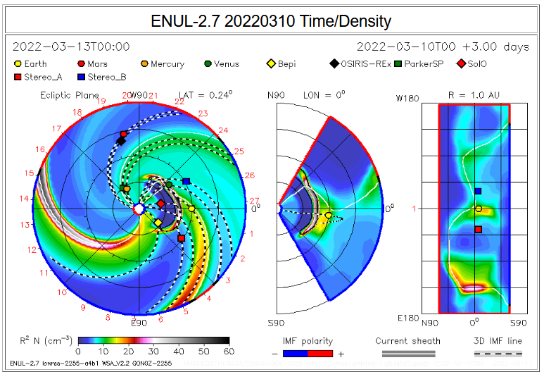
2022/03/10 CME
2022/03/12 21 UT
A Good Recent IPS CME Forecast
IPS Ecliptic Cut IPS Meridional Cut

Slide 9
2022/03/10 CME
2022/03/12 21 UT
A Good Recent IPS CME Forecast
IPS Ecliptic Cut IPS Meridional Cut
Time Series Comparison Pearson’s “R” Correlation

Slide 10
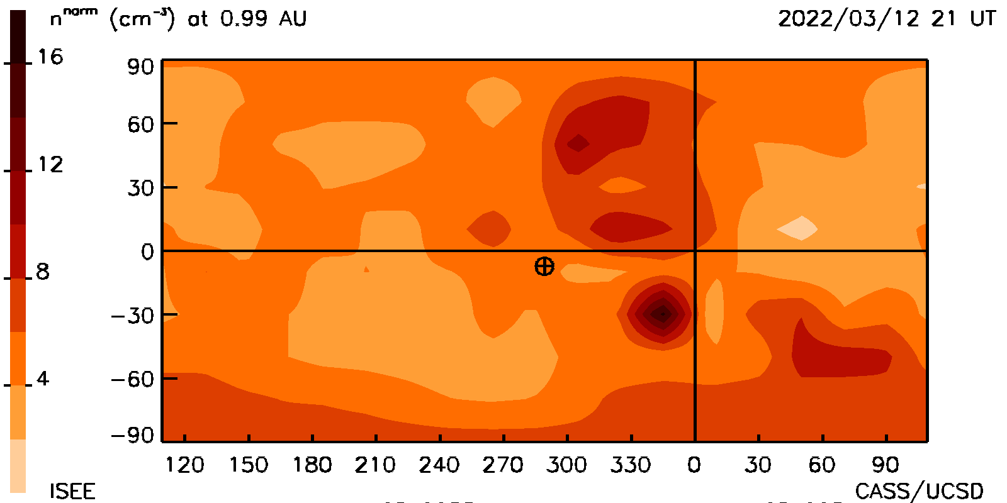
2022/03/10 CME
2022/03/12 21 UT
A Good Recent IPS CME Forecast
Synoptic Cut at Earth
Time Series Comparison Pearson’s “R” Correlation

Slide 11
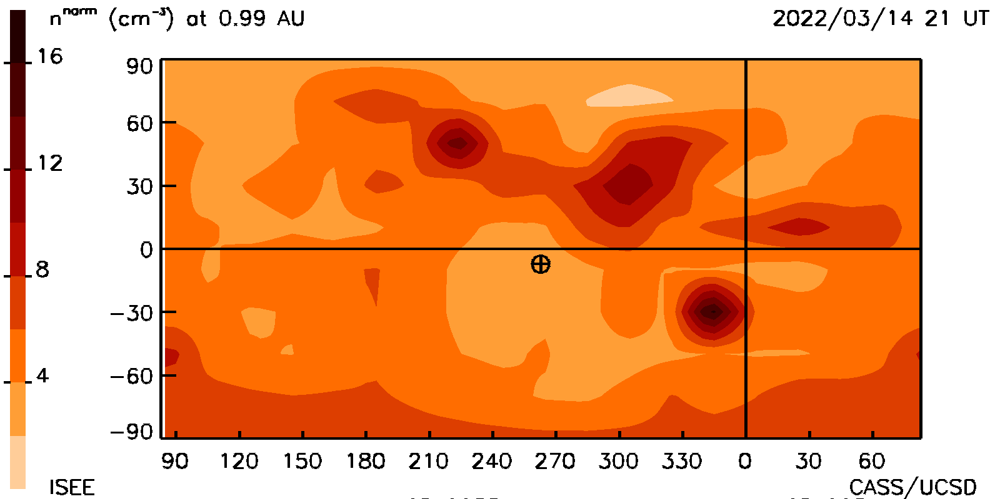
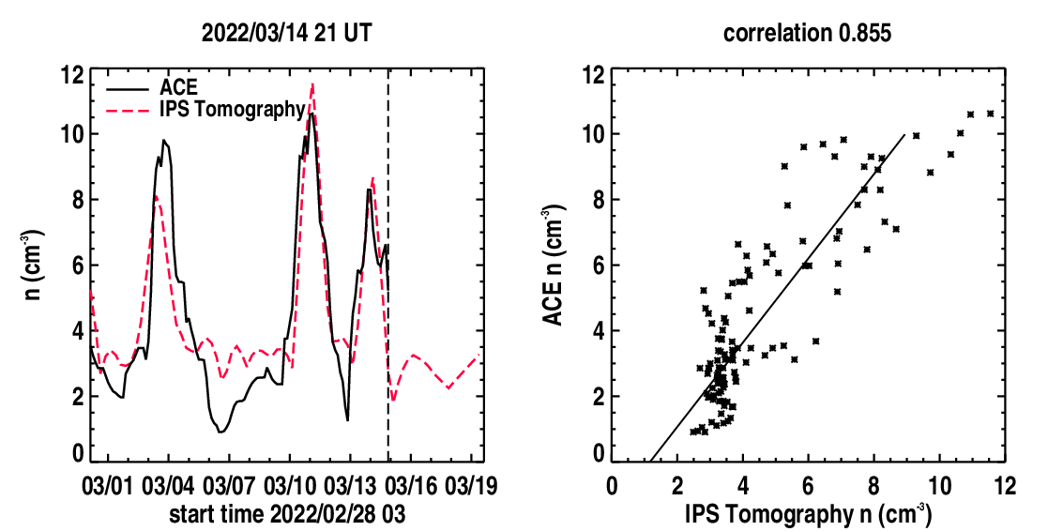
2022/03/10 CME
2022/03/14 21 UT
A Good Recent IPS CME Forecast
Synoptic Cut at Earth
Time Series Comparison Pearson’s “R” Correlation

Slide 12
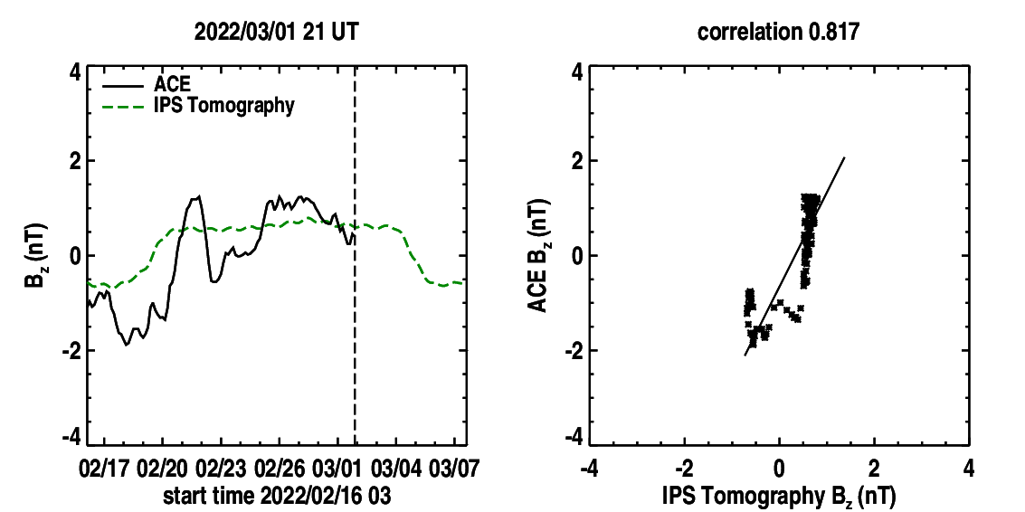
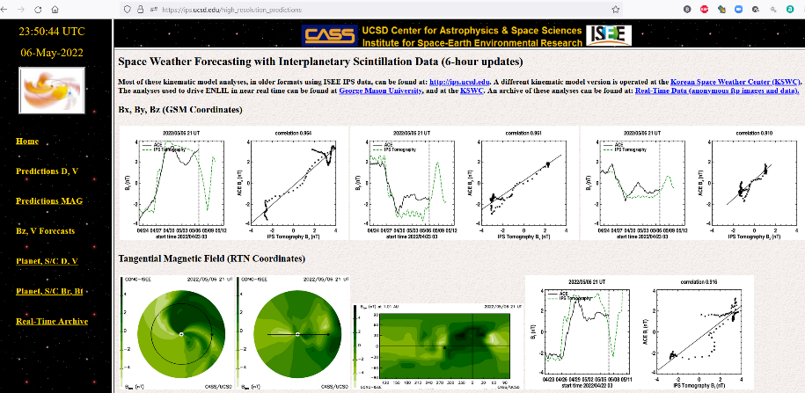
Jackson, B.V., et al., 2011, Adv. in Geosciences, 30, 93-115; Jackson et al., 2013, Solar Phys., 258, 151-165; Jackson et al., 2020 Frontiers, doi:10.3389/fspas.2020.568429
https://ips.ucsd.edu https://ips.ucsd.edu/high_resolution_predictions https://ips.ucsd.edu/experimentalforecasts
ISEE IPS Data
GSM Bz Forecast
UCSD and other IPS Web pages (2022/05/06)
Websites:
ISEE: http://stsw1.stelab.nagoya-u.ac.jp/index-e.html
USCD: https://ips.ucsd.edu/high_resolution_predictions
CCMC: https://iswa.ccmc.gsfc.nasa.gov/IswaSystemWebApp/
KSWC: http://www.spaceweather.go.kr/models/ips
GMU: http://spaceweather.gmu.edu/projects/enlil/
Soon at the UK Met
(Python scripting of UCSD analysis finished,
Siegfried Gonzi, UK Met)
ENLIL Python scripting underway?
Jackson, B.V., et al., 2019, Space Weather,
17, 639-652, doi: 10.1029/2018SW002098.
Use of contingency Tables –
Hit Rate ~80%! (data over 11 years)
Web analysis runs “automatically” using Linux on a P.C.
Notes:
UCSD has forecast background and CME solar wind conditions in real time at the Earth and throughout the heliosphere globally since the year 2000 with updates over this period at UCSD and at other locations around the world using a variety of different visualizations. Recently this has been used to drive the ENLIL 3-D MHD model, and to use ENLIL as a kernel in the tomographic result to provide comparative modeling results that can be accessed from this website (shown at top left on the website panel).

Slide 13
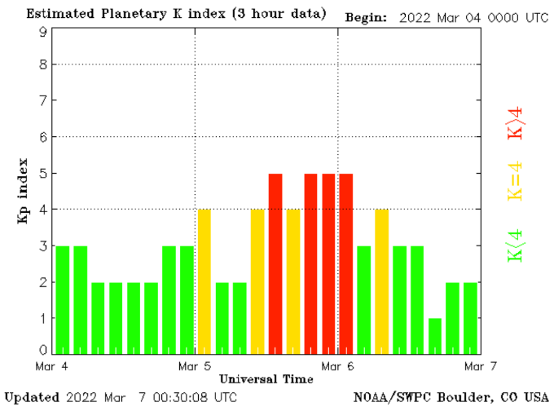
Jackson, B.V., et al., 2011, Adv. in Geosciences, 30, 93-115; Jackson et al., 2013, Solar Phys., 258, 151-165; Jackson et al., 2020 Frontiers, doi:10.3389/fspas.2020.568429
https://ips.ucsd.edu https://ips.ucsd.edu/high_resolution_predictions https://ips.ucsd.edu/experimentalforecasts
ISEE IPS Data
GSM Bz Forecast
UCSD and other IPS Web pages (2022/05/06)
Websites:
ISEE: http://stsw1.stelab.nagoya-u.ac.jp/index-e.html
USCD: https://ips.ucsd.edu/high_resolution_predictions
CCMC: https://iswa.ccmc.gsfc.nasa.gov/IswaSystemWebApp/
KSWC: http://www.spaceweather.go.kr/models/ips
Time Series Comparison Pearson’s “R” Correlation
March 5, 2022
minor to moderate
geomagnetic storm
forecast
GMU: http://spaceweather.gmu.edu/projects/enlil/
Soon at the UK Met
(Python scripting of UCSD analysis finished,
Siegfried Gonzi, UK Met)
ENLIL Python scripting underway?
Jackson, B.V., et al., 2019, Space Weather,
17, 639-652, doi: 10.1029/2018SW002098.
Use of contingency Tables –
Hit Rate ~80%! (data over 11 years)
Web analysis runs “automatically” using Linux on a P.C.
Notes:
UCSD has forecast background and CME solar wind conditions in real time at the Earth and throughout the heliosphere globally since the year 2000 with updates over this period at UCSD and at other locations around the world using a variety of different visualizations. Recently this has been used to drive the ENLIL 3-D MHD model, and to use ENLIL as a kernel in the tomographic result to provide comparative modeling results that can be accessed from this website (shown at top left on the website panel).

Slide 14
(09 June 2022 09UT -- Very recent analysis)
Faraday Rotation – Rotation Measure
Web analysis runs “automatically” using Linux on a P.C.

Slide 15
Jackson, B.V., et al., 2011, Adv. in Geosciences, 30, 93-115; Jackson et al., 2013, Solar Phys., 258, 151-165; Jackson et al., 2020 Frontiers, doi:10.3389/fspas.2020.568429
https://ips.ucsd.edu https://ips.ucsd.edu/high_resolution_predictions https://ips.ucsd.edu/experimentalforecasts
In-situ values at inner Planets/Spacecraft: Web analysis runs “automatically” using Linux on a P.C.

Slide 16
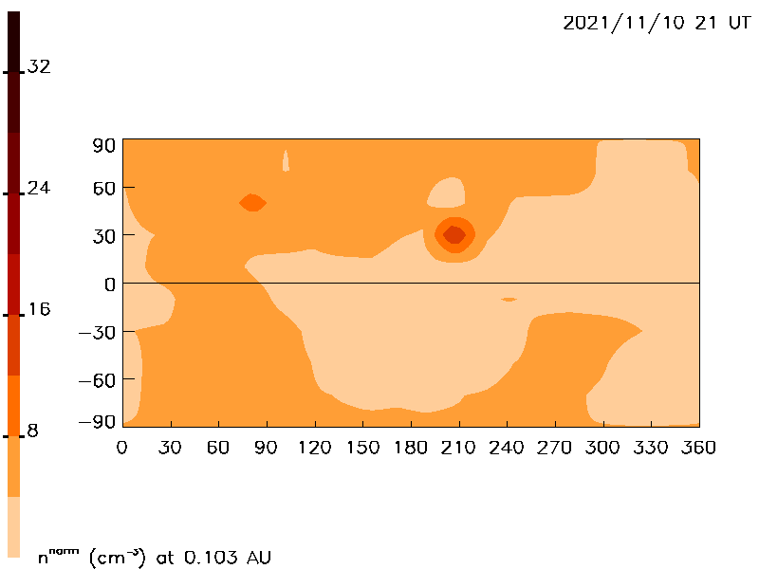
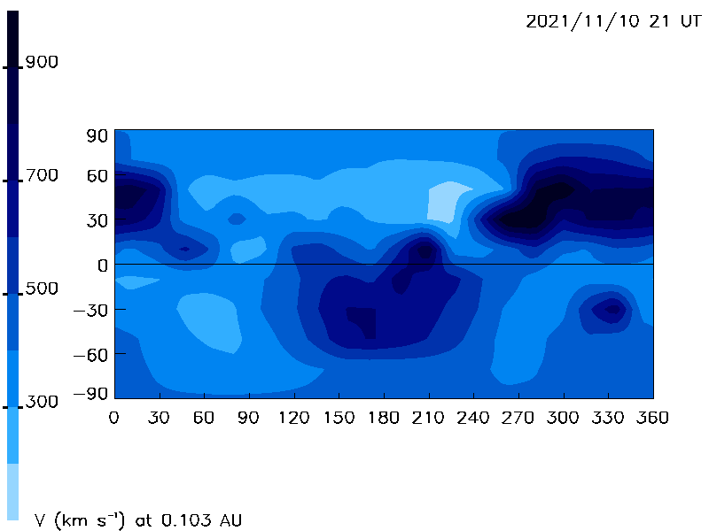
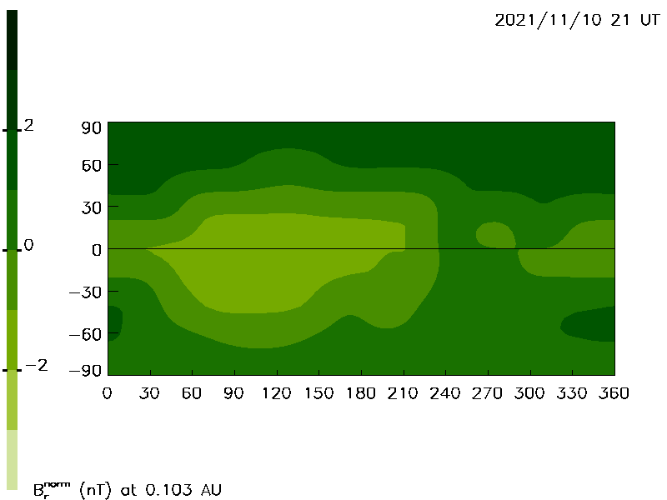
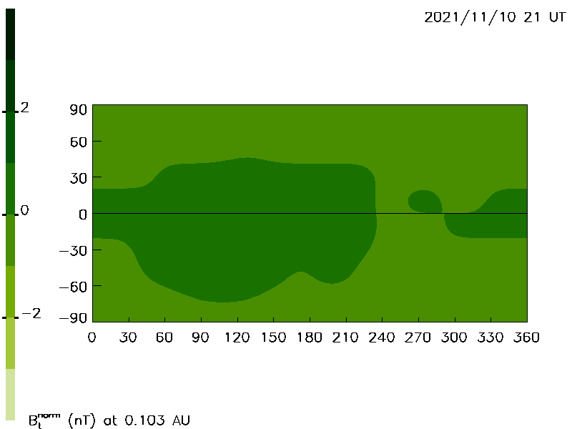
0.1 AU Lower Boundaries Used For ENLIL Propagation
Density Velocity
B radial B tangential

Slide 17
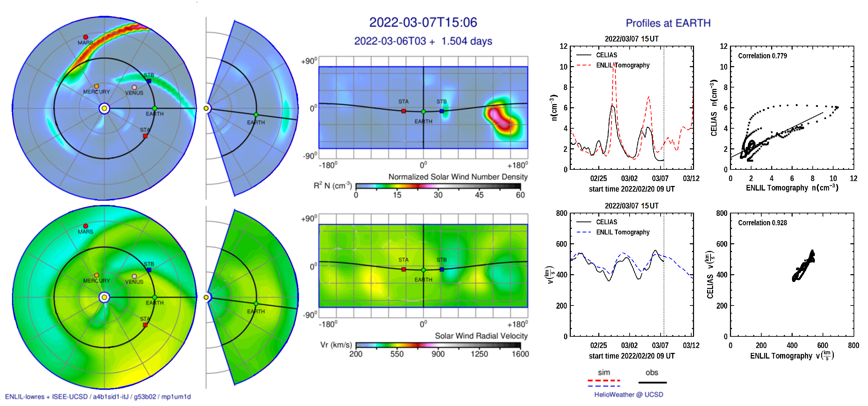
Jackson, B.V., et al., 2011, Adv. in Geosciences, 30, 93-115; Jackson et al., 2013, Solar Phys., 258, 151-165; Jackson et al., 2020 Frontiers, doi:10.3389/fspas.2020.568429
https://ips.ucsd.edu https://ips.ucsd.edu/high_resolution_predictions https://ips.ucsd.edu/experimentalforecasts
IPS boundary values use to drive ENLIL: Web analysis runs “automatically” using Linux on a P.C.

Slide 18
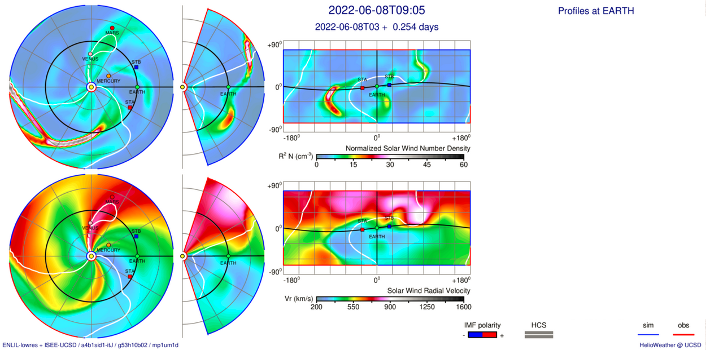
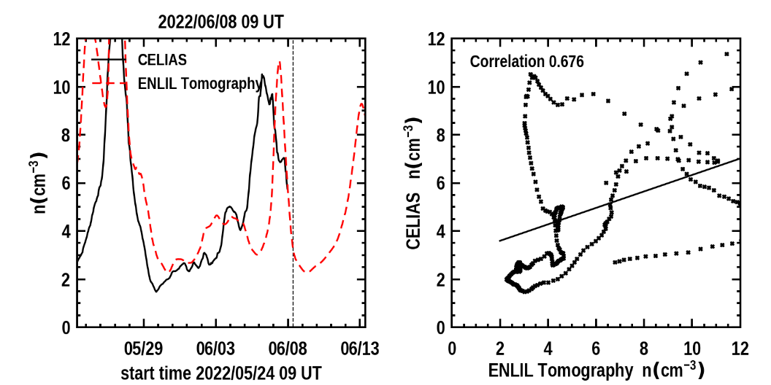
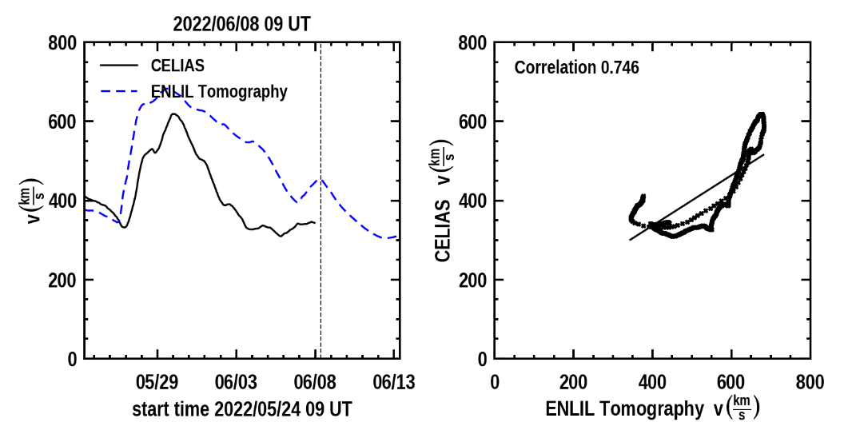
Jackson, B.V., et al., 2011, Adv. in Geosciences, 30, 93-115; Jackson et al., 2013, Solar Phys., 258, 151-165; Jackson et al., 2020 Frontiers, doi:10.3389/fspas.2020.568429
https://ips.ucsd.edu https://ips.ucsd.edu/high_resolution_predictions https://ips.ucsd.edu/experimentalforecasts
IPS boundary values use to drive ENLIL: Web analysis runs “automatically” using Linux on a P.C.

Slide 19
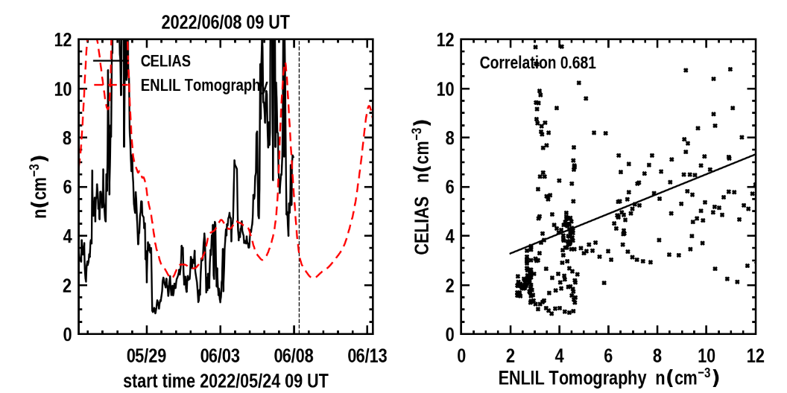
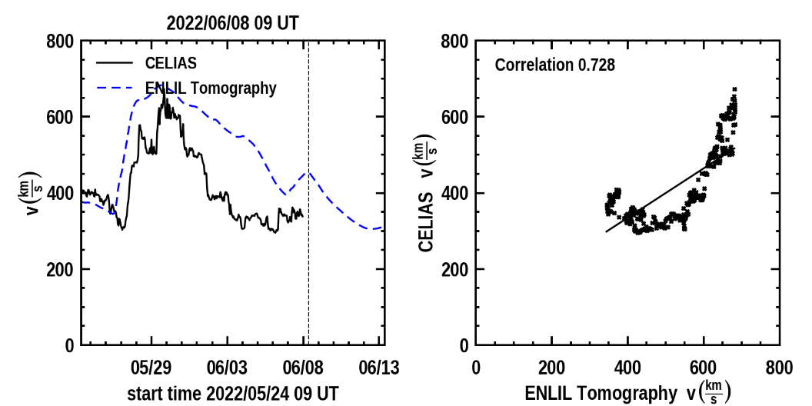
Jackson, B.V., et al., 2011, Adv. in Geosciences, 30, 93-115; Jackson et al., 2013, Solar Phys., 258, 151-165; Jackson et al., 2020 Frontiers, doi:10.3389/fspas.2020.568429
https://ips.ucsd.edu https://ips.ucsd.edu/high_resolution_predictions https://ips.ucsd.edu/experimentalforecasts
IPS boundary values use to drive ENLIL: Web analysis runs “automatically” using Linux on a P.C.

Slide 20
More Verifications and Checks

Slide 21
Checks at BepiColombo – Venus Pass August 10, 2021
In Agreement with Venus Shock Standoff

Slide 22
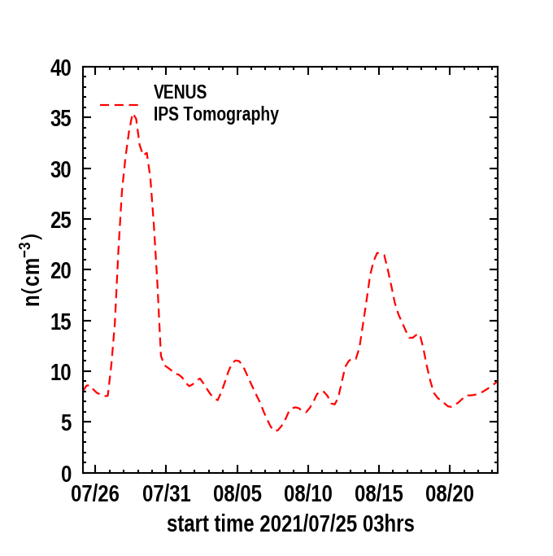
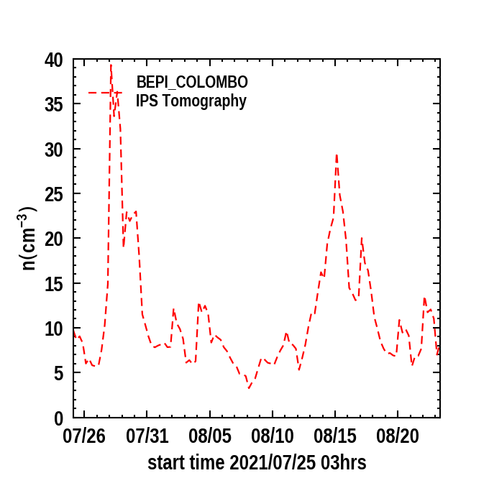
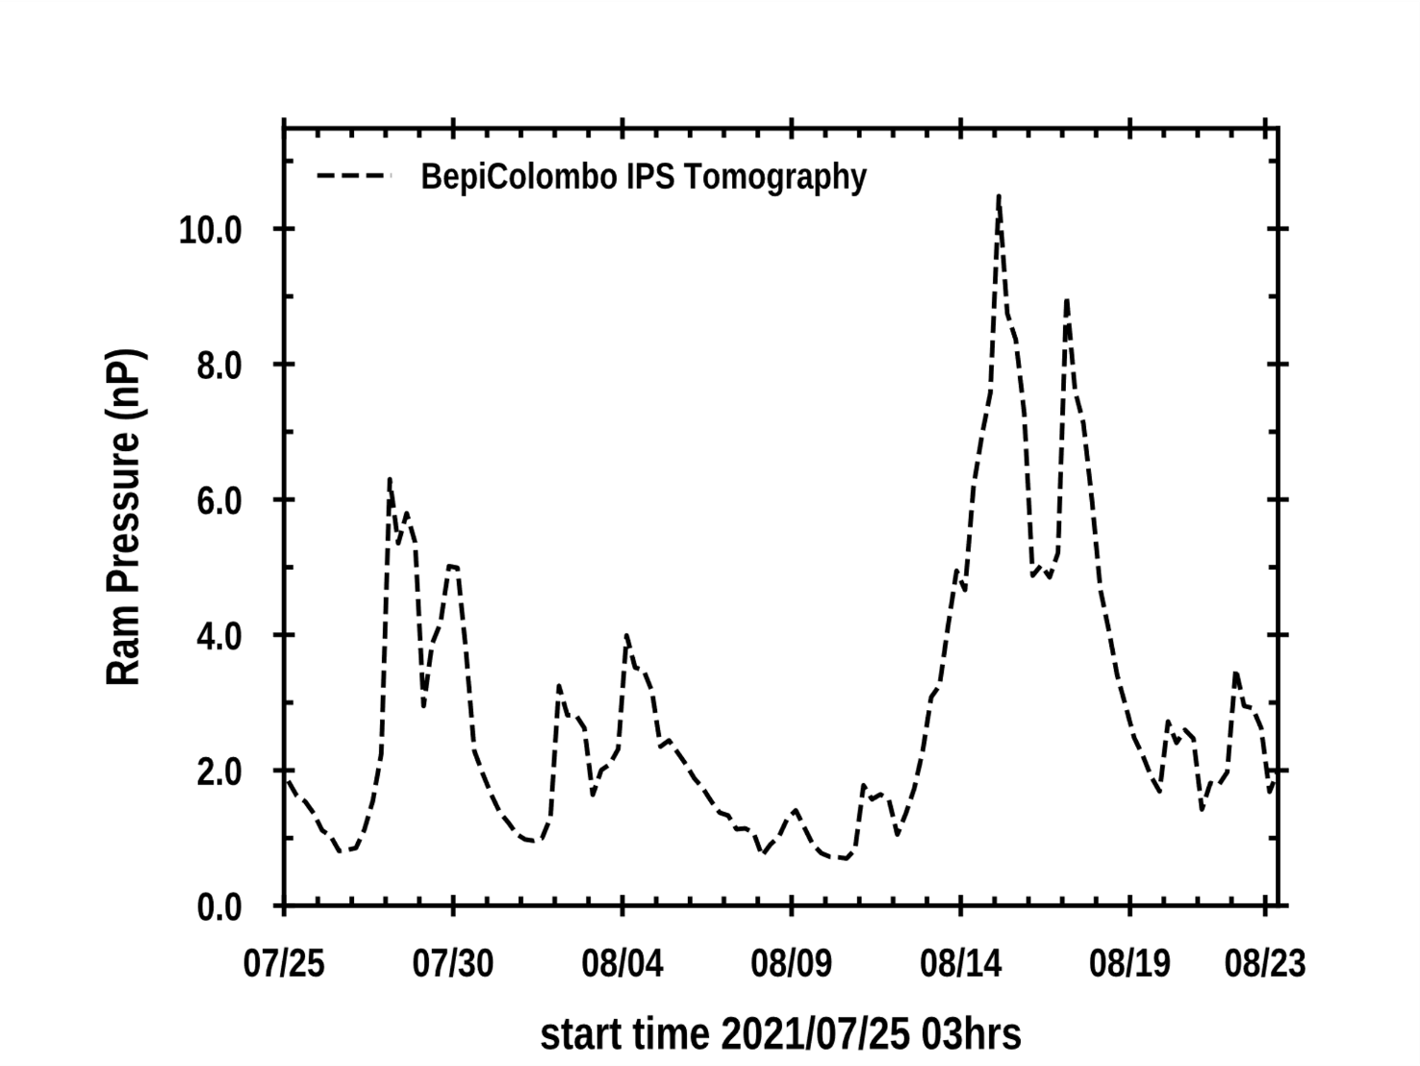
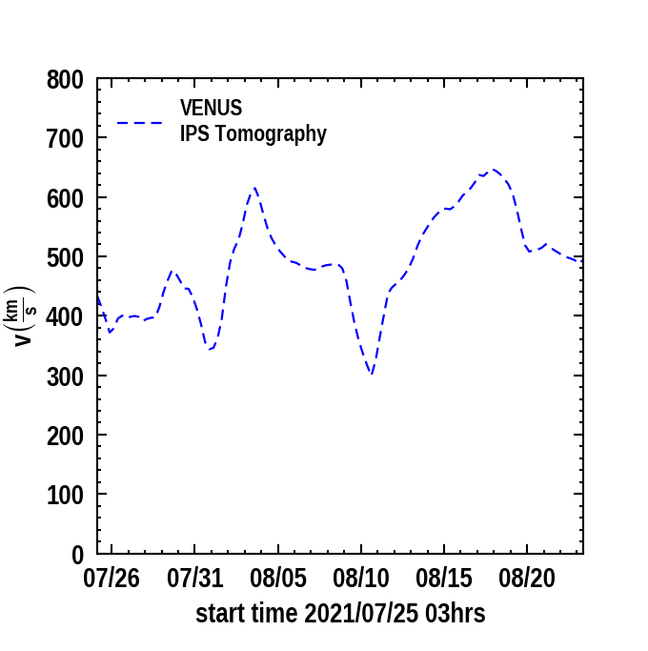
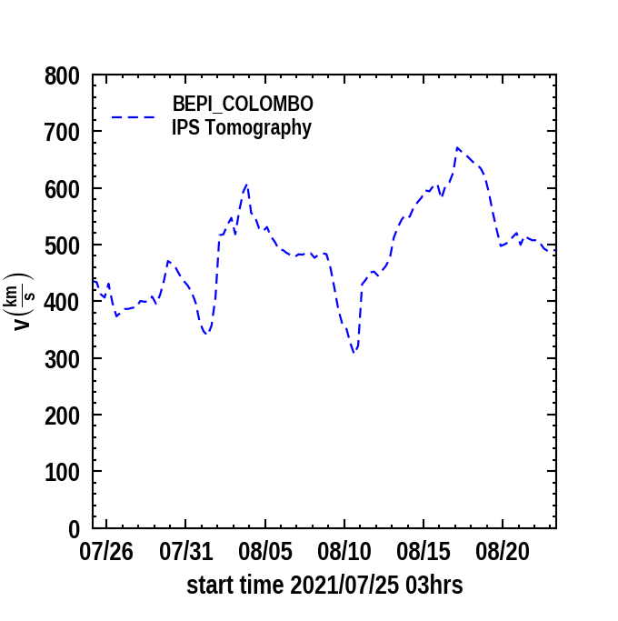
Checks at BepiColombo – Venus Pass August 10, 2021
In Agreement with Venus Shock Standoff
Density
Ram Pressure 10⁻⁶ nV² (nP)
Magnetic Br (RTN)
Velocity
Magnetic Bt (RTN)

Slide 23
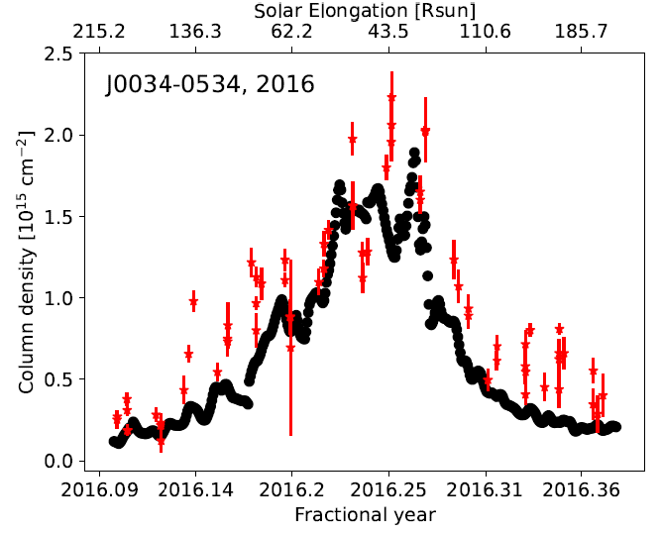
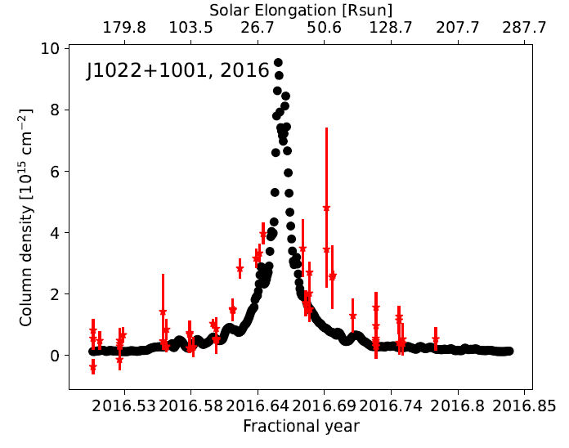
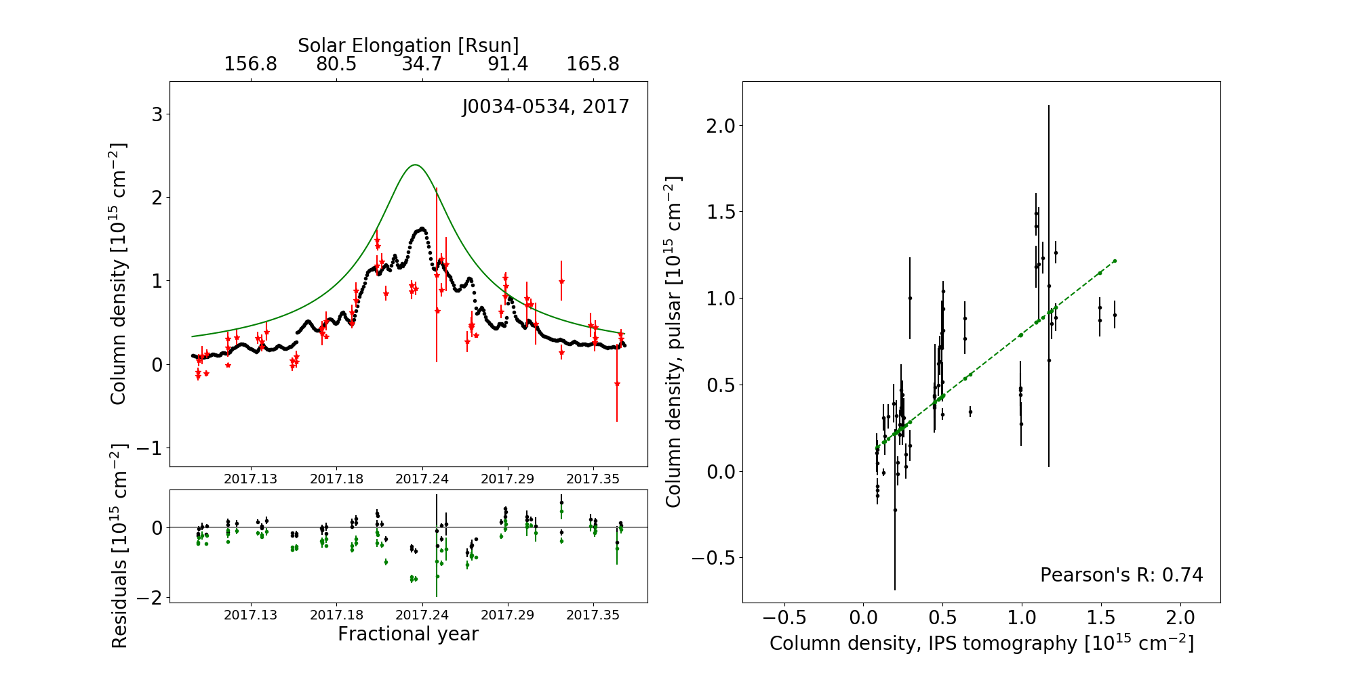
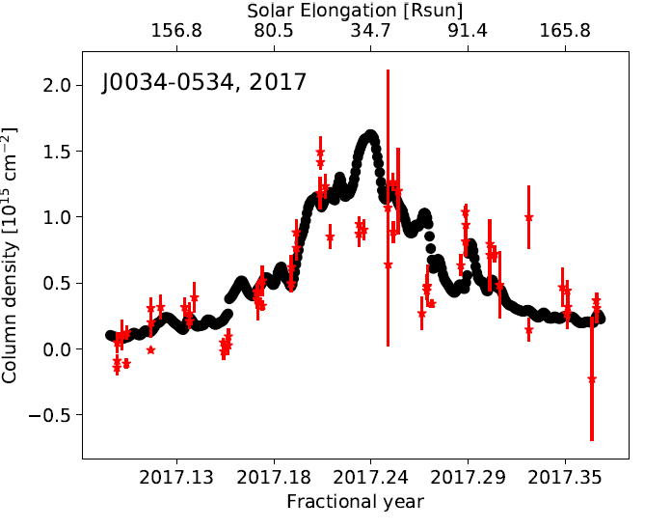
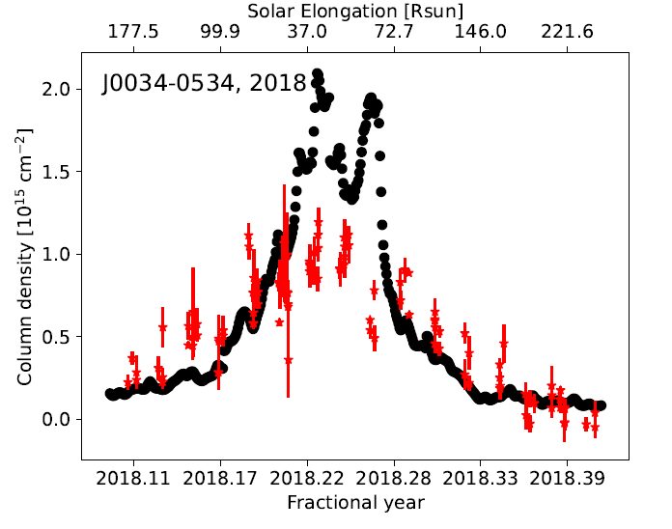
Tiburzi, C., Jackson, B.V., et al., 2022, Adv. in Space Res., (accepted)
Pulsar Dispersion Measures ~agree with the ACE L0 density 3-D reconstructions
closer to the Sun. 4% Helium abundance.
Each LoS segment multiplied by:
g = AR^{α} Np^{β}
α = 3.60
β = 0.70
A = fits LoS wt.
This converts g to N and fits plasma N_{p} at ϴ

Slide 24
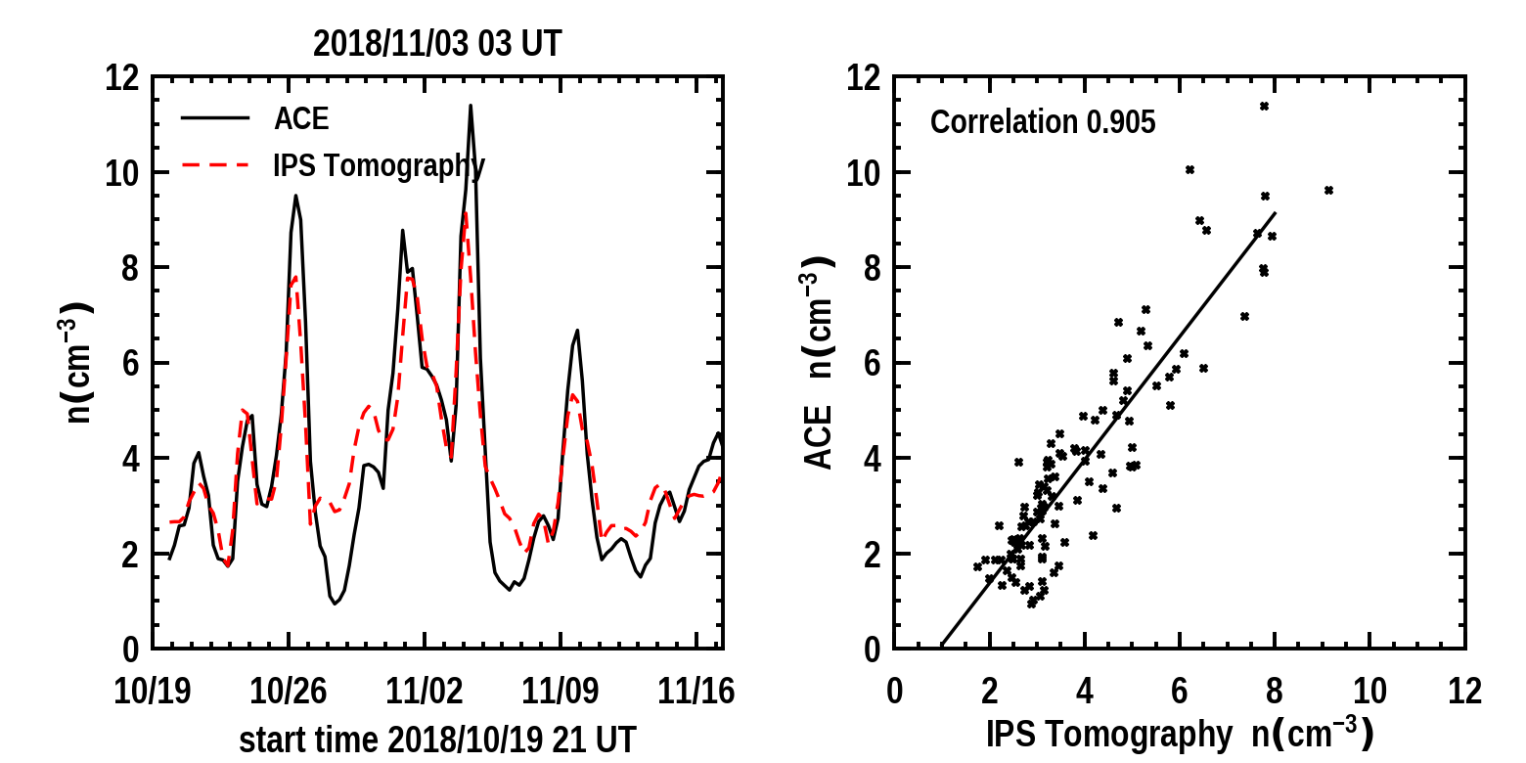
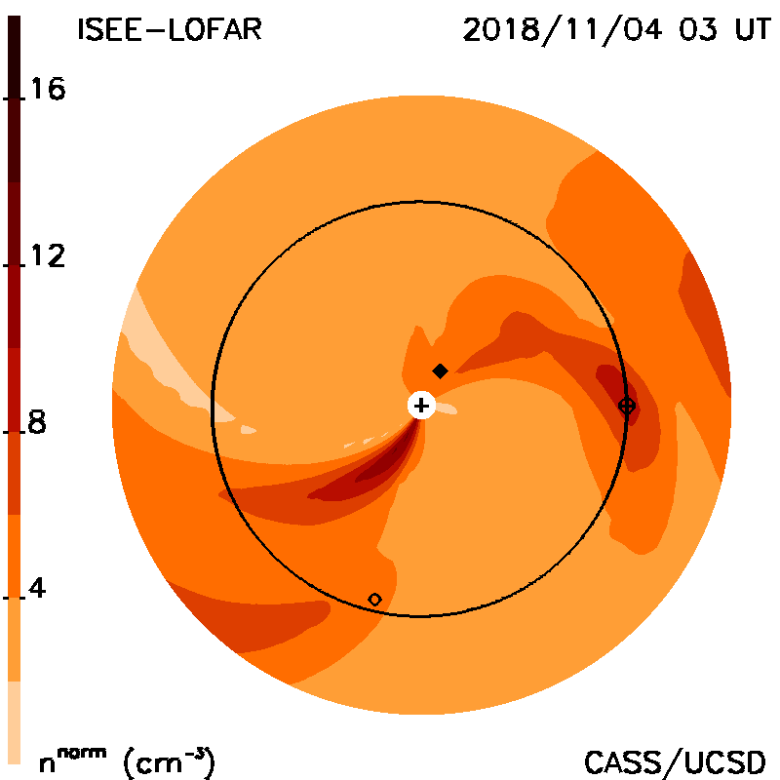
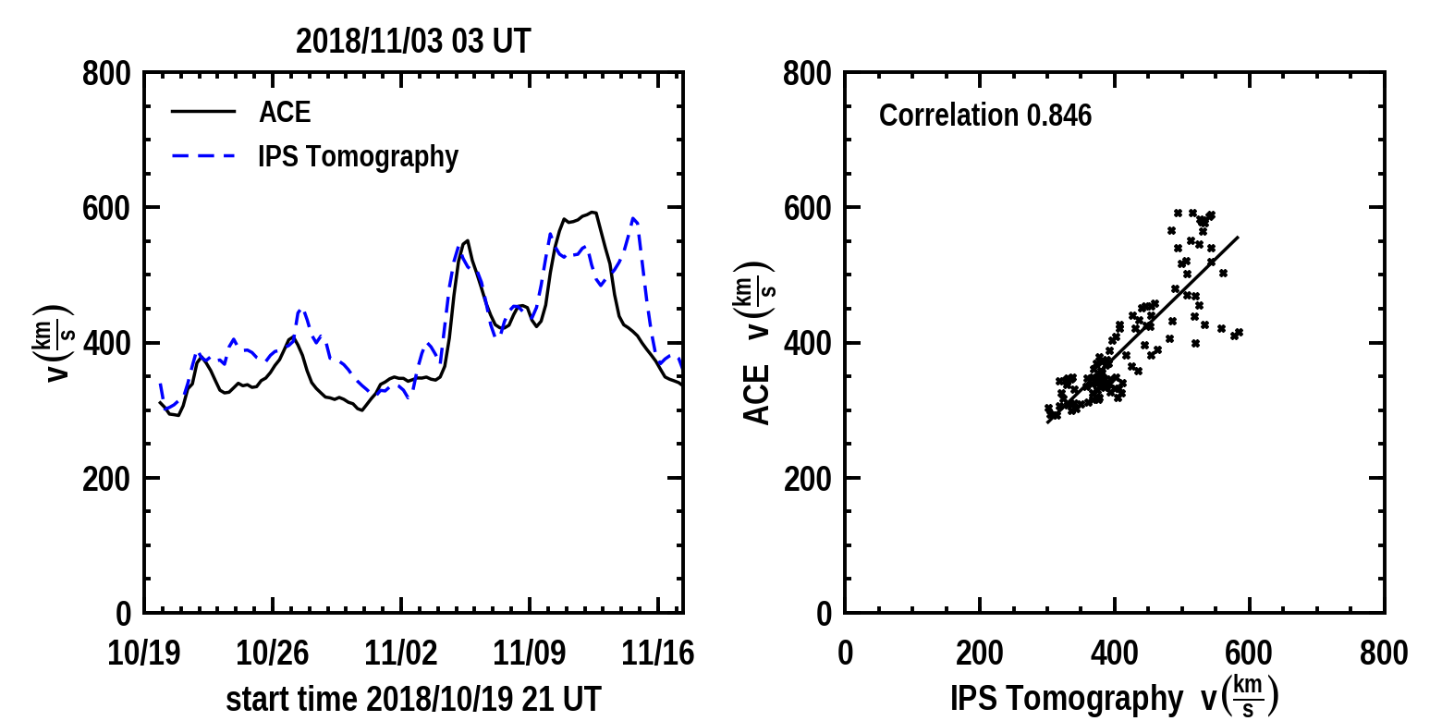
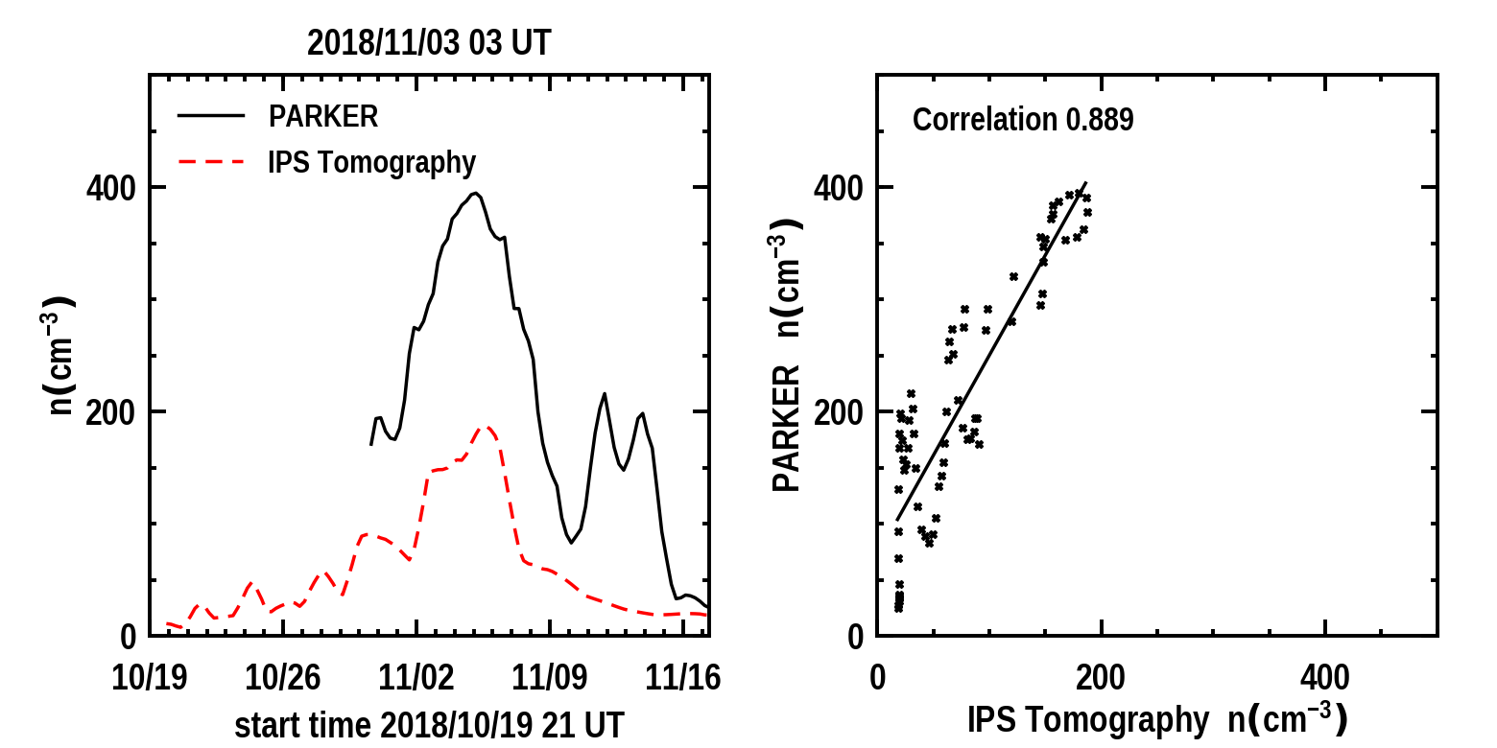
Jackson, B.V., et al., 2022, Adv. in Space Res., (under review)
1st PSP Pass
At Earth
At PSP (min distance = 0.17 AU)
: oops!

Slide 25
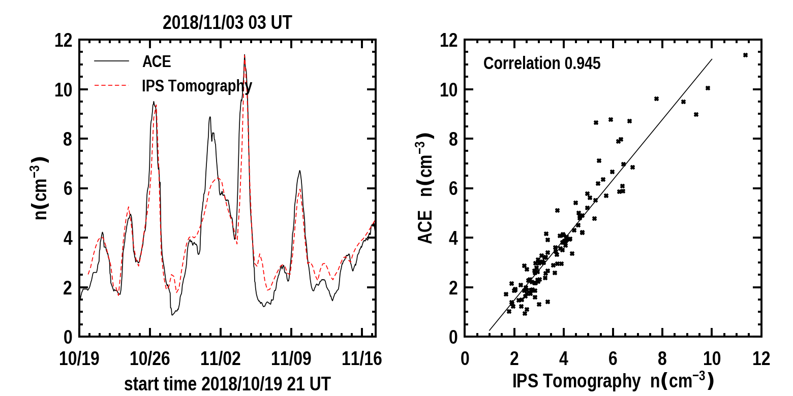
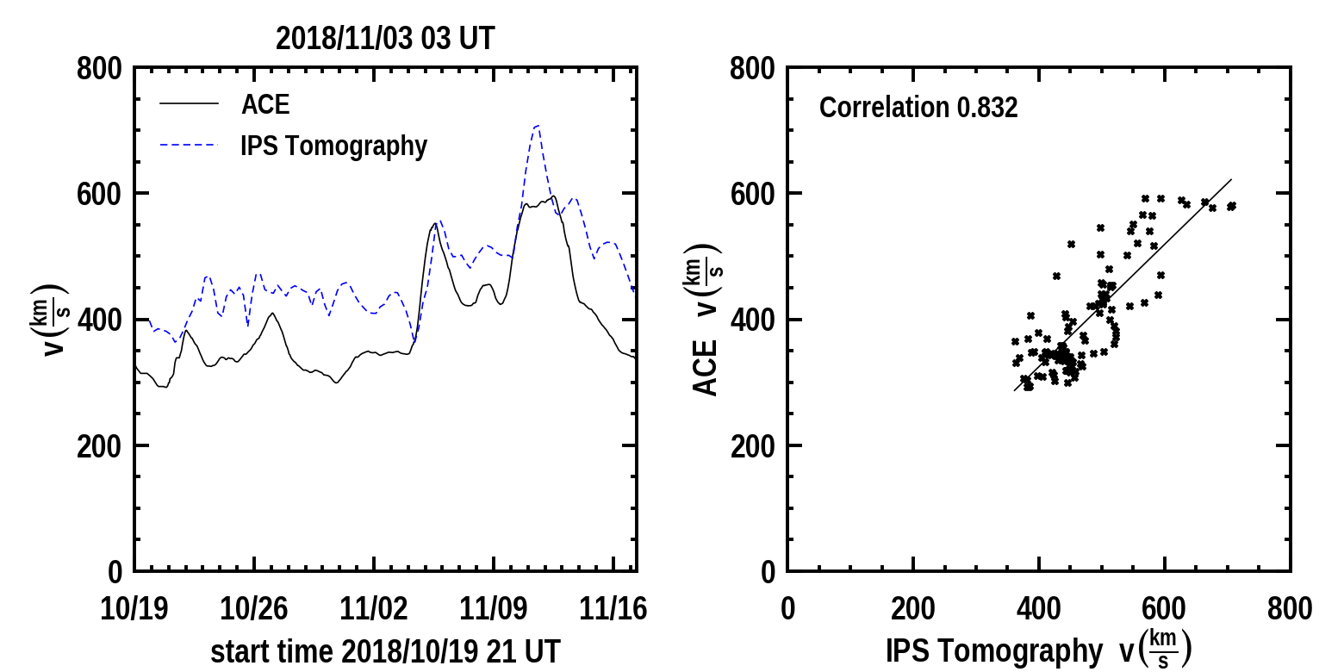
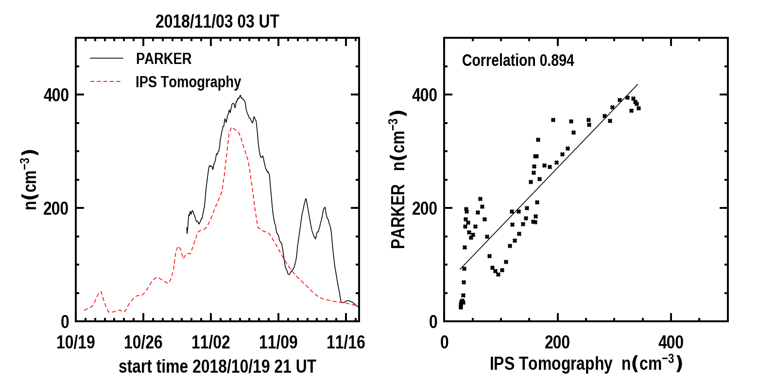
Jackson, B.V., et al., 2022, Adv. in Space Res., (under review)
1st PSP Pass
At Earth
At PSP: But this can be “fixed”! ??

Slide 26
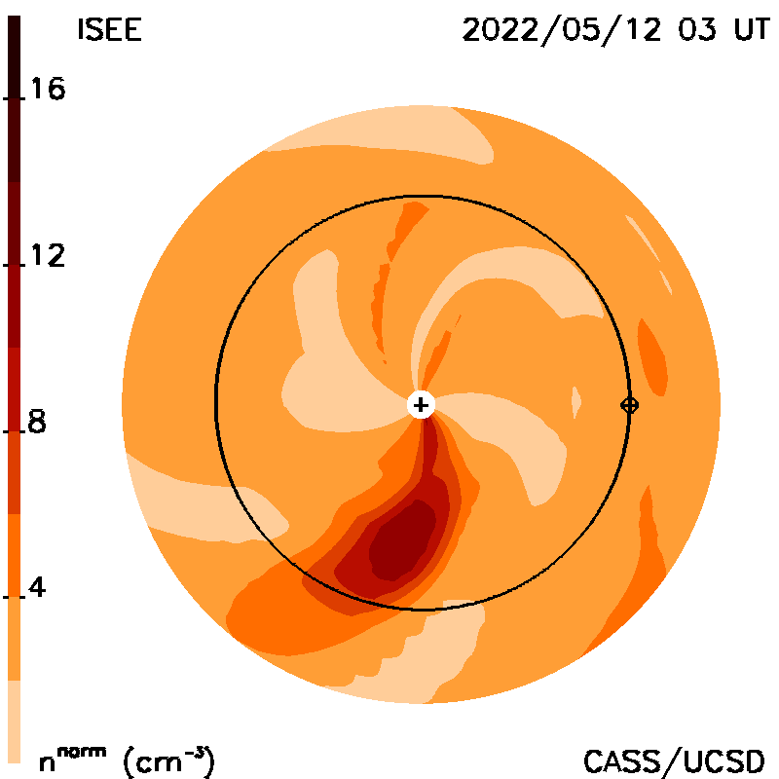
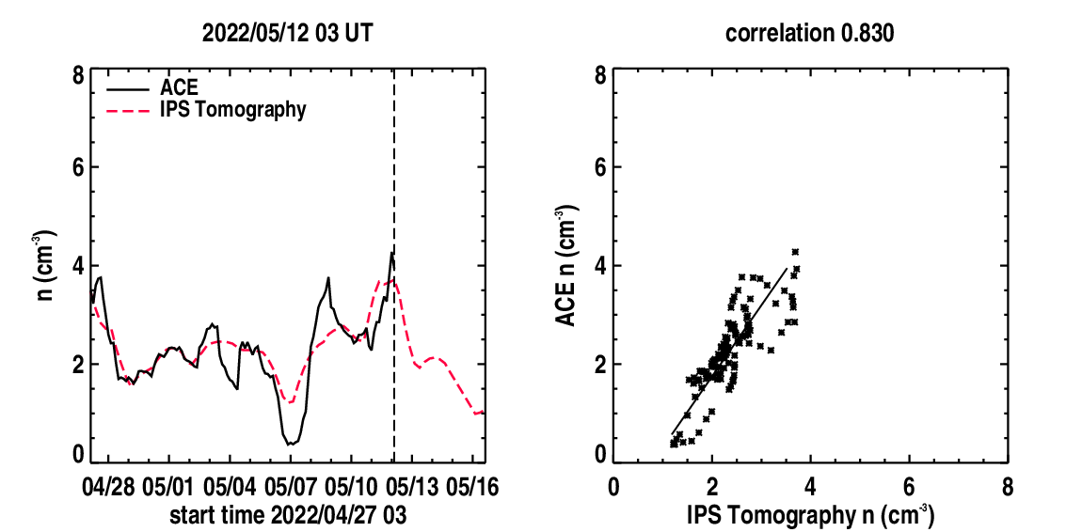
One Big Caveat
ACE
CELIAS
DSCOVR
Density
ACE, CELIAS, and DSCOVR densities are
all different!!!

Slide 27
One Big Caveat
ACE
CELIAS
DSCOVR
Velocity
ACE, CELIAS, and DSCOVR velocities are different!!!

Slide 28
Conclusions:
I’ve shown interplanetary scintillation (IPS) and its use in forecasts of CMEs and corotating structure arrival in this new solar cycle.
The new UCSD Webpages and these analyses now provide far more information globally, and to the distance of Jupiter.
IPS boundaries can drive the ENLIL modeling to give better results and confirm solar wind analyses near inner heliospheric spacecraft.
With caveats, we can now tweak MHD modeling (ENLIL) to provide better results in-situ both for 3-D MHD and UCSD IPS analyses.

