Slide 1
The Moon to Mars Space Weather Analysis Office Real-time Validation Efforts
Dr. Yaireska (Yari) Collado-Vega
Michelangelo Romano
M2M Team
Heliophysics Science Division
Space Weather Laboratory
NASA Goddard Space Flight Center
In close collaboration with the Community Coordinated
Modeling Center (CCMC) and the Space Radiation Analysis
Group (SRAG) from JSC.

Slide 2
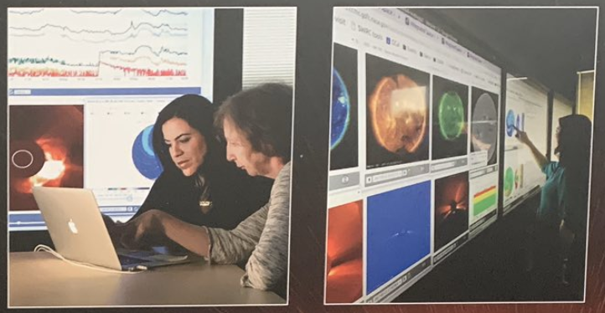
M2M Space Weather Analysis Office
Mission Statement: The Moon to Mars (M2M) Space Weather Analysis Office was established to support NASA’s Space Radiation Analysis Group (SRAG) with human space exploration activities by providing novel capabilities to characterize the space radiation environment. M2M also supports NASA robotic missions with space weather assessments and anomaly analysis support.
NOAA's Space Weather Prediction Center is the United States Government official source for space weather forecasts.
M2M will work as the proving grounds and testbed for the capabilities that will eventually transition to operational agencies.

Slide 3
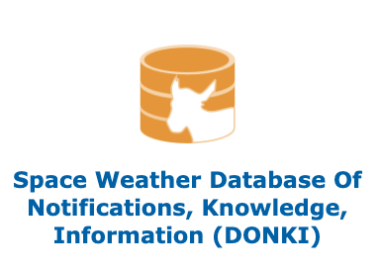
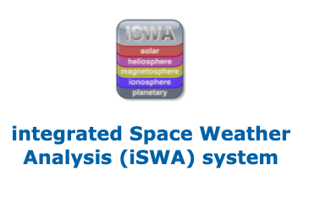
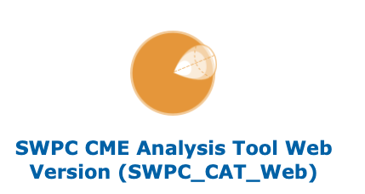
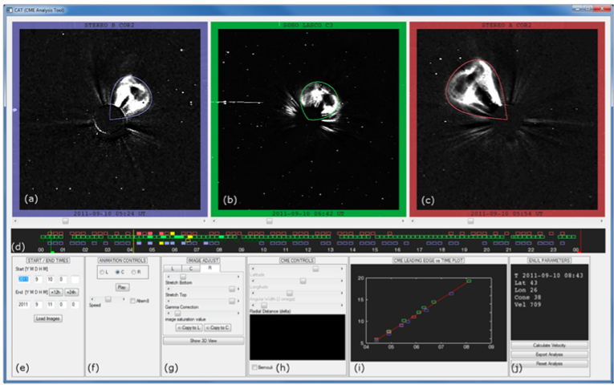
Overview of current M2M Activities
Real-time analysis of SWx activity (7 days a week; 8am-4pm ET).
SWx notifications and weekly reports issued to support NASA missions.
Documented/archived analysis to support research and requests for information.
Support on anomaly analysis for NASA robotic missions
Part of the GSFC Mission Resilience Program activities
Support of information for NASA payloads in launch activities.
Integrated Solar Energetic Proton Alert/Warning System (ISEP)
Host ISEP models and SEP Scoreboards within M2M environment on AWS.
Offer real-time analysis of ISEP models in support of SRAG console operators as a proving ground of the new capabilities.
Validate performance of ISEP models tested in a real-time operational setting.
Resources used to support real-time analysis:
SWPC_CAT

Slide 4
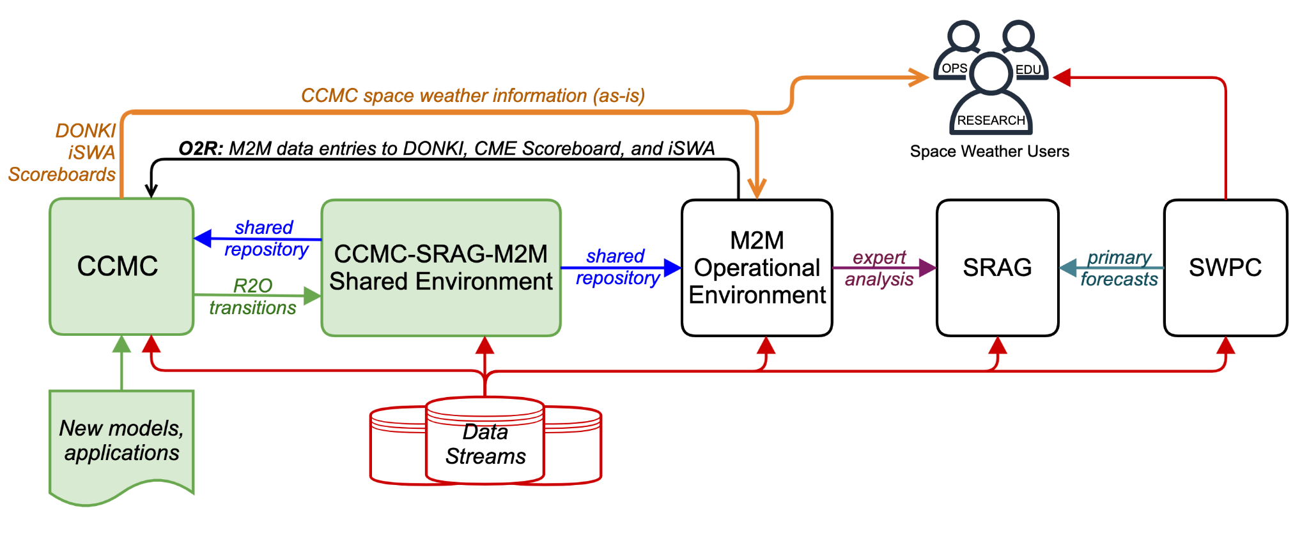
CCMC – M2M partnership: NASA in-house R2O2R pipeline in Support of Human Exploration
CCMC transitions ISEP models/software to the shared environment. M2M staff then transitions the models/software from the shared environment and maintains them within the M2M environment, serving SRAG as proving grounds of the capabilities in real time.

Slide 5
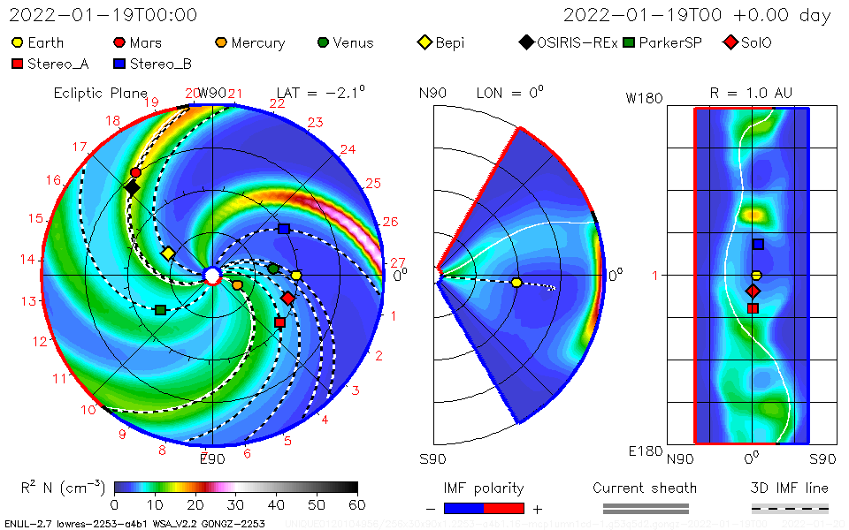
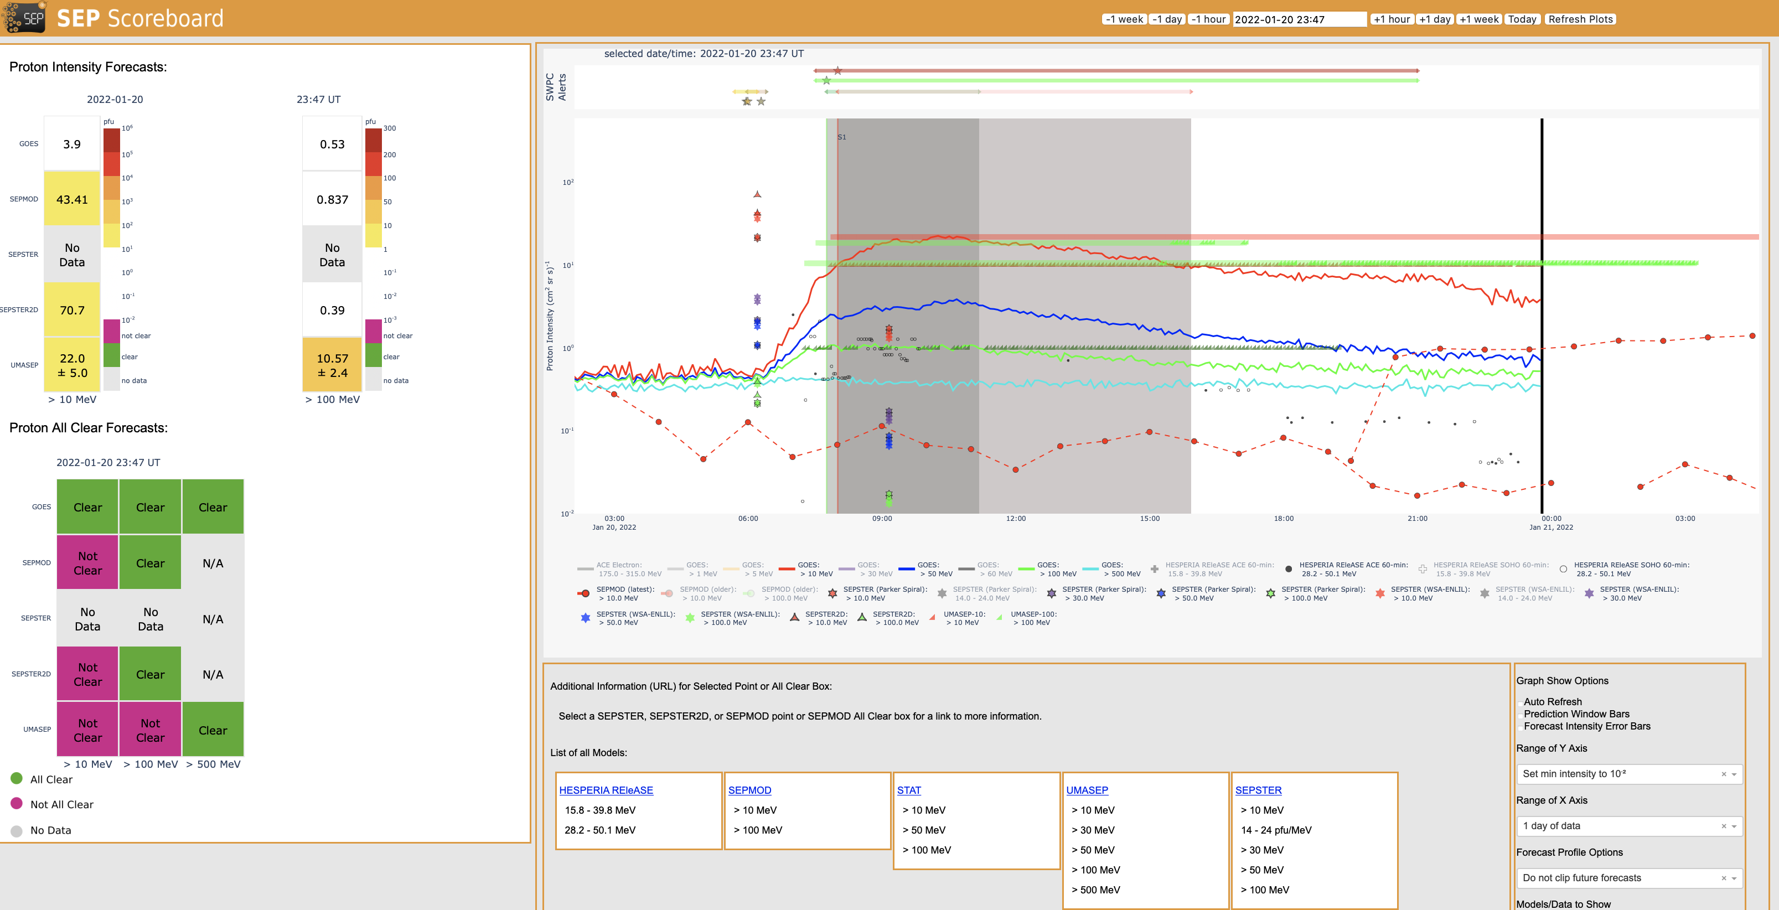
Real Time Analysis/Validation

Slide 6
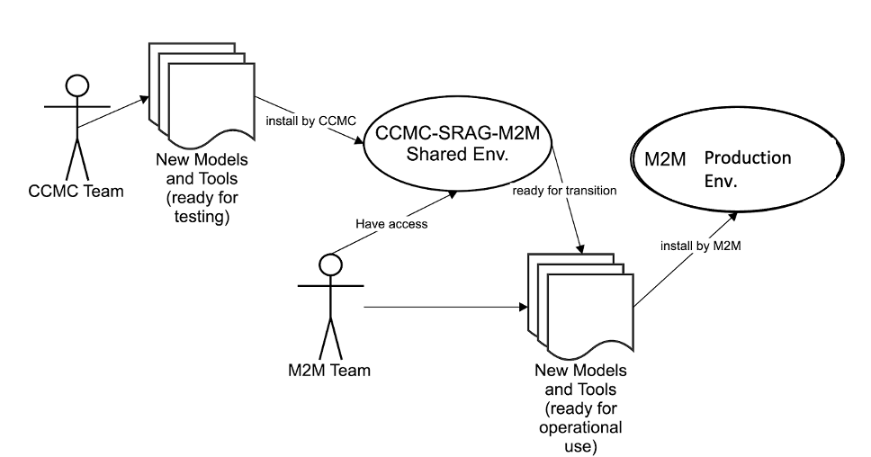
Overview of M2M’s Real-time Validation Efforts
M2M’s Role within the ISEP Project
https://ccmc.gsfc.nasa.gov/isep/
M2M implements and maintains the configuration of software related to the ISEP project in a real-time environment for supporting SRAG console operators.
M2M analysts lead efforts to validate models and evaluate how model performance is impacted by availability of real-time data and human-in-the-loop analysis.
Ongoing validation efforts support the assessment of model outputs populated into CCMC Scoreboards (see next slides).

Slide 7
CME Scoreboard
https://kauai.ccmc.gsfc.nasa.gov/CMEscoreboard/
Example of CME with Community Predictions
M2M assists with populating the CME Scoreboard with events and predictions
Official arrival times are determined in consultation with ICME experts at NASA GSFC involved with the Large-Scale Structures Originating from the Sun (LASSOS) project.

Slide 8
Framework of M2M’s Real-time Validation
Currently: M2M conducts an event-based validation in which the real-time model outputs for specific events of interest (e.g., SPEs/ESPEs or ICME arrivals) are evaluated. M2M validation studies include the following components:
Event Analysis (e.g., event onset, duration, associated activity, etc.)
Details of each event analysis are documented in the M2M_Catalog within The Space Weather Database Of Notifications, Knowledge, Information (DONKI) hosted by CCMC.
Review of Human-in-the-loop Activities (e.g., CME analysis and model triggering)
Real-time data availability for CME analysis, review of initial/updated CME measurements, and identified model triggers are closely examined.
Assessment of Model Performance (e.g., advanced warning time, prediction accuracy, etc.)
The configuration and real-time outputs of each model are carefully evaluated by reviewing real-time model input data and relevant observational data.
Future Work: M2M, CCMC, and SRAG plan to develop an automated validation technique to evaluate real-time model outputs over a continuous period of time (e.g., the past 30 or 60 days).
Such a technique will enable end-users to gauge model accuracy during specific periods of time and also offer continuously updated assessments of model performance.

Slide 9
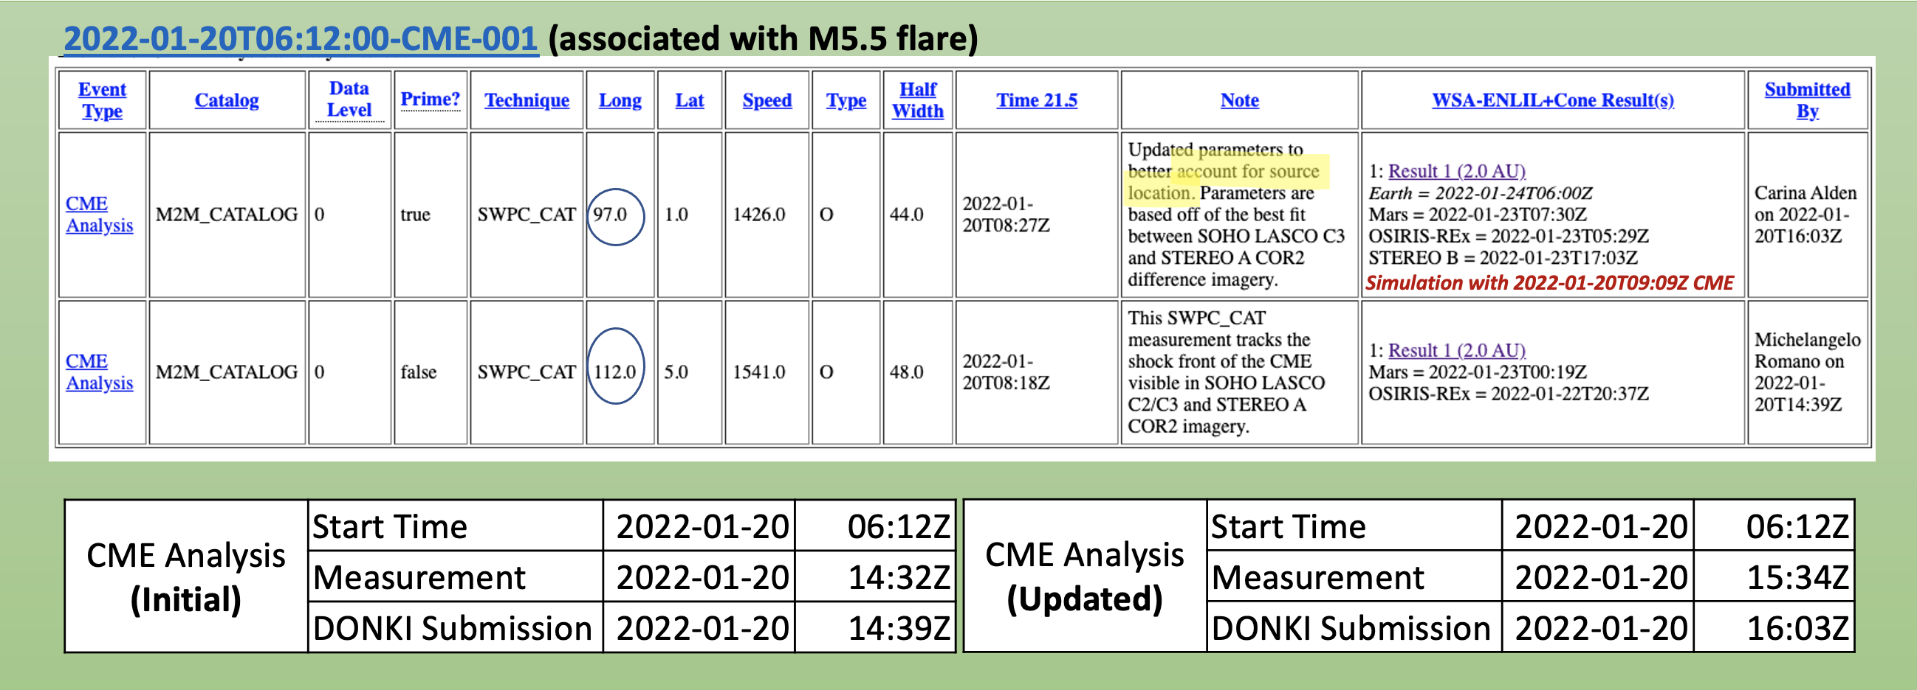
Review of Human-in-the-Loop Activities Example
2022-01-20 SEP Event
Questions regarding the real-time analysis of associated flare and CME triggers:
Was the source of the flare clearly identified and distinguishable from other eruption signatures in real-time?
How quickly were CME measurements made after coronagraph imagery became available?
Were initial CME measurements updated based on additional data or further analysis?
At what point were models triggered and forecasts issued using CME parameters derived in real-time?
Were there other CME events observed and were they appropriately accounted for by models?

Slide 10
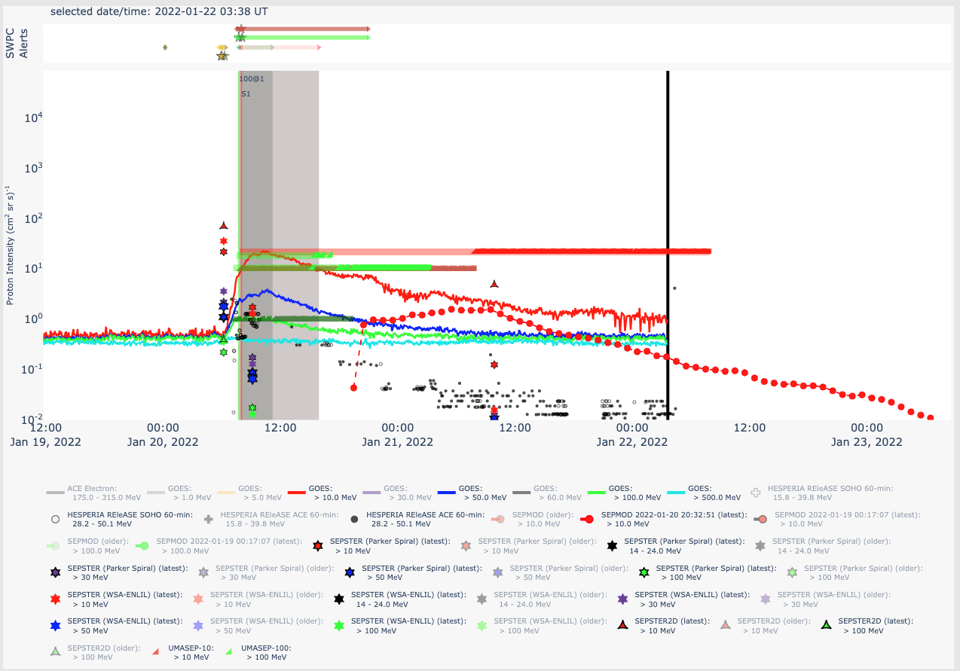
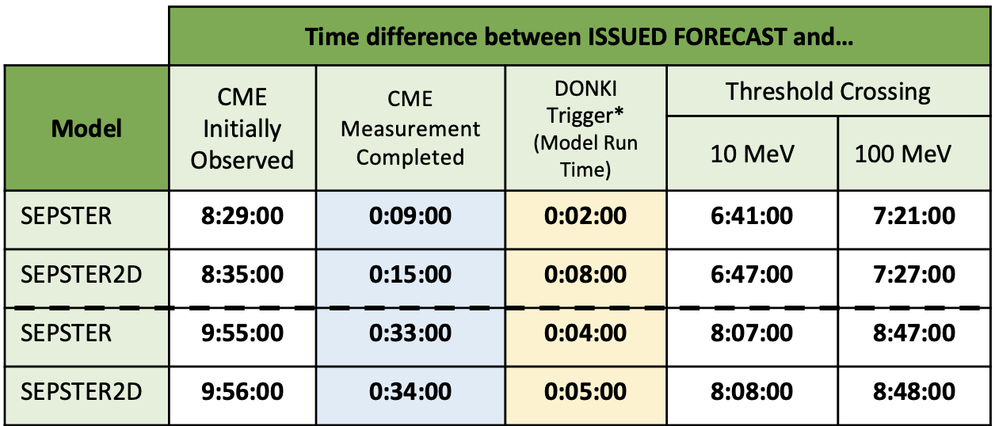
Assessment of Model Performance Example
2022-01-20 SEP Event
Factors impacting forecast issue times for each model are reviewed closely to assess Advanced Warning Times:
Validation metrics for each model within the SEP Scoreboards are calculated in close collaboration with SRAG and CCMC.
SEP Intensity Scoreboard for 2022-01-20 SEP Event
Initial
Updated
*DONKI Trigger refers to criteria for launching model (e.g., CME parameters submission to DONKI).

Slide 11
Summary
Given the new challenges with deep space exploration missions, additional support is needed in analyzing the space weather environment beyond the Sun-Earth line. The Moon to Mars (M2M) Space Weather Analysis Office will address these space weather needs by conducting and providing model-based predictions and analyses as proving grounds of tool development in support of SRAG.
CCMC and M2M are collaborating to create an effective NASA in-house R2O2R pipeline for space radiation environment predictive capabilities in support of human missions beyond LEO.
M2M also supports NASA robotic missions with space weather assessments and anomaly analysis support.
This Office is focused internally to NASA missions, but the capabilities developed could be used for commercial applications and in support of other non-NASA space endeavors if transitioned to operational agencies.
We look forward to additional collaborations with NASA missions/groups to further analyze and validate predictions of the space weather environment at different locations. We are also looking forward to strengthening our collaboration with NOAA.

Slide 12
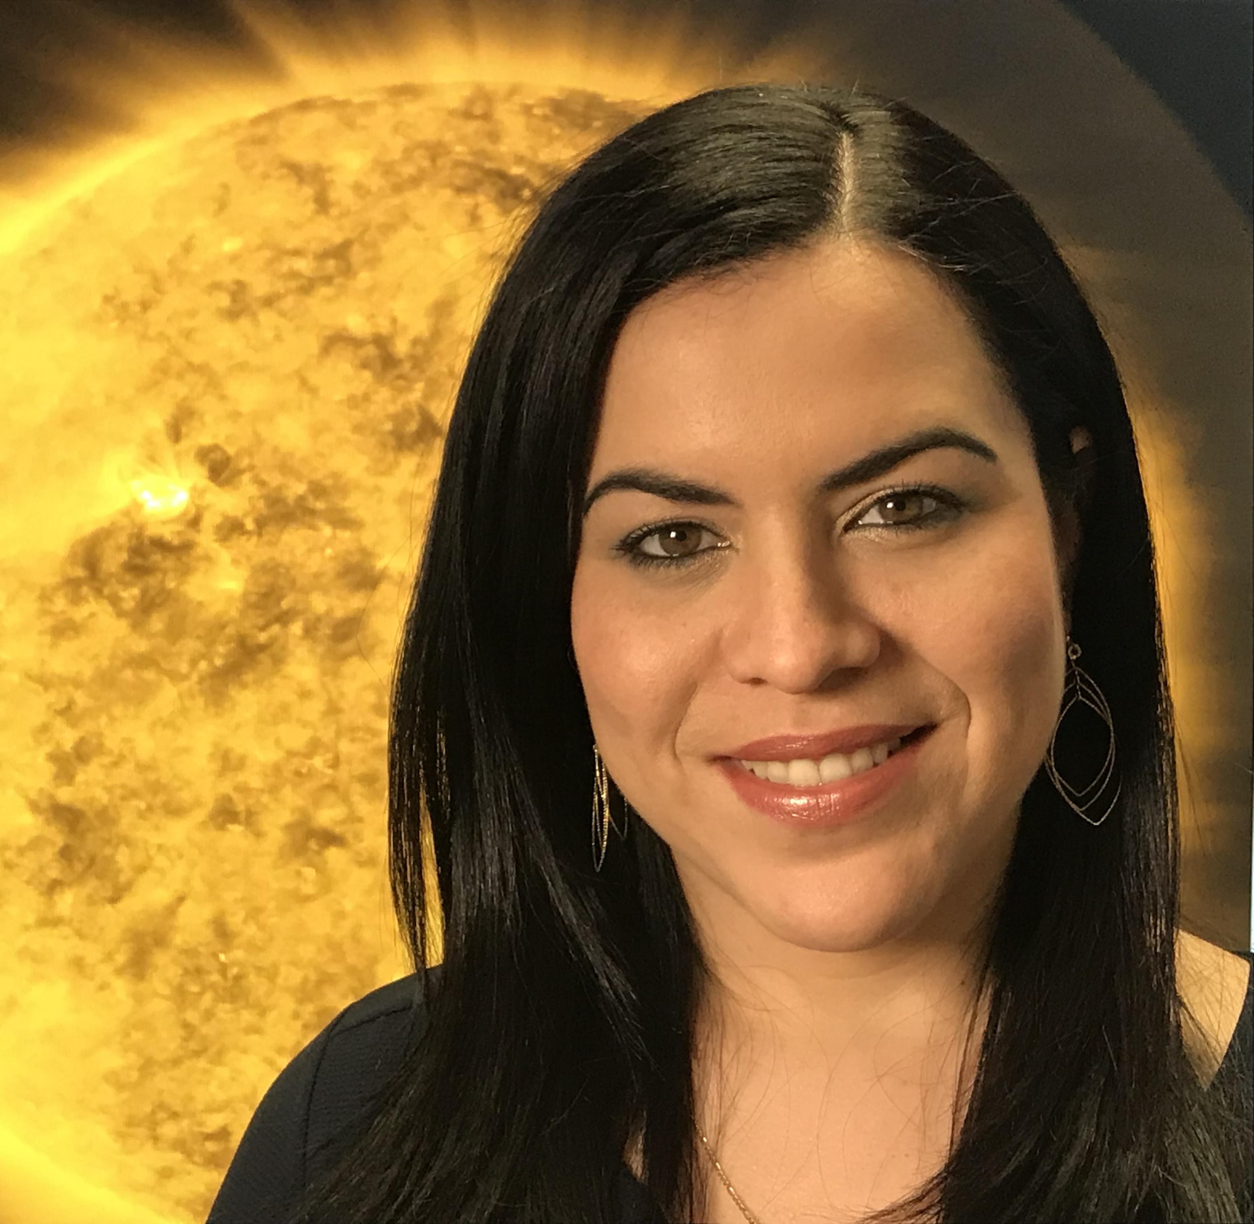
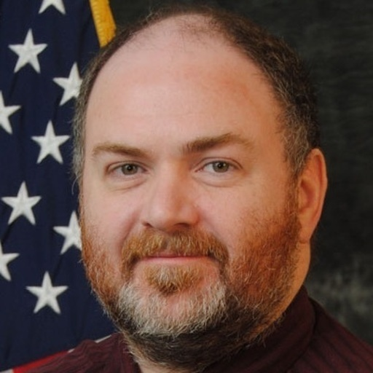
M2M Space Weather Office Team
Yaireska (Yari) Collado-Vega, PhD
Director
Anna Chulaki
Deputy
Robert Loper, PhD
Analyst
Carina Alden
Analyst
Michelangelo Romano
Analyst/PM
Mary Keenan, PhD
Scientific Software Developer
Mary Aronne
Analyst
Mattie Anastopulos
Analyst
Chris Stubenrauch
Analyst
Thank you!

