Slide 1
Maturing Models Toward Operations
An Operational Capability is:
Available in real-time
Maintained and Operated 24x7 by forecasting entity
Robust to potential interruptions (e.g., bad/missing data, network issues, general error handling, power disruptions, etc.)
Valuable to forecasting efforts generalized across relevant SWx events

Slide 2
Maturing Models Toward Operations
How are models selected for operational implementation? all highly collaborative efforts
Internal: develop in-house (to varying extents) capabilities – WAM, IPE, USTEC, GLOTEC
Direct: Identify model within research community which meets existing need – WSA, Enlil, OVATION, CARI-7
Competition: Organize community challenge to identify most skilled model according to predefined metrics – Geospace (UMich SWMF)
Regardless of origins, all require substantial additional development to support real-time operations
Scripting to manage execution, error handling
Additional tools to facilitate operational utility (e.g., CME Analysis Tool for WSA-Enlil)
Supporting utilities – visualization, UI, forecast product, database, dissemination, etc.

Slide 3
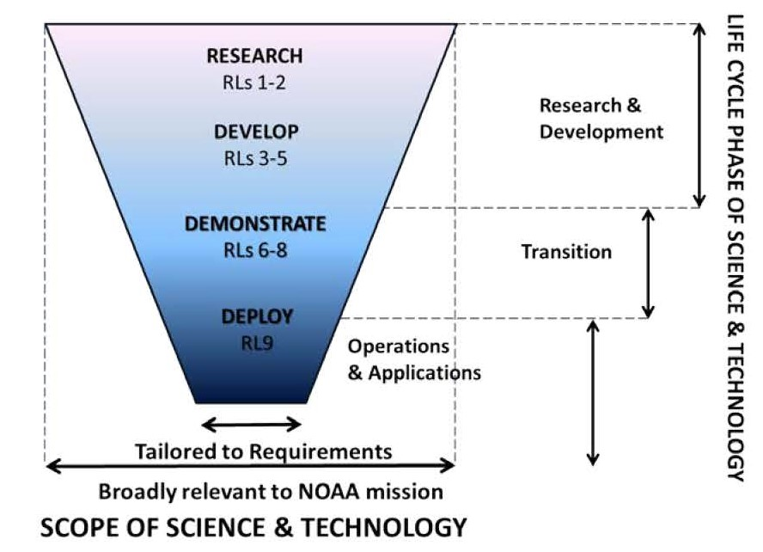
Maturing Models Toward Operations
R2O Funnel
ROSES SWR2O2R Program supports R&D, targeting RL5
Proving Grounds facilitate rigorous V&V in Ops-like environment and prepping for testbed
Final V&V and implementation
Progression is always a question of Cost vs Benefit
Not all projects will reach operational implementation

Slide 4
Maturing Models Toward Operations
Space Weather R2O Progression
RL Activities
1 | Basic Research
2 | Applied Research
3 | Proof-of-Concept Developed
4 | Initial Validation Complete
5 | Proving Ground Validation Complete
6 | Product Running RT in Test Environment
7 | Product Running in Staging Environment
8 | Stability Tested in Ops Environment
9 | Full Operations
 | Research & Development |  |  |  | Demonstration |  | Transition & Operations
RL | 1 | 2 | 3 | 4 | 5 | 6 | 7 | 8 | 9
 | Universities & Industry
 |  | Proving Grounds (e.g. NASA /NOAA ACE, SWPT)
 |  | NOAA Space Weather Prediction Testbed
Application Identified
Product Running in RT
Service Change notice for public product
Code Delivered to Proving Ground
Science Briefing & Approval
Promoted to Full Operations
Documented
Proof-of-Concept
Complete
Stability Test

Slide 5
Maturing Models Toward Operations
What constitutes readiness for transition to Proving Grounds (RL5)?
Substantial preliminary V&V undertaken - Modern software dev practices greatly expedite this process
Illustration that capability meets operational need – improves upon existing or provides new capability
Repeatable vs Reproducible - How portable is code? Migration to other architectures, compilers, OSs is inevitable
Built-in Unit tests, Regressions tests, CI all very valuable here
Prelim CONOPS and prototype product(s) available - illustrates feasible real time execution and associated latencies
Draft Transition Plan developed (preliminary description of full scope of path to ops – is the potential afforded worth cost to implement?)
Identify target implementation environment and governing standards
Describe critical software dependencies

Slide 6
Maturing Models Toward Operations
Benchmarks and Baselines
Illustration that a new capability improves predictive skill requires comparison to baseline performance (existing capability)
Establishment of Benchmark datasets can expedite determination of skill, but care should be taken
Should be as balanced as possible across phenomena of interest
Too small – encourages overfitting of models
Perhaps better to establish robust sets and pull randomized subsets for testing
SWPC aims to expand and update performance metrics for existing operational capabilities to facilitate R2O2R efforts

Slide 7
Maturing Models Toward Operations
“Essential Space Environment Quantities” (ESEQs) – Quantities indicative of phenomena of interest
Valuable in establishing targets for quantifying model skill
Examples:
Solar/Solar Wind – density, B, CME arrival (which quantity?)
SEPs – onset, intensity, duration
Geospace – Kp, Dst, dB/dt
Ionosphere – Total Electron Content, Max Useable Freq, Neutral density
May provide means of automating comparisons for early V&V
Particular care should be taken to ensure such targeted quantities align with forecasting methodologies

Slide 8
Maturing Models Toward Operations
Key Takeaways
CCMC is a key partner in facilitating the evaluation of models for potential advancement into SWx Proving Grounds
Communication between operations and research throughout the R2O2R cycle is fundamental to accelerating improved SWx forecasting
Modern software development practices are beneficial to everyone
High level of code portability is critical
Cultivation of strong collaborative relationships plays a vital role in advancing R2O2R process and SWx capabilities

