Slide 1
Simulation of SEPs in geospace with SWMF/AMPS
Valeriy Tenishev

Slide 2
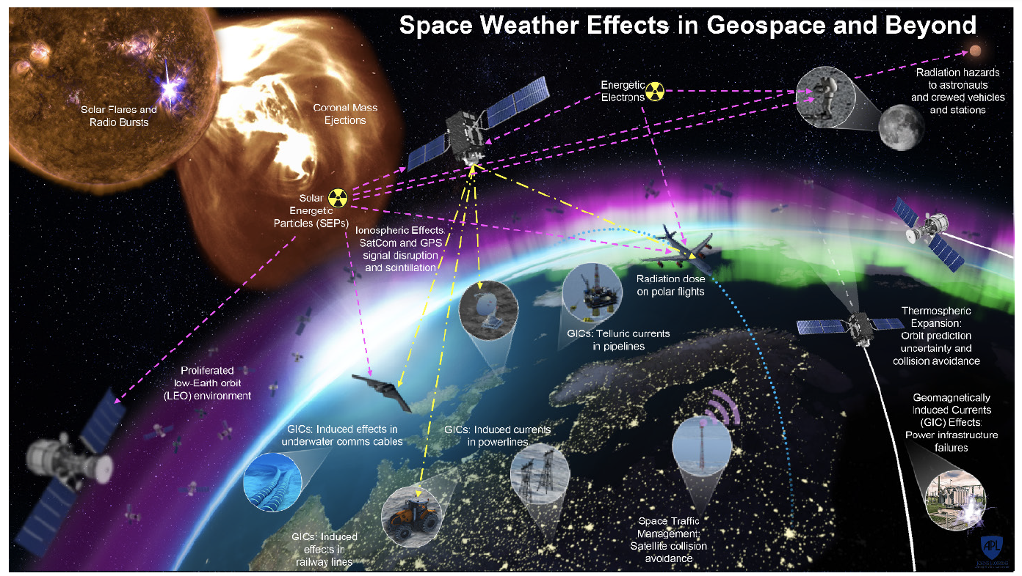
Effects due to SEPS in geospace
Valeriy Tenishev
CCMC Workshop, 2022

Slide 3
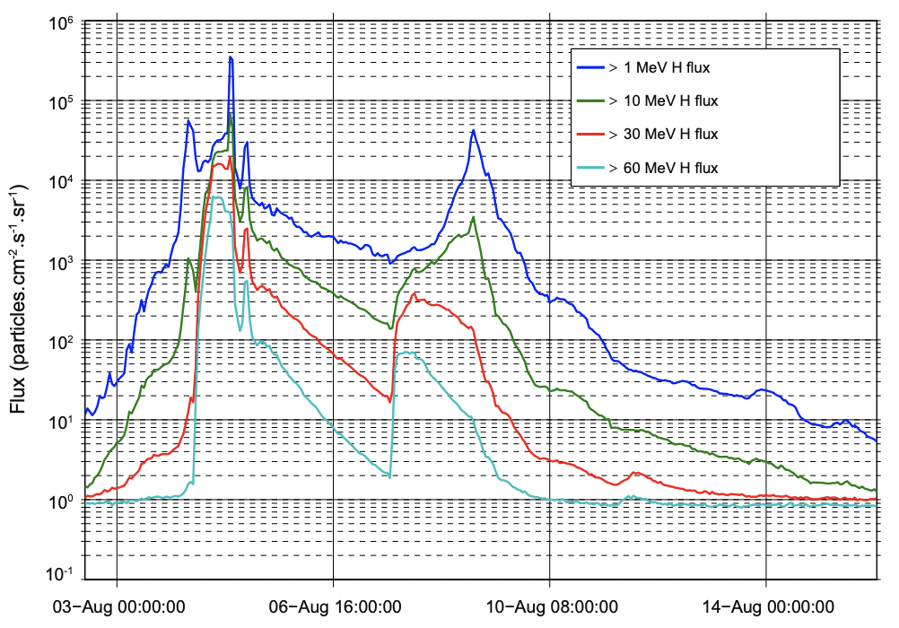
Variability of SEPs
Valeriy Tenishev
CCMC Workshop, 2022

Slide 4
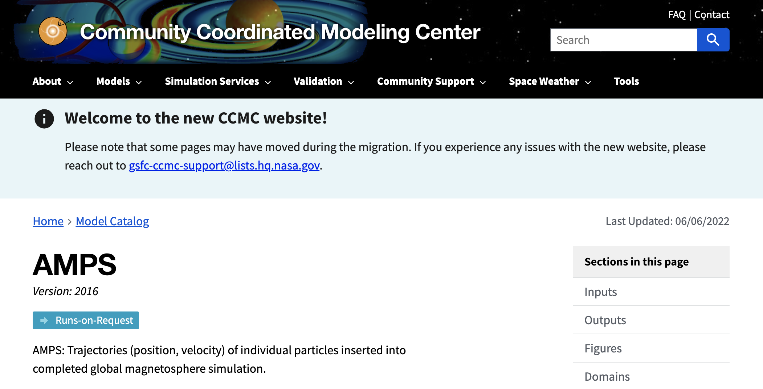
AMPS in CCMC
Valeriy Tenishev
CCMC Workshop, 2022

Slide 5
AMPS in CCMC
Analyze charged particle trajectories moving in plasma
Post processing tool: use pre-calculated plasma and magnetic field
Import of the plasma flow simulations into AMPS
Time-dependent results of the plasma modeling is saved in files
Output
Individual particle trajectories
Samples of the distribution functions
Particle trajectory integration in AMPS
Trajectory affected by the Lorentz force
Particle tracking along a magnetic field line
Valeriy Tenishev
CCMC Workshop, 2022
Notes:
Analyze charged particle trajectories moving in plasma
Post processing tool: use pre-calculated plasma and magnetic field
Import of the plasma flow simulations into AMPS
Time-dependent results of the plasma modeling is saved in files
Kameleon is used for interpolating of the plasma model into AMPS’ mesh
Results provided by AMPS
Individual particle trajectories
Samples of the distribution functions
Particle trajectory integration in AMPS
Boris
Guiding center
Particle tracking along a magnetic field line

Slide 6
Update of AMPS in CCMC
Calculation of fluxes and rigidity cutoff
Precalculated geomagnetic field or an empirical model
A single point or spherical shell
2. At the later stage: modeling SEPs in the heliosphere
Parker or Focused Transports equation
3D or magnetic field line (SWMF, Parker spiral)
Turbulence model (SWMF/AWSOM, $δB=f(B)$)
Diffusion coefficient
Seed population, injection efficiency
Background solar wind model
Valeriy Tenishev
CCMC Workshop, 2022

Slide 7
Update of AMPS in CCMC
Calculation of fluxes and rigidity cutoff
Precalculated geomagnetic field or an empirical model
A single point or spherical shell
2. At the later stage: modeling SEPs in the heliosphere
Parker or Focused Transports equation
3D or magnetic field line (SWMF, Parker spiral)
Turbulence model (SWMF/AWSOM, $δB=f(B)$)
Diffusion coefficient
Seed population, injection efficiency
Background solar wind model
Valeriy Tenishev
CCMC Workshop, 2022

Slide 8
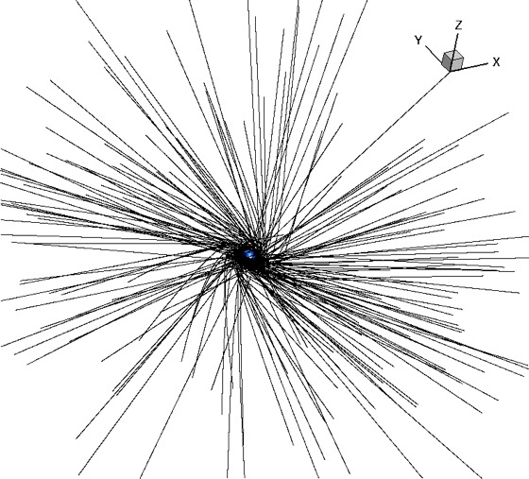
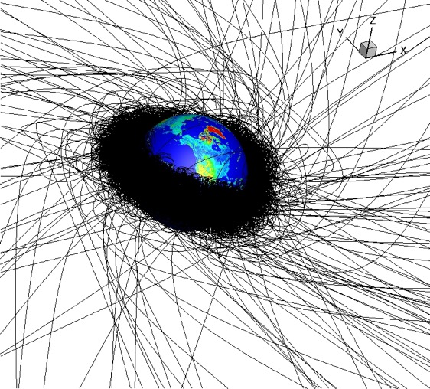
Backward Particle Tracking
Small and Large scale energetic particle trajectory integration
Radiation environment in the entire Earth’s magnetosphere
Valeriy Tenishev
CCMC Workshop, 2022

Slide 9
Rigidity cutoff
Suppression of the rigidity cutoff during a geomagnetic storm.
The calculation was performed for conditions of the geomagnetic storm on March 17, 2015. In general, rigidity cutoff suppression is more significant in the mid-latitude region.
Rigidity cutoff map
The map is calculated for an altitude of 500 km.
Rigidity cutoff map calculated for quiet geomagnetic conditions.
Valeriy Tenishev
CCMC Workshop, 2022

Slide 10
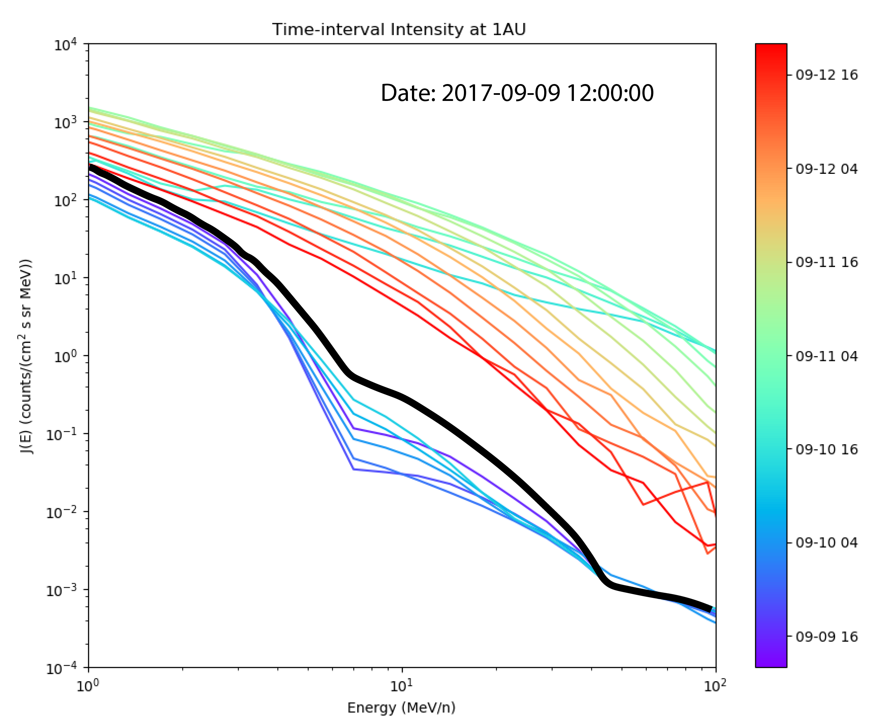
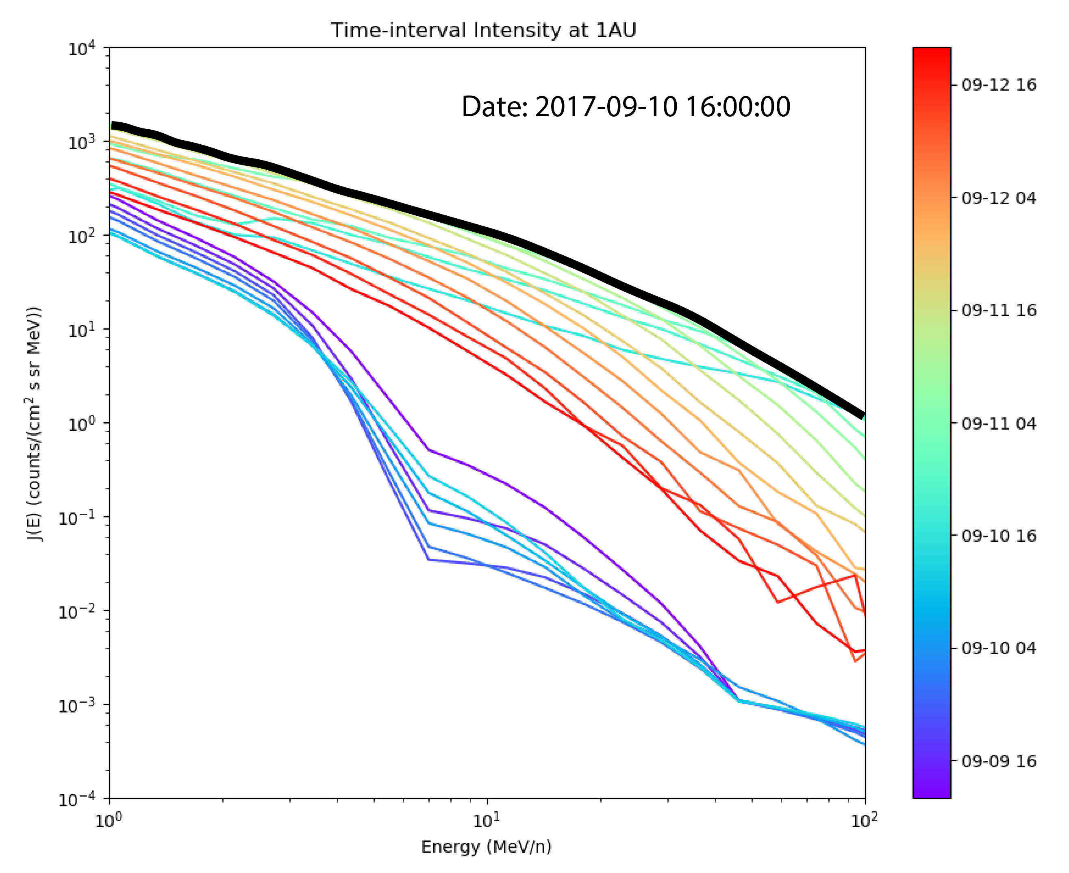
Example: Energy Spectrum of SEPs
Event: 2017-09-09 - 2017-09-12
Energy spectrum of SEPs outside of the Earth’s magnetosphere calculated with iPATH
Valeriy Tenishev
CCMC Workshop, 2022

Slide 11
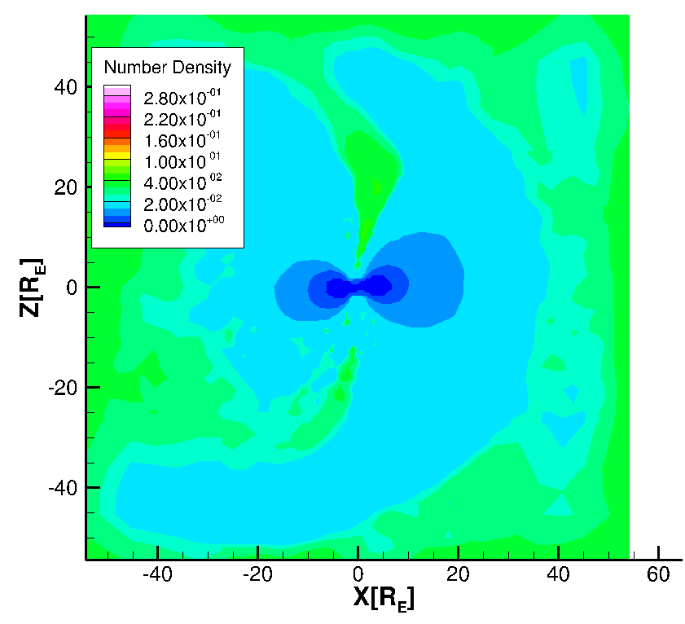
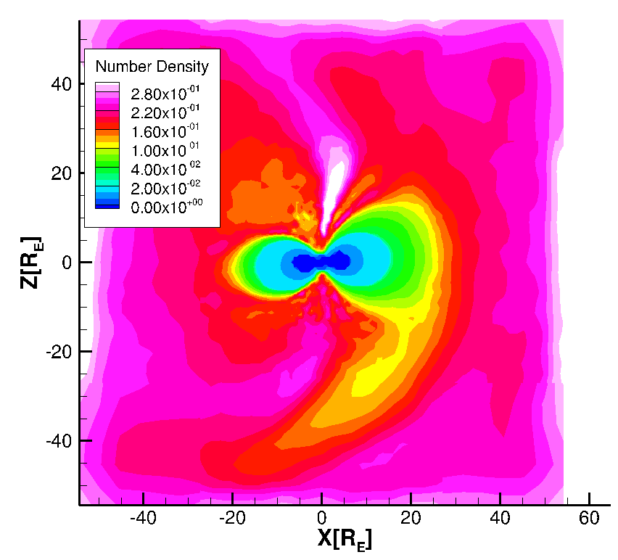
Simulated distribution of SEPs in geospace
Event: 2017-09-09 - 2017-09-12
Density of the energetic particles increased by an order of magnitude
Before the event
Main phase of the event
Valeriy Tenishev
CCMC Workshop, 2022

Slide 12
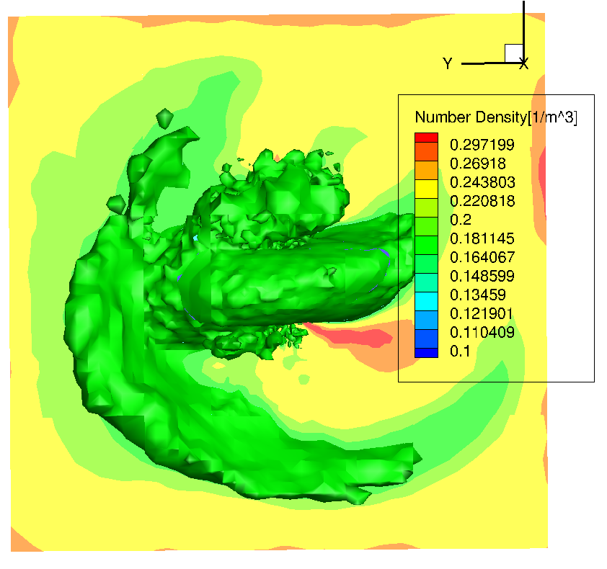
Conclusion
Kinetic effects dominates distribution of energetic particles in geospace
Combination of SWMF/AMPS + SWMF/BATSRUS codes provides capabilities for modeling SEPs and GCRs in geospace
The content of SEPs can exabit a major density increase during a SEP event
Structure of energetic particles' density in geospace
Valeriy Tenishev
CCMC Workshop, 2022

