Slide 1
Simulating Long-Term Dynamics of Radiation Belt Electrons Using DREAM3D Model
Sang-Yun Lee¹, Weichao Tu¹,
Misa M. Cowee², Gregory S. Cunningham², Dedong Wang³,
Yuri Y. Shprits^{3,4,5}, Michael G. Henderson², Geoffrey D. Reeves²
¹West Virginia University, West Virginia, USA
²Los Alamos National Laboratory, New Mexico, USA
³GFZ German Centre for Geosciences, Potsdam, Germany
⁴Institute of Physics and Astronomy, University of Potsdam, Potsdam, Germany
⁵University of California Los Angeles, Los Angeles, CA, USA
06.09.2022
CCMC Workshop

Slide 2
Introduction
Several models have been developed to investigate the radiation belt dynamics such as DREAM3D, VERB, salambo, CIMI, etc.
A benchmarking challenge has been proposed to evaluate the performance of various radiation belt models.
- The target is the entire year of 2017 using GEO observations as the outer boundary condition.
In this study, we used the DREAM3D to simulate the radiation belt dynamics by investigating the effects of various boundary conditions, radial diffusion coefficients, hiss and chorus wave models.

Slide 3
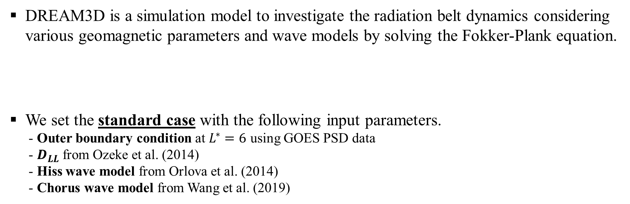
Model Description
DREAM3D is a simulation model to investigate the radiation belt dynamics considering various geomagnetic parameters and wave models by solving the Fokker-Plank equation.
We set the standard case with the following input parameters.
- Outer boundary condition at $L^{∗}=6$ using GOES PSD data
- $D_{LL}$ from Ozeke et al. (2014)
- Hiss wave model from Orlova et al. (2014)
- Chorus wave model from Wang et al. (2019)
$$\frac{∂f}{∂t} = \frac{1}{G}\frac{∂}{∂α}\left(GD_{αα}\frac{∂f}{∂α}\right) + \frac{1}{p^{2}}\frac{∂}{∂p}\left(p^{2}D_{pp}\frac{∂f}{∂p}\right) + \frac{1}{G}\frac{∂}{∂α}\left(GD_{αp}\frac{∂f}{∂p}\right)+ \frac{1}{p^{2}}\frac{∂}{∂p}\left(p^{2}D_{pα}\frac{∂f}{∂α}\right) + L^{2}\frac{∂}{∂L}\left(\frac{D_{LL}}{L^{2}}\frac{∂f}{∂L}\right) − \frac{f}{τ}$$

Slide 4
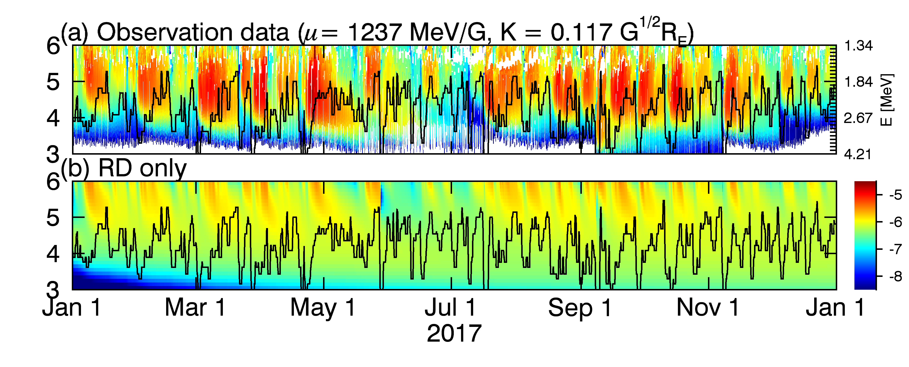
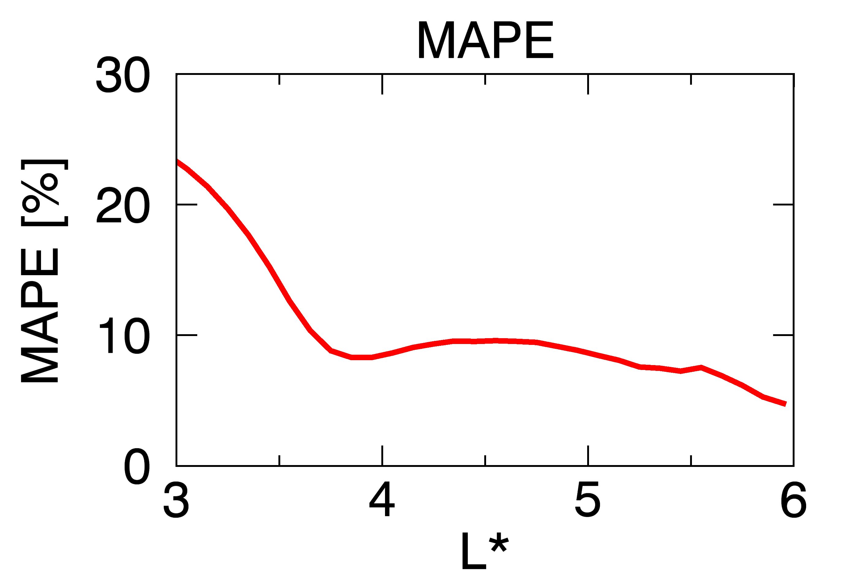
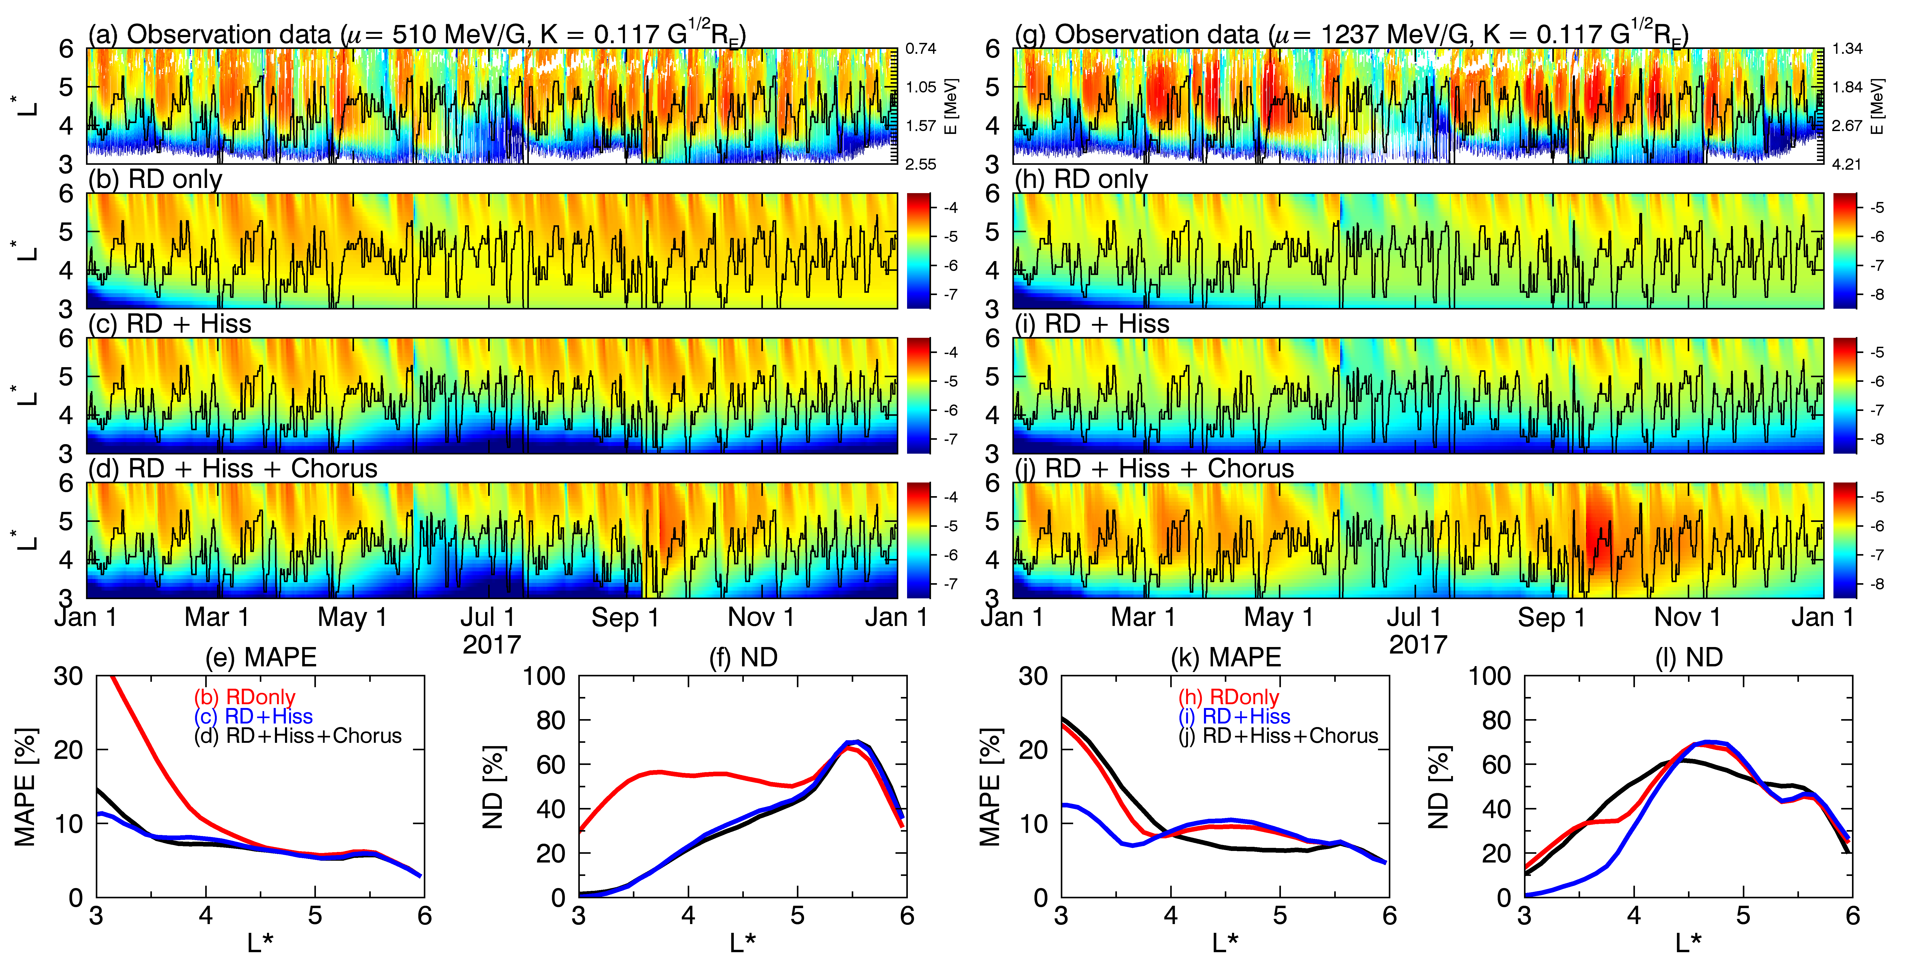
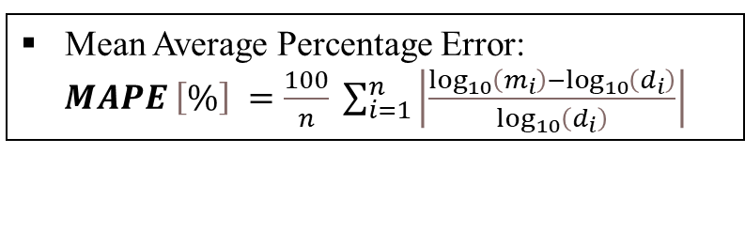
Results – 1. Standard
(b) RD only
[Ozeke et al. (2014)]
Mean Average Percentage Error:
$MAPE \left[\%\right] =\frac{100}{n} \sum_{i=1}^{n}{\left|\frac{\log_{10}\left(m_{i}\right)−\log_{10}\left(d_{i}\right)}{\log_{10}\left(d_{i}\right)}\right|}$
[Kim et al. 2012; Tu et al., 2013]
The radial diffusion reproduces the variation of PSD below L=6.

Slide 5
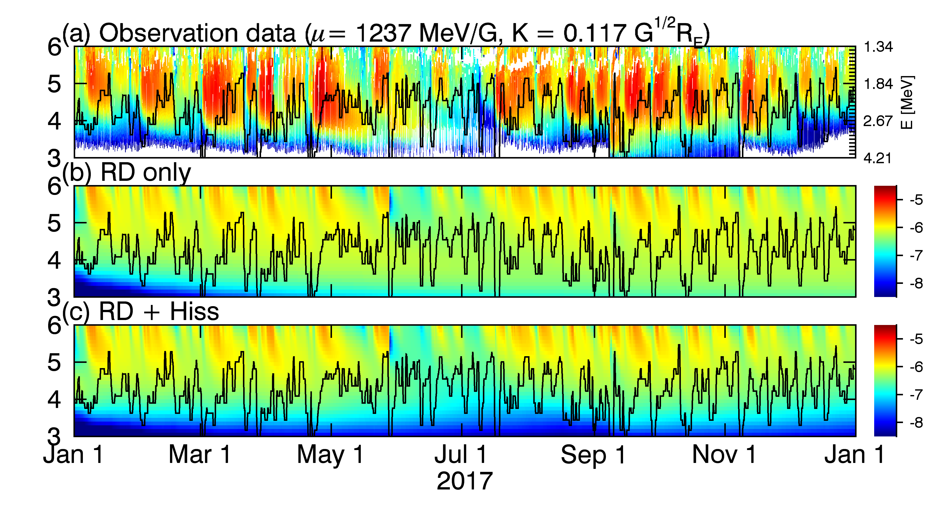
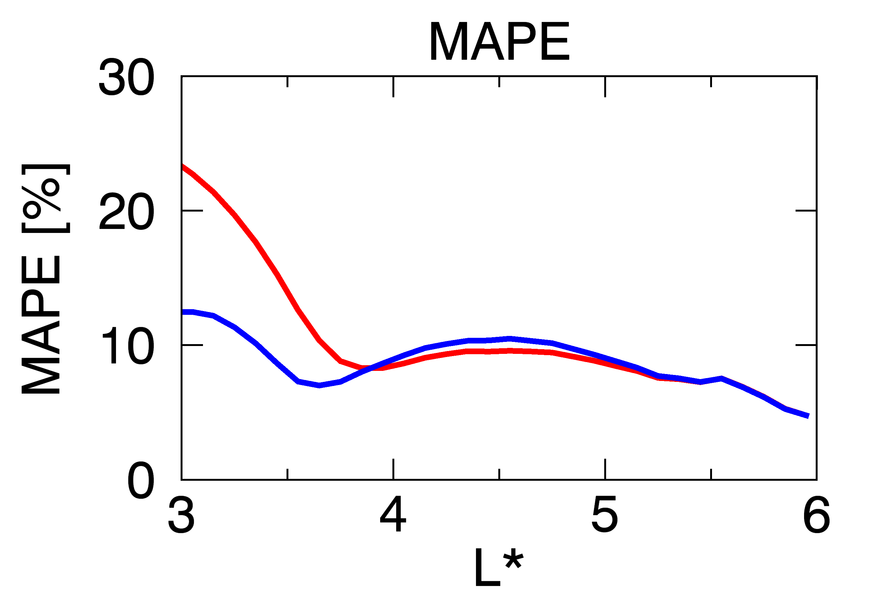
Results – 1. Standard
(b) RD only
(c) RD + Hiss
[Ozeke et al. (2014)]
[Orlova et al. (2014)]
Mean Average Percentage Error:
$MAPE \left[\%\right] =\frac{100}{n} \sum_{i=1}^{n}{\left|\frac{\log_{10}\left(m_{i}\right)−\log_{10}\left(d_{i}\right)}{\log_{10}\left(d_{i}\right)}\right|}$
[Kim et al. 2012; Tu et al., 2013]
The radial diffusion reproduces the variation of PSD below L=6.
The hiss waves effectively reduce PSD inside the plasmasphere.

Slide 6
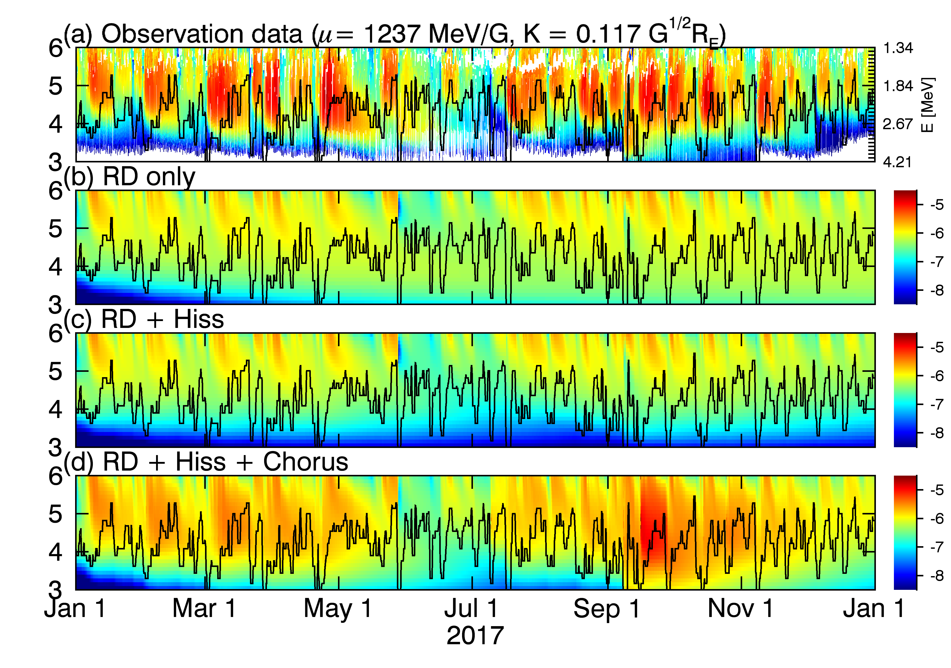
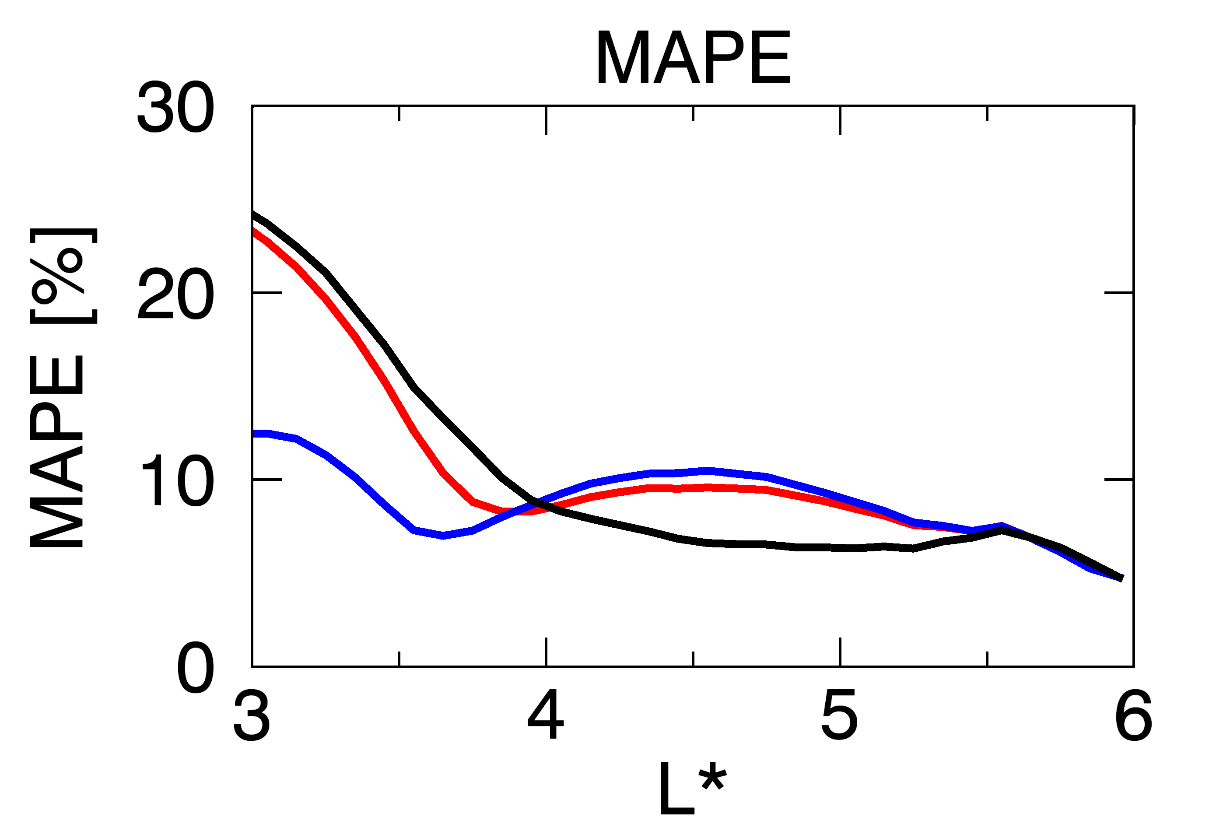
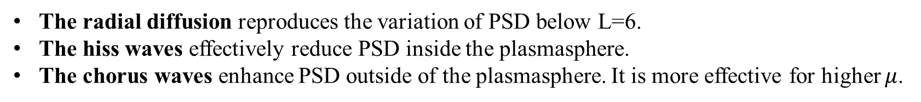
Results – 1. Standard
(b) RD only
(c) RD + Hiss
(d) RD + Hiss + Chorus
[Ozeke et al. (2014)]
[Orlova et al. (2014)]
[Wang et al. (2019)]
Mean Average Percentage Error:
$MAPE \left[\%\right] =\frac{100}{n} \sum_{i=1}^{n}{\left|\frac{\log_{10}\left(m_{i}\right)−\log_{10}\left(d_{i}\right)}{\log_{10}\left(d_{i}\right)}\right|}$
[Kim et al. 2012; Tu et al., 2013]
The radial diffusion reproduces the variation of PSD below L=6.
The hiss waves effectively reduce PSD inside the plasmasphere.
The chorus waves enhance PSD outside of the plasmasphere. It is more effective for higher $μ$.

Slide 7
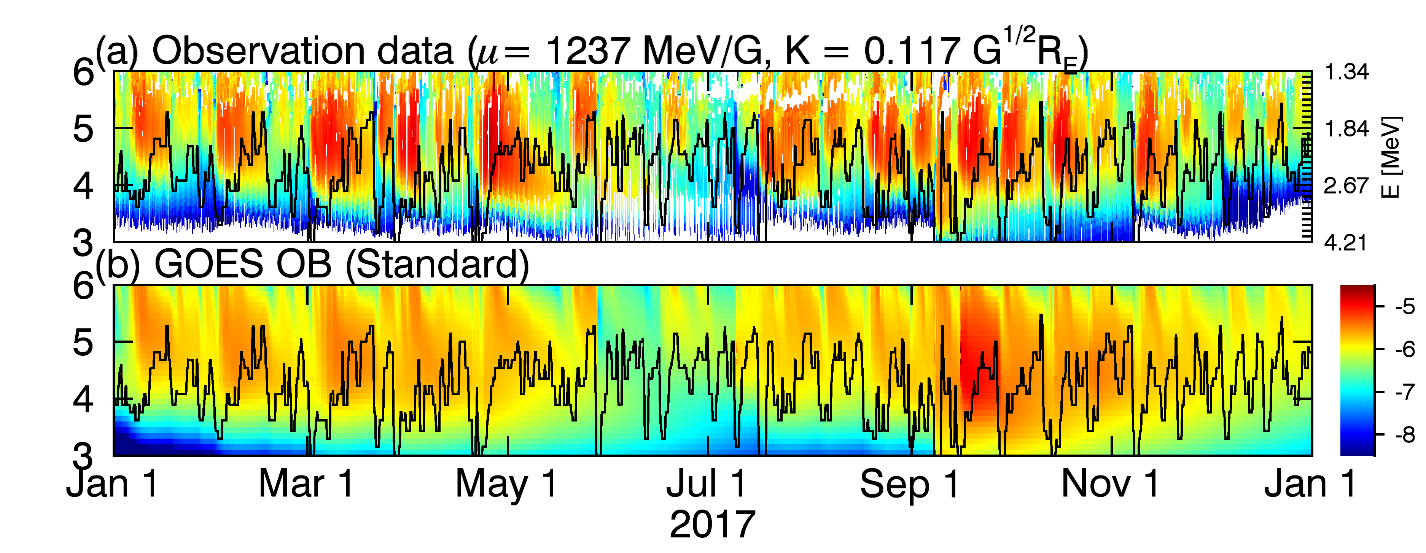
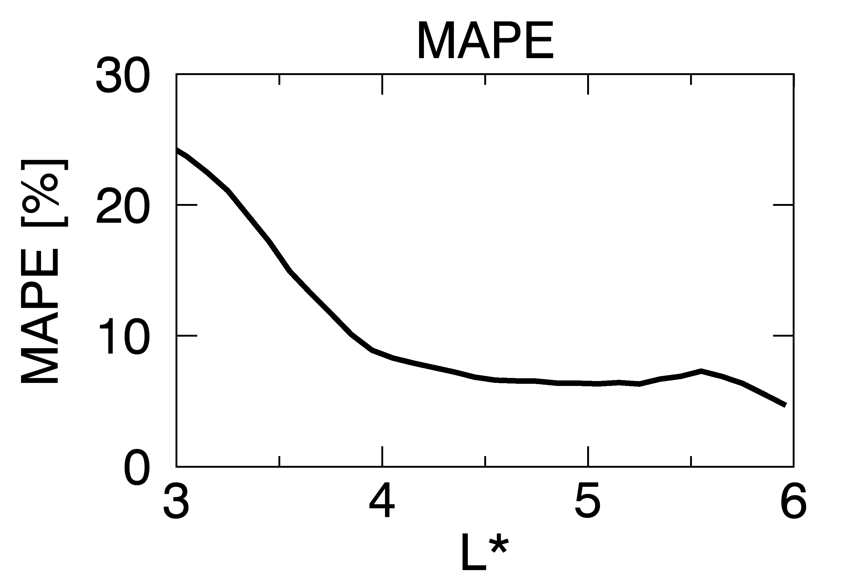
Results – 2. Outer boundary conditions
(b) GOES OB (Standard)

Slide 8
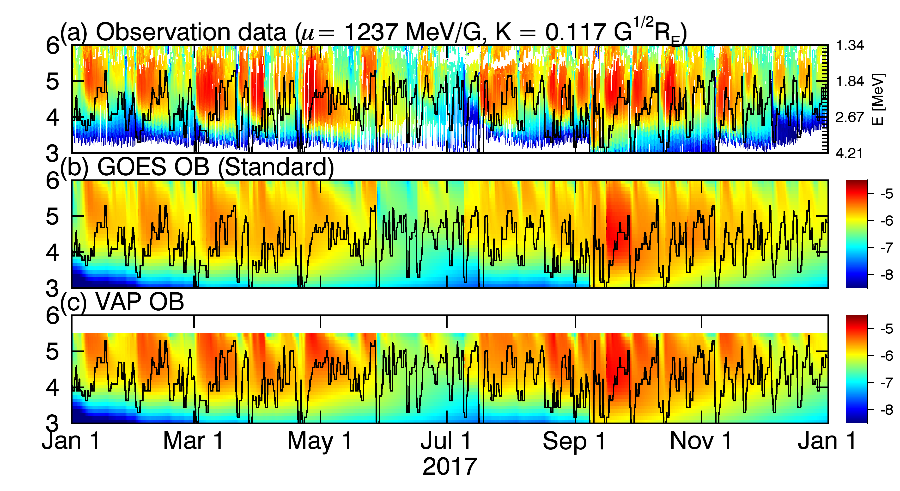
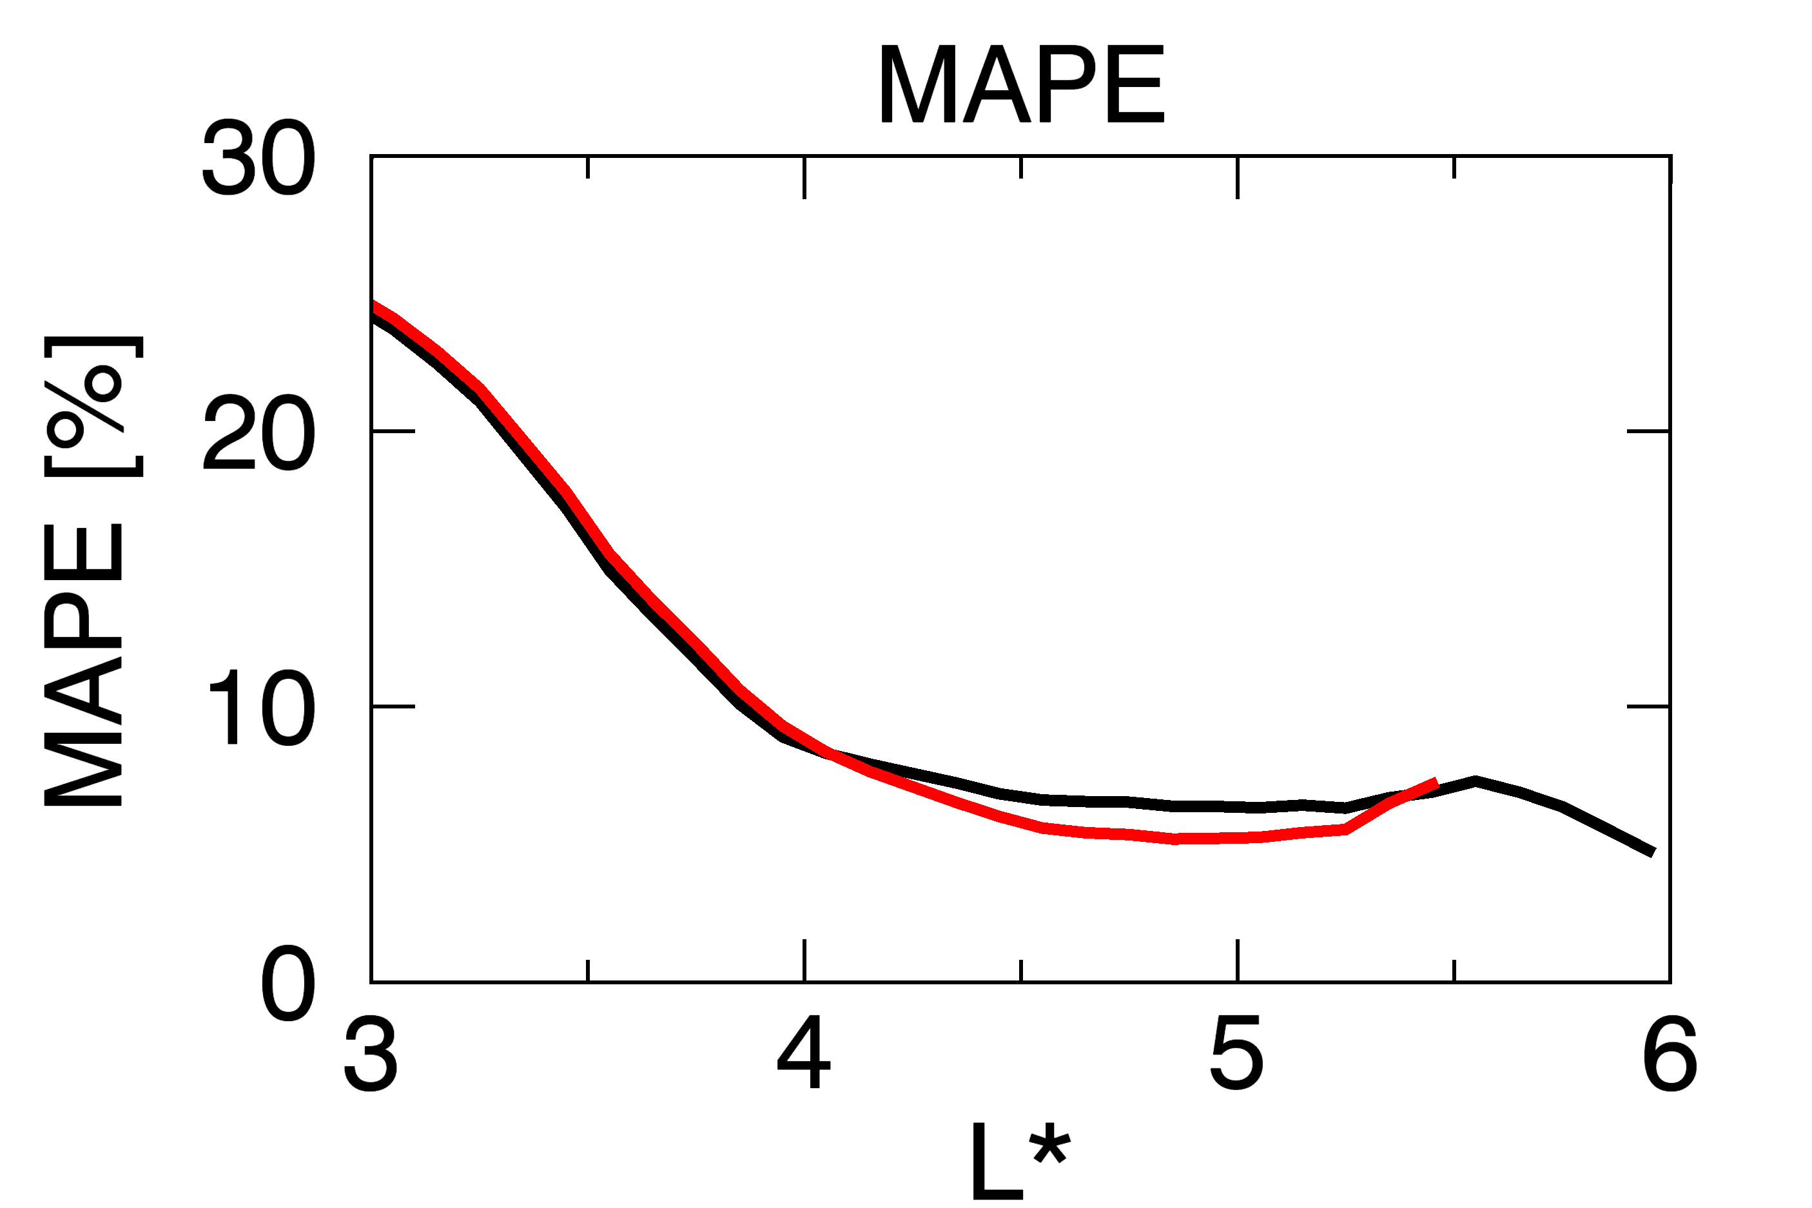
Results – 2. Outer boundary conditions
(b) GOES OB (Standard)
(c) VAP OB
(VAP OB) Enhanced PSD due to the high values of PSD at lower boundary at L=5.5 compared to the GOES OB.

Slide 9
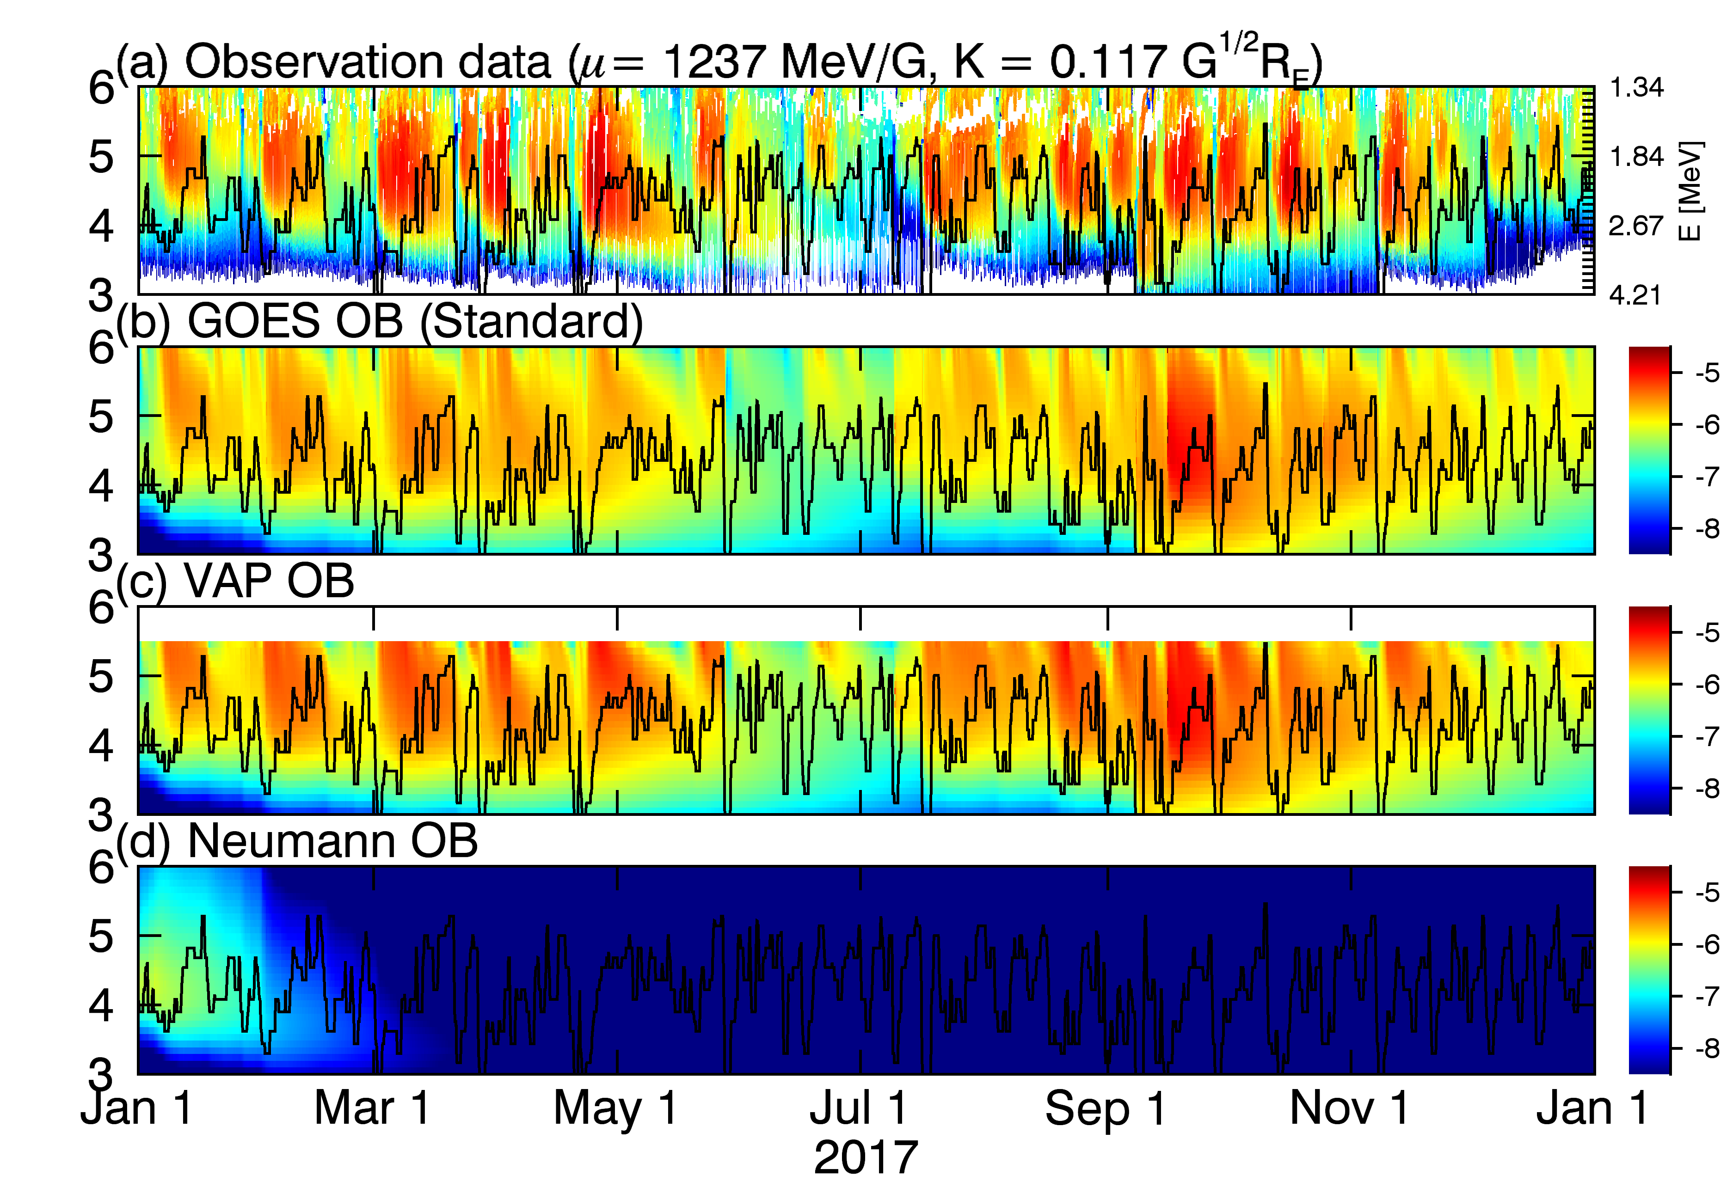
Results – 2. Outer boundary conditions
(b) GOES OB (Standard)
(c) VAP OB
(VAP OB) Enhanced PSD at higher mu due to the high values of PSD at lower boundary at L=5.5, compared to the GOES OB.
(Neumann BC) The importance of data-driven boundary conditions.
- Chorus heating cannot reproduce enough values of PSD without any data driven boundary conditions.

Slide 10
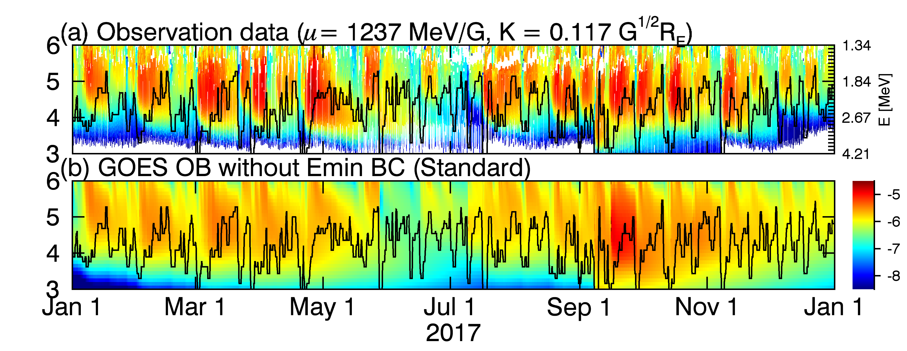
Results – 3. Minimum energy boundary conditions
(b) GOES OB (Standard)
Emin BC at $E=100 keV$
(GOES OB + Emin BC) Large PSD → Overestimation

Slide 11
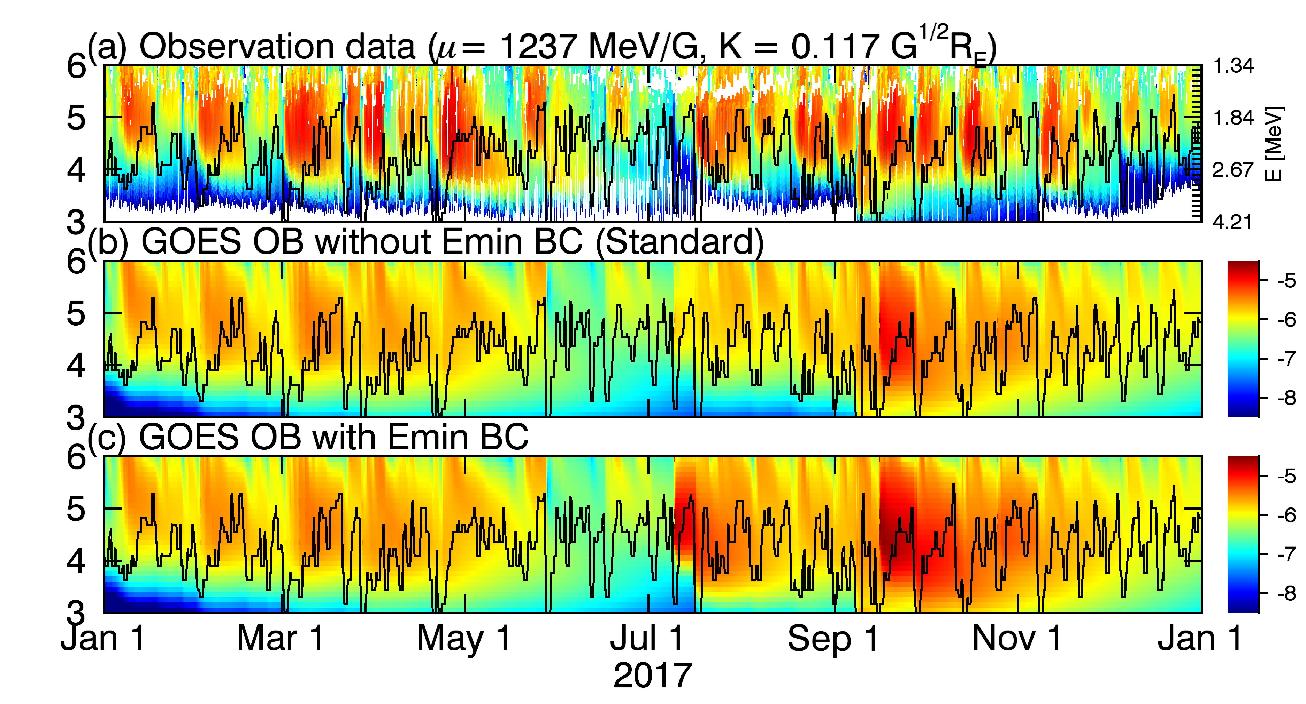
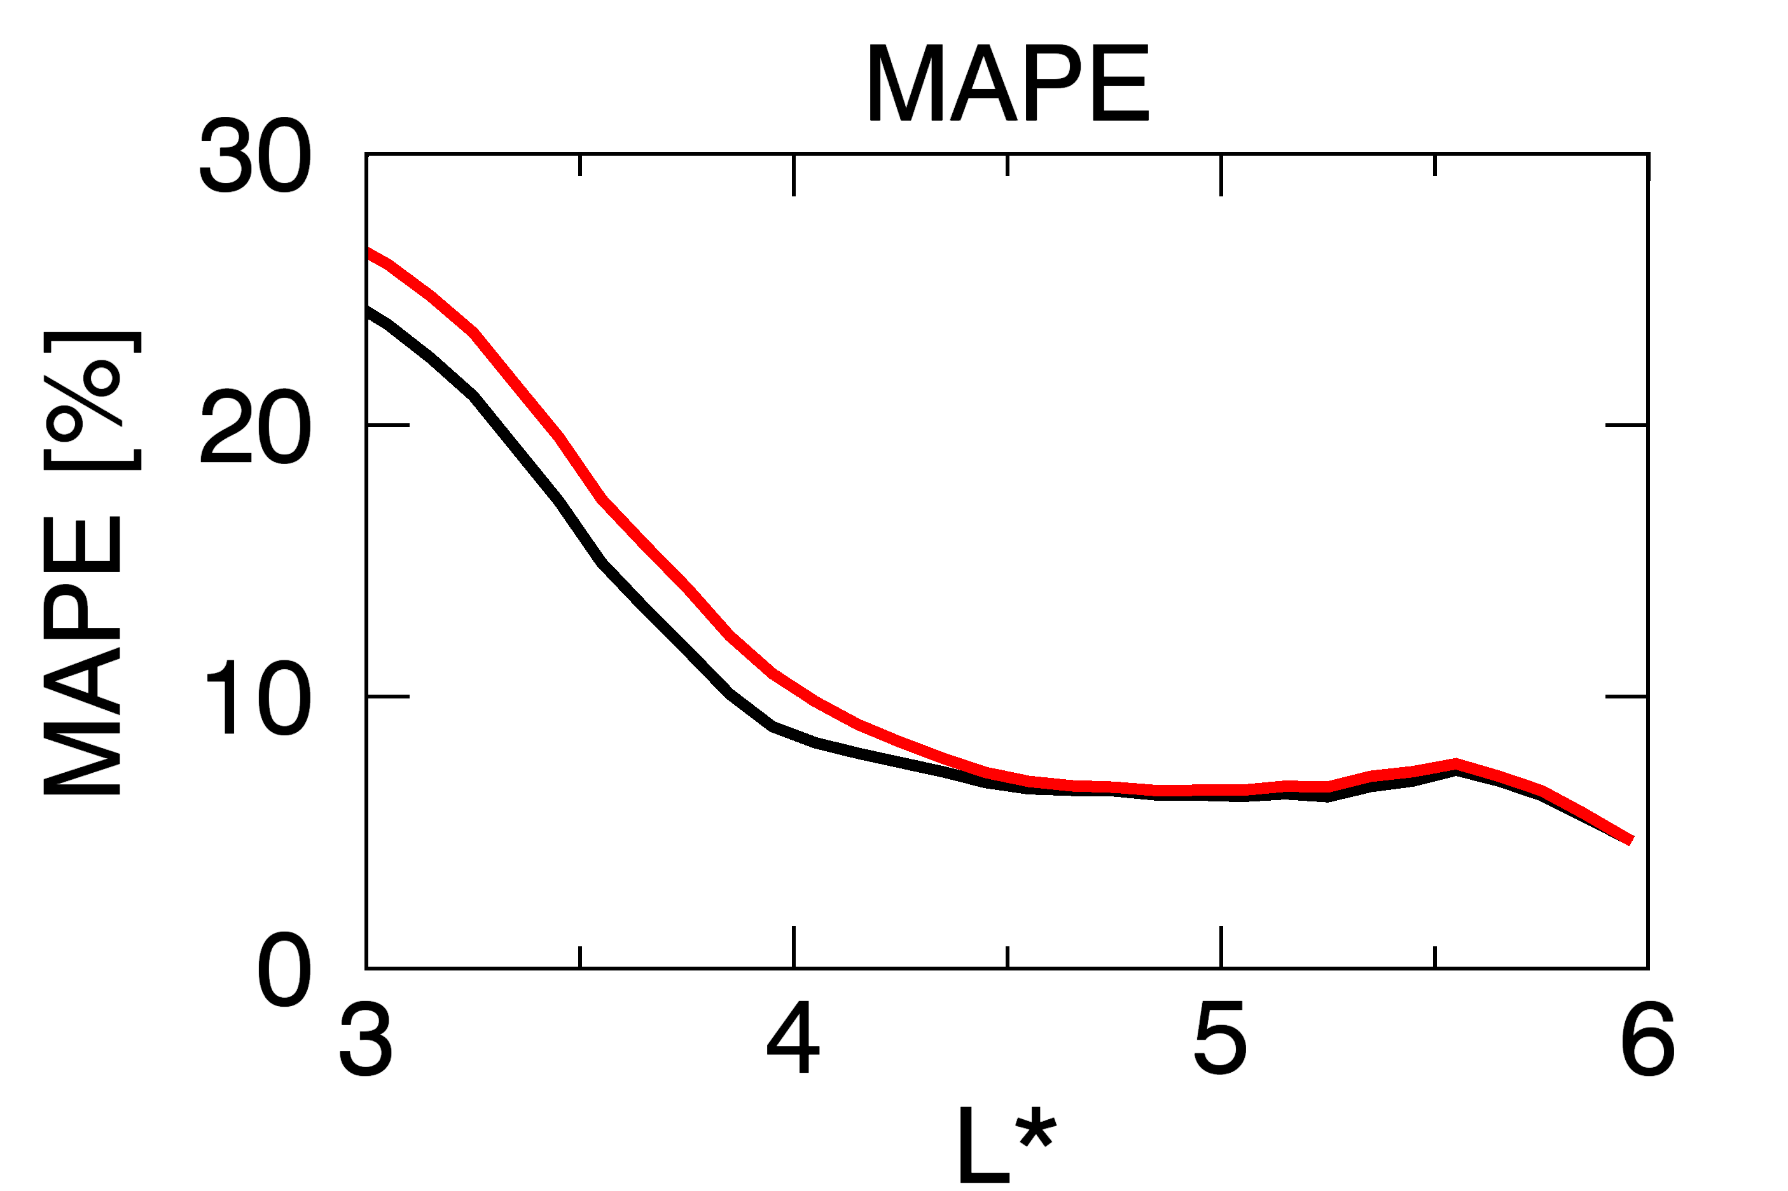
Results – 3. Minimum energy boundary conditions
(b) GOES OB (Standard)
(c) GOES OB + Emin BC
Emin BC at $E=100 keV$
(GOES OB + Emin BC) Large PSD → Overestimation

Slide 12
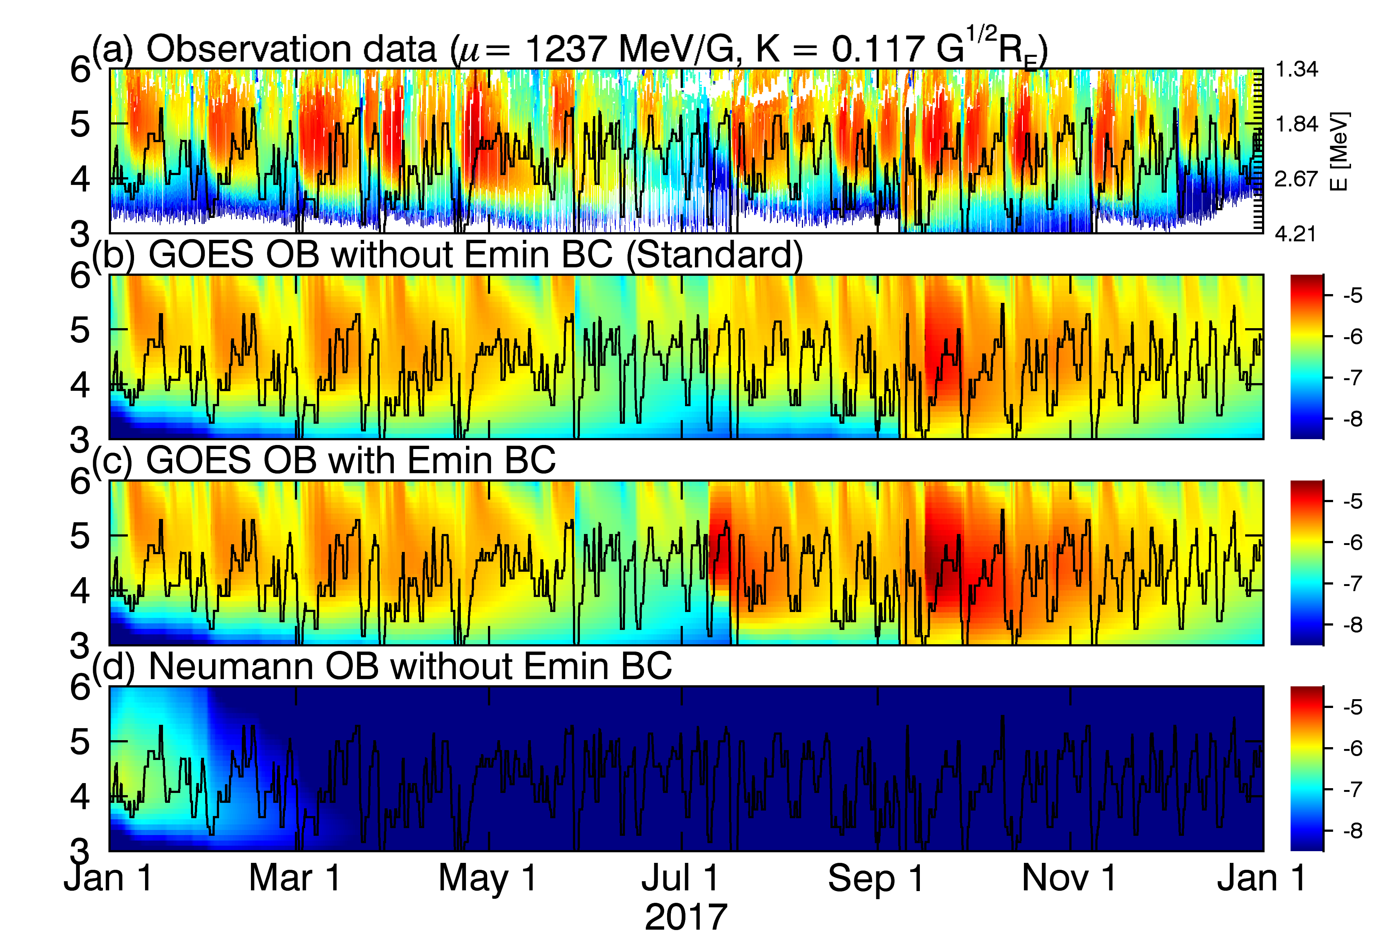
Results – 3. Minimum energy boundary conditions
(b) GOES OB (Standard)
(c) GOES OB + Emin BC
Emin BC at $E=100 keV$
(GOES OB + Emin BC) Large PSD → Overestimation

Slide 13
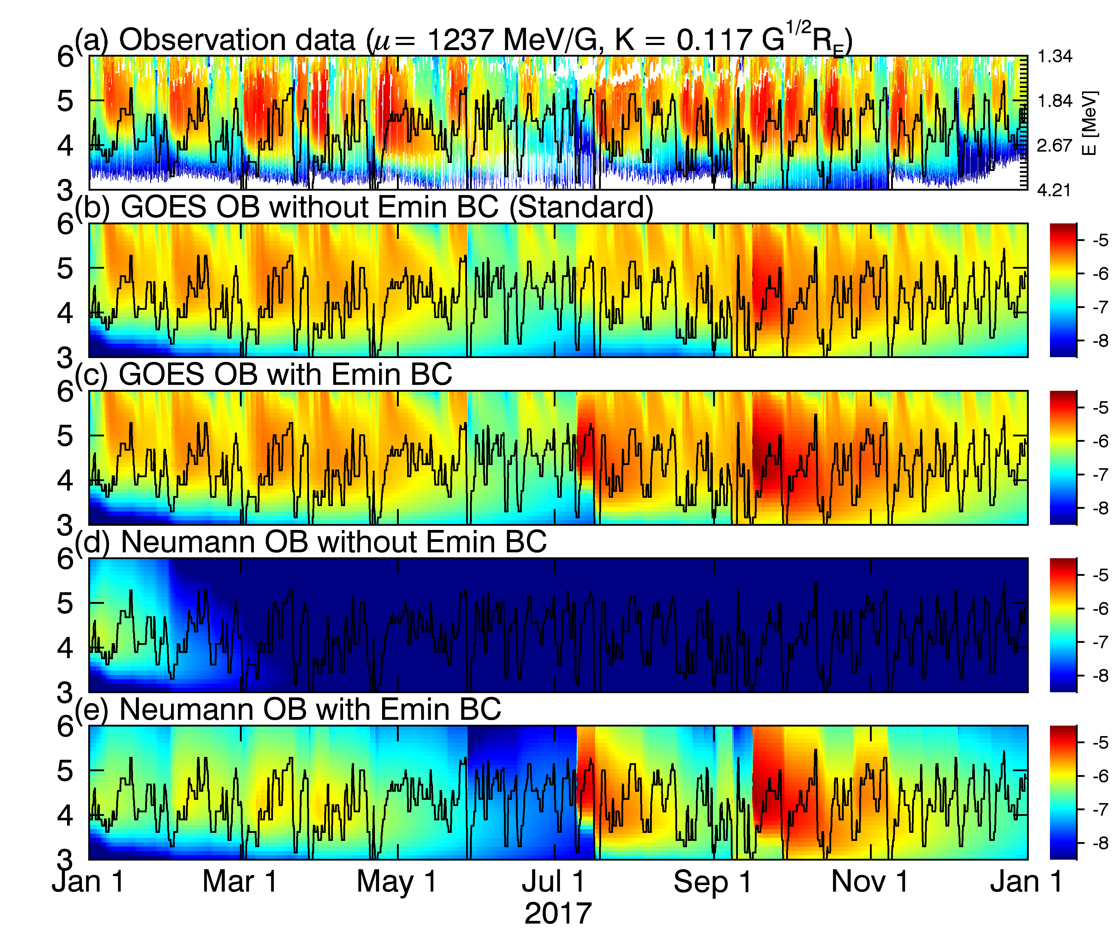
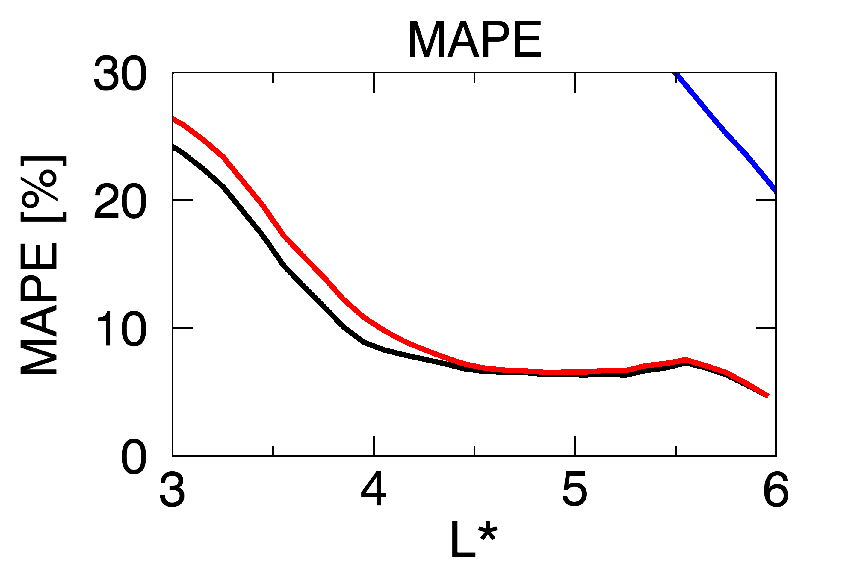
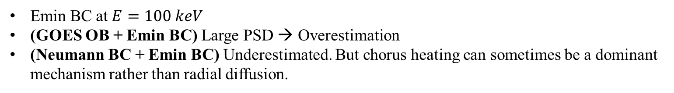
Results – 3. Minimum energy boundary conditions
(b) GOES OB (Standard)
(c) GOES OB + Emin BC
(e) Neumann BC + Emin BC
Emin BC at $E=100 keV$
(GOES OB + Emin BC) Large PSD → Overestimation
(Neumann BC + Emin BC) Underestimated. But chorus heating can sometimes be a dominant mechanism rather than radial diffusion.

Slide 14
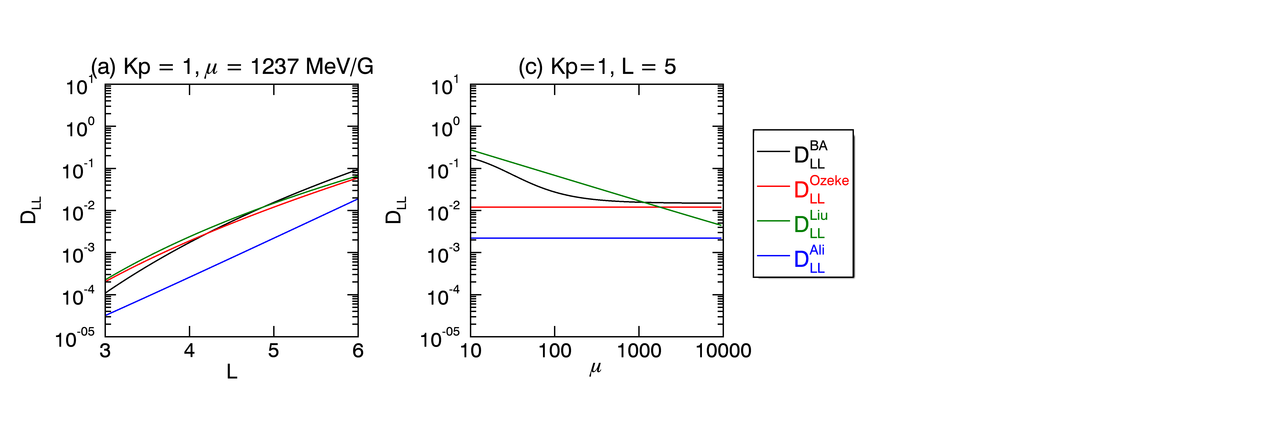
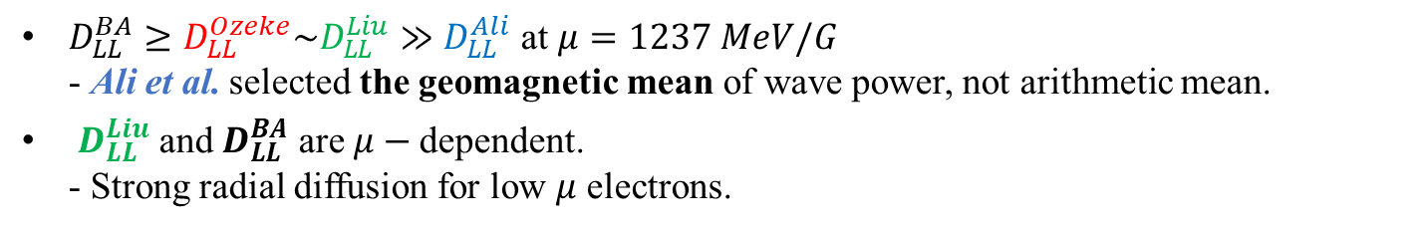
Results – 4. Radial diffusion coefficients
Brautigam and Albert, 2000
Ozeke et al., 2014
Liu et al., 2016
Ali et al., 2016
$D_{LL}^{BA}≥D_{LL}^{Ozeke}\sim D_{LL}^{Liu}≫D_{LL}^{Ali}$ at $μ=1237 MeV/G$
- Ali et al. selected the geomagnetic mean of wave power, not arithmetic mean.
$D_{LL}^{Liu}$ and $D_{LL}^{BA}$ are $μ−$dependent.
- Strong radial diffusion for low $μ$ electrons.

Slide 15


Results – 4. Radial diffusion coefficients
(b) $D_{LL}^{Ozeke}$ (Standard)

Slide 16
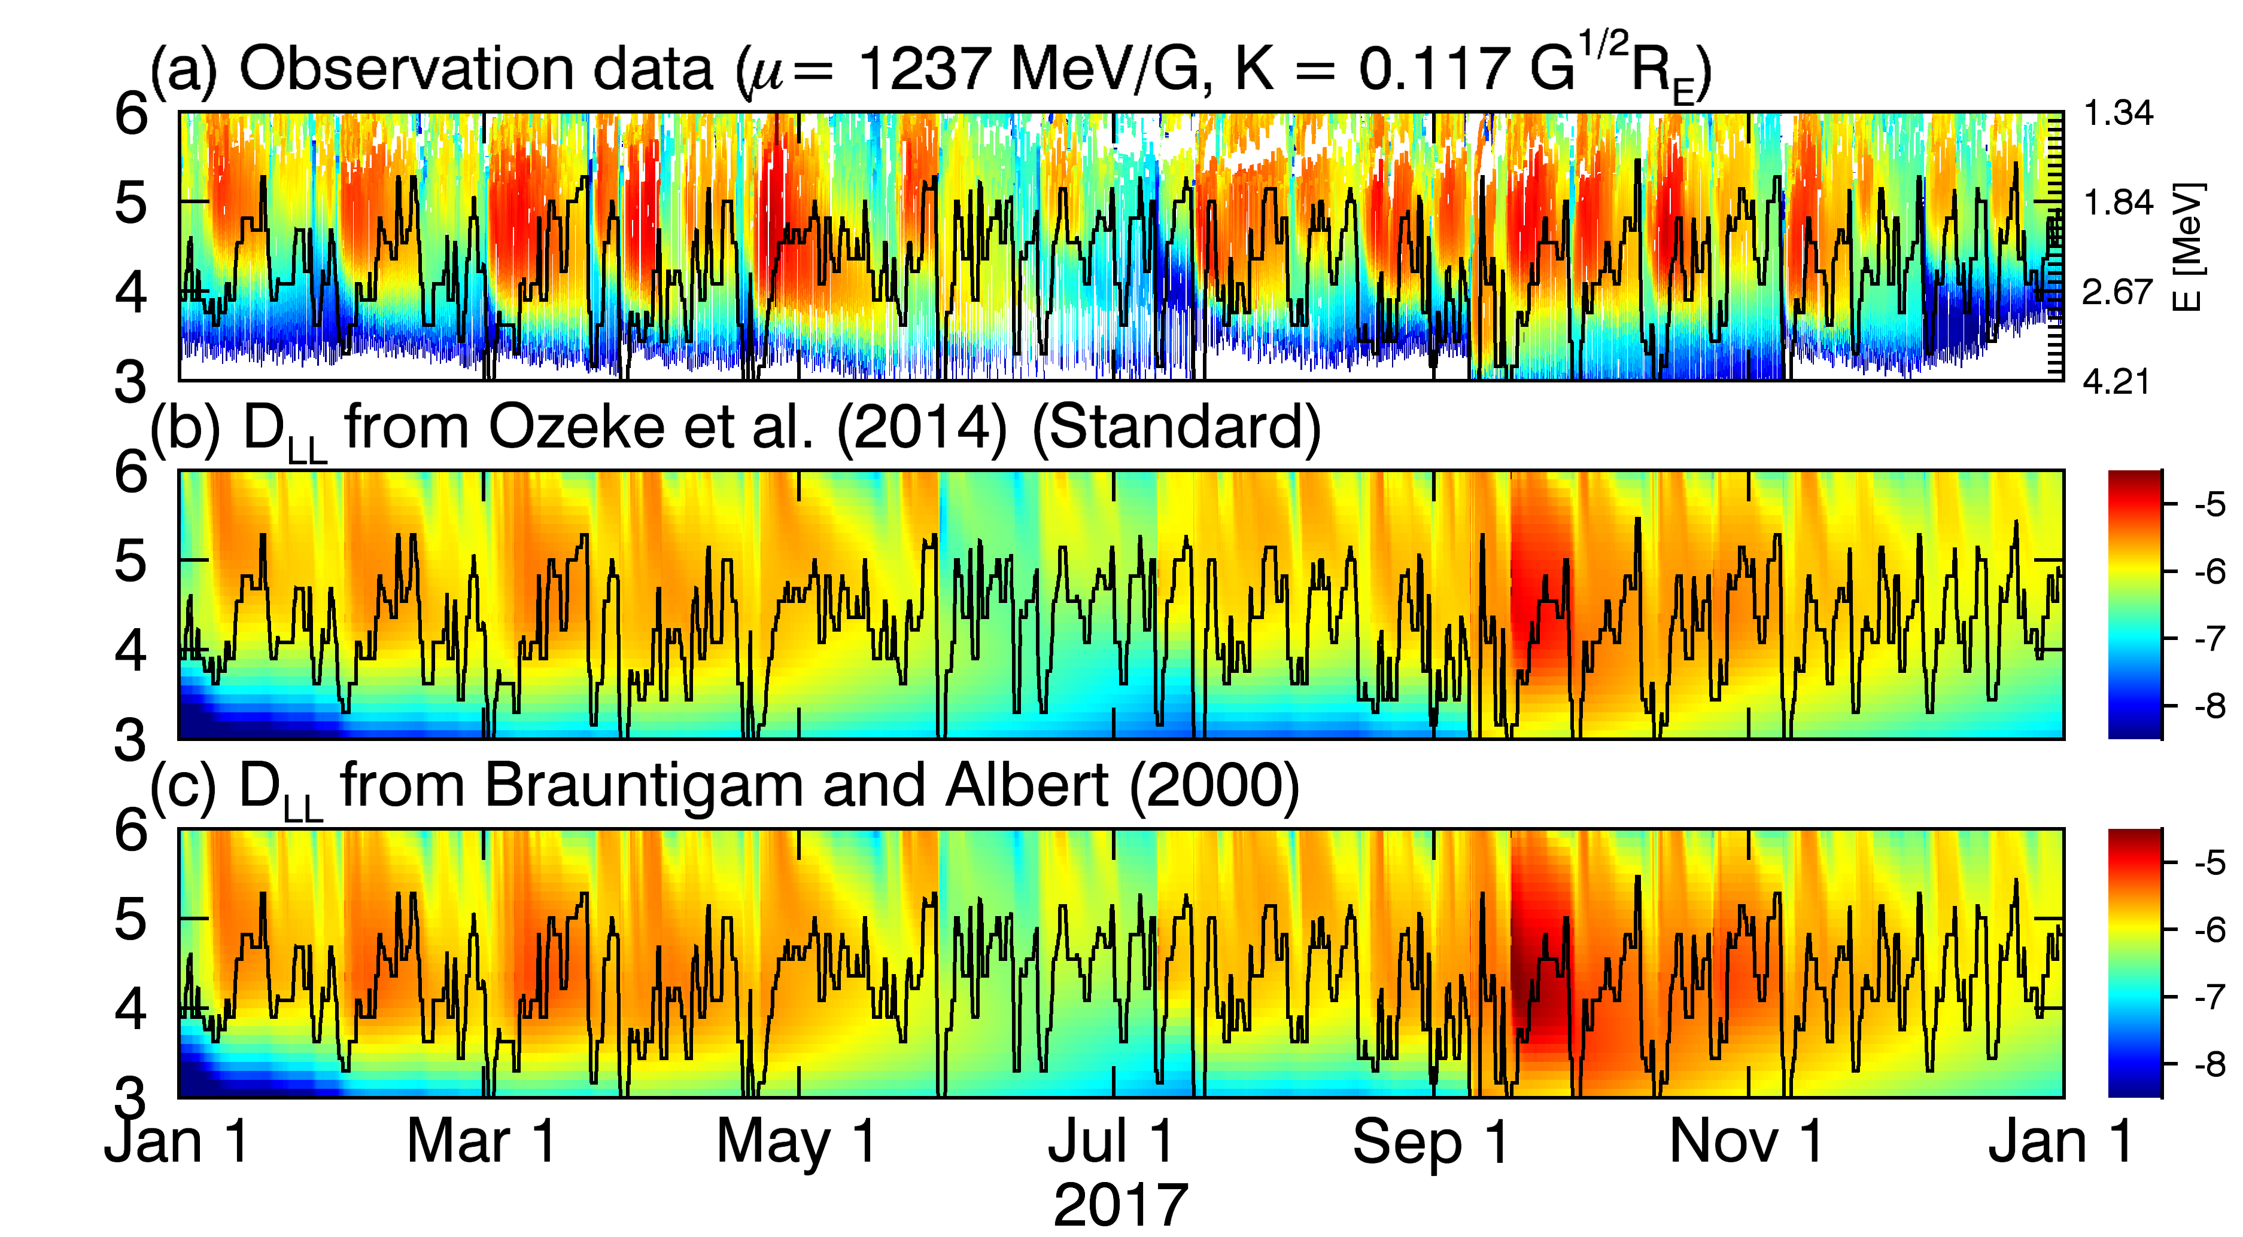
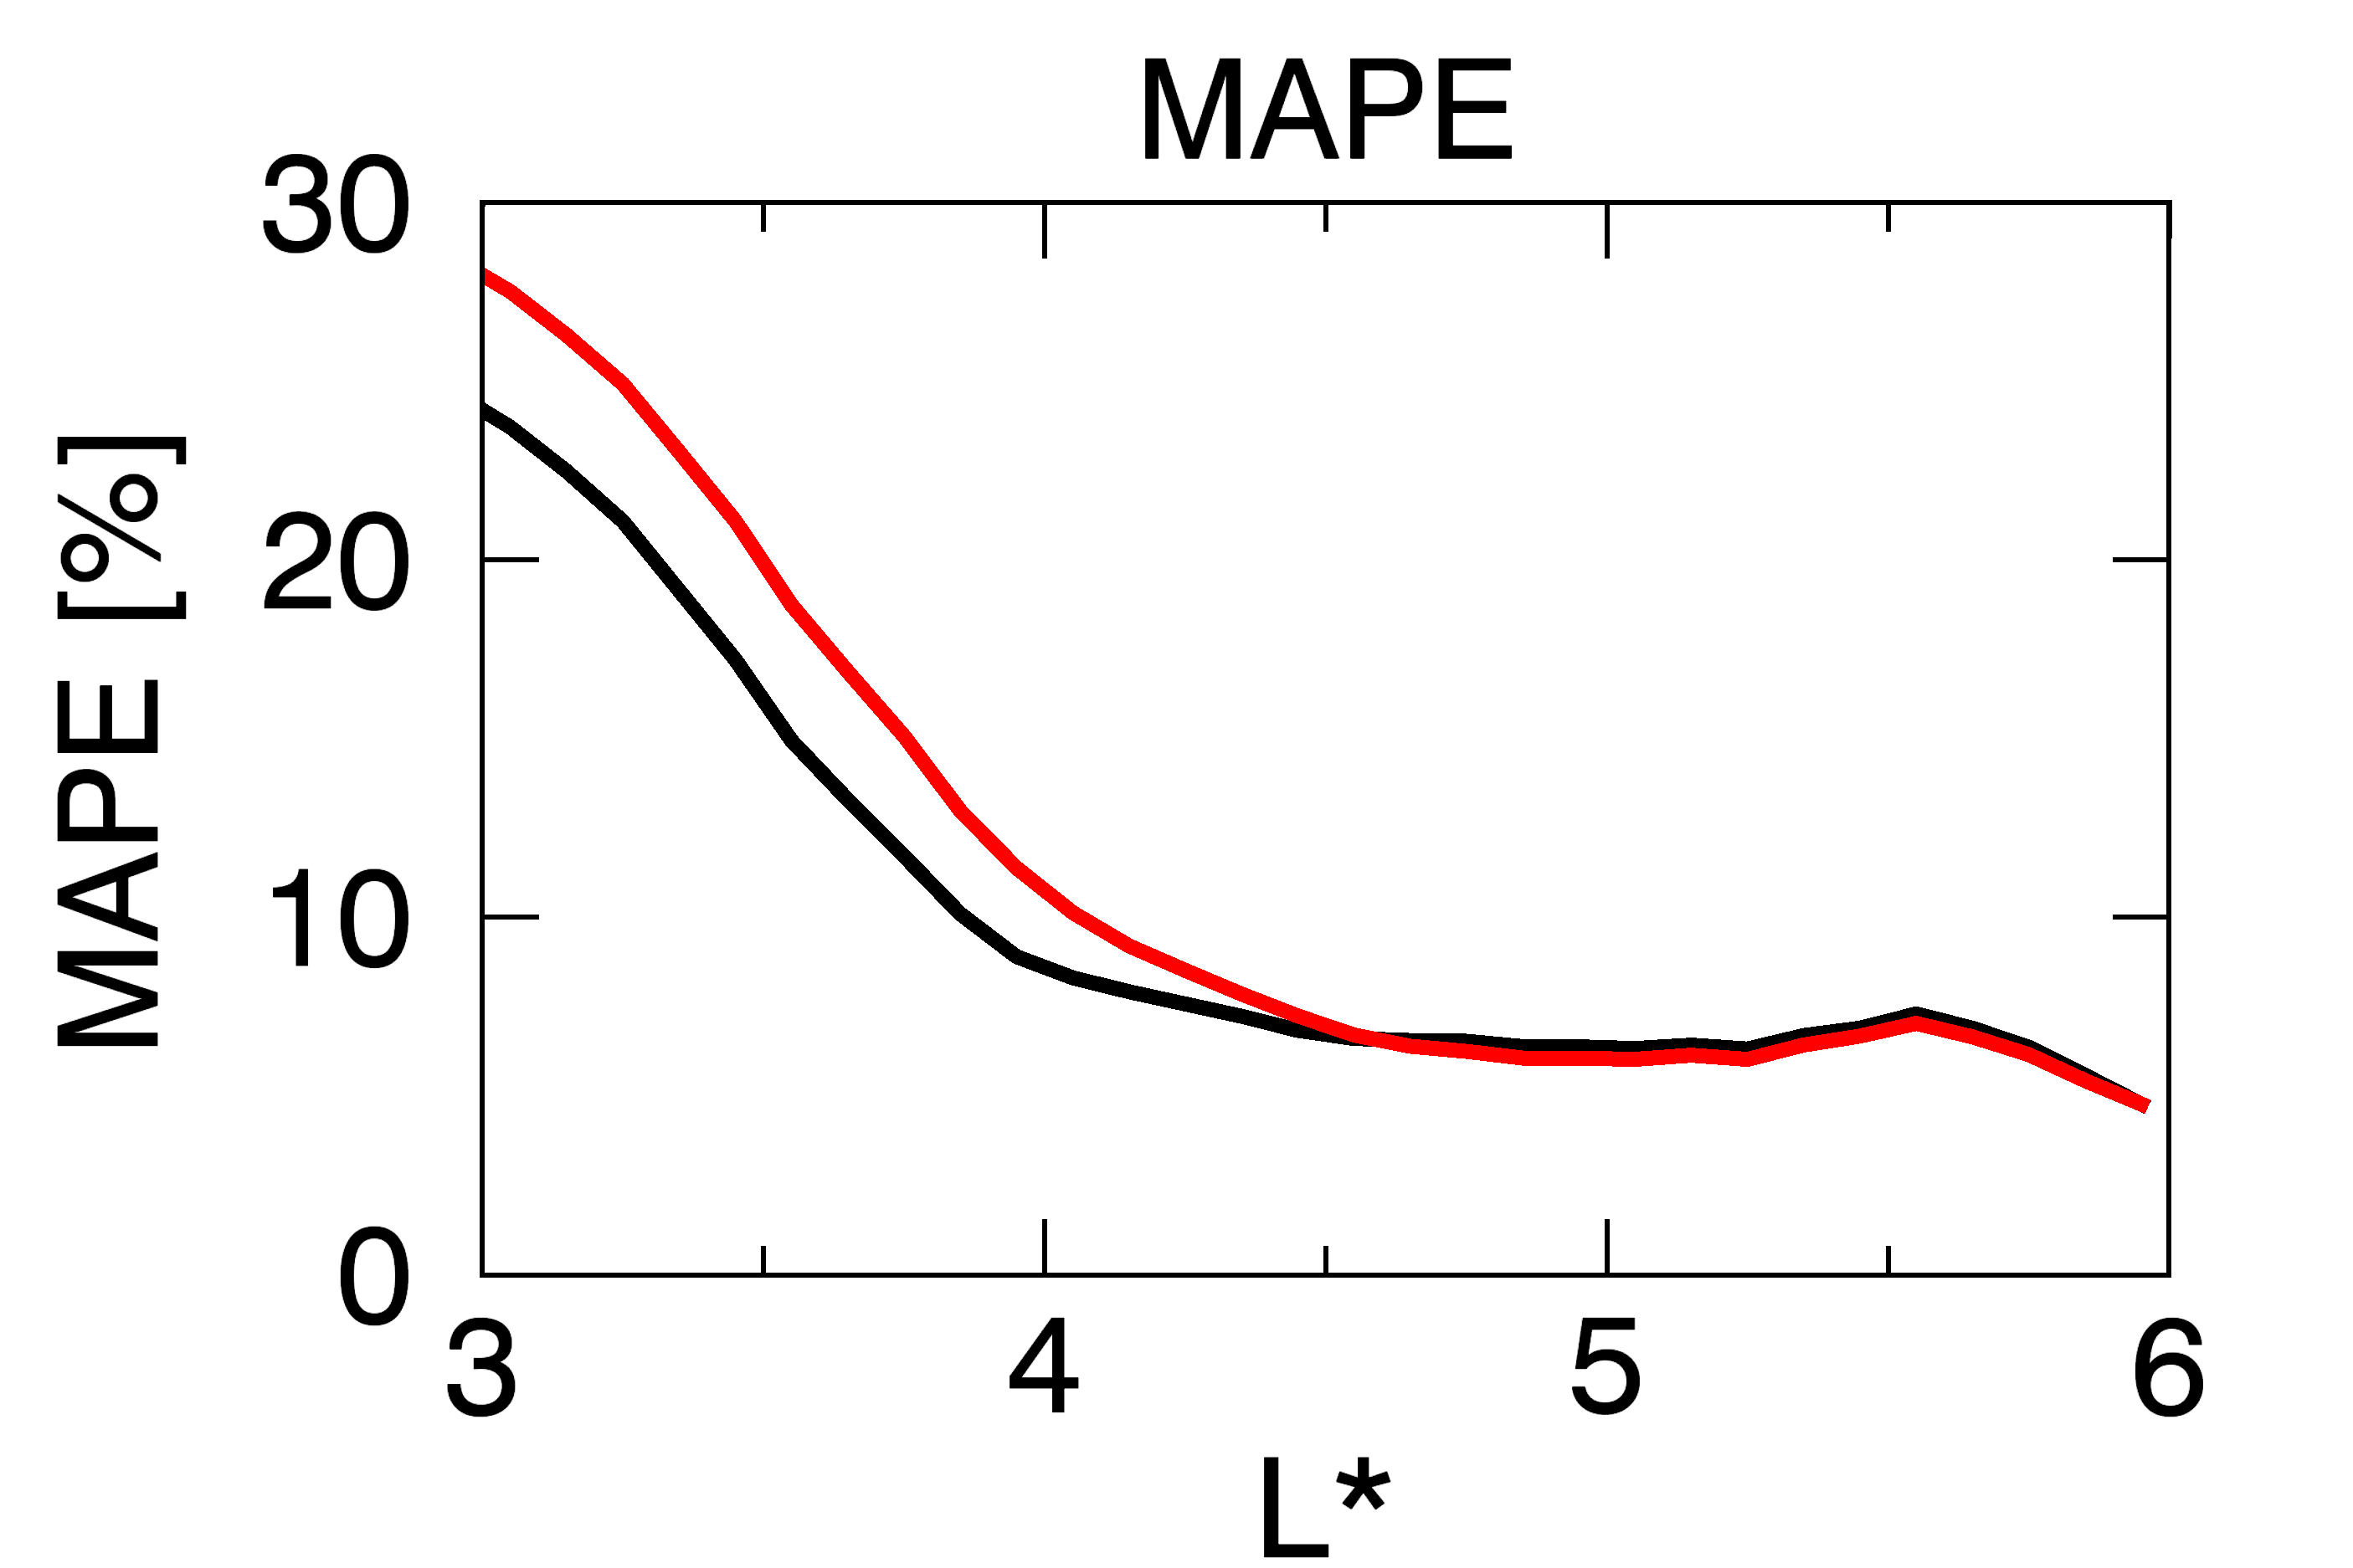
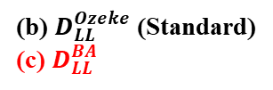
Results – 4. Radial diffusion coefficients
(b) $D_{LL}^{Ozeke}$ (Standard)
(c) $D_{LL}^{BA}$

Slide 17
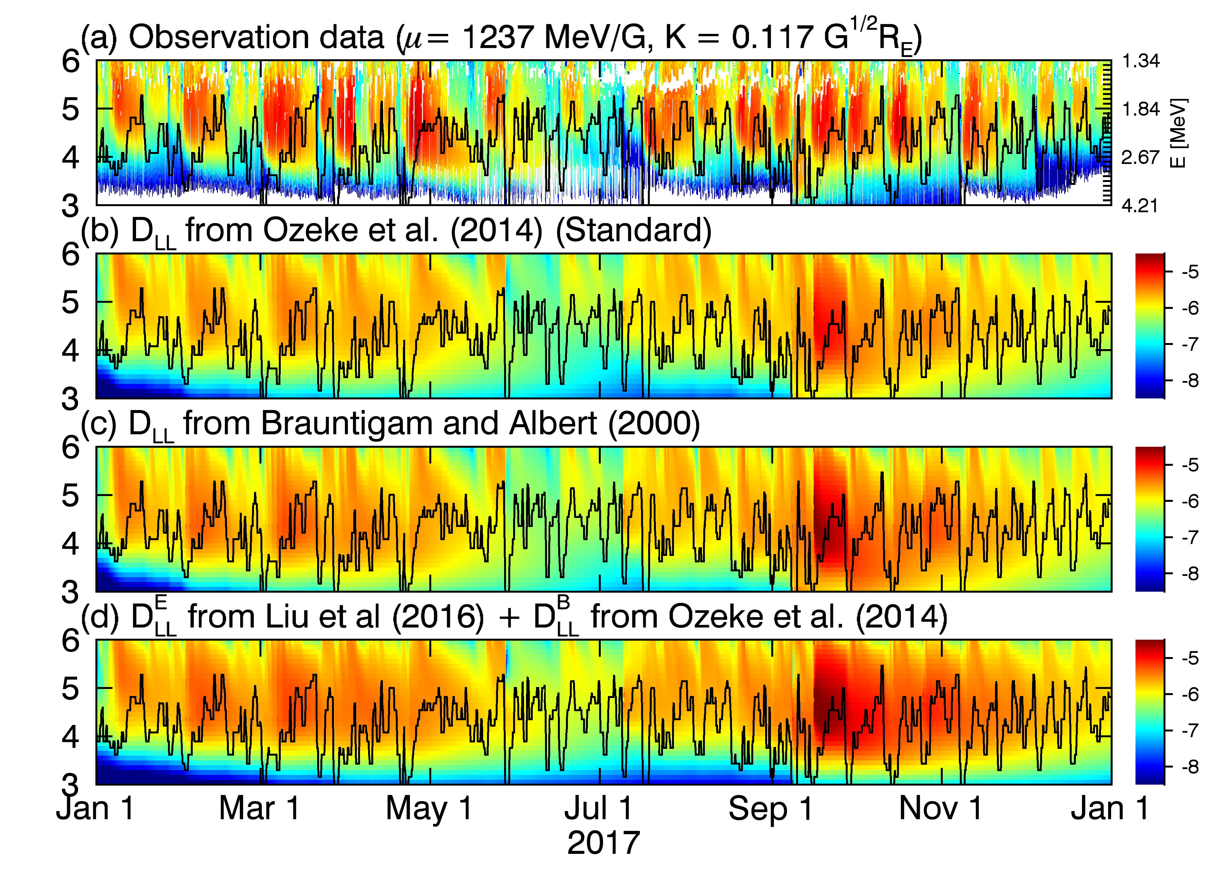
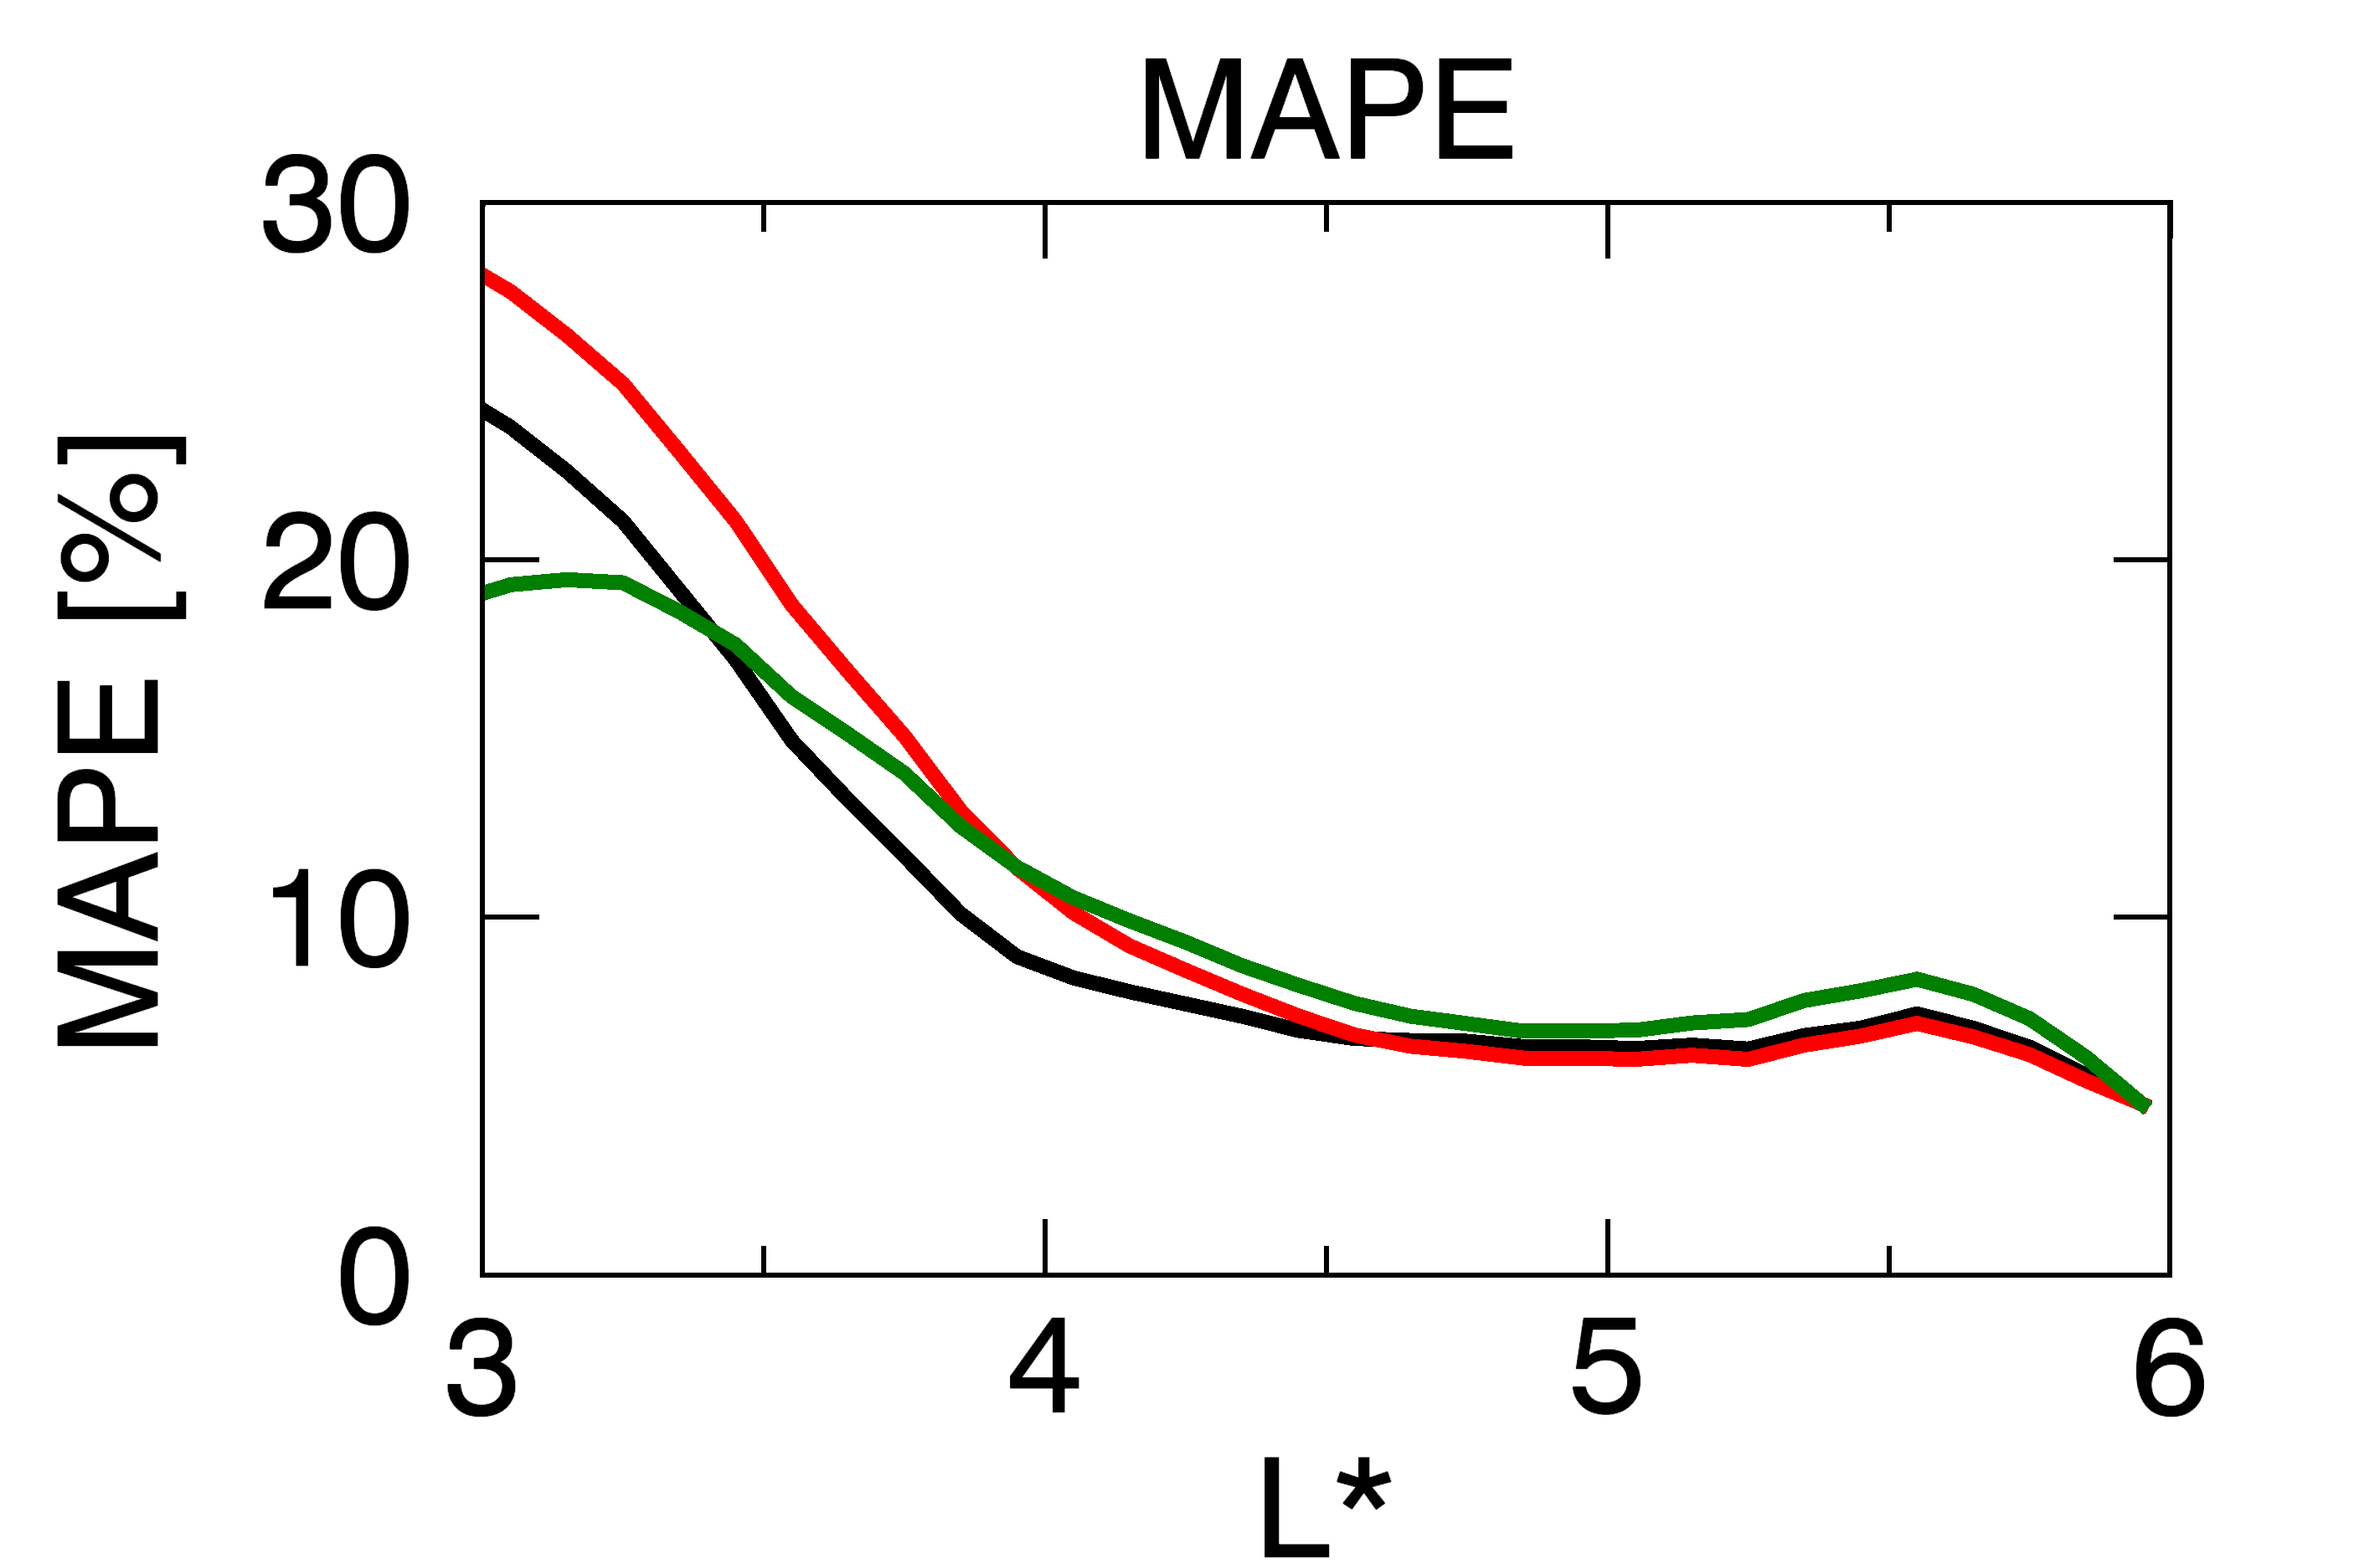
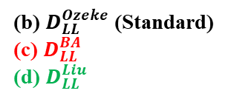
Results – 4. Radial diffusion coefficients
(b) $D_{LL}^{Ozeke}$ (Standard)
(c) $D_{LL}^{BA}$
(d) $D_{LL}^{Liu}$

Slide 18
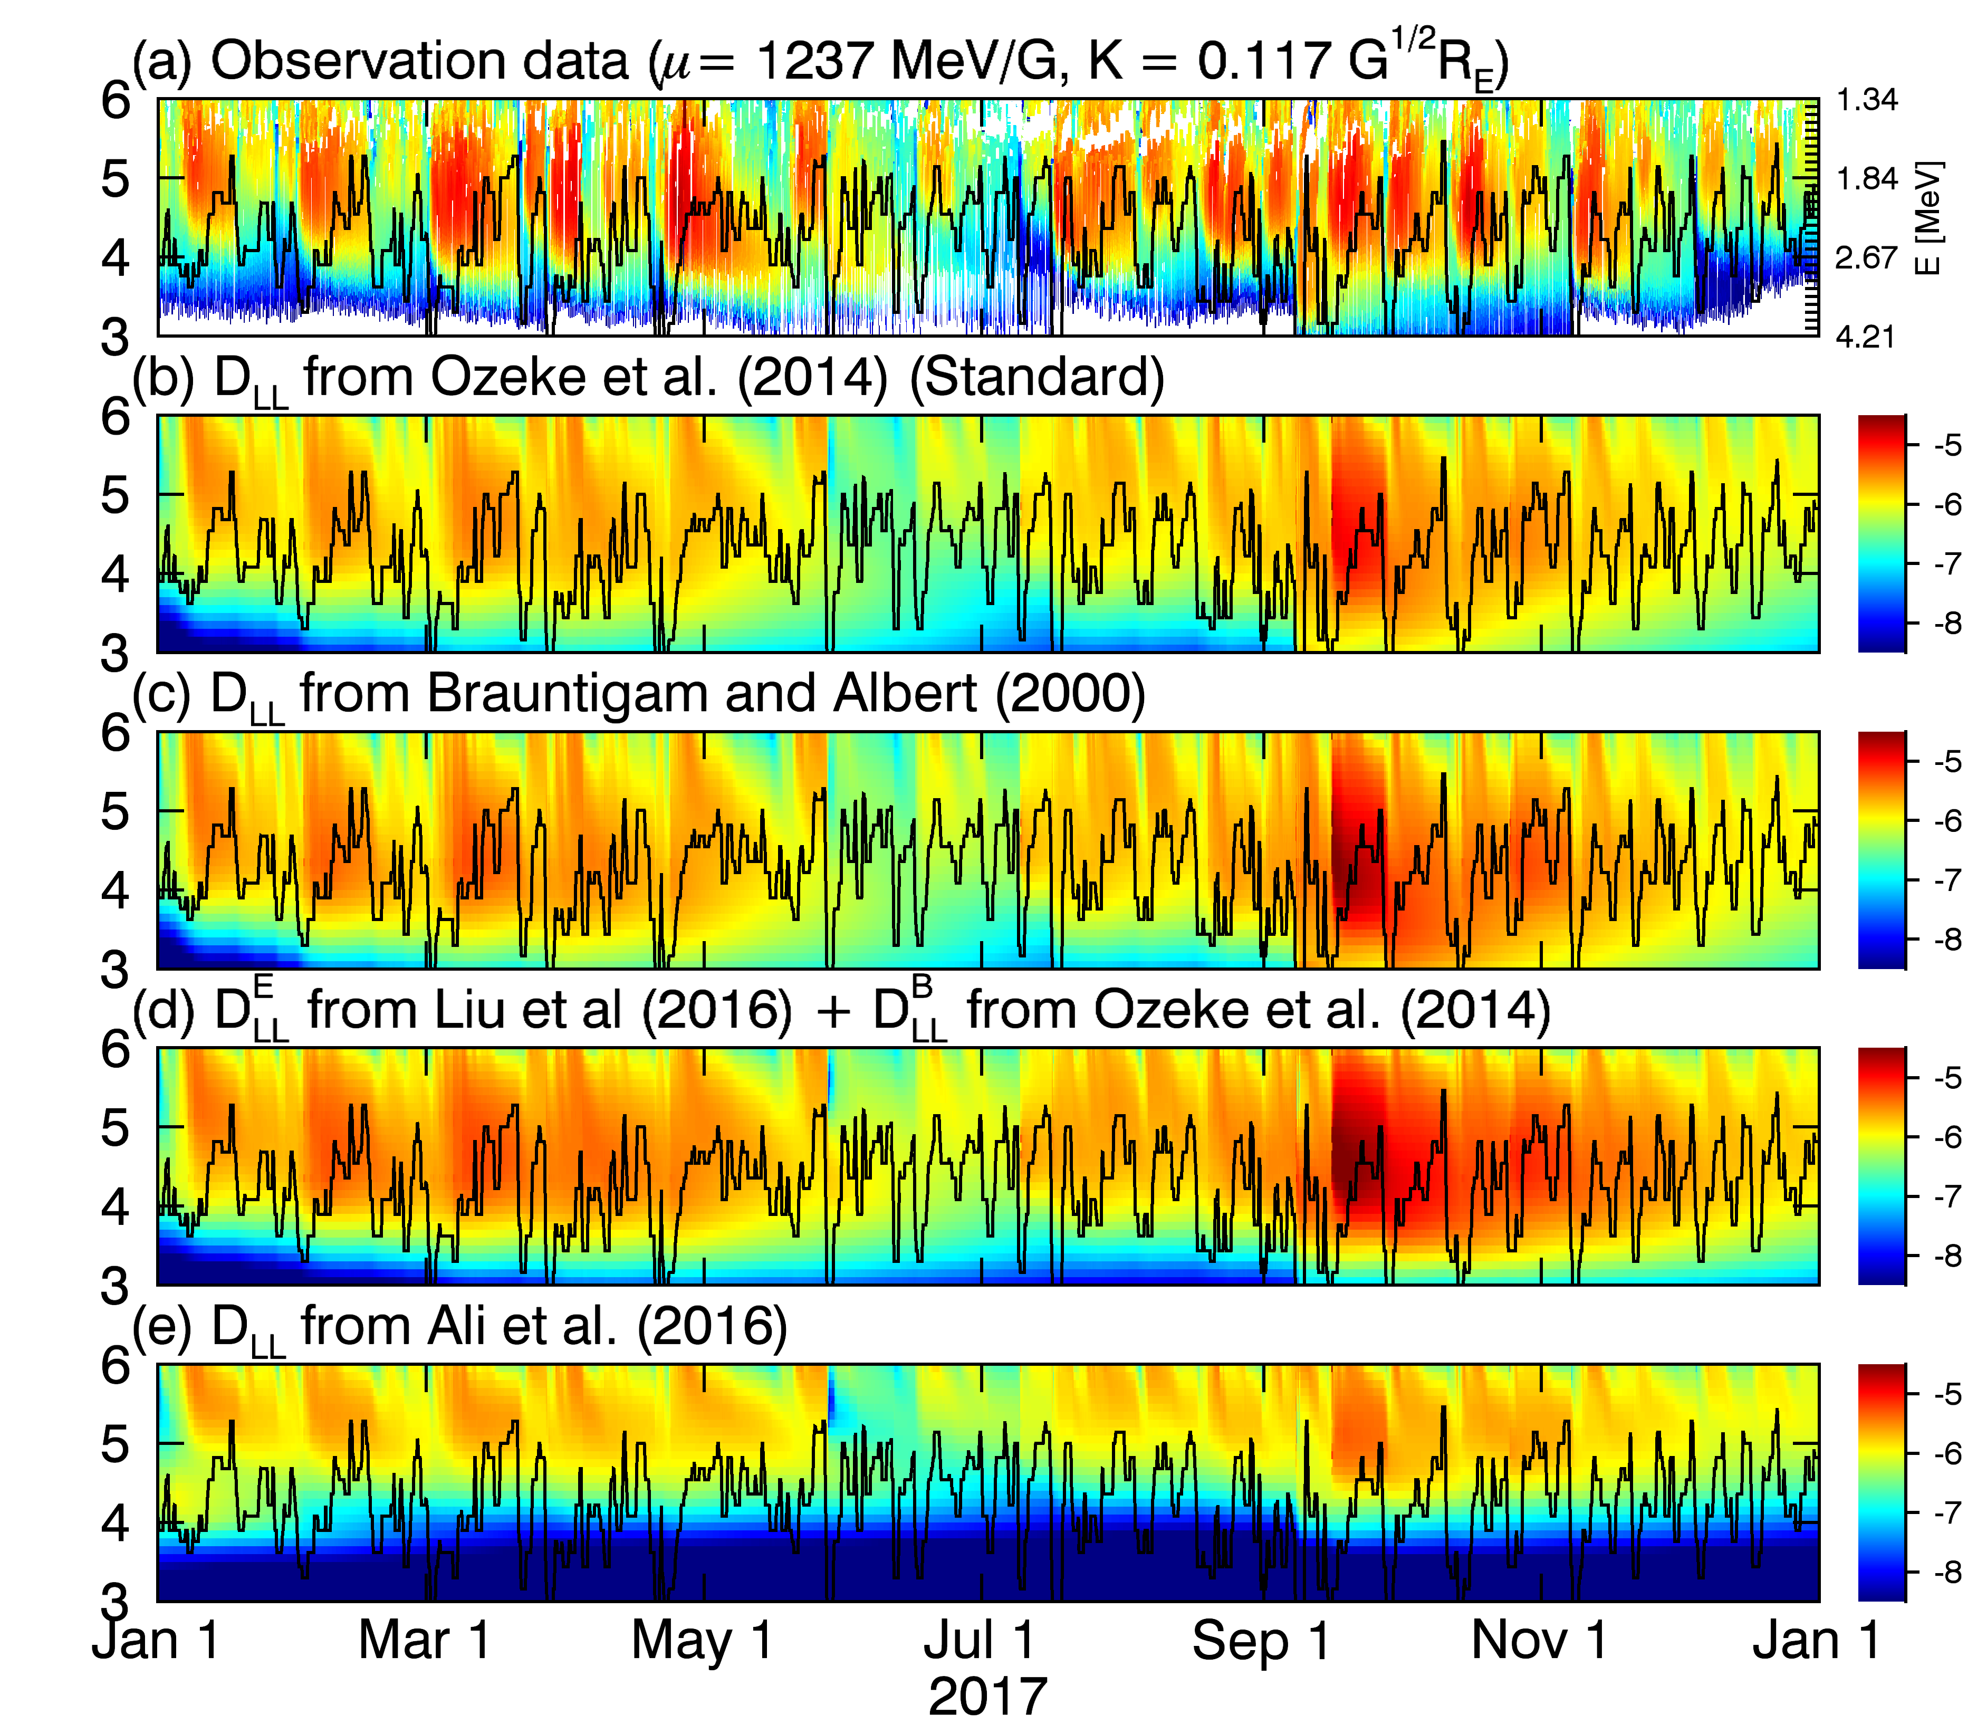
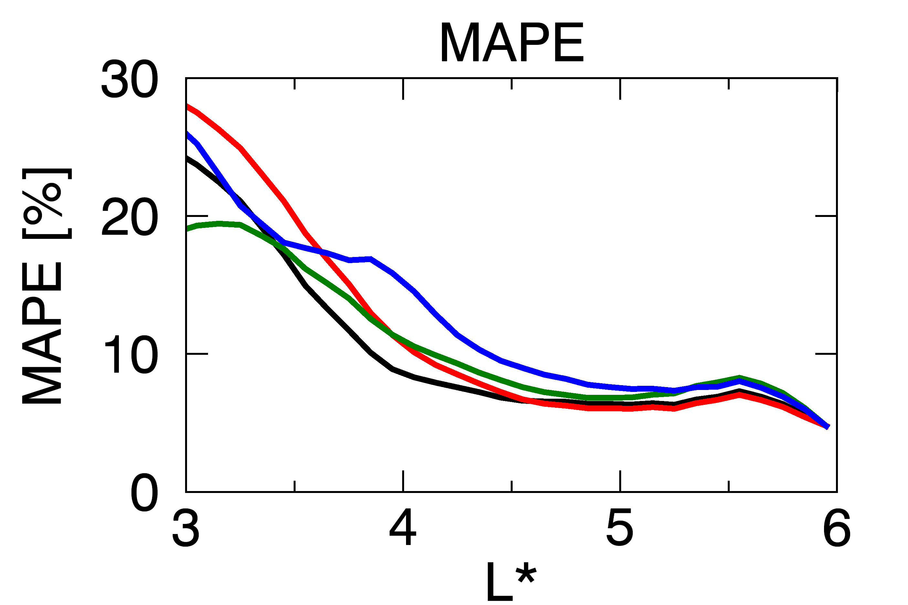

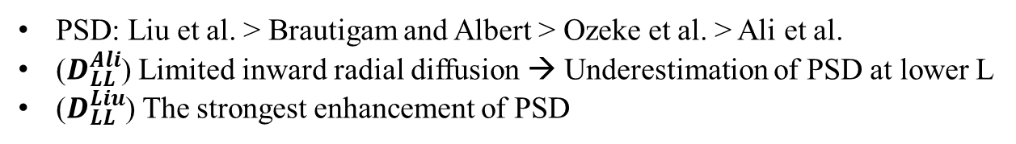
Results – 4. Radial diffusion coefficients
(b) $D_{LL}^{Ozeke}$ (Standard)
(c) $D_{LL}^{BA}$
(d) $D_{LL}^{Liu}$
(e) $D_{LL}^{Ali}$
PSD: Liu et al. > Brautigam and Albert > Ozeke et al. > Ali et al.
($D_{LL}^{Ali}$) Limited inward radial diffusion → Underestimation of PSD at lower L
($D_{LL}^{Liu}$) The strongest enhancement of PSD

Slide 19
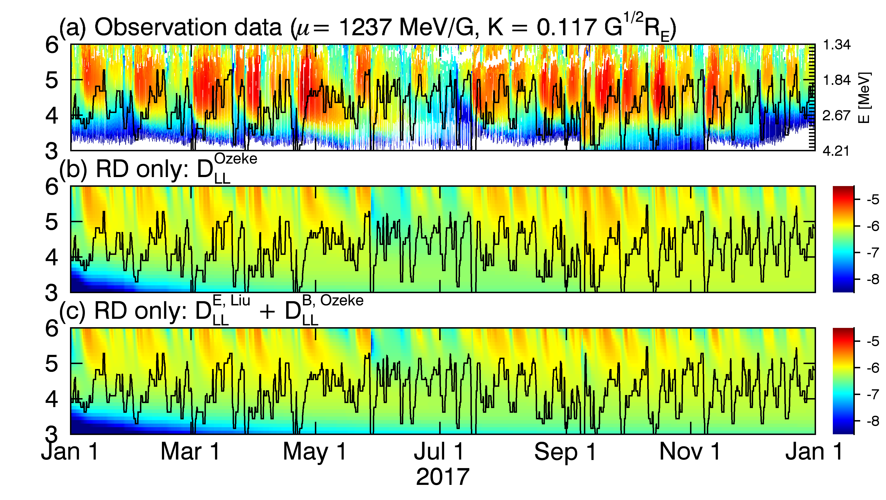

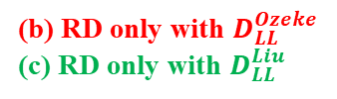

Results – 4. Radial diffusion coefficients
(b) RD only with $D_{LL}^{Ozeke}$
(c) RD only with $D_{LL}^{Liu}$
(RD only: $D_{LL}^{Ozeke}$ & $D_{LL}^{Liu}$) Almost same

Slide 20
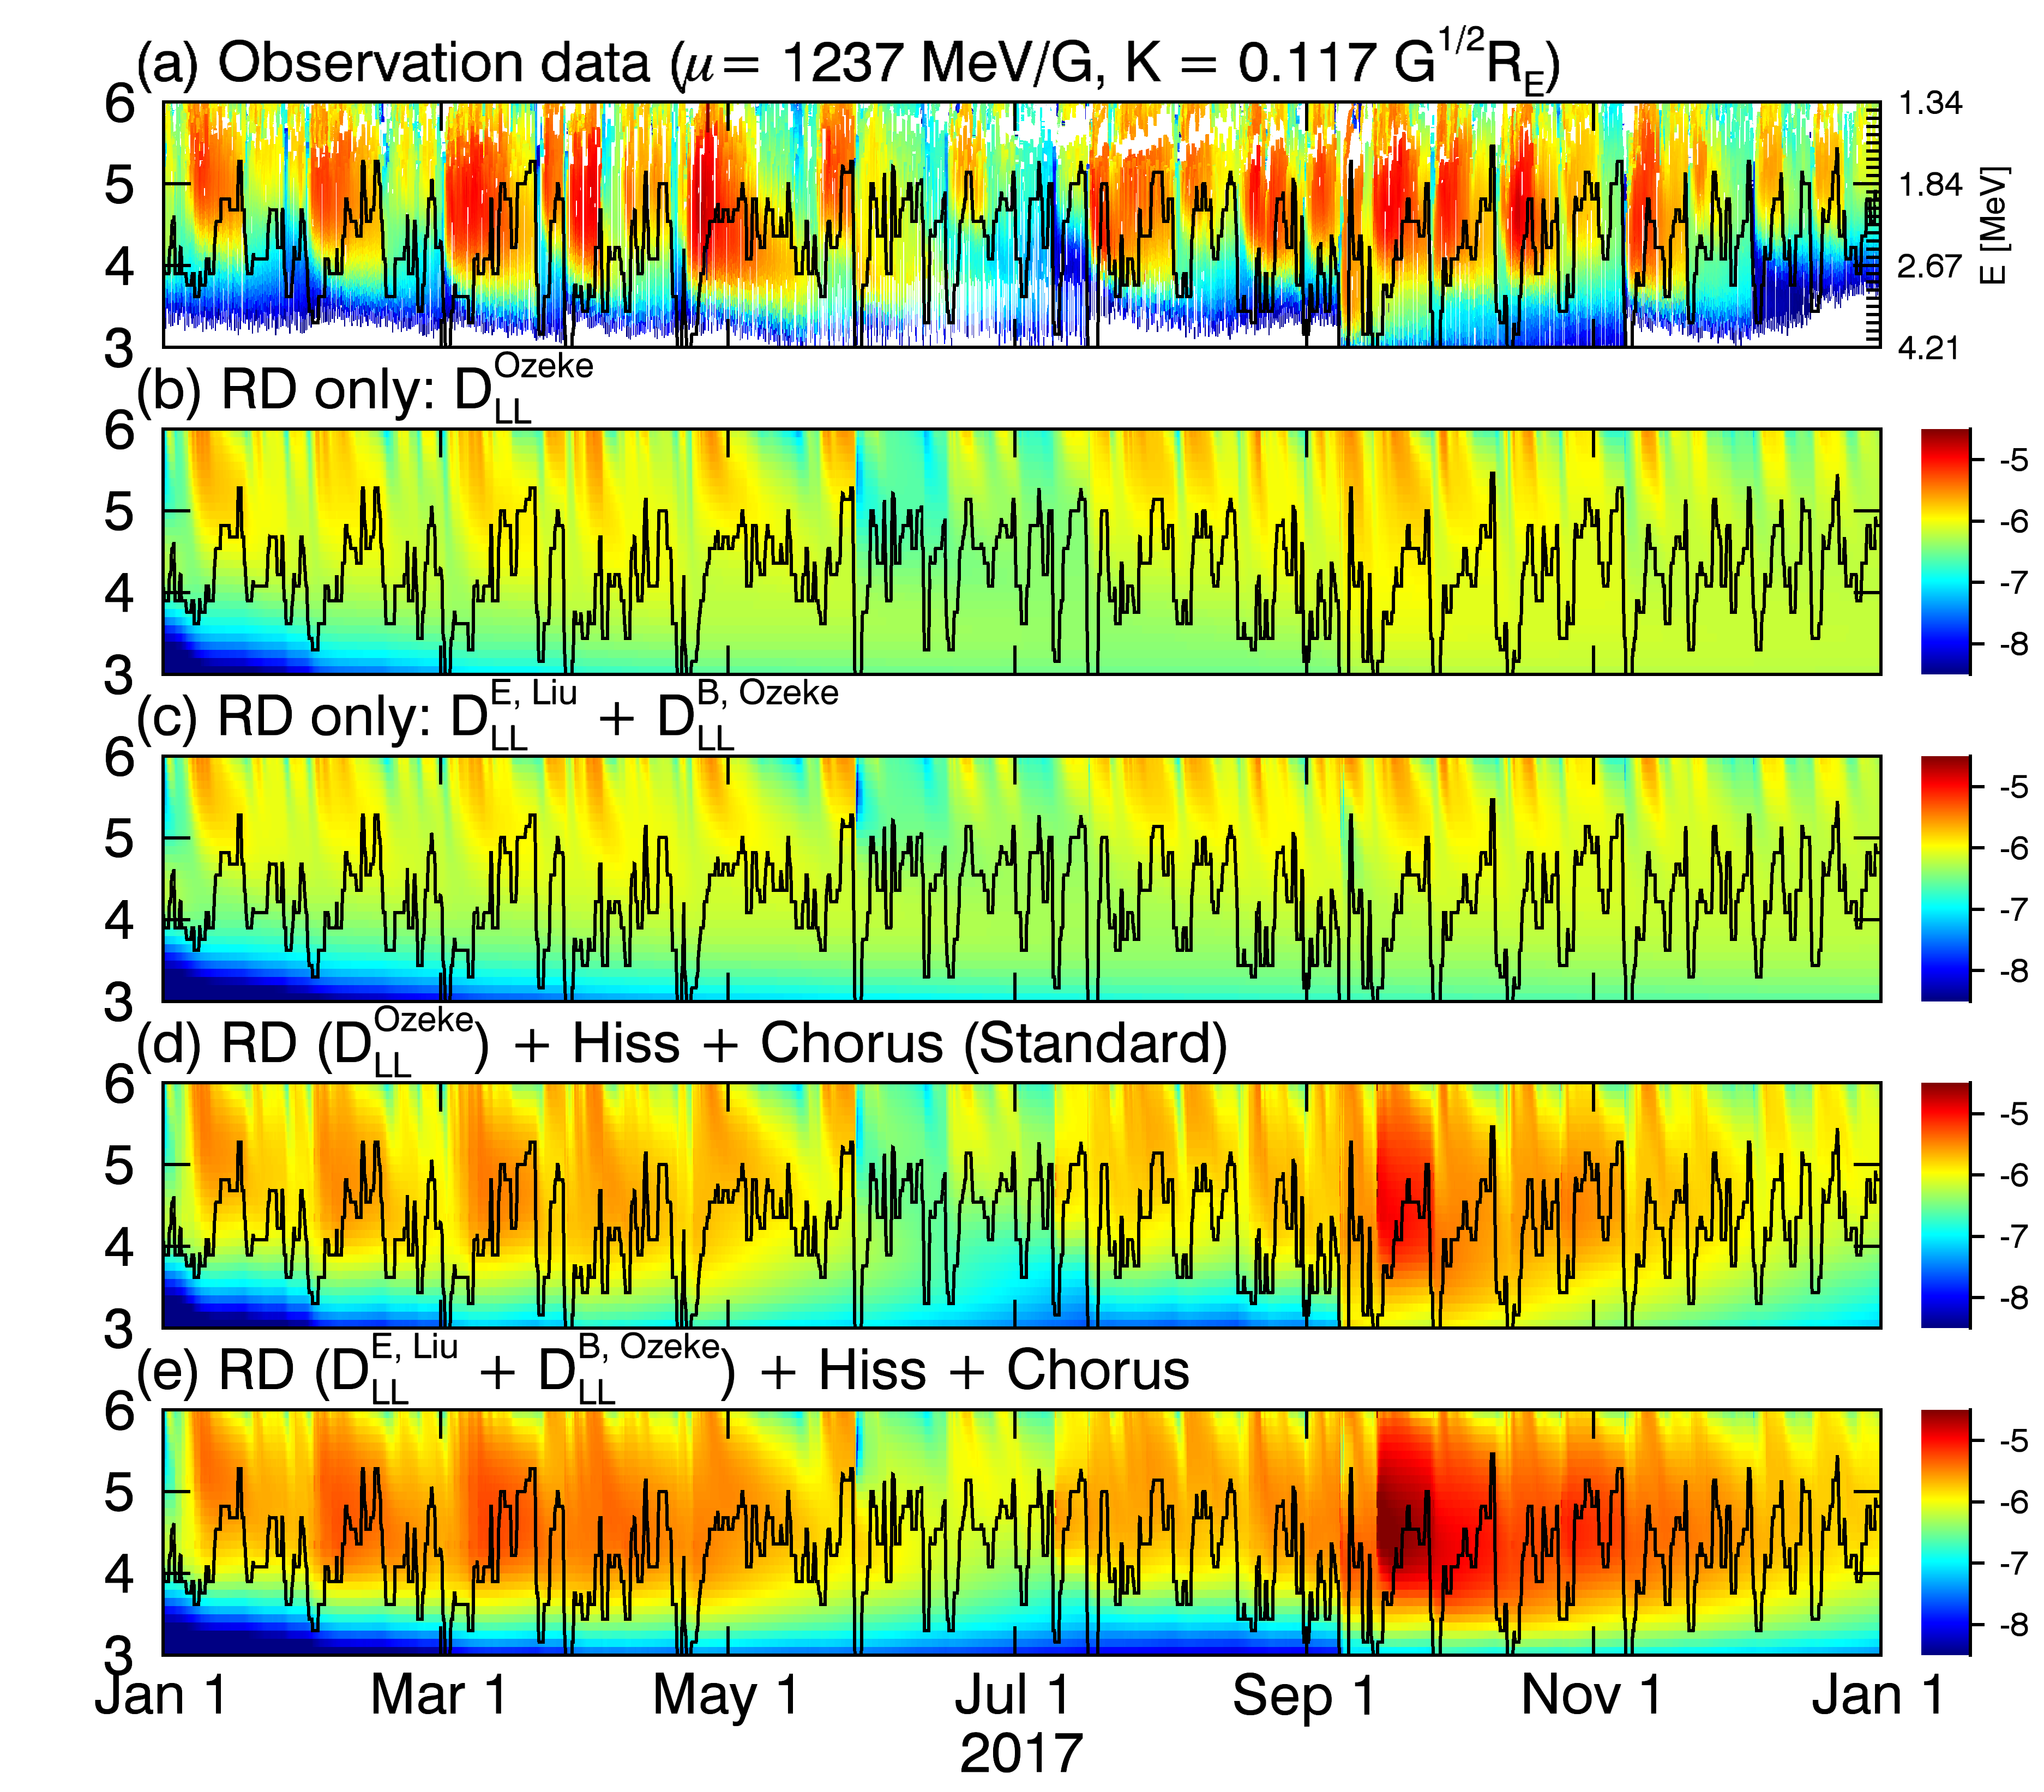
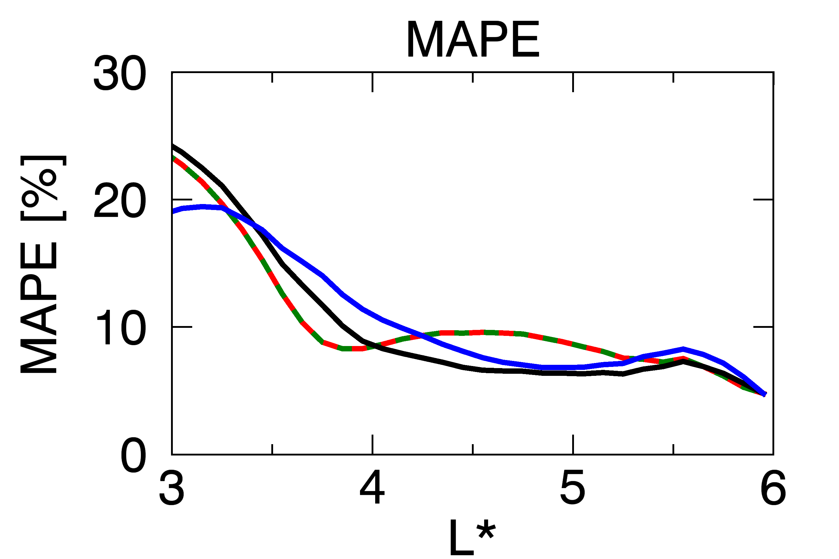
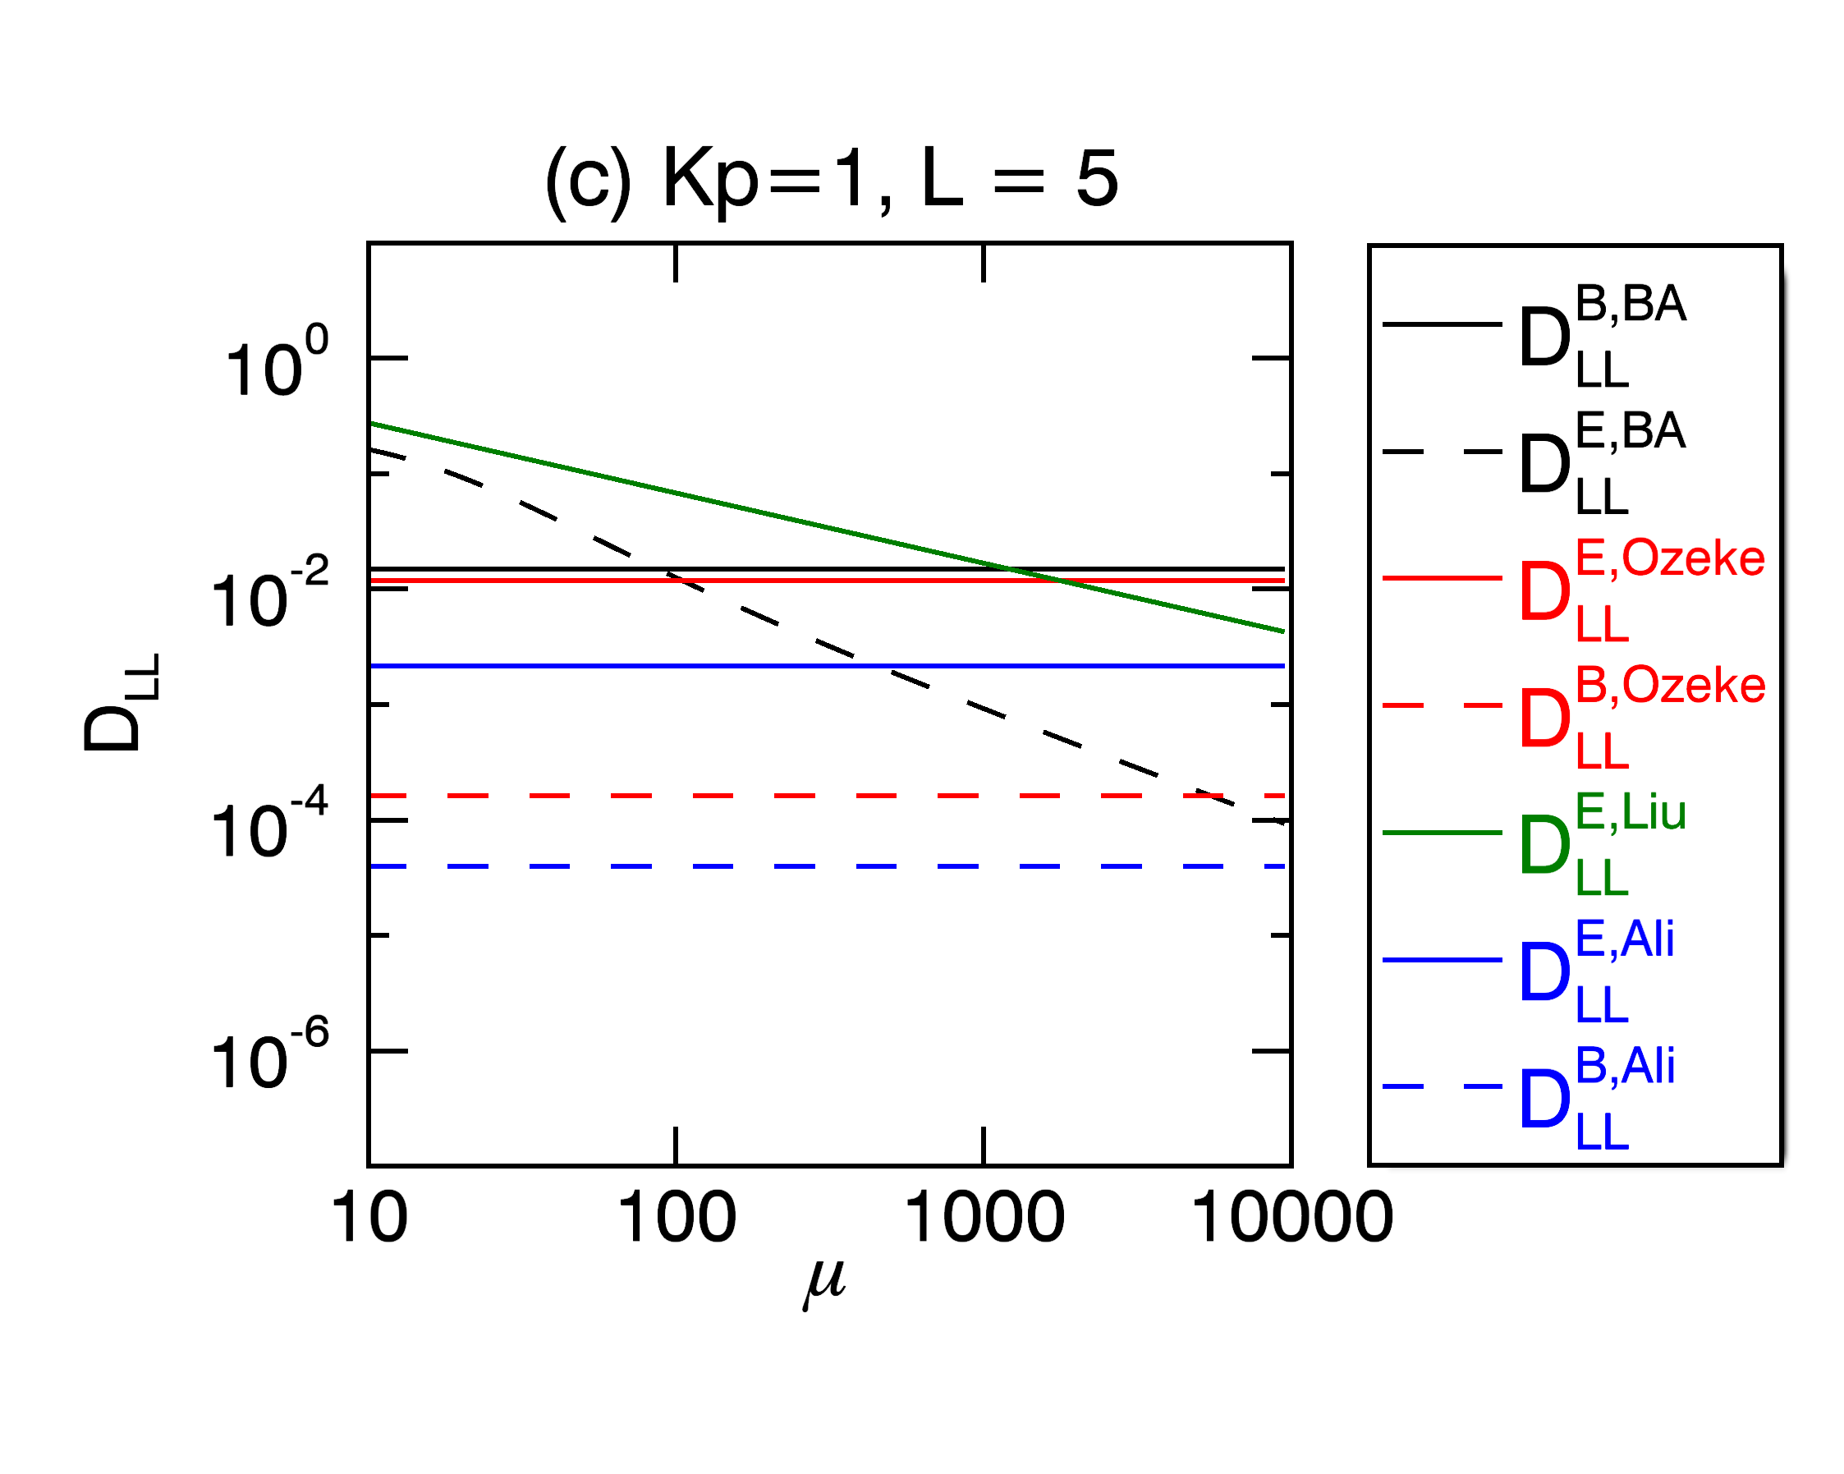
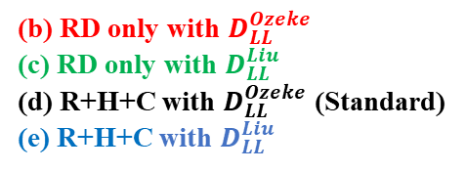
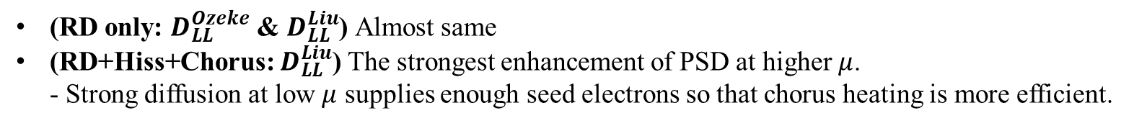
Results – 4. Radial diffusion coefficients
(b) RD only with $D_{LL}^{Ozeke}$
(c) RD only with $D_{LL}^{Liu}$
(d) R+H+C with $D_{LL}^{Ozeke}$ (Standard)
(e) R+H+C with $D_{LL}^{Liu}$
(RD only: $D_{LL}^{Ozeke}$ & $D_{LL}^{Liu}$) Almost same
(RD+Hiss+Chorus: $D_{LL}^{Liu}$) The strongest enhancement of PSD at higher $μ$.
- Strong diffusion at low $μ$ supplies enough seed electrons so that chorus heating is more efficient.

Slide 21
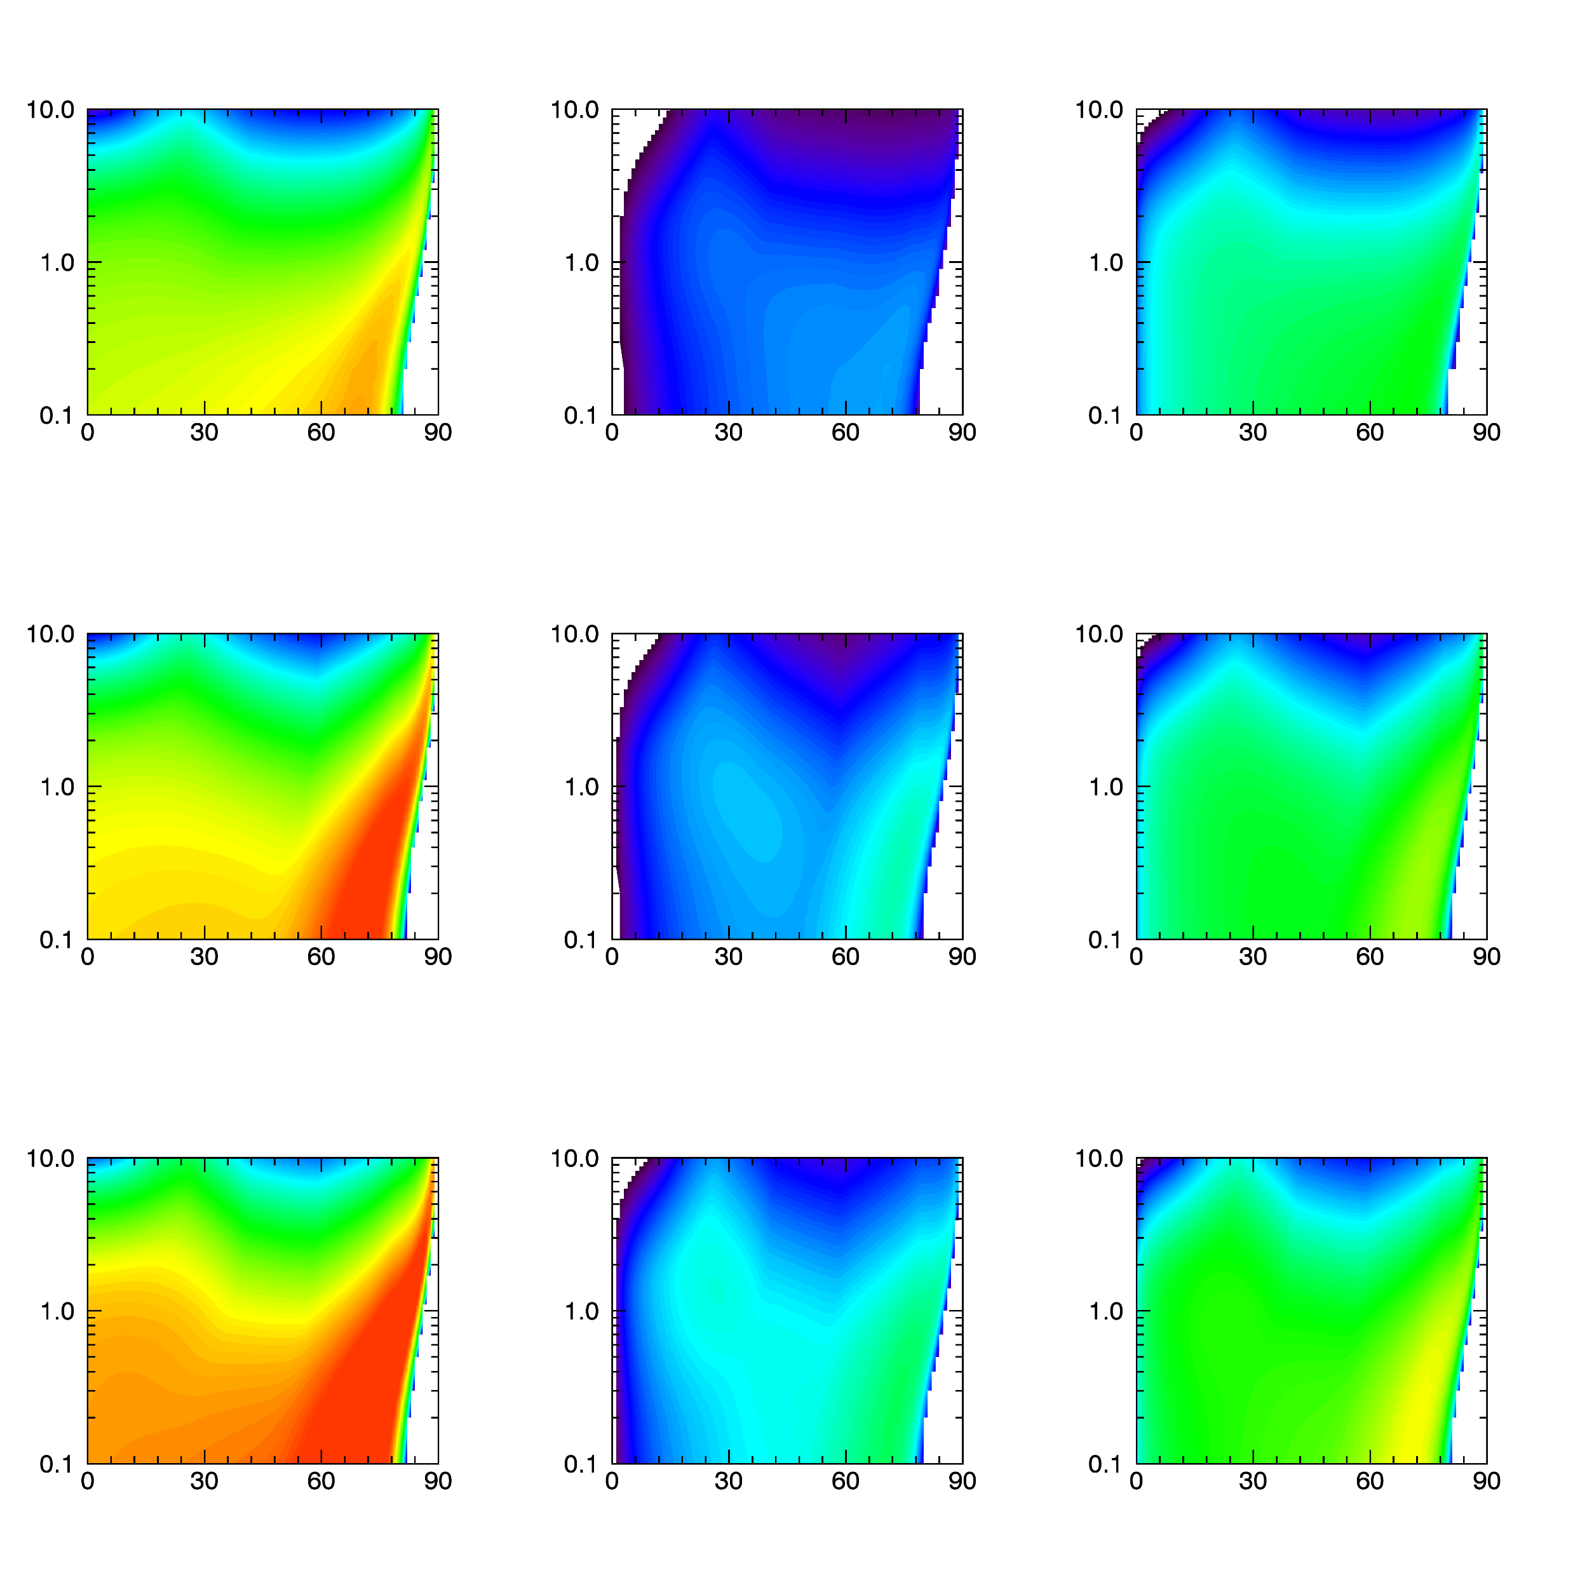













Results – 5. Hiss wave models
1. Orlova et al. 2014
2. Agapitov et al. 2020
$$L^{∗}$$
$$AE [nT]$$
$$τ\left(E,L\right)$$
$τ\left(AE, L\right)$at$1 MeV→τ\left(AE, L,E\right)$
3. CRRES statistical wave model
4. Simple model (Shprits et al. 2006)
$$D_{αα}$$
$$AE<100 nT$$
$$100>AE>500$$
$$AE>500 nT$$
$$τ=5/Kp$$
$$E [MeV]$$
$$α \left[°\right]$$
$$α \left[°\right]$$
$$α \left[°\right]$$

Slide 22
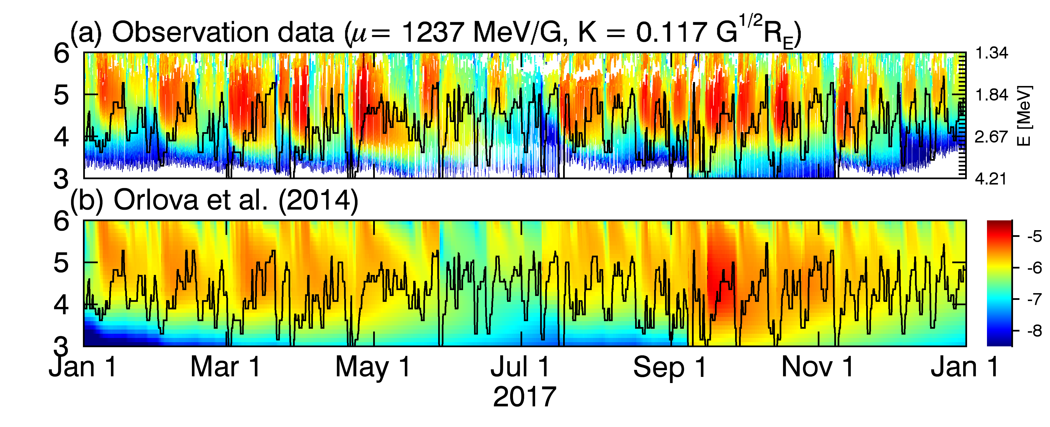
Results – 5. Hiss wave models
(b) Orlova et al. (Standard)
[Standard]

Slide 23
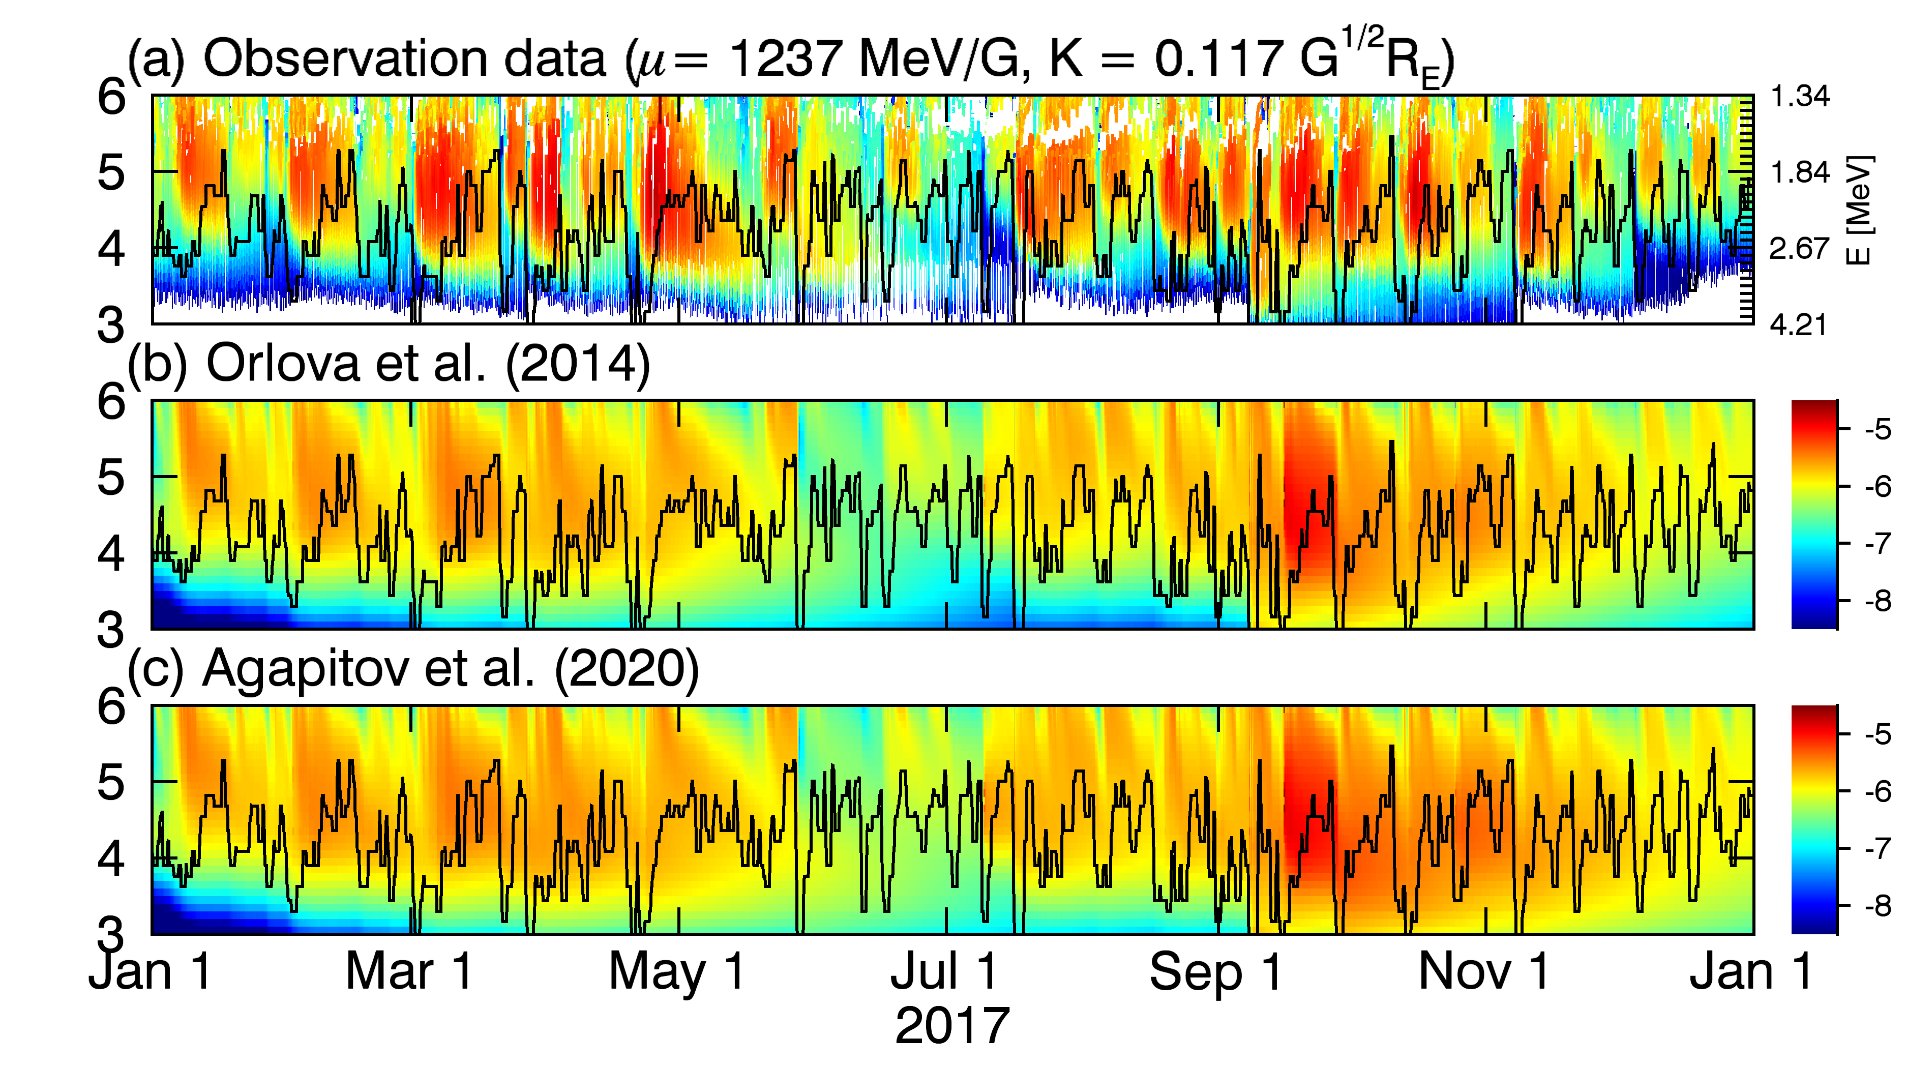
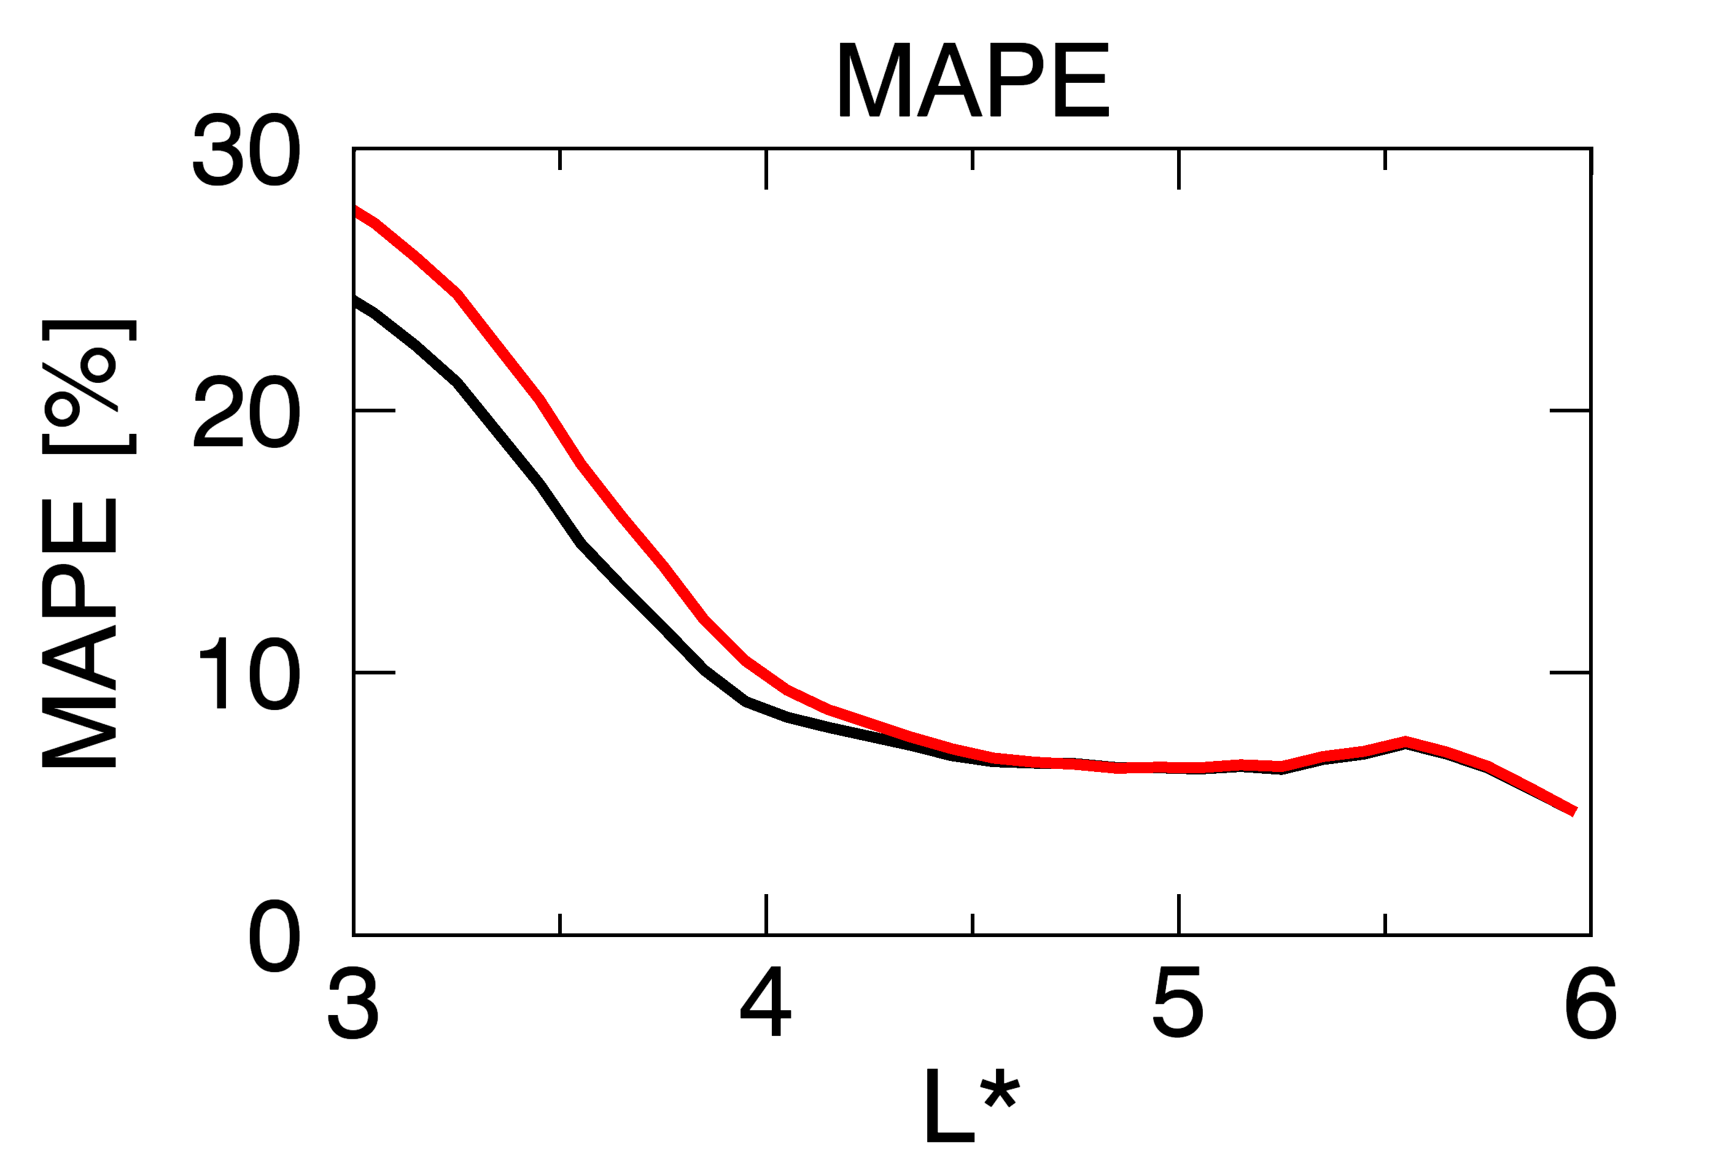
Results – 5. Hiss wave models
(b) Orlova et al. (Standard)
(c) Agapitove et al.
[Standard]

Slide 24
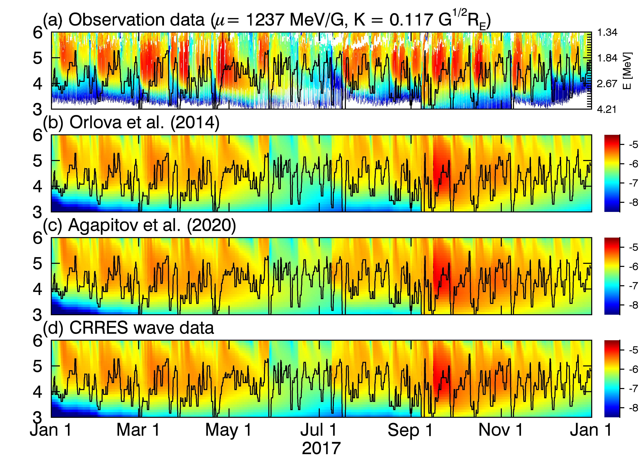
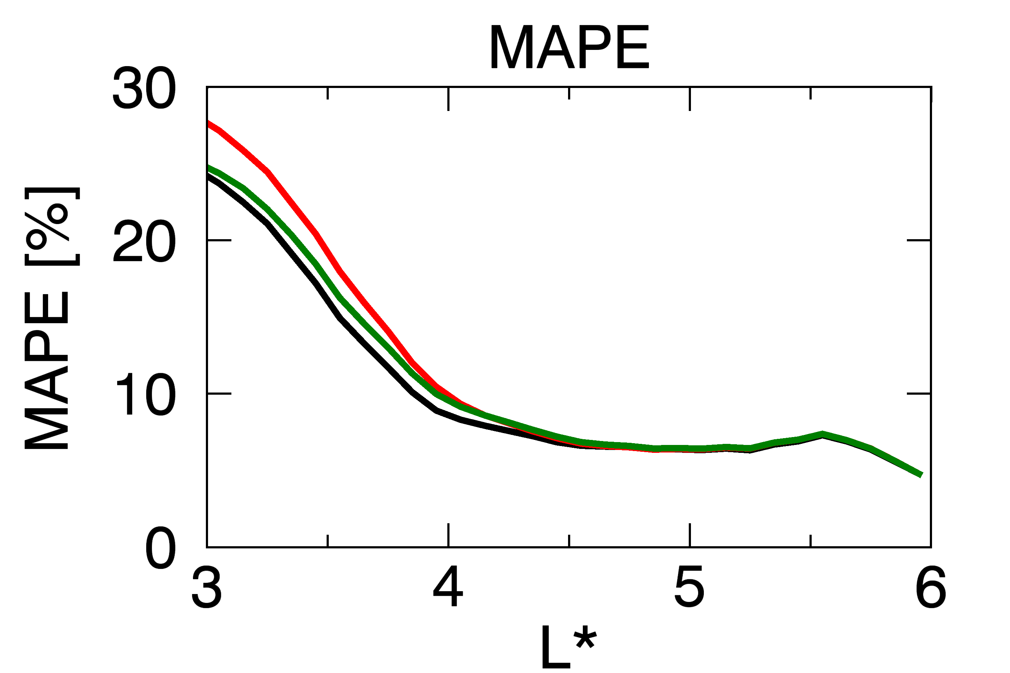
Results – 5. Hiss wave models
(b) Orlova et al. (Standard)
(c) Agapitove et al.
(d) CRRES
[Standard]

Slide 25
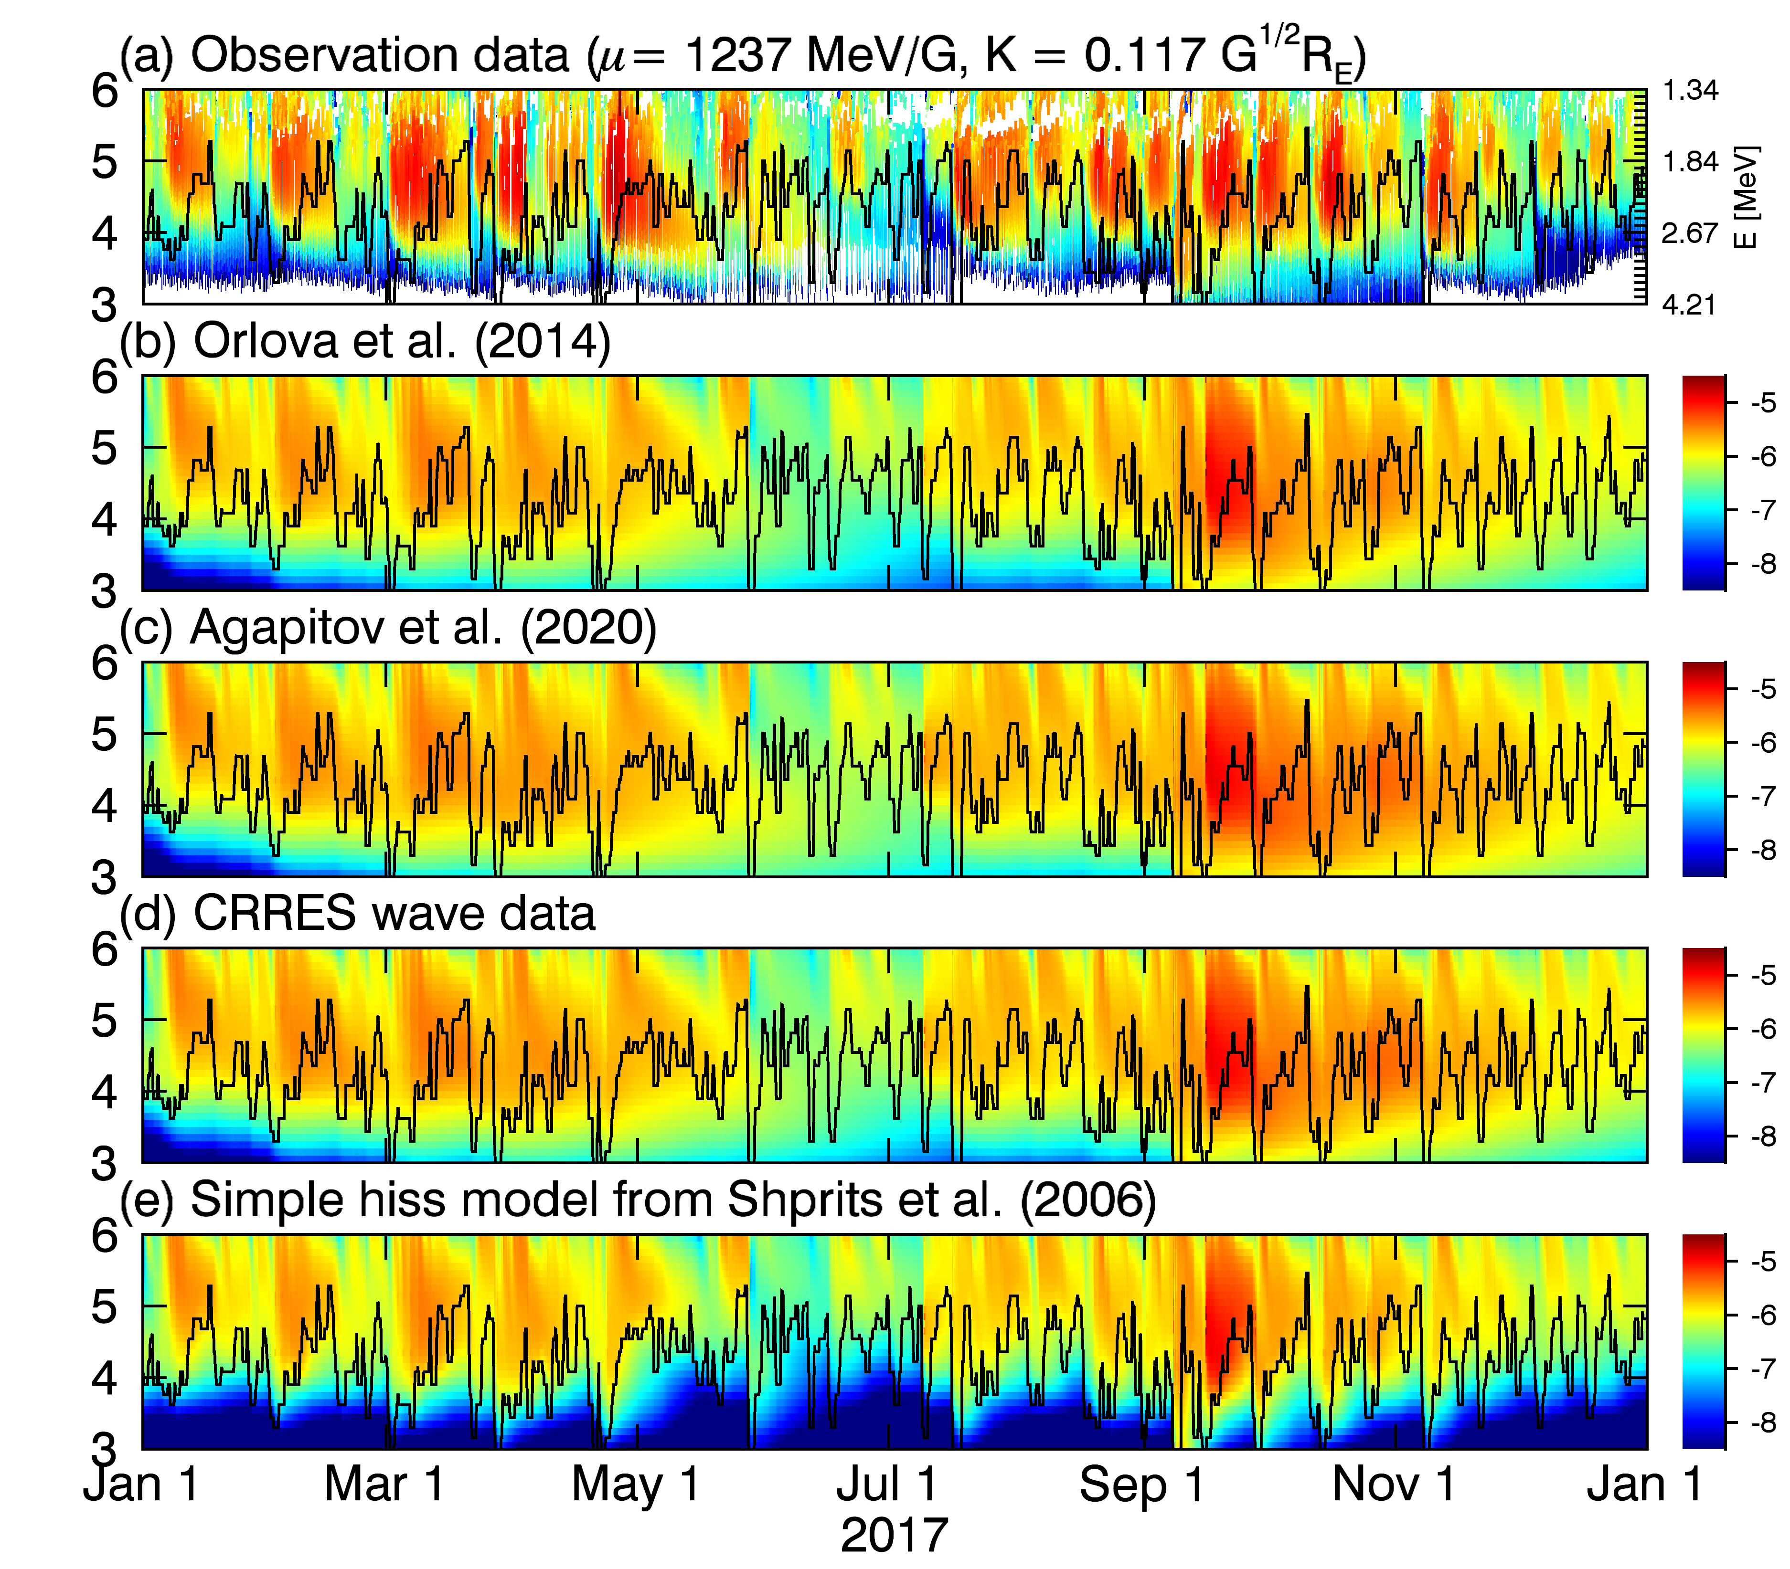
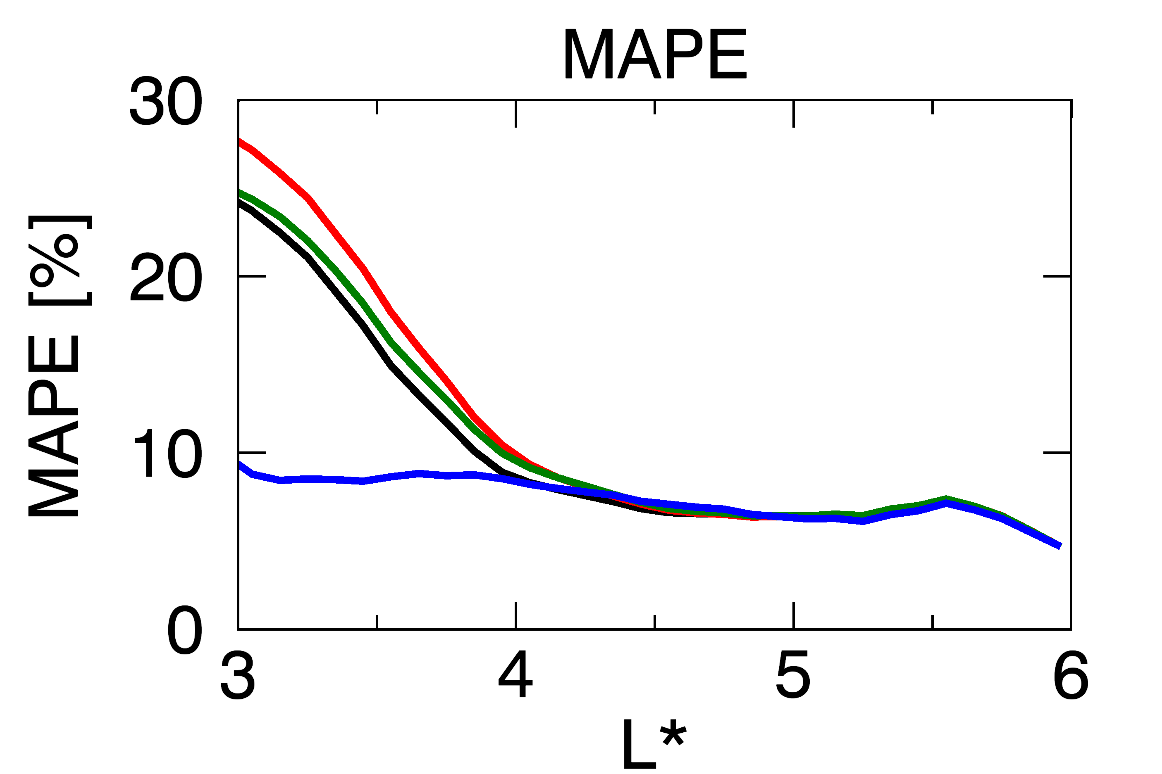
Results – 5. Hiss wave models
(b) Orlova et al. (Standard)
(c) Agapitove et al.
(d) CRRES
(e) Simple model (Shpits et al.)
[Standard]
(Simple model: $τ=5/Kp$) The best performance due to the strong reduction of PSD
Weak reduction → Overestimated $D_{LL}$ ??

Slide 26
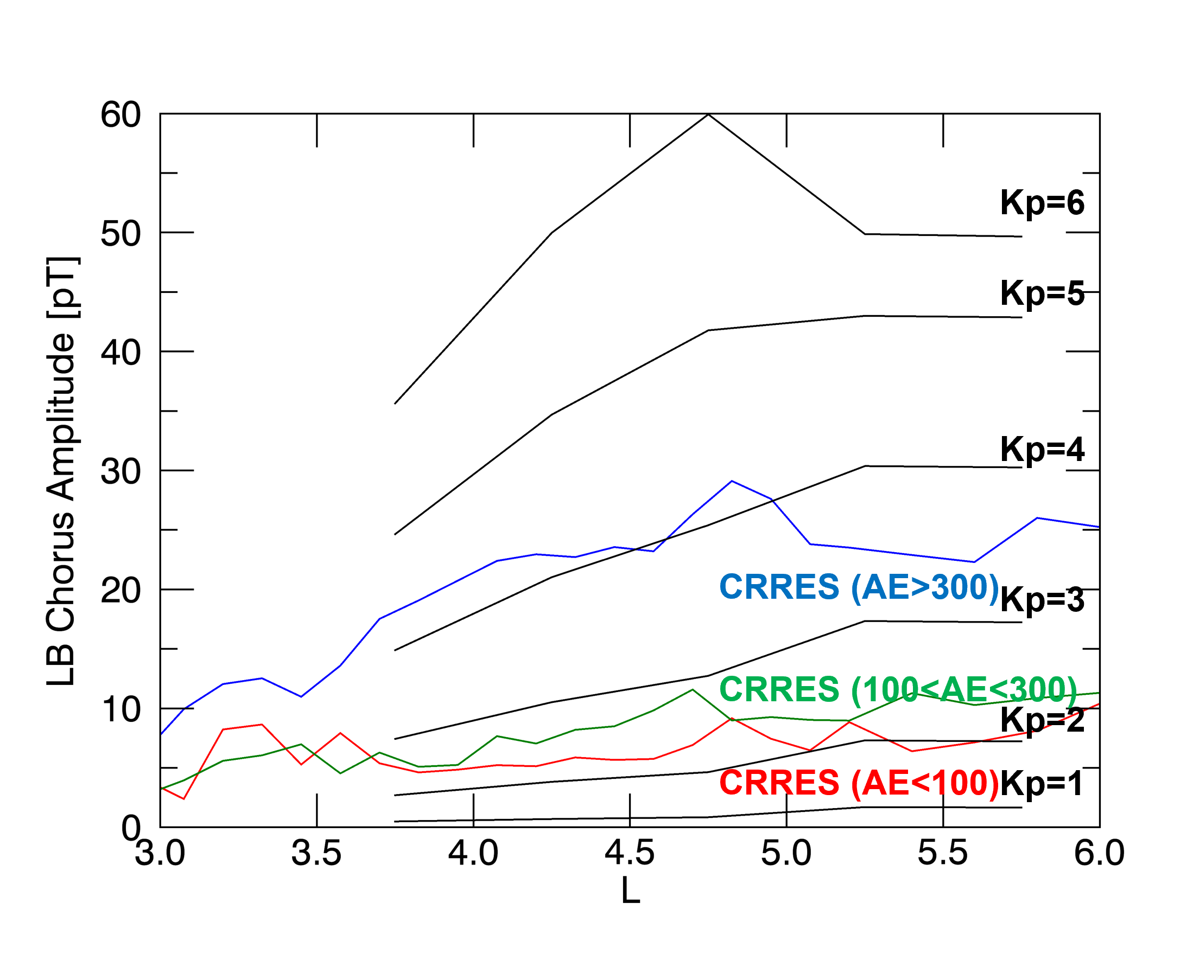
Results – 6. Chorus wave models
Wang et al. 2019
The chorus model from Wang et al. shows the $Kp−$dependent amplitude of LB chorus up to 60 pT,
while CRRES statistical wave model has a $AE−$dependency with the limited wave amplitude up to 30 pT.

Slide 27

Results – 6. Chorus wave models
(b) Wang et al. (Standard)
[Standard]
(Chorus model from Wang et al. (2019)) Stronger wave power → Enhanced PSD

Slide 28


Results – 6. Chorus wave models
(b) Wang et al. (Standard)
(c) CRRES
[Standard]
model
(Chorus model from Wang et al. (2019)) Stronger wave power → Enhanced PSD
CRRES statistical wave model have relatively weaker wave power for chorus waves as well as hiss wave.

Slide 29

Discussion & Conclusions
In this study, we investigated the electron PSD distribution obtained from the DREAM3D models by comparing the observation data from the combination of GOES and VAP for the entire year of 2017.
Model results with various models of radial diffusion coefficients, outer & Emin boundary conditions, hiss and chorus waves are compared.
Data-driven outer BCs are more critical than Emin BC for the model performance.
The $μ$-dependent $D_{LL}$ from Liu et al. results in large PSD by supplying seed electrons to be accelerated by chorus waves.
The high performance with the simple hiss model implies that stronger loss mechanisms are required.
EMIC wave is not included in this study. Relativistic electrons scattered by EMIC wave should be considered for a future work.
Current model strongly relies on the data-driven boundary condition.

Slide 30
Thank you

Slide 31


Results – 4. Radial diffusion coefficients
Brautigam and Albert, 2000
Ozeke et al., 2014
Liu et al., 2016
Ali et al., 2016
$D_{LL}^{BA}≥D_{LL}^{Ozeke}\sim D_{LL}^{Liu}≫D_{LL}^{Ali}$ at $μ=1237 MeV/G$
- Ali et al. selected the geomagnetic mean of wave power, not arithmetic mean.
The electric part of $D_{LL}^{Liu}$ and $D_{LL}^{BA}$ are $μ−$dependent.
- Strong radial diffusion for low $μ$ electrons.

