Slide 1
Versatile Electron Radiation Belt (VERB) code at CCMC
Drozdov Alexander
University of California Los Angeles (UCLA)
CCMC VERB code development team
Yuri Shprits, GFZ, UCLA (Model Developer)
Dedong Wang, GFZ (Model Developer)
Dmitri Kondrashov, UCLA (Model Developer)
Lutz Rastaetter, NASA GSFC CCMC (CCMC Model Host)
Yihua Zheng, NASA GSFC CCMC (CCMC Model Host)
Acknowledgments
CCMC team
RBSP ECT Team, NASA Omniweb
Subbotin D. A., Kellerman A.C., Aseev N.A,
Zhu H., Usanova M., Orlova K.G.,

Slide 2
Outline
Introduction
The VERB code
Implementation at CCMC
Example of runs
Future features
Development challenges
Conclusions

Slide 3
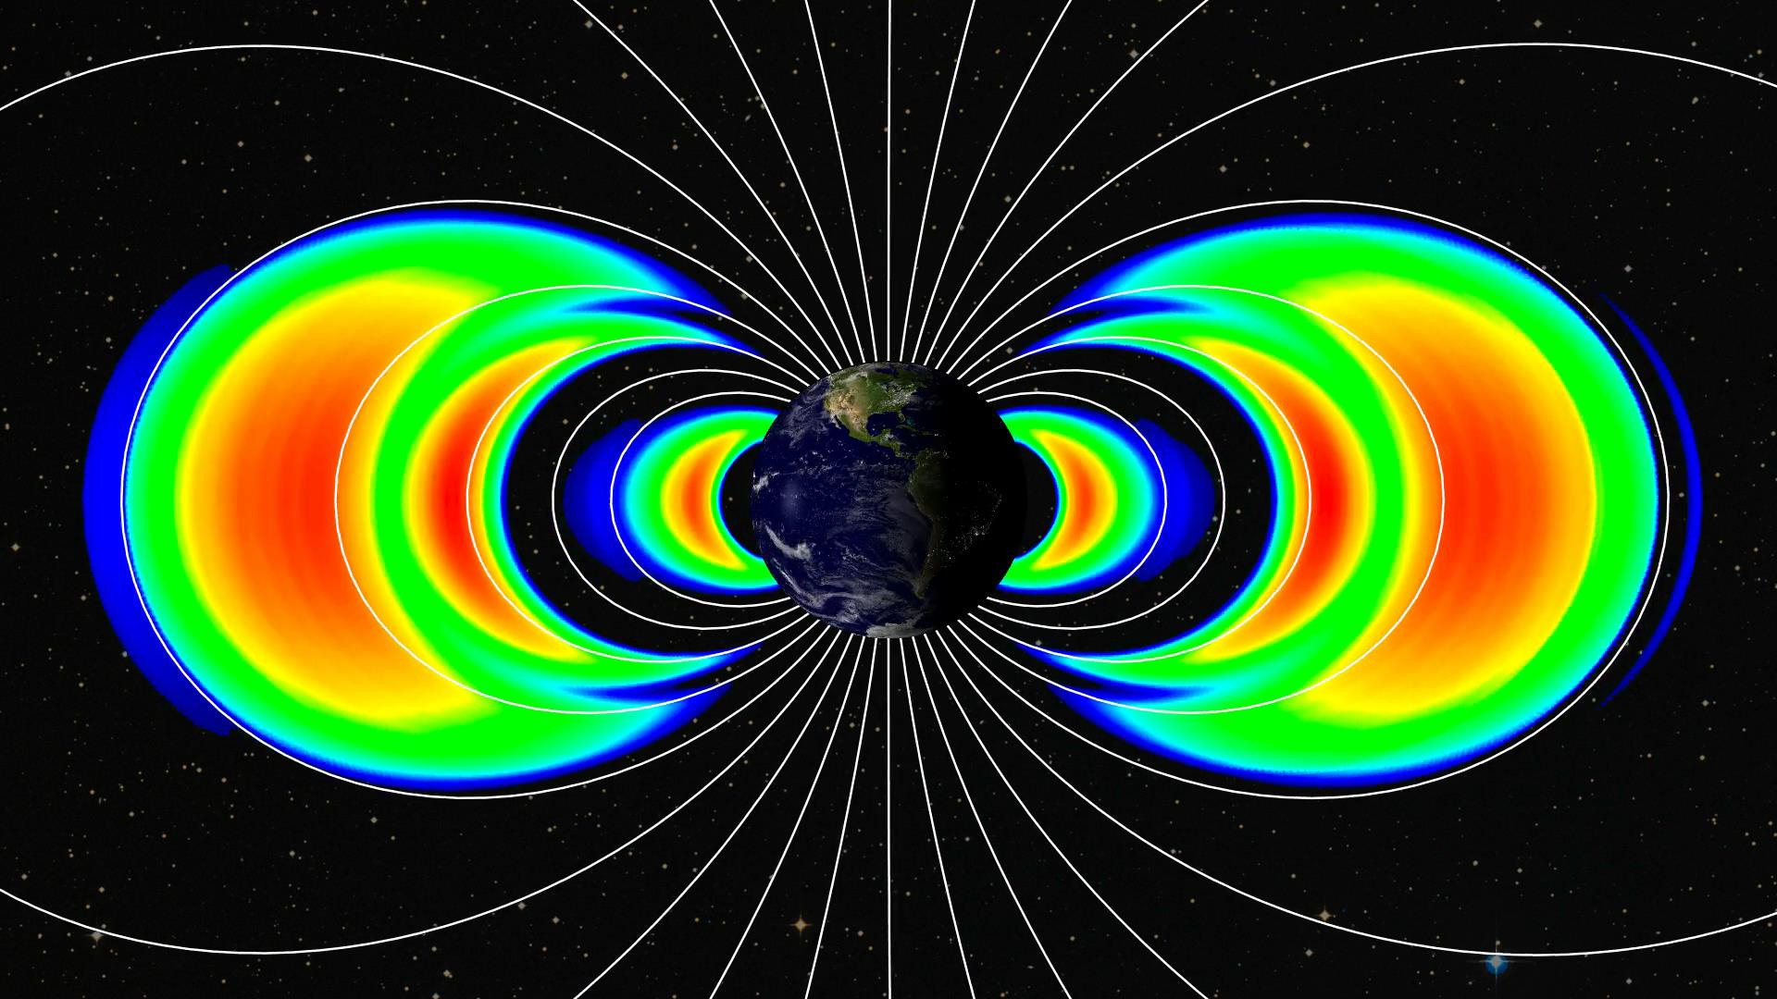
Radiation Belts
Image Credit: APL, NASA

Slide 4
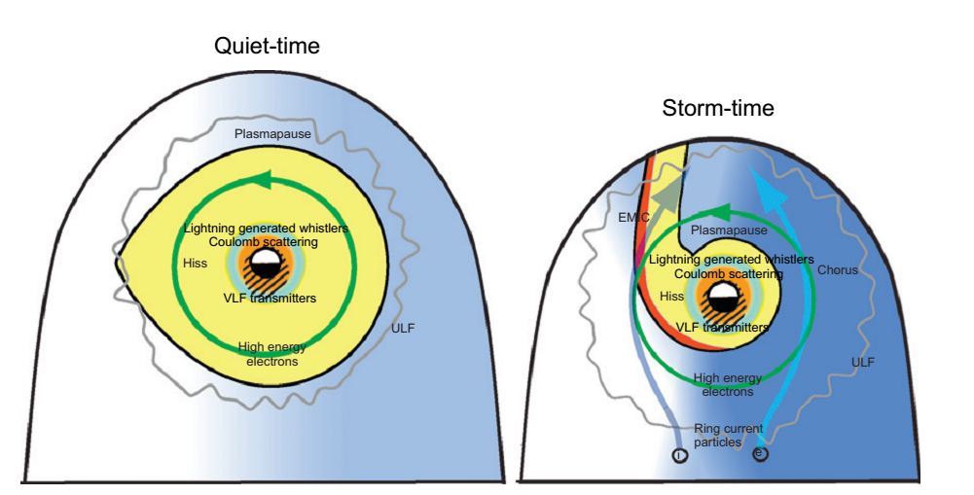
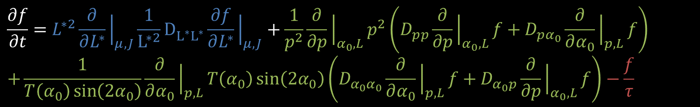
Fokker-Planck equation and
Versatile Electron Radiation Belts (VERB) code
Phase-space density dynamics
VERB code
Radial diffusion
Local diffusion
  Pitch-angle
  Energy
  Mixed-terms
Loss into atmosphere or magnetopause
Waves:
ULF
Hiss
Chorus
VLF transmitters
Lightning whistlers
EMIC
Shprits et al., 2008
$$\frac{∂f}{∂t}=L^{∗2}\frac{∂}{∂L^{∗}}{\left.​\right|}_{μ,J}\frac{1}{L^{∗2}}D_{L^{∗}L^{∗}}^{}\frac{∂f}{∂L^{∗}}{\left.​\right|}_{μ,J}+\frac{1}{p^{2}}\frac{∂}{∂p}{\left.​\right|}_{α_{0},L}p^{2}\left(D_{pp}\frac{∂}{∂p}{\left.​\right|}_{α_{0},L}f+D_{pα_{0}}\frac{∂}{∂α_{0}}{\left.​\right|}_{p,L}f\right)$$
$$+\frac{1}{T\left(α_{0}\right)\sin\left(2α_{0}\right)}\frac{∂}{∂α_{0}}{\left.​\right|}_{p,L}T\left(α_{0}\right)\sin\left(2α_{0}\right)\left(D_{α_{0}α_{0}}\frac{∂}{∂α_{0}}{\left.​\right|}_{p,L}f+D_{α_{0}p}\frac{∂}{∂p}{\left.​\right|}_{α_{0},L}f\right)−\frac{f}{τ}$$
$$\frac{∂f}{∂t}=?$$

Slide 5
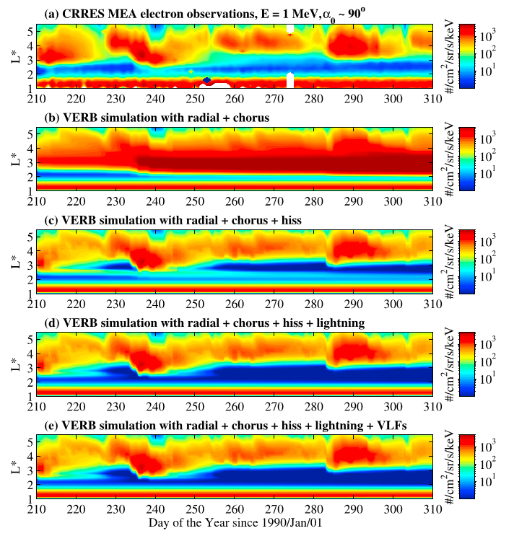
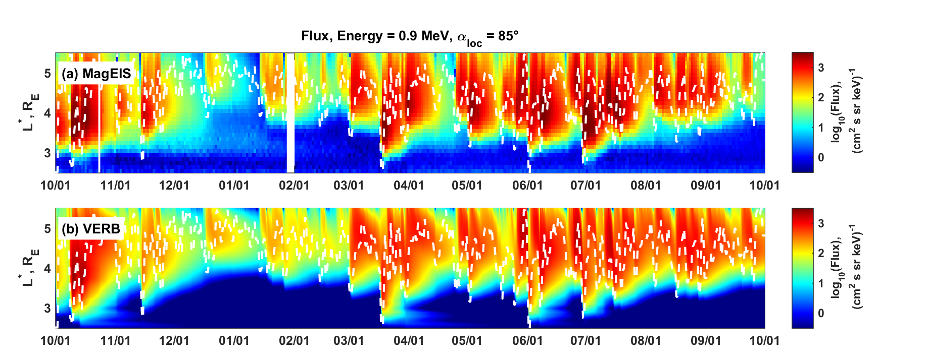
Validation
The comparison shows that the VERB code numerical solution of the two-dimensional diffusion equation with mixed terms converges to the analytical solution.
The comprehensive long-term VERB code simulations provide a qualitative agreement with the observations during the CREES and Van Allen Probes periods.
Aseev et al., 2016
Analytical
solution
Model
Kim et al., 2011
Drozdov et al., 2015
Drozdov et al., 2015
The one-year VERB code simulations provide a qualitative agreement with the observations during the Van Allen Probes period.

Slide 6

VERB code scheme at CCMC
BC (Satellite data), Kp
Parameters.ini
Dxx.ini
Visualization at CCMC website
Input preparation scripts
(matlab)
VERB code (C++)
Read inputs
Next time step
User/CCMC Interface
Developer/CCMC Interface
Diffusion coefficients
Radial diffusion
Interpolation
Local diffusion
CALC. or
LOAD
Results output
CCMC website
Input
Post-processing scripts
(matlab)
Diffusion coefficients
PSD on the radial and local grid.
The VERB code uses an unconditionally stable, implicit scheme and the operator-splitting method to numerically solve the Fokker-Planck equation.

Slide 7
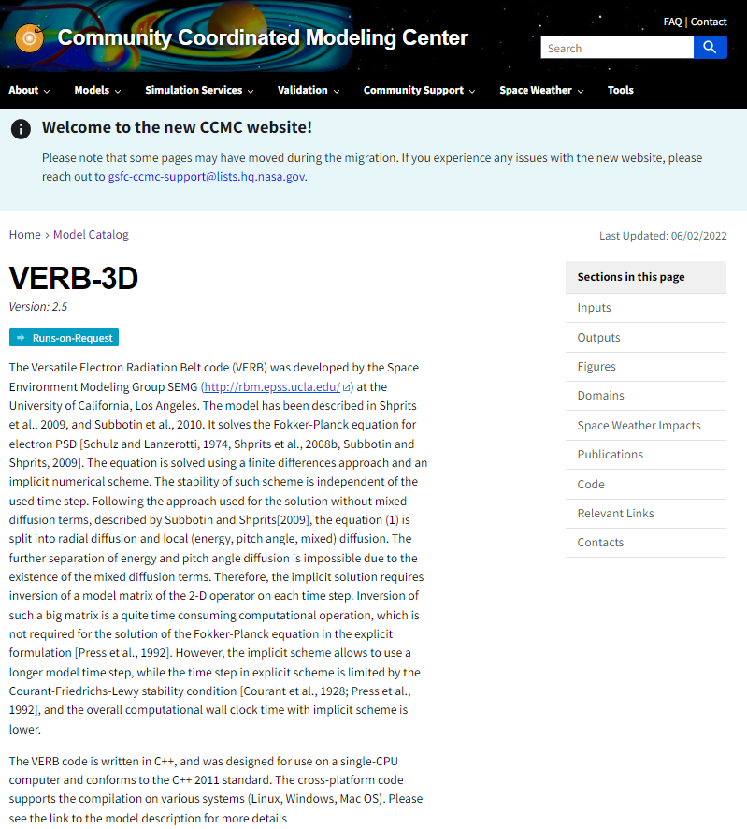
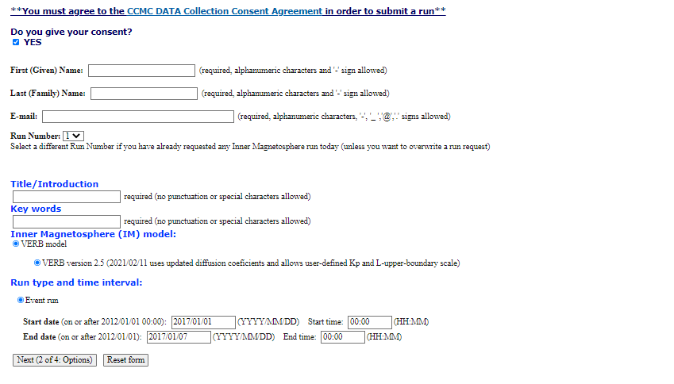
VERB code at CCMC
https://ccmc.gsfc.nasa.gov/models/VERB-3D~2.5
Creating a simulation request:
Credentials
Name of the simulation
Simulation period
Drozdov et al., 2015
The one-year VERB code simulations provide a qualitative agreement with the observations during the Van Allen Probes period.

Slide 8
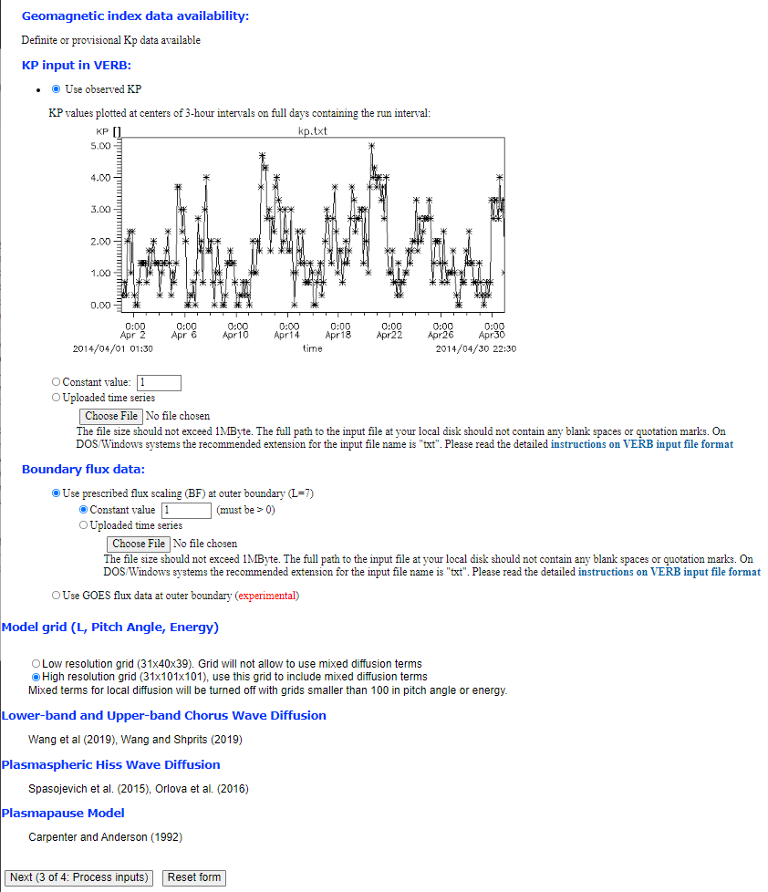
Setup simulation parameters
Setup Kp-index:
Default Kp from the World Data Center for Geomagnetism, Kyoto.
Fixed Kp value, e.g., Kp = 1
Kp form the data file
Setup L upper boundary or boundary flux (bf) scaling:
Default Fixed Dirichlet boundary condition (e.g., =1)
Bf scaling from data files
Bf scaling from observations (experimental feature)
  GOES 13
  GOES 15
Setup grid size
  Low resolution (no mixed terms)
  High resolution (with mixed terms)
Radial diffusion, chorus and hiss waves are scaled by Kp.

Slide 9
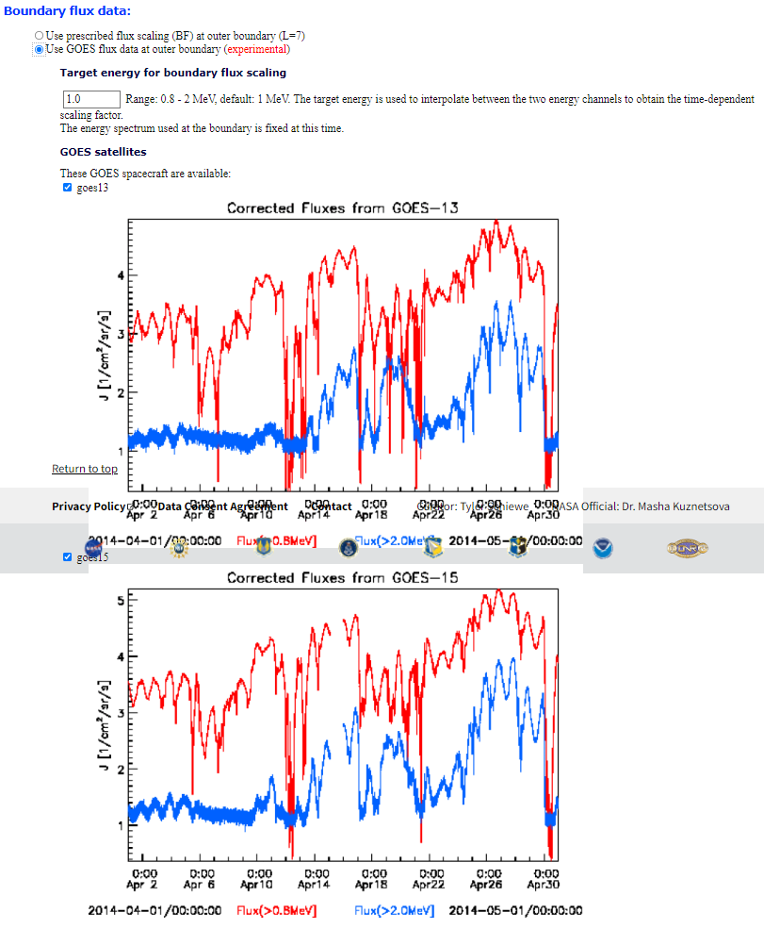
Setup simulation parameters
Setup Kp-index:
Default Kp from the World Data Center for Geomagnetism, Kyoto.
Fixed Kp value, e.g., Kp = 1
Kp form the data file
Setup L upper boundary or boundary flux (bf) scaling:
Default Fixed Dirichlet boundary condition (e.g., =1)
Bf scaling from data files
Bf scaling from observations (experimental feature)
  GOES 13
  GOES 15
Setup grid size
  Low resolution (no mixed terms)
  High resolution (with mixed terms)
Radial diffusion, chorus and hiss waves are scaled by Kp.

Slide 10
Setup simulation parameters
Setup Kp-index:
Default Kp from the World Data Center for Geomagnetism, Kyoto.
Fixed Kp value, e.g., Kp = 1
Kp form the data file
Setup L upper boundary or boundary flux (bf) scaling:
Default Fixed Dirichlet boundary condition (e.g., =1)
Bf scaling from data files
Bf scaling from observations (experimental feature)
  GOES 13
  GOES 15
Setup grid size
  Low resolution (no mixed terms)
  High resolution (with mixed terms)
Radial diffusion, chorus and hiss waves are scaled by Kp.

Slide 11
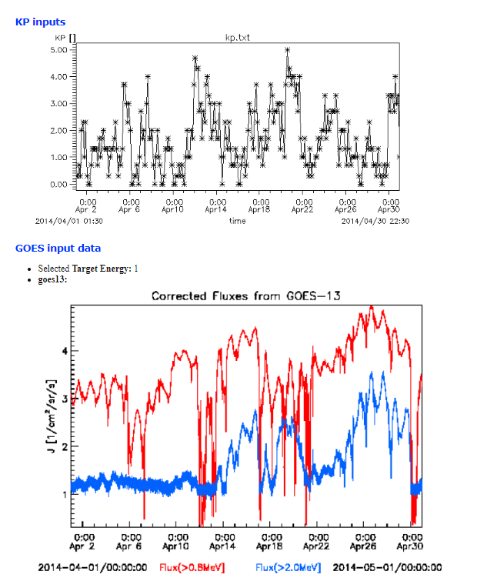
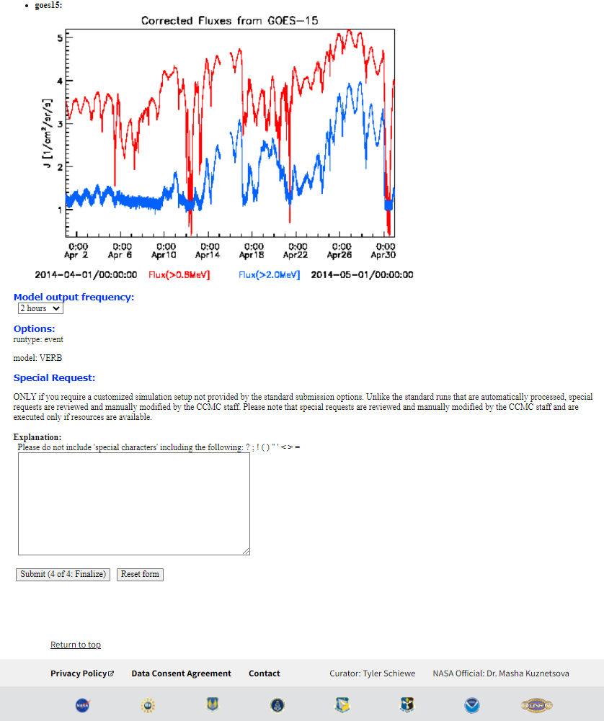
Review input and submit

Slide 12
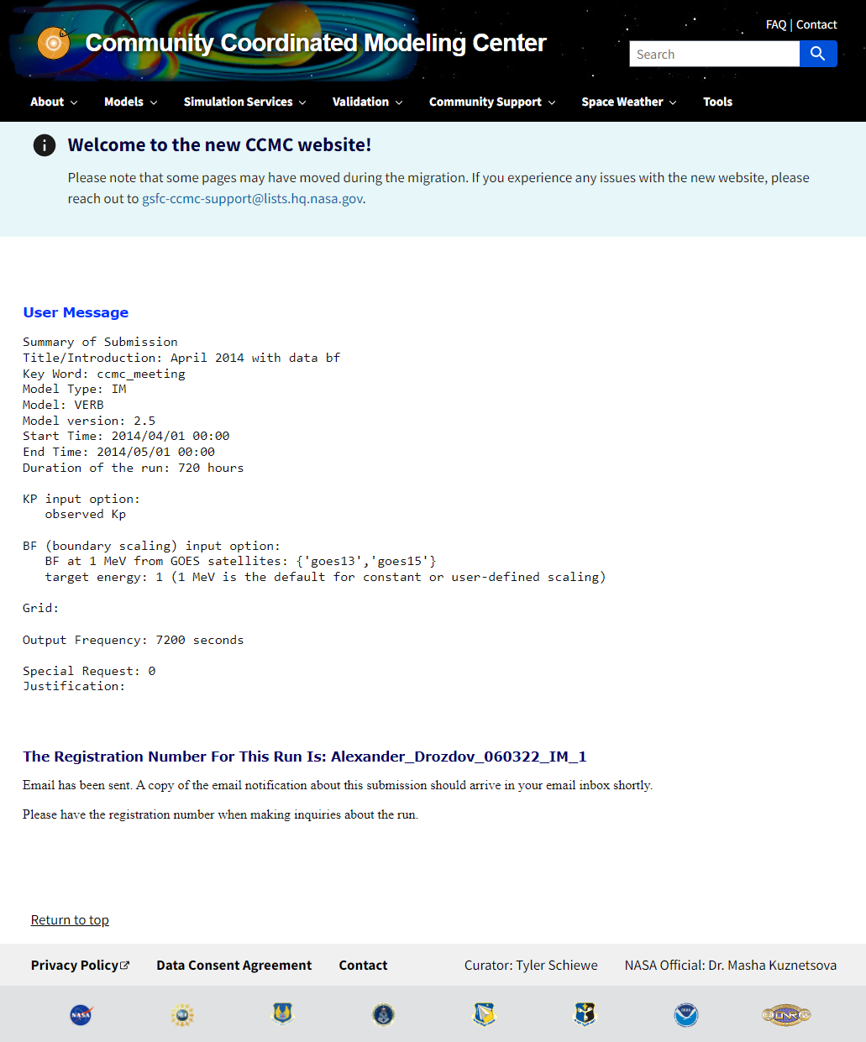
Review input and submit
Confirmation page

Slide 13
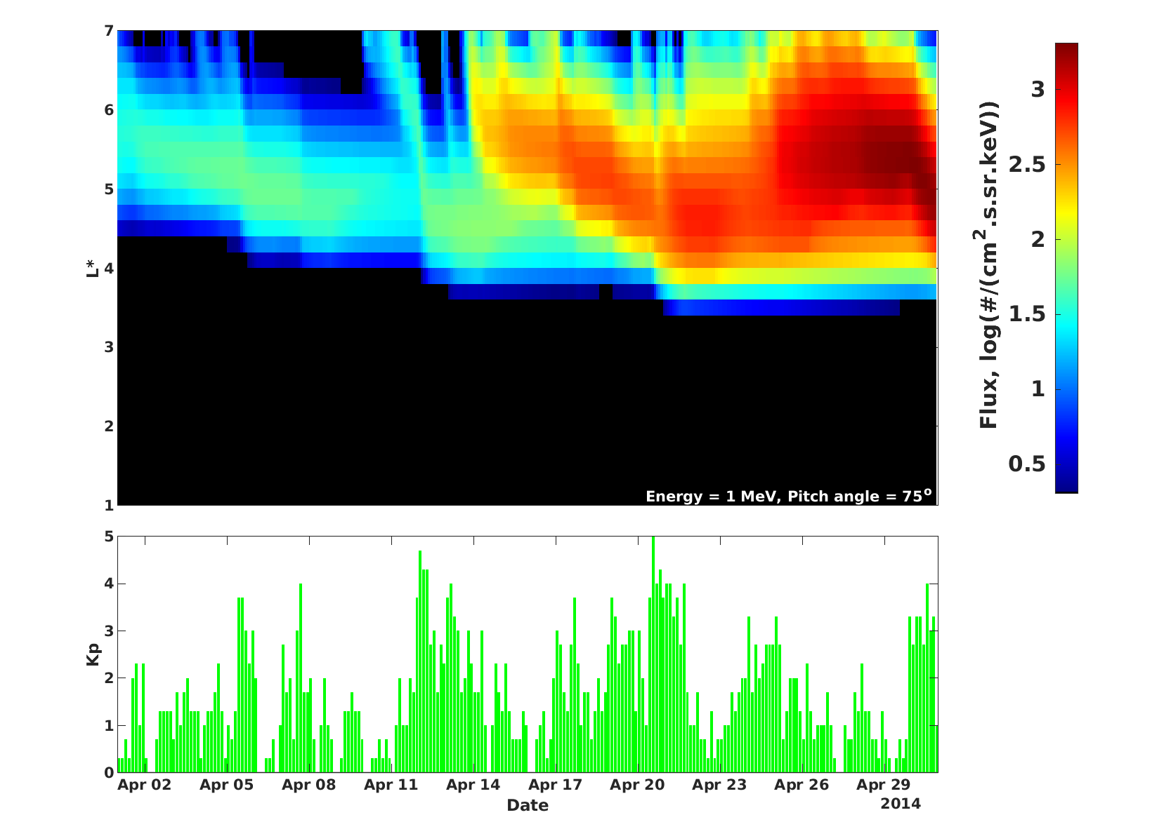
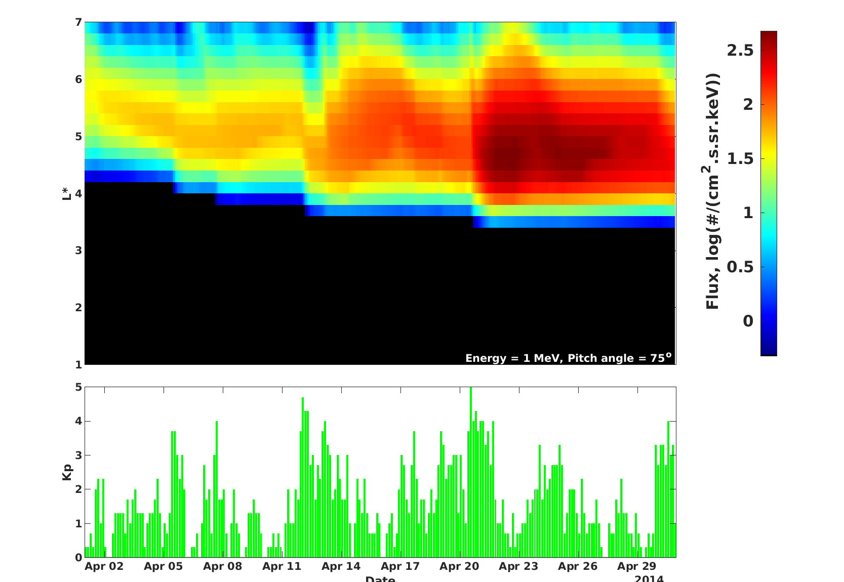
VERB code simulation results at CCMC
Flux 1 MeV eq. pitch angle 75°
Default Kp from the World Data Center from Geomagnetism, Kyoto.
Bf scaling from uploaded file
  Bf reconstructed by neural network
  Landis, D. A., Saikin, A. A., Zhelavskaya, I., Drozdov, A. Y., Aseev, N., Shprits, Y. Y., et al. (2022). Title: NARX neural network derivations of the outer boundary radiation belt electron flux. Space Weather. https://doi.org/10.1029/2021sw002774
Flux 1 MeV eq. pitch angle 75°
Default Kp from the World Data Center from Geomagnetism, Kyoto.
Default Bf scaling from observations (GOES 13 and 15)
Drozdov et al., 2015
The one-year VERB code simulations provide a qualitative agreement with the observations during the Van Allen Probes period.

Slide 14
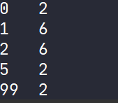
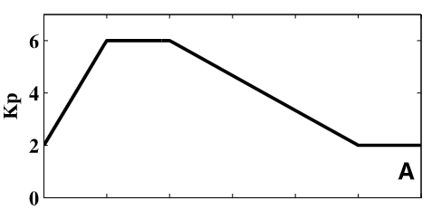
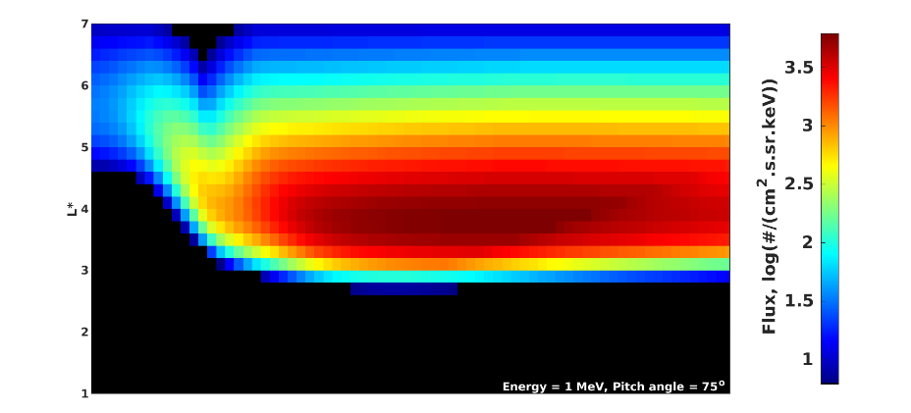
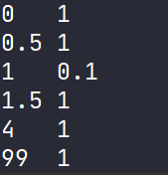
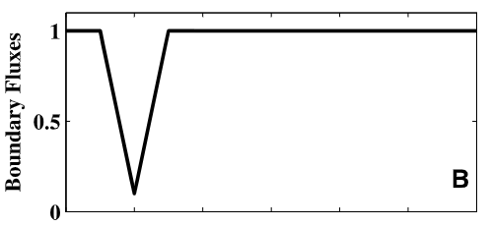
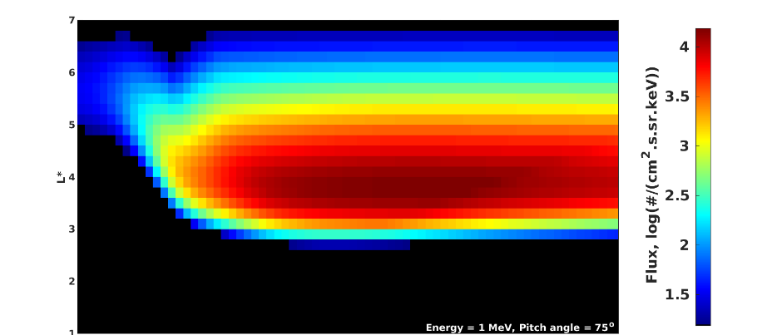
VERB code simulation results at CCMC
Kp and Bf are defined using data files:
Flux 1 MeV eq. pitch angle 75°
Regular grid
With mixed terms
Small grid
No mixed terms
Shprits, Y. Y., Subbotin, D., & Ni, B. (2009). Evolution of electron fluxes in the outer radiation belt computed with the VERB code. Journal of Geophysical Research, [Space Physics], 114(A11). https://doi.org/10.1029/2008JA013784
Drozdov et al., 2015
The one-year VERB code simulations provide a qualitative agreement with the observations during the Van Allen Probes period.

Slide 15
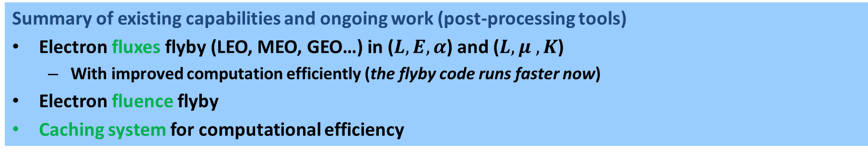
Future of the VERB code at CCMC
Summary of existing capabilities and ongoing work (post-processing tools)
Electron fluxes flyby (LEO, MEO, GEO…) in ($L, E, α$) and ($L, μ , K$)
  With improved computation efficiently (the flyby code runs faster now)
Electron fluence flyby
Caching system for computational efficiency
Future directions
GUI improvement and Visualization capabilities
Transition to AWS
Guidelines for CCMC users on using VERB according to science and engineering objectives for assessing space radiation environment
Other VERB code capabilities
Improvement of the simulation parameters (diffusion coefficients, plasmapause, etc.)
Uncertainty quantification and ensemble runs
Forecasting/Data assimilation/Machine learning capabilities
Drozdov et al., 2015
The one-year VERB code simulations provide a qualitative agreement with the observations during the Van Allen Probes period.

Slide 16

Flux: Van Allen Probes flyby, St. Patrick 2013 storm
Flyby in energy and pitch angle space
Flyby in μ and K space
Comparison with observations

Slide 17
Flux: POES flyby, St. Patrick 2013 storm
Flyby in energy and pitch angle space
Flyby in μ and K space
Comparison with observations

Slide 18
Fluence: Van Allen Probes flyby, St. Patrick 2013 storm
Van Allen Probes
AE9 (magenta)
VERB flyby (red, blue)
Observed (black)
Flux
1-day average flux
Fluence

Slide 19
Development challenges
Front- and backend on CCMC (developer/CCMC interface)
Implementation of any codes’ feature requires CCMC personal with access to the web pages. The input from the web forms must be processed, which requires a close interaction between the code developers and CCMC staff. But we are all busy.
Testing (user/CCMC interface)
Simulation runs take time and run-on-request requires approval of each simulation.
AWS is a great step towards the solution if the CCMC website can be mirrored.
Fundings
Original implementation of the VERB code into CCMC did not have a specific funding program.
Drozdov et al., 2015
The one-year VERB code simulations provide a qualitative agreement with the observations during the Van Allen Probes period.

Slide 20
Summary
The 3D VERB code is at CCMC. It can be used to test scientific ideas and theories.
Current work is focused on obtaining the results from virtual satellite flybys.
Future work will include more flexibility of the simulation parameters, and enhanced capabilities of using the VERB code.

Slide 21
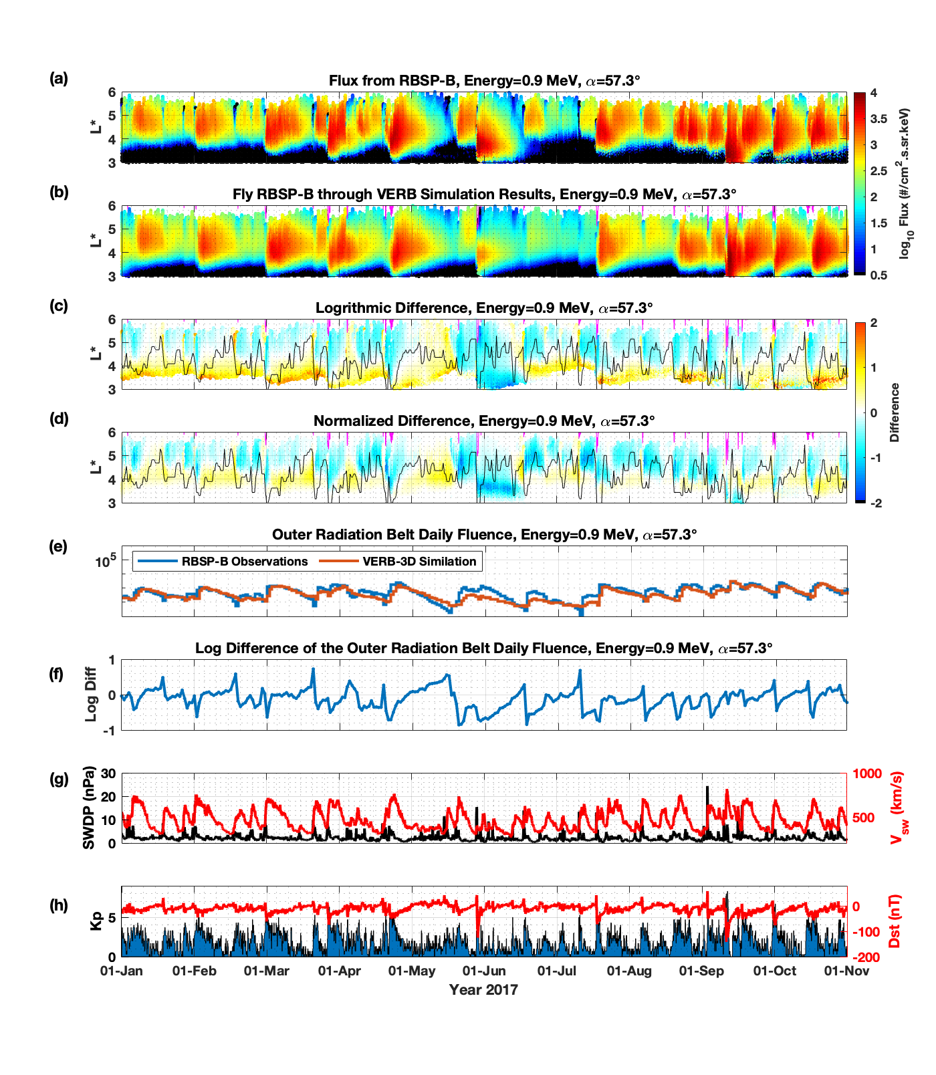
Instead of “Thank you” slide
COSPAR International Space Weather Action Team (ISWAT) Challenge

