Slide 1

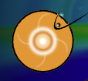

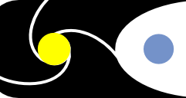
CIMI Update
Mei-Ching Fok, Alex Glocer, Natasha Buzulukova Suk-Bin Kang, Cristian Ferradas
Geospace Physics Laboratory, NASA Goddard Space Flight Center
CCMC 2022 Workshop
June 6-10, 2022

Slide 2
Outline
The Comprehensive Inner Magnetosphere-Ionosphere (CIMI) Model
CIMI output
CIMI new capabilities, recent focuses

Slide 3
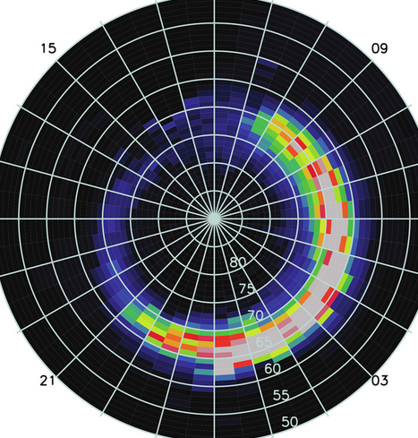
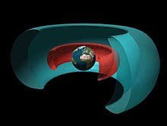

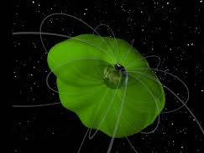
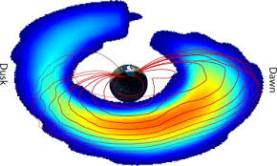
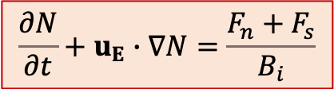

Comprehensive Inner Magnetosphere-Ionosphere (CIMI) Model
f_{s}: phase space density of radiation belt-ring current particles
Particle Precipitation
$$\frac{∂f_{s}}{∂t}+〈{\dot{L}}_{i}〉\frac{∂f_{s}}{∂L_{i}}+〈{\dot{φ}}_{i}〉\frac{∂f_{s}}{∂φ_{i}}+\dot{p}\frac{∂f_{s}}{∂p}=\frac{1}{G_{pα_{o}}}\frac{∂}{∂p}\left[G_{pα_{o}}\left(D_{pp}\frac{∂f_{s}}{∂p}+D_{pα_{o}}\frac{∂f_{s}}{∂α_{o}}\right)\right]$$
$$+\frac{1}{G_{pα_{o}}}\frac{∂}{∂α_{o}}\left[G_{pα_{o}}\left(D_{α_{o}α_{o}}\frac{∂f_{s}}{∂α_{o}}+D_{α_{o}p}\frac{∂f_{s}}{∂p}\right)\right]{−vσ_{sH}〈n_{H}〉f_{s}−\left(\frac{f_{s}}{0.5τ_{b}}\right)}_{losscone}$$
[Fok et al., 2014; 2021]
N: plasma content
Φ: convection potential
$$\frac{∂N}{∂t}+u_{E}∙∇N=\frac{F_{n}+F_{s}}{B_{i}}$$
$$∇∙\left(−\overset{⃡}{Σ}∙∇Φ\right)=J_{∥}sinI$$
Radiation Belts
Ring Current
Plasmasphere
M-I Coupling
Courtesy of J. Goldstein

Slide 4
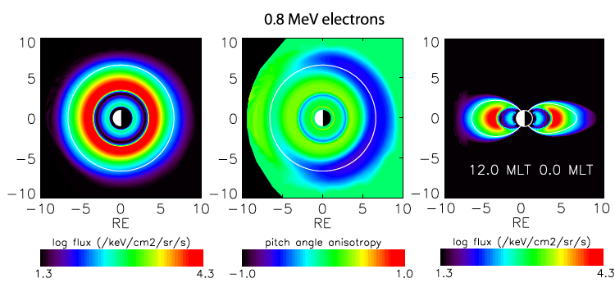
CIMI Output: Energetic ion and electron fluxes
flux (t, E, r_{o}, mlt_{o}, α_{o})
[Fok et al., 2008]

Slide 5
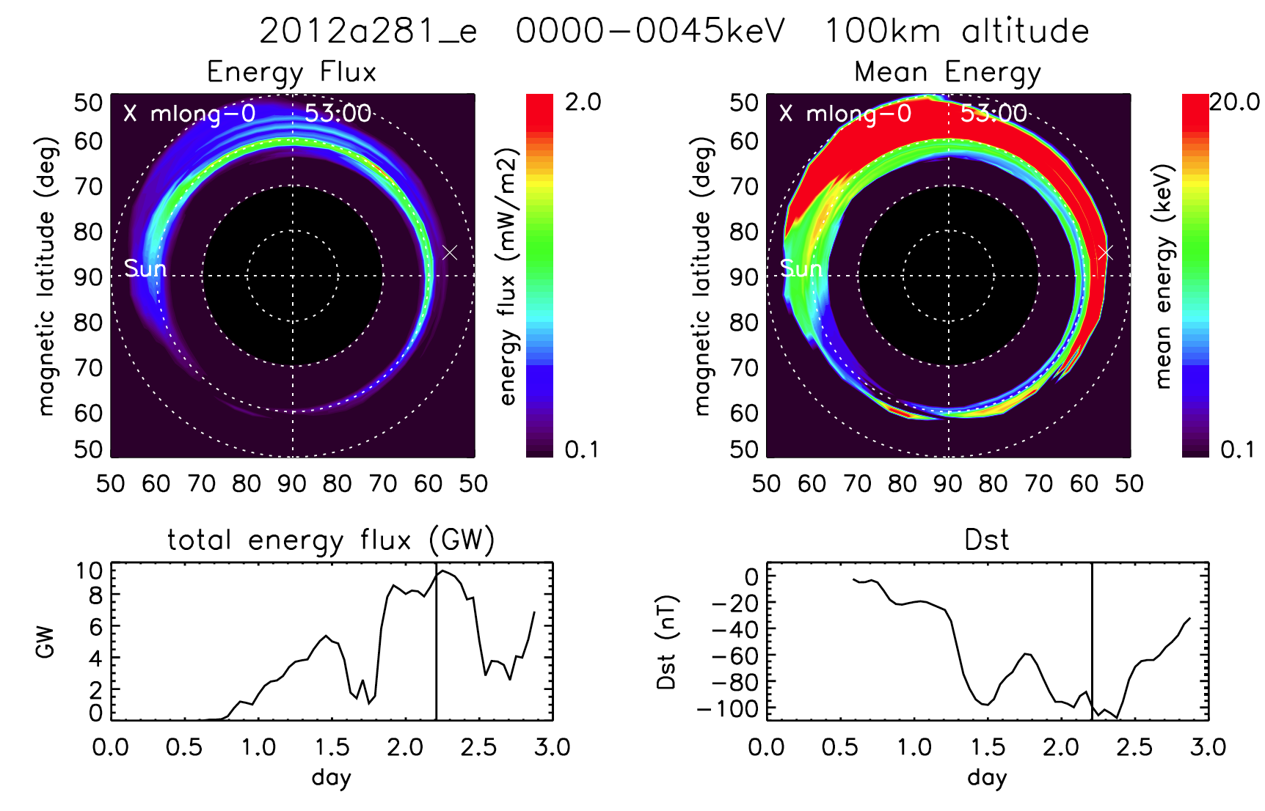
CIMI Output: Precipitating ion and electron fluxes
pre-flux (t, E, mlat_{i}, mlt_{i})
Oct 7 Oct 8 Oct 9, 2012
Oct 7 Oct 8 Oct 9, 2012

Slide 6
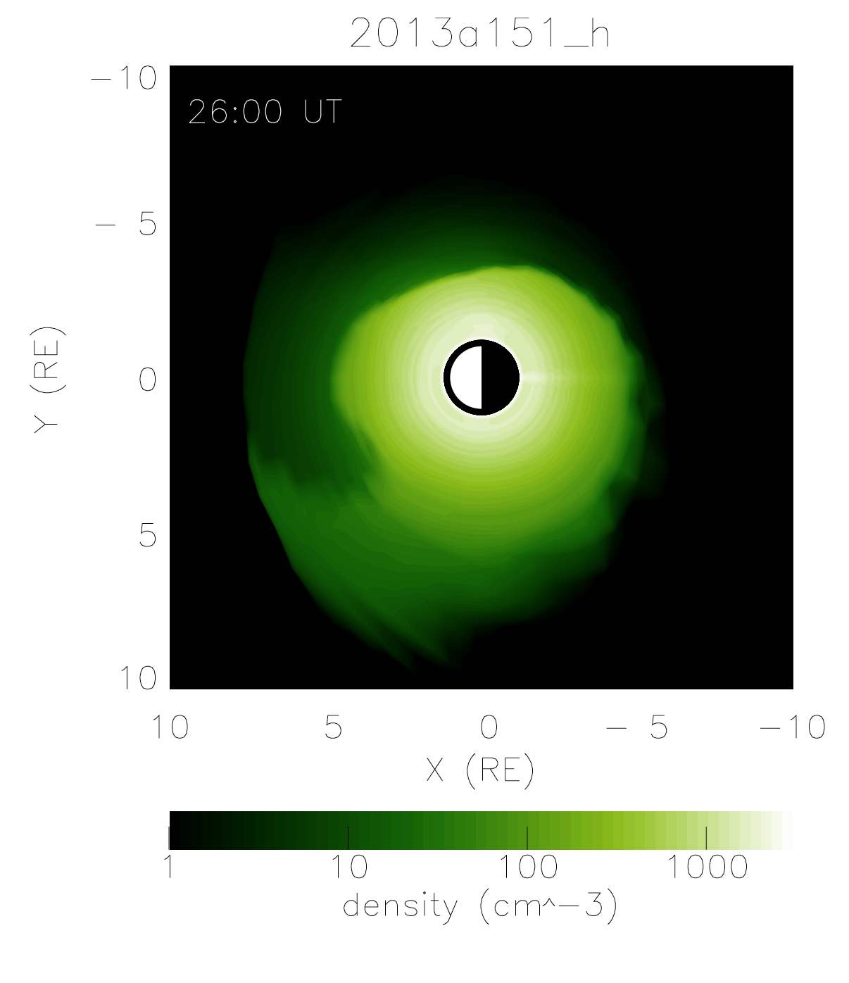
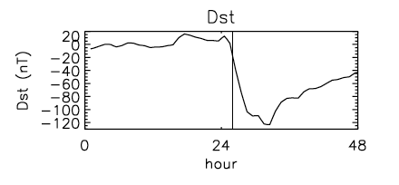
CIMI Output: Plasmasphere flux tube content
N_{plsp} (t, r_{o}, mlt_{o})
May 31 June 1, 2013

Slide 7
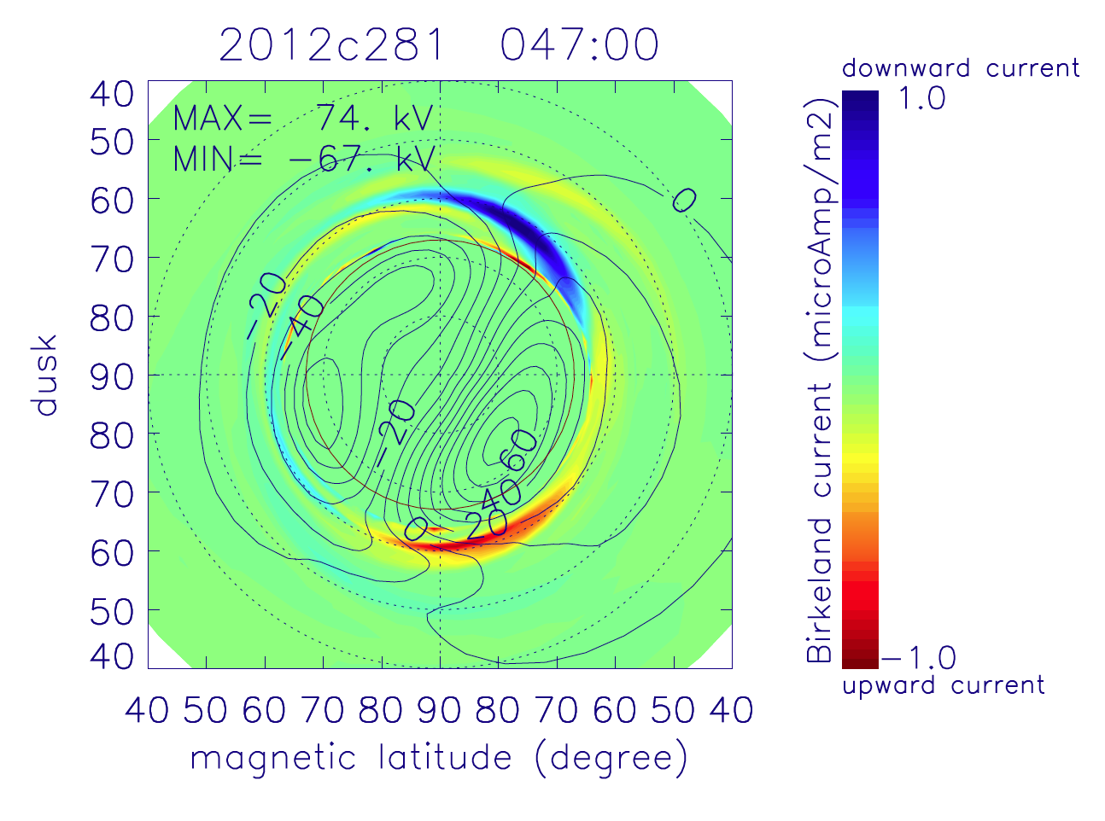
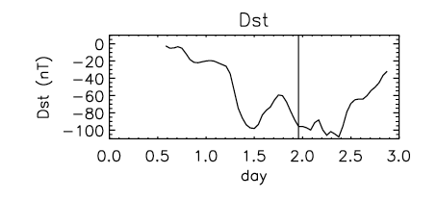
CIMI Output: Convection potential & Region 2 currents
Φ, J_{R2} (t, mlat_{i}, mlt_{i})
Oct 7 Oct 8 Oct 9, 2012

Slide 8
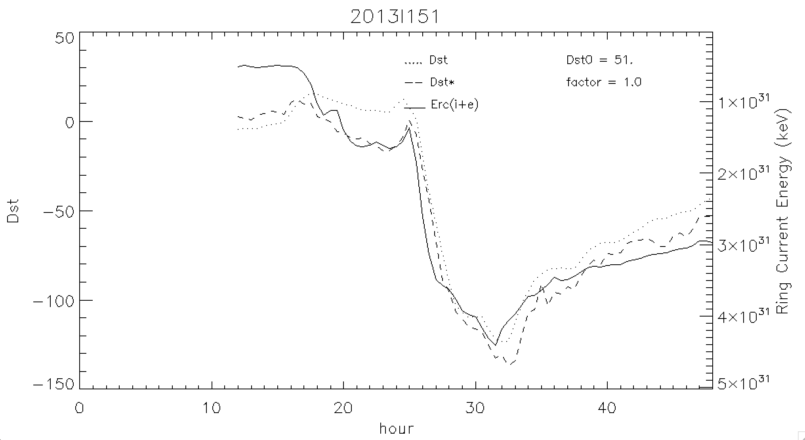
CIMI Higher-Level Output: Ring current total energy
Dst
Dst*
CIMI total E
Hour starts from 00 UT on May 31, 2013

Slide 9
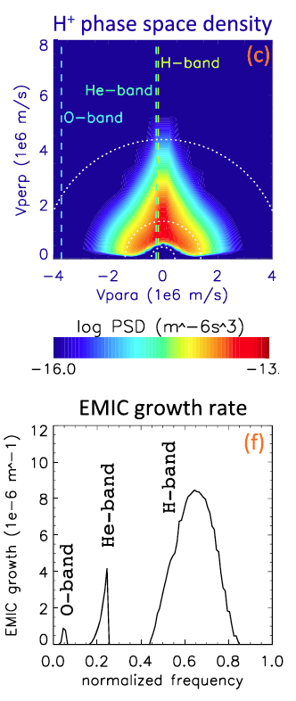
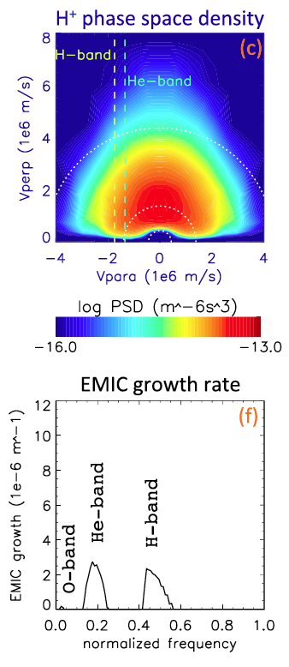
CIMI Higher-Level Output: Plasma wave growth
At late main phase
Ro = 7.6 RE
MLT = 13.4 hr
At recovery phase
Ro = 4.5 RE
MLT = 22 hr
[Fok et al., 2016]
Notes:
Dashed lines are resonant velocities at the peak of each band
White dotted circles represent 1, 10, 100 keV energies

Slide 10
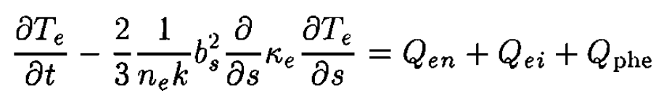
CIMI Higher-Level Output: Heat transfer to plasmasphere
CIMI
Heating Rate (S_{ring})
SAMI3
SAMI3 electron temperature equation
Isosurfaces of O⁺ density at 100 cm⁻³
+ S_{ring}
Plasmaspheric electrons
heat
Hot ring current (RC) ions
heat
Plasmaspheric H+ Ionospheric O+
High T_{o+}
Ionospheric O⁺ outflow
Without RC heating
With RC heating
O⁺ shell/torus
[Krall et al, 2020]

Slide 11
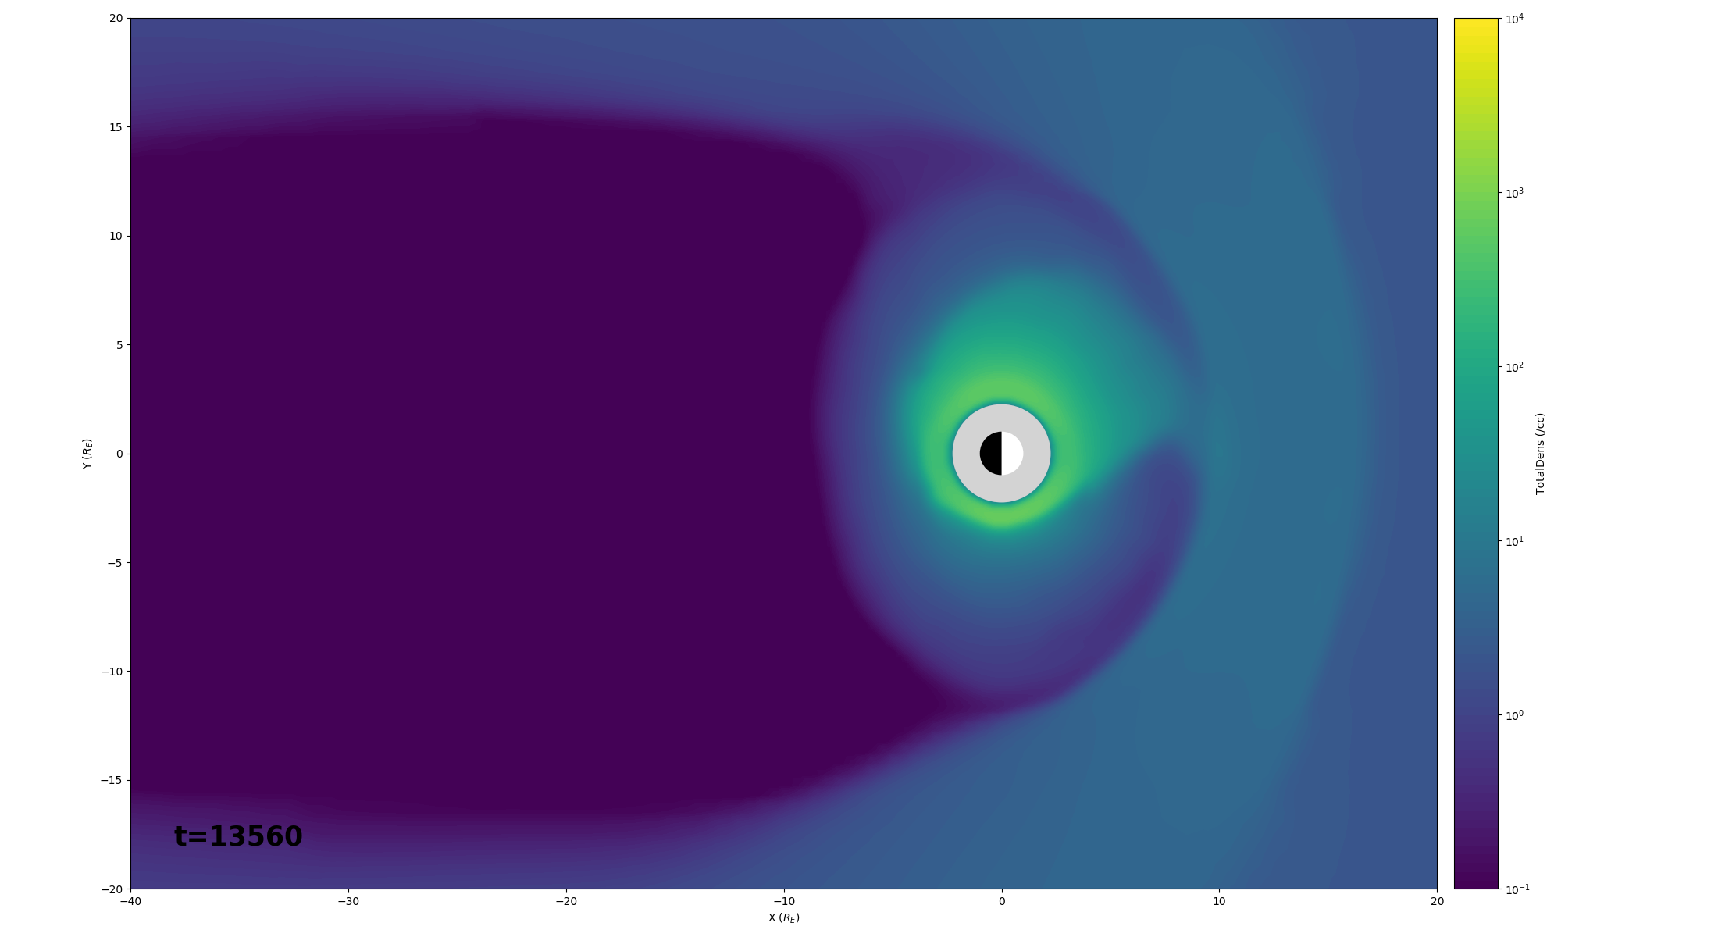
New Capability: Separate plasmasphere fluid in BATSRUS-CIMI
Y
X

Slide 12
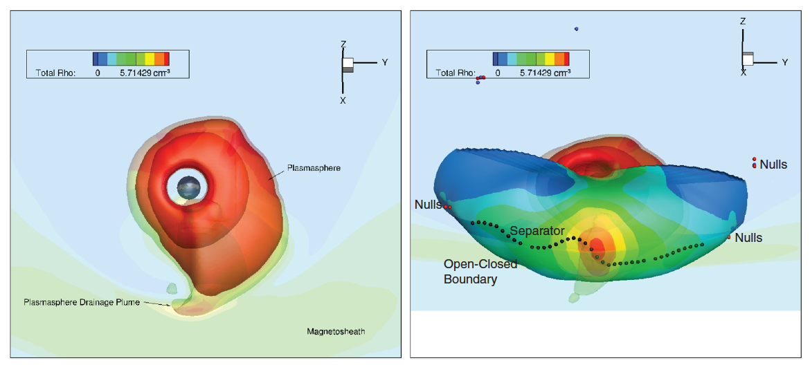
System-wide Impacts of the Plasmasphere
Iso-contours of plasmasphere density
The plasmasphere encounters the dayside magnetopause
Global reconnection rate decreases as indicated by the cross polar cap potential
[Glocer et al, 2020]

Slide 13


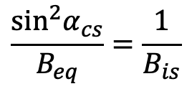
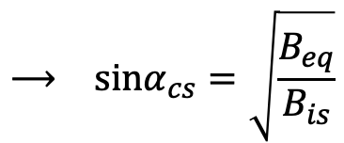
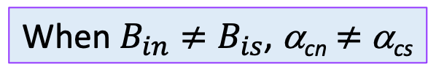
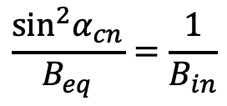
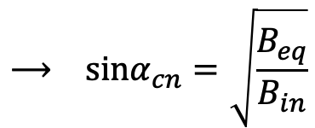
New Capability: CIMI with IGRF internal field
When $B_{in}≠B_{is}$, α_{cn} $≠$ α_{cs}
90°
Find $α_{cn} and$ $α_{cs}$:
B_{m}
B_{eq}
$$⟶ sinα_{cn}=\sqrt{\frac{B_{eq}}{B_{in}}}$$
α_{eq}
$$\frac{\sin^{2}α_{cn}}{B_{eq}}=\frac{1}{B_{in}}$$
α_{cn}
*
B_{in}
V
$$\frac{\sin^{2}α_{cs}}{B_{eq}}=\frac{1}{B_{is}}$$
$$⟶ sinα_{cs}=\sqrt{\frac{B_{eq}}{B_{is}}}$$
Mirror points
✻
B_{is}
α_{cs}
Loss cone
$$B_{is}<B_{in}$$

Slide 14
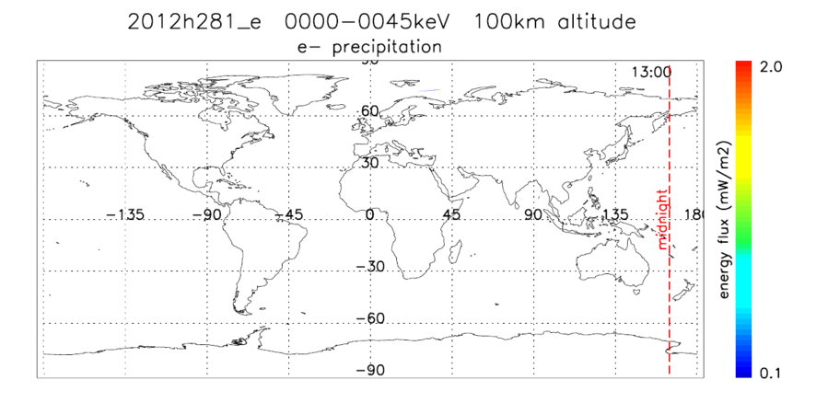


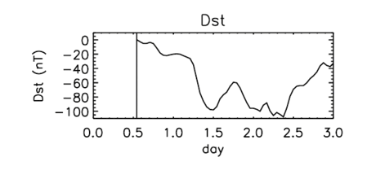
North-South Asymmetry in Precipitation with IGRF
7-9 October 2012

Slide 15
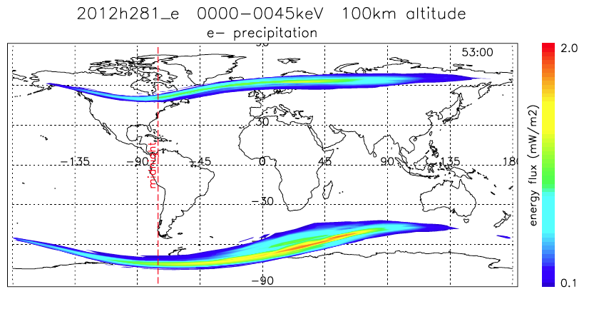
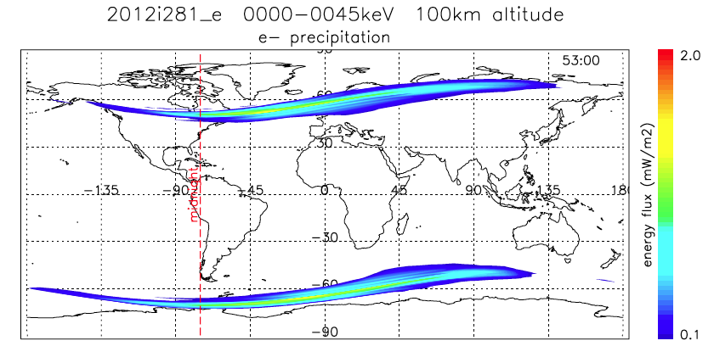
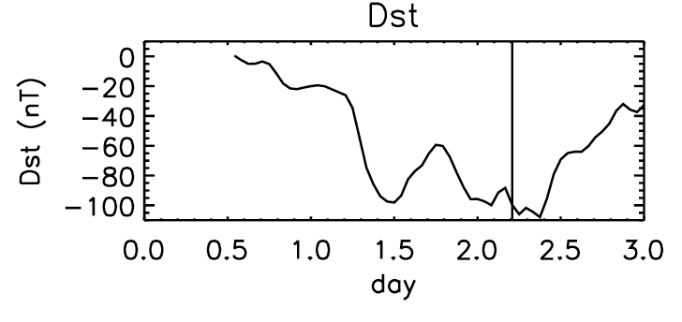
North-South Asymmetry in Precipitation with IGRF
IGRF
The simulated N-S asymmetries cannot be reproduced with dipole internal field.
Dipole
7-9 October 2012

Slide 16
Recent Focus: CIMI Coupled with Ionosphere Models
CIMI
Heating Rate
SAMI3
IPE
TIEGCM
GITM
Φ
Precipitation

Slide 17
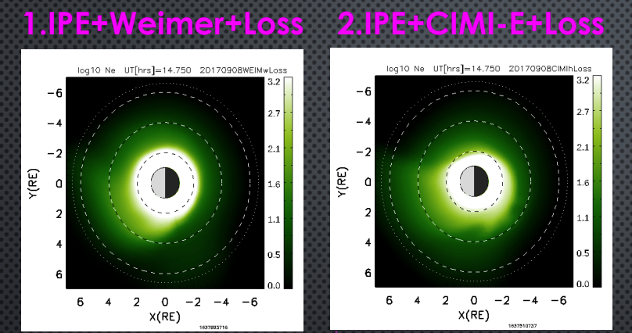

CIMI Coupled with IPE
CIMI
IPE
(Ionosphere Plasmasphere Electrodynamics)
Φ
strong erosion
IPE+CIMI-E produces stronger plasmasphere erosion
[Maruyama et al, in preparation]

Slide 18
Summary
CIMI Output
Ring current, radiation belt fluxes & pitch-angle distributions
Energetic ion & e- precipitation
Plasmasphere density
Region 2 currents & convection potentials
Total energy content, plasma wave growths, heating to the plasmasphere
CIMI new capabilities
Inclusion of a separate plasmasphere fluid in BATSRUS-CIMI
Inclusion of IGRF & N-S asymmetries
Recent focuses
Coupling with ionosphere/thermosphere models
Seeking open-source license for CIMI

