Slide 1
Solar Radiation Storm Advisories for the International Civil Aviation Organization
A Case Study of the 20 January 2005 Storm
Hazel M. Bain^{1,2} Kyle Copeland³, Robert Steenburgh², Terry Onsager²
1) CIRES, University of Colorado Boulder
2) NOAA Space Weather Prediction Center
3) U.S. Federal Aviation Administration, Civil Aerospace Medical Institute

Slide 2
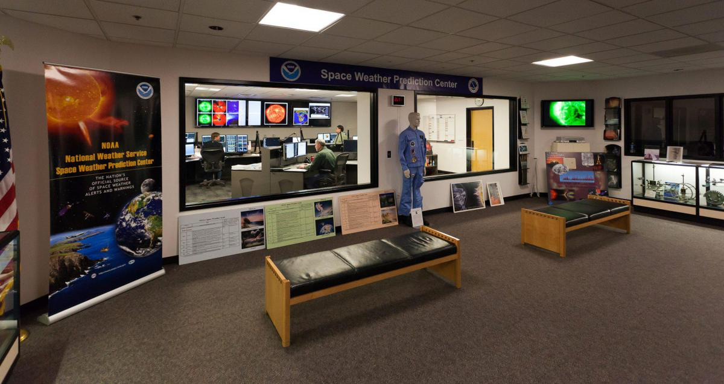
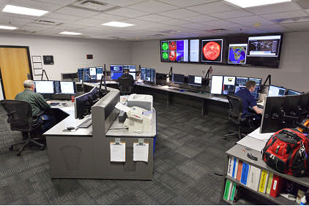
International Civil Aviation Organization
NOAA Space Weather Prediction Center provides advisories to ICAO for space weather events likely to impact:
- High Frequency (HF) communications
- Navigation systems
- Radiation environment
Provide operationally relevant information to aviation operators allowing them to make informed decisions.
Allows operators to anticipate and plan for degraded performance of communications and navigations systems and improve safety margin

Slide 3
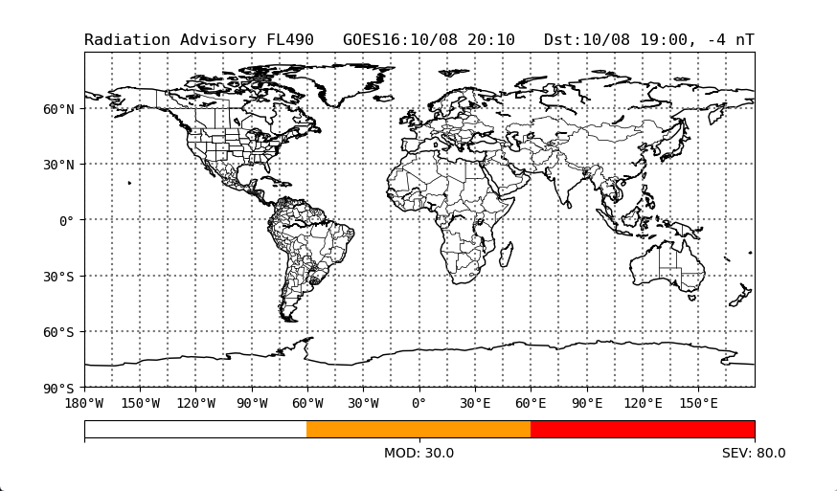
ICAO Radiation Advisories
36 Flight Levels between 25,000 ft and 60,000 ft in 1,000 ft increments.
Thresholds:
MOD = 30 µSv/hr
SEV = 80 µSv/hr
MOD advisories only issued when the MOD threshold is reached at 46,000 ft (FL460) and below.
HNH
MNH
ENH
ESH
MSH
HSH

Slide 4
NOAA SWPC ICAO Radiation Advisories
NOAA SWPC radiation advisories are guided by the U.S. Federal Aviation Administration (FAA) CARI-7 dose rate model (Copeland 2017).
Model determines effective dose rates from radiation entering a dynamically changing Earth atmosphere:
Background galactic cosmic rays (GCR)
Transient solar energetic particles
Geomagnetic and atmospheric response

Slide 5
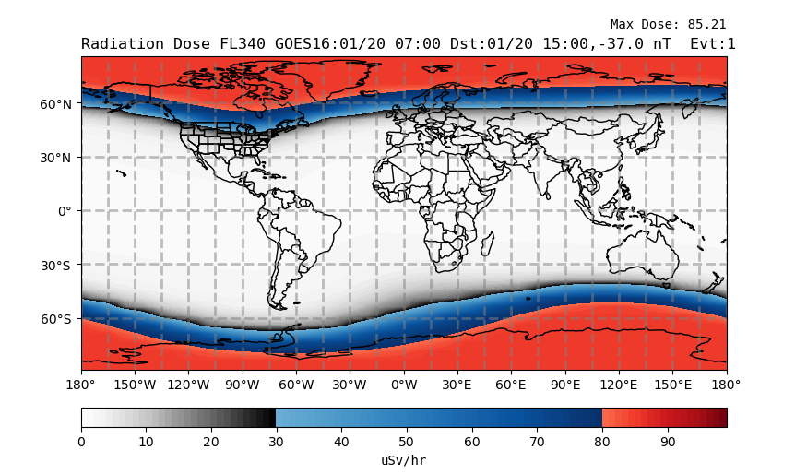
Radiation Dose Rate Map
Radiation dose rate map produced every 5 minutes

Slide 6
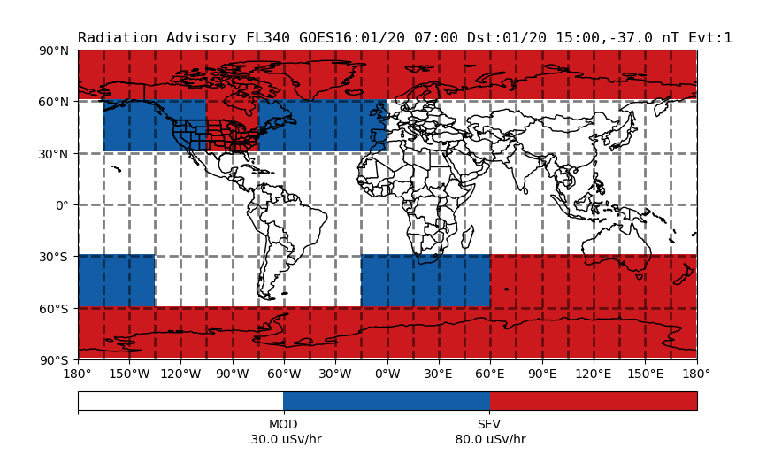
Radiation Advisory Map
Radiation advisory map produced every 5 minutes

Slide 7
Jan 2005 Case Study
Notes:
Over to Bill

Slide 8
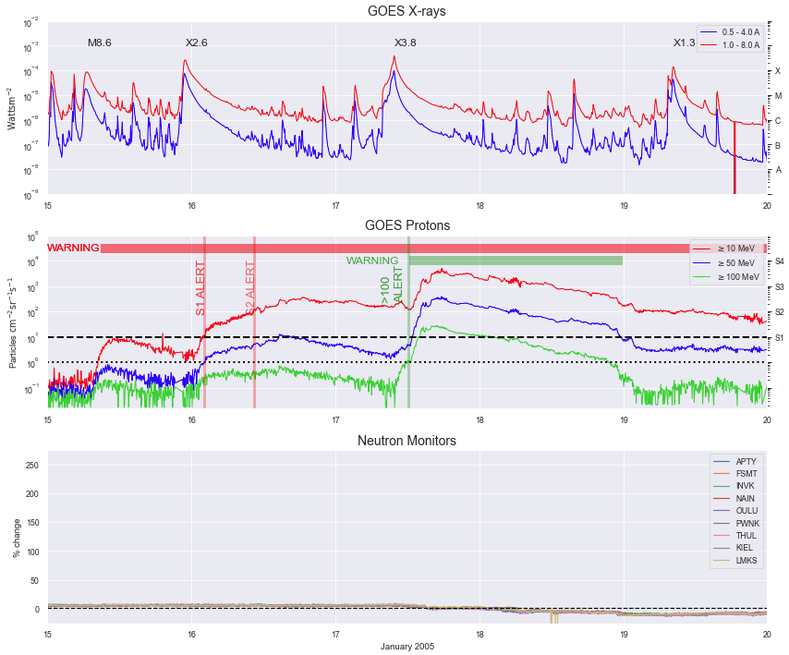
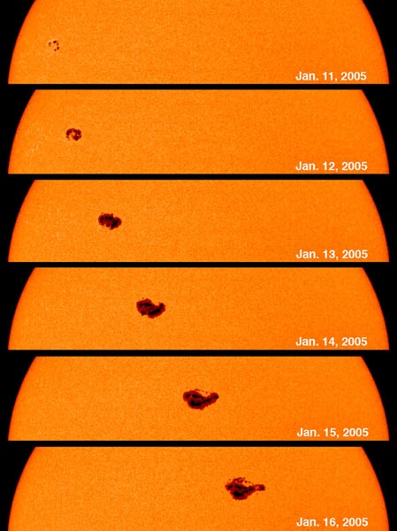
11 - 20 Jan 2005 - Region 720 emerges and produces several large solar flares & CMEs
GOES X-rays
R2/M8
R3/X2
R3/X3
15 Jan
GOES protons
Neutron Monitors
15
16
17
Jan 2005
18
19
20
Notes:
15 Jan - Region 720 produces an R3 (X2) solar flare radio blackout
A solar radiation storm begins soon after the peak with >10 MeV flux reaching 365 pfu (S2) on 16 January.
17 Jan - Region 720 produces another R3 (X3) solar flare radio blackout
>100 MeV proton flux peak flux was 28 pfu
>10 MeV proton flux peaked at 5040 pfu (S3)

Slide 9
SWPC Proton Warnings & Alerts
GOES X-rays
R2/M8
R3/X2
R3/X3
Issue Time | Message | Valid
15 Jan 0855 | S1 WARNING: Proton 10MeV Integral Flux > 10pfu | 15 Jan 0900 - 2359
16 Jan 0229 | S1 ALERT: Proton Event 10MeV Integral Flux > 10pfu | 16 Jan 0210
16 Jan 1030 | S2 ALERT: Proton Event 10MeV Integral Flux > 100pfu | 16 Jan 1030
17 Jan 1221 | WARNING: Proton 100MeV Integral Flux > 1pfu | 17 Jan 1215 - 1500
17 Jan 1240 | ALERT: Proton Event 100MeV Integral Flux > 1pfu | 17 Jan 1215
17 Jan 1436 | S3 ALERT: Proton Event 10MeV Integral Flux > 1000pfu | 17 Jan 1410
15 Jan
GOES protons
Neutron Monitors
No ICAO radiation threshold crossed
S3 event can causes loss/degradation of HF comms in polar regions
15
16
17
18
19
20
Jan 2005
Notes:
15 Jan - Region 720 produces an R3 (X2) solar flare radio blackout
A solar radiation storm begins soon after the peak with >10 MeV flux reaching 365 pfu (S2) on 16 January.
17 Jan - Region 720 produces another R3 (X3) solar flare radio blackout
>100 MeV proton flux peak flux was 28 pfu
>10 MeV proton flux peaked at 5040 pfu (S3)

Slide 10
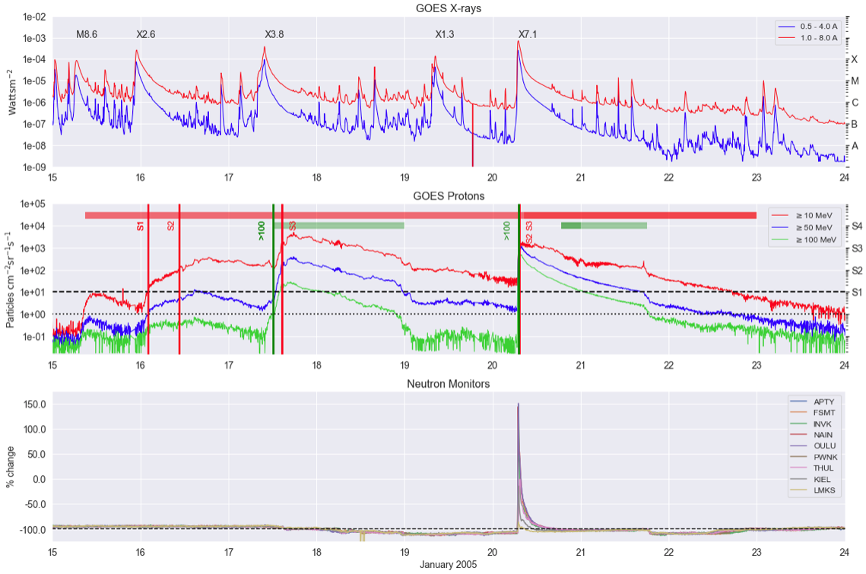
R2/M8
R3/X2
R3/X3
R3/X7
R3/X7
Notes:
Note absence of Neutrons up until 20th Jan

Slide 11
GOES X-rays
R3/X7
SWPC Proton Warnings & Alerts
Issue Time | Message | Valid
20 Jan 0702 | S2 ALERT: Proton Event 10MeV Integral Flux > 100pfu | 20 Jan 0701
20 Jan 0704 | >100 ALERT: Proton Event 100MeV Integral Flux > 1pfu | 20 Jan 0701
20 Jan 0712 | S3 ALERT: Proton Event 10MeV Integral Flux > 1000pfu | 20 Jan 0705
GOES protons
Neutron Monitors
Notes:
20 Jan - Region 720 produces another R3 (X7) solar flare radio blackout
The >100 MeV protons reached 652 pfu (strongest >100 MeV event since Oct 1989 (680 pfu)

Slide 12
SWPC
ICAO
advisories
GOES protons
ICAO Adv
MOD Advisory Map
SEV Advisory Map

Slide 13
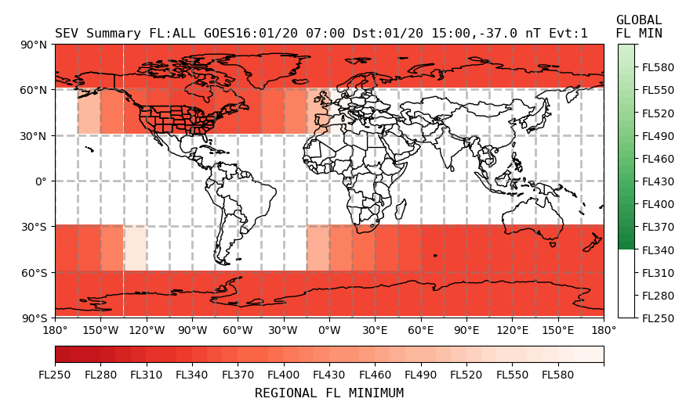
ICAO Product
20 Jan 2005 0700UT
SEV advisory issued
FNXX03 KWNP 200700
SWX ADVISORY
DTG: 20050120/0700Z
SWXC: SWPC
ADVISORY NR: 2005/1
SWX EFFECT: RADIATION SEV
OBS SWX: 20/0700Z HNH MNH MSH HSH E180 - W180 ABV FL330
FCST SWX +6 HR: 20/1300Z NOT AVBL
FCST SWX +12 HR: 20/1900Z NOT AVBL
FCST SWX +18 HR: 20/0100Z NOT AVBL
FCST SWX +24 HR: 20/0700Z NOT AVBL
RMK:
NXT ADVISORY: 20050120/1300Z=

Slide 14
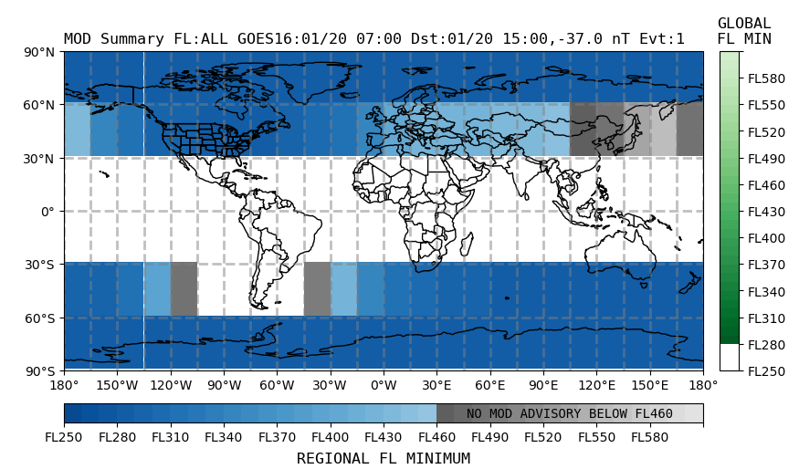
20 Jan 2005, 0703UT
MOD advisory issued
FNXX03 KWNP 200703
SWX ADVISORY
DTG: 20050120/0703Z
SWXC: SWPC
ADVISORY NR: 2005/2
SWX EFFECT: RADIATION MOD
OBS SWX: 20/0703Z HNH MNH MSH HSH E180 - W180 ABV FL280
FCST SWX +6 HR: 20/1300Z NOT AVBL
FCST SWX +12 HR: 20/1900Z NOT AVBL
FCST SWX +18 HR: 20/0100Z NOT AVBL
FCST SWX +24 HR: 20/0700Z NOT AVBL
RMK: NOTE SEV RADIATION ADVISORY 2005/1 ALSO IN EFFECT FOR FL330 AND ABOVE
NXT ADVISORY: 20050120/1300Z=

Slide 15
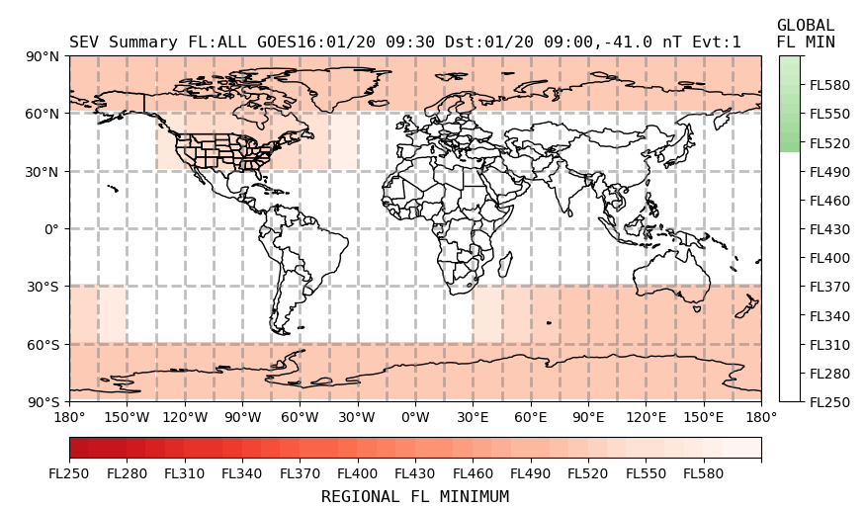
20 Jan 2005 0930UT
SEV advisory updated
FNXX03 KWNP 200930
SWX ADVISORY
DTG: 20050120/0930Z
SWXC: SWPC
ADVISORY NR: 2005/3
NR RPLC: 2005/1
SWX EFFECT: RADIATION SEV
OBS SWX: 20/0930Z HNH MNH MSH HSH E180 - W180 ABV FL510
FCST SWX +6 HR: 20/1530Z NOT AVBL
FCST SWX +12 HR: 21/0030Z NOT AVBL
FCST SWX +18 HR: 21/0600Z NOT AVBL
FCST SWX +24 HR: 21/1200Z NOT AVBL
RMK: SEV ADV UPDATED TO MOVE EFFECTED AT AND ABOVE 440. MOD ADV NOW INCLUDES FL BELOW 440 - SEE MOD ADV FOR FURTHER DETAILS.
NXT ADVISORY: 20050120/1530Z=

Slide 16
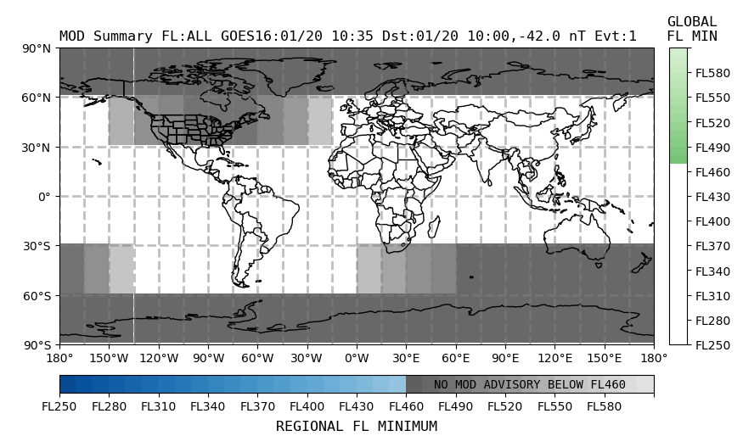
20 Jan 2005, 1035UT
MOD advisory ends
FNXX03 KWNP 201035
SWX ADVISORY
DTG: 20050120/1035Z
SWXC: SWPC
ADVISORY NR: 2005/2
SWX EFFECT: RADIATION MOD
OBS SWX: NO SWX EXP
FCST SWX +6 HR: 20/1700Z NOT AVBL
FCST SWX +12 HR: 20/2300Z NOT AVBL
FCST SWX +18 HR: 21/0500Z NOT AVBL
FCST SWX +24 HR: 21/1100Z NOT AVBL
RMK: MOD EVENT ENDED, SEV RADIATION ADVISORY REMAINS IN EFFECT FOR FL330 AND ABOVE
NXT ADVISORY:NO FURTHER ADVISORIES=

Slide 17
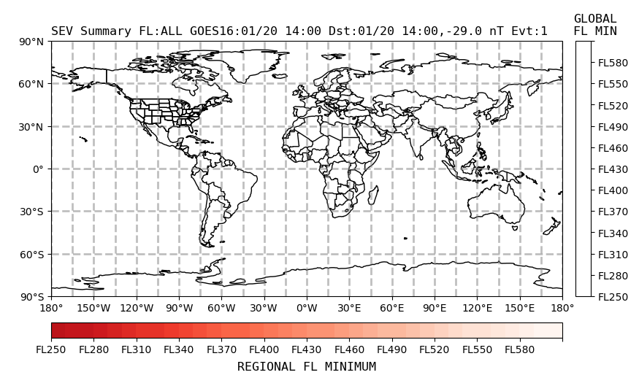
20 Jan 2005 1400UT
SEV advisory ends
FNXX03 KWNP 201400
SWX ADVISORY
DTG: 20050120/1400Z
SWXC: SWPC
ADVISORY NR: 2005/5
NR RPLC: 2005/3
SWX EFFECT: RADIATION SEV
OBS SWX: NO SWX EXP
FCST SWX +6 HR: 20/2000Z NOT AVBL
FCST SWX +12 HR: 21/0200Z NOT AVBL
FCST SWX +18 HR: 21/0800Z NOT AVBL
FCST SWX +24 HR: 21/1400Z NOT AVBL
RMK: SEV EVENT ENDED.
NXT ADVISORY: NO FURTHER ADVISORIES=

Slide 18
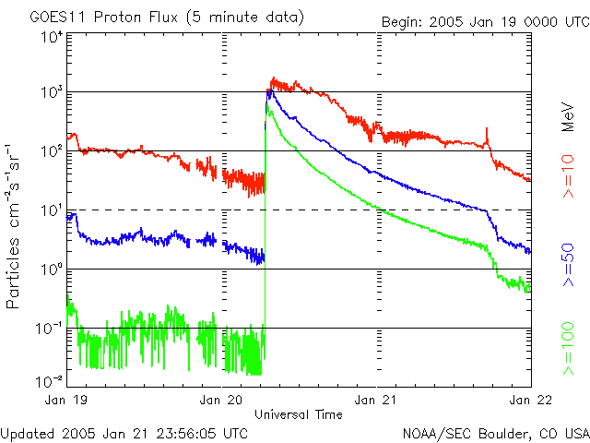
Summary
Onset and Peak:
SEV radiation advisory issued for altitudes above 33,000 ft, for polar and mid latitude regions of the northern and southern hemisphere.
MOD radiation advisory at lower altitudes, down to 28,000 ft
As the event evolves and radiation dose rates change, advisories are updated periodically.
In total, ICAO radiation advisories would have been in effect for around 7 hours.

Slide 19
Questions

