Slide 1
Extending the capabilities of the Global Ionosphere-Thermosphere Model (GITM) Planets and Beyond: (aka makin’ it gassy, keepin’ it classy)
Jared Bell: Code 675
CCMC Workshop
06/07/2022

Slide 3
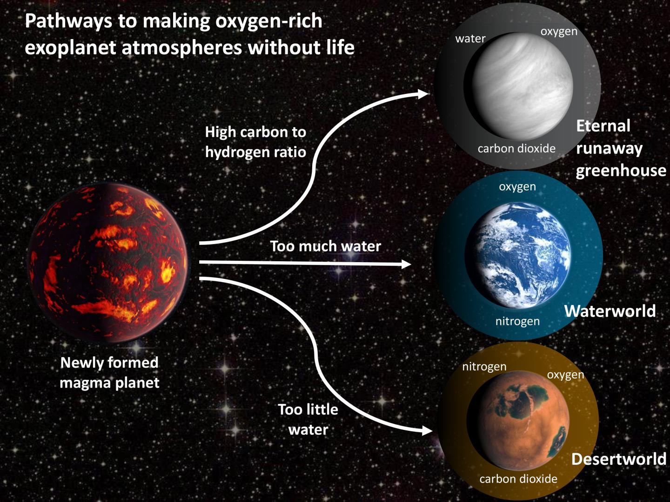
Why Study Planetary Upper Atmospheres?
Where Atmospheric Escape occurs.
Major mechanism of atmospheric evolution.
Impacts our investigations of all planets.
Understanding how these systems behave and evolve is critical to our survival and exploration.

Slide 4
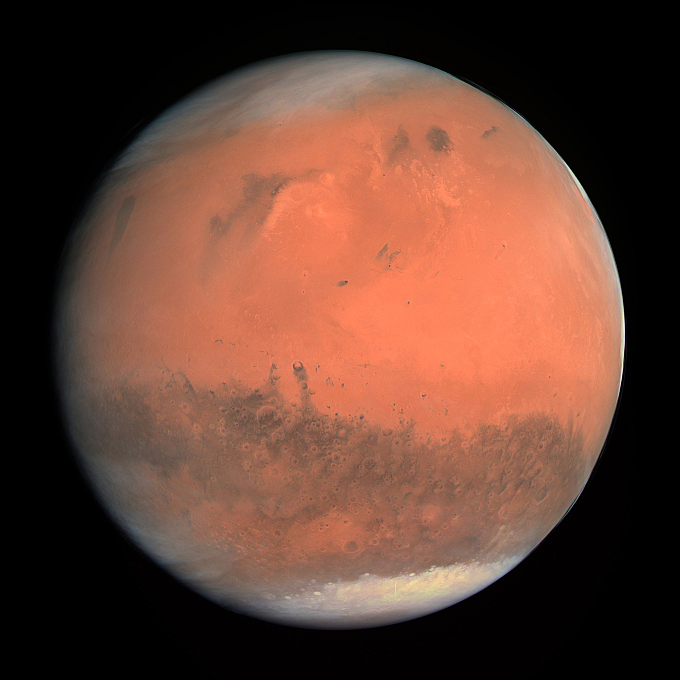
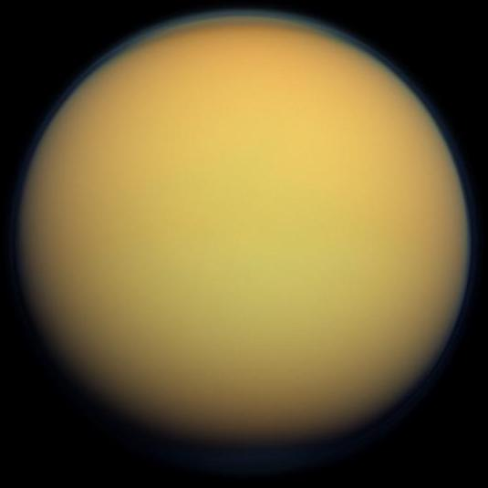
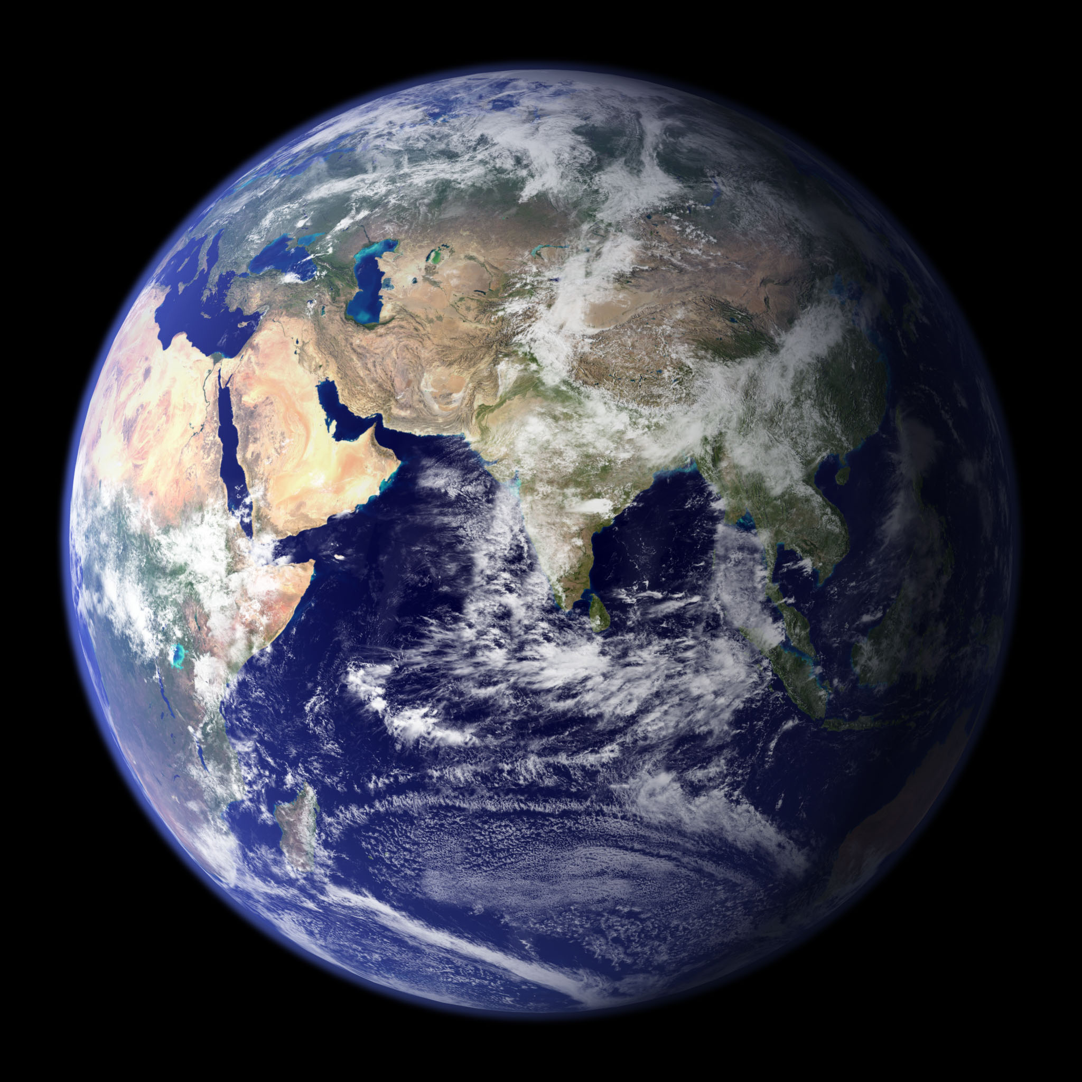
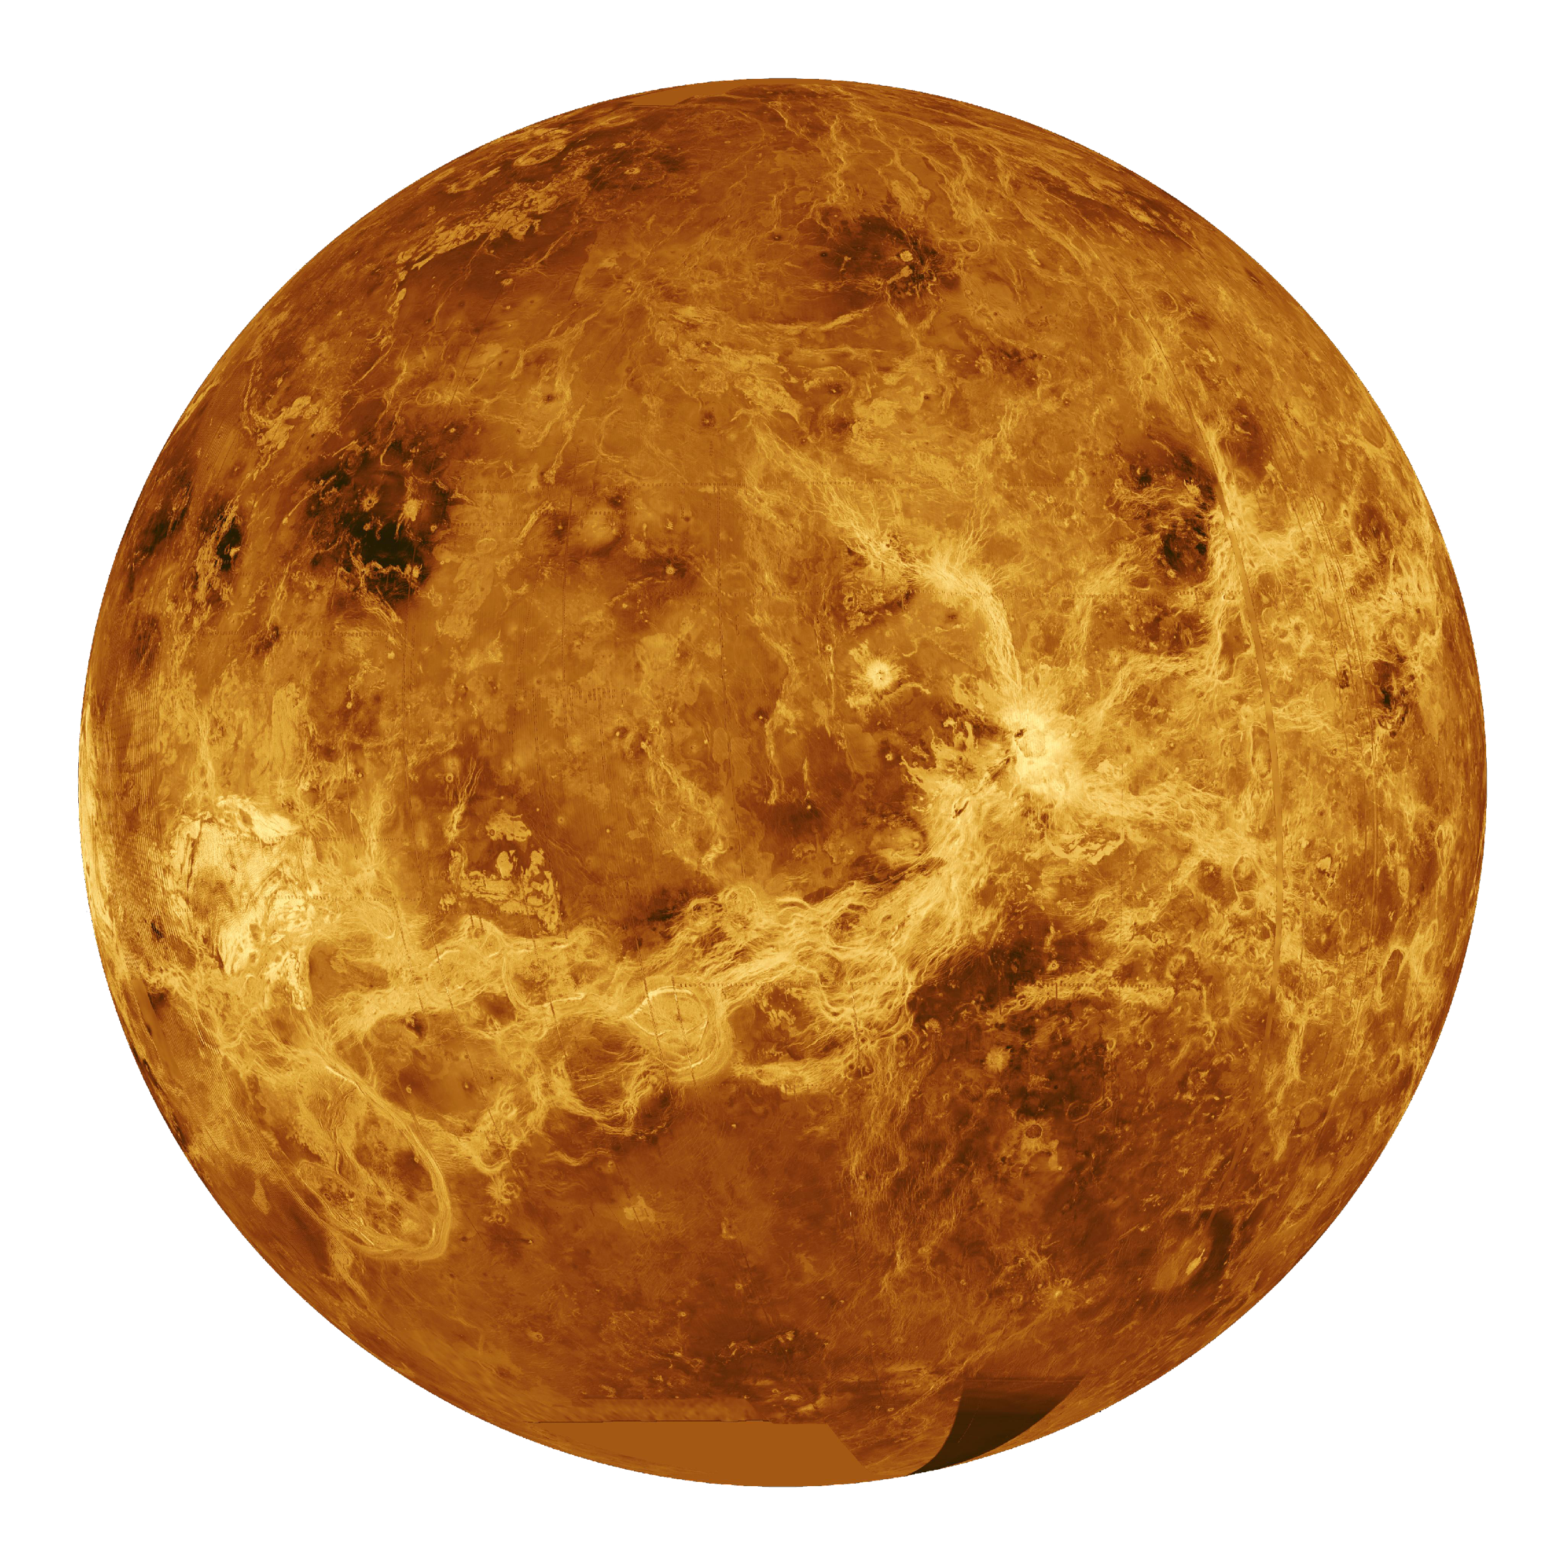
Possible Evolution of Earth’s Atmosphere
Atmospheric Escape
Hydrodynamic Escape
Mars-like
Proto Earth
Earth
Atmospheric Escape
Venus-like

Slide 5
Why Study Planets?
“It’s hard to make a study of psychology with a sample set of one”
Bell’s Corollary:
“ It’s hard to make a convincing study of atmospheres with a sample set of one.”
-shamelessly stolen from Dr. Kunio Sayanagi of Hampton University.

Slide 6
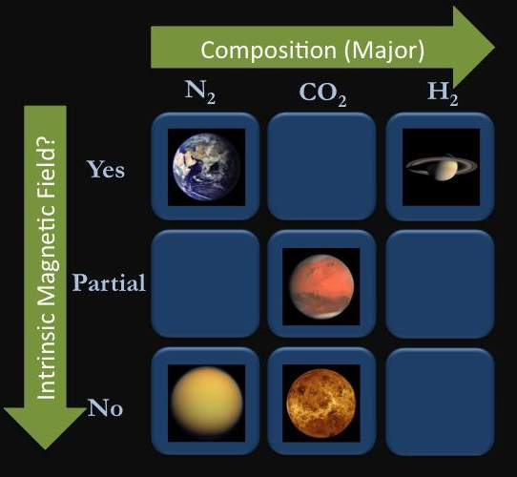
Solar System Planetary Laboratories
Atmospheric composition (Neutral and Ion)
Presence (or absence) of an intrinsic magnetic field.
Saturn
Mars
Titan
Venus

Slide 7
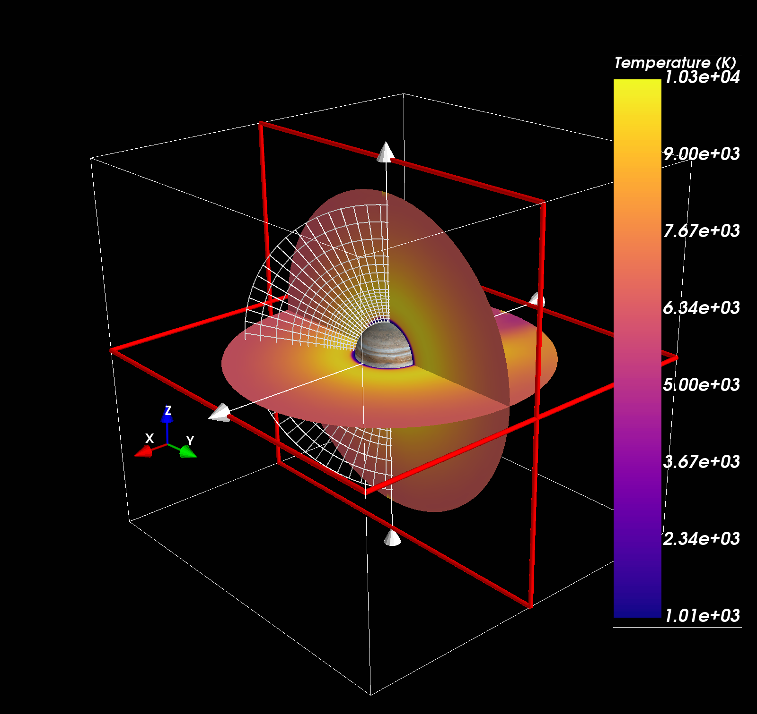
Our Numerical Tool: GITM
Global Ionosphere-Thermosphere Model (GITM).
Multi-species Navier-Stokes
Non-hydrostatic, 3-D model for the upper atmosphere.
Capable of capturing mechanisms driving atmospheric escape.
We can control the parameters and we can validate with data (where available) to test ideas.
Exoplanet Simulation--Osiris

Slide 8
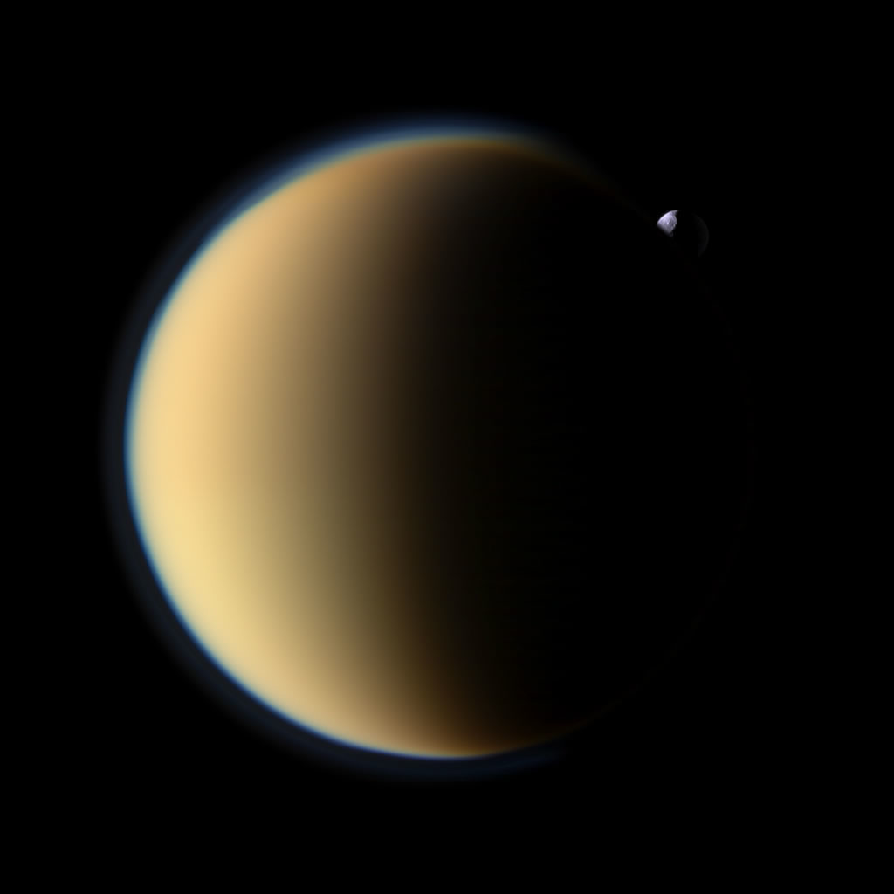
TITAN: A PRIMITIVE EARTH (A SMALL MOON, BIG IMPLICATIONS)

Slide 9
Only other Nitrogen atmosphere in our solar system (CH₄, H₂ also).!
Surface Pressure: 1.5 bar (1.5 Earth)
Surface Gravity: 1.35 m/s²
Major Ions: C₂H₅⁺, CH₅⁺, HCNH⁺
Rotation Rate ~ 16.0 Earth days (slow)
Planetary Radius: 2575 km (2/3 of Mars)
Year: 29.5 Earth years
2nd largest moon in solar system, orbits Saturn

Slide 10
Quantitative Validation
Compare T-GITM predicted Densities against actual data from Titan (Cassini Mission).
Figure: Simulated densities (black) vs data (red).
Mag (solid line) has plasma heating (magnetosphere).
NoMag (dashed line) does not use plasma heating
Upshot: incoming plasma has a huge impact!

Slide 11
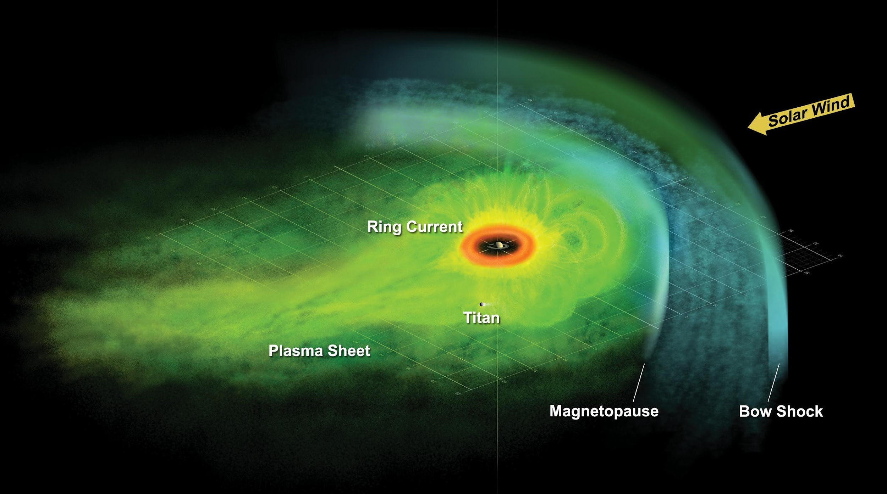
No Surprise: Titan swims in a huge magnetosphere!
Image: NASA/JPL

Slide 12
Further Development For T-GITM
Particle Precipitation
Current heating rates are specified by offline calculations.
We need to implement self-consistent calculations:
Specify O+/e- precipitation as a function Energy, space, time.
calculate energy deposition, ionization/dissociation rates.
Heating Efficiencies and Complex, Extensive Chemistry:
Currently use constant or based on off-line calculations.
We want to time-varying consistent enthalpies of heat, ion-neutral chemistry, electron temperatures, ion temperatures.

Slide 13
SATURN: AN EXAMPLE OF INTENSE MAGNETOSPHERE DRIVING

Slide 14
Saturn Quick Facts
Atmosphere H₂ (~86%) and He (13.5%?—still unknown)
Most oblate planet in solar system:
60,268 km (equator)
54,364 km (polar).
Surface Gravity: 10.44 m/s²
Major Ions: H⁺, H₃⁺
Rotation Rate ~ 10.65 hrs.
Year: 29.5 Earth years

Slide 15
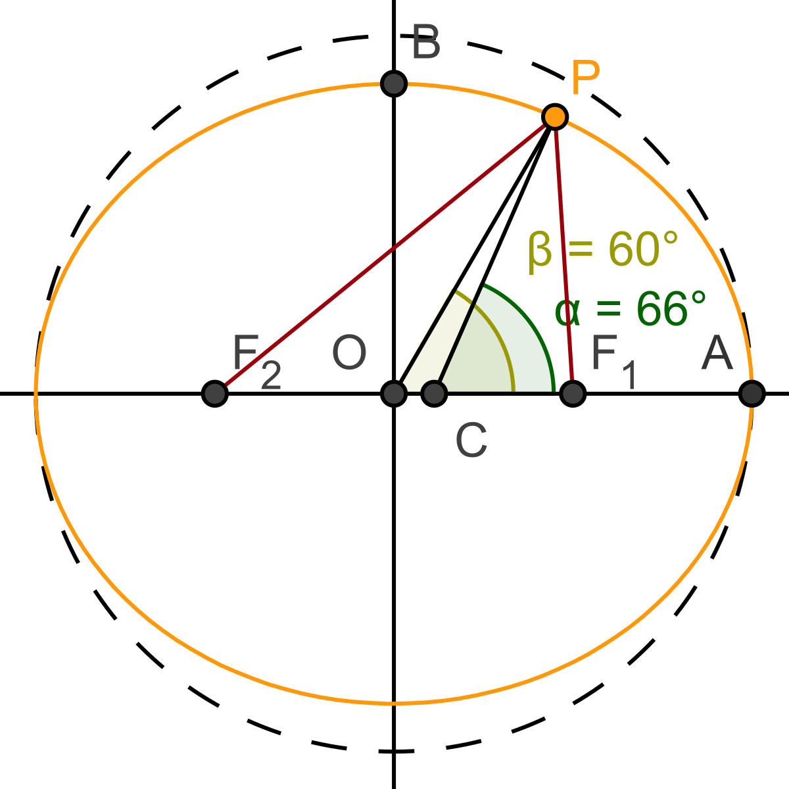
First Major Challenge:
Extend GITM numerical core to use generalized spherical oblate coordinates.
Geodetic coordinates are orthonormal and provide a direct mapping from the standard geocentric.
WARNING: Meridional Distance is not analytically solvable! We do a high-order integration at the beginning of the run!

Slide 16
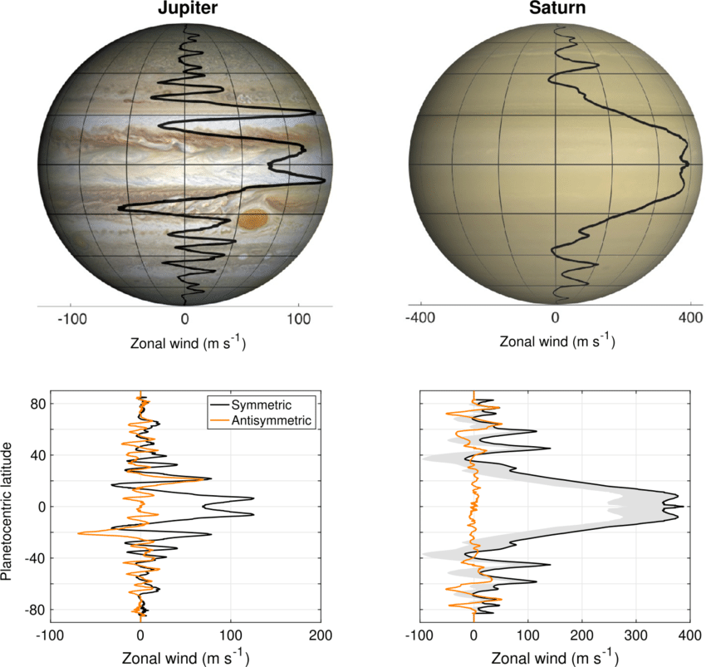
Second Major Challenge
Mid-latitude dynamo is expected to be huge!
Strong field and rapid rotation leads to strong ionosphere-neutral atmosphere shear and hence a strong dynamo.
SAMI (Huba) has been implemented as part of Earth GITM.
Will work to adjust this for Saturn going forward.

Slide 17
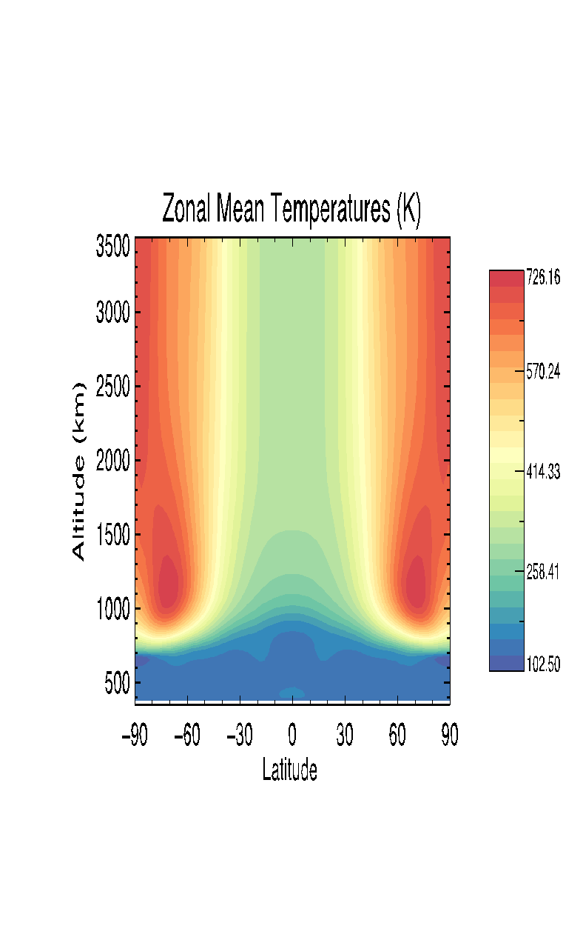
Current Saturn GITM Temperatures
Intense magnetosphere inputs in the auroral zones (as seen here at high latitudes).
This energy is then transported toward the equator.
Supported the Cassini Mission to the Saturn system.
Bell et al. [2018]

Slide 18
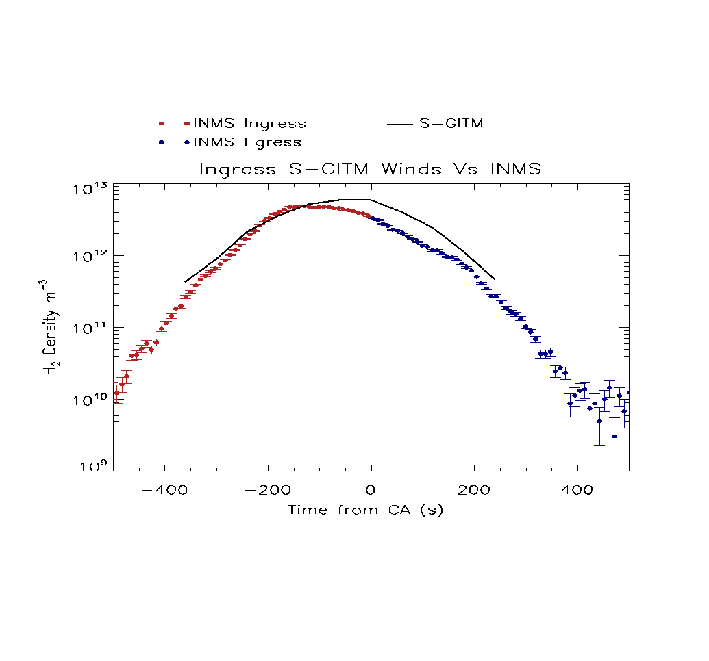
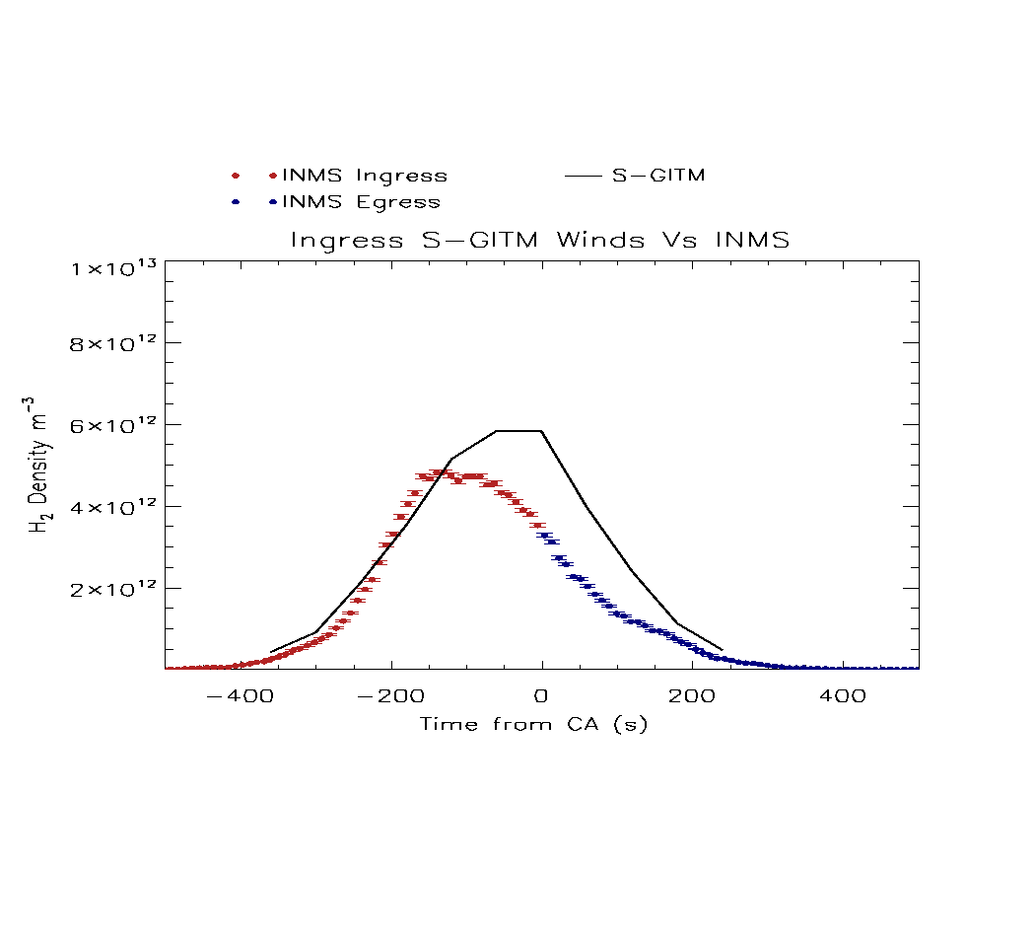
Benchmarking Saturn GITM
Validated model predictions by comparing with in-situ Cassini Ion-Neutral Mass Spectrometer data (INMS).

Slide 19
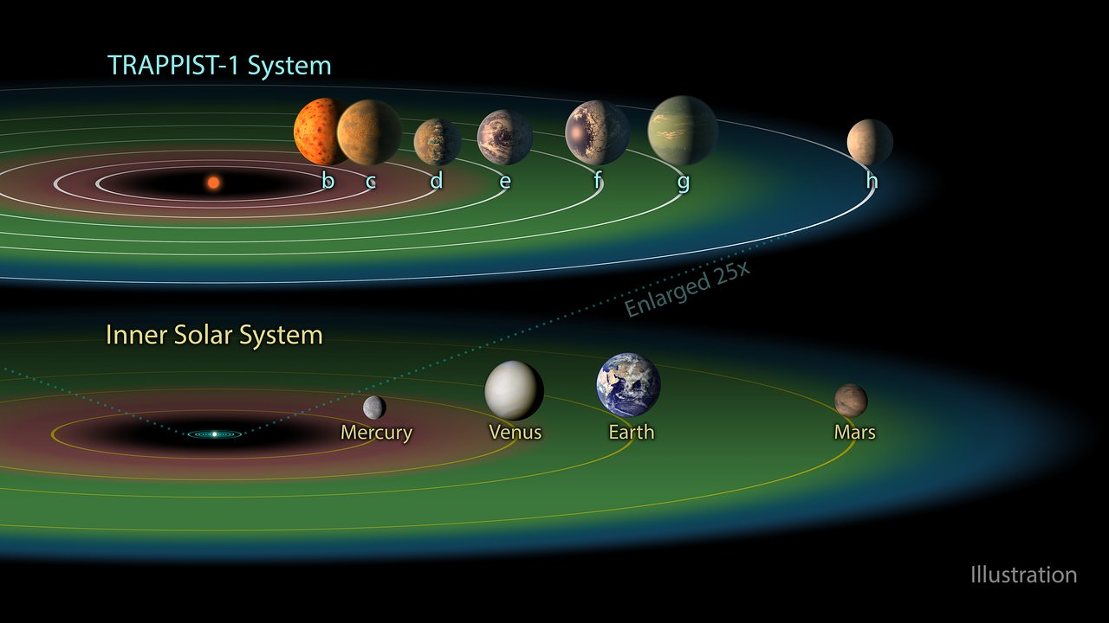
Other Star Systems
Studying other planets allows us to learn more about our own planet, Earth
Studying other star systems allows us to learn more about how our own may have evolved.
What makes ours capable of life?
How common could life be?

Slide 20
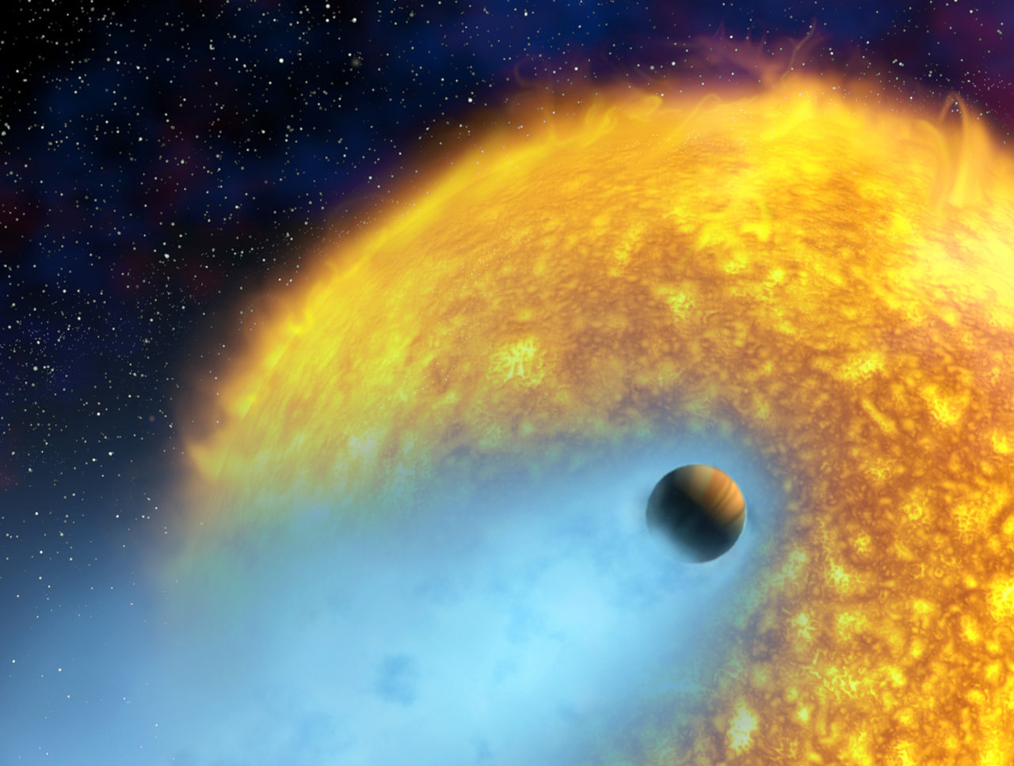
Osiris (HD 209458b)
Hot Jupiter orbiting a G-type star—solar like.
First exoplanet detected using the transiting method.
Many have studied this—providing us with a rich opportunity for benchmarking codes with new capabilities.
Murray-Clay [2009], Garcia-Munoz [2007], Yelle [2004], Koskinen [2013], Lavvas [2014].
Image courtesy NASA

Slide 21
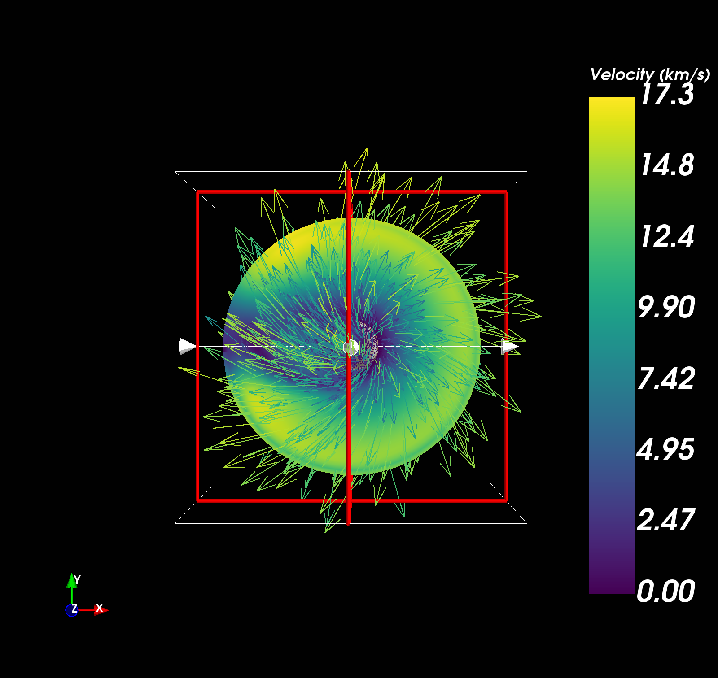
3-D Winds
3-D View from the north pole looking down on the planet (star to the right).
Contours are the speeds (magnitudes only).
Vectors show the actual wind velocities.
Mostly expanding outward.
Dusk
Dawn
Star

Slide 22
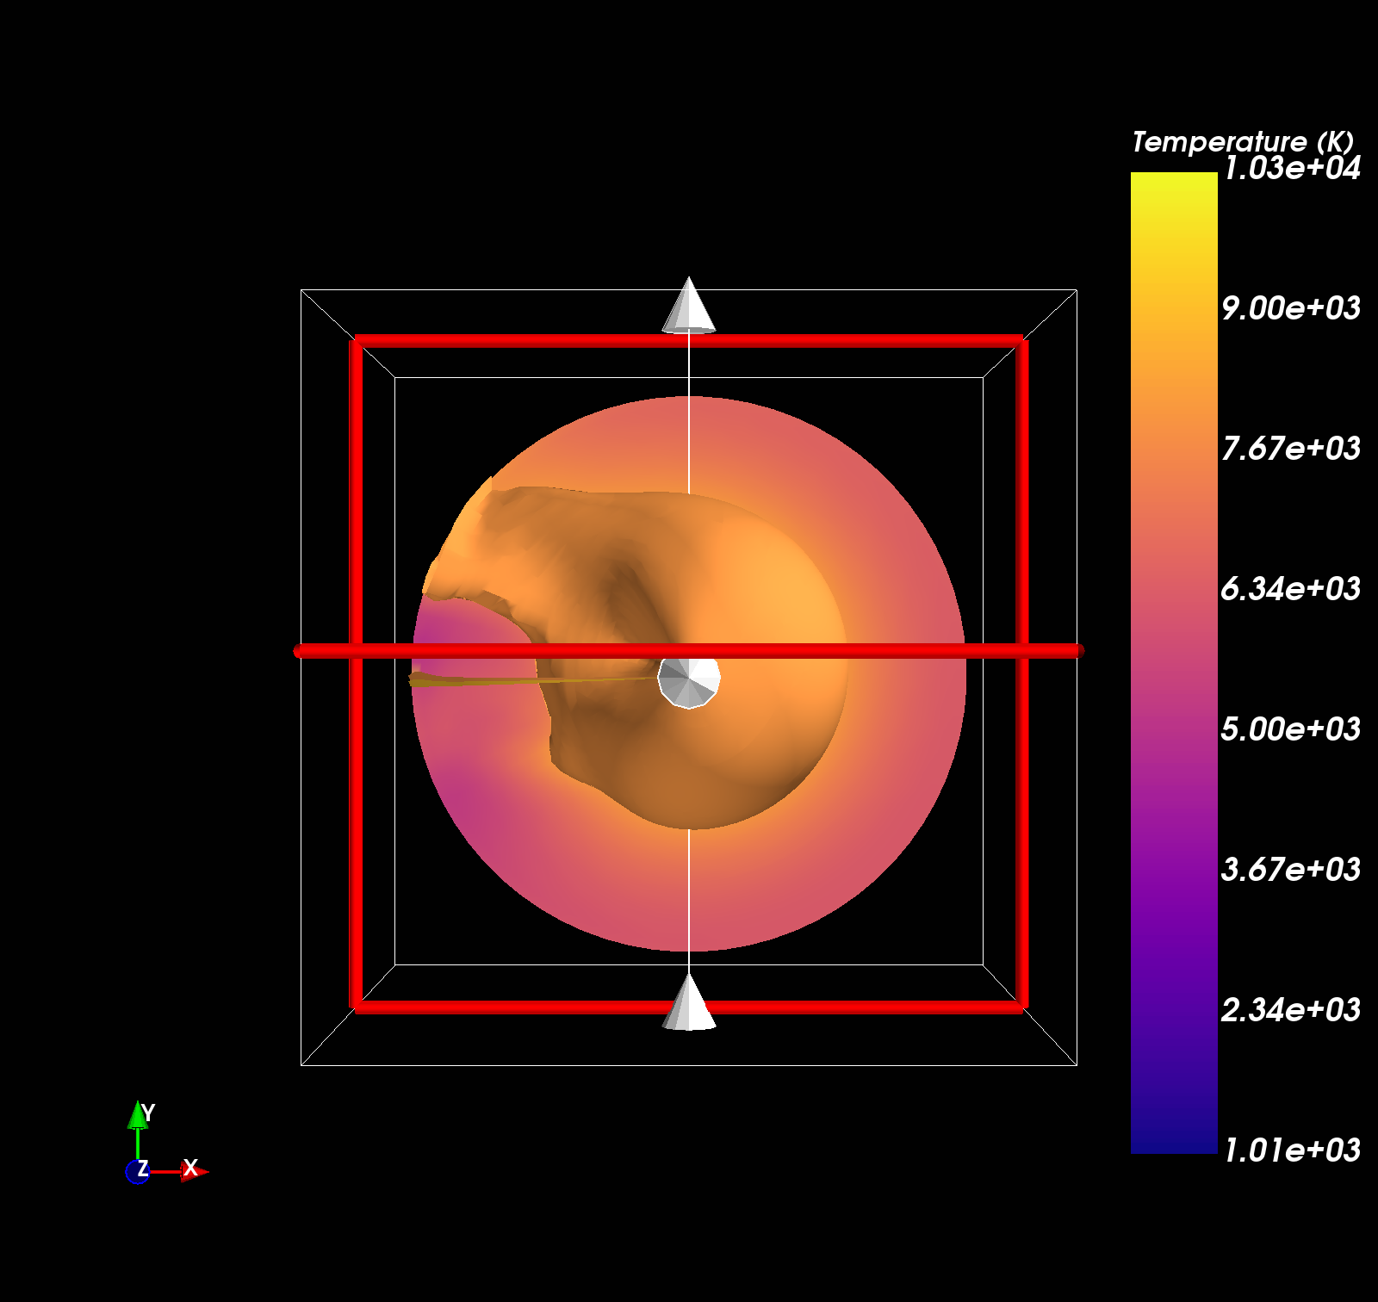
3-D Temperatures (Northern Pole)
Looking down on the plane’s north pole (star to the right).
Contours are temperatures.
Isosurface at 8000 K extends back into the nightside.
Looks like a “plume” of denser atmosphere.
The nightside hotspot that was seen before.
This feature disappears if you don’t account for full 3-D Navier-Stokes (i.e., hydrostatic models can’t do it).
Dawn
Dusk
Star

Slide 23
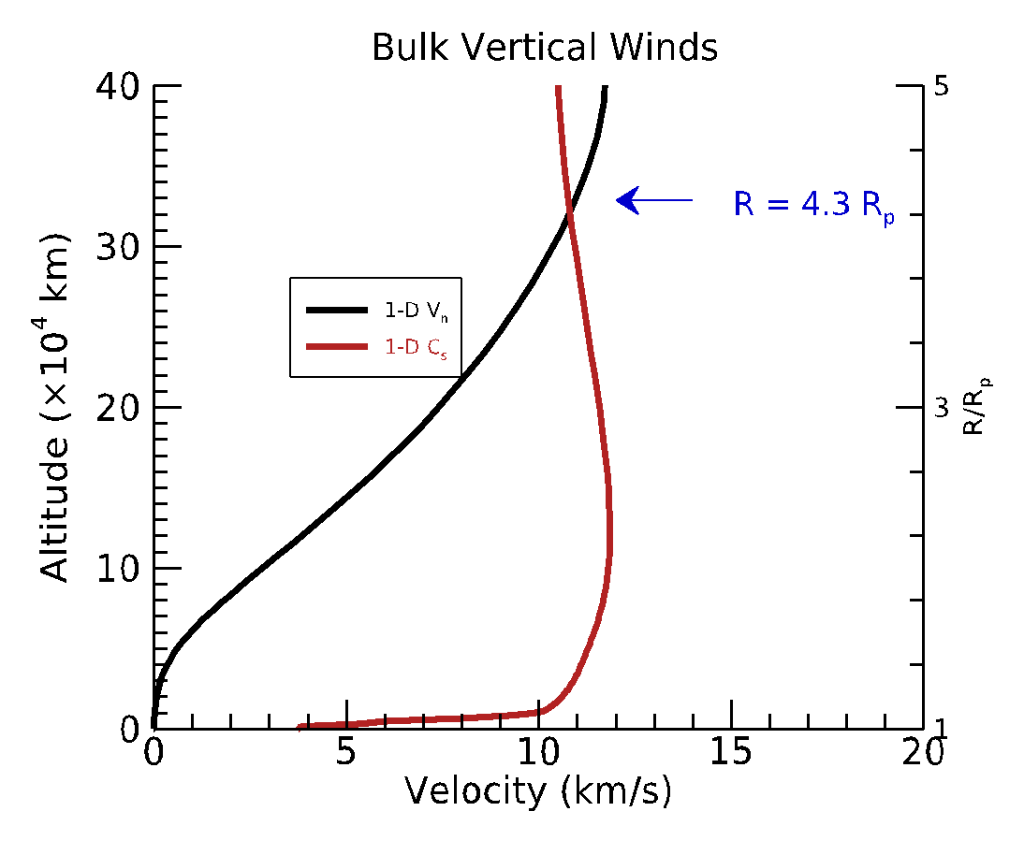
Global Mean Result: Vertical Winds
Vertical axis is altitude above the “surface” (1-bar pressure level).
Left axis is in km, right axis is in units of planetary radii (R_{p}).
Horizontal axis is the local wind speed (black)
Local sound speed in red.
Sonic point at 4.3 R_{p}
Earth may have looked like this Early in its lifetime.

Slide 24
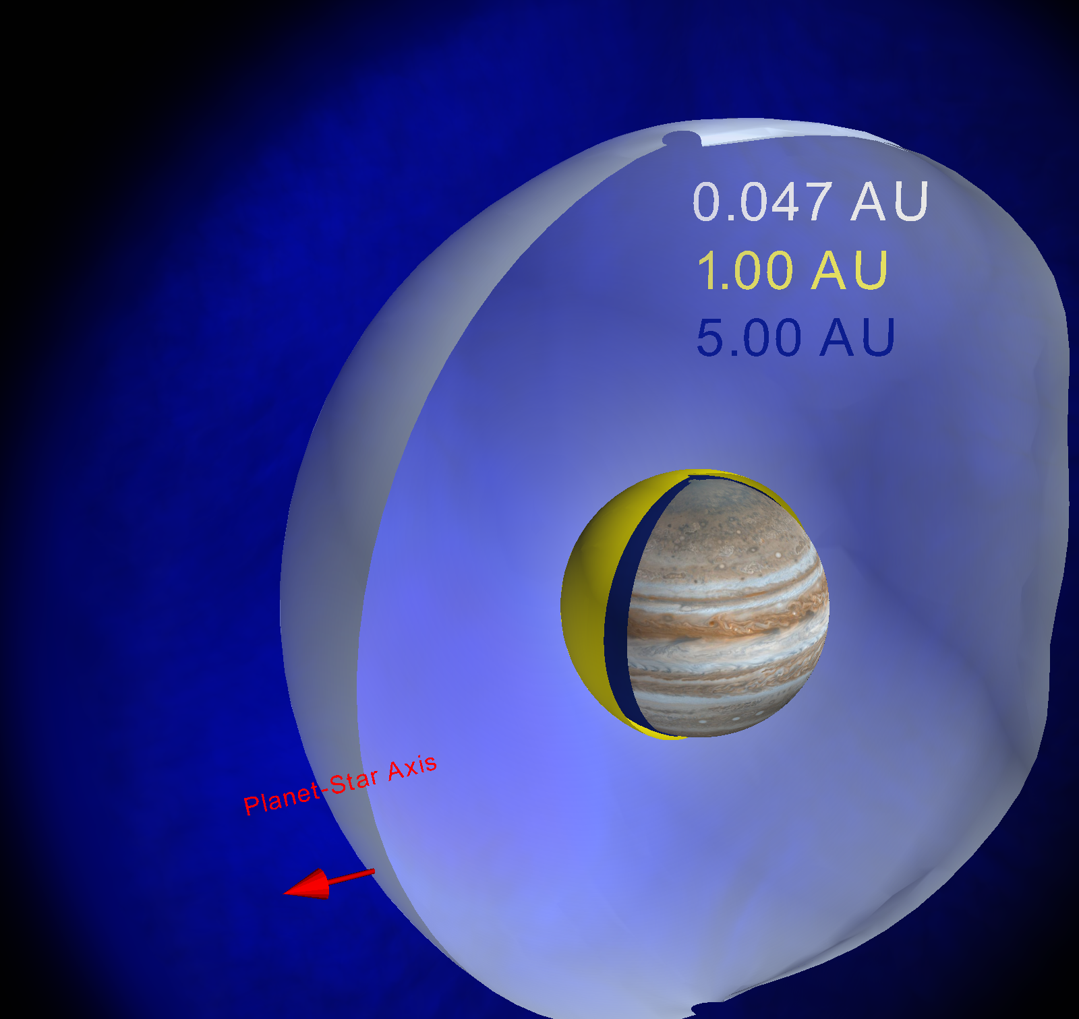
Ionosphere of Osiris
Shells are the “top” of the ionosphere.
Shown to scale with Jupiter.
It’s huge!
And hot!
Exo-GITM is basically Jupiter moved to 0.047 AU.

Slide 25
Exo-GITM Challenge at Osiris
GITM treats ionosphere as a minor component :
Fine for planets in our solar system in the current configuration.
Our results work around this by assuming a single fluid & non-magnetic planet.
Close-in exoplanets,
neutral atmosphere disappears above the stratopause:
Only atomic ions remain!
Currently re-writing the core solvers to account for this.
Benchmarking at Earth, Titan, and Saturn.

Slide 26
Thank you!

Slide 27
Backup slides

Slide 28
Numerical Solvers in GITM
Use AUSM+-up to provide high accuracy, O(4), numerical flux calculations (low dissipation). Liou et al. [2006, 2009].
Can resolve acoustic shocks at the same time as resolving winds deep in the atmosphere on the order of 10⁻⁹ m/s in the same simulation.
Use Weighted Essentially Non-Oscillatory (WENO) 5th order solvers for the facevalues in the scheme on a non-uniform mesh.
Horizontal Winds/Fields: Use O(2) Rusanov solvers to solve the fluid equations and provide numerical stability to global simulations.

Slide 29
Boundary conditions

Slide 30
Neutrals—Part 1: Continuity
We solve continuity for each species in GITM.
Carry 11 neutral species-–some excited states of Oxygen and Nitrogen:
O(³P), O₂, N₂, N(⁴S), NO, He, N(²D), N(²P), H, CO₂, O(¹D).
Bi-molecular Ion-Neutral, Ion-Ion, Recombination, &
Termolecular chemistry.
66 total reactions.
Bailey, et al [2002], Sojka [2005]
Solar EUV/UV Photons: EUVAC/FISM Models with 57-photon bins
hv + AB 🡪 A + B, A⁺ + B, AB⁺
e_{ph}⁻ + AB 🡪 A + B + e⁻_{ph}, etc.
Photo electrons: GLOW model option (slow)
GLOW-fast (scale the solar photon rates)
Solomon & Qian [2005], McGranaghan [2016].
Auroral electron impact ionization/dissociation:
e- + AB 🡪 A⁺ + B
e- + A. 🡪 A⁺ + e-

Slide 31
Neutrals—Part 2: Momentum
Viscosity
We solve separate vertical momentum for each species in GITM.
Assume all species share the same horizontal winds.
Capture molecular and turbulent diffusion self-consistently in the momentum equation (Bell et al. [2014]).
Ion-Neutral Drag
Molecular Diffusion
Turbulent Contribution

Slide 32
Neutrals—Part 3: energy
Ion-neutral energy transfer
Electron-neutral energy transfer
Joule Heating
Solar EUV/UV;
Chemical Heat/Cool;
Auroral electron
Thermal Conduction
Radiative cooling functions
fast approximations
(Roble et al. [1988], Fuller-Rowell [1982]).

Slide 33
Ions—Part 1: Continuity
We solve continuity for each species in GITM.
We use only a bulk ion wind.
Important: All ions share same velocity
Carry 9 ion species-–some excited states of Oxygen:
O(⁴S)⁺, O₂⁺ , N₂ ⁺ , N⁺, NO⁺, He⁺, H⁺ , O(²D)⁺ O(²P)⁺
Bi-molecular Ion-Neutral, Ion-Ion, Recombination
66 total reactions.
Auroral electron impact ionization/dissociation:
Solar EUV/UV Photons:

Slide 34
Ions—Part 2: Momentum
Ambipolar field
We only solve for a bulk momentum vector, u_{i.}
E determined from potentials imposed from the magnetosphere.
Empirical models or MHD model.
B-field is either
IGRF empirical specification or
User-specified tilted, off-set dipole
(Note: Earth always uses IGRF and APEX Coordinates—Richmond (1992)).
Ion-Neutral Drag
Lorentz Force

Slide 35
IONS—Part 3: energy
Energy transfer terms
Joule Heating
Chemical Heating/Cooling
Thermal Conduction

Slide 36
Electrons

Slide 37
electrons—Part 1: Continuity
We assume charge neutrality, so that ions and electrons balance.

Slide 38
electrons—Part 2: Momentum
Assume that electrons can follow the E X B direction, so that we can allow shear between electrons and ions in the dynamo region.

Slide 39
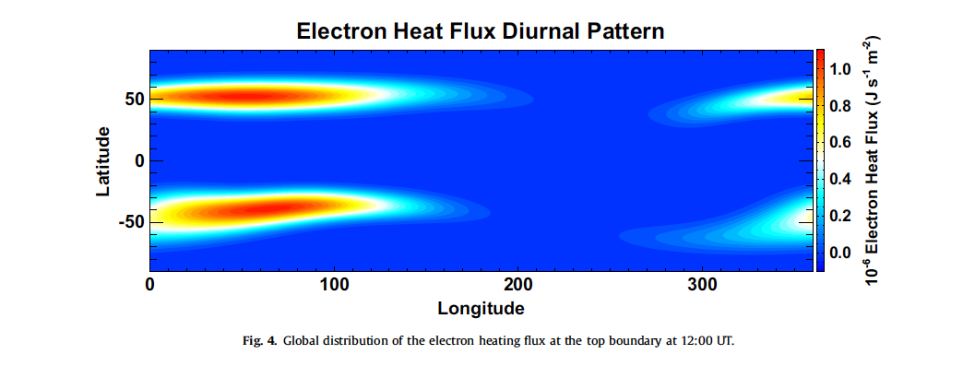
electrons—Part 3: energy
Energy transfer terms
Direct Solar EUV/UV
Direct Auroral heating
Thermal Conduction
We assume conduction along B-field lines.
Vertical and horizontal (Zhu et al. [2016]).

