Slide 1
Role of Coupling with
Lower Atmosphere on Ionosphere/Thermosphere
Model Performance
J. S. Shim¹, I. Song¹
Data Provider: I. Tsagouri², L. Goncharenko³, A. J. Coster³
Modelers: M. Codrescu⁴, M. Fedrizzi⁴, T. J. Fuller-Rowell⁴, J. McInerney⁵,
A. J. Ridley⁶, S. C. Solomon⁵, A. Vitt⁵
CCMC Group⁶
1. Department of Atmospheric Sciences, Yonsei Uni., Seoul, Korea, 2. National Observatory of Athens, Penteli, Greece, 3. Haystack Observatory, Westford, MA, USA, 4. NOAA SWPC, Boulder, CO, USA, 5. High Altitude Observatory, NCAR, Boulder, CO, USA, 6. Space Physics Research Laboratory, Univ. of Michigan, Ann Arbor, MI, USA, 6. NASA GSFC, Greenbelt, MD, USA

Slide 2
Motivation
To extend previous study on
“Validation of Ionospheric Specifications During Geomagnetic
Storms: TEC and foF2 during the 2013 March Storm Event”
(Shim et al., 2018):
performed by Ionosphere Plasma Density WG
(led by Ioanna Tsagouri, National Observatory of Athens) of
“International Forum for Space Weather Modeling
Capabilities Assessment”(ISWAT Predecessor)
to track improvement of models’ performance
to investigate impact of upper and lower boundary forcing on model performance

Slide 3
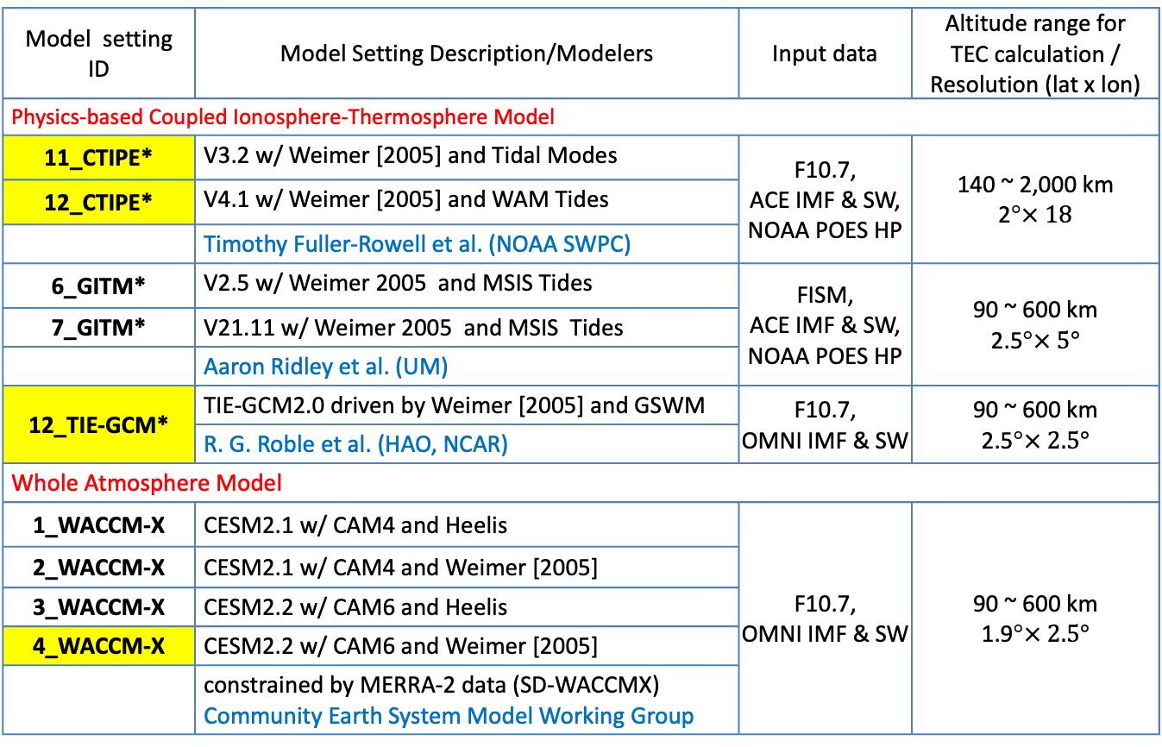
Models used in Study
Model setting ID | Model Setting Description/Modelers | Input data | Altitude range for TEC calculation / Resolution (lat x lon)
Physics-based Coupled Ionosphere-Thermosphere Model
11_CTIPE* | V3.2 w/ Weimer [2005] and Tidal Modes | F10.7, ACE IMF & SW, NOAA POES HP | 140 ~ 2,000 km 2°$× 18$
12_CTIPE* | V4.1 w/ Weimer [2005] and WAM Tides
 | Timothy Fuller-Rowell et al. (NOAA SWPC)
6_GITM* | V2.5 w/ Weimer 2005 and MSIS Tides | FISM, ACE IMF & SW, NOAA POES HP | 90 ~ 600 km 2.5°$× 5°$
7_GITM* | V21.11 w/ Weimer 2005 and MSIS Tides
 | Aaron Ridley et al. (UM)
12_TIE-GCM* | TIE-GCM2.0 driven by Weimer [2005] and GSWM | F10.7, OMNI IMF & SW | 90 ~ 600 km 2.5°$× 2.5°$
 | R. G. Roble et al. (HAO, NCAR)
Whole Atmosphere Model
1_WACCM-X | CESM2.1 w/ CAM4 and Heelis | F10.7, OMNI IMF & SW | 90 ~ 600 km 1.9°$× 2.5°$
2_WACCM-X | CESM2.1 w/ CAM4 and Weimer [2005]
3_WACCM-X | CESM2.2 w/ CAM6 and Heelis
4_WACCM-X | CESM2.2 w/ CAM6 and Weimer [2005]
 | constrained by MERRA-2 data (SD-WACCMX) Community Earth System Model Working Group
* Model results are submiited by the CCMC

Slide 4
SD-WACCMX: Specified Dynamics WACCM-X
Tropospheric and stratospheric dynamics below z = 50 km is constrained by MERRA-2
MERRA version 2:
  The Modern-Era Retrospective analysis for Research and Applications
  Data assimilation product (NASA GSFC GEOS global model + Numerous meteorological observations) below the mesopause

Slide 5
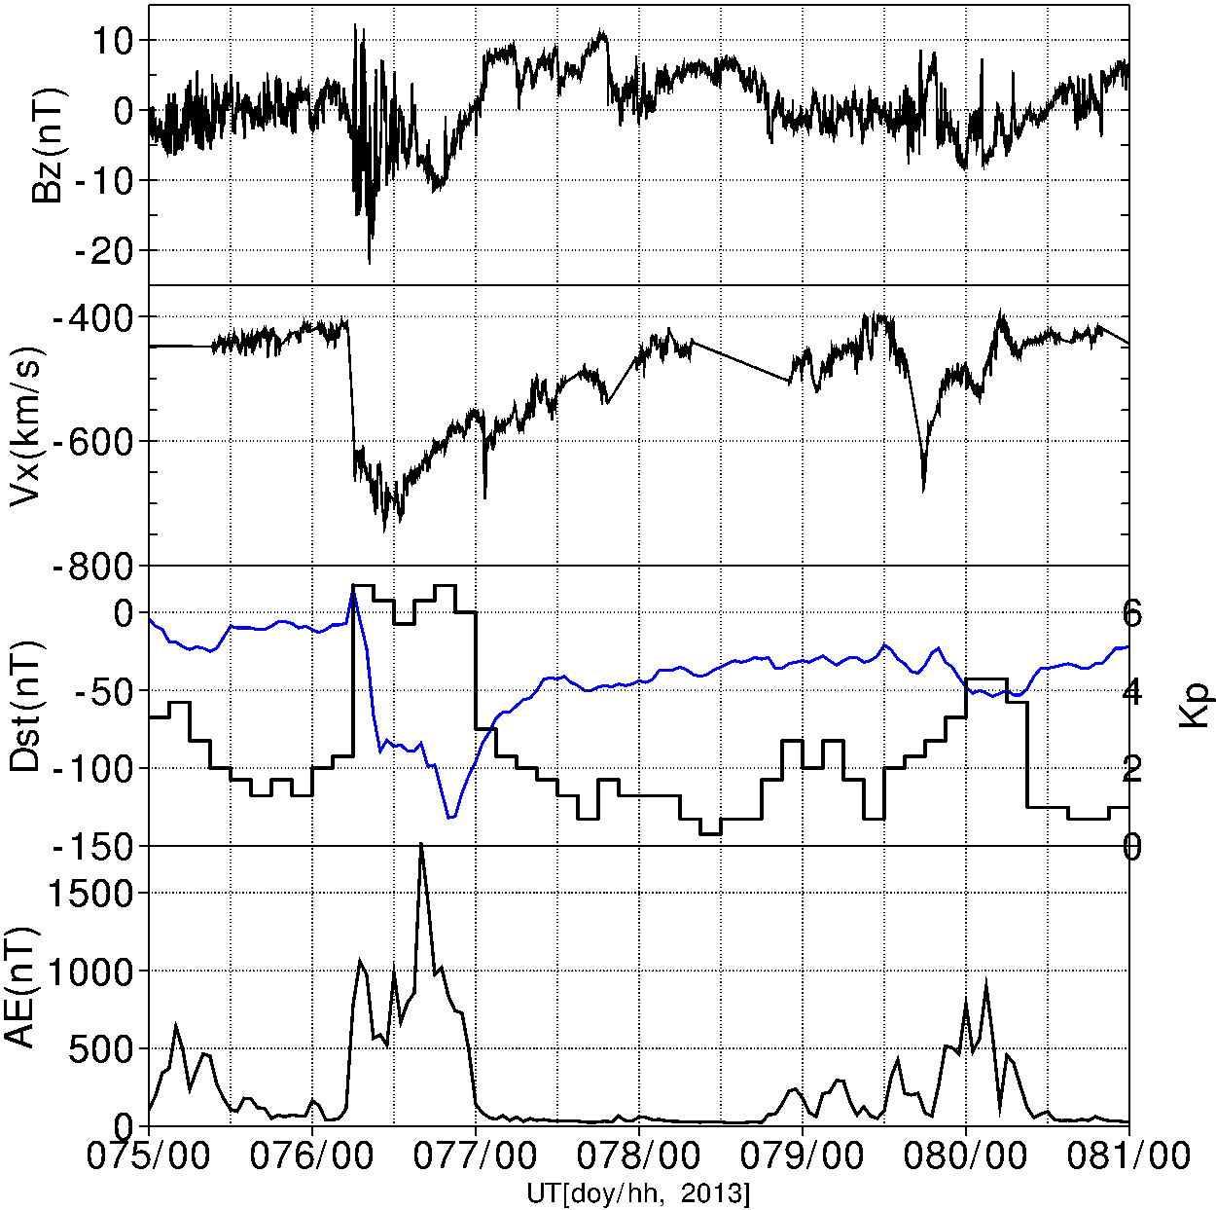
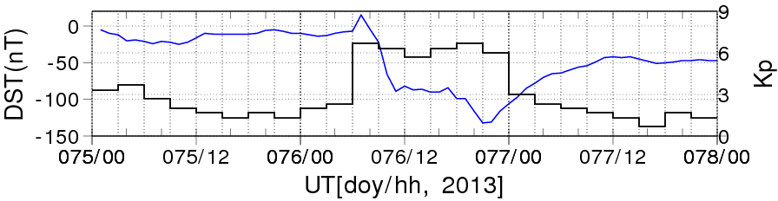
Solar Wind & Geomagnetic Conditions
Dst (nT)
CME-driven geomagnetic storm
Quiet-time References:
  median of 30 days (+/- 15 days of the storm)

Slide 6
TEC and foF2 at 12 Ionosonde Stations
Ionosonde Stations |  |  | Geographic Coord. |  | Geomagnetic Coord.
Name |  | Code | Lon. (°E) | Lat. (°N) | Lat. (°N)
American Longitude | Millstone Hill | MH453 | 288.50 | 42.60 | 52.10
 | Idaho National Lab | IF843 | 247.32 | 43.81 | 50.64
 | Boulder | BC840 | 254.70 | 40.00 | 47.80
 | Eglin AFB | EG931 | 273.50 | 30.50 | 39.81
 | Port Stanley | PSJ5J | 302.10 | -51.60 | -41.8
European-African Longitude | Chilton | RL052 | 359.40 | 51.50 | 53.35
 | Pruhonice | PQ052 | 14.60 | 50.00 | 49.3
 | Ebre | Ebre | 0.50 | 40.80 | 42.79
 | Athens | AT138 | 23.50 | 38.00 | 36.17
 | Louisvale | LV12P | 21.20 | -28.50 | -28.51
 | Hermanus | HE13N | 19.22 | -34.42 | -33.96
 | Grahamstown | GR13L | 26.50 | -33.30 | -34.10
12 stations from 3 sectors;
North America (NA), Europe (EU) and Southern Hemisphere (SH)
Observations:
  foF2 data from the Global Ionosphere Radio Observatory (GIRO)
  GPS vertical TEC data from MIT Haystack Observatory (error ~ 1TECU)
Notes:
F107=about 120

Slide 7
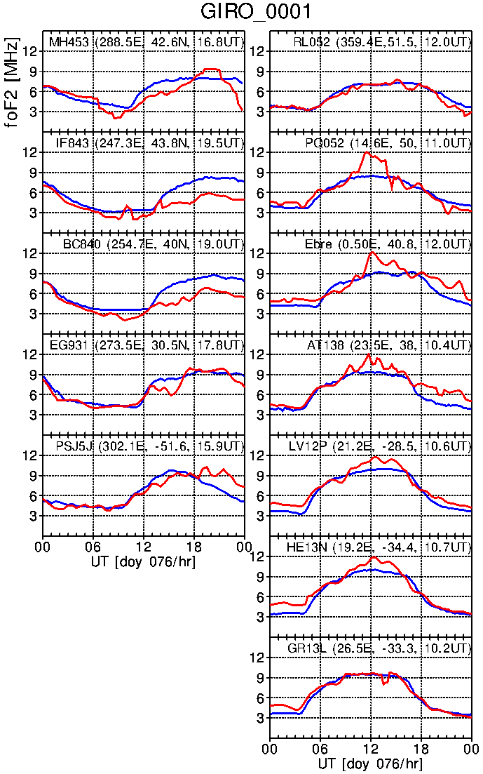
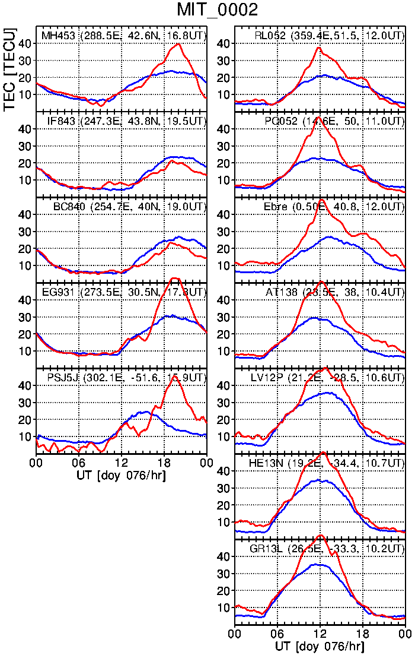
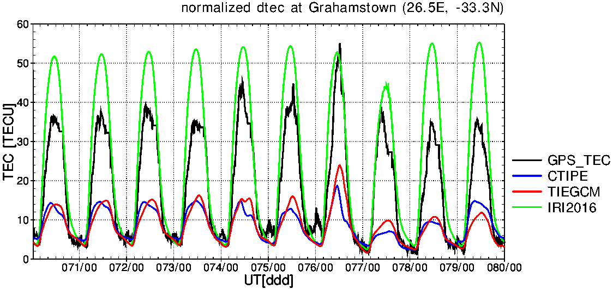
Observed foF2/TEC during the Main Phase
American EU/AF American EU/AF
foF2
TEC
30-day median
doy 076 (03/17)
SED in European sector/Millstone Hill around 12 UT/ 20 UT (Yue et al., 2016, Liu et al, 2016)
Negative storm in the west side in North American sector
Mostly foF2 and TEC changes are similar with larger change in TEC except Chilton and Grahamstown.

Slide 8
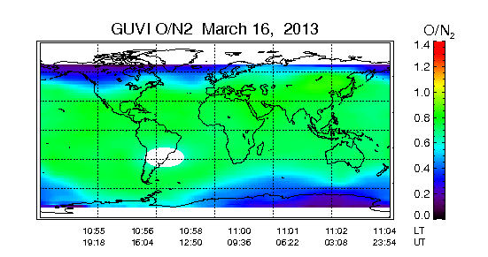
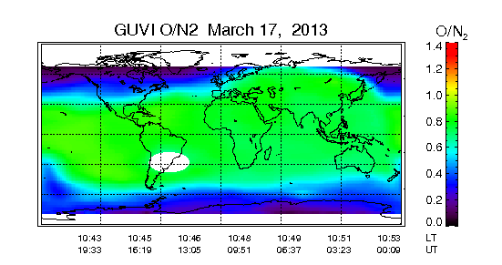
Observed & Modeled O/N₂ : CTIPE
11_CTIPE 12_CTIPE
03/16/2013 16:00 UT 03/16/2013 16:00 UT
03/17/2013 16:00 UT 03/17/2013 16:00 UT
Yamazaki, Y., and A. D. Richmond (2013), A theory of ionospheric response to upward-propagating tides: Electrodynamic effects and tidal mixing effects, J. Geophys. Res. Space Physics

Slide 9
Effects of Tides on foF2: CTIPE
11_CTIPE: driven by imposed the (2,2), (2,3), (2,4), (2,5), and (1,1) propagating tidal modes
12_CTIPE: driven by WAM monthly mean spectrum of tides
11_CTIPE /12_CTIPE tend to underestimate/overestimate foF2 for both quiet and disturbed conditions
12_CTIPE predicts well foF2 decrease in North America region on doy 076.
storm time
GIRO foF2
GIRO 30-day
median
modeled
storm time foF2
modeled
30-day median

Slide 10
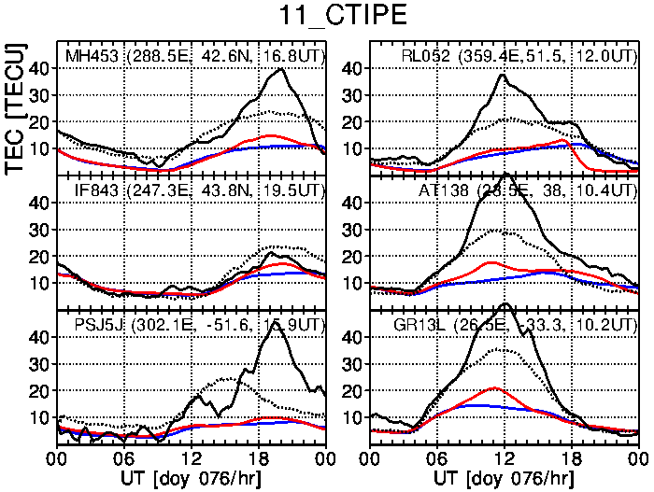
Effects of Tides on TEC: CTIPE
11_CTIPE /12_CTIPE show the same tendency to underestimate/overestimate TEC as foF2 prediction
12_CTIPE predicts better TEC peak during the storm than 11_CTIPE
storm time
GPS TEC
GPS 30-day
median
modeled
storm time TEC
modeled
30-day median

Slide 11
12_TIEGCM vs 4_WACCMX: foF2
12_TIEGCM and 4_WACCMX produce similar foF2 changes during the storm.
4_WACCMX
  produces better quiet time foF2 than 12_TIEGCM does.
  predicts well foF2 decrease in North America region on doy 076
  captures increase in foF2 at Idaho National Lab around ~10-11UT (~2-3 LT)

Slide 12
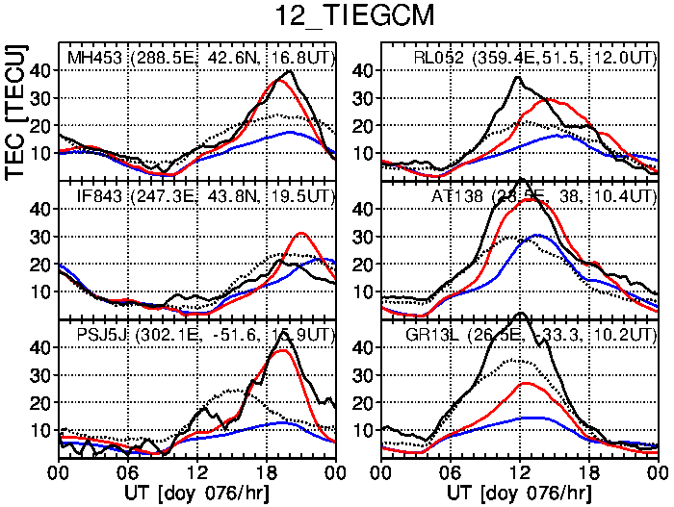
12_TIEGCM vs 4_WACCMX: TEC
4_WACCMX
  shows better peak time prediction than 12_TIEGCM in EU.
  captures well the changes in TEC at Idaho National Lab.
  underestimate quiet time TEC (possibly due to the excessive mixing in the lower thermosphere due to the gravity wave parameterization, Liu et al. 2017)
12_TIEGCM and WACCMX underestimate quiet and storm time TEC at the three locations in South Africa (SAA).

Slide 13
Summary
Compared CTIPe simulations with different lower boundary conditions:
  11_CTIPE/12_CTIPE underestimates/overestimates foF2 and TEC for both quiet time and disturbed time.
  12_CTIPE produces well foF2 decrease in North America (NA) region on doy 076.
Compared TIE-GCM and 2 simulations obtained from WACCM-X:
  WACCM-X simulations underestimate quiet time foF2/TEC almost all 12 locations
  at the three locations in South Africa (SAA), all 3 simulations underestimate quiet and storm time TEC.
  WACCM-X predicts well foF2/TEC decrease in NA on doy 076
12_CTIPE and 4_WACCMX better capture the opposite responses to the storm in the eastern (positive phase) and western (negative phase) parts of NA.
There is no one best simulation for all locations and all metrics used.

Slide 14
Future Plans
Collaboration with KOPRI (Korea Polar Research Institute):
KOPRI has been monitoring the polar ionosphere, the thermosphere, and magnetosphere at Jang Bogo Station (JBS), Antarctica and
Ny-Ålesund, Svalbard and Kiruna using:
  Vertical Incidence Pulsed Ionospheric Radar (VIPIR)/Dynasonde
  GPS TEC/Scintillation monitor
  Fabry-Perrot Interferometer (FPI) (630.0nm, 732.0nm)
  Magnetometers
  Auroral All Sky Camera (visible, 557.7nm, 630.0nm, 427.8nm)
Comparisons with TIE-GCM simulations for polar ionospheric densities, neutral winds and ion drifts.
The observation will be beneficial to understand the complex polar ionospheric variability and to improve model capability to capture the variability.

Slide 15
International Space Weather Action Teams:
G2B-05
Ionosphere Variability
– Ionosphere Plasma Density: NmF2/foF2, hmF2, TEC
led by Ioanna Tsagouri (tsagouri@noa.gr)
Preparing papers on
  Advances in observational, monitoring and detection capabilities
  Advances in theory and modeling

