Slide 1






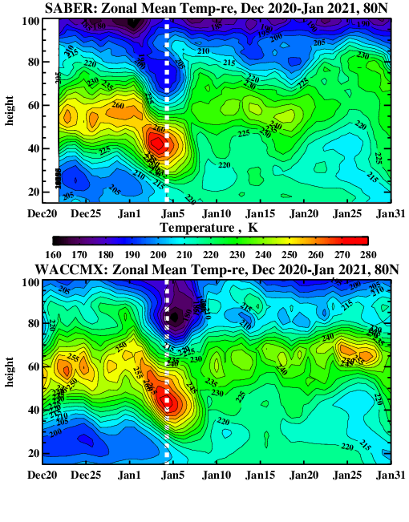
GEOS Meteorology in Whole Atmosphere Models: Current and Future Applications
Valery Yudin,
Ruth Lieberman, Svetlana Karol, Hanli Liu, Joe McInerney and
GMAO/GEOS Development/Production Team
Goddard Earth Observing System -> GEOS global meteorology (surf to ~80 km) produced by
GMAO at NASA/GSFC, https://gmao.gsfc.nasa.gov/
Current products: GEOS-5/FP ---- support of 22 NASA’s missions, operational with updates
2 streams, (1) Forward Processing (FP) and (2) FP for
Instrument Teams (FP-IT, NRT, Obs. campaigns)
MERRA-2 ----since 1980 to present (runs a few weeks behind real time)
During last 12 years GEOS met fields, as the day-to-day variable lower atmosphere drivers of the Ionosphere-Thermosphere-Mesosphere represent the Specified Dynamics/Meteorology in WA models & TIME-GCM.
GEOS-OSSE framework for novel NASA-EOS missions since 2012, high-res. ( ~7 km) Nature Runs ( 1-year of GEOS at 72-layers) employed for OSSE by NWP centers
Latest and future GEOS configurations: the hour-to-hour variable lower atmosphere drivers of the ITM, GEOS with the HR (12-25 km) operational dynamics at 181-layers and new DAS.
SABER/TIMED
WX/GEOS-5FP
2022 CCMC Workshop, Jun 6-10

Slide 2
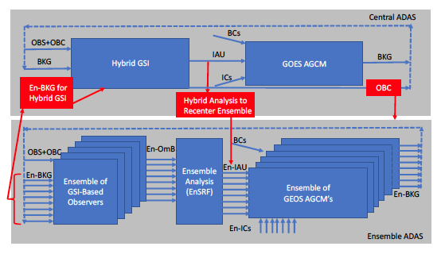
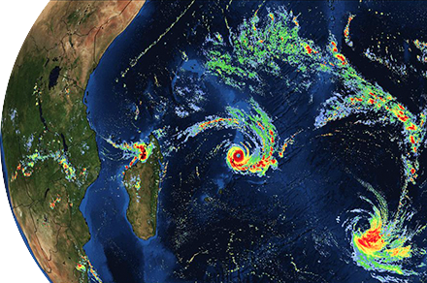
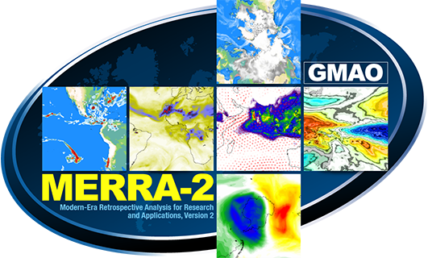
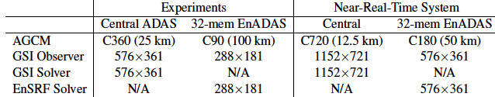
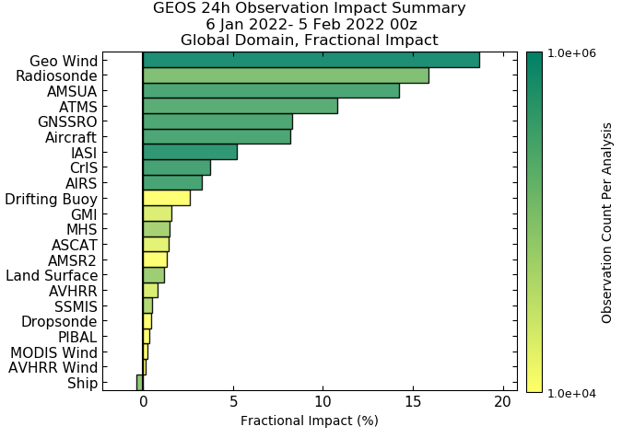
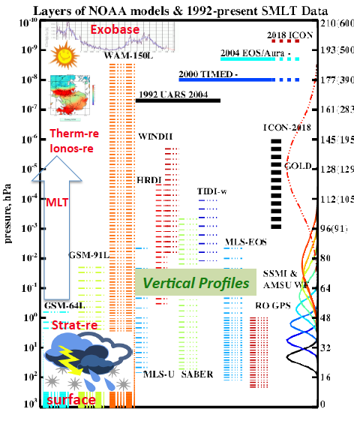
GEOS-5/FP and MERRA-2 in WA Models
GEOS analyses by GSI-ADAS of NOAA and GMAO at 72 layers (top ~80 km, ~25 km) instant. & time-aver. products
MERRA-2: Gelaro et al.(2017), Takacs et al. (2018), 3-hrly on 0.5 x 0.66 deg with modern satellite data, analysis of aerosols and MLS-EOS stratospheric O₃ and T (based on GEOS-5.12, 3DVar, 1980-pres).
GEOS-5/FP
(Forward Processing for NRT & OWF):
operational observations of NWS
with (EnKF, GEOS-5.27, 02.25.21);
3-hrly archives at 0.25 x 0.31 deg
https://gmao.gsfc.nasa.gov/weather_prediction
Whole Atmosphere Models extended to exobase:
CESM-FV/WACCM-X (Liu et al., 2018; Pedatella et al., 2020) a
WAM-GSM (Fuller-Rowell et al., 2020; Yudin et al., 2020, 2022).

Slide 3
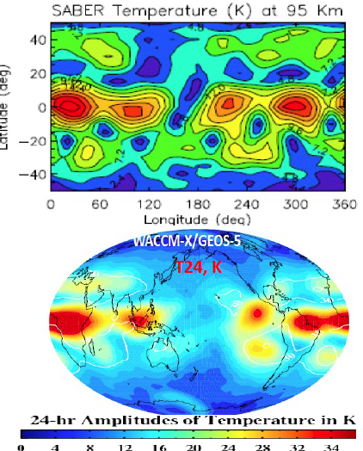
GEOS-meteorology in WACCM/FV – WACCM-SD
Preparation step: xy-remap to the reduced resolutions of WACCM (GMAO-2010) and use of GEOS vertical layers below the stratopause (WXFV-146L), in the SD-domain.
SD for 2D (P_{s} and fluxes) and 3D fields X=(U,V, T) with the lin-interpolation of GEOS analyses (X_{a}) in time (t) to “relax” model (X_{m}) to (X_{a})
X_{m}(t+δt) = (1-W_{a})X_{m}(t) + W_{a}X_{a}(t)
τ~50 hr, δt= 300s of WACCM-X: W_{a} ~ 0.0017,
SD domain: surface to ~45 km; transition: 45 – 52 km.
X_{a}(t) = X_{a}(t_{a1}) + [X_{a}(t_{a2}) -X_{a}(t_{a1})]/[(t_{a2}-t_{a1})=3hr] x (t-t_{a1})
Less accurate representation of diurnal and
sub-diurnal variations with the 3-hrly GEOS-X_{a} archives
=> τ~50 hr not 6-hr as in MERRA-2
Mass conservation by fixers (P_{s} and SD-winds):
mass correction δP_{s} ~ 6-17 Pa in WX/SD
T-24 hr, K
SD-algorithm is a nudging type scheme of the relaxation forecast to analyses

Slide 4
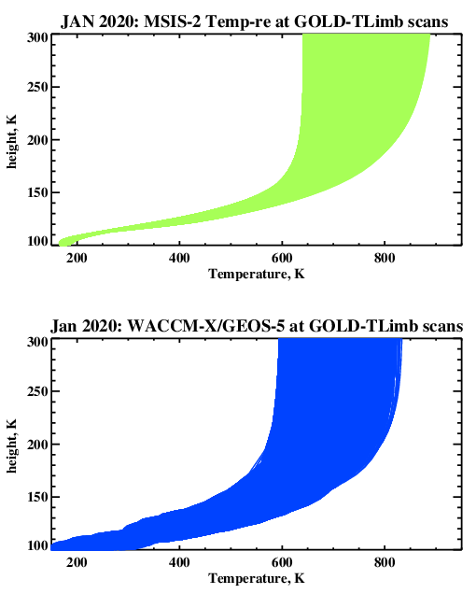
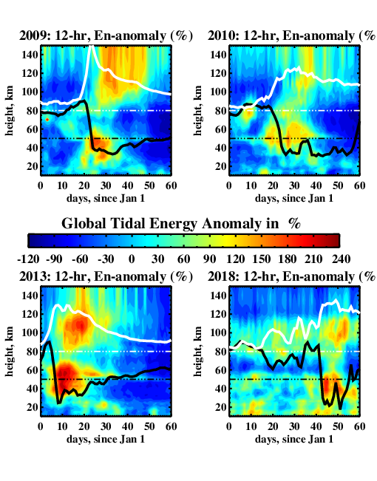
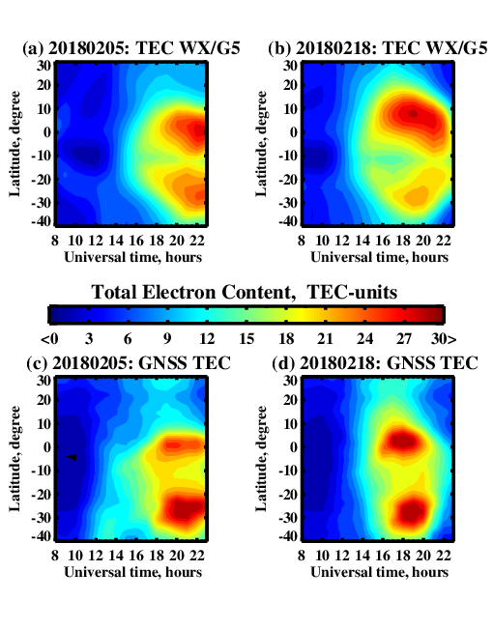
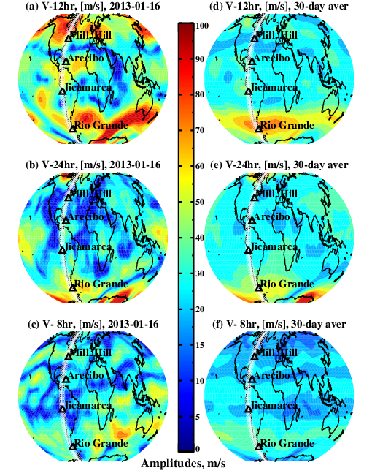
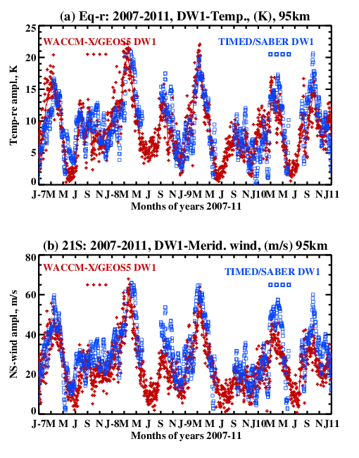
WACCM-X/GEOS selected results
SSW events and their effects on the ITM
MSIS2
WACCMX
Tidal QBO in DW1
amplitudes, 95 km
(2007-2011) WACCMX/GEOS
(Yudin et al., 2015) and SABER tides (Ortland, 2017).
Westerly QBO amplifies Mar-Apr DW1 amplitudes.
2013-01-16 Jan-aver/2013

Slide 5
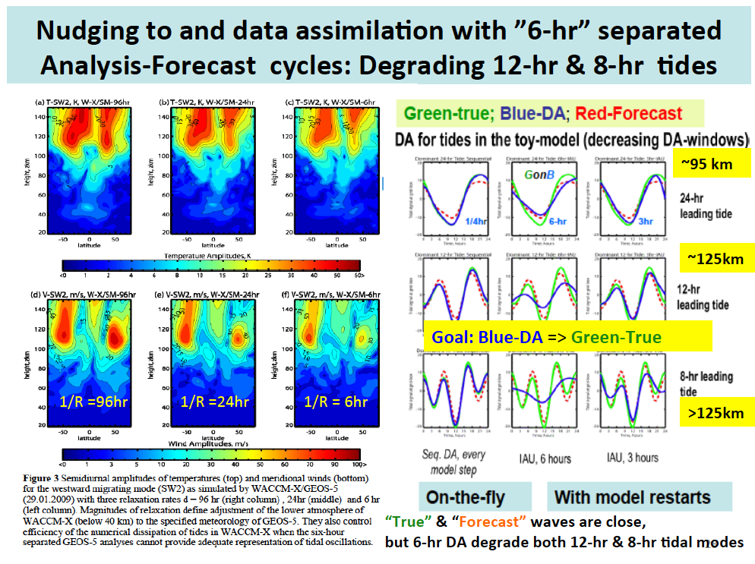
τ= 72
τ= 24
τ= 6
τ= 72
SW2 wind amplitudes ~2 times weaker

Slide 6
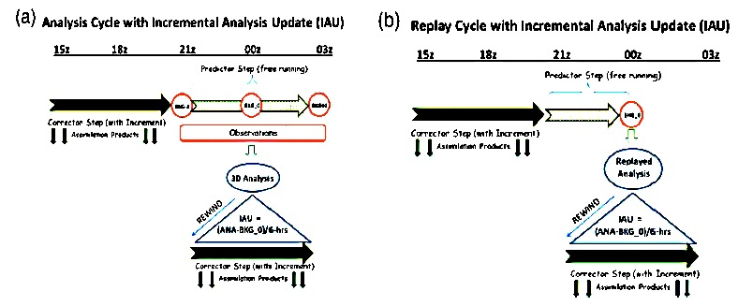
GMAO Incremental Analysis Update (IAU) algorithms in DA (a) and REPLAY (b) runs in GEOS-AGCM
A18 A00
in REPLAY: the subgrid-scale processes are recalculated online and consistent with the resolution and the large-scale analyses and physics
A18 A00
AT-Corrector
3h-Predict
AT-Corrector
3h-Predict
AT = (X_{a} – X_{b})/6hr: Corrector
3-hr Predictor to the center of analysis window, 00z.
Rewind
Next AT-Corrector: 21z->3z
3DVar-IAU
in MERRA-2
REPLAY-IAU
With GEOS
AT-Corrector
The Incremental Analysis Update (IAU) of GEOS (Takacs et al., 2018) in:
(a) a fully cycled 3DVar DAS, such as MERRA-2, and 4DEnVar in GEOS-FP.
(b) a REPLAY to force GEOS-AGCM to track preexisting MERRA-2 analyses
In “REPLAY” (b) gridded GEOS analyses X_{a} replace the Observations (a),
the time-invariant Analysis Tendency (AT) forcing is applied at the corrector step; the 3-hr “rewind” after the 3-hr predictor-forecast is used.
The time-invariant AT likely degrade less diurnal cycles comparing to the nudging SD-schemes with the linear interpolation in time between two X_{a} analyses.

Slide 7
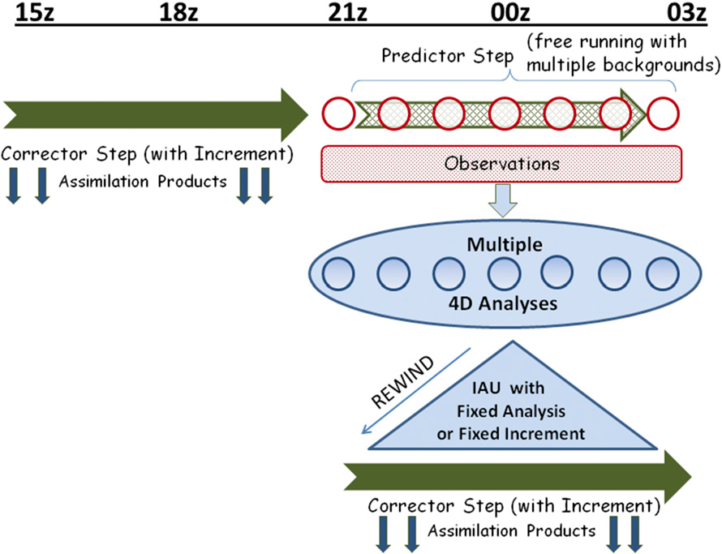
GMAO IAU in the hybrid 4D-EnVar (Takacs et al, 2018)
3D-IAU AT = (X_{a} – X_{b})/6hr =const: Corrector
3-hr Predictor to the center of analysis 00z.
Rewind
Next AT-Corrector: 21z->03z
4D-IAU rapid [AT(i=1,6)]/1hr
Rewind
Next AT-Corrector: 21z->03z with [AT(i)]
IAU differs from SD-WACCM by acknowledging the temporal resolution of DA
AT(t) = const between 2-analyses
6-hour Corrector by AT(i)
The current GEOS-FP system uses an hourly (2-hr) implementation of IAU in the 4DEnVar approach:
a tendency is created from each analysis within
the assimilation time window by subtracting the analysis from the model state at a given time and keeping the corresponding “analysis” tendency fixed over a certain time interval, typically 1 hr.

Slide 8
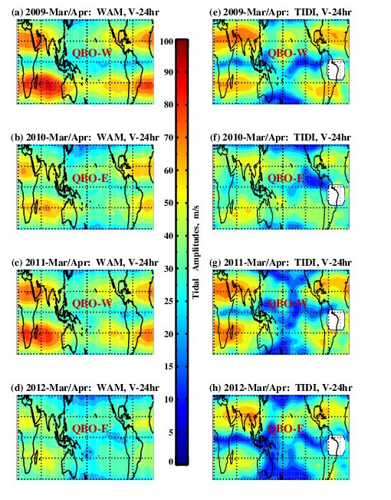
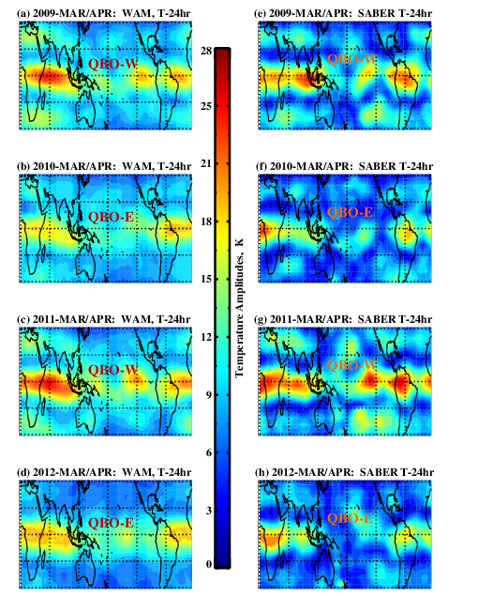
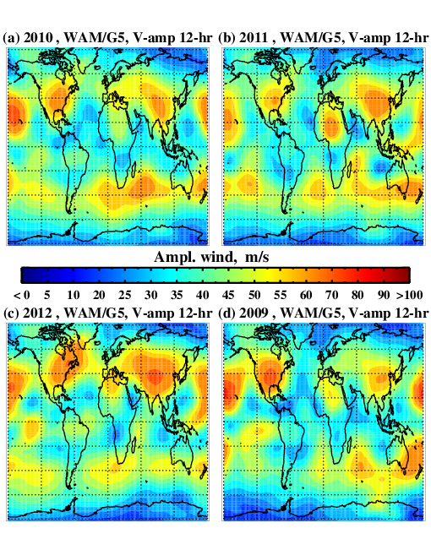
GEOS in WAM/GSM: WAM-SM, as
Specified Meteorology – Simplified Replay
Preparation step: xy-remap + vertical remap to WAM-150L.
WAM-SM for P_{s} (mass) and 3D fields(U,V, T, Q) with the constant AT forcing between analyses, τ∼72 hr.
To preserve the 24-hr and sub-diurnal (12/8-hr) variations in WAM with the 3-hr GEOS archives => “weaker” relaxation (3-4 days, not 6-hr as IAU).
SM is the simplified IAU for “non-parent to GEOS” model without the “predictor” step (no 3-hr “rewind”, as in the REPLAY.
Multi-year tidal variability, driven by QBO in 24-hr tidal winds and T-re
2009
QBO-W
2010
QBO-E
2011
QBO-W
2012
QBO-E
WAM-SM, V-24
TIDI/TIMED, V-24
WAM-SM, T-24
SABER/TIMED, T-24

Slide 9
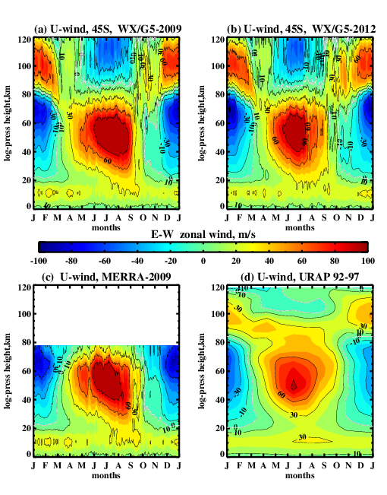
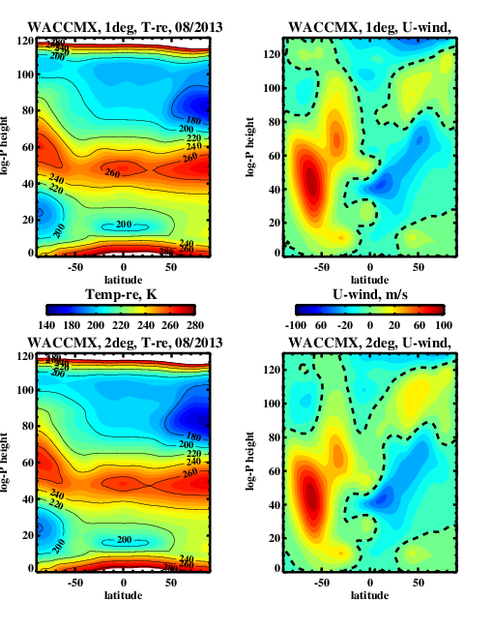
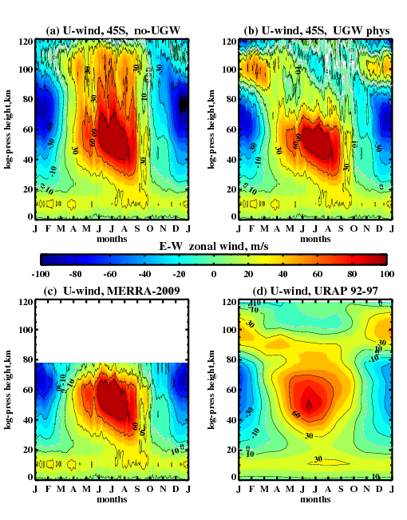
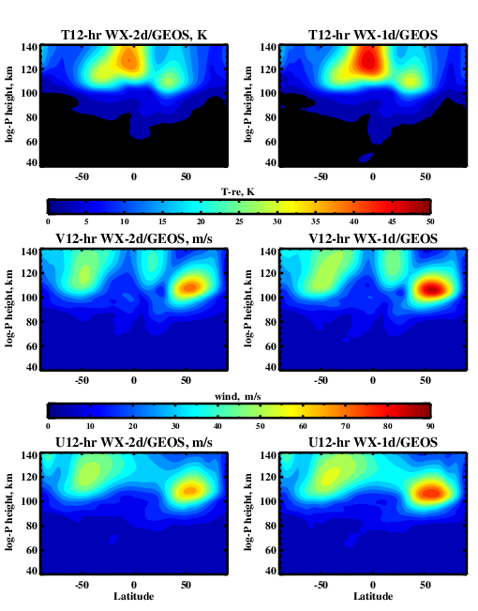
WACCMX-SD vs WAM-SM & URAP at 45ºS, annual cycles of zonal winds
WACCMX-SD:
2 deg vs 1 deg (Aug 2013)
2009 WA zonal wind simulations at ~ 2º with two different schemes of GW physics forced by MERRA-2
in WAM and WACCM-X
1-deg
WACCMX-2009. WACCMX-2012
WAM without GW physics
2-deg
WAM-2009 with GWP
URAP 1992-97
MERRA-2, 2009
2-deg
1-deg
URAP 1992-97
Colder summer polar MLT for 2º and bit stronger 12-hr tidal amplitudes for 1 deg (with different zero wind line for EW winds)

Slide 10
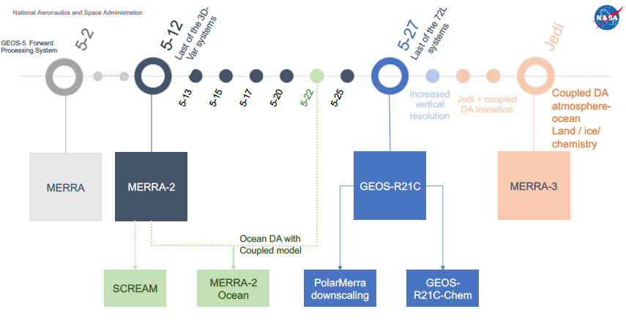
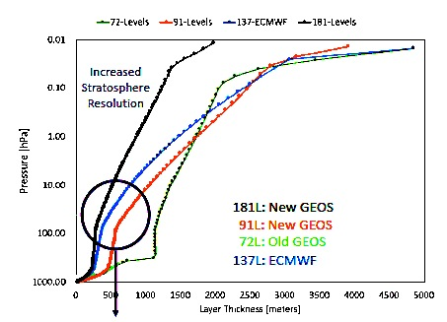
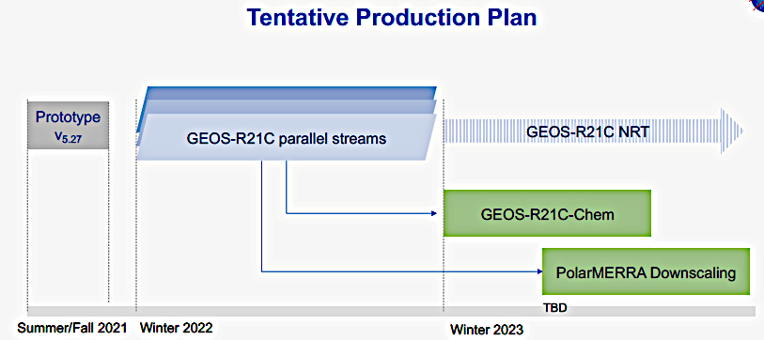

GMAO/GEOS Timeline: from GEOS/MERRA-2 (GEOS-5.12, 2015) to
GEOS-R21C (GEOS-5.27, 2021) and GEOS/MERRA-3
2021-22
72L
180L
GEOS-R21C/ WA-1hr
GEOS-H
Heliophys.
applications
Timely to orchestrate/work with GEOS-R21 team for the 1-hr data flow
et al., 2021

Slide 11
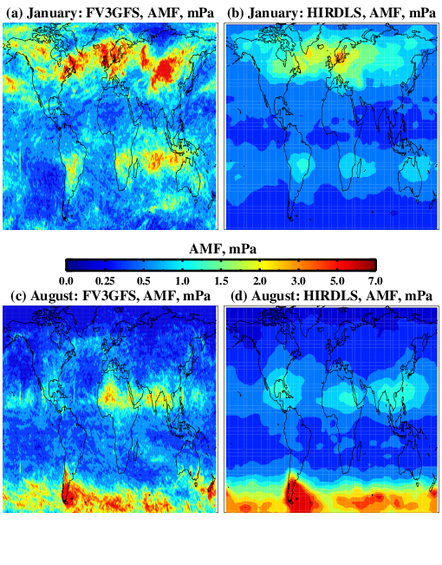
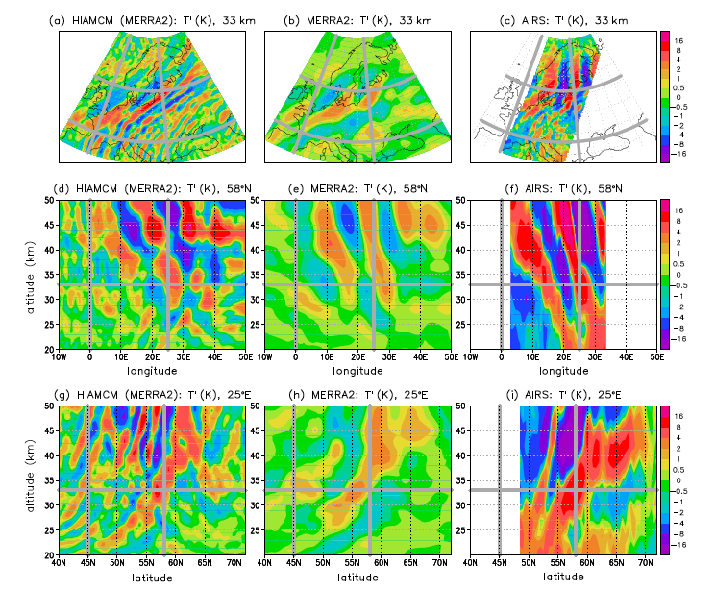
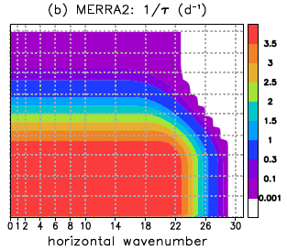
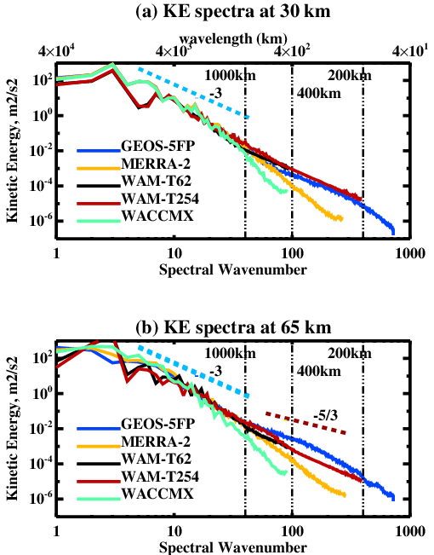
Resolving GW Hotspots and Supporting GW Dynamics in Models Constrained by GEOS
Becker et al., (2021)
Ern et al., 2018
FV3GFS, AMF
HIRDLS, AMF
Yudin et al., (2021), FV3GFS-C762 (12.5 km)
Becker et al., (2021): HIAMCM/MERRA-2 (left), MERRA-2(mid) and AIRS (right); T’ colorbars -16/16 K (maps and height-XY);
Nudging in the spectral space: only large-scale dynamics with L_{h} > 1500 km (n < 28)

Slide 12
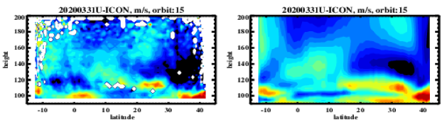
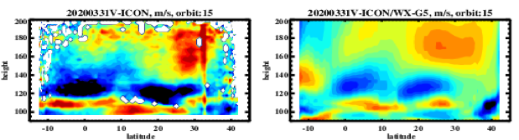
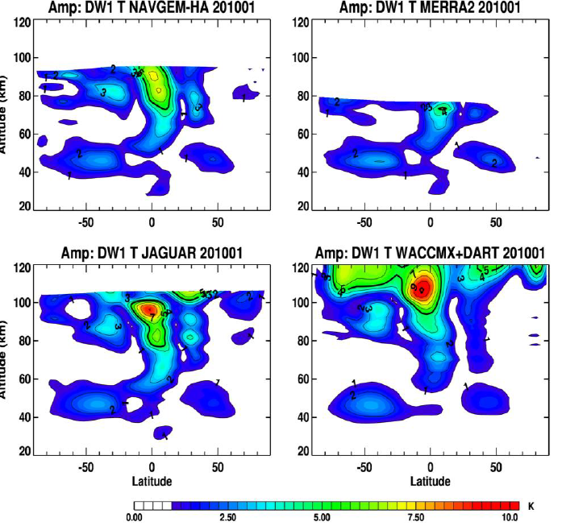
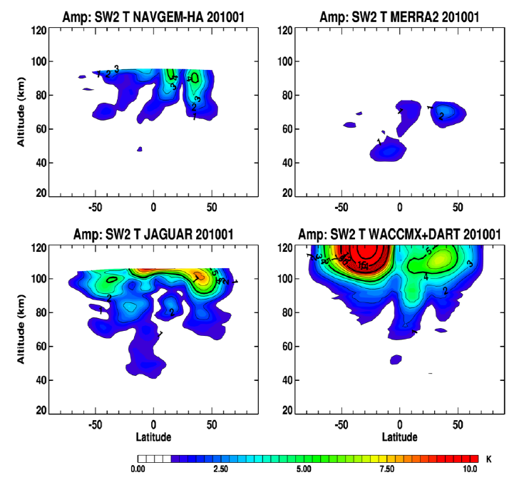
Summary: GEOS-WA for ITM Research and SW Applications
GEOS in ITM models =>High consistency between WA models and ITM data when coupled to the realistic terrestrial weather and stratospheric dynamics of GEOS
CCMC group, J. Yue, J. Wang and M. Chou, ported WACCM-X on Pleiades and performed the WACCM-X/SD simulations at GSFC/CUA
2. Forthcoming upgrades of GEOS products
High-resolution (12.5 – 25 km, and 91L/181L)
Rapid (1-2hr) A-F cycling with the 1-hr archives
(watch GEOS-R21C reanalysis production in 2023).
GEOS ensemble – uncertainty of LA drivers
IAU scale-aware application of GEOS in WA models
4. Future of GEOS products in the SW research
Tidal weather (3-5 days), WACCMX with GEOS-Fst
OSSE-ITM support for GDC, AWE, and DYNAMIC.
5. GEOS-H development: raising the top lid, extension of GEOS-model and DA into the ITM
(WA model with operational/NRT GEOS-DAS).
ICON/MIGHTI. WACCM-X/GEOS5-FP
McCormack et al., 2021. MERRA-2
MERRA-2
NAVGEM-HA
NAVGEM-HA
JAGUAR
WACCMX+DART
JAGUAR
WACCMX+DART
24-hr DW1 and 12-hr SW2

