Slide 1
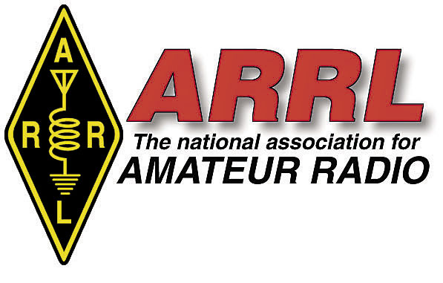
Detecting Large Scale Traveling Ionospheric Disturbances using machine learning and Amateur Radio Data
Applying data science to IONOSPHERIC PHYSICS
Bill Engelke, AB4EJ
CCMC - june, 2022
V7

Slide 2
introduction
Transient Ionospheric Disturbances are electron density waves that travel through the ionosphere and affect radio propagation (fading, GPS accuracy, etc.)
We can see these waves in amateur radio “spot” data
New technique developed to recognize these using Machine Learning (NASA-sponsored project)
Companion project to NSF-sponsored Personal Space Weather Network (delayed due to electronic chip shortages)

Slide 3
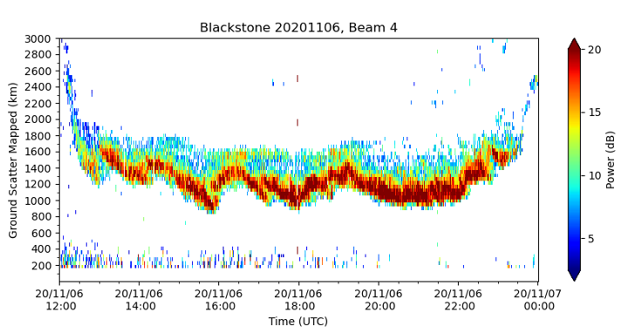
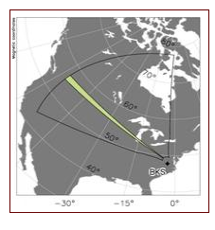
Observing tids in hf radar
Traditional way of observing TIDs
Virginia Tech SuperDARN HF Radar
LSTIDs:
Period of 1 to 4 hours

Slide 4
What is “spot data”? Why use it?
“Spots” are automated reports of digital amateur radio signals received. Generated by a variety of propagation monitoring and contact-making programs and reported to volunteer-managed databases. Over 24 million are reported daily.
We have spot data for many days where relevant HF Radar was in maintenance (North America coverage)
There is spot data for many areas not covered by HF Radar

Slide 5
SPOT Data sources
WSPR: http://wsprnet.org
RBN: http://www.reversebeacon.net/
PSKReporter: https://www.pskreporter.info/

Slide 6
Representing spot data
Show data for direct comparison to SuperDARN plot
X axis: UTC 1200 to 2400
Y axis: spot signal distance in km
Point color: number of spots this minute at this range

Slide 7
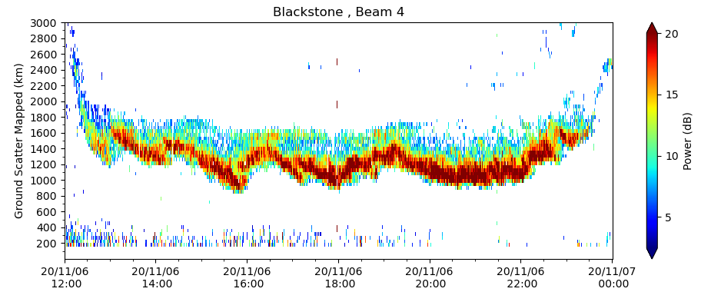
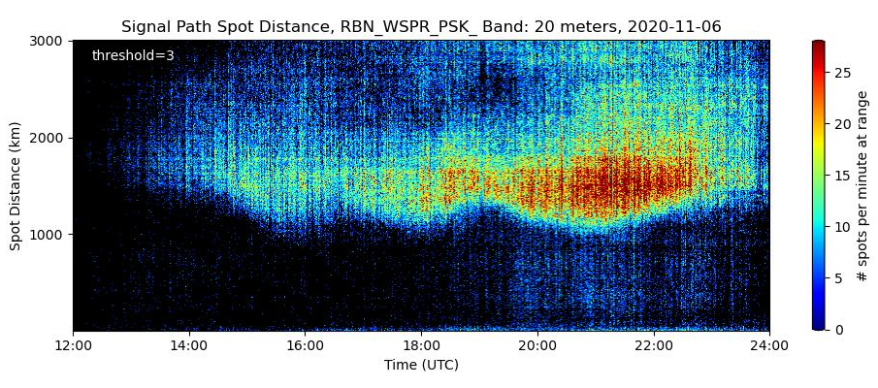
TIDs can be observed in both the HF Radar and spot data plots

Slide 8
Using Machine learning to detect tids
Using Tensorflow
Open source
Object detection model
Concept: manually identify the shapes in the plot that correspond to TIDs seen in HF radar; train based on these

Slide 9
Training and test sets
Should have several thousand images
Randomly split images into 80% training and 20% test
Go thorough images manually and mark features

Slide 10
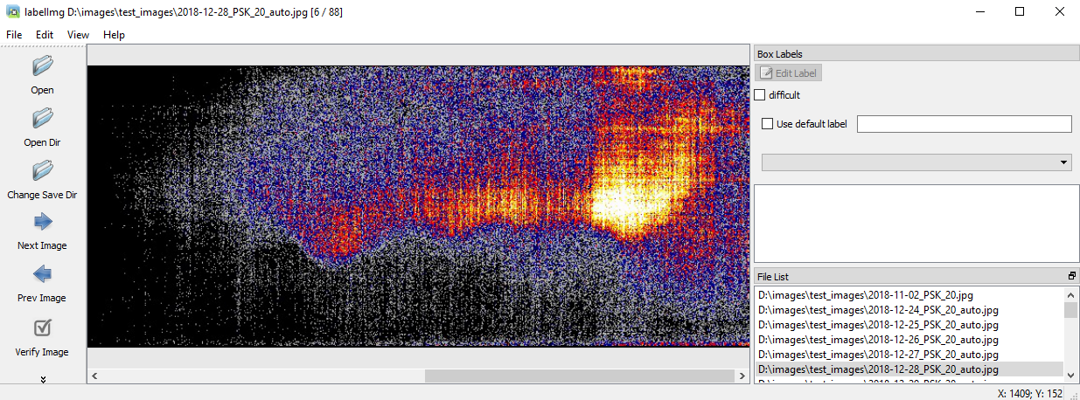
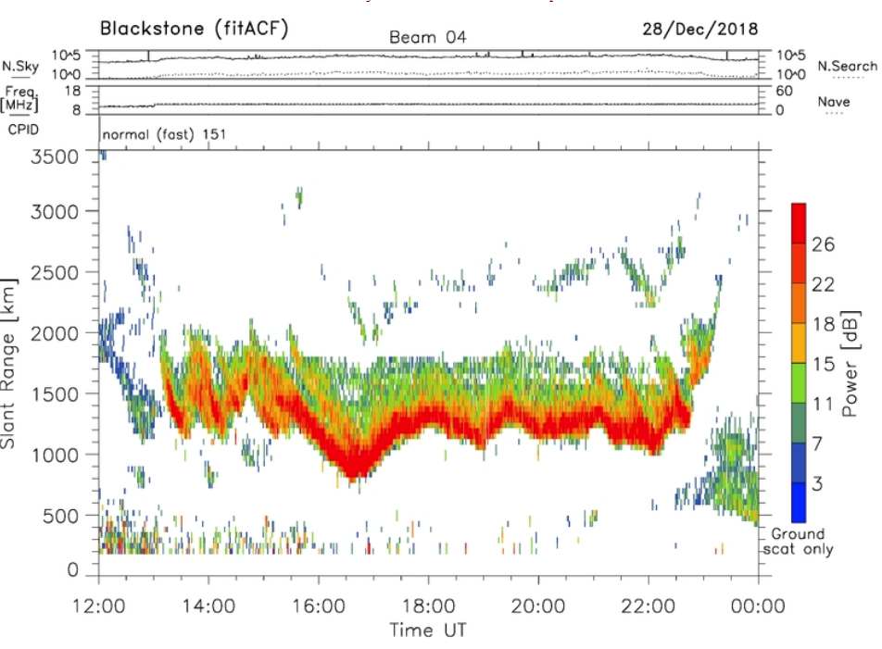
training
Make spot plot
Plot HF radar data for corresponding time frame; verify presence of TIDs in both images

Slide 11
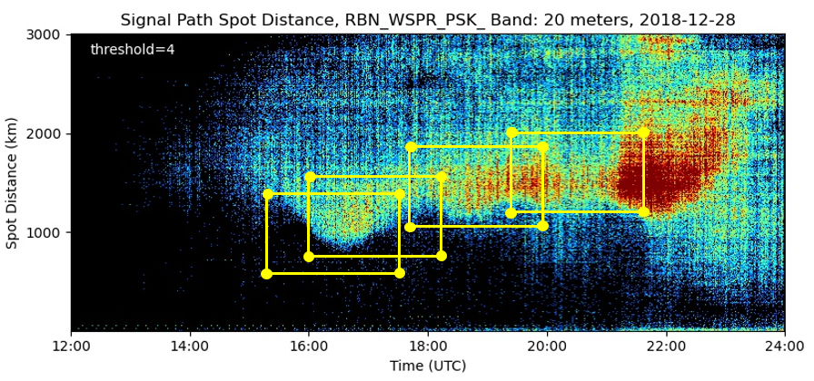
1. Use labelimg program to identify desired features
Used PSK plots for years 2016 through 2019 (4 years’ worth)

Slide 12
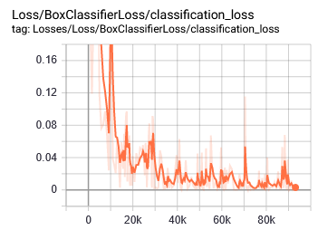
2. Run training program
“Loss” indicates difference between system’s assessment and human assessment
As loss decreases in training steps, the system “learns” to recognize the desired features through generalization
Using GPU cuts training time by over 80% (still takes 6 to 8 hours)
Output of the training run is an Object Detection Model

Slide 13
Using the object detection model
Using the Model, the Detector program searches an image for a sub-image that looks like the object(s) it was trained for
Compensates for scale
Can sometimes find a feature in the image that is obscured and not immediately recognizable by human eye

Slide 14
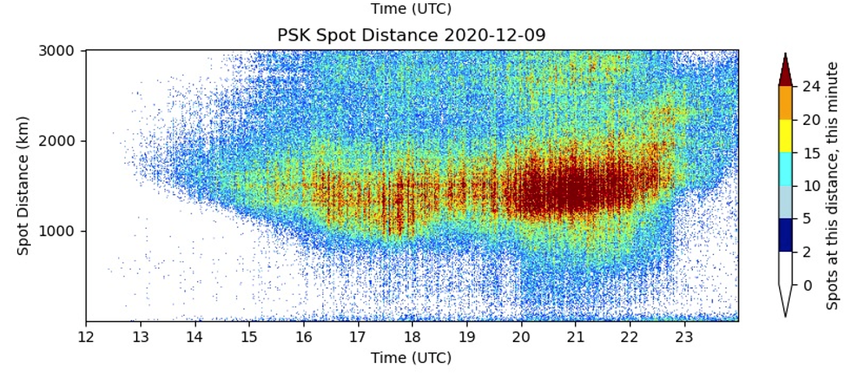
Testing the object detector
Select a spot plot from a year not included in the training set;
Run the object detection program

Slide 15
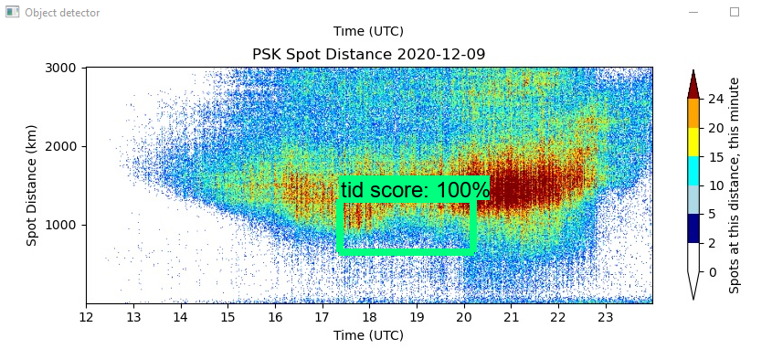
Output of Object Detection program is an image annotated with any TIDs detected, each with a confidence score.
Object detector spots a TID in the image
The high level of confidence indicates that this TID is very similar to one that was identified in the training set.

Slide 16
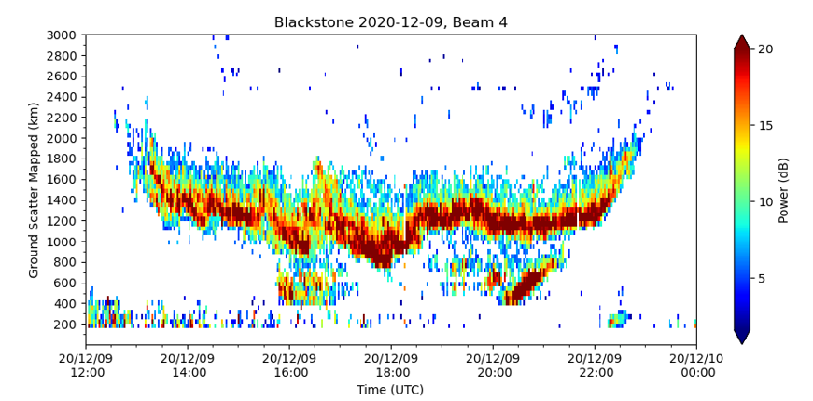
SuperDARN plot confirms the presence of one or more TIDs on this date

Slide 17
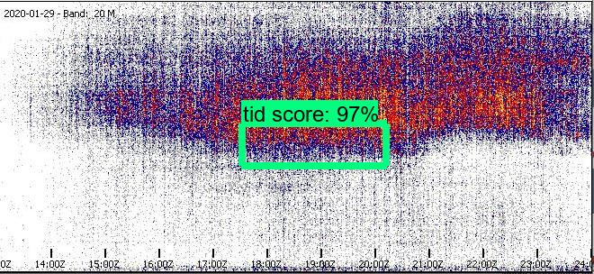
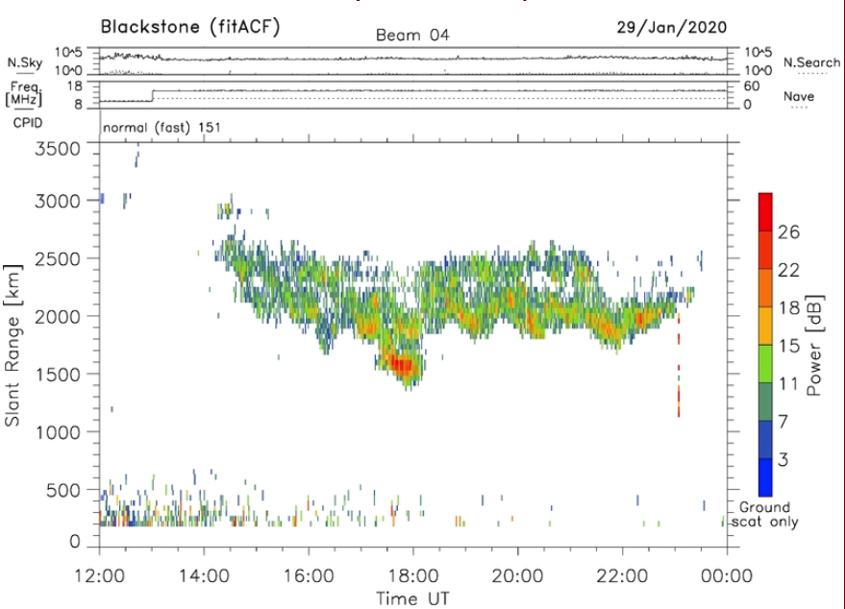
In some cases, the Object Detector finds a TID that is not clear to the human eye. We see evidence in the SuperDARN plot for this date.

Slide 18
Ionospheric climatology analysis
Shows how LSTID activity changes seasonally in North America
Can be done for other locations and bands as well

Slide 19
summary
System can examine several images per second (when GPU-accelerated)
Allows us to study years of propagation reports for correlation analysis with solar and geomagnetic factors
May lead to improved understanding of TIDs, influence of various factors on HF propagation & GPS accuracy

Slide 20
Acknowledgements
NASA Grants 80NSSC21K0002 and 80NSSC21K1772
SuperDARN plotting software: https://zenodo.org/record/3727269
SuperDARN data: https://link.springer.com/article/10.1007/BF00751350
Thanks to Virginia Tech SuperDARN team for use of the North America data

Slide 21
Q & A
Bill Engelke, AB4EJ
bengelke@cs.ua.edu

