Slide 1
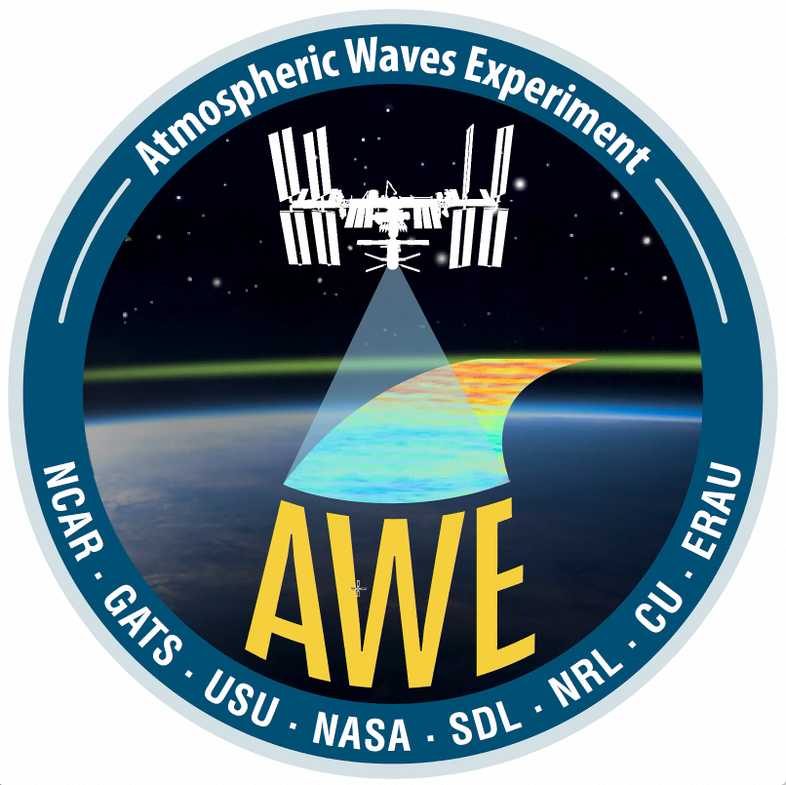
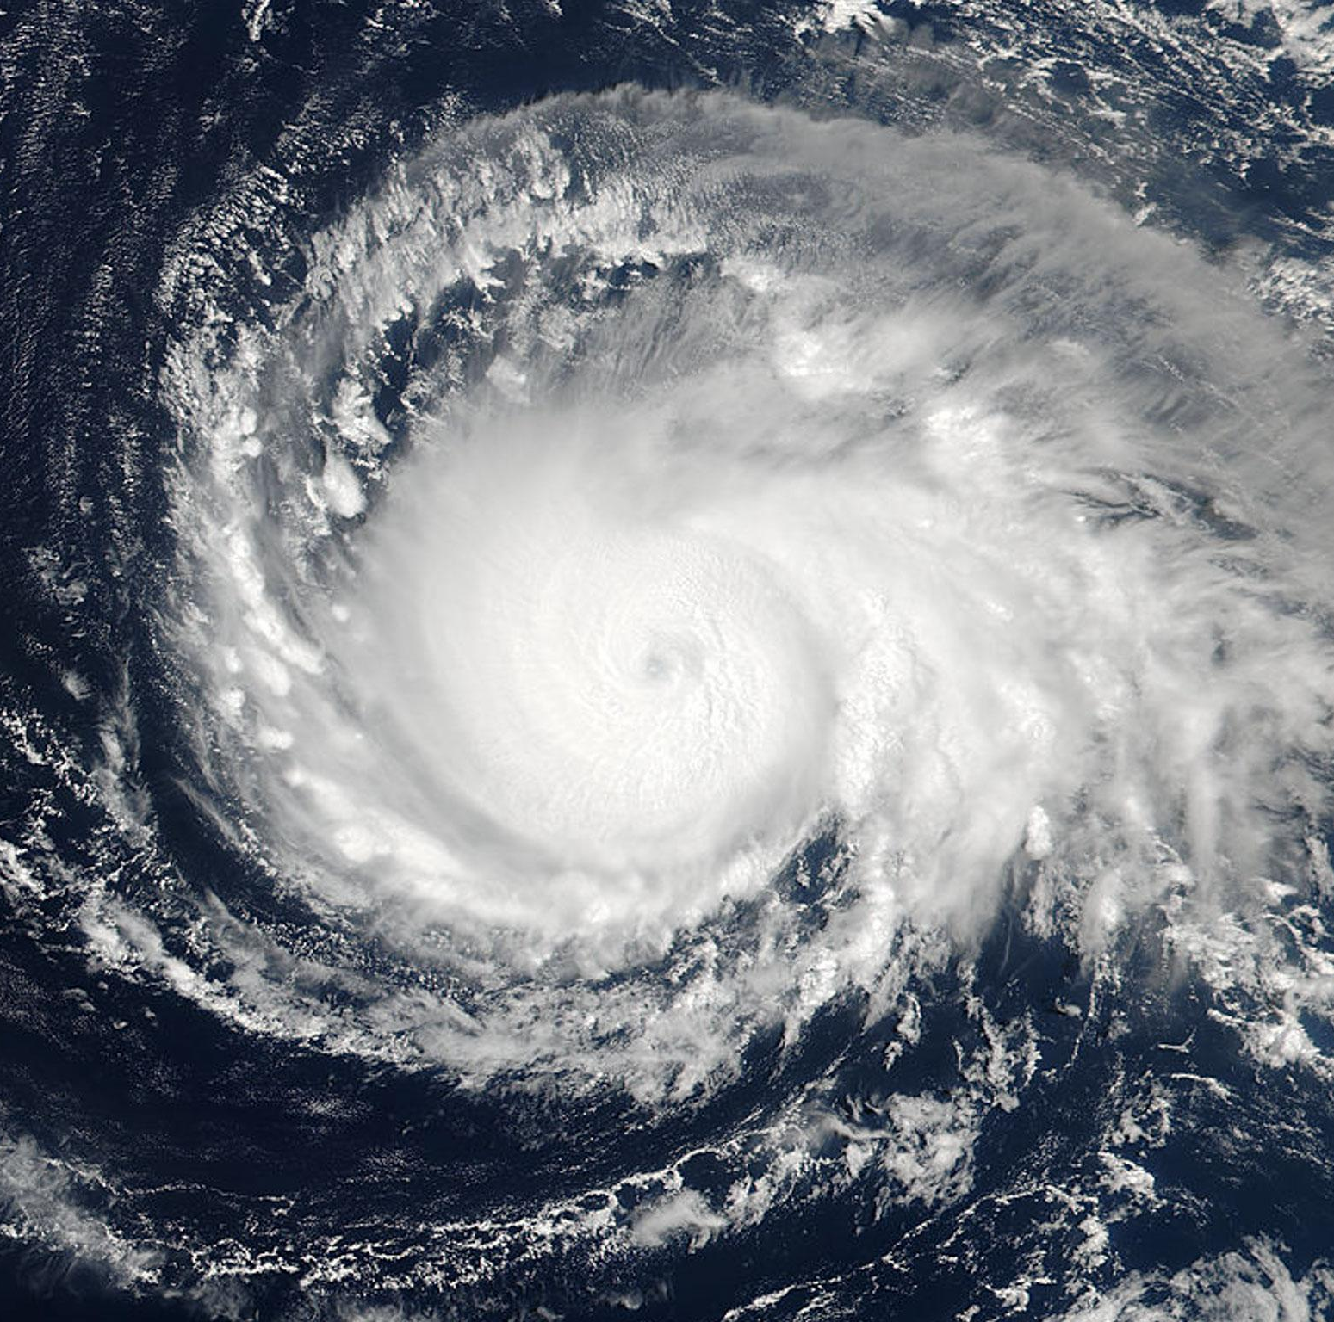
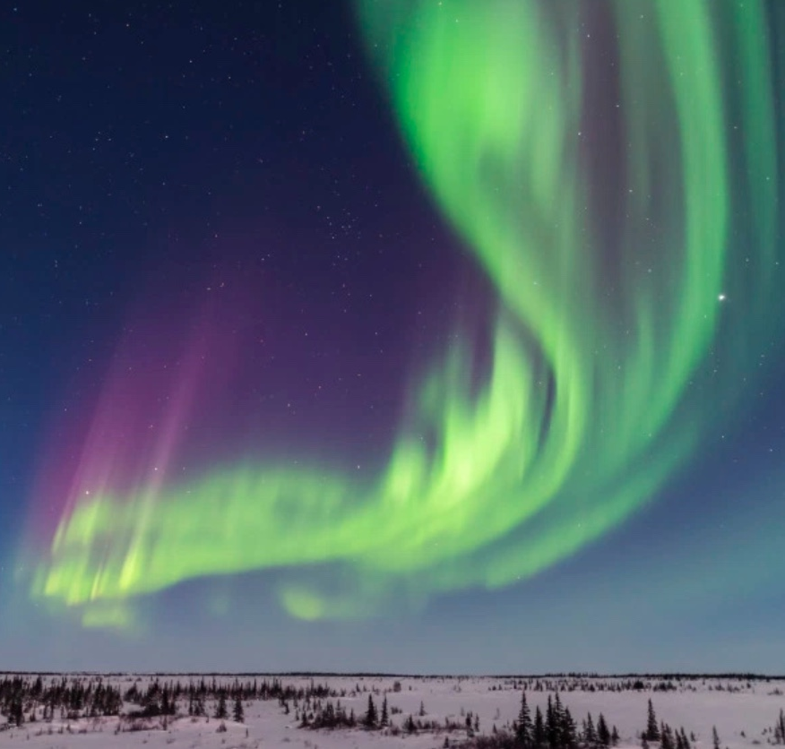
Development of NCAR WACCM-X
Hanli Liu NCAR/HAO
NCAR/HAO: Gang Lu, Astrid Maute, Joe McInerney, Nick Pedatella, Kevin Pham, Liying Qian, Art Richmond, Stan Solomon, Wenbin Wang
NCAR/ACOM: Chuck Bardeen, Rolando Garcia, Dan Marsh, Francis Vitt
NCAR/CGD: Peter Lauritzen, Steve Goldhaber
NCAR/CISL: Jeff Anderson, Kevin Raeder
NASA CCMC Workshop, 6-10 June 2022

Slide 2
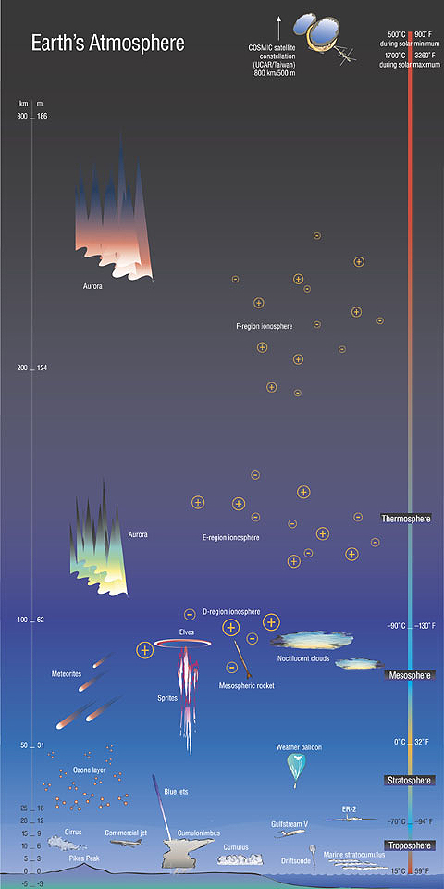
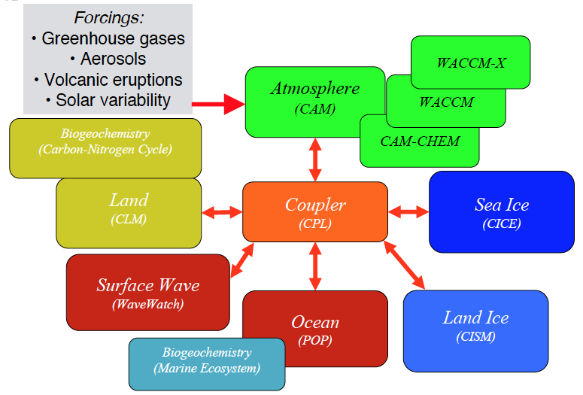
NCAR Community Earth System Model (CESM)
WACCM-X
WACCM
CESM Workshop in June: 800+ registrants (2021)
CAM
BGC
LAND
LAND ICE
OCEAN
SEA ICE

Slide 3
Solar,
Magnetospheric
WACCM-X Science Goals
Solar impacts on the Earth System.
Understand and quantify couplings between atmospheric layers through chemical, physical and dynamical processes.
Implications of the couplings to climate (downward coupling) and to space environment (upward coupling).
WACCM-X
WACCM
Meteorological
(waves,
transport)
Meteorological
(waves,
transport)
Meteorological
(waves,
transport)
CAM
BGC
LAND
LAND ICE
OCEAN
SEA ICE

Slide 4
Important Physical Properties
Deep: 10% of Earth radius, ~29 scale-heights, 10¹³ change in density from Earth surface to exobase.
Diffusive separation above the homopause.
Ion-neutral coupling
Different transport processes of neutral species and ionospheric plasma (oriented along magnetic field lines).
Coupling between dynamics and photochemistry.
Short temporal and spatial scales
Increasing significance of gravity waves and tides.
Large wind (~300m/s) and acoustic speed (~800m/s).
Geomagnetic storms and fine ionospheric structures.
Ionospheric irregularities.
Large molecular viscosity and diffusion (both vertically and horizontally).
Notes:
这些特性可能是熟知的，主要看一下对模式的要求。

Slide 5
Requirements for Model Formulation
Diffusive separation above the homopause: Species Dependent Dynamical Core.
Conservative and efficient computation of advective transport of large number of chemically active species.
Frequent mapping between dycore grid and geomagnetic grid.
Parameterization schemes that can accommodate short time steps (5 minutes or less).
Code design that is capable of subcycling and super-cycling.
Mesh refinement capability.
Efficient scaling for high-resolution simulations.
”Deep” capability: Nonhydrostatic, variable gravity, spherical geometry.

Slide 6
Major CESM WACCM-X Components
Model Framework | Chemistry | Neutral Atm. Physics | Ionosphere Physics | Resolution
 |  |  |  | Horizontal: Finite Volume: 1.9° x 2.5° 0.9° x 1.25° 0.47° x 0.625° (lat x lon configurable as needed) Spectral Element: NE16 (~200km) NE30 (~100km) NE60 (~50km) NE120 (~25km) Vertical: WACCM: 0-140km 66 levels WACCM-X: 0-~600km 130 levels 273 levels
Atmosphere component of NCAR Community Earth System Model (CESM) Extension of the NCAR Community Atmosphere Model (CAM) Finite Volume Dynamical Core (modified to consider species dependent Cp, R, m) Species Dependent Spectral Element Dynamical Core | MOZART+ Ion Chemistry (~80+ species) Fully-interactive with dynamics. | Long wave/short wave/EUV RRTMG IR cooling (LTE/non-LTE) Modal Aerosol (CARMA) Convection, precip., and cloud param. (CLUBB) Parameterized GW Major/minor species diffusion (+UBC) Horizontal/Vertical molecular viscosity and thermal conductivity (+UBC) Species dependent Cp, R, m. | Parameterized electric field at high latitude. IGRF geomagnetic field. Auroral processes, ion drag and Joule heating Ion/electron energy equations Ambipolar diffusion Ion/electron transport Ionospheric dynamo Coupling with plasmasphere, magnetosphere
Notes:
Red are recent development (CLUBB comes with CAM6 physics, it is for improved troposphere microphysics)

Slide 7
Key WACCM-X Capabilities
• Physics-based whole atmosphere general circulation model (0-600km)
• Solves dynamics, radiative transfer, photolysis and energetics
• Fully interactive chemistry, including ion chemistry.
• Ionospheric electrodynamics using fully interactive dynamo.
• Ion transport in the F-region.
• Magnetospheric inputs using empirical or specifications (AMIE, GAMERA).
• Meteorology can be constrained by reanalysis data (MERRA2).
1980-2017 on Climate Data Gateway (https://doi.org/10.26024/5b58-nc53)
• Whole atmosphere data assimilation for specification and forecast.
• High-resolution capabilities.
Notes:
A bit like ICON

Slide 8
Current/Future Development
Data Assimilation.
System for Integrated Modeling of Atmosphere (SIMA).
Spectral element dynamical core on a cubed sphere.
High resolution capability.
NASA DRIVE Center for Geomagnetic Storms (CGS): Part of the MAGE (Multiscale Atmosphere-Geospace Environment) Model Development.

Slide 9
Data Assimilation in WACCMX
Data assimilation capability implemented in WACCMX using the DART ensemble Kalman filter
Recently extended to include ionosphere-thermosphere observations
WACCMX+DART is the first whole atmosphere data assimilation model that is capable of assimilating observations from the surface to ~500 km
Used to assess the impact of new satellite missions (COSMIC2, NASA GOLD and ICON) on specifying and forecasting the space environment
Scientific applications:
Studies of middle-upper atmosphere variability due to the lower atmosphere and solar/geomagnetic activity
Predictability of the near-Earth space environment
Observations Assimilated in WACCMX
400
300
COSMIC GNSS RO EDP
Ground-based GNSS TEC
200
ICON/MIGHTI U, V
GOLD T_{disk}
Altitude (km)
100
Aura MLS T
50
TIMED/SABER T
Met Obs
0

Slide 10
Current Community Atmosphere Models
Existing Applications
System of Integrated Modeling of Atmosphere
sima.ucar.edu
Geospace Models
Weather (WRF & MPAS)
Weather
Existing
Applications
Chemistry (WRF-CHEM)
WACCM-X
Geospace
Climate
Chemistry
Climate (CAM)
Chemistry (WACCM/CAM-CHEM)

Slide 11
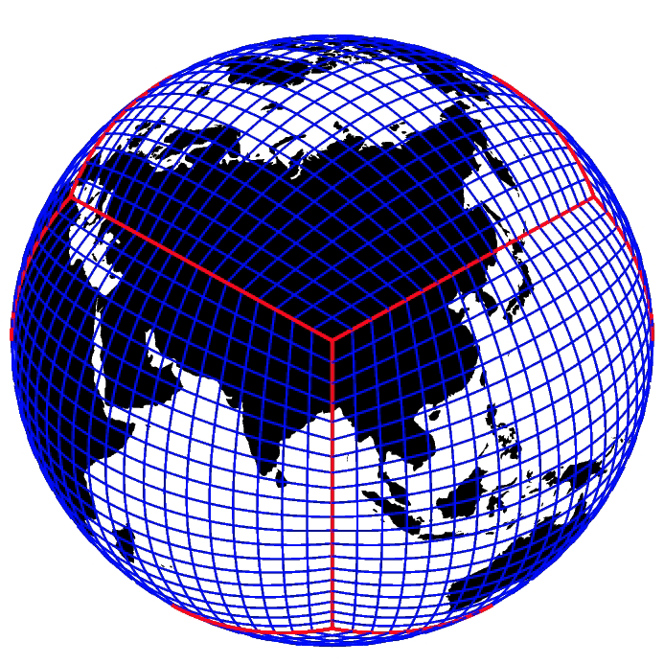
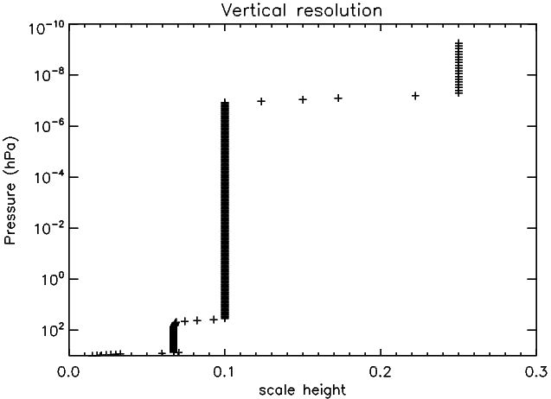
SIMA WACCM-X SE CSLAM
Neutral dynamics and physics
WACCM-X Species Dependent Spectral Element Dynamical core with CSLAM transport
Cubed sphere grid: No polar singularity or lost physics from filtering.
Molecular viscosity/diffusion in horizontal direction.
Regridding between physics mesh and geomagnetic grid.
Interactive ionospheric dynamo, transport, and energetics.
Planned to be part of CAM7/WACCMX-7
High-resolution Configuration: NE120/L273
NE120 horizontal resolution (~25 km)
L273: 0.1 scale height
No gravity wave parameterization used in NE120/L273

Slide 12
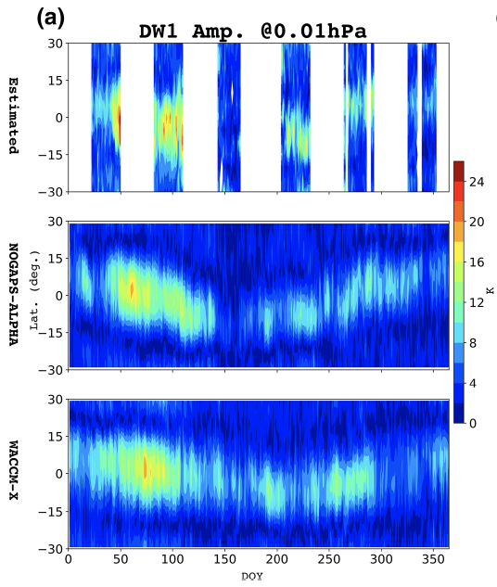
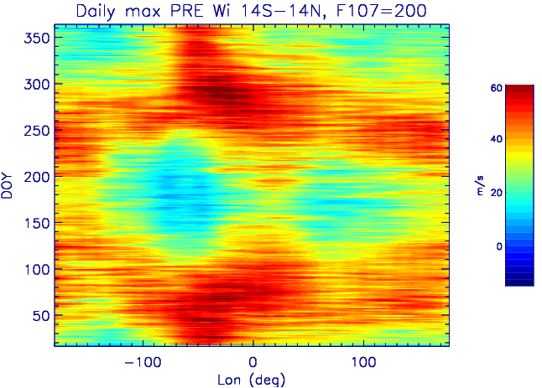
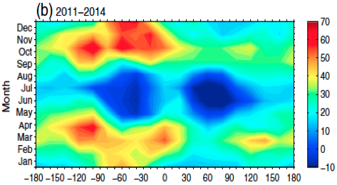
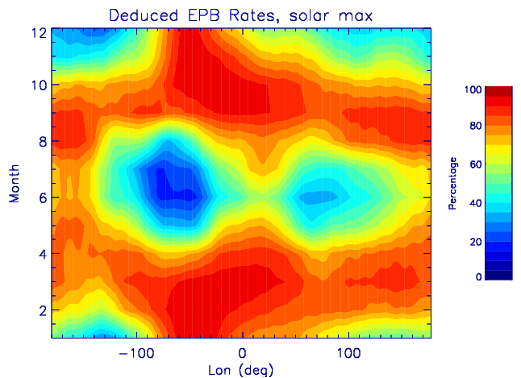
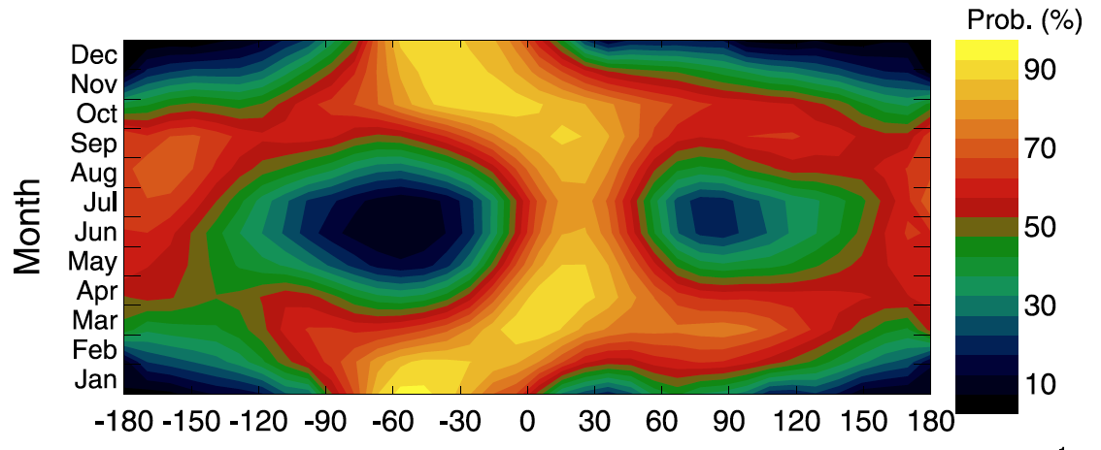
Upper Atmosphere Weather: Tides and PRE
Huang and Hairston, 2015
Kil et al., 2009
Wang et al. (2021)
Liu, 2020
Notes:
A couple of numerical experiment results

Slide 13
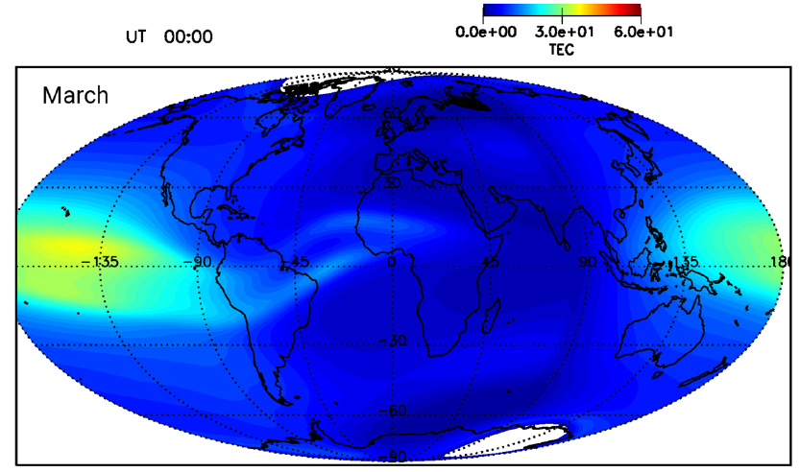
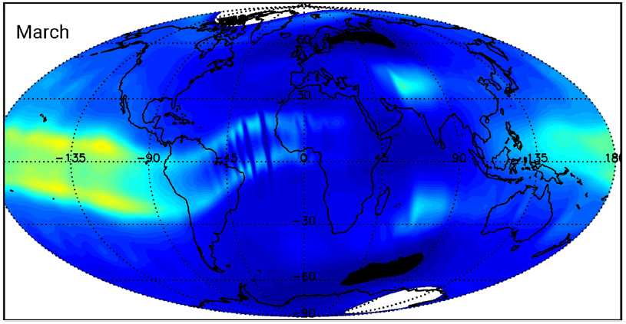
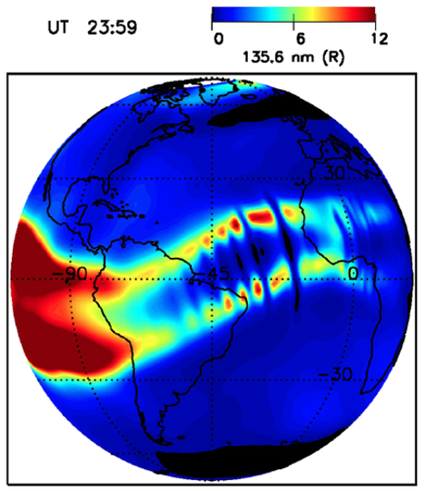
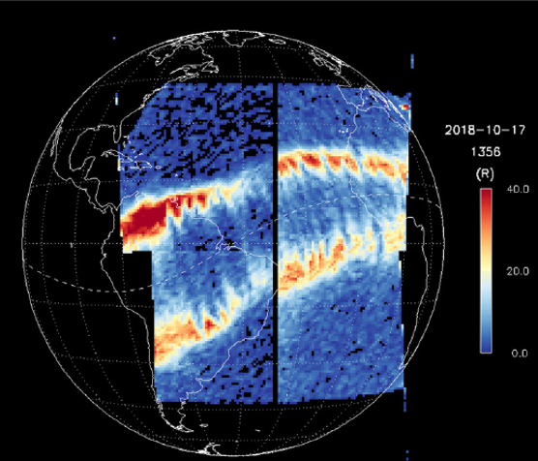
Thermosphere gravity wave and EPB:
w (m/s)
Huba and Liu, 2020
Eastes et al. 2019

