Slide 1
Thermosphere-Ionosphere Electrodynamics General Circulation Model
TIEGCM 2.5
Wenbin, Wang
High Altitude Observatory
National Center for Atmospheric Research
Notes:
.

Slide 2
From TIEGCM 2.0 to TIEGCM 2.5
 | TIEGCM 2.0 | TIEGCM 2.5
Horizontal Resolution | 5.0⁰ 2.5⁰ | 2.5⁰ 1.25⁰ 0.625⁰ | Resolve mesoscale structures
Vertical Resolution | ¼ scale height | ¼ scale height. 1/8 scale height 1/16 scale height | Simulate vertically layered structures
Top boundary | Pressure Level 7.0 (~500 km solar minimum ~700 km solar maximum) | Pressure Level 7.0 Pressure Level 9.0 Pressure Level 11.0 (~600-800 km solar minimum >1000 km solar maximum) | EIA Profile, ion-neutral coupling in the equatorial region
Topside photoelectron heating | Swartz & Nisbet, 1972 | Smithtro & Solomon, 2008 | LEO satellite drag
Helium | Included as a major species | Included as a major species
 |  | A component model of the coupled whole geospace model: CGS MAGE Model

Slide 3
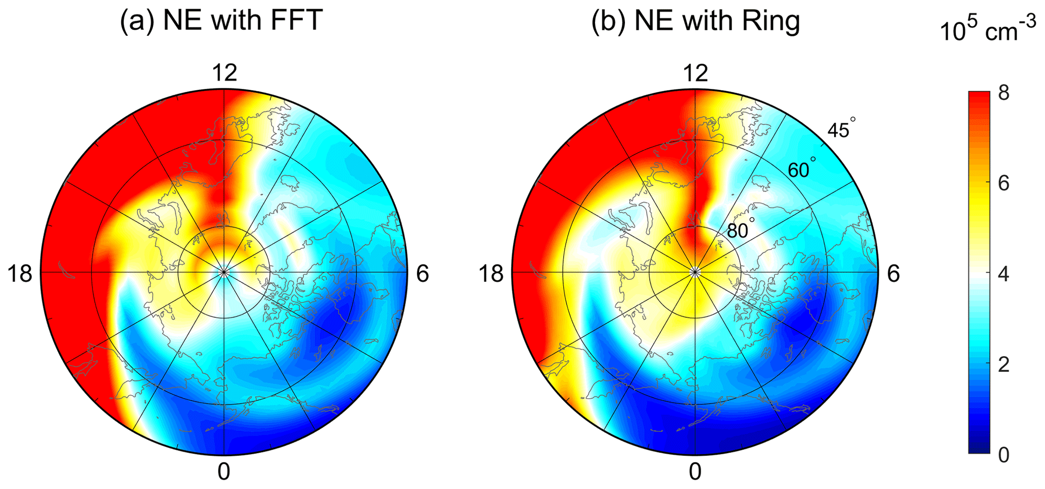
Horizontal Resolution
Replace FFT filtering with Ring-average
Also implemented in WACCM-X for O⁺ solver
Dang et al. (2021) Azimuthal averaging–reconstruction filtering techniques for finite-difference general circulation models in spherical geometry, Geosci. Model Dev., 14, 859–873. https://doi.org/10.5194/gmd-14-859-2021.

Slide 4
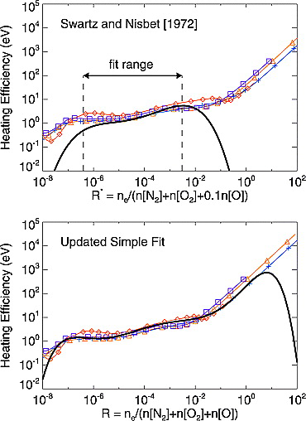
Thermal Electron Heating
Smithtro, C. G., and S. C. Solomon (2008), An improved parameterization of thermal electron heating by photoelectrons,with application to an X17 flare,J. Geophys. Res.,113, A08307, doi:10.1029/2008JA013077.

Slide 5
1. Not include H, H⁺, He⁺ 2. Basic assumption in the model Fluid approach

Slide 6
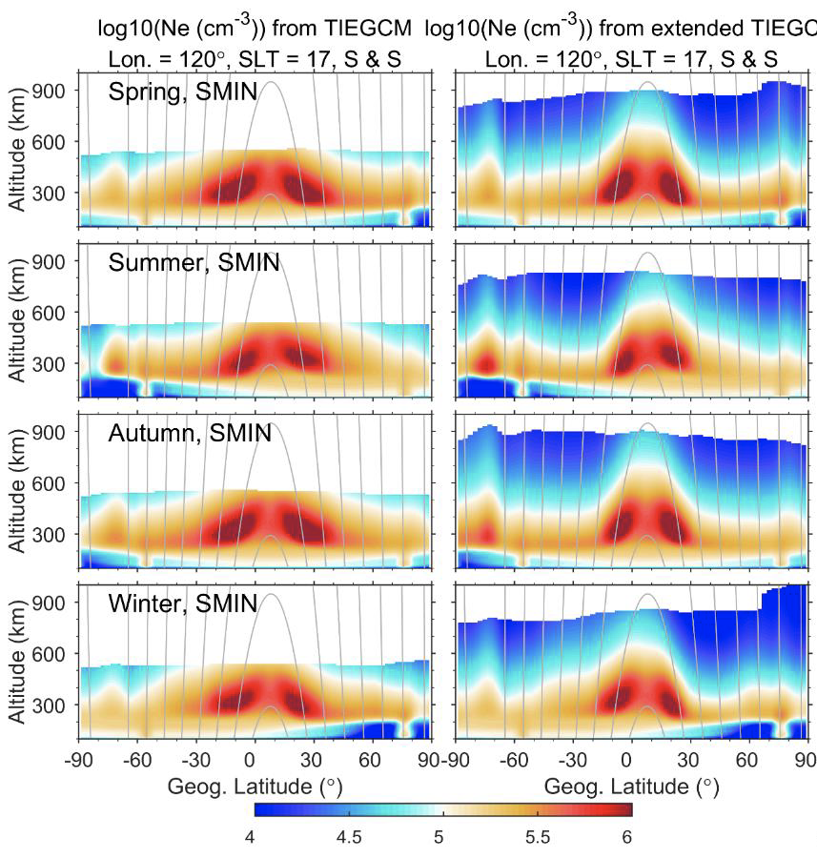
Solar Minimum
Solar Maximum

Slide 7
TIEGCM 2.5---- Comparison between observations and simulations: Topside Ne

Slide 8
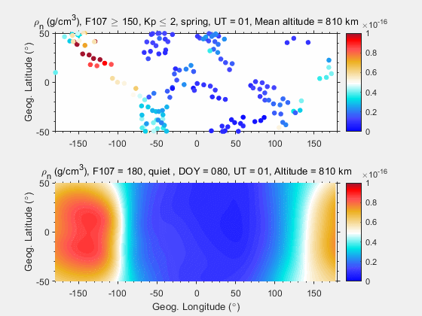
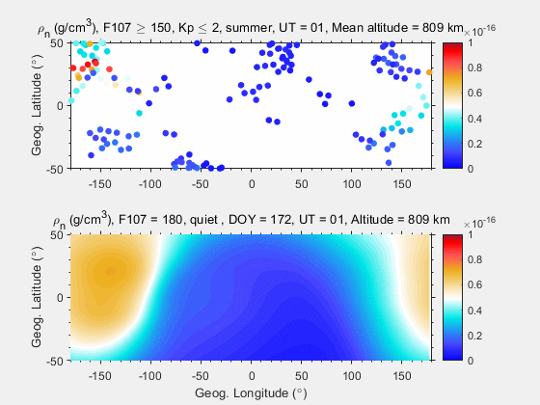
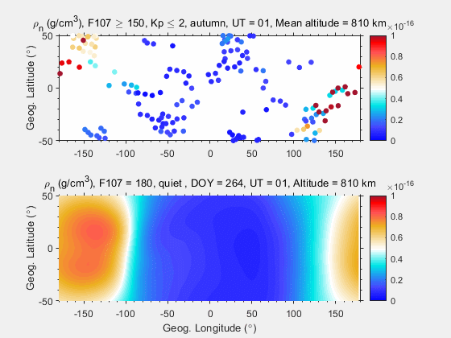
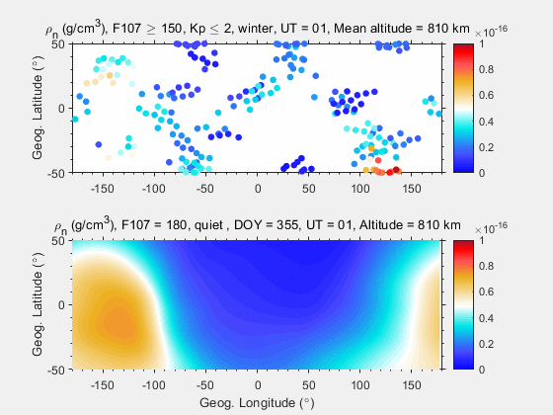
TIEGCM 2.5---- Comparison between observations and simulations: Neutral density

Slide 9
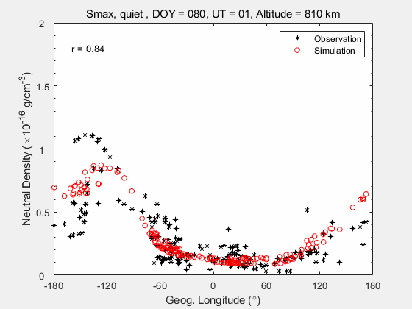
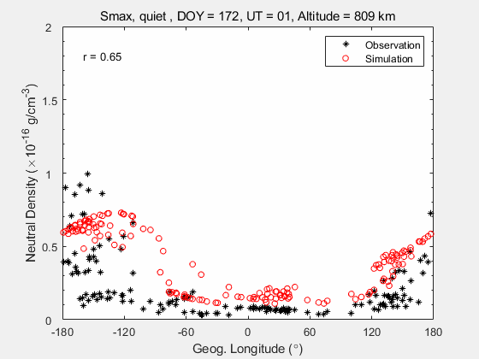
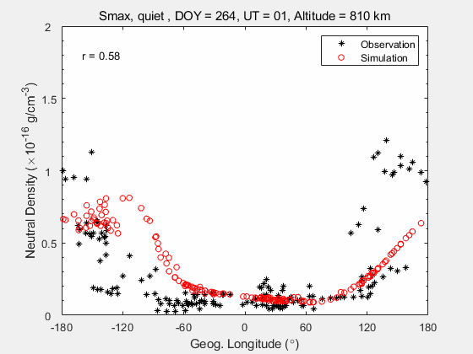
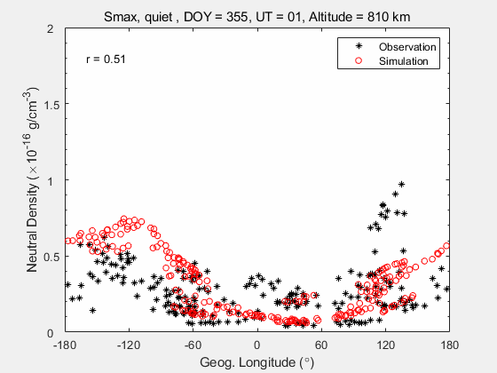
TIEGCM 2.5---- Comparison between observations and simulations: Neutral density

Slide 10
TIEGCM 2.5---- Comparison between observations and simulations

Slide 11
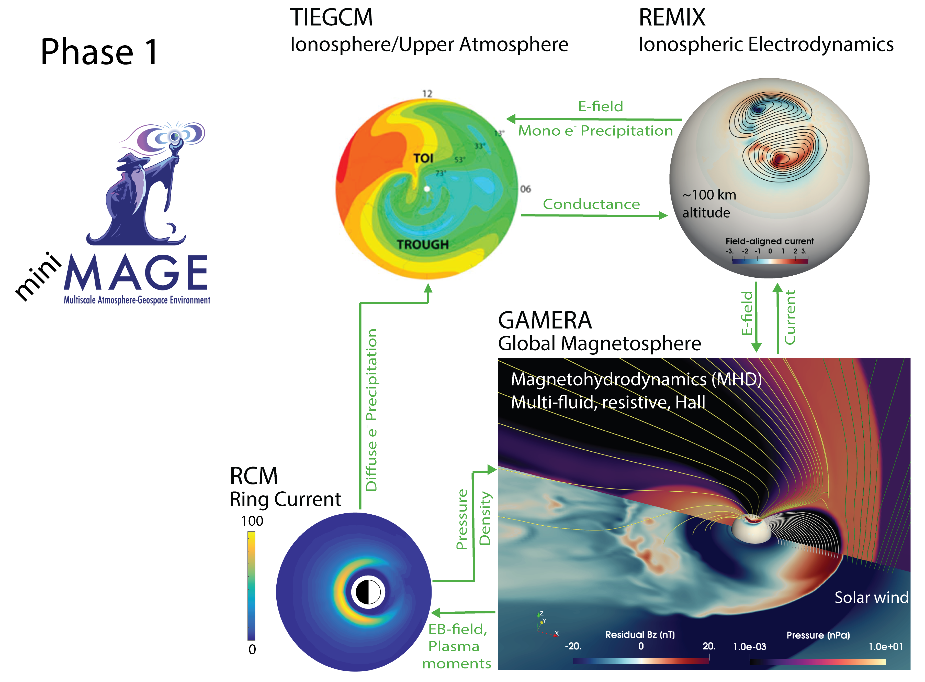
Grid Agnostic MHD for Extended Research Applications (GAMERA)
Spiritual successor to LFM
Complete rewrite of LFM from scratch using best practices
Incredibly efficient
GAMERA’s “quad” resolution runs real time compared to LFM’s 1:9 quad resolution
GAMERA has been run at “hex” resolution (~0.25° in ionosphere), which is 4x greater in every dimension than “quad”
Current highest resolution: 0.625° TIEGCM 0.25° REMIX/GAMERA For this study:
1.25° TIEGCM 1° REMIX
Notes:
Preliminary Low Resolution tests.
Mini-MAGE is capable of going to 0.625° for TIEGCM and 0.25° for GAMERA/REMIX.
Sorathia 2020 GRL has hex resolution. <30km in the auroral zone.

Slide 12
RMSE in % change: MAGE 16.2
DTM. 17.6
MSIS. 27.3

Slide 13
Summary
Installed on AWS and at CCMC
Enables a better simulation of ionospheric mesoscale structures and topside ionosphere
Provides specification of neutral density in the upper thermosphere
Coupled fully with the magnetospheric model GAMERA in the CGS MAGE
Further validation is critically needed

Slide 14
Electron density profiles during the Nov. 2003 super storm

Slide 15
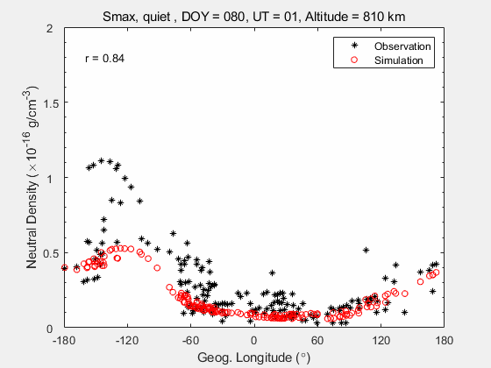
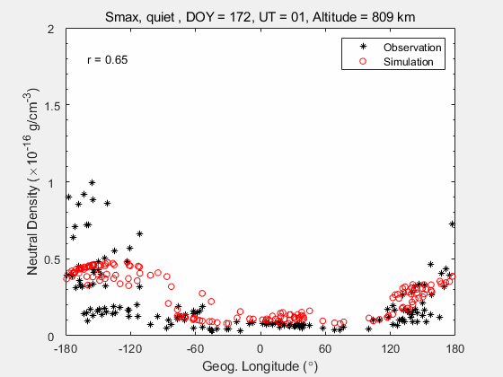
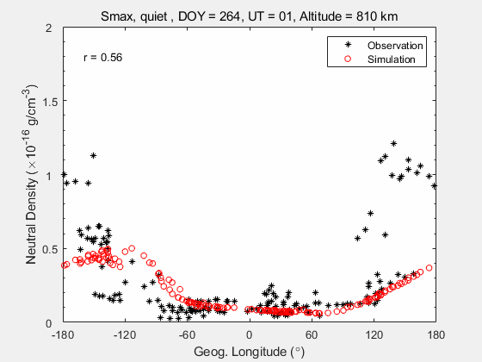
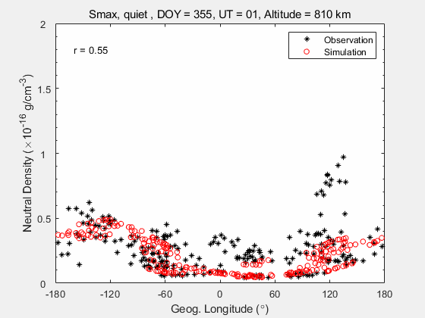
Altitue extension of TIEGCM —— Comparison of observations and simulations
With He, S&N

Slide 16
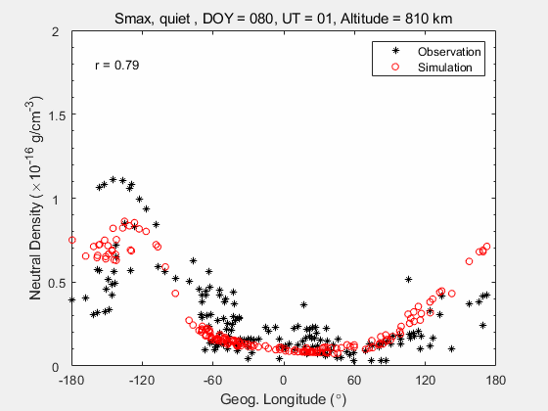
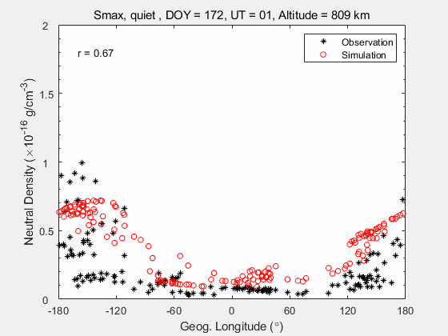
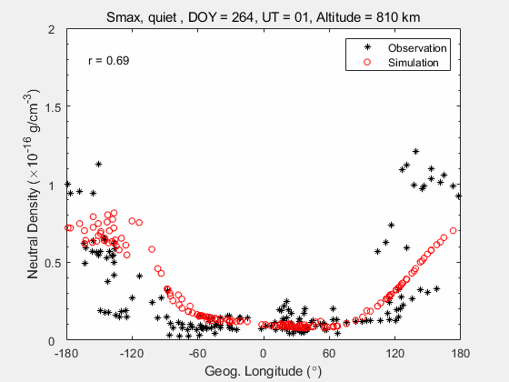
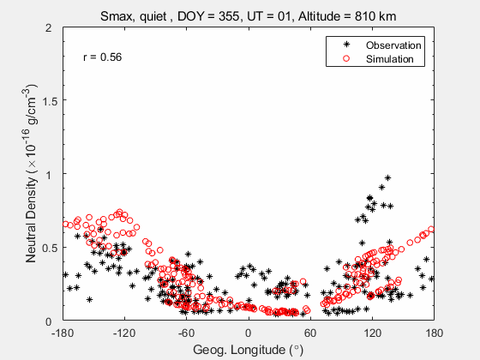
Altitue extension of TIEGCM —— Comparison of observations and simulations
No He, S&S

Slide 17
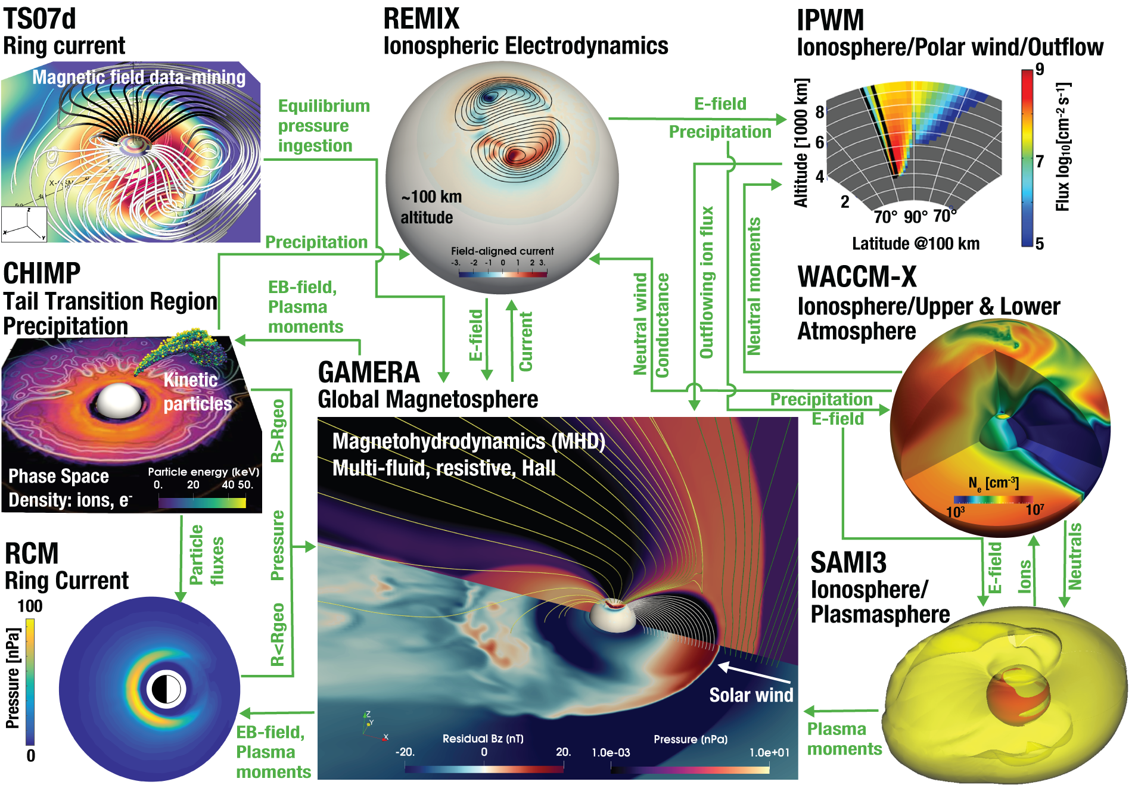
Multiscale Atmosphere-Geospace Environment (MAGE)
Notes:
Unified Community Integrated Model
deep learning concatenation of best in show geophysical modules

