Slide 1


The semi-empirical thermosphere model DTM2020
Sean Bruinsma
CNES, Space Geodesy Office
Toulouse, France
This project has received funding from the European Union’s Horizon 2020 research and innovation programme under grant agreement No 776287

Slide 2
Summary
THE DTM2020 MODELS
The DTM2013 model was updated using more and different accelerometer inferred densities, SwarmA, and TLE global mean densities at 250 km
Two models were constructed, as well as a model for the 1σ uncertainty:
  an ‘operational’ model: DTM2020_Oper
  a ‘research and operational’ model: DTM2020_Res
The CIRA and the new DTM2020 models were assessed by comparing to density data, also the recently released HASDM database was used as an independent validation
The DTM models, as well as the Whole Atmosphere Model MCM, are available on the SWAMI website and on Github:
http://swami-h2020.eu
Papers:
J. Space Weather Space Clim., https:/doi.org/10.1051/swsc/2021032
J. Space Weather Space Clim., https:/doi.org/10.1051/swsc/2021034

Slide 3
Two DTM2020 models:
THE DTM2020 MODELS
DTM2020 models are, compared with DTM2013, based on:
More & different data, different preprocessing (satellite model)
All data except GRACE were used without scale factors
Improved data correction and editing
Iterative and sequential model development
DTM2013:
F30 & Kp
‘old’ DB
DTM2019:
F30 & Kp
intermediate DB
“OPERATIONAL”: DTM2020_Oper
same algorithm as DTM2013
drivers: F10.7 & Kp
complete database
“RESEARCH”: DTM2020_Res
different Hp algorithm
drivers: F30 & Hp60
database 2000-2019
Intermediate:
F30 & Kp
Complete DB

Slide 4
Main density data used in the construction/validation of DTM2020
THE DTM2020 MODELS
Hi-Res accelerometer density observations, but very sparse:
Below 250 km
Above 500 km
For cycle max
(15 years)
Spectrometer data:
Eccentric orbits
Before EUV
No recent data
Biased

Slide 5
Main density data used in the construction/validation of DTM2020
THE DTM2020 MODELS
Thermosphere = 4D
Density data:
TUD instead of CNES
Smaller densities

Slide 6
Drivers: F10.7, F30
THE DTM2020 MODELS

Slide 7
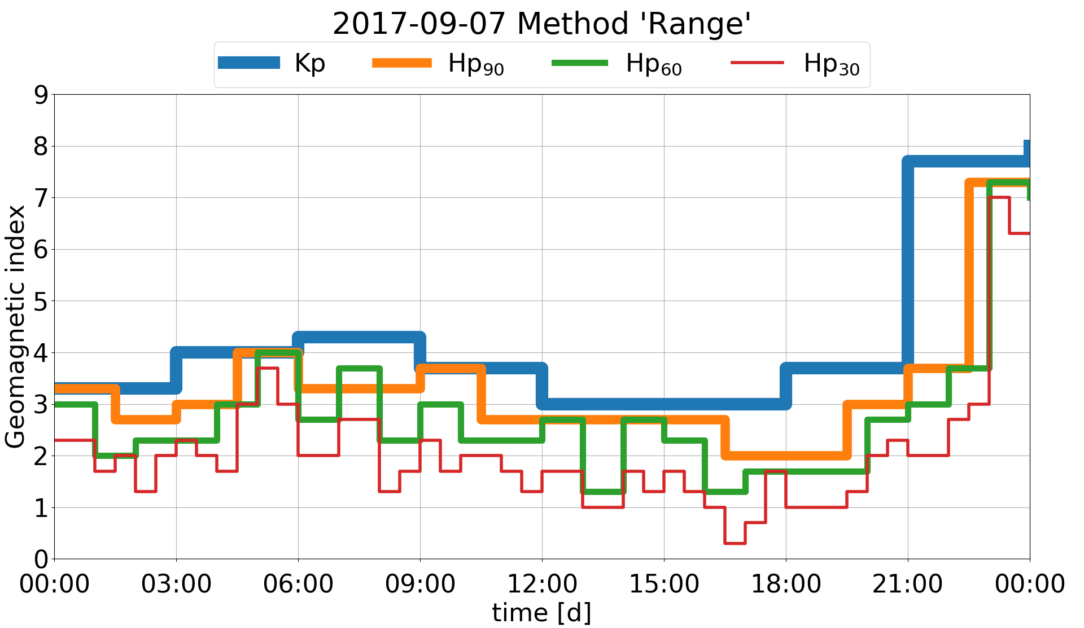
Drivers: F10.7, F30
THE DTM2020 MODELS
Drivers: F10.7, F30 & Kp, Hp

Slide 8
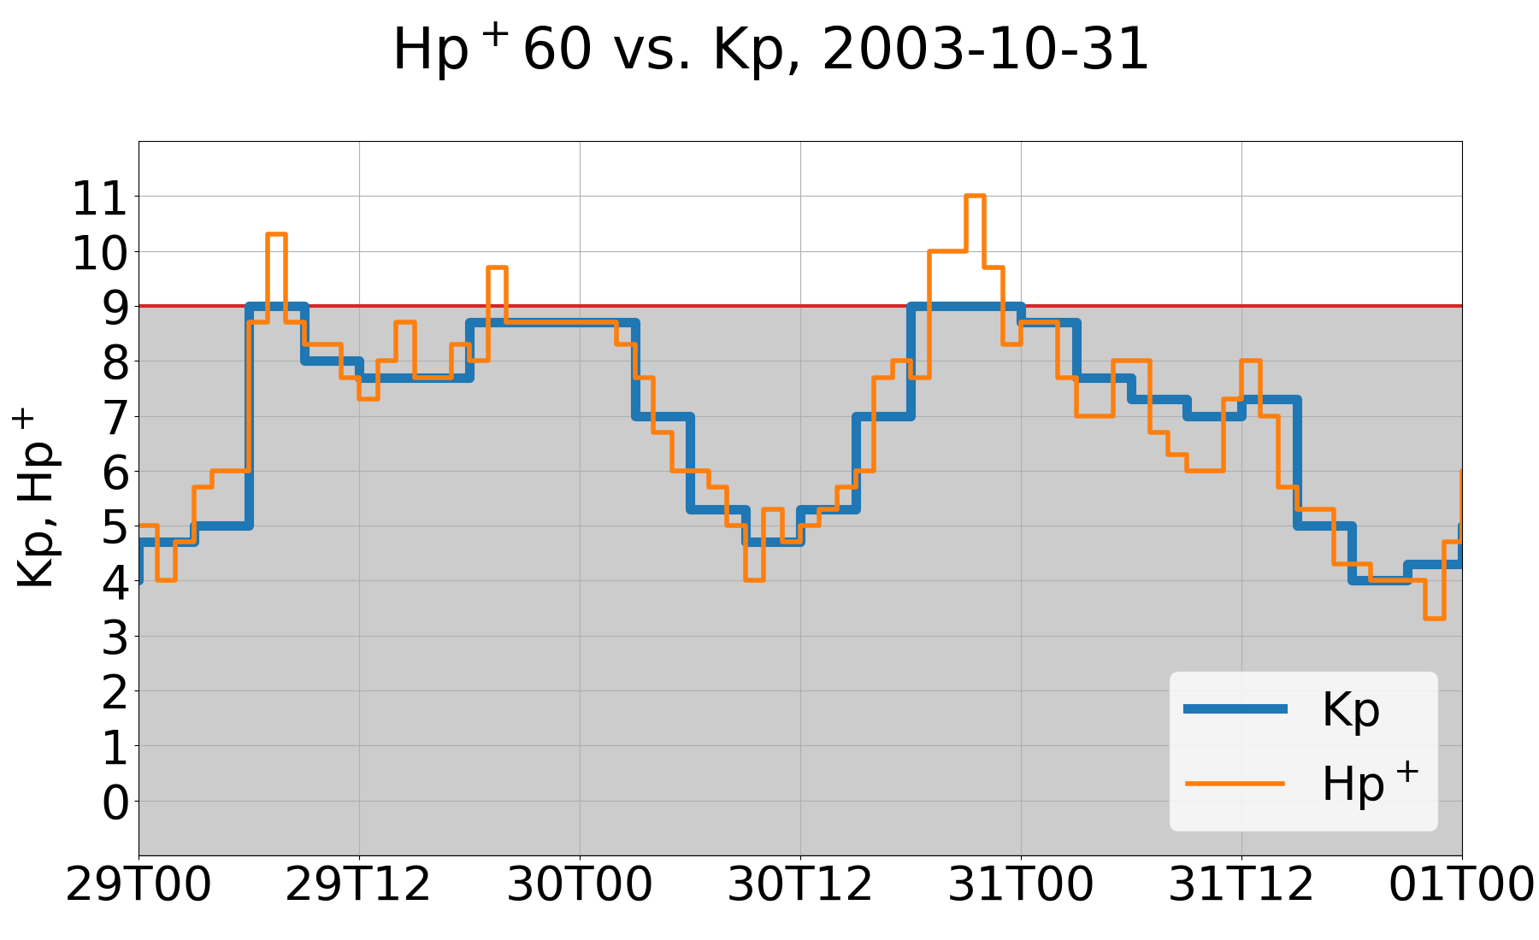
Drivers: F10.7, F30
THE DTM2020 MODELS
Drivers: F10.7, F30 & Kp, Hp

Slide 9
Assessment: complete datasets (mean density ratio Obs/Mod)
THE DTM2020 MODELS
ingested not used
 | GOCE | CHAMP | GRACE | SwarmA | Stella | TLE250 (‘00-’13) | HASDM 250 km | HASDM 400 km | HASDM 475 km | Starlette
MSIS00 | 0.82 | 0.69 | 0.75 | 0.89 | 0.86 | 0.94 | 0.95 | 0.87 | 0.83 | 0.90
DTM2013 | 0.79 | 0.76 | 0.76 | 0.76 | 0.76 | 0.93 | 0.95 | 0.95 | 0.90 | 0.78
JB2008 | 0.81 | 0.78 | 0.83 | 0.92 | 0.93 | 0.98 | 1.04 | 0.99 | 0.99 | 0.92
MSIS 2.0 | 0.95 | 0.79 | 0.80 | 0.99 | 0.85 | 1.06 | 1.10 | 0.97 | 0.92 | 0.90
DTM2020_Oper | 0.99 | 0.98 | 1.04 | 1.13 | 1.01 | 1.14 | 1.17 | 1.26 | 1.21 | 1.04
DTM2020_Res | 1.00 | 0.98 | 0.99 | 1.00 | 0.97 | 1.17 | 1.23 | 1.25 | 120 | 1.01
Courtesy of the SET HASDM Database
DTM2020: 20-30% smaller than DTM2013
MSIS 2.0: 10-20% smaller than MSIS00

Slide 10
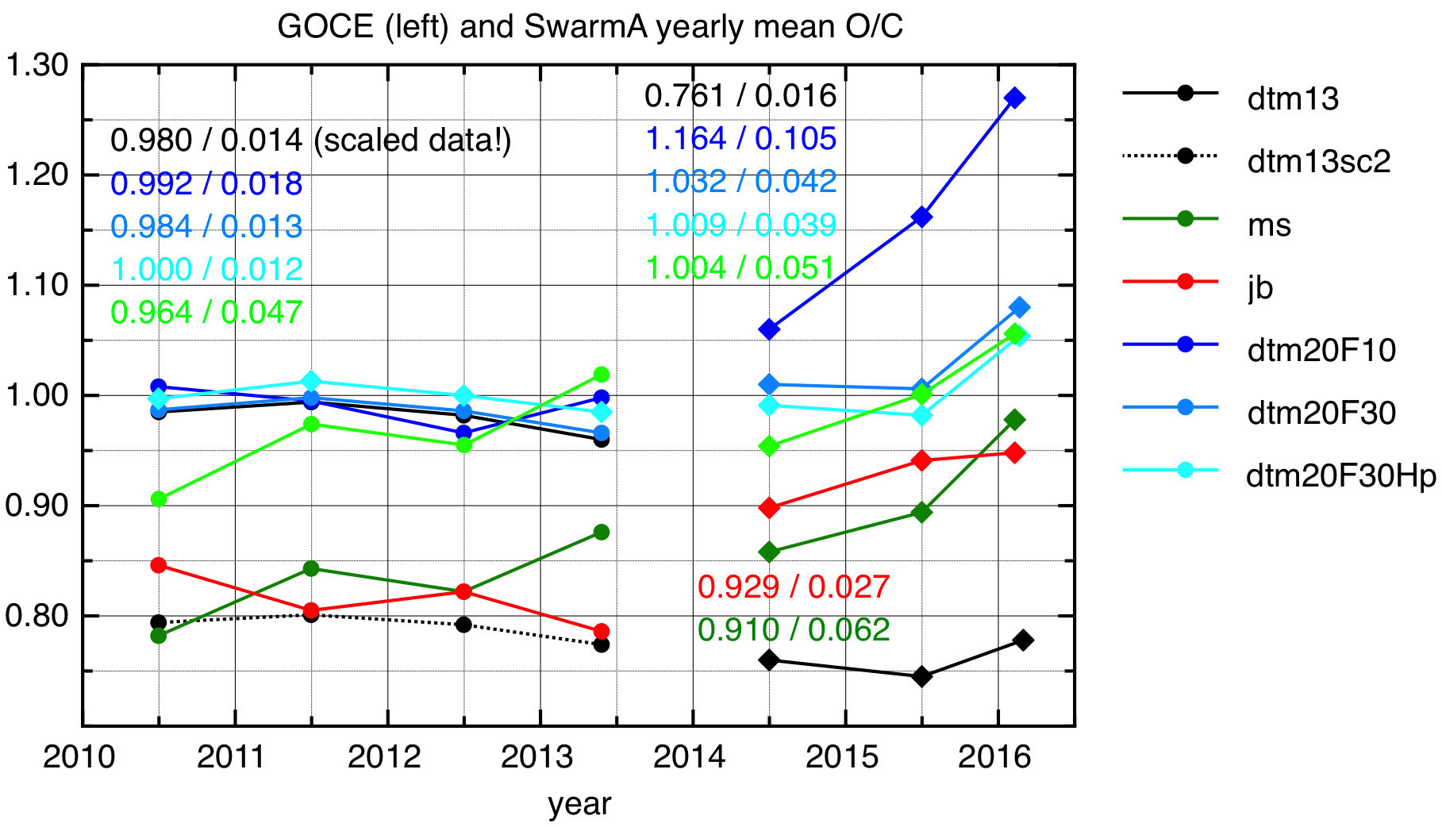
GOCE & SwarmA: yearly means
THE DTM2020 MODELS

Slide 11
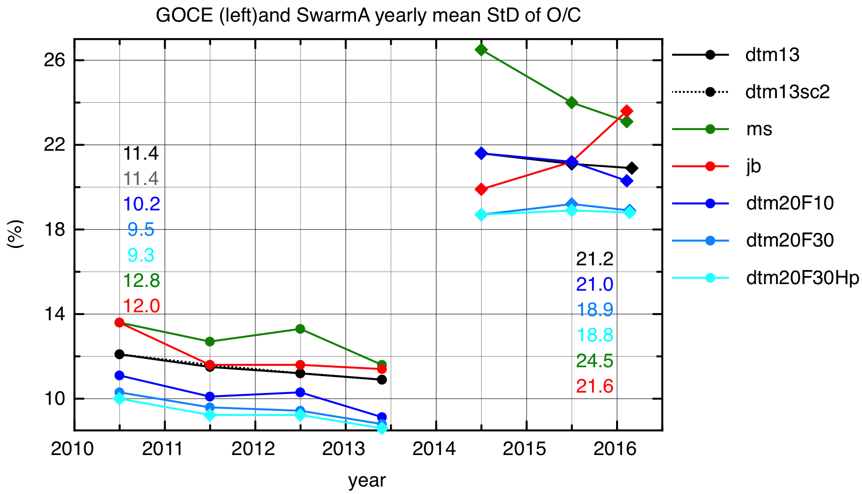
GOCE & SwarmA: yearly means
THE DTM2020 MODELS

Slide 12
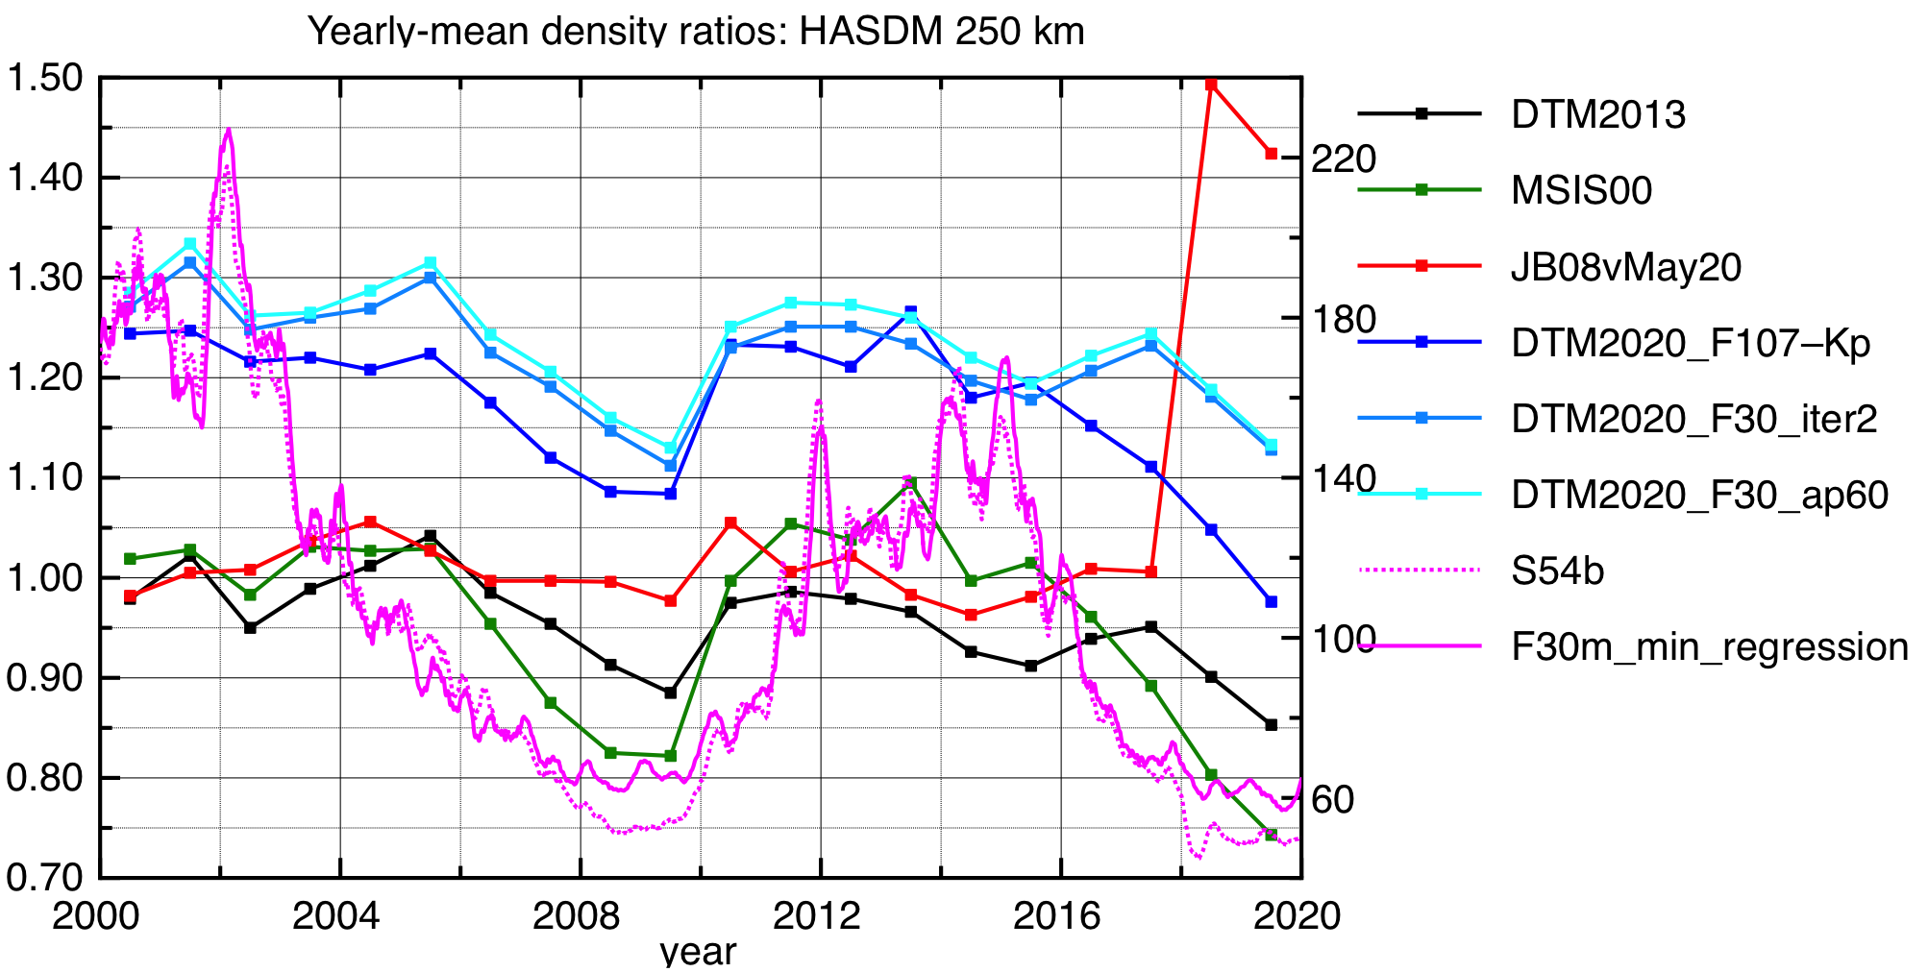
HASDM 250 km: yearly means - external validation
THE DTM2020 MODELS
0.96 / 5.1%
1.04 / 12.4%
1.01 / 2.6% (w/o ‘18&’19)
1.17 / 7.0%
1.24 / 4.7%
Courtesy of the SET HASDM Database

Slide 13
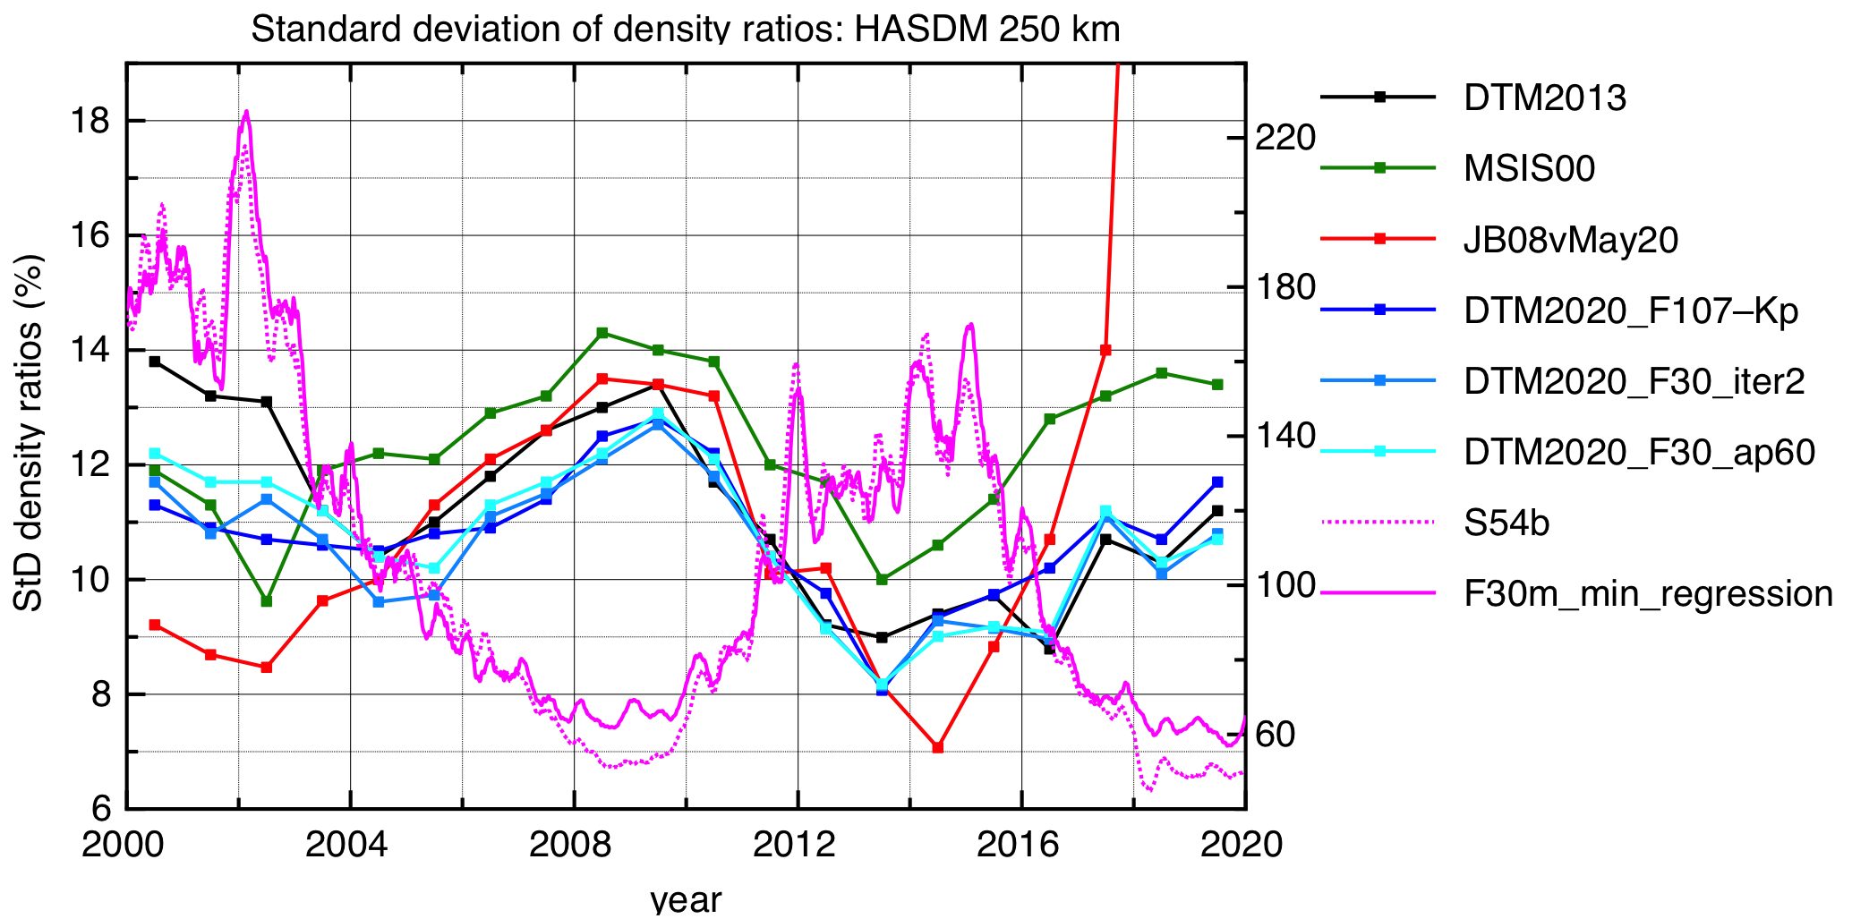
HASDM 250 km: yearly means - external validation
THE DTM2020 MODELS
0.96 / 5.1%
1.04 / 12.4%
1.01 / 2.6% (w/o ‘18&’19)
1.17 / 7.0%
1.24 / 4.7%
Courtesy of the SET HASDM Database

Slide 14
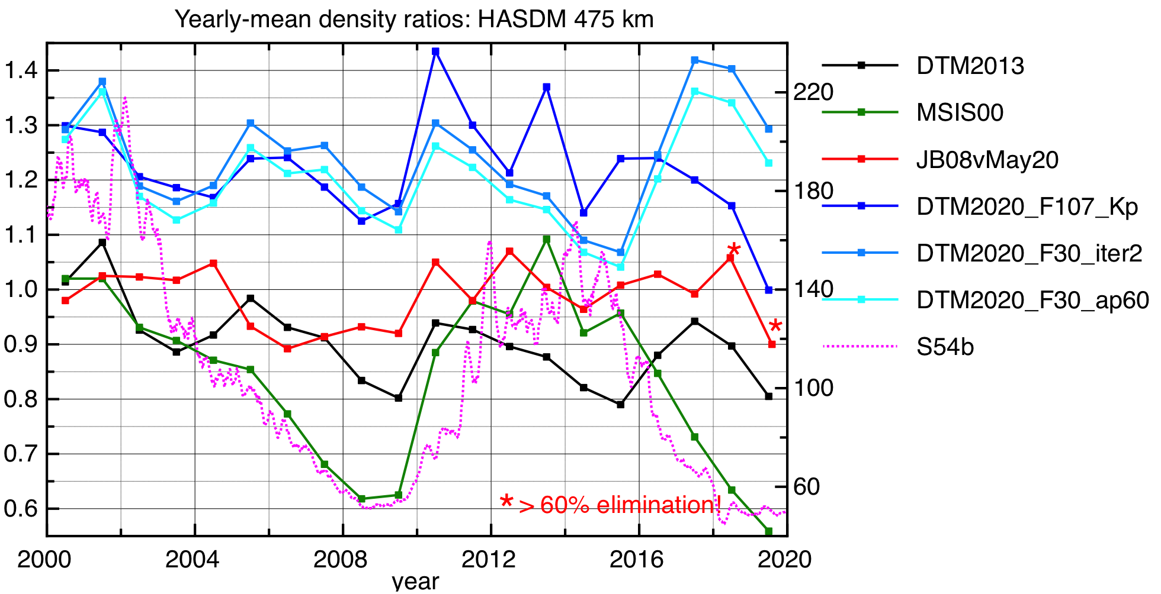
HASDM 475 km: yearly means - external validation
THE DTM2020 MODELS
0.90 / 8.3%
0.99 / 5.9%* >60% elim
1.22 / 8.0%
1.20 / 7.7%
Courtesy of the SET HASDM Database

Slide 15
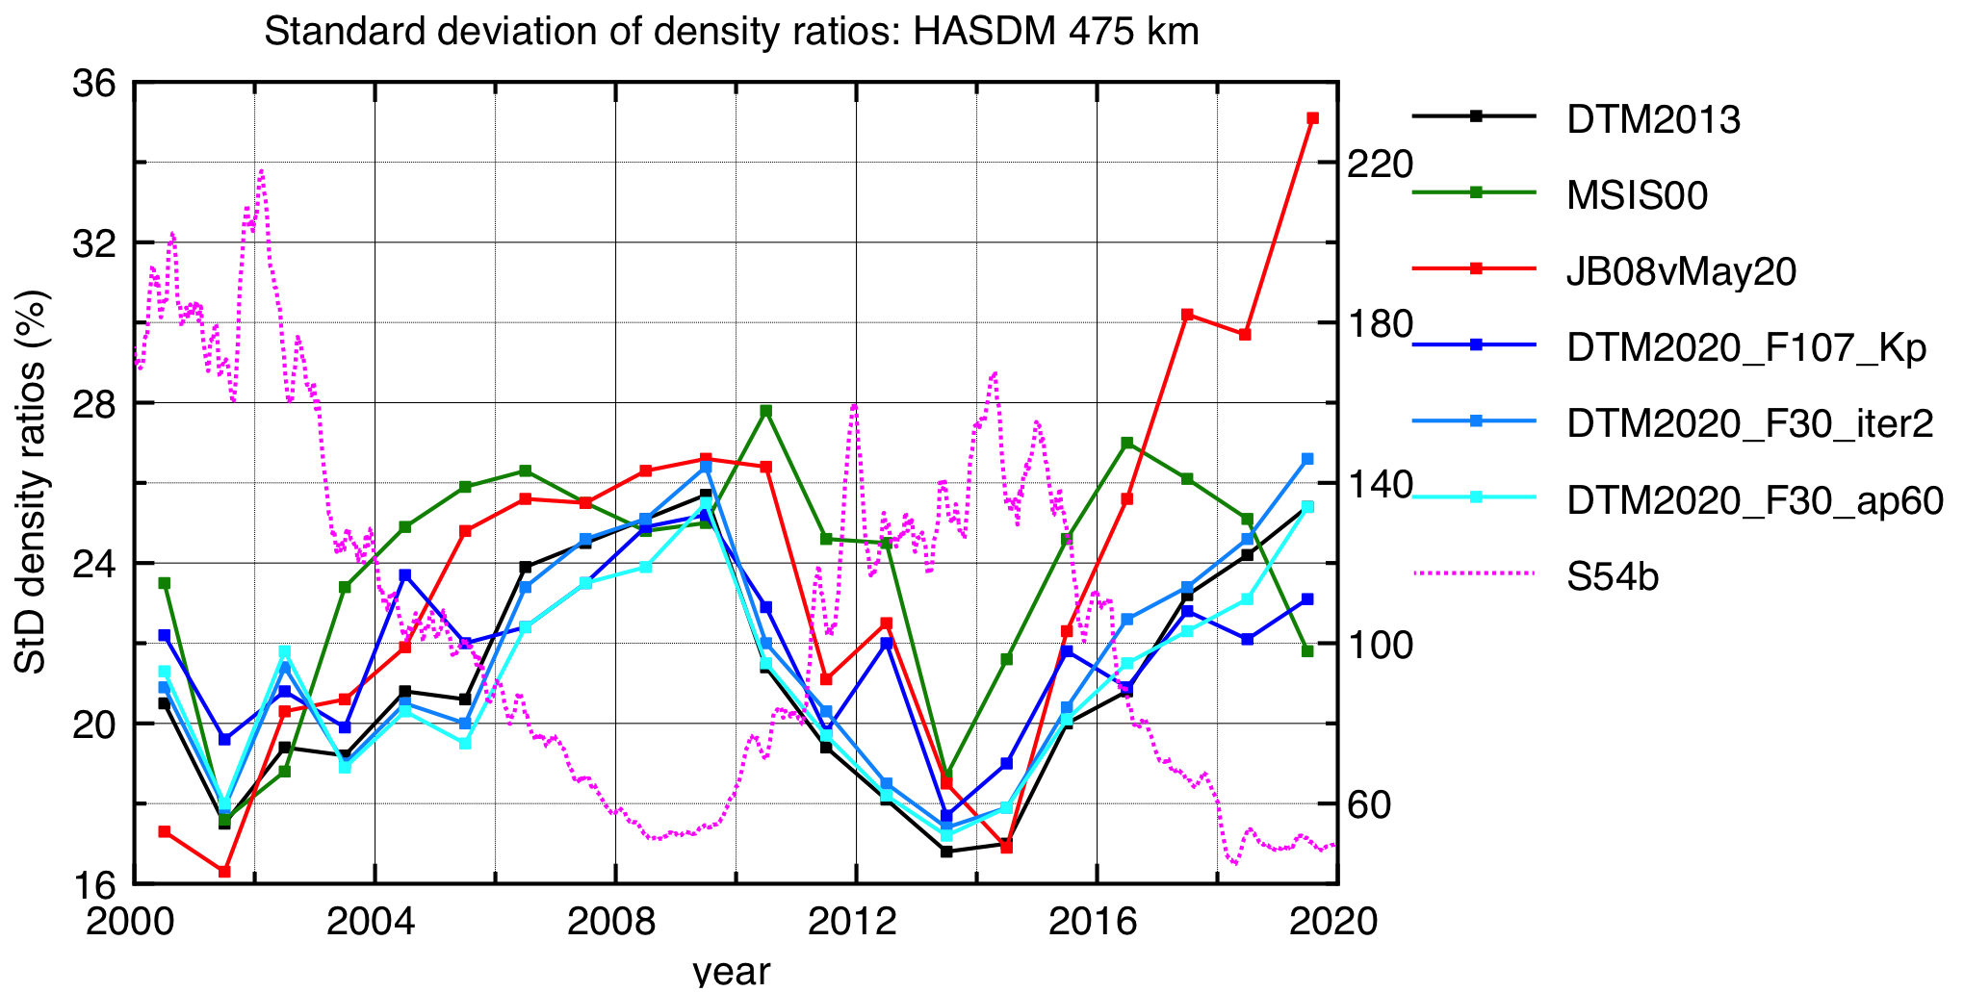
HASDM 475 km: yearly means - external validation
THE DTM2020 MODELS
0.90 / 8.3%
0.99 / 5.9%* >60% elim
1.22 / 8.0%
1.20 / 7.7%
Courtesy of the SET HASDM Database

Slide 16
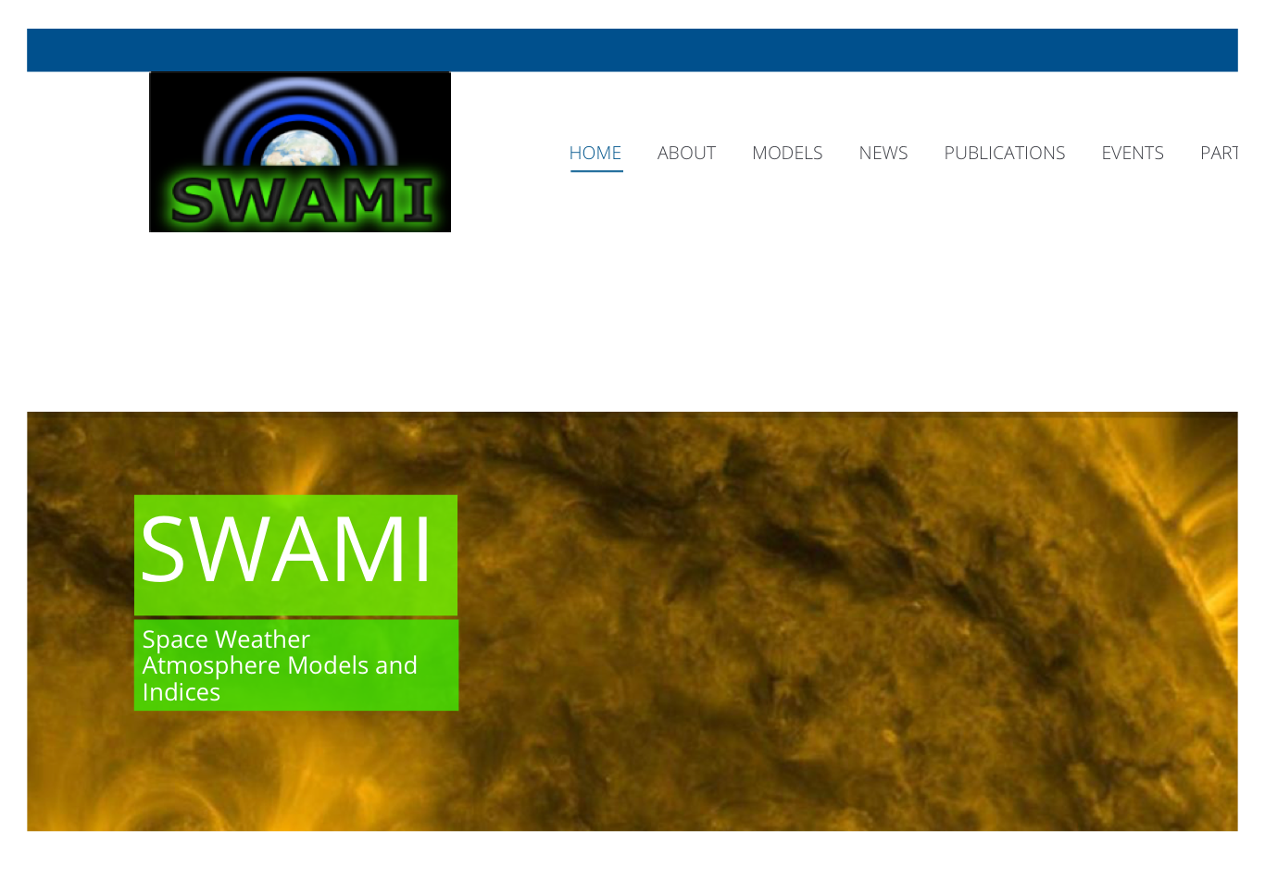
Take home message: improved DTM (and MCM) models available
THE DTM2020 MODELS
Fitted to TUD densities without scaling
Densities are 20-30% smaller
StD smaller, correlations higher
But:
Relatively sparse data, uneven distribution
And:
Model is improved, not driver predictions
F30 solar proxy:
https://spaceweather.cls.fr/services/radioflux/
Hp geomagnetic index:
ftp://ftp.gfz-potsdam.de/pub/home/obs/Hpo
http://swami-h2020.eu

