Slide 1
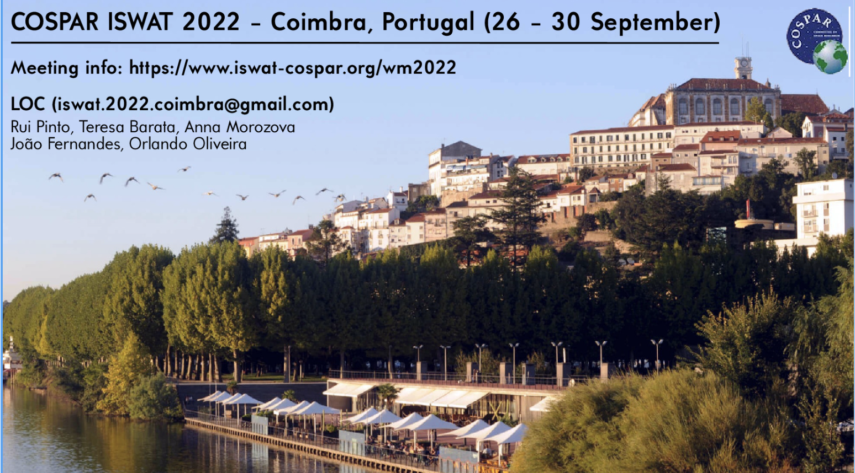
International Space Weather Actions Teams
ISWAT 3rd Working Meeting (in-person)
Coimbra University, Portugal. September 26 – 30, 2022
https://www.iswat-cospar.org/wm2022
Early Bird Registration Deadline (200 Euro): July 31, 2022
Outcome-focused working meeting self-organized by ISWAT Cluster Moderators, Team Leads & Participants
The ISWAT initiative is a global hub addressing challenges across the field of space weather

