Slide 1
Conductance Models in CCMC SWMF v2021
Zihan Wang (wzihan@umich.edu), Shasha Zou
CLaSP, University of Michigan
Mostafa El-Alaoui, Masha Kuznetsova, Katherine Garcia-Sage, Lutz Rastaetter
CCMC GSFC
Notes:
Hello everyone, my name is Zihan Wang. I am a postdoc at University of Michigan. Today, I will give an update about the conductance models available at CCMC SWMF.

Slide 2
Outline
COMPASS: a new COnductance Model based on PFISR And SWARM Satellite observations
Empirical Conductance models available at CCMC SWMF

Slide 3
Motivation
Develop a new conductance model to improve the ionospheric electrodynamic (IE) module within the Space Weather Modeling Framework (SWMF).
Conductance=f(FAC, MLT, …)
Previous: FAC and conductance are both based on AMIE inversion technique.
Now: FAC and conductance are from simultaneous observations from SWARM and PFISR.
Wang, Z., & Zou, S. (2022). COMPASS: A new COnductance Model based on PFISR And SWARM Satellite observations. Space Weather, 20, e2021SW002958. https://doi.org/10.1029/2021SW002958
Notes:
Conductance provides the boundary conditions for MHD. Because it is hard for MHD simulations to provide an accurate estimates of the precipitation, conductance is usually specified by FACs with an empirical model.
Previously, in SWMF, … Because simultaneous observations of conductance and FACs are usually unavailable.
But now, …, we plan to update the conductance model in SWMF

Slide 4
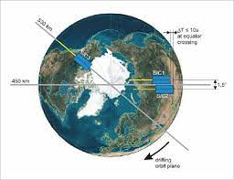
Build the dataset
FACs are from SWARM.
Conductances are calculated using electron densities from PFISR.
Definition of conjunctions between PFISR and SWARM: Δlon<4°, Δlat<0.075°
Conjunctions between 2014 and 2020: ~3900
PFISR
SWARM
Data source: https://amisr.com/amisr/ and https://vires.services/
Notes:
Newt, I will introduce you we built the dataset. The FACs are from. The conductances are from. When SWARM satellite flies over the field-aligned beam of PFISR, we call it a conjunction. This kind of conjunction can provide both accurate FACs and conductances. The definition of conjunctions is … Between 2014 and 2020, there are 3900 conjunctions.
Mesoscale

Slide 5
Overview of all conjunctions
There is a power law relationship between FACs (both upward and downward) and conductance.
Notes:
Here is an overview of all conjunctions in this dataset. Note that the FACs and conductances are in log scale. There is a power law relationship between FACs and conductances.

Slide 6
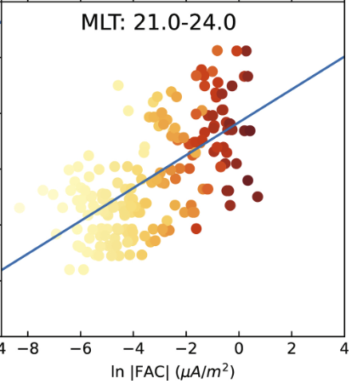
Fitting Technique
Weighted Least Square is used to fit:
$Σ_{P or H}=c{|J_{//}|}^{a}$,
where a and c are parameters depending on MLT and polarity of FAC.
More weights are given to larger FAC and conductance.
Notes:
Then we bin all data by the MLT and use least square fitting to get the parameters in the power law relationship. These parameters depend on both MLT and polarity of FAC.

Slide 7
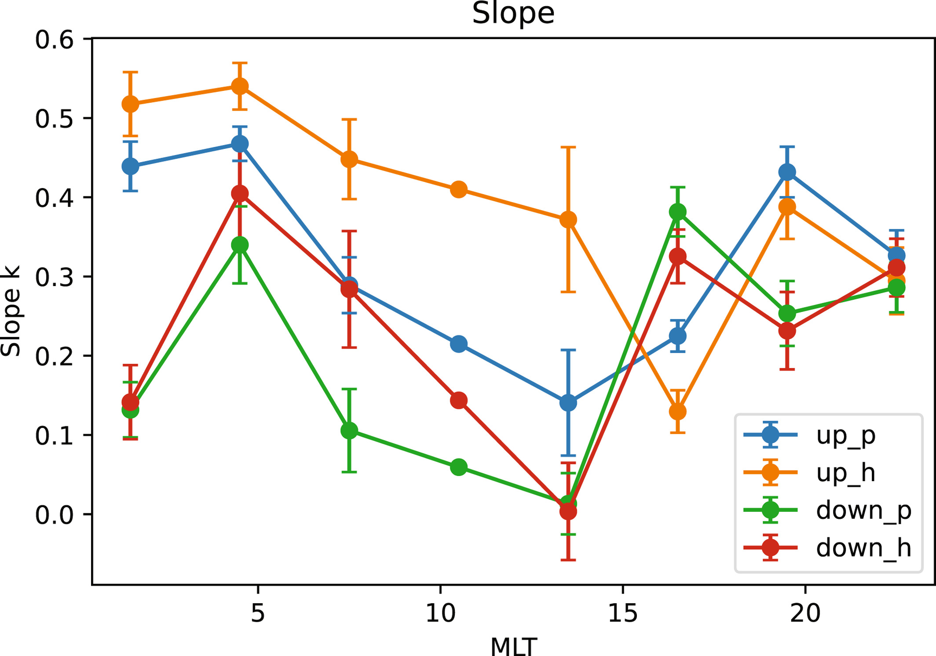
Discussions: MLT dependence of fitting parameters
Dayside v.s. nightside
Slopes are larger on the nightside.
Larger average energy of precipitation electrons on the nightside, producing larger conductance, even if FACs are the same.

Slide 8
Discussions: MLT dependence of fitting parameters
Upward vs downward FACs:
The slopes of upward FACs are larger, except dusk side. Downward FACs are carried by proton precipitation on the dusk side.
Notes:
Protons also have higher energy.

Slide 9
Discussions: MLT dependence of fitting parameters
Hall vs Pedersen:
The slopes of Hall conductance are larger than those for Pedersen, except dusk side.
All features agree with previous findings.
Notes:
Pedersen is larger than Hall on the dusk side: the average energy of precipitating electrons is lower on the dusk side than that on the dawn side or by the fact that the proton precipitations contribute more to the Pedersen conductance due to proton beam spreading and thus stopping at higher altitudes.
Lower average energy of precipitating electrons or proton beam spreading.

Slide 10
Takeaways
Conductance varies as a power of FACs, and the power indices for different MLTs are between 0 and 0.6.
Both upward and downward FACs are positively correlated with both Hall and Pedersen conductances.
Power indices are larger on the nightside.
The slopes of upward FACs are larger than downward FACs, except dusk side.
The slopes of Hall conductance are larger than those of Pedersen, except dusk side.

Slide 11
Outline
COMPASS: a new COnductance Model based on PFISR And SWARM Satellite observations
New conductance models available in CCMC SWMF v2021

Slide 12
FAC-driven Model List
Ridley Legacy Model (Ridley et al, 2004)
Conductance Model for Extreme Events (Mukhopadhyay et al, 2020)
ADELPHI (Robinson et al, 2020)
COMPASS (Wang et al, 2022)
FAC-driven conductance is later combined with conductance driven by F10.7.

Slide 13
Ridley Legacy Model (RLM)
Inverse-exponential
A₀, A₁, A₂ depend on MLT, MLAT, and direction of FAC. $J_{//}$ and $Σ$ are from AMIE.
Conductance Model for Extreme Events (CMEE)
The formula is same as RLM. CMEE uses AMIE data in 2003, while RLM used AMIE data in January 1997, a relatively quiet month.

Slide 14
ADELPHI
$Σ_{P or H}=b+k|J_{//}|$,
k and b are parameters depending on MLT and polarity of FAC.
$J_{//}$ are from AMPERE and $Σ$ are from PFISR. During storm time.
COMPASS
$Σ_{P or H}=c{|J_{//}|}^{a}$,
a and c are parameters depending on MLT and polarity of FAC.
$J_{//}$ are from SWARM and $Σ$ are from PFISR.
Notes:
Now, we use ordinary least square fitting to get the parameters in the power law relationship. These parameters depend on both MLT and polarity of FAC.

Slide 15
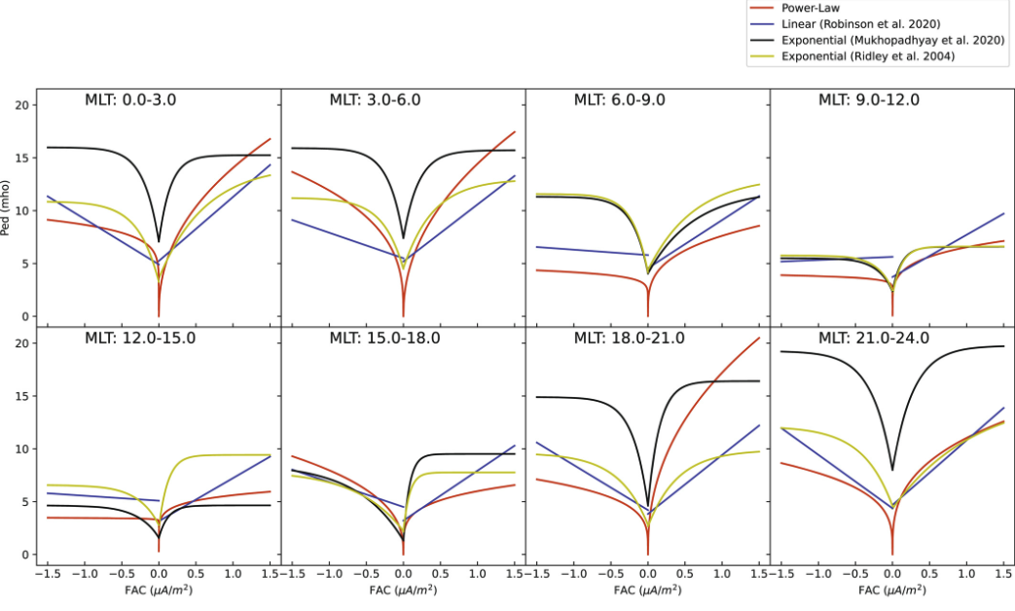
At MLAT=66 degrees, positive means upward FACs.
Ped
Notes:
Similarity: Both upward and downward FACs can increase conductance.

Slide 16
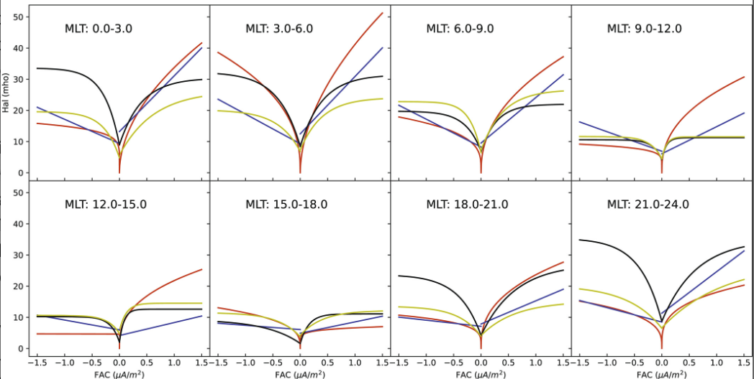
Hall
Notes:
Both the power-law and linear functions predict higher conductance for larger FACs, while the two exponential functions predict conductance saturation when the magnitudes of FACs exceed about 0.5 μA/m².
Due to the different choices of functional forms, the differences among these models increase for larger FACs, for example, during intense or super storms.

Slide 17
Due to the different choices of functional forms, the differences among these models increase for larger FACs, for example, during intense or super storms.
Assessment efforts on their performances and impacts are underway.
A diverse set of conductance models offer ensemble forecast opportunity with uncertainty quantification.

Slide 18
Bonus: A more flexible constant conductance model
Northern and Southern hemisphere can have different constant conductance.
e.g., $Σ_{P}=5S$ in the northern hemisphere, and $Σ_{P}=1S$ in the southern hemisphere.

Slide 19
Takeaways
More conductance models will be/are available in SWMF Run on Request at CCMC.
Ridley Legacy Model (Ridley et al, 2004)
COMPASS. (Wang et al, 2022)
Conductance Model for Extreme Events (Mukhopadhyay et al, 2020).
ADELPHI (Robinson et al, 2020).
A more flexible constant conductance model. Should be good to study hemispheric asymmetry.

