Slide 1
Geomagnetic storm statistics: SWMF Geospace simulation perspective
Tuija Pulkkinen, University of Michigan, Ann Arbor
Thanks to: Qusai Al Shidi, Austin Brenner

Slide 2
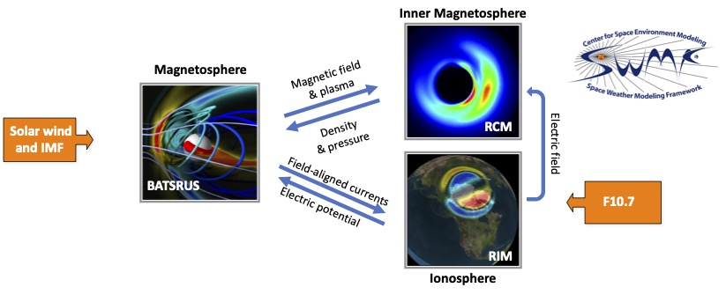
Outline
Creating storm simulation statistics for CCMC
Standardized Space Weather Modeling Framework (SWMF) setup
Current status:
Ionospheric output,
2D cuts noon-midnight &
equatorial plane
Current results:
Geomagnetic index comparison
Magnetotail current sheet analysis from 2D data
Magnetopause analysis from 2D noon-midnight data

Slide 3
Superposed epoch analysis
Simulations of 131 storms,
30 major storms (Dst < -100 nT)
101 minor storms (-100 < Dst < -50 nT)
Geomagnetic index comparison
Dst statistics similar to data
AL consistently lower than observed
CPCP slightly larger than empirical model (Ridly & Kihn, 2004)
(Pulkkinen et al., 2022)

Slide 4
Skill scores:
Geomagnetic indices
Comparison with Liemohn et al. (2018):
Dst skill scores slightly higher for full storm set and for major storms (data dominated by storm conditions)
Errors:
Larger for higher disturbances
for all indices
AL error scales ~linearly with AL

Slide 5
Model performance:
Individual magnetic stations
Mean error for horizontal component of the magnetic field for SuperMag magnetic stations
Model - Observation
Polar cap disturbances overestimated
Auroral and subauroral disturbances underestimated
Regional differences

Slide 6
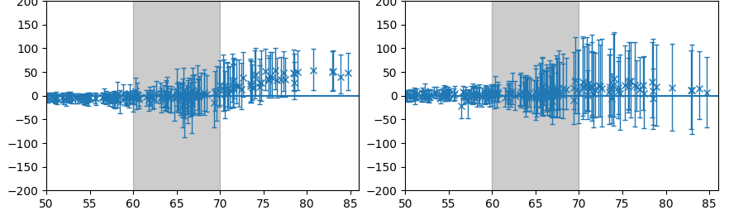
Model performance:
Individual magnetic stations
Individual station errors vs latitude with quartiles
Horizontal component
North component
Mean, quartiles [nT]
Auroral
zone
Polar
cap
Auroral
zone
Polar
cap
Latitude
Latitude
(Al Shidi et al., 2022)

Slide 7
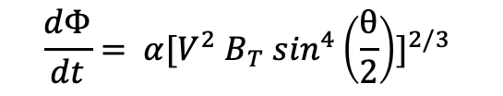
Solar wind coupling
Newell coupling function:
Observations and simulation have similar statistics for all indices
having a deterministic model does not much improve the correlations
$$\frac{dΦ}{dt}= α[V^{2} B_{T} \sin^{4}\left(\frac{θ}{2}\right)]^{2/3}⁡$$

Slide 8
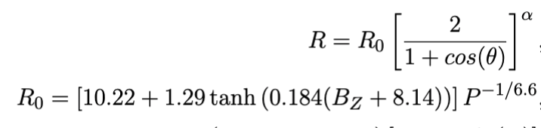
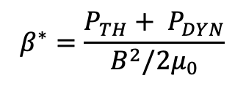
Magnetopause detection
Geospace simulation
Dayside: last closed fieldline
Nightside: β* = 0.7
Shue et al. (1998) model
Density
Velocity
$$β^{∗}=\frac{P_{TH}+ P_{DYN}}{B^{2}/2μ_{0}}$$
Vx
Current
Beta*
Beta*

Slide 9
Magnetopause position
Shue model (1998) comparison

Slide 10
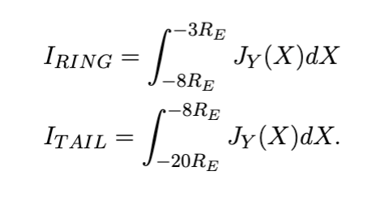
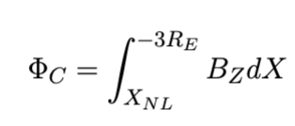
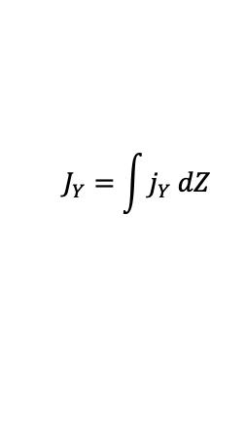
Magnetotail current sheet
Identification of current sheet center as
min(B_{X}) between the maxima of |B_{X}|
Current intensity
$$J_{Y}=\int{j_{Y} dZ}$$
Ring current
Tail current
Closed flux

Slide 11
Where does Dst come from?
Ring current: -8 < X < -3 Re
Tail current: -20 < X < -8 Re
Dst from SWMF/Geospace
Main phase: substantial contribution from tail current
Recovery phase: close agreement between ring current and Dst variations

Slide 12
Magnetotail current
Main phase vs recovery phase
For same value of ring/tail current, Dst larger and CPCP smaller during main phase than during recovery phase
Dst
Main phase dayside compression gives positive contribution to Dst
CPCP
Main phase dayside reconnection increases CPCP before ring current intensifies

Slide 13
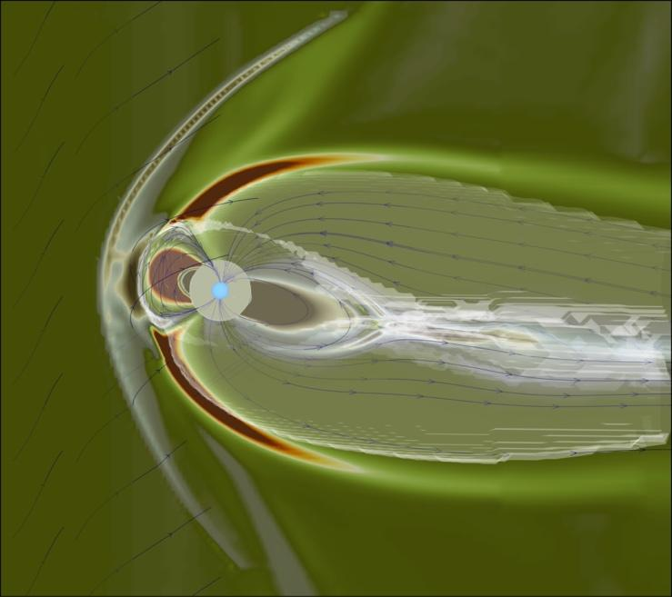
CCMC Resources
Re-running of storms with standardized input
CMEE ionosphere
Highest spatial resolution 1/8 Re
High time resolution output
Ionospheric and 3D tail data stored at 1-min intervals
Quicklook plots can be generated using 2D output
Solar wind driving & geomagnetic indices

Slide 14
Thank you!

