Slide 1
SEP forecasting with
HESPERIA REleASE
O. E. Malandraki¹, P. Kuehl², M. Karavolos¹, A. Posner³, B. Heber², K. Whitman⁴, L. Mays⁴, M. Kuznetsova⁴, A. Taktashvili⁴
¹ National Observatory of Athens, IAASARS, Greece
² Christian-Albrechts-Universitaet zu Kiel, Germany
³ Heliophysics, NASA Headquarters, Washington, DC, USA
⁴ NASA Goddard Space Flight Center, 8800 Greenbelt Rd, Greenbelt, MD 20771, USA
CCMC 2022 Workshop, College Park, Maryland, June 6-10, 2022

Slide 2
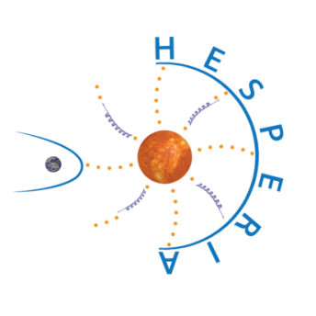
PROTEC-1-2014 ‘Space Weather’ ‘HESPERIA’: High Energy Solar Particle Events Forecasting and Analysis
Solar energetic particles (SEPs) are of prime astrophysical interest, but are also a space weather hazard motivating the development of predictive capabilities.
The project was funded through the European Union’s HORIZON 2020 research and Innovation Programme (Contract No 637324) and coordinated by the National Observatory of Athens in Greece (Project Coordinator: Dr. Olga Malandraki).
Main result: HESPERIA REleASE and HESPERIA UMASEP-500 SEP Forecasting tools provided through National Observatory of Athens (NOA) infrastructure.
2

Slide 3
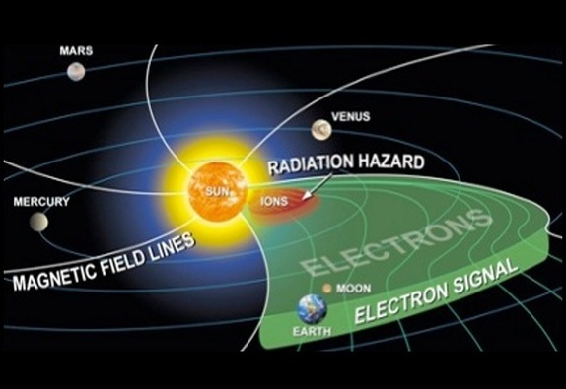
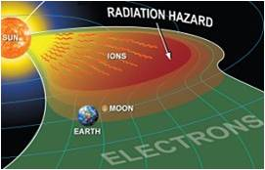
HESPERIA REleASE
Predicting 30-50 MeV SEP events by using the Relativistic Electron Alert System for Exploration (REleASE) scheme
This tool has been implemented and evaluated a real-time SEP predictor by using the REleASE scheme (Posner, 2007)
The implemented model infers the maximum proton intensity and onset at 30-50 MeV based on near relativistic and relativistic electron intensity time profiles measured by SOHO/EPHIN and ACE/EPAM
The tool provides advanced forecasting methods
Validation: POD, FAR, and average warning time.

Slide 4
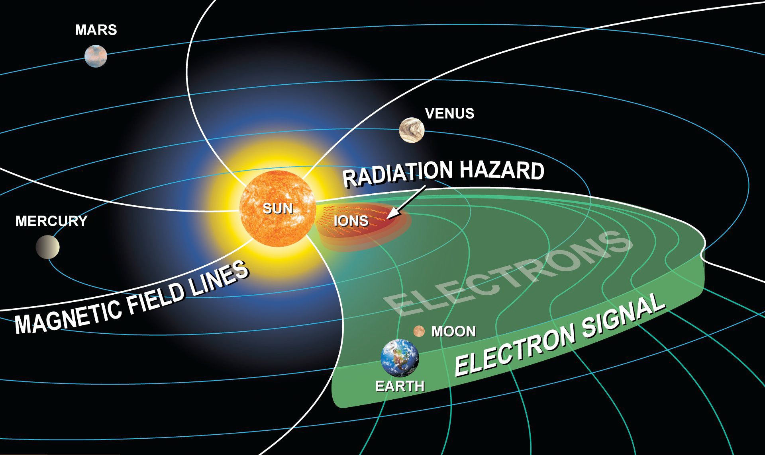
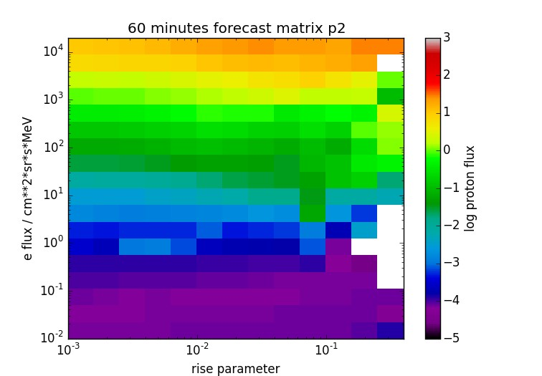
HESPERIA REleASE
The REleASE scheme (Posner 2007)
Near relativistic electrons travel faster than ions and are present in SEP events. The faster electrons arrive at L1 30-90 min before the slower protons.
The REleASE scheme uses this effect to predict the proton flux by utilizing:
the actual electron flux
the increase of the electron
flux in the last 60 minutes

Slide 5
HESPERIA REleASE
Development
RELeASE utilizes an empirical matrix to predict the proton intensity (30, 60, 90 min)
Real-time SOHO/EPHIN electron data (0.25-1.0 MeV) are available:
Advantage
1-min resolution
Disadvantages
limited time data coverage (less than 4 hours per day)
if no real-time data are available → no forecast produced
HESPERIA Innovation: Real-time electron intensities by ACE/EPAM in a comparable energy range (0.175-0.315 MeV) adapted to the existing REleASE forecasting matrix.
Advantage
Very good data coverage
Disadvantages
5-min resolution

Slide 6
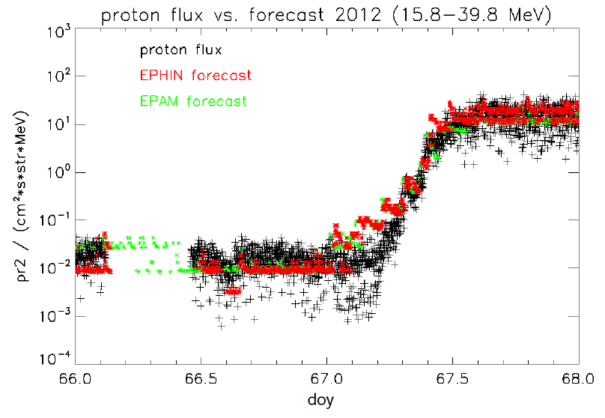
HESPERIA REleASE
An example of an SEP event where the EPHIN and EPAM based forecasts predicted the real proton flux accurately

Slide 7
HESPERIA REleASE
Validation
The performance was tested by using all historic EPAM and EPHIN data from 2009 until 2016. The following results for events are possible:
True forecast (Alarm and Event): T
Missed event (No / late Alarm and Event): M
False alarm (Alarm and no Event): F
By using the total number of true forecasts, missed events and false alarms of the analyzed time period, it is possible to calculate the Probability of Detection (POD) and False Alarm Ratio (FAR):
False Alarm Ratio: FAR = F / (T+F)
Probability of Detection: POD = T / (T+M)

Slide 8
HESPERIA REleASE
VALIDATION (cntd.)
The largest interval (that is possible with EPHIN) was selected 2009-2016 to calculate POD, FAR, and AWT.
The obtained POD using both data sources (EPHIN/EPAM) was 63.2%.
The FAR using EPHIN and EPAM were 29.4%, and 35.1% , respectively.
The AWT (Advanced Warning Time) using EPHIN and EPAM were 107 and 123 min, respectively.
The results are satisfactory (low FAR, high POD, high AWT).
We conclude that the REleASE forecasting scheme can be used with ACE/EPAM data, and can probably be used with other near relativistic electron flux measurements.
The HESPERIA REleASE system can generate alerts which are distributed to registered users (R.163 product).

Slide 9
Assets of HESPERIA REleASE
No need for any prior solar flare (soft X-ray observations) to issue forecasts
Providing forecasts also in the case of backside flares which other schemes cannot provide
30% of the SEP events observed at Earth’s orbit are due to backside solar events (Richardson et al., 2014)

Slide 10
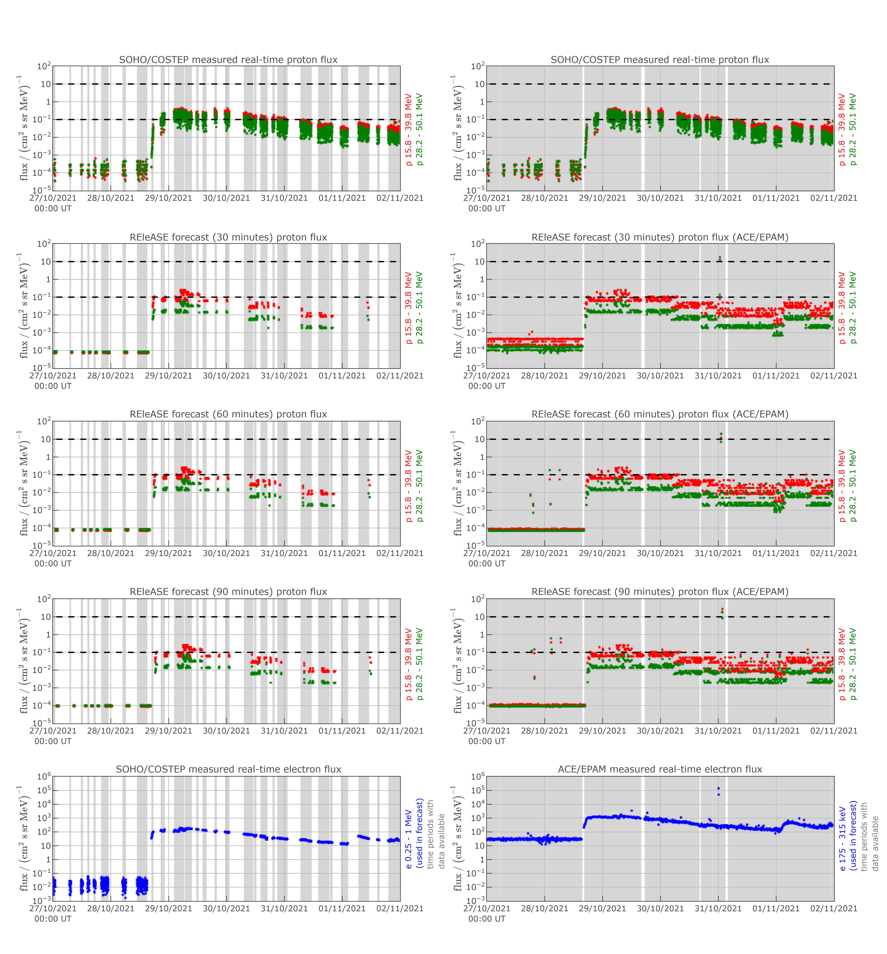
28 October 2021 (HALLOWEEN EVENT)
10

Slide 11
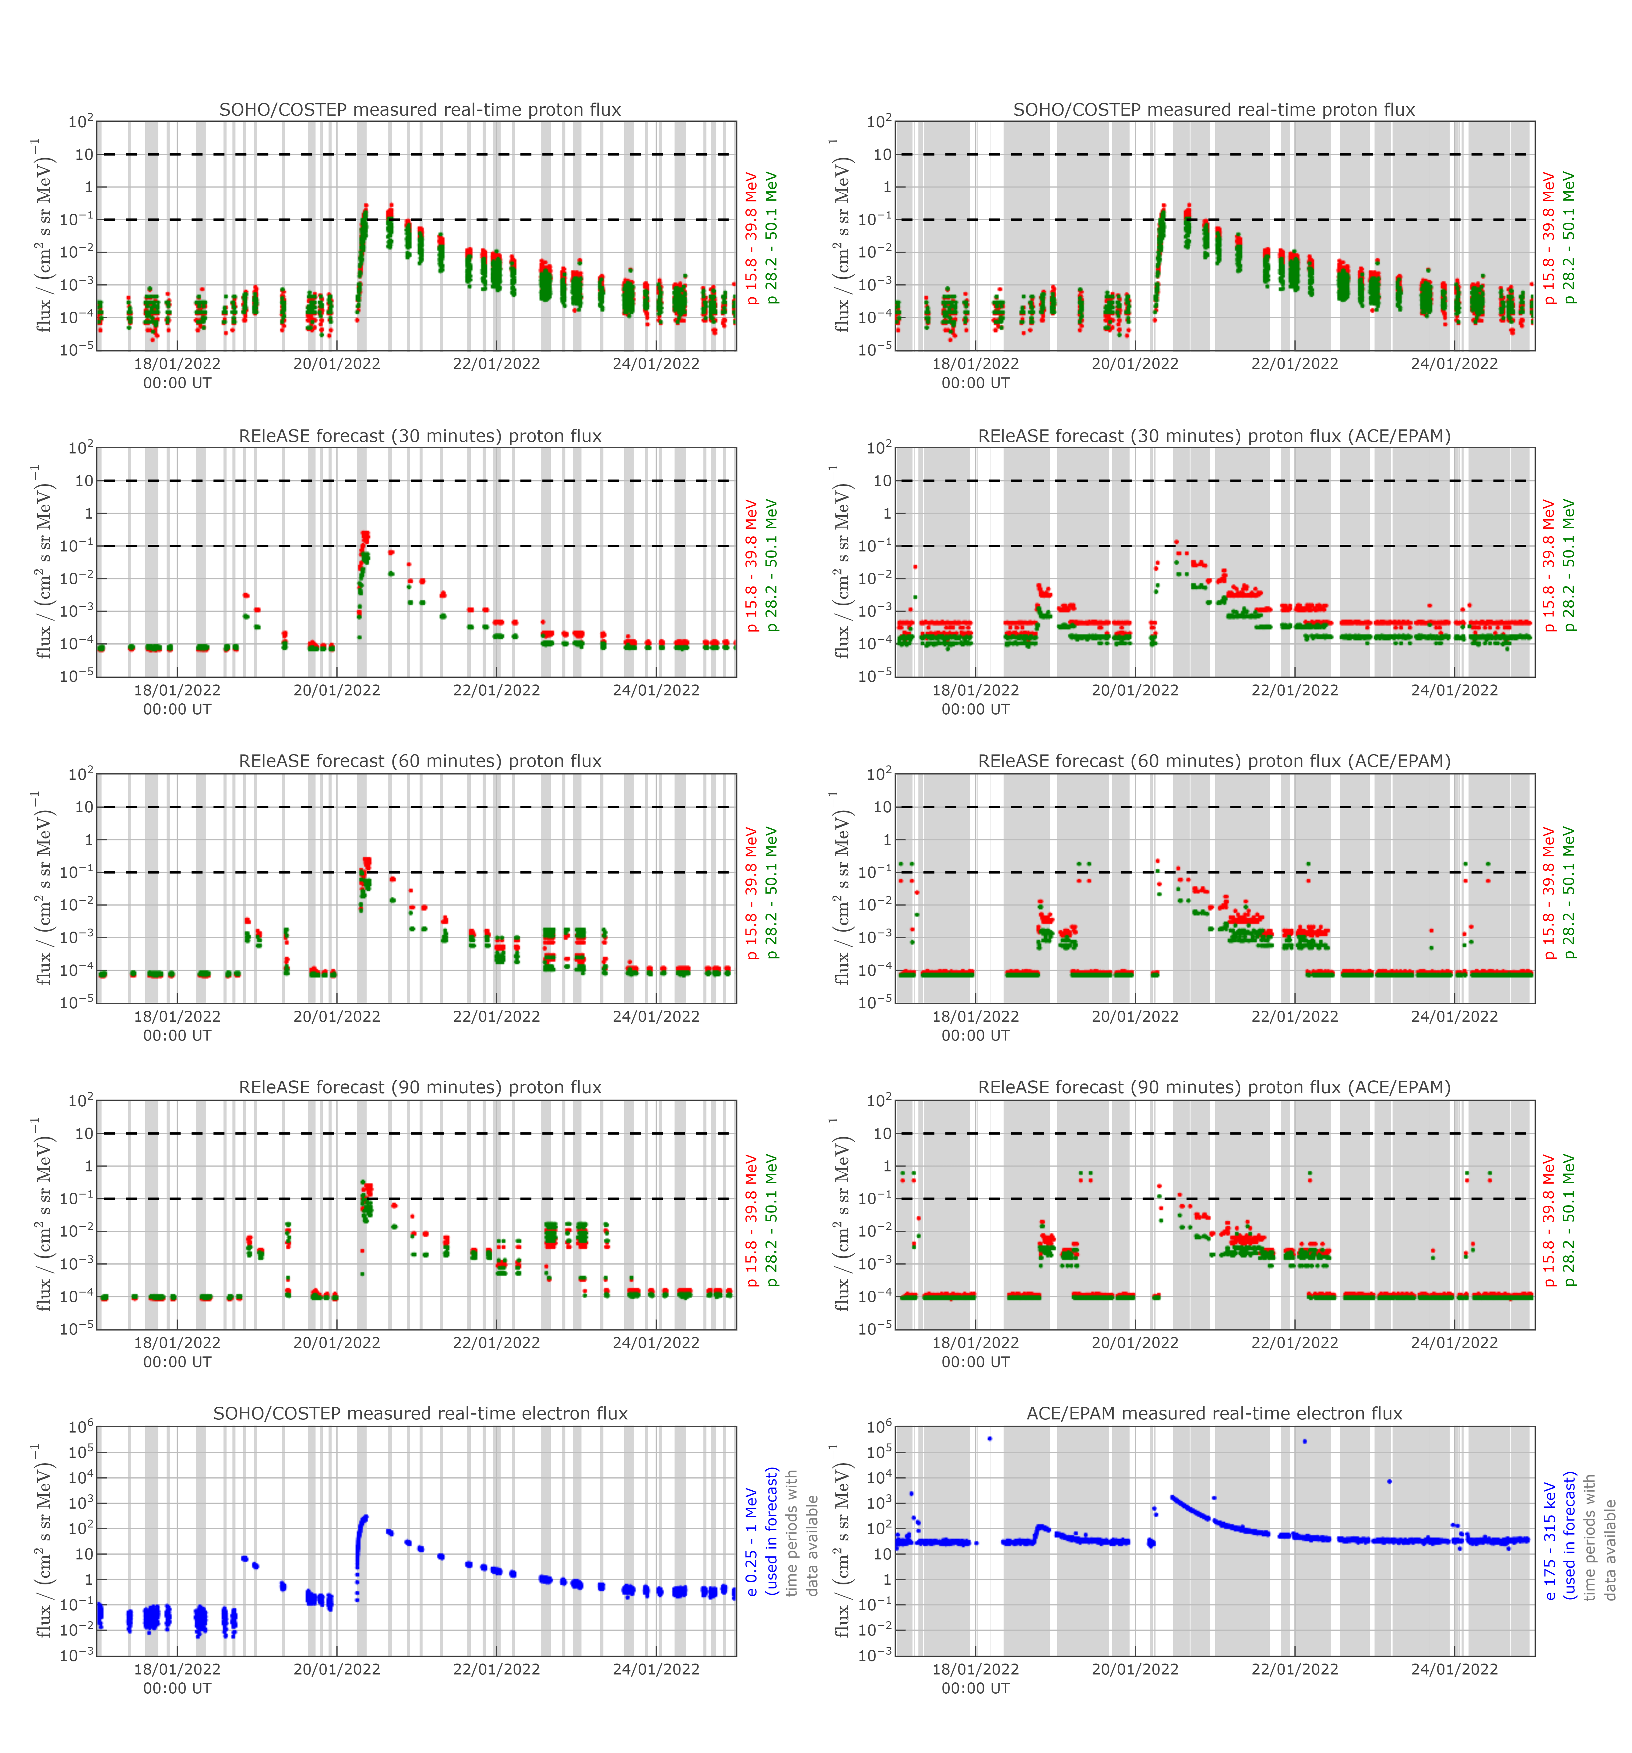
20 JANUARY 2022
11

Slide 12
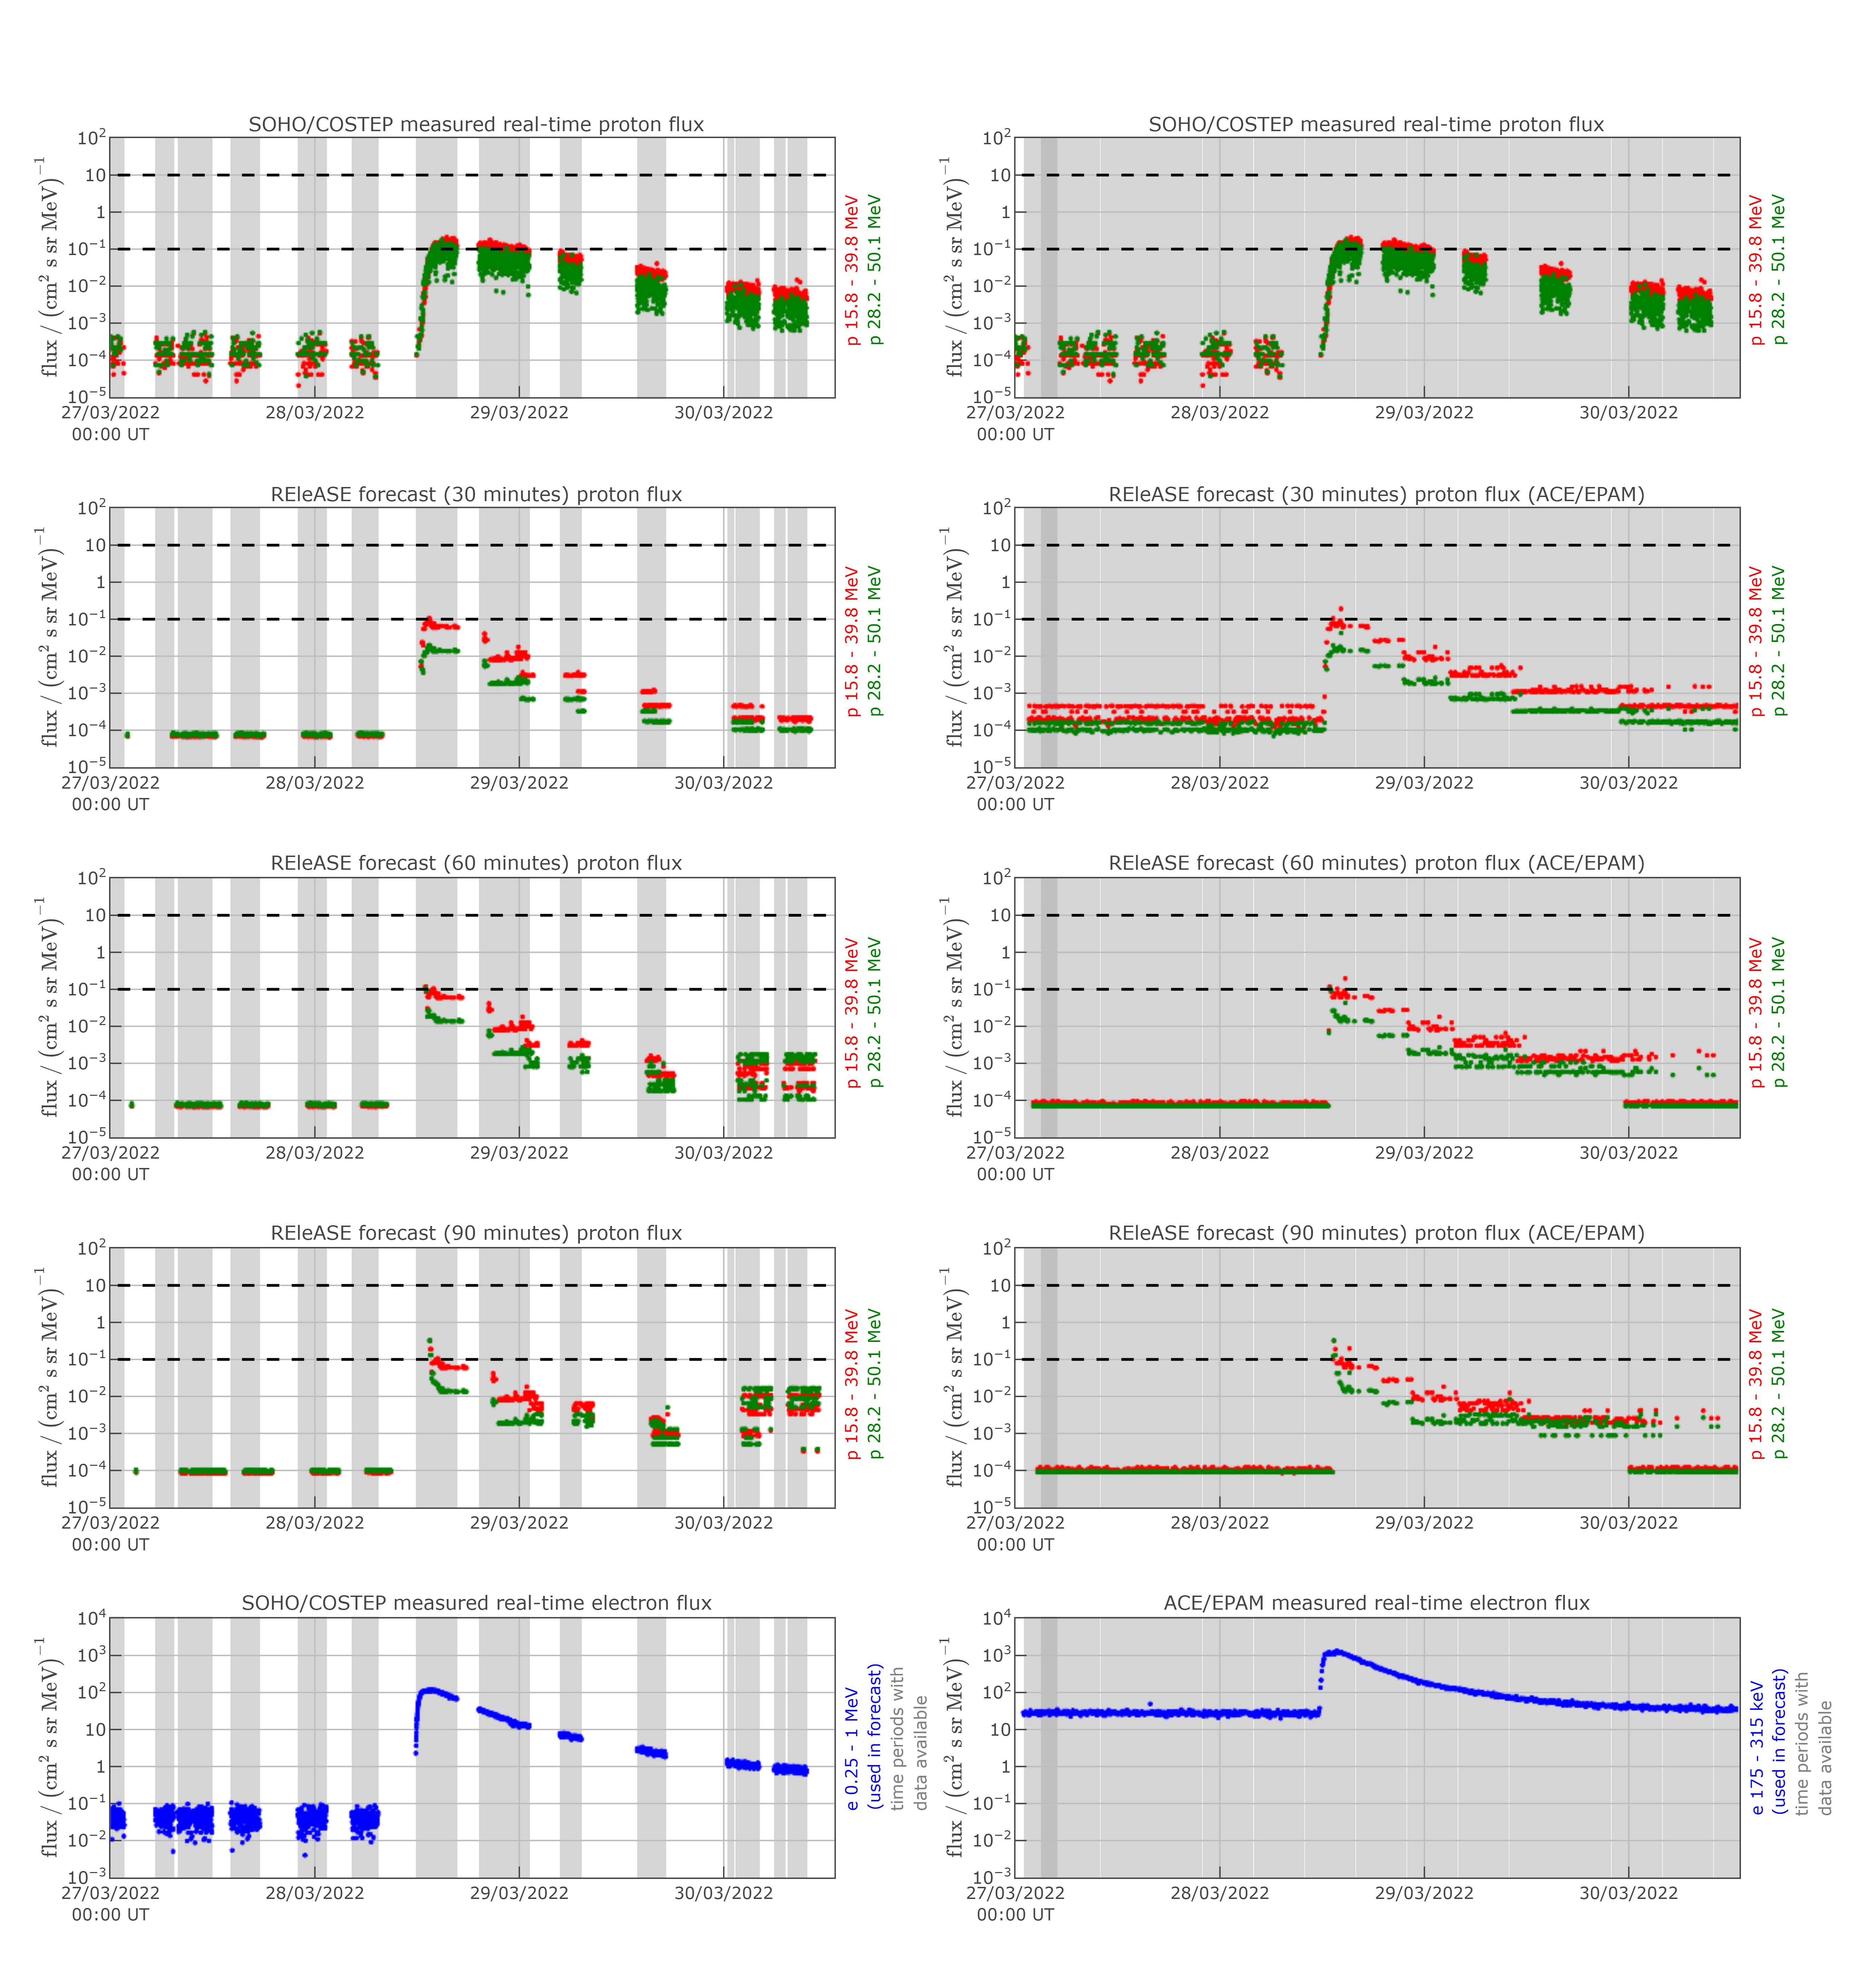
28 MARCH 2022
12

Slide 13
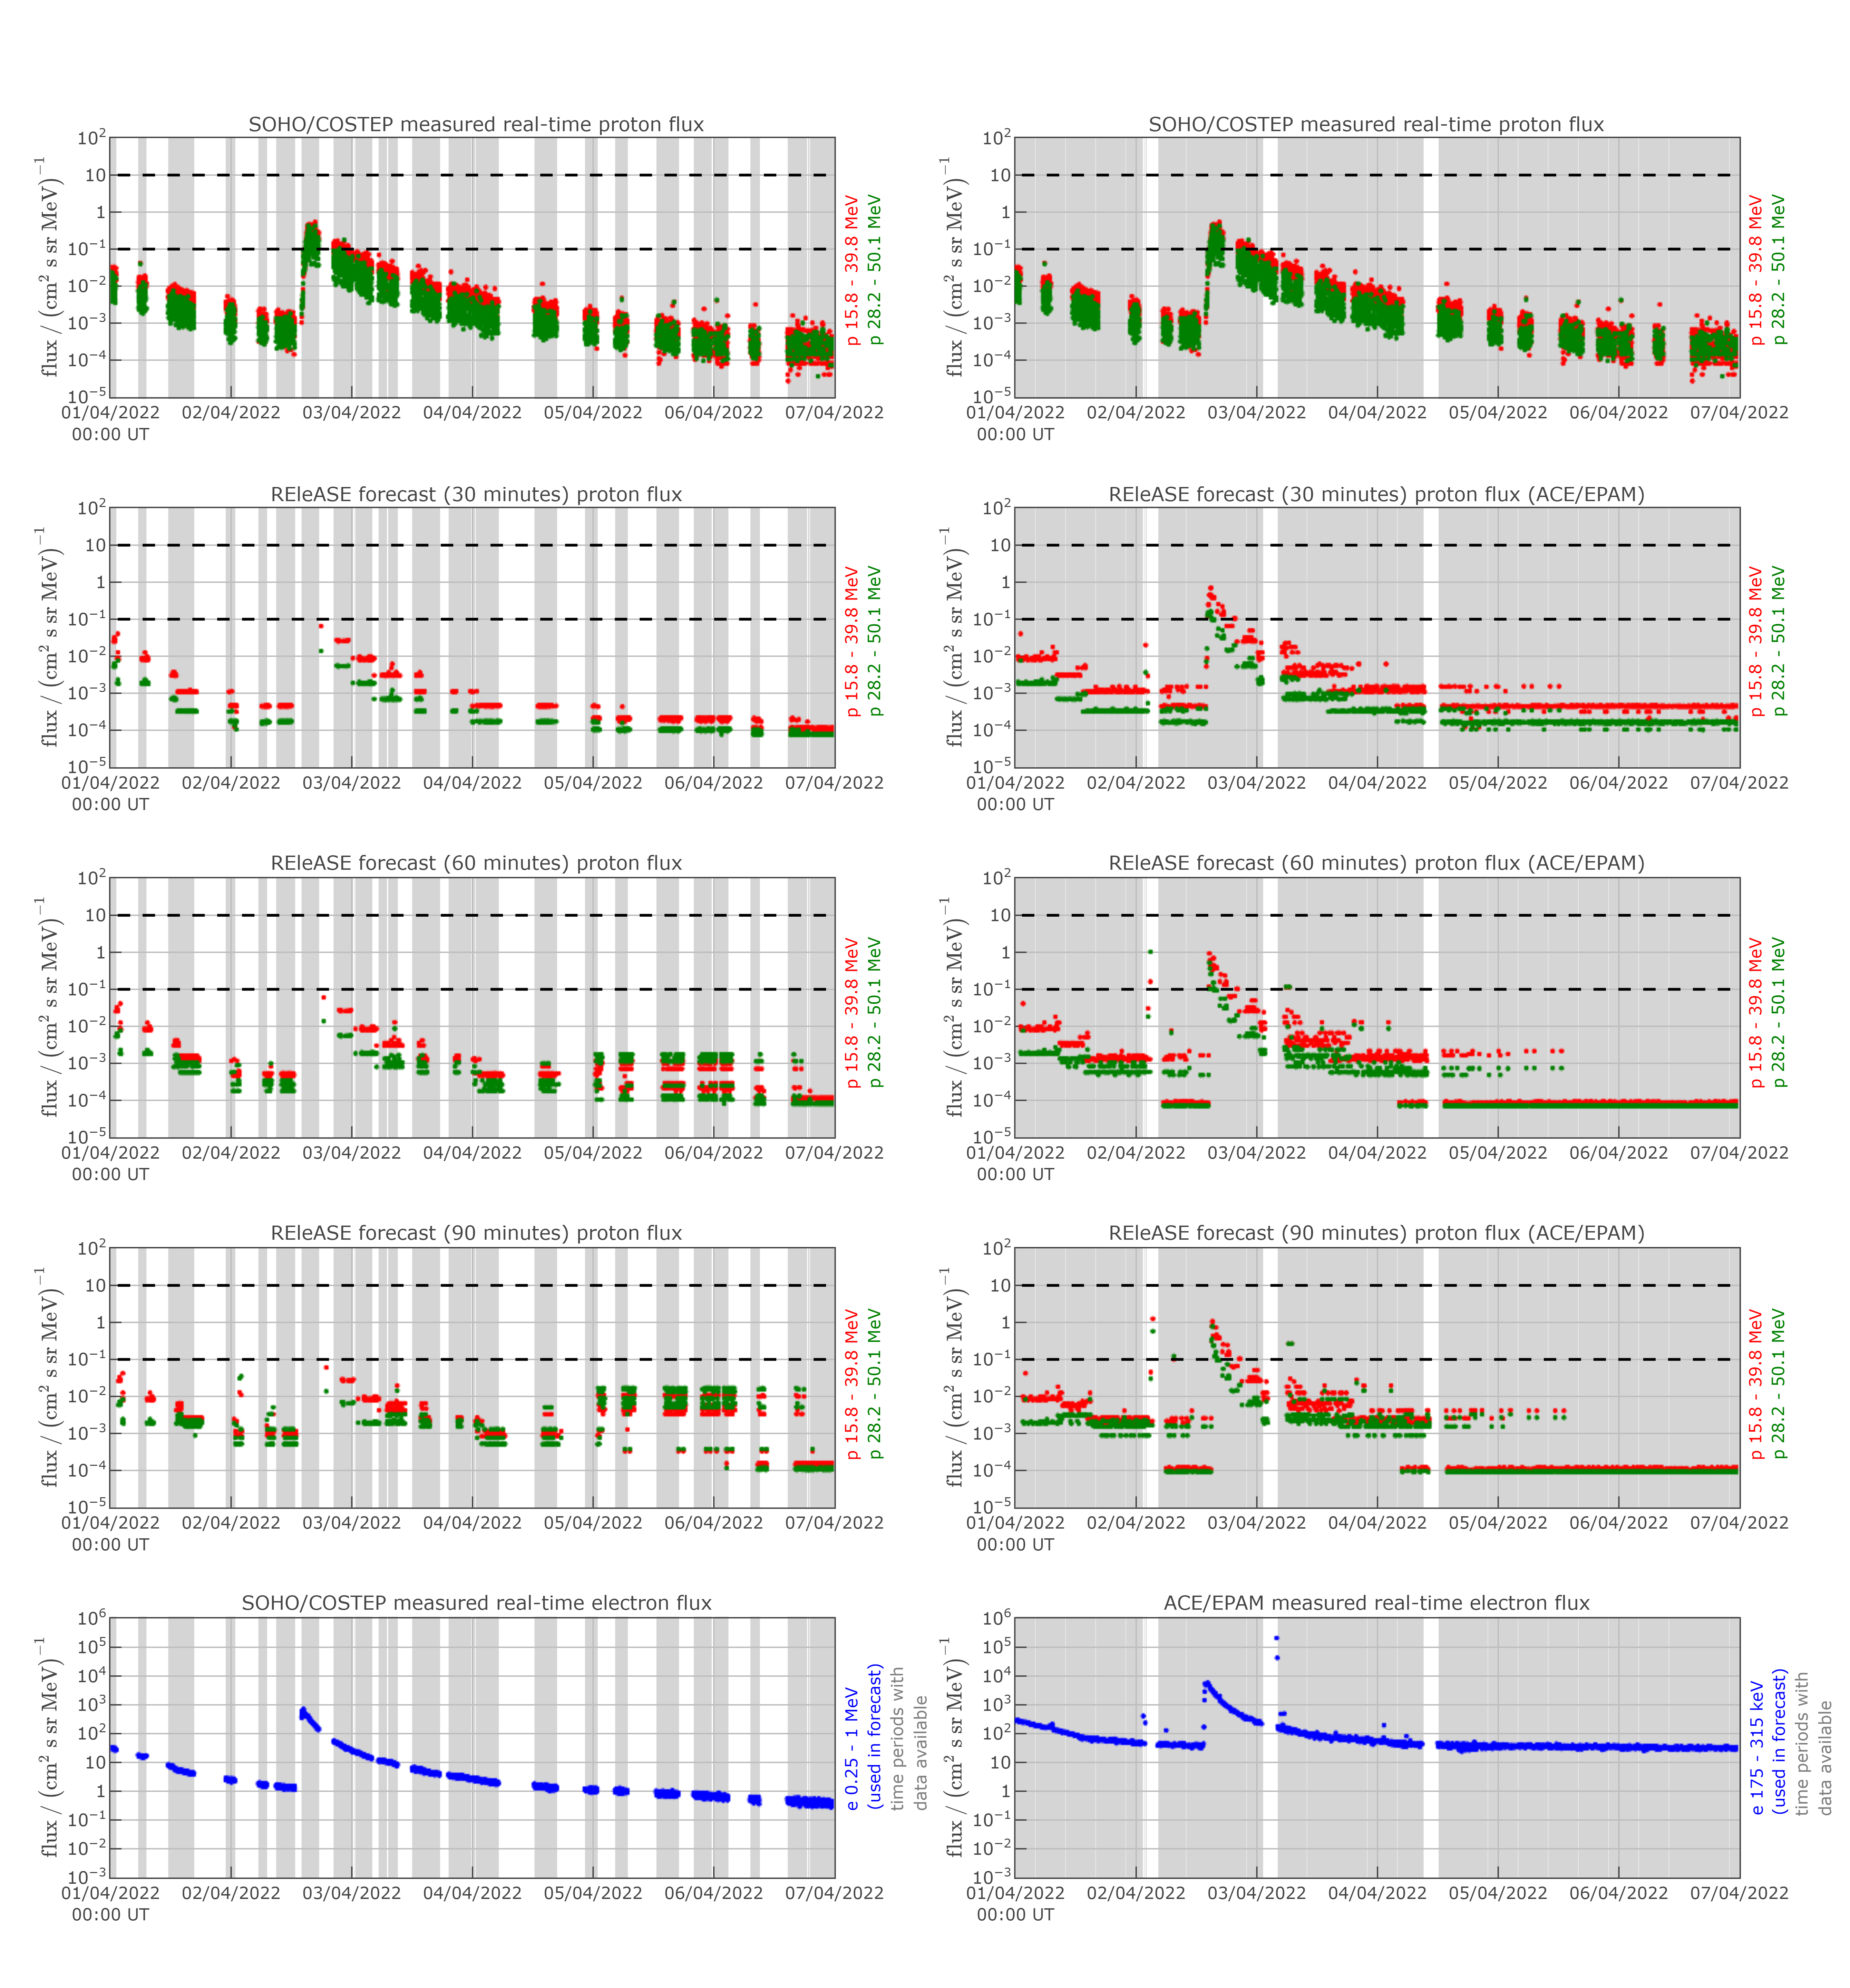
02 APRIL 2022
13

