Slide 1
iPATH and SEPCaster – modelling Solar Energetic Particle Events
Gang Li, Junxiang Hu, and Meng Jin
CCMC 2002 Workshop
2022. 06. 07

Slide 2
PATH –> iPATH ->SEPCaster
1D, parallel shock, proton, Hvy ions, observer @1 AU, forward Monte-Carlo simulation
2D, parallel and perpendicular shock, proton, Hvy ions, backward Monte-Carlo simulation, updated perp. Diffusion coefficient, simultaneous predictions at multiple locations
3D, simulation starting from 2Rs, addition of AWSoM, parallel and perpendicular shock, proton, Hvy ions, backward Monte-Carlo simulation, updated perp. Diffusion coefficient, updated seed population, off-ecliptic plane, simultaneous predictions at multiple locations
Zank+ (2000), Li+ (2003,2005), Verkhoglyadova+(2009,2010)
Li+ (2012), Hu+ (2017,2018), Fu+(2019), Ding+(2020)
Li+ (2021), Jin+(TBP)
2000-2010
2010-2020
2020 & beyond

Slide 3
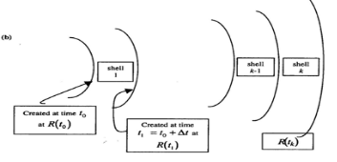
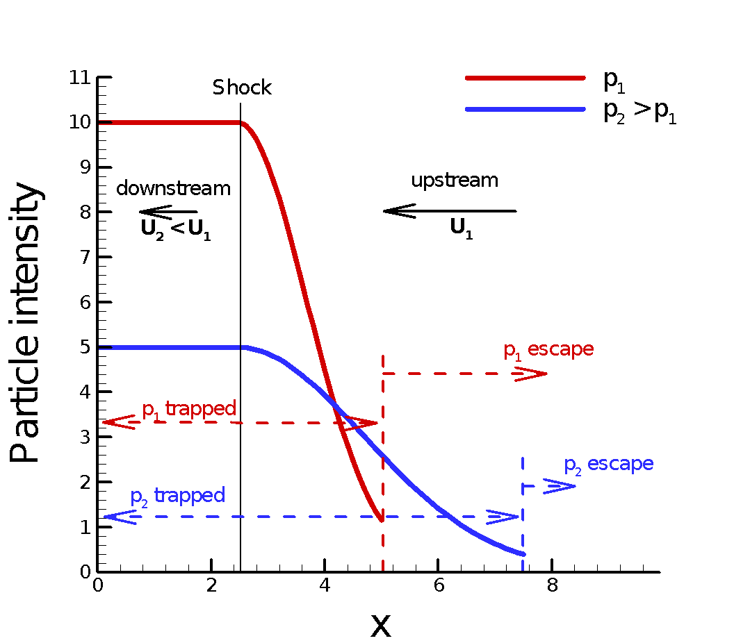
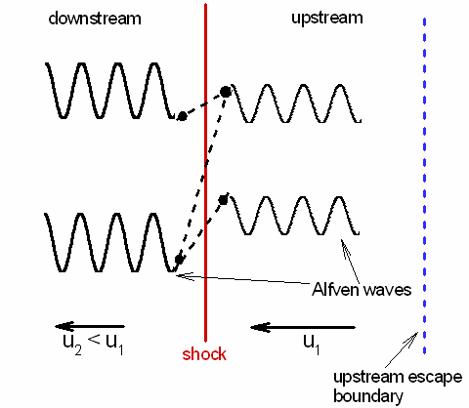
PATH: Particle Acceleration and Transport in the Heliosphere
Zank+, 2000
1) setup: background solar wind and shock tracing – “shell” model
2) Particle acceleration at and propagate with the shock
3) particle transport after escaping from the shock

Slide 4
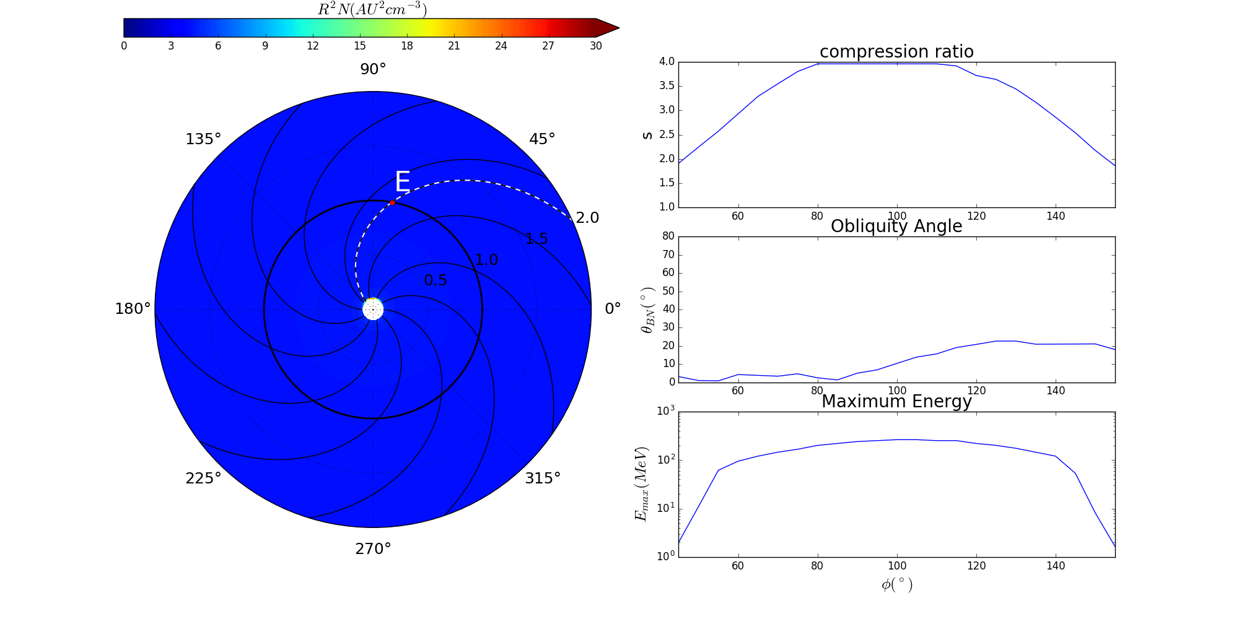
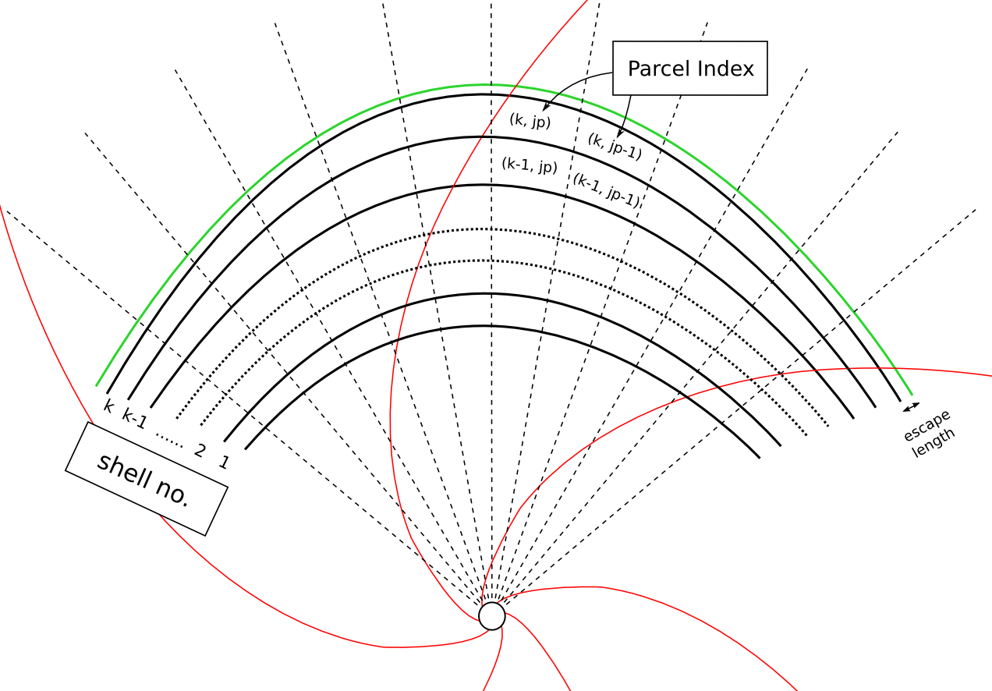
iPATH: physics-based particle Acceleration and Transport in the Heliosphere code that can be used to examine SEP in the ecliptic plane
1D shells replaced by 2D parcels
Hu+ (2017)

Slide 5
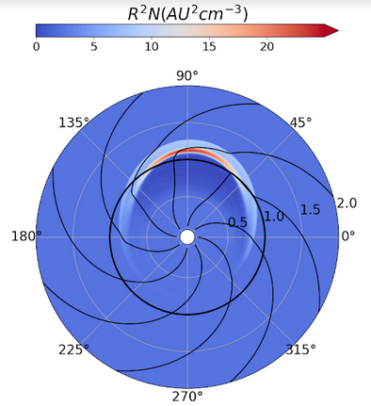
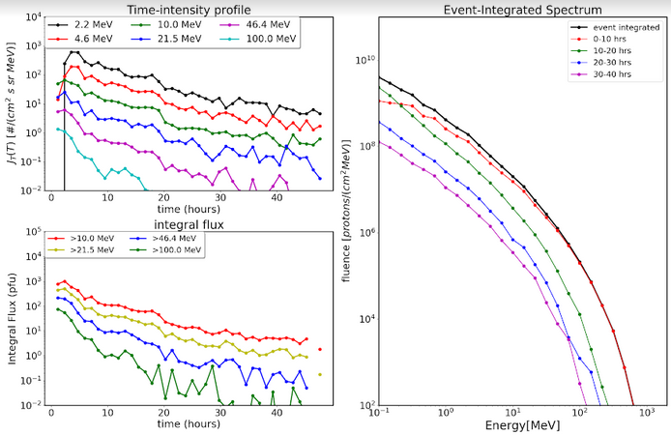
IPATH @ CCMC
iPATH is being adapted to an SEP forecast/nowcast tool, and will be hosted @ CCMC.
CME kinetics
Time profiles and spectra

Slide 6
SEPCaster: Forecasting Solar Energetic Particle Events at the Cis-Lunar Environment using the combined AWSoM-iPATH model
SEPcaster is an extension of iPATH, but allow the shock to initiate from very close to the Sun (instead of 10 Rs or 20 Rs used in PATH/iPATH).

Slide 7
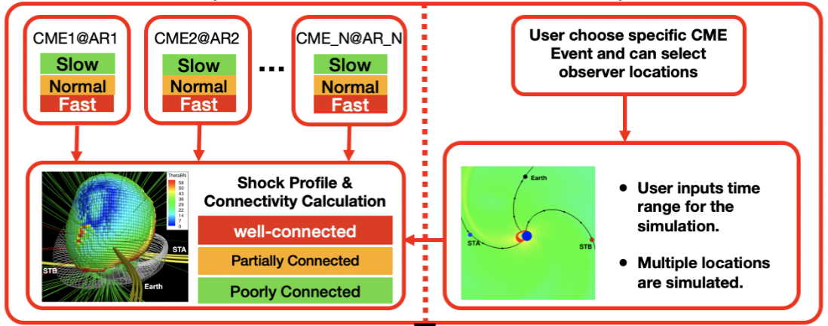
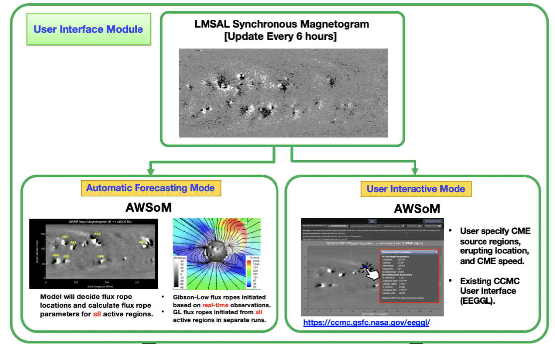
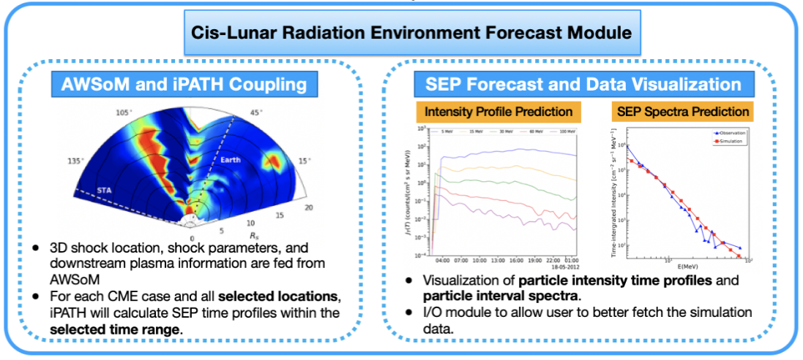
AWSoM-iPATH interface
SEPCaster Modules
AWSoM
User interface – allow user inputs
Output data visualization and different format per request
iPATH

Slide 8
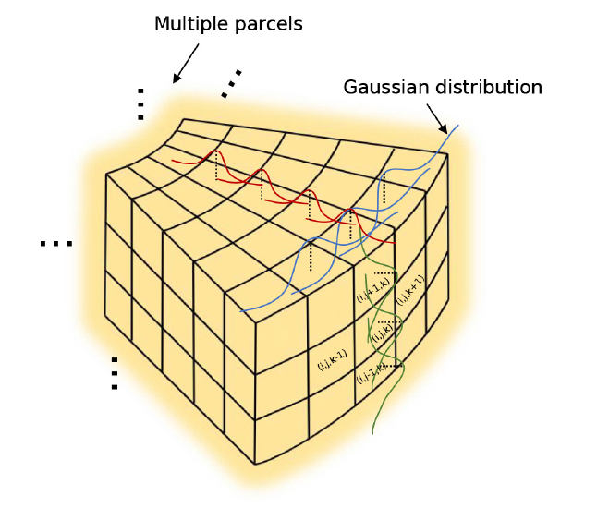
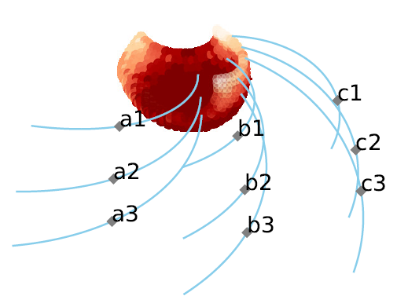
SEPCaster is 3D in nature

Slide 9
Features of SEPCaster that are operation friendly
1) both a standalone user-specific environment or a web-based user interface
2) two different modes: automatic forecast mode, and a user-interactive mode
3) data I/O module with clear specifications of input and output data format
4) uncertainty estimates – providing a confidence level
SEPCaster will focus on the transition of basic research ==> practical application

Slide 10
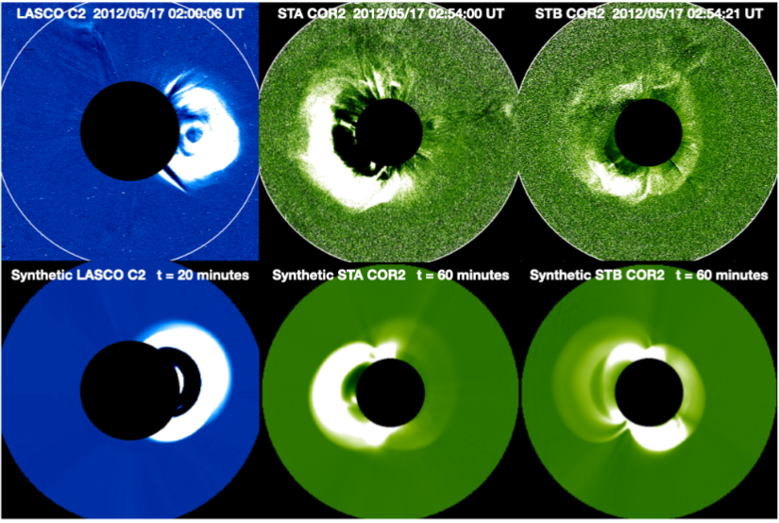
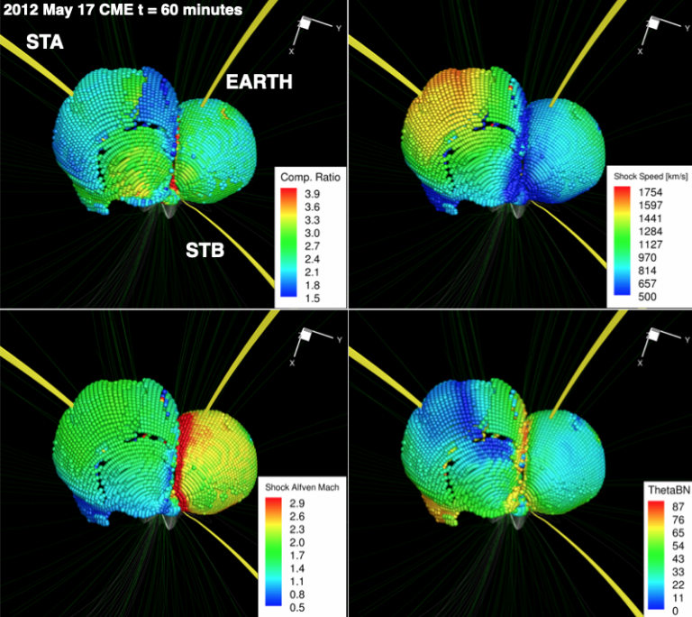
Combining AWSoM and iPATH in action: 2012 May 17 event
CME morphology and magnetic connection obtained through AWSoM/EEGGL
Li+ (2021)

Slide 11
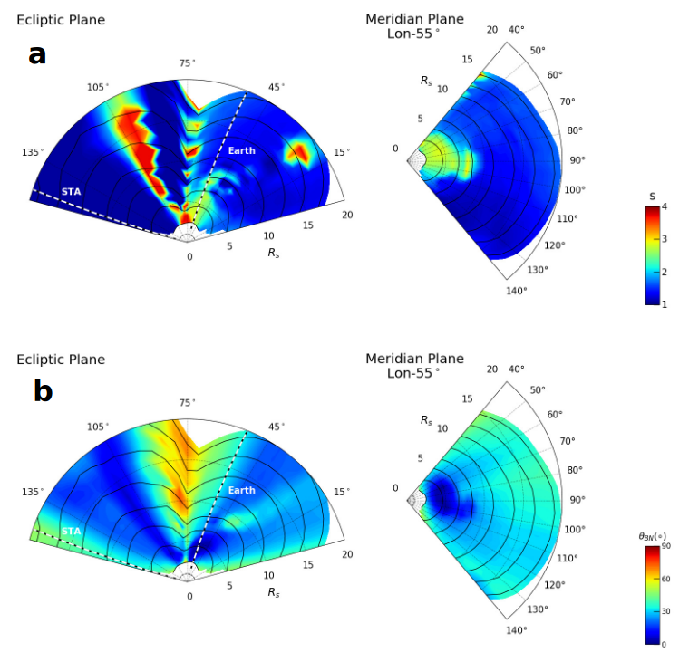
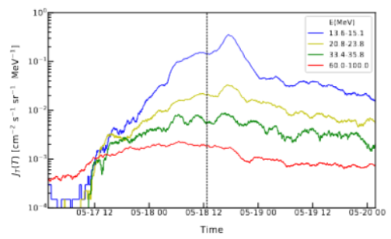
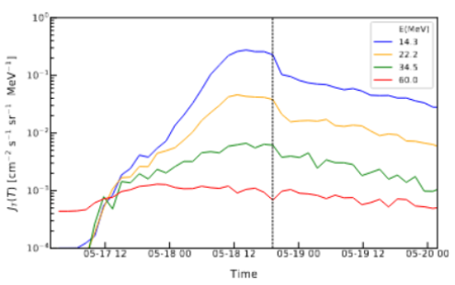
Time profile @ STA
observation
simulation
3D shell structures: passing MHD parameters from AWSoM to iPATH
iPATH model output

Slide 12
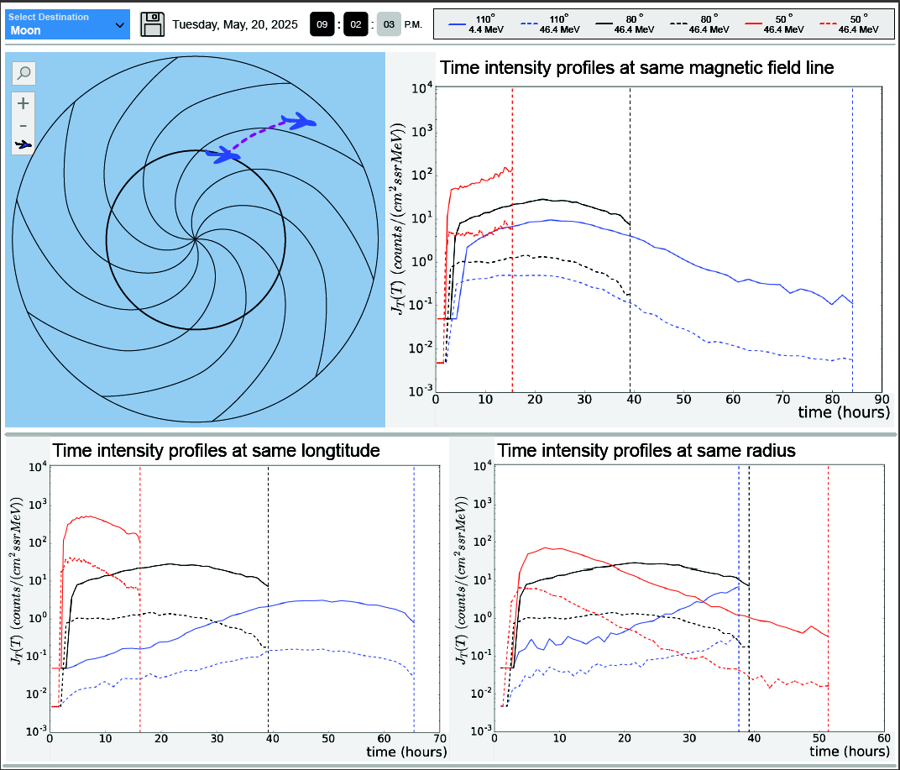
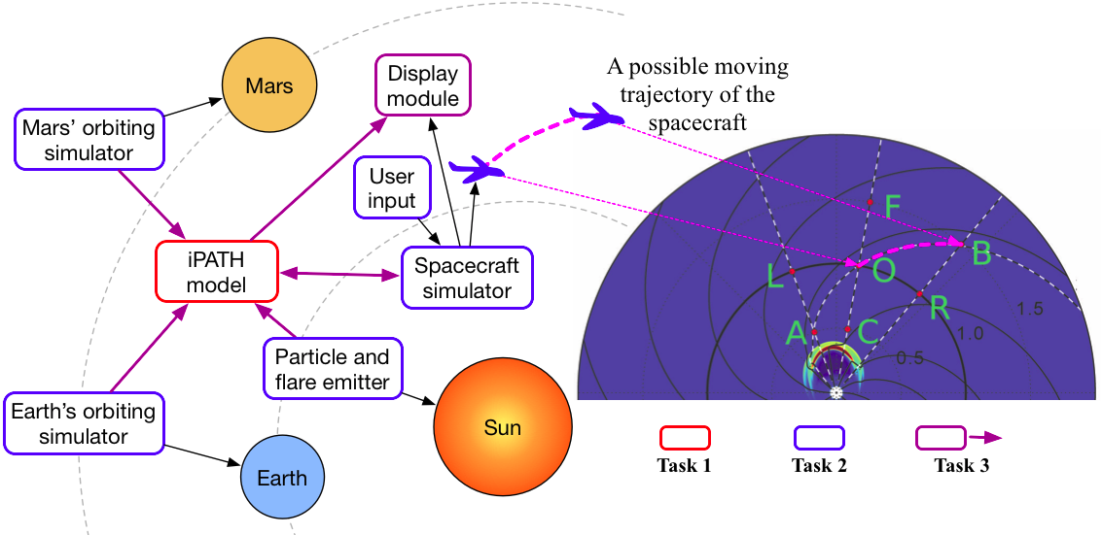
SEPCaster in Year 2030: when Earth-to-Mars Swx forecast is needed
AWSoM model
Tailored for mission-based SEP Forecast

Slide 13
Backup

Slide 14
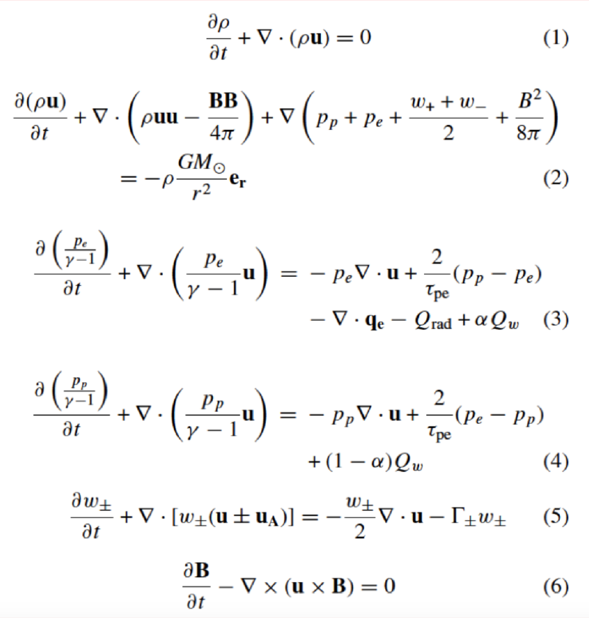
References: van der Holst et al. 2010, Manchester et al. 2012, Jin et al. 2012,Sokolov et al. 2013, Oran et al. 2013, Jin et al. 2013, van der Holst et al. 2014

Slide 16
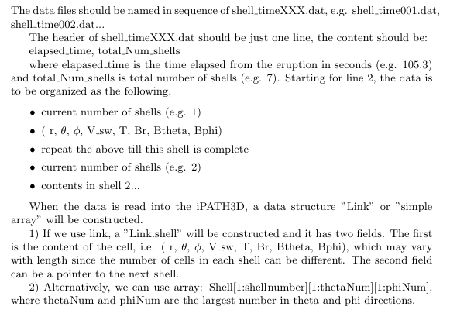
Input Data Format – a generic space weather interface
Use AWSoM, we propose a data format that any 3D MHD code should provide for a space weather forecasting.

