Slide 1
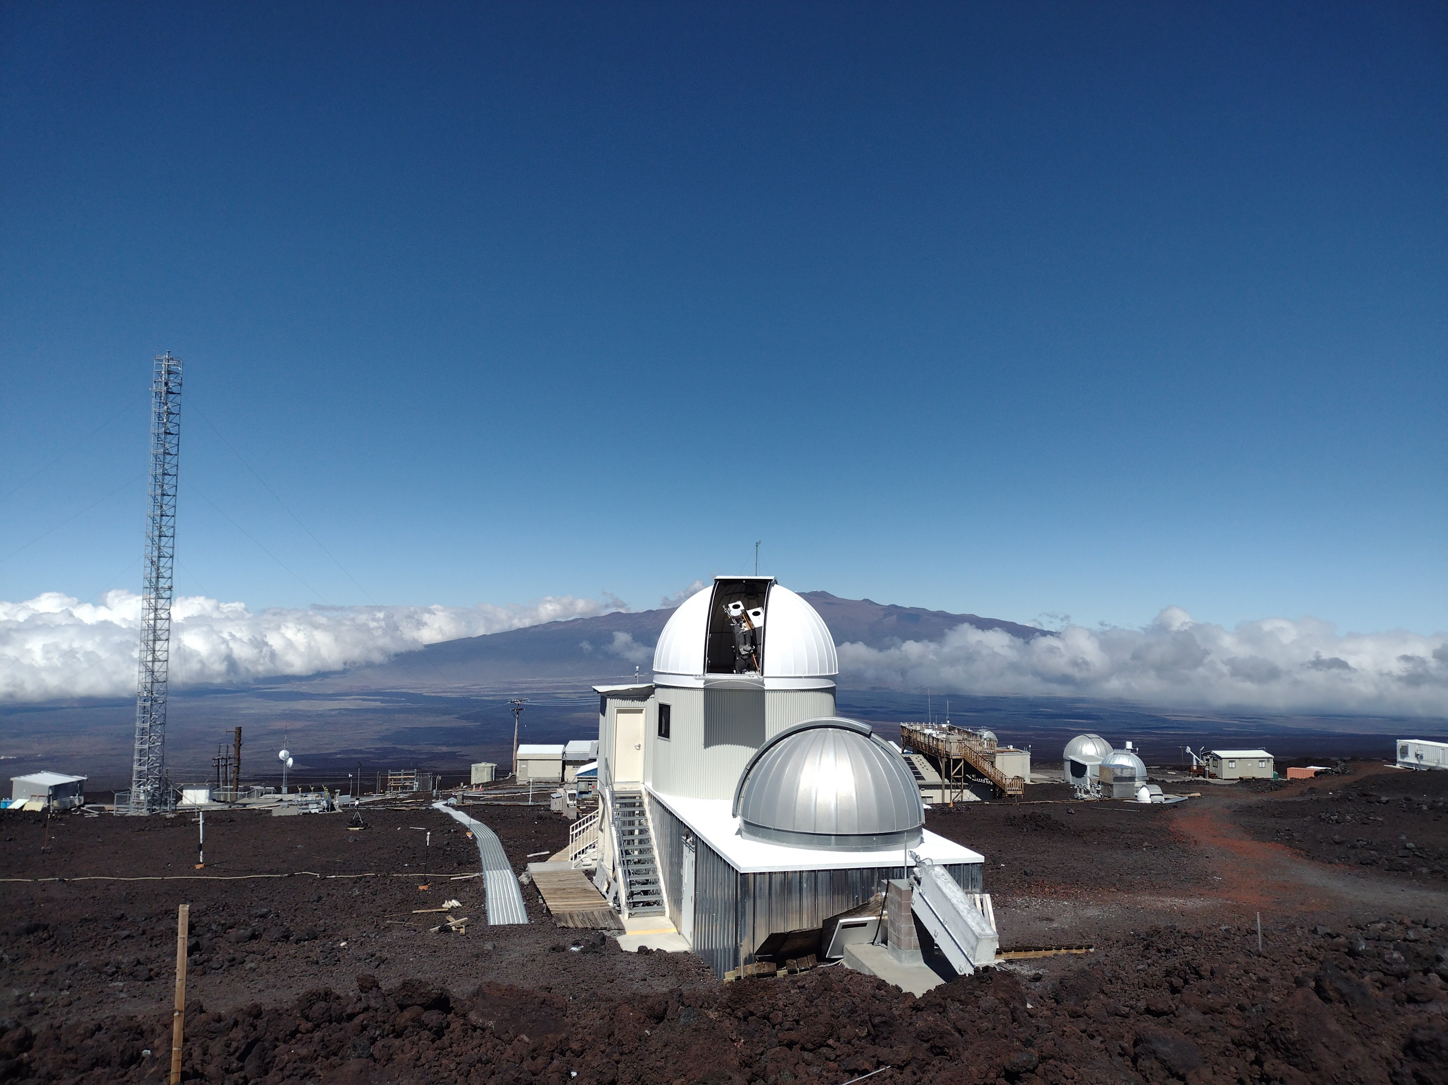
Near-real-time MLSO CME Alerts to SEP Scoreboard
Mauna Loa Solar Observatory, HAO/NCAR
(https://www2.hao.ucar.edu/mlso/mlso-home-page)
J. T. Burkepile (MLSO Project Scientist)
Mike Galloy (MLSO Lead Programmer)
Ben Berkey, Lisa Perez-Gonzales, Marc Cotter (MLSO Observers)
O. C. St. Cyr (HAO Affiliate Scientist and CUA@NASA-GSFC)
SEP Scoreboard, CCMC, NASA-GSFC
(https://ccmc.gsfc.nasa.gov/scoreboards/sep)
Joycelyn Jones (Software Developer)
Leila Mays (Project Lead)
Space Radiation Analysis Group, NASA-JSC
(https://srag.jsc.nasa.gov/)
Phil Quinn

Slide 2
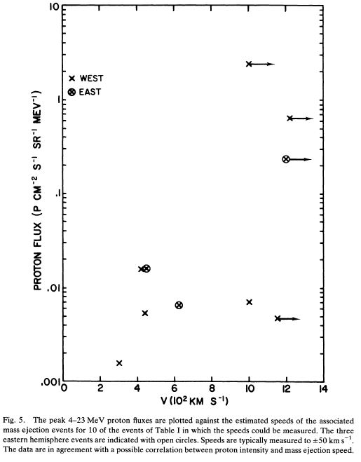
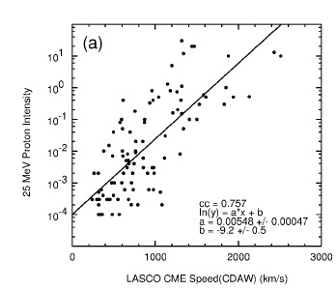
SEPs associated with fast CMEs since the 1970s
Richardson et al., 2015
Intensity of 25 MeV protons plotted vs. the speed of the associated CME for events 30°-90° west of the particle-observing spacecraft.
Kahler et al., 1978
“The data are in agreement with a possible correlation between proton intensity and mass ejection speed.”

Slide 3
SEP Scoreboard Current Models
SEP Intensity
HESPERIA REleASE (relativistic electrons)
SEPMOD (WSA-ENLIL + CME cone model)
STAT (CORHEL + CME)
UMASEP (proton intensity)
SEPSTER & SEPSTER2D (CME speed and connectivity)
SEP Probability
MAG4 (vector magnetograms)

Slide 4
CME Alert Latency Due to Coronagraph Downlink
Present day situation with SOHO LASCO
- Telemetry is downlinked 3x per day
- DSN attempts to provide contacts ~8 hours apart
Present day situation with STEREO-A beacon
- Coverage is seasonal, but usually >50%
- Highly compressed COR2 images are downlinked every 15 minutes
- COR2 has an inner field-of-view limitation of ~3 R_{S}
Future prospects with NOAA’s CCOR’s
-Telemetry latency issues should be reduced in the future
- Image Requirements: Cadence is 15 minutes, Latency 30 minutes
- CCOR has an inner field-of-view limitation of >3 R_{S}
Additional future possibilities
-ESA/NASA Solar Orbiter Metis low-latency images
-NASA PUNCH CCOR
-ISRO Aditya-L1

Slide 5
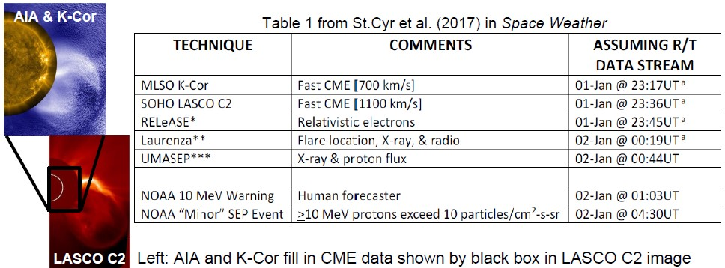
CME Alert Latency Due to Coronagraph Field-of-View

Slide 6
Mauna Loa Solar Observatory
Nominal observing day: 17 UT to 02:30 UT
K-Coronagraph (K-Cor) Science Goals
Understand the physical processes leading to CMEs and their space weather consequences. FOV: 1.05 to 3 Rsun; 15 sec cadence
Quantify rate-of-change of CME properties to understand CME shock-acceleration of particles
Detect Earth-directed CMEs
K-Cor fills in low corona observational gap
Assess variation in energy input into corona over solar cycle by quantifying changes in coronal morphology and density

Slide 7
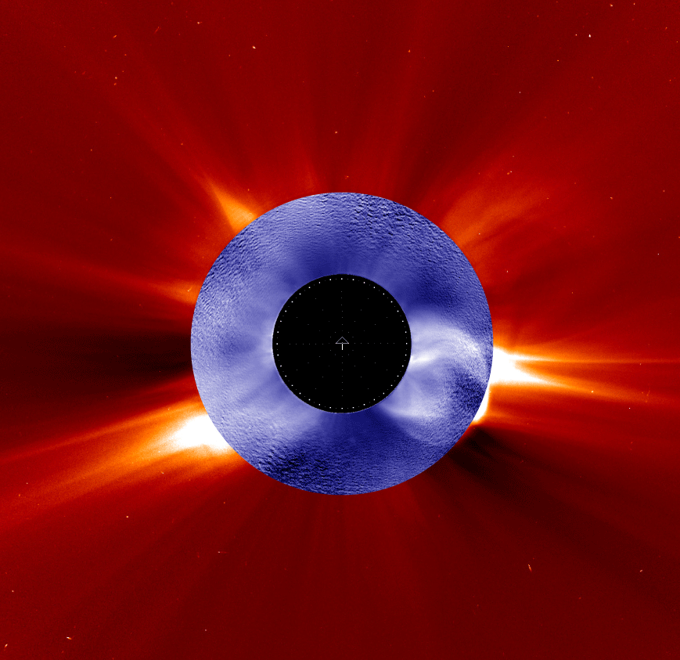
Recent developments at MLSO to provide near real-time CME Detections
Jan 1, 2016 CME
2017: K-Cor CME detection package created by Dr. William Thompson and collaborators (Thompson et al. 2017) https://doi.org/10.1002/2017SW001694
2017: NCAR/HAO begin processing K-Cor data at MLSO within 1 minute of acquisition (Very Low Latency).
2018: NCAR/HAO install modified version of Thompson code at MLSO. Automated CME alerts begin. Prior to this, all alerts were issued by MLSO observers only.
2021: HAO begins work with CCMC SEP Scoreboard, SRAG, and SPASE teams to incorporate K-Cor alerts into SEP Scoreboard.

Slide 8
K-Cor CME alert info to be provided to SEP Scoreboard
While K-Cor is observing, a ‘heartbeat’ is sent every 5 minutes to the SEP Scoreboard including “All Clear” = True (no CME) or ‘All Clear” = False (CME in progress). Include latest K-Cor; and updated K-Cor movie if desired.
When a CME is detected, by the observer or algorithm, an alert is sent to SEP Scoreboard (and other users) with the following:
-Time of detection - Location of CME
- CME Width (observer only) - CME speed and height of CME (Code only)
- Confidence level (observer only)
- Small movie (e.g. 512 x 512) can also be included
* Observers issue retraction if they deem the code sent out a ‘false alarm’
LEFT: K-Cor observations of Sept 24, 2014 CME that produced a moderate SEP storm.

Slide 9
CME DETECTION ALERTS SENT OUT BEFORE CME ENTERS LASCO FOV
ENERGETIC PROTONS |  |  |  | CORONAL MASS EJECTIONS
Date | Rise Time | Flux p⁺/(cm²*s*sr) | Detected by | K-Cor 1st image time | Detection Alert Time | LASCO 1st img time | Δ Time Alert & LASCO 1st image
20140924 Disk ctr CME | 23 UT | 3000 [1.8 - 10 MeV] 100 [14 - 100 MeV] | STEREOA | 20:55:08 | 21:01:49 | 21:12:08 | 10 min 17 sec
20150315 | 4 UT | 100 [ > 5 MeV] 7 [> 10 MeV] | GOES | 01:20:45 | 01:27:27 | 01:48:05 | 20 min 37 sec
20160101 | 24 UT | 40 to 50 [> 5MeV] 10 [> 10 MeV] | GOES | 22:56:09 | 23:18:25 | 23:24:04 | 5 min 39 sec
20170904 Disk ctr CME | 23 UT | 175 [> 5 MeV] 75 [> 10 MeV] | GOES | 18:28:21 | NONE Too faint | 19:00:05 | N/A
20210507 | 24 UT | 0.1 [2.2 - 12 MeV] 1.5 0.62 - 2.2 MeV] | STEREO-A/SolO | 18:54:43 | 19:03:56 | 19:24:05 | 20 min 9 sec
20220511 | 18 UT | 5 [> 10 Mev] | GOES | 18:17:29 | 18:37:19 | 18:48:05 | 10 min 46 sec
Need to add LASCO latency to times in far right column. Monitoring recent NOAA SWPC data: latency ranged from 47 minutes to 3 hrs 13 minutes

Slide 10
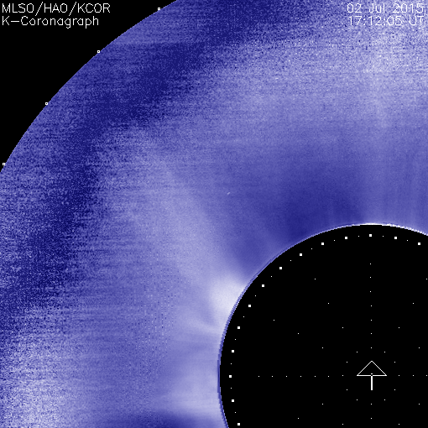
Summary & Future
K-Cor CME alerts are ‘first line of defense’. K-Cor observes down to 1.05 Rsun to track CMEs as they form.
K-Cor: Very low latency (< 3 minutes) Rapid data processing; high time cadence (15 sec); alerts are fully automated; reliable internet at MLSO
Modify detection code to reduce number of false alarms due to noisy skies, dust on optics/instrument issues
CME observed by K-Cor
Improve algorithm by adding CME widths and acceleration
Ground-based network of coronagraphs would significantly improve duty cycle for SEP forecasting: NSO/NCAR designing next generation ground-based space weather forecasting network (ngGONG). Includes coronagraphs.
If you would like to receive K-Cor CME alerts please email me: iguana@ucar.edu

Slide 11
BACKUP SLIDES

Slide 12
What are the CME Observables
that relate to SEPs and
are visible in coronagraphs?
Time of appearance [Depends on coronagraph field-of-view!]
Location of the associated activity and the CME
CME Size [Angular Width and Expansion Rate]
CME Dynamics [Speed and Acceleration(?)]
Brightness [a measure of Mass Density and source location]
Morphology [e.g., shocks, etc.]

Slide 13
CMEs with SEPs have larger widths, speeds and accelerations than the average CME
ENERGETIC PROTONS | Proton Flux | K-COR CORONAL MASS EJECTION (CME) PROPERTIES | CORONAL MASS EJECTION (CME) PROPERTIES
DATE | Proton Flux | Eruption Location: Disk | Limb Angle[deg.] | Width [deg.] | Speed [k/s] at height in Rsun | Accel. [m/s²]
20140924 | 3000 [1.8 - 10 MeV] 100 [14 - 100 MeV] | N15 W20 | 21 [NE] | >=130 | DC: 708 @1.52 Hum: 911 @2.3 | Not detected
20150315 | 100 [ > 5 MeV] 7 [> 10 MeV] | S15 W30 | 228 [SW] | 81 | DC: 566 @1.53 Hum: 582 @2.4 | 186
20160101 | 40 to 50 [> 5MeV] 10 [> 10 MeV] | S20 W70 | 247 [SW] | 75 | DC: 44 @1.65 Hum: 740 @2.7 | 312
20170904 | 175 [> 5 MeV] 75 [> 10 MeV] | S10 W10 | 230 [SW] | 111 | DC: NONE Human: 367 | Not detected
20210507 | 0.1 [2.2 - 12 MeV] 1.5 0.62 - 2.2 MeV] | N20 E25 | 78 [NE] | 90 | DC: 513 @1.53 Human: 1105 @2.8 | 510
20220511 | 5 [> 10 Mev] | S15 W90 | 265 [SW] | >=49 | DC: 112 @2.01 Hum: 461 @2.8 | 188
AVERAGE of these 6 SEP-CMEs |  |  |  | 89 | Final Speed: 694 | 299 +/- 152
AVERAGE of MLSO Mk3 coronameter |  |  |  | 37 | 390
DC = Detection code Hum = Human

