Slide 1
Solar Source SEP Event Prediction through Multi-Layer Ensembling
Presented by: Dustin Kempton
CCMC Workshop June 7, 2022

Slide 2
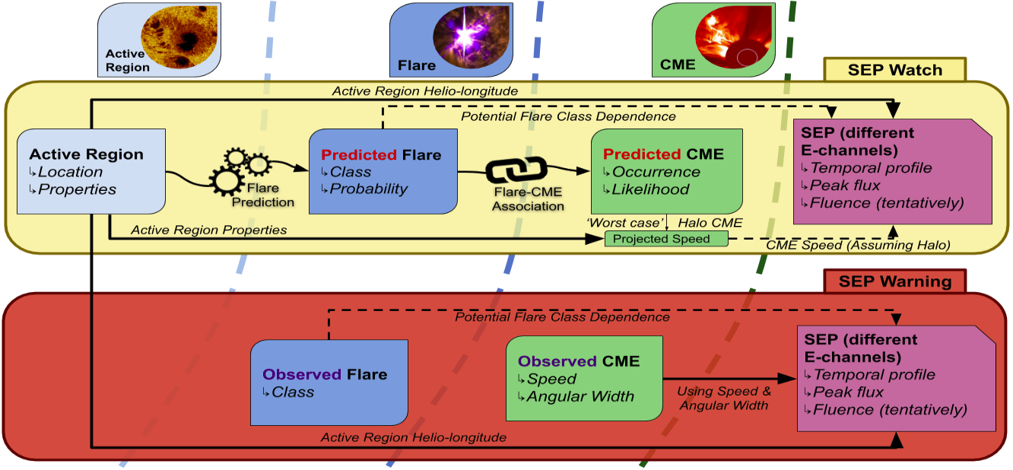
The Idea

Slide 3
The Watch System

Slide 4
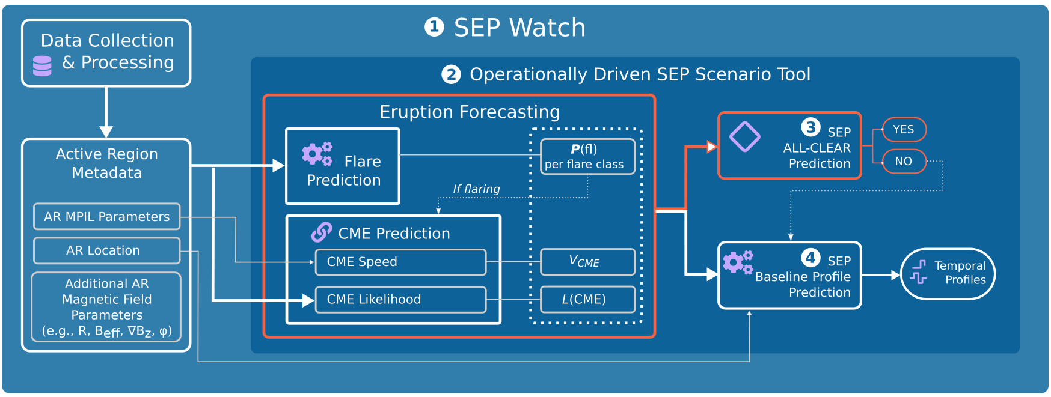
The Logic Flow for a Watch System

Slide 5
Getting from Active Region Data to SEP All Clear
The simplifying assumptions and the logic that ensues

Slide 6
Four Layers of SEP Event Prediction Data
1
Solar Energetic Particle Events
Coronal Mass Ejections
2
3
Solar Flares
Active Regions
4

Slide 7
SEP Event Prediction Assumptions
Active Regions
Flaring
⊕magnitudes
Non-Flaring
CME
⊕halo
No-CME
SEP
Event
No
SEP

Slide 8
Overcoming Imbalanced Data
Because Machine Learning Algorithms like Balance

Slide 9
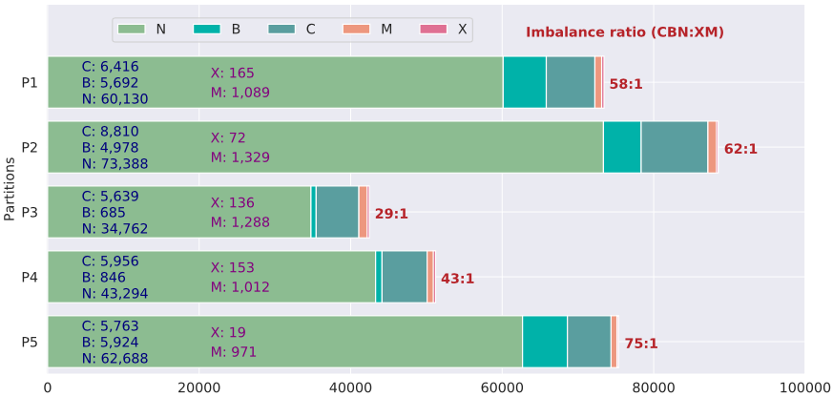
DMLab@GSU
SWAN-SF¹ (data source)
Each partition of SWAN-SF contains approximately an equal number of X- and M-class flares.
As we can see, an extreme imbalance ratio between flare samples (X and M) and non-flare samples (C, B and N) exists in every partition of SWAN-SF
1. R. A. Angryk et al.: Multivariate Time Series Dataset for Space Weather Data Analytics, in Nature Scientific Data 2020

Slide 10
The Classical Balancing Act
Different undersampling methods
CBN
XM
CBN
XM
CBN
XM
Preserves climatology
X-based undersampling
M-based undersampling
Why US1 turns it to an easier problem?
TSS
Plot from Ahmadzadeh et al., in IEEE Big Data 2019
(Train - Test) partition pairs

Slide 11
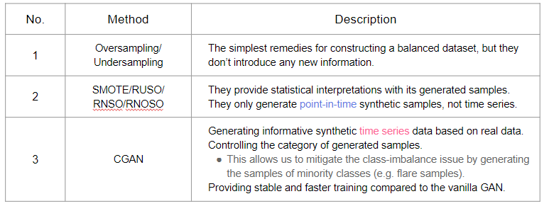
Data Augmentation Methods

Slide 12
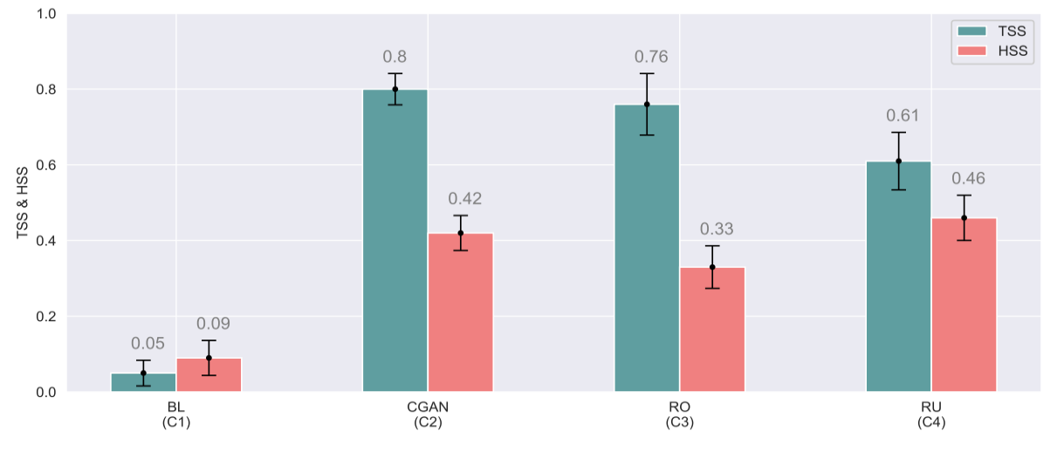
Synthetic C-GAN Based Oversampling
Figure from Chen et al, in Neural Computing and Applications 2022

Slide 13
An Ensemble of Machine Learning Models
Using many models, to determine the All-Clear State

Slide 14
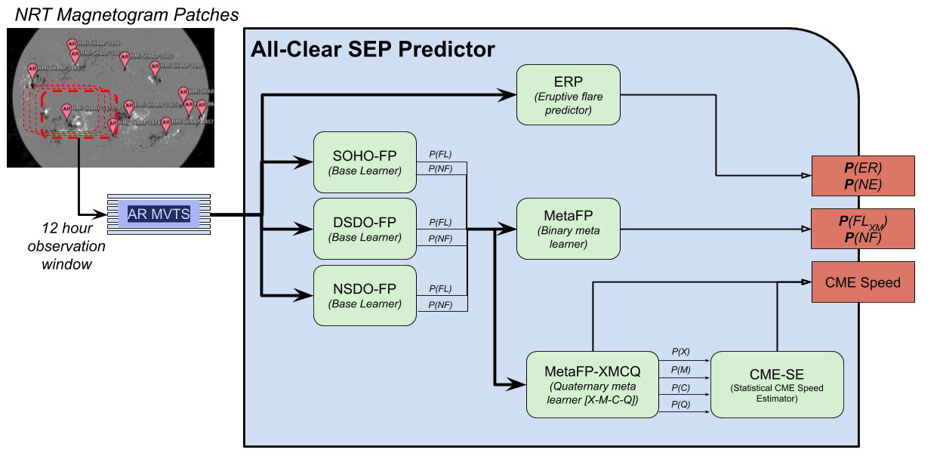
Watch System-All Clear-ML Models Overview
Figure from Anli et al., in CogMI 2021

Slide 15
The Models
All-clear Flare Predictor
A binary predictor of flare occurrence greater than M1.0
Eruptive Flare Predictor
A binary predictor of flare occurrence greater than C1.0
The flare also has an accompanying CME
CME Speed Estimator
Assumes a CME will occur
Estimates the likely speed given the likelihood of various flare strength occurrence

Slide 16
The All-clear flare predictor
Predicts the occurrence of ≥M1.0 flares

Slide 17
The Eruptive flare predictor
Predicts the occurrence of eruptive flares (≥C1.0 with CMEs)
ERP
(Eruptive flare predictor)
AR MVTS
P(ER)
P(NE)

Slide 18
The CME Speed Estimator
Predicts the CME Speed [not the occurrence]

Slide 19
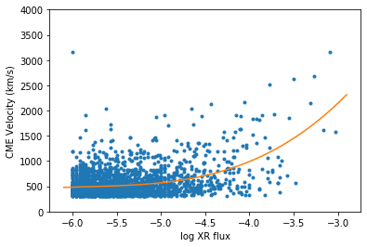
Flare XR Flux vs CME Velocity

Slide 20
Full-disk Aggregation
Moving from AR based Prediction to an Aggregate

Slide 21
Watch System-All Clear-ML Models Overview

Slide 22
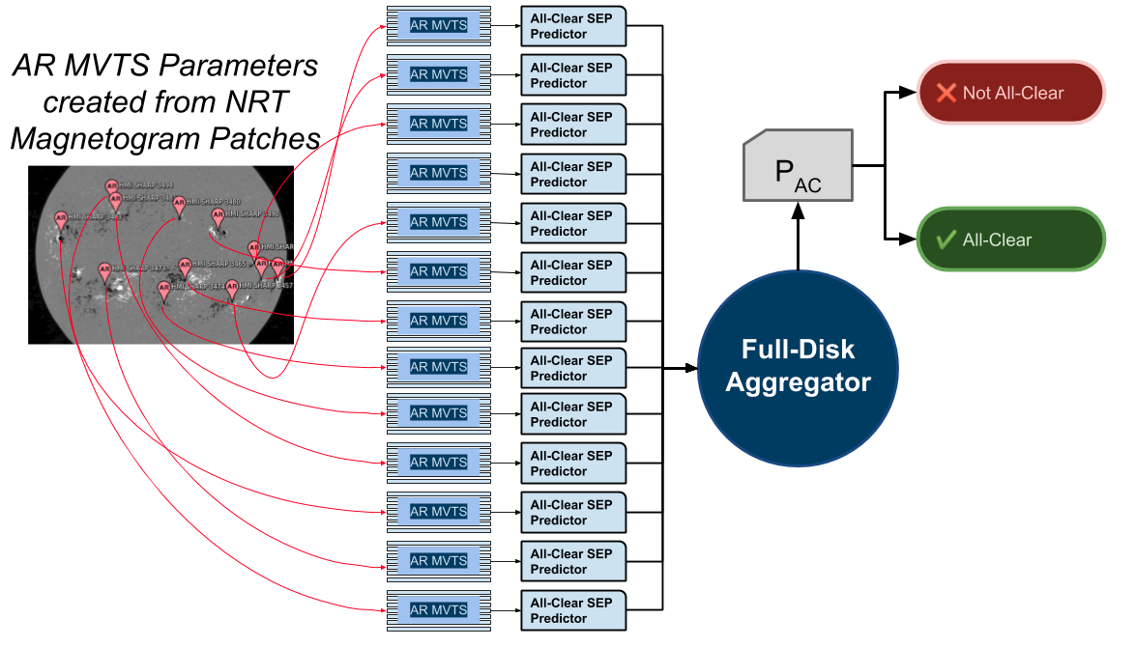

Slide 23
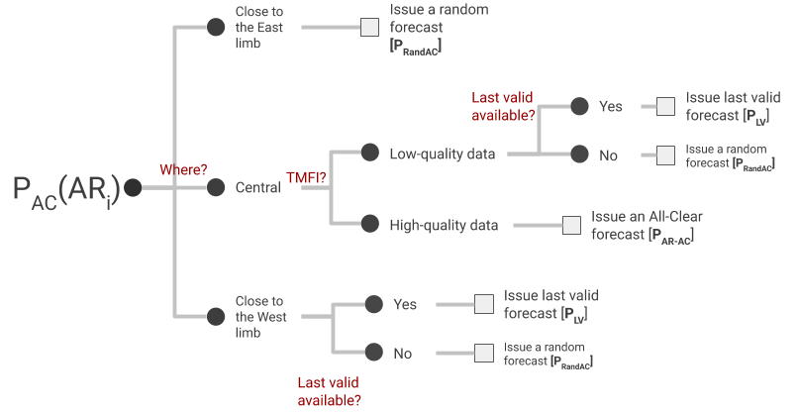
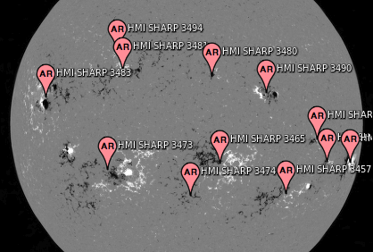
Full-disk Aggregation

Slide 24
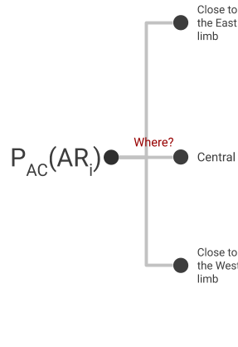
Full-disk aggregation

Slide 25
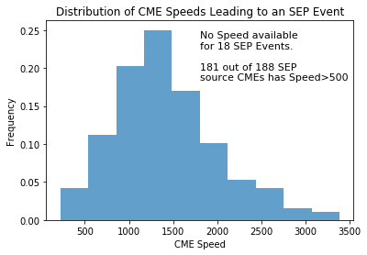
CME Speeds and SEP Events (between 1997-2018)

Slide 26
Assumptions
No eruptive activity → All-clear
Not all eruptive activity causes SEP Events
Limited to the visible area (No Far Side)
Currently don’t account for Flare-accelerated SEP events
We assume halo CME directed at earth
Full-disk aggregation [independent events]

Slide 27
System Deployment

Slide 28
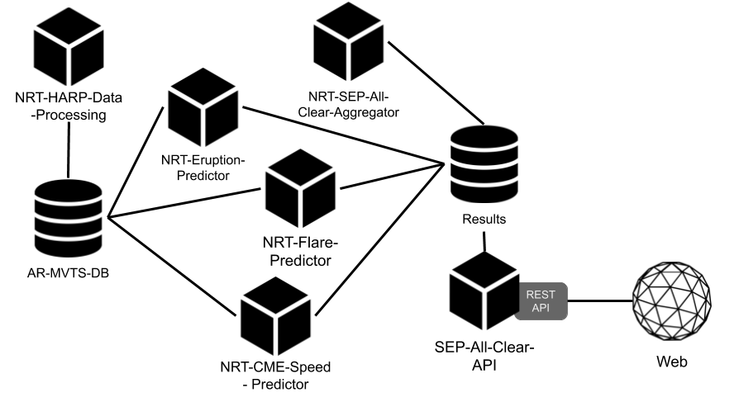
System of Microservices

Slide 29
System
Deployment: https://bitbucket.org/gsudmlab/isepcleardeploy/src/V0.1.1/
https://bitbucket.org/gsudmlab/nrt-harp-data-processing
https://bitbucket.org/gsudmlab/nrt-sep-all-clear-aggregator
https://bitbucket.org/gsudmlab/nrt-eruption-predictor
https://bitbucket.org/gsudmlab/nrt-flare-predictor
https://bitbucket.org/gsudmlab/nrt-cme-speed-predictor
https://bitbucket.org/gsudmlab/sep-all-clear-api

Slide 30
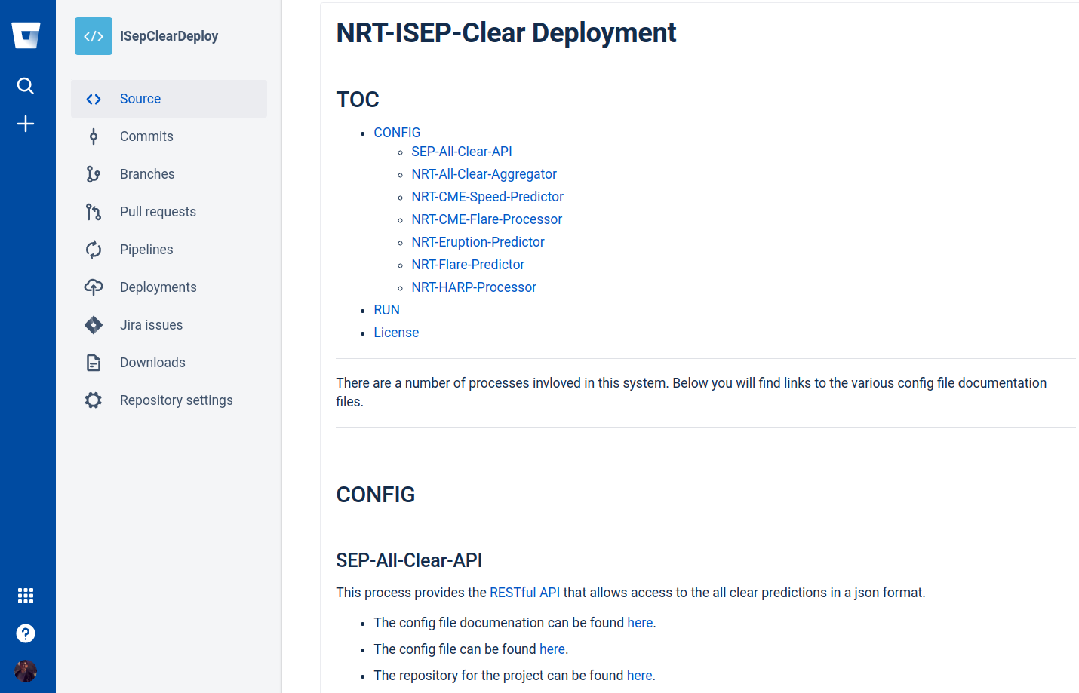
Deployment Project

Slide 31
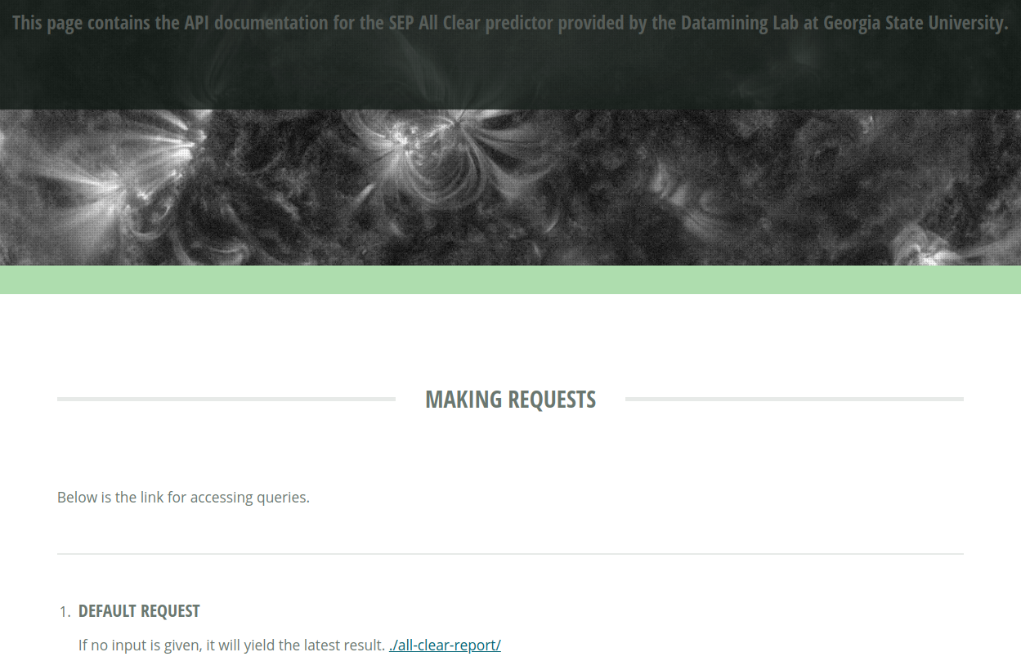
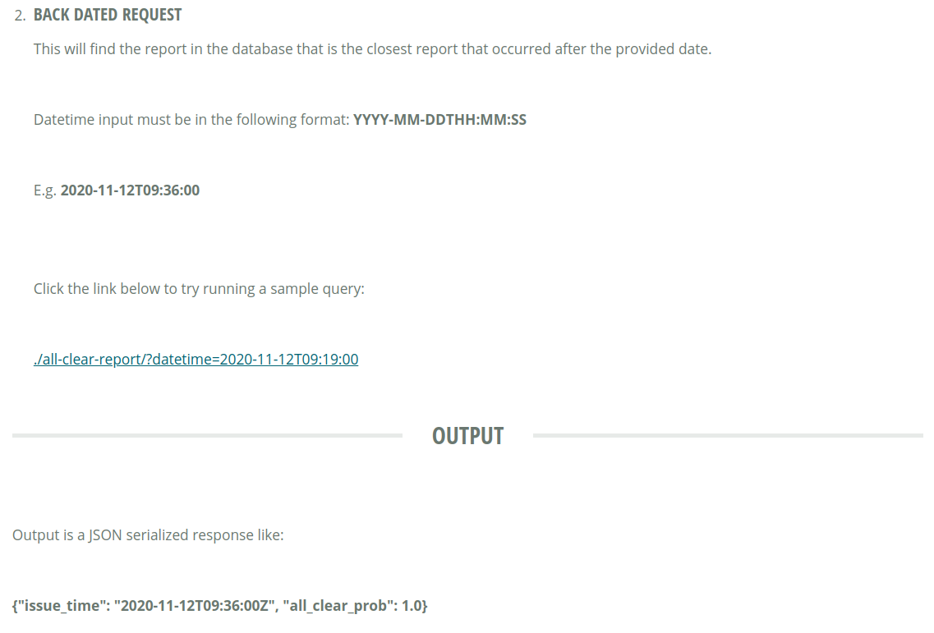
API
Available: https://dmlab.cs.gsu.edu/sep-prediction/

Slide 32
Questions?
Contact:
Dustin Kempton
dkempton1@gsu.edu

