Slide 1









SAWS-ASPECS: Advanced Solar Particle Events Casting System
A. Papaioannou & A. Anastasiadis
for the ASPECS Team
ESA Contract No. 4000120480/17/NL/LF/hh
CCMC 2022 Workshop
07.06.2022

Slide 2
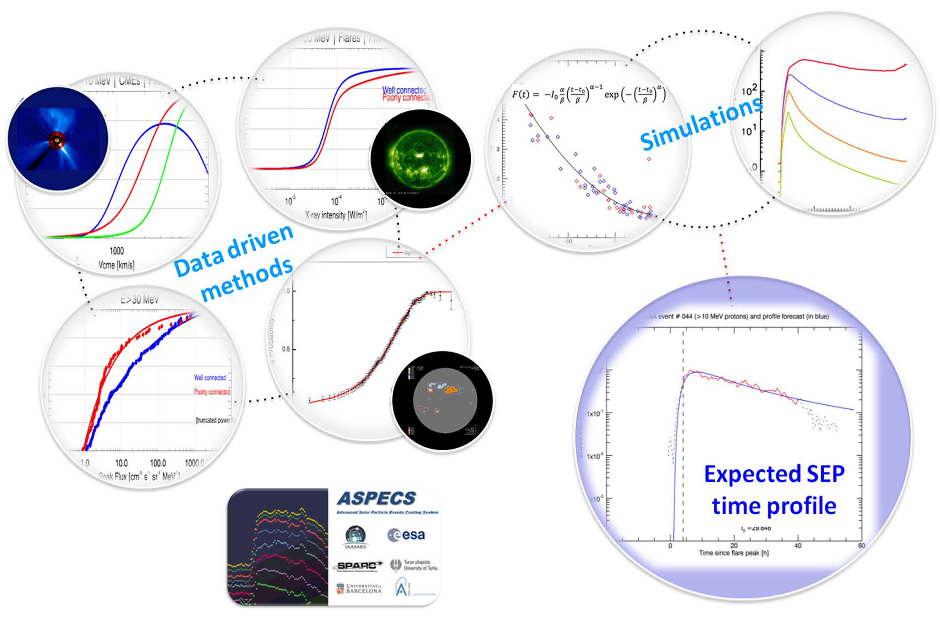
http://tromos.space.noa.gr/aspecs
CCMC 2022 Workshop
07.06.2022

Slide 3
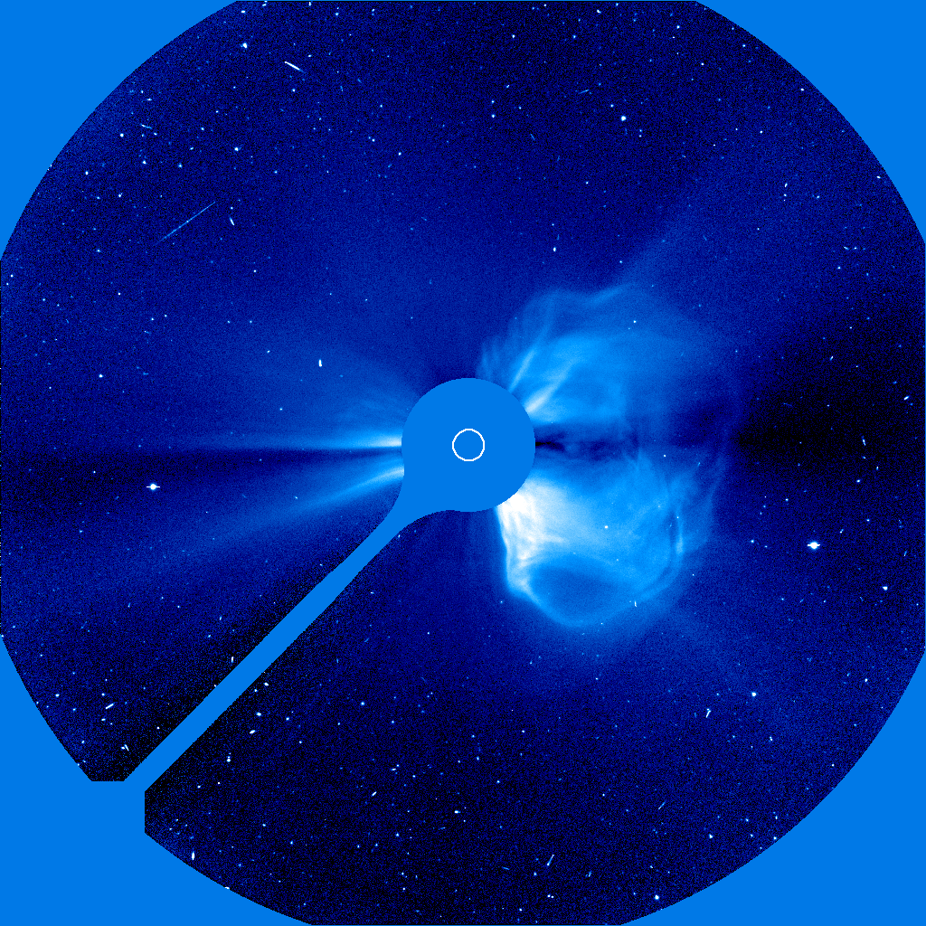
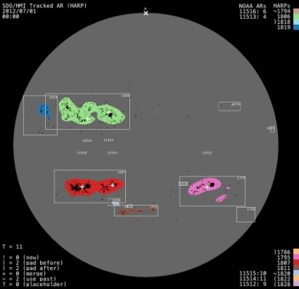
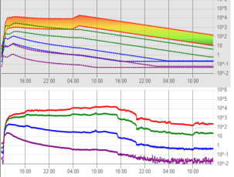
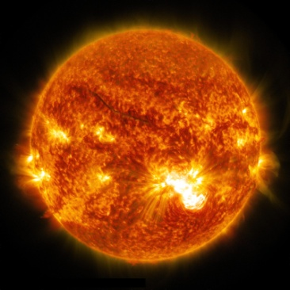
The SAWS-ASPECS system
CME
Probability of SEP Occurrence
Expected Peak Flux
SEP
AR
SEP time profile
flare
CCMC 2022 Workshop
07.06.2022

Slide 4
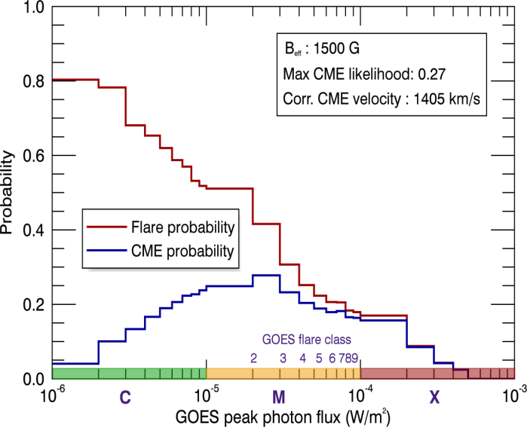
Forecasting
Nowcasting
Probability of SEP Occurrence
Pre-event mode
Post-event mode
Potential of an AR
Eruptive event
CCMC 2022 Workshop
07.06.2022

Slide 5
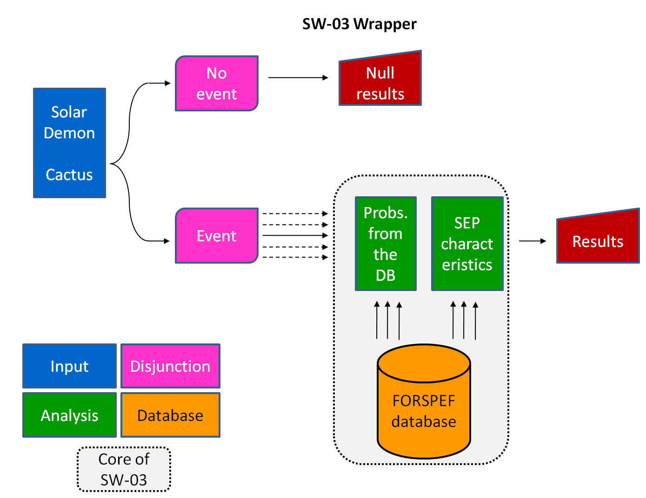
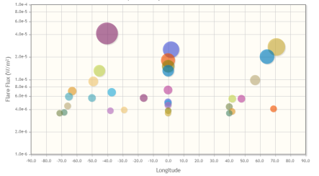
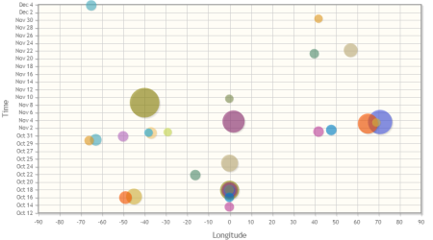
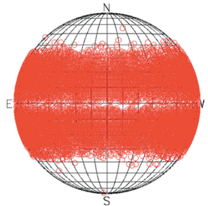

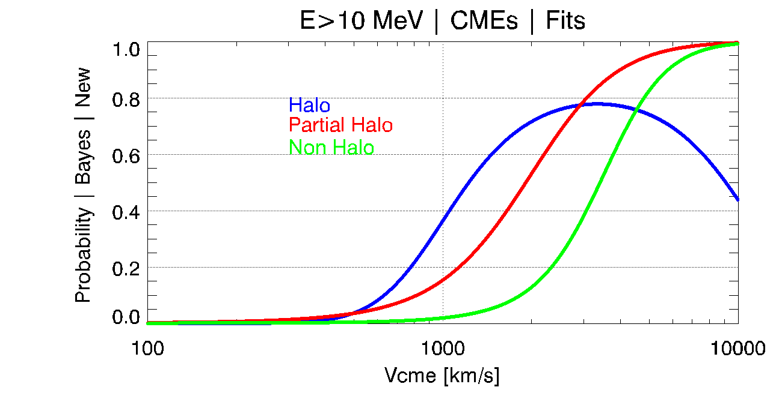
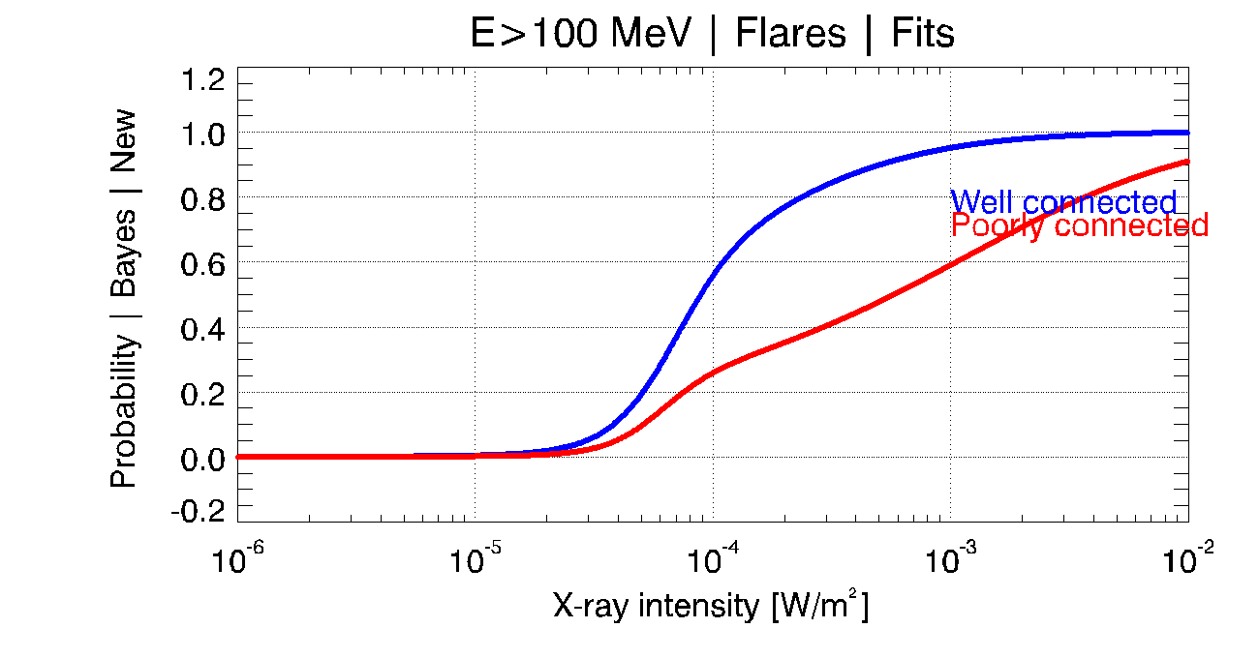
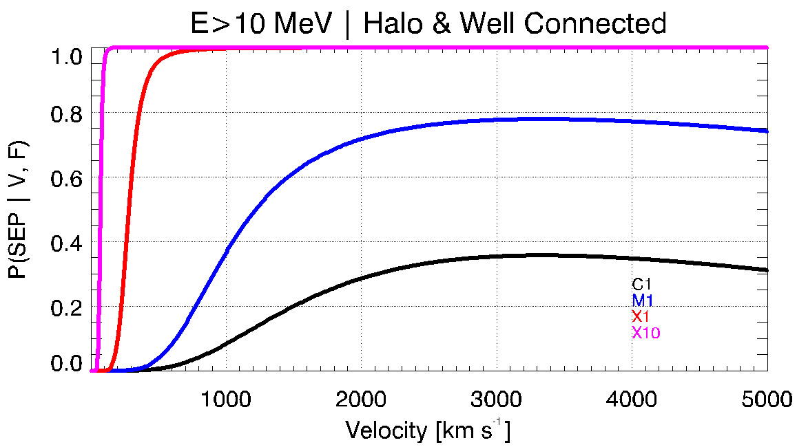
The SAWS-ASPECS system
Nowcasting mode | SEP events
Solar flare
CME
Probs.
Char.
Core of the Nowcasting
mode
CME
SF
SF+CME
CCMC 2022 Workshop
07.06.2022

Slide 6
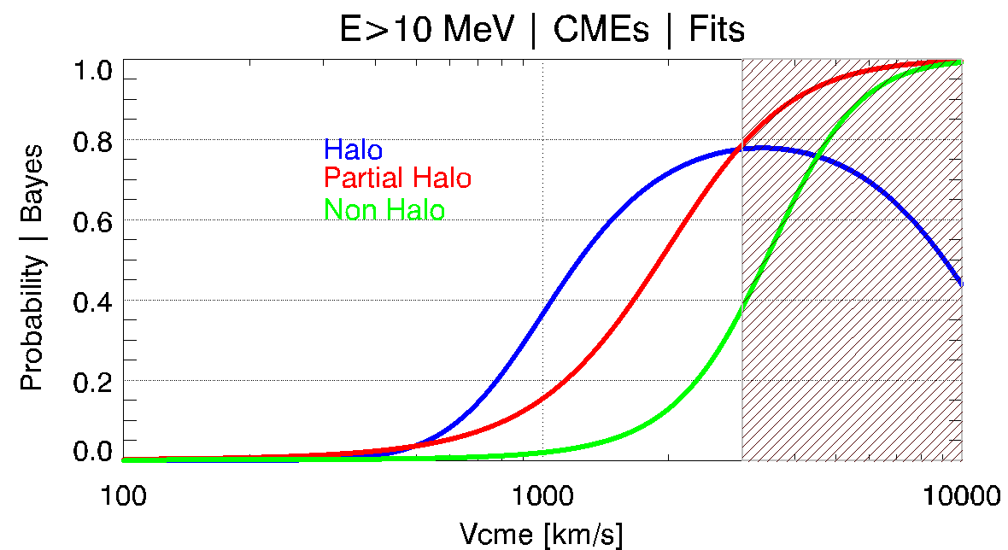
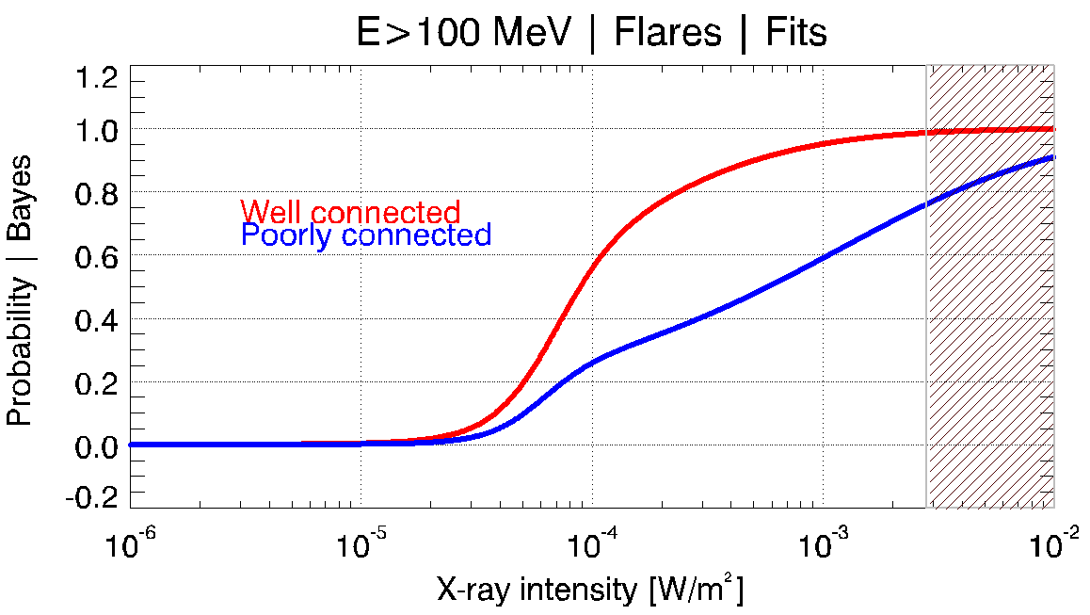
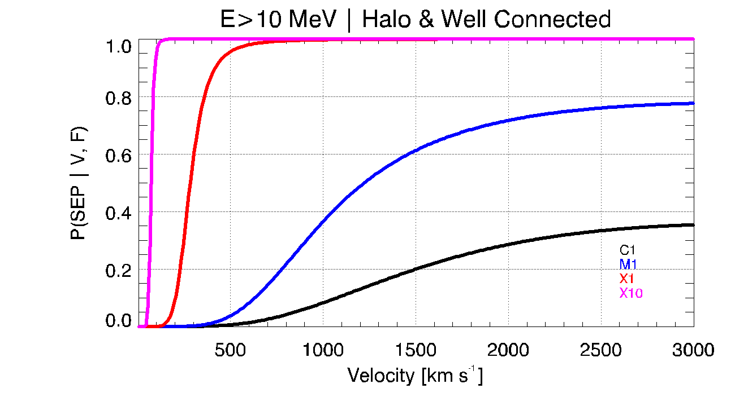
The SAWS-ASPECS system
Nowcasting mode | SEP events
Probability of SEP Occurrence
Papaioannou et al., 2022
JSWSC, DOI: 10.1051/swsc/2022019
CCMC 2022 Workshop
07.06.2022

Slide 7
Forecasting
Nowcasting
Probability of SEP Occurrence
Pre-event mode
Post-event mode
Potential of an AR
Eruptive event
Expected Peak Flux
SEP time profile
CCMC 2022 Workshop
07.06.2022

Slide 8
The SAWS-ASPECS system
SEP event time profiles
I_{peak}
Expected Peak Flux @ Different Confidence Levels
Expected Peak Flux
CCMC 2022 Workshop
07.06.2022

Slide 9

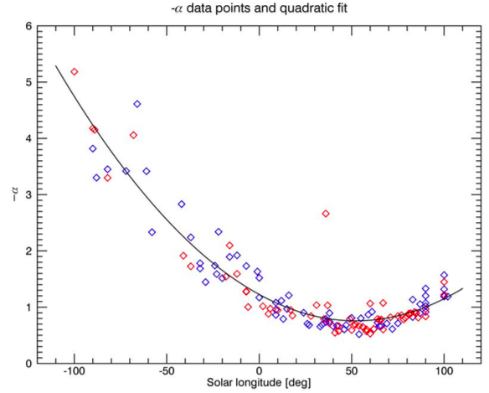
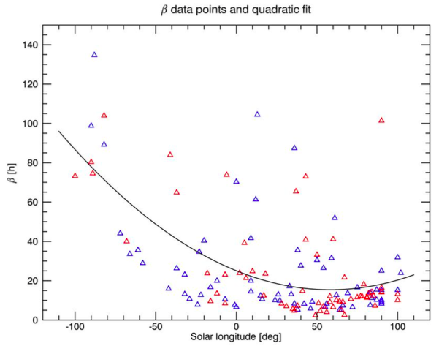
The SAWS-ASPECS system
SEP event time profiles
SEP time profile
Time profile
Kahler & Ling, Sol. Phys. 2017
Paassilta et al., Adv. Space Res., 2022 - submitted
CCMC 2022 Workshop
07.06.2022

Slide 10
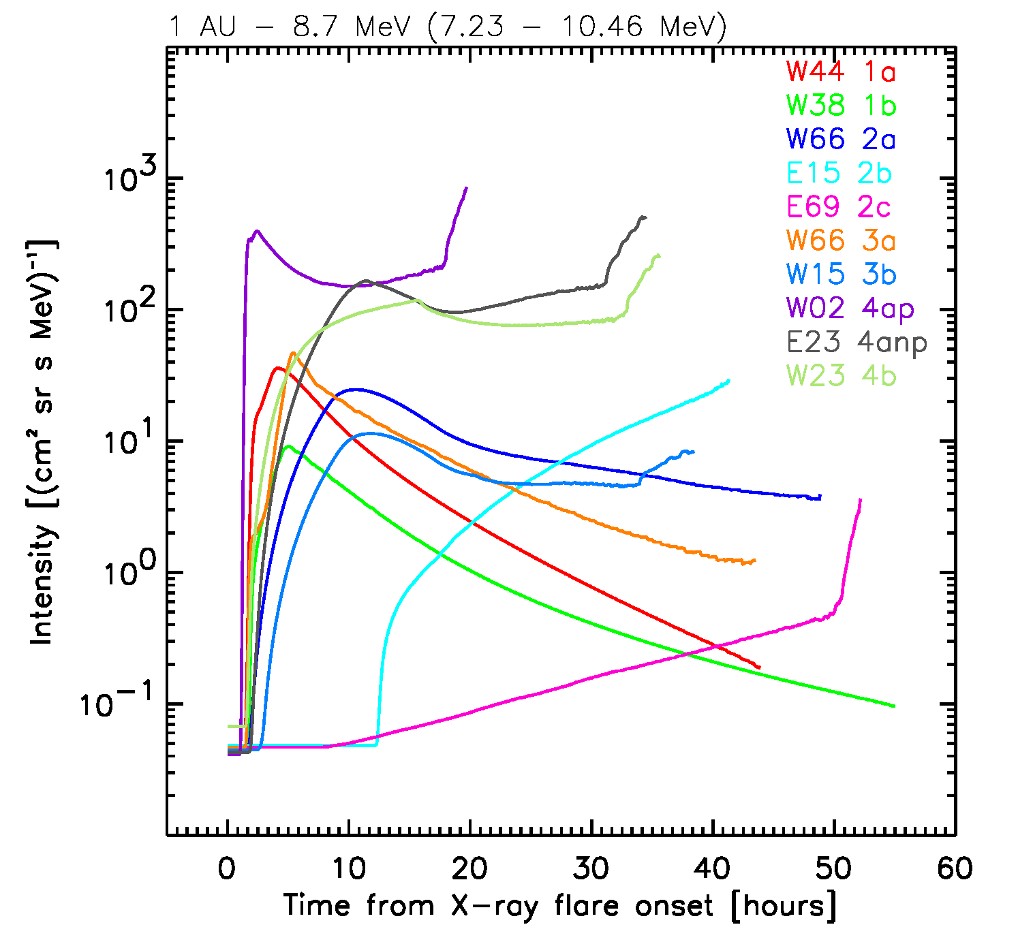
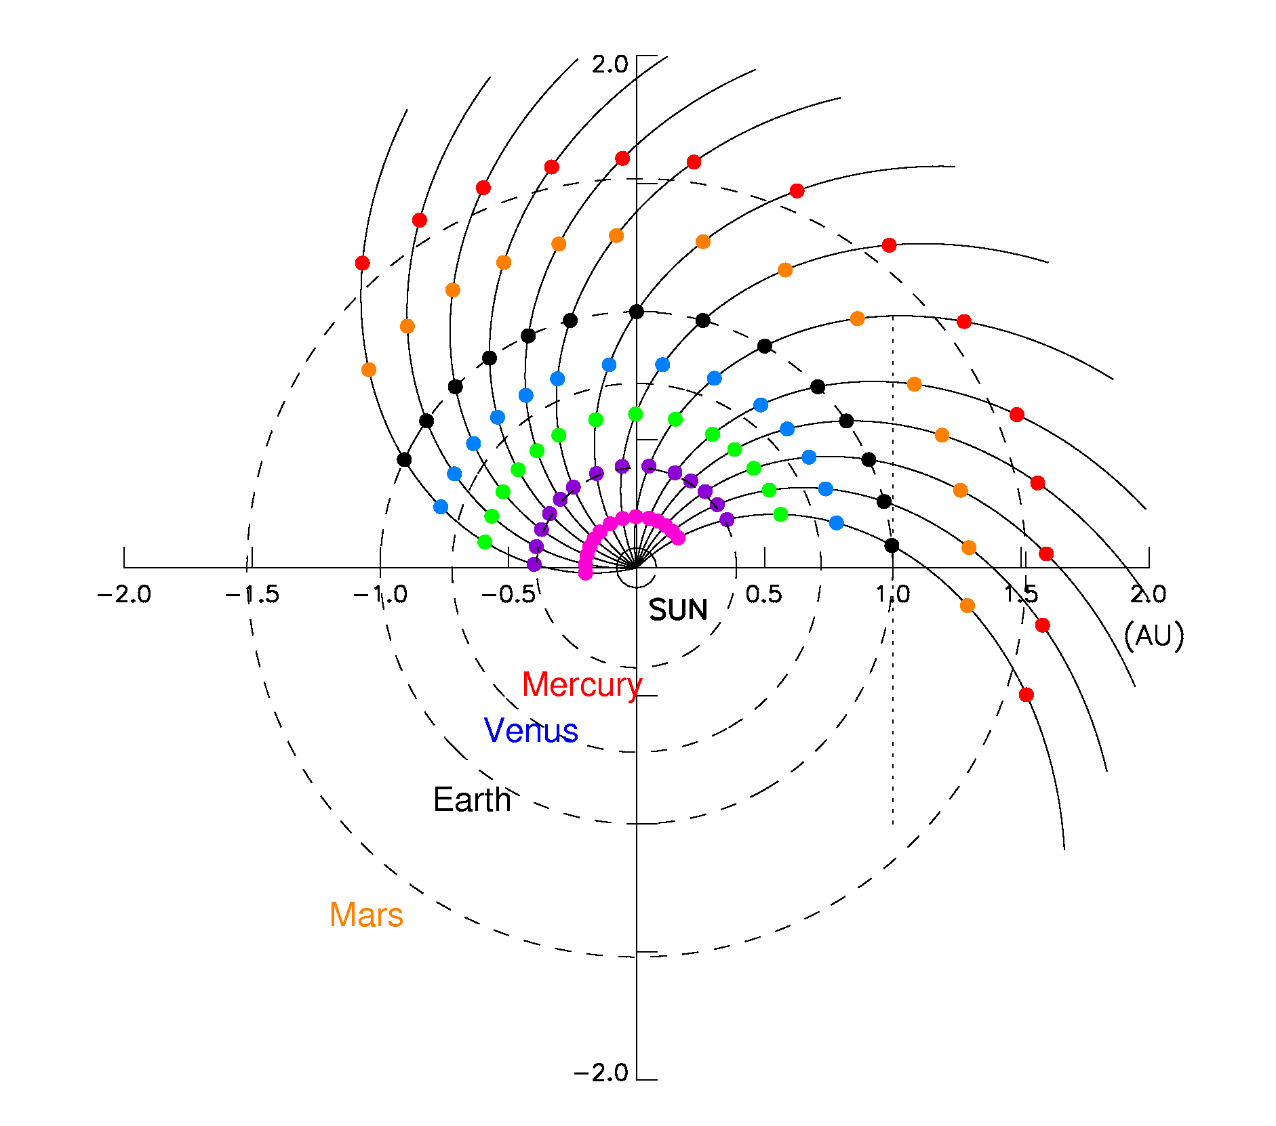
The SAWS-ASPECS system
SEP event time profiles
SEP time profile
Time profile
> Select reference cases considering the heliolongitude of their solar origin to better describe the shape of the intensity-time profiles.
> Generate synthetic time profiles for a number of scenarios using MHD transport codes and store them in a database.
Aran et al., SEPEM Tech. Rep., 2011
CCMC 2022 Workshop
07.06.2022

Slide 11
The SAWS-ASPECS system
In a nutshell
Probability of SEP Occurrence
Expected Peak Flux
SEP time profile
CCMC 2022 Workshop
07.06.2022

Slide 12
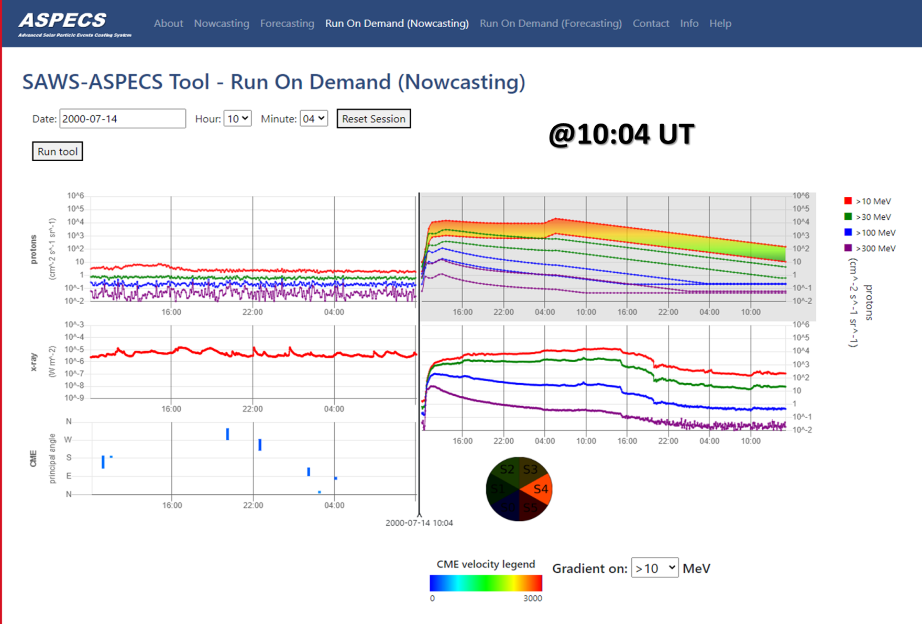
The SAWS-ASPECS system
Outputs | SEP time profile
Nowcasting
Available online
Flare: X5.7 @ N22W07
http://phobos-srv.space.noa.gr/
CCMC 2022 Workshop
07.06.2022

Slide 13
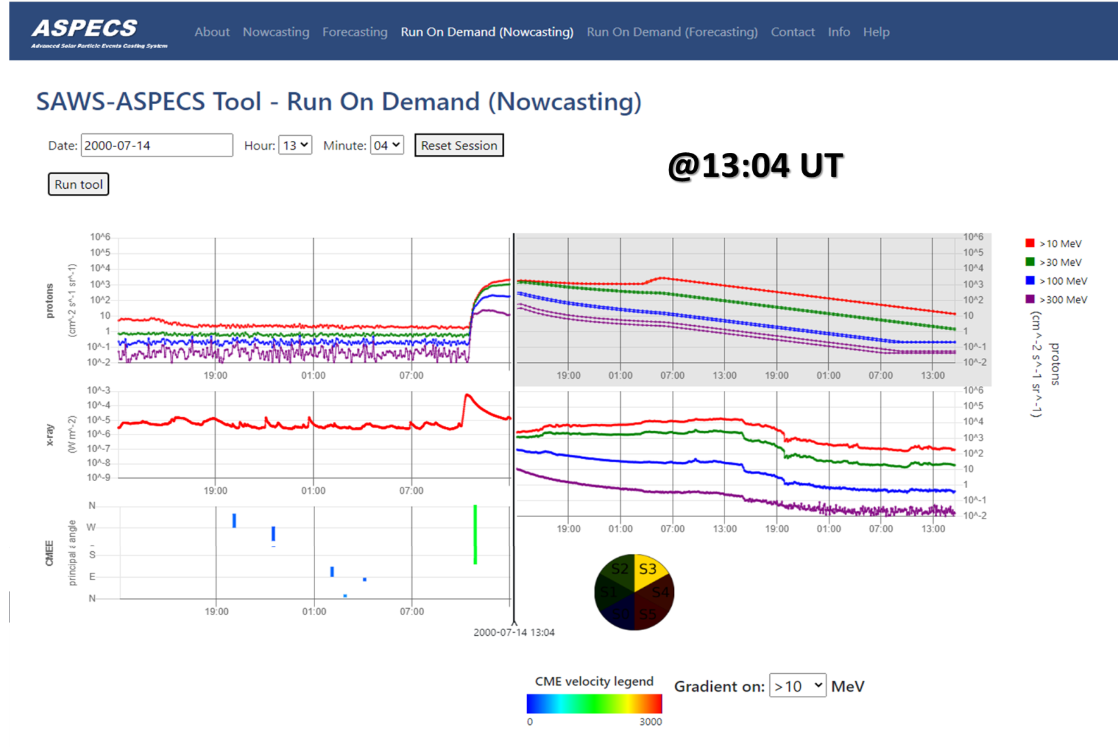
The SAWS-ASPECS system
Outputs | SEP time profile
Nowcasting
Available online
Flare: X5.7 @ N22W07
http://phobos-srv.space.noa.gr/
CCMC 2022 Workshop
07.06.2022

Slide 14
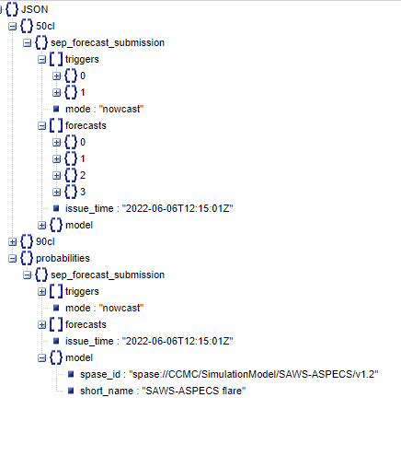
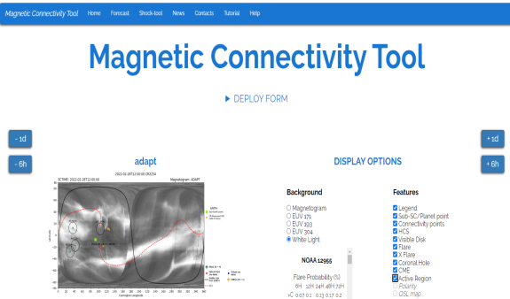
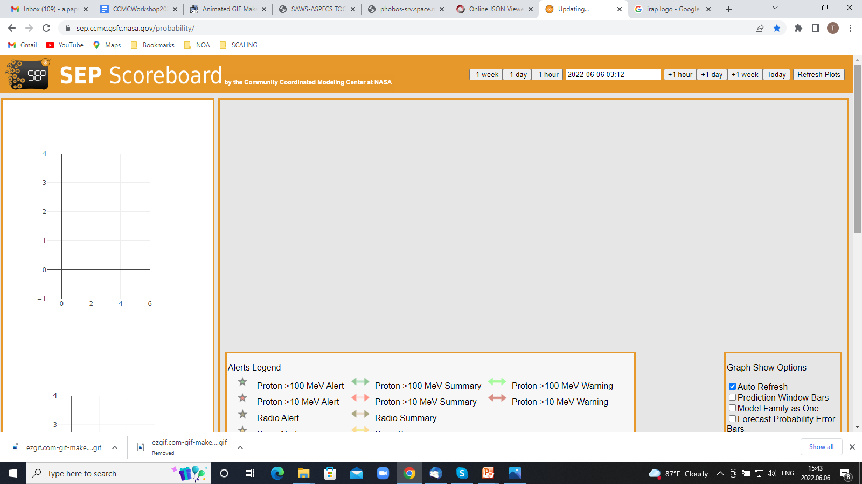

The SAWS-ASPECS system
Outputs | JSON files
> ASPECS provides all outputs in JSON files and thus facilitates direct integration to any other platform /tool.
> Current integrations include:
CCMC 2022 Workshop
07.06.2022

Slide 15
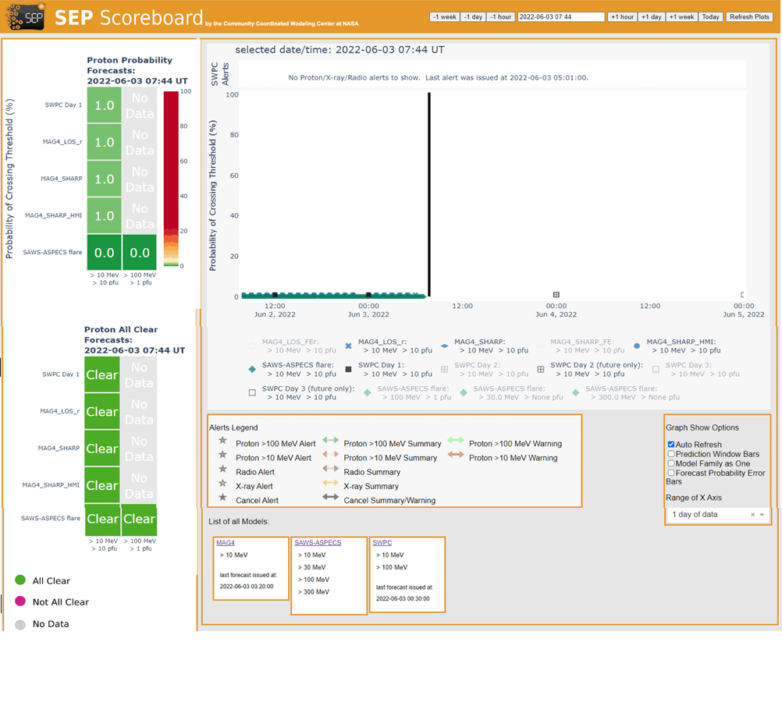
The SAWS-ASPECS system
Integration into CCMC
> Probabilities:
ASPECS is included in the probability SEP Scoreboard
Red rectangles denote the ingested ASPECS’s outputs. Currently, the “all clear” prediction and the “probability of crossing threshold” are displayed.
CCMC 2022 Workshop
07.06.2022

Slide 16
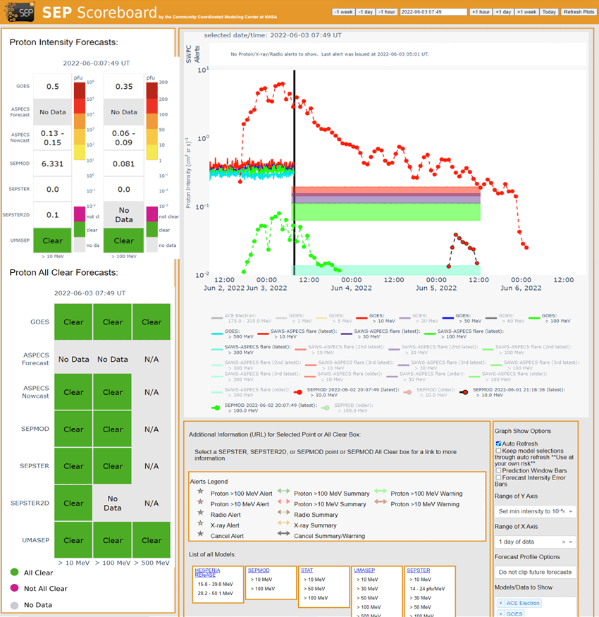
The SAWS-ASPECS system
Integration into CCMC
> Intensity [time-profiles]:
ASPECS is included in the intensity SEP Scoreboard
Red rectangles denote the ingested ASPECS’s outputs. Currently, the ASPECS’s “nowcast” & “forecast” predictions as well as the predicted time profiles are displayed.
CCMC 2022 Workshop
07.06.2022

Slide 17
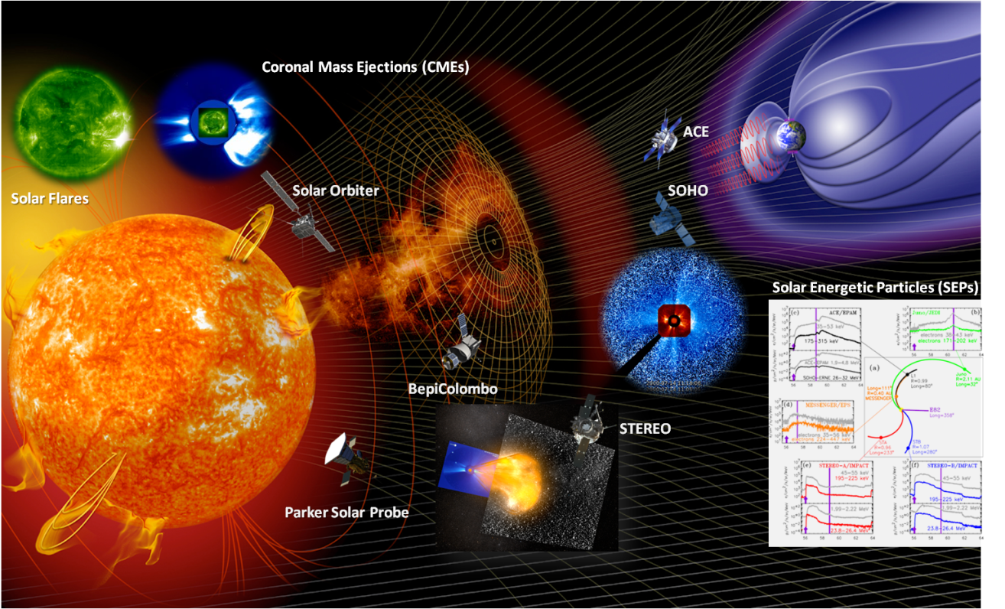
Thank you !
Anastasiadis & Papaioannou, HelAs/Ipparchos, 2021
CCMC 2022 Workshop
07.06.2022

Slide 18
The SAWS-ASPECS system
Backup slides
Forecasting mode
CCMC 2022 Workshop
07.06.2022

Slide 19
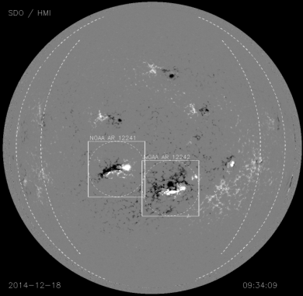
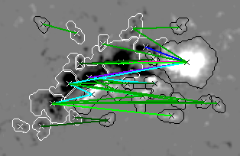

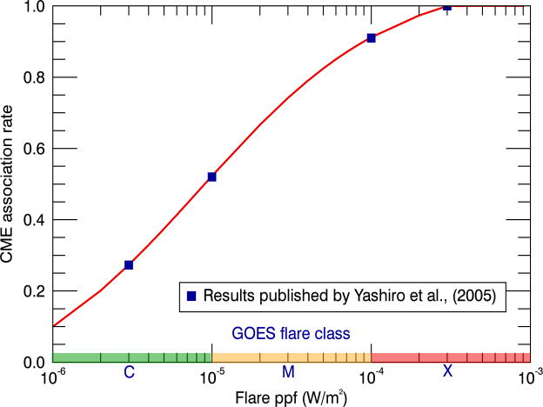
The SAWS-ASPECS system
Forecasting mode | Solar Flares
Probs.
CME vel. estimation
Core of the Forecasting
Mode (SFs)
CCMC 2022 Workshop
07.06.2022

Slide 20
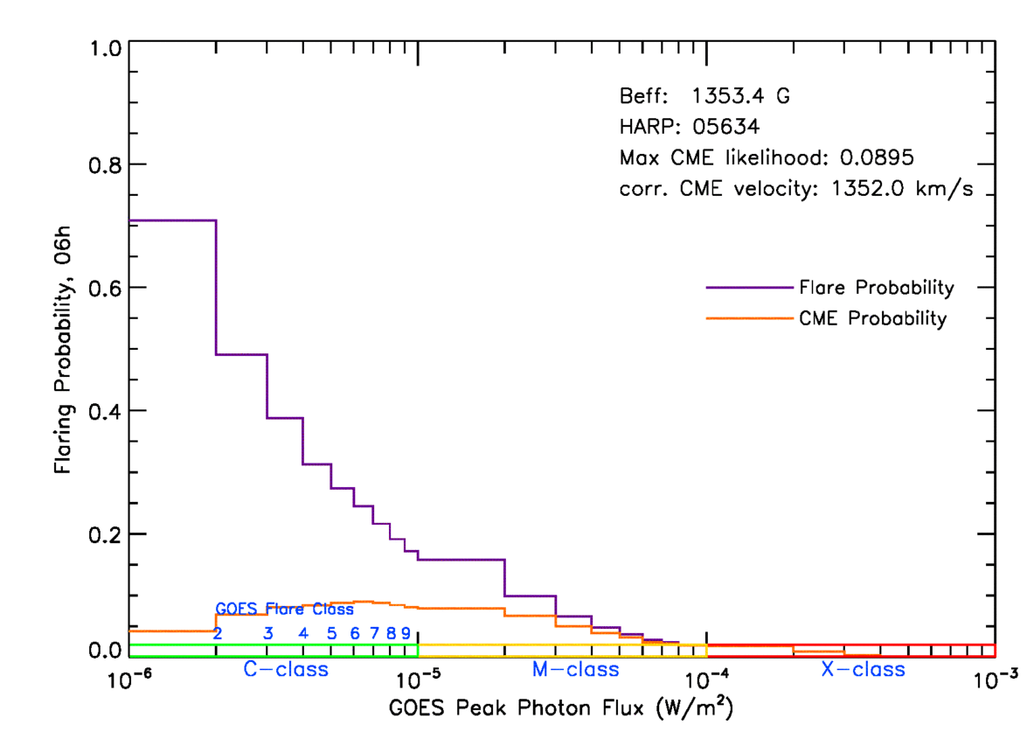
The SAWS-ASPECS system
Forecasting mode | Solar Flares
> Final Output:
Flare & (Projected) CME prob.
A pictorial output of the range of probabilities for different flare classes (magenta histogram). Also shown is the respective CME likelihood curve (orange histogram).
A range of time windows
CCMC 2022 Workshop
07.06.2022

Slide 21
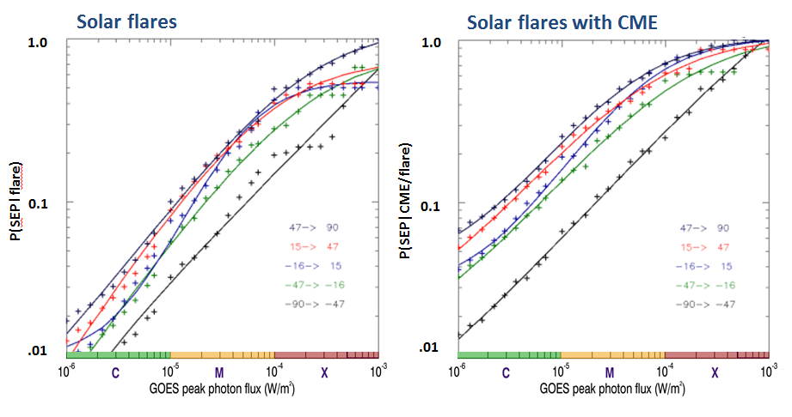
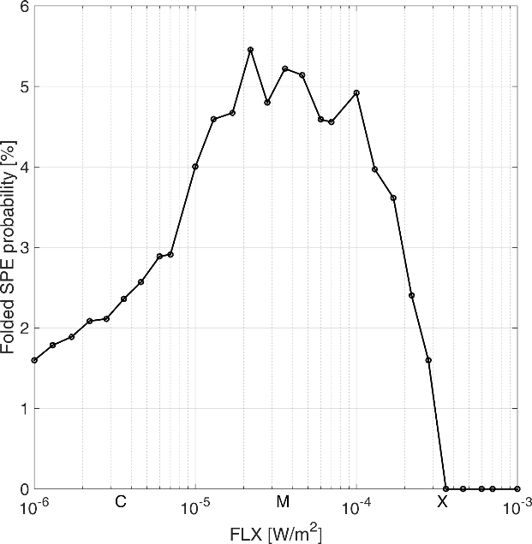
The SAWS-ASPECS system
Forecasting mode | SEP events
PT
Probability of SEP Occurrence
Papaioannou et al., J. Phys.: Conf. Ser., 2015
Anastasiadis et al.,
Sol. Phys., 2017
CCMC 2022 Workshop
07.06.2022

Slide 22
The SAWS-ASPECS system
Backup slides
Validation
CCMC 2022 Workshop
07.06.2022

Slide 23
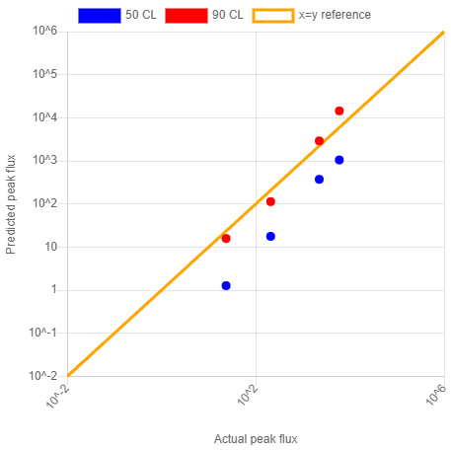
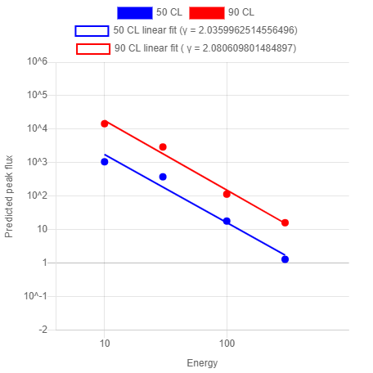
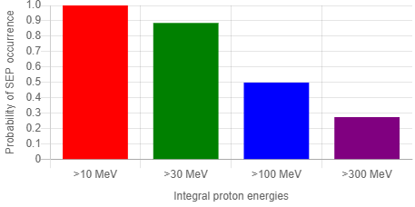
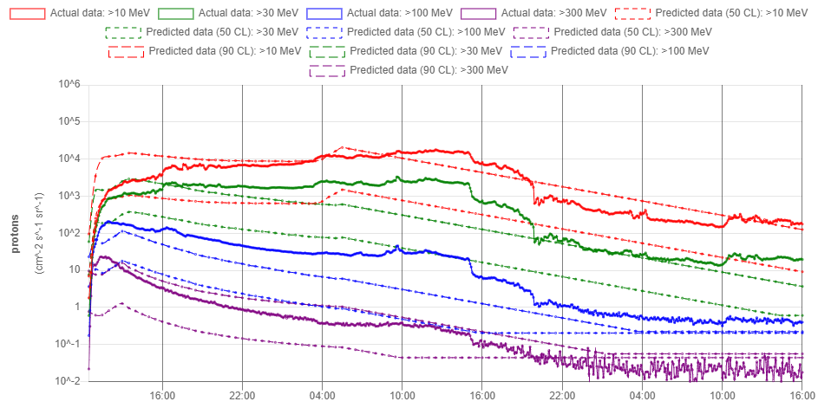
The SAWS-ASPECS system
Validation | Toolbox
Available online
CCMC 2022 Workshop
07.06.2022

Slide 24
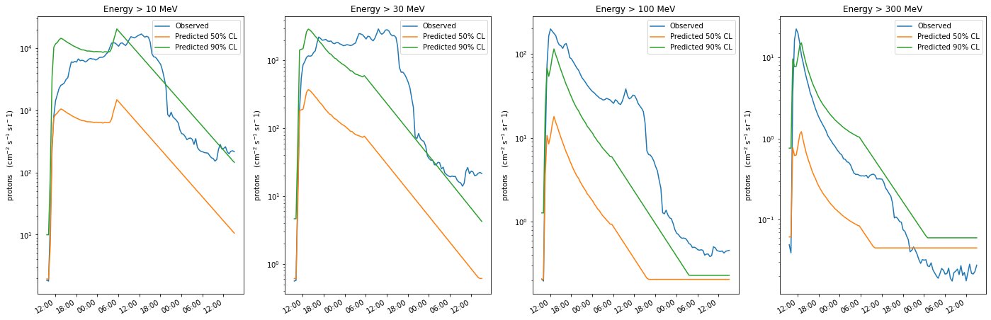
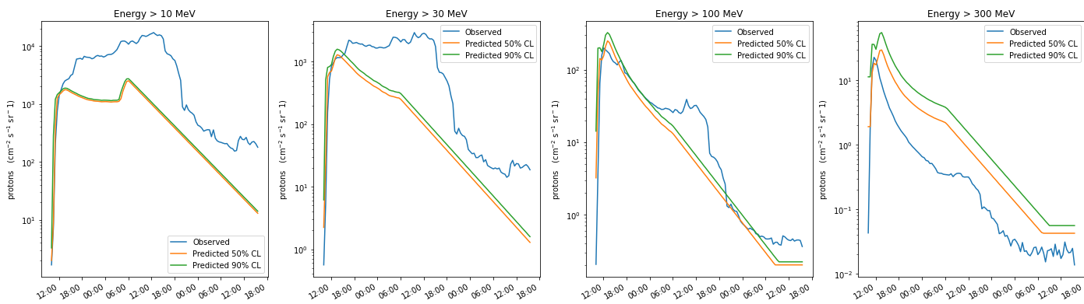
The SAWS-ASPECS system
Validation | Evolution of the SEP time profile
@10:04 UT
@13:04 UT
CCMC 2022 Workshop
07.06.2022

Slide 25
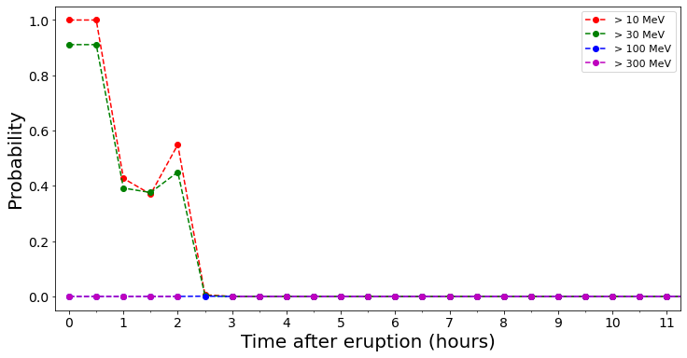
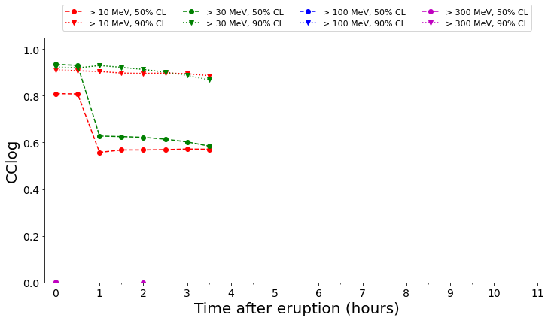
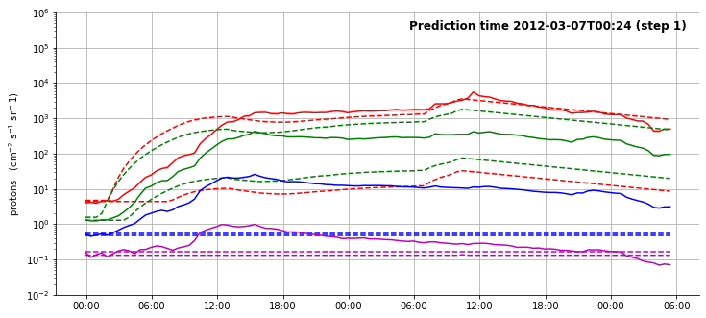
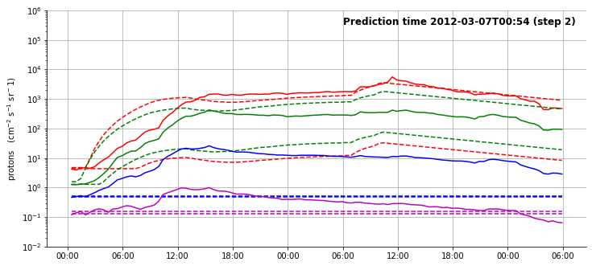
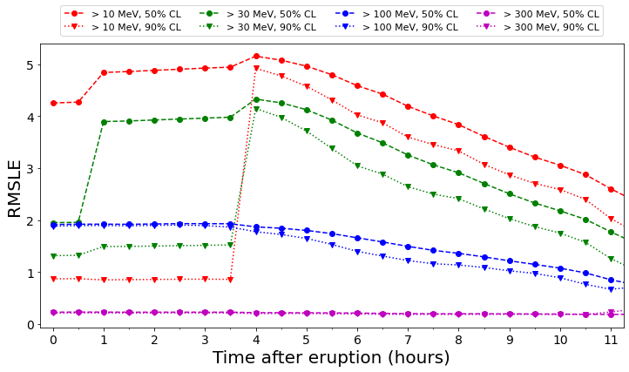
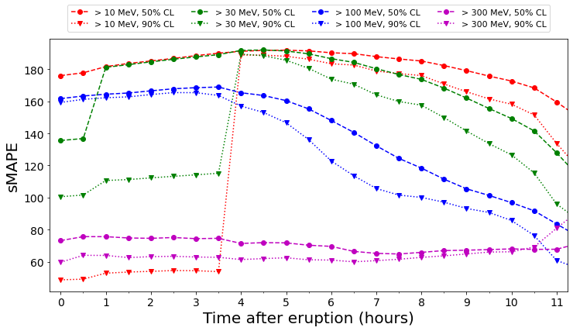
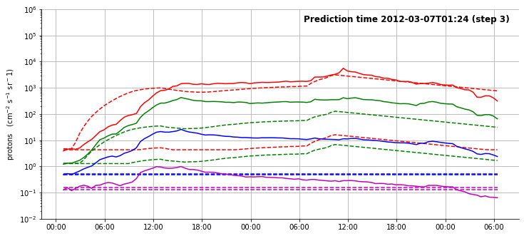
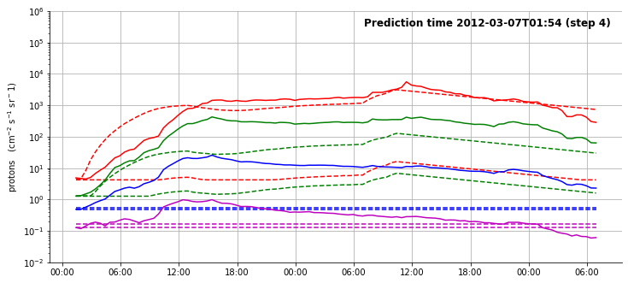
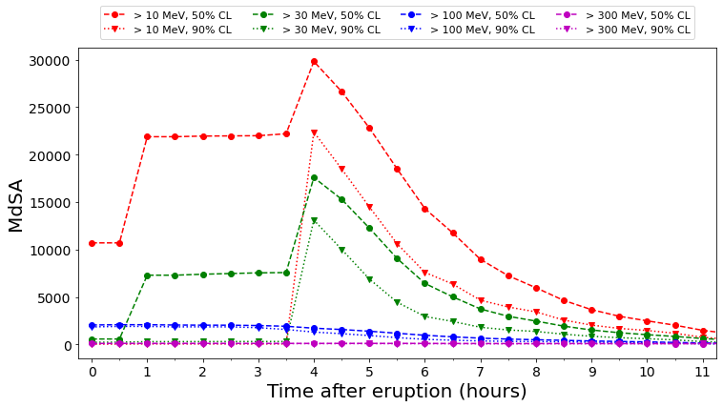
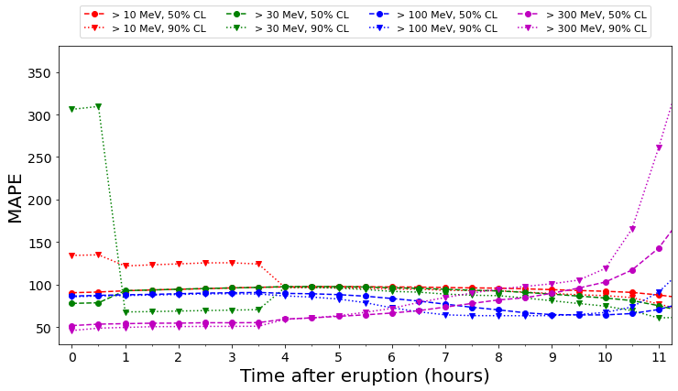
The SAWS-ASPECS system
Validation | Evolution with time steps
P(SEP)
Peak flux
RMSL
sMAPE
MdSA
MAPE
SEP time profile
Metrics
CCMC 2022 Workshop
07.06.2022

